Slide 1
PLC based elevator control with variable speed drive
Professor:Dr afshar

Slide 2
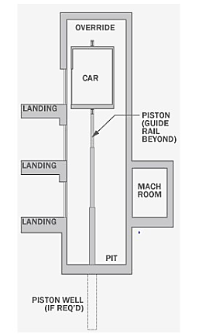
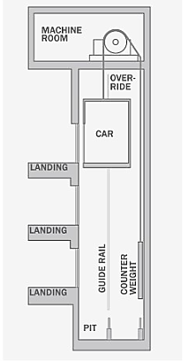
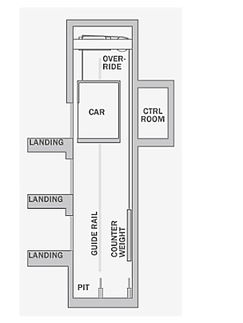
1. Introduction
Elevators are the important medium of vertical transportation in both residential environment and the industrial environment. Now days, there is tremendous development in structural and architectural engineering for multi storage buildings.
We have different types of elevator :

Slide 3
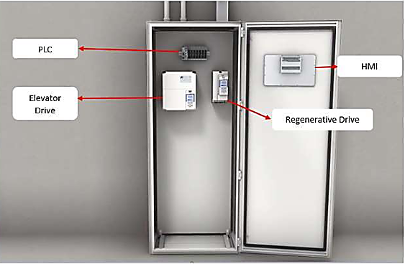
1-the car is atthe first floor 2-Signals from call buttons will activate the movement of the car 3-The elevator finishes a call when the call signal matches the floor level sensor.
4-The elevator finishes a call when the call signal matches the floor level sensor.
5-The door is then opened for a fixed period then closed before the car moves to another floor

Slide 4
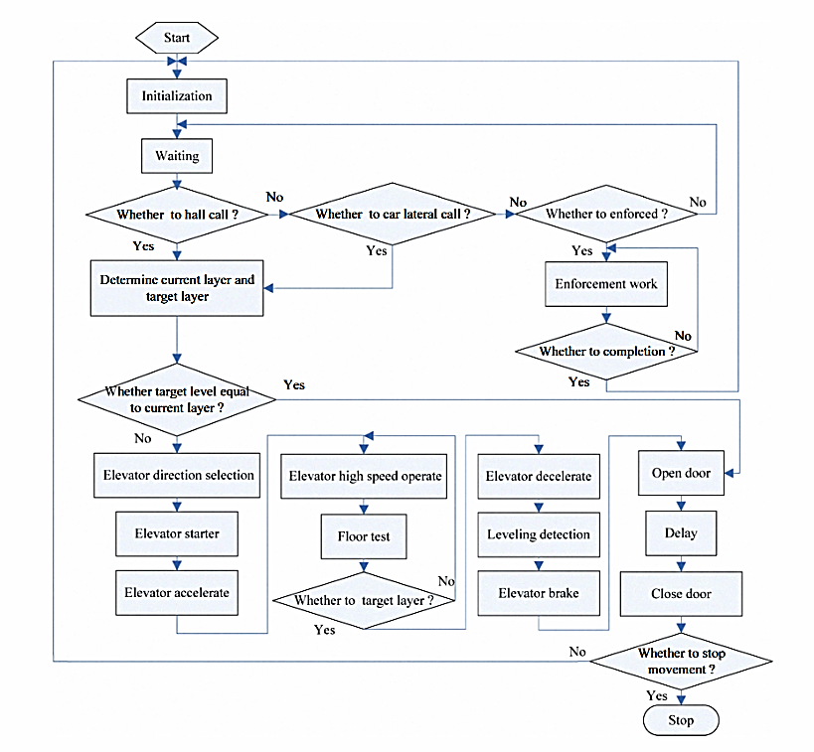
2.Flow chart

Slide 5
manual/automatic
3.
All steps are done in an automatically way and the only part you can say need man power is the part which the user push the buttons whether on the inside or outside and the control is local usually there is a cabinet next to the elevator which we put our plc in it and then the whole process is under plc observation.
Logic programs can be downloaded into the PLC through a remote PLC gatewayor by plugging a USB device that contains the program.

Slide 6
5.safety
If obstacle sensor detects there is an object or person between the
door sides, the door stays open or opens if it is closing.
If overload sensor detects the elevator is overloaded the door stays open and the alarm sounds.
Also, if the fire sensor is activated, the elevator will stop on the nearest floor and the alarm will sound and it will stop until the sensor is deactivated.

Slide 7
6.components
01
02
03
Floor door and cabin door (outputs)
04
Sensors (inputs)
07
Buttons (inputs)
05
Overload sensor:
Floor door and cabin door (outputs)
06
Floor level sensor
Car motor (outputs)

Slide 8
7.redundancy
Elevator movement process control and safety process are done by using sensors. If one of these sensors has a problem, the process should be stopped and the sensor should be repaired or replaced. Therefore, it is necessary to add one or two additional sensors of each type for the possible failure cases.

Slide 9
8.Disturbance and solution
01
02
03
Problem: Contamination
Problem: Power Failure
Problem: Worn Sheaves
Solution: Oil and Lubrication Analysis
Solution: Power Quality Survey
Solution: Regrooving

Slide 10
9.Flow chart with disturbances

Slide 11



10.modeling
the elevatorcontrol indicators include three aspects: (1) The efficiency of the elevator which means the speed; (2) The comfort of elevator which means the stability; (3) The leveling accuracy;
Modeling of the Elevator Control System
Inverter model
Elevator control system model

Slide 12
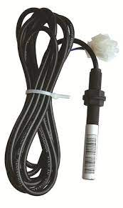
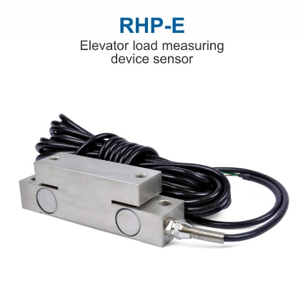
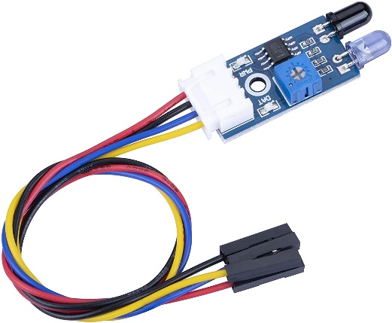
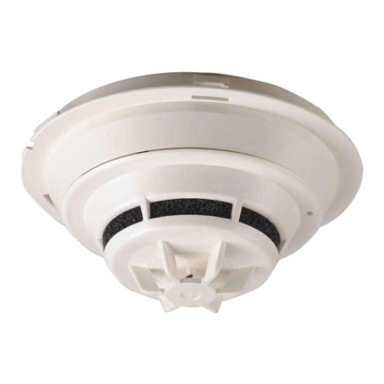
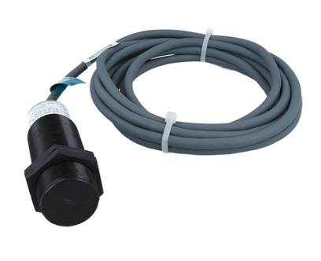
11.Sensors & actuators
Floor level sensor
Floor level sensor
weight sensor /Overload sensor
speed sensor
Flame detector

Slide 13
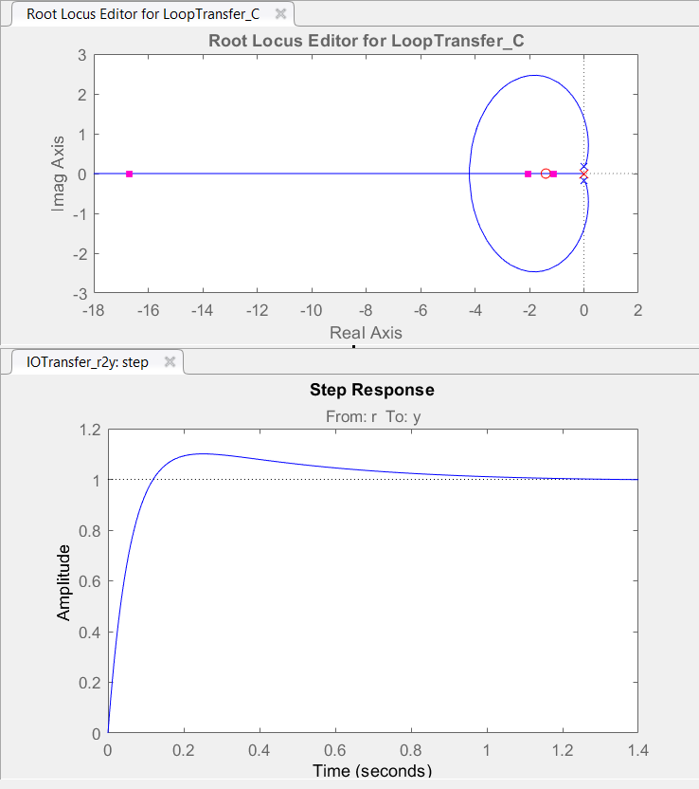
12.controller

Slide 14
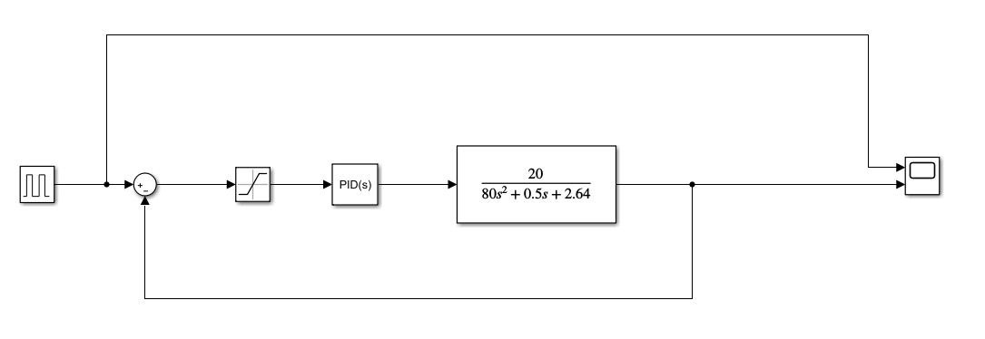
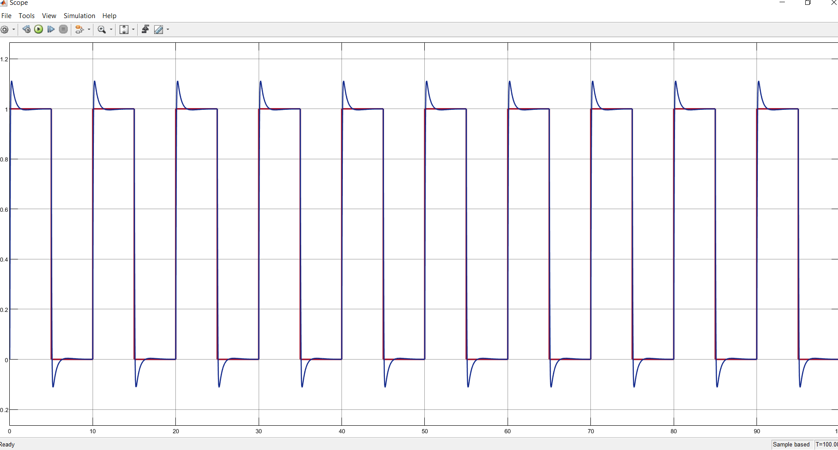

Slide 15
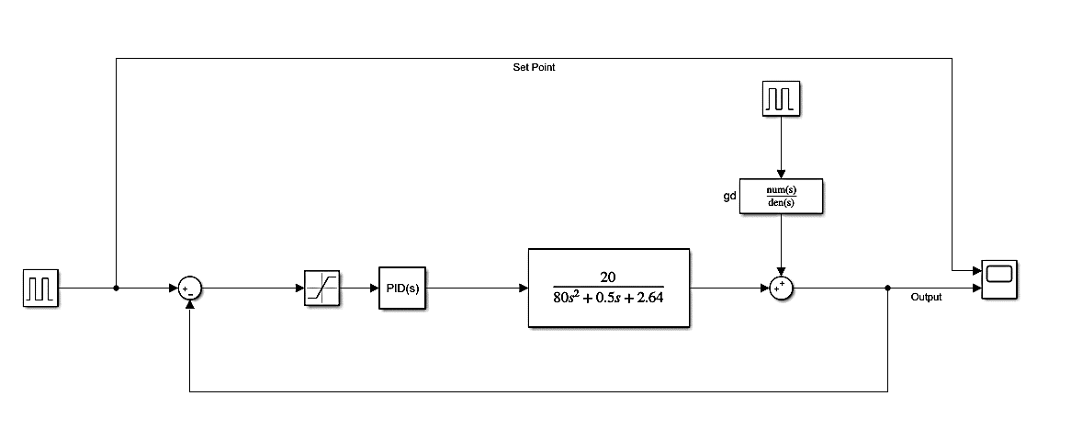
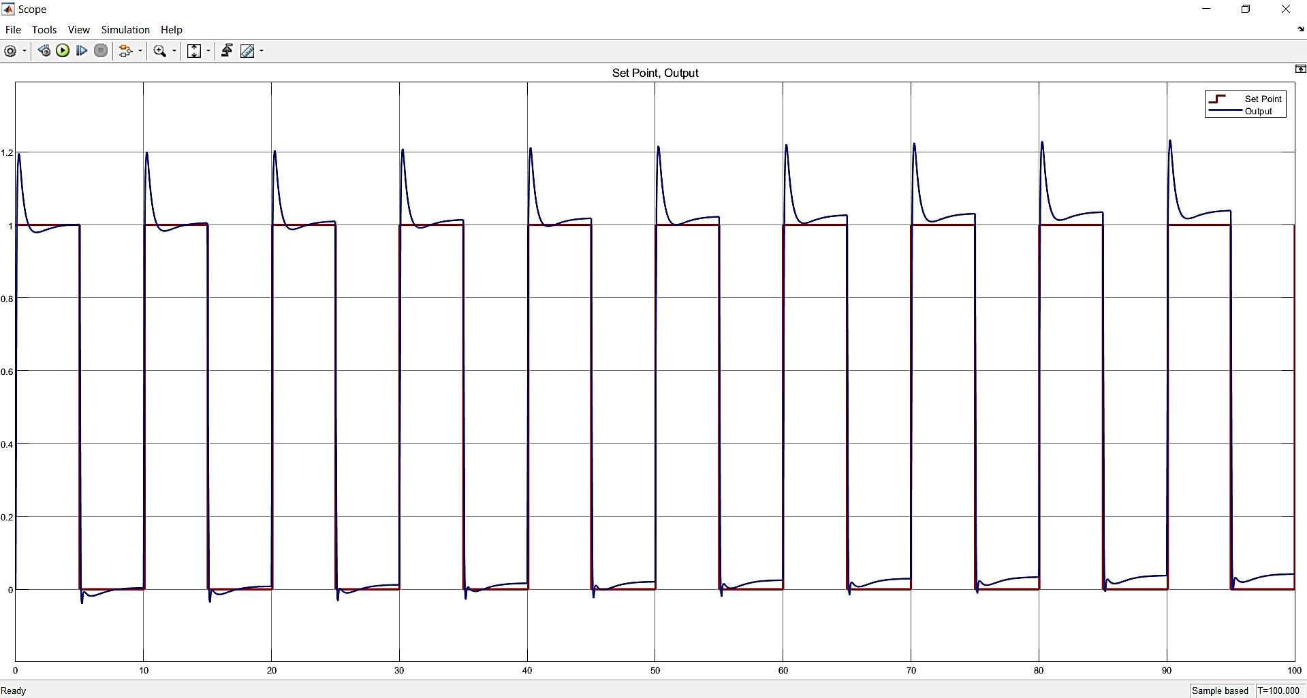
13. In presence of disturbance

Slide 16
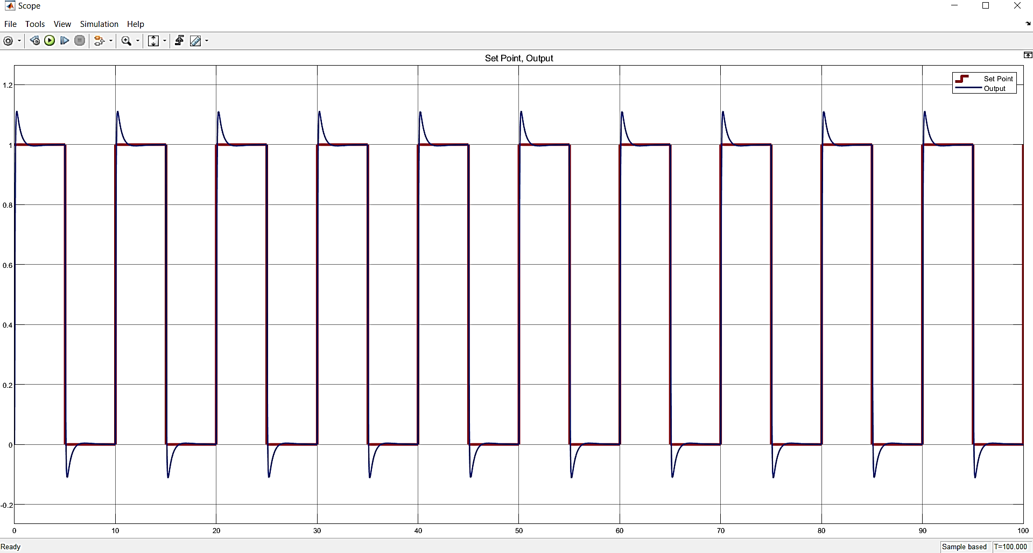
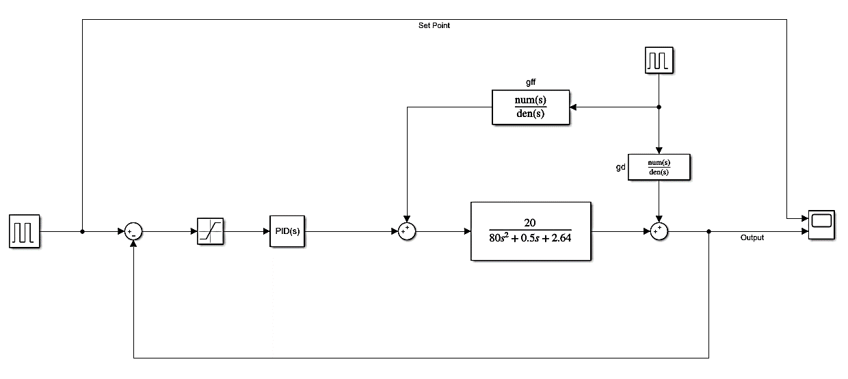
Feedforward controler

Slide 17
15. Case of emergency?
In case of power outage or any problem, it is necessary to ignore all previous elevator commands and stop the elevator on the lowest floor.

Slide 18
17.Choosing plc
In this project, the used PLC-unit is s7313c as shown in figure and has the following features: • 16 digital inputs • 16 digital outputs • Memory: o Ram ▪ Integrated: 32KB for program and data ▪ Expandable: no o Load memory

Slide 19
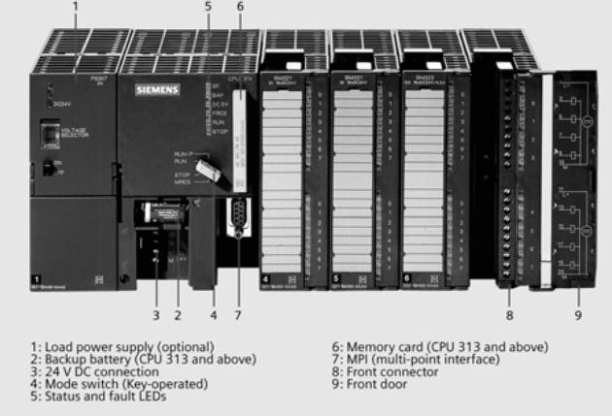
▪ Upgradable FEPROM : with micro memory card (MMC)UP TO 4 MB o Backup ▪ Without battery: program and data • Profibus-DP/Device Net • Execution times o Pit operation: 0.1 ㎲ to 0.2 ㎲ o Word operation: 0.5 ㎲

Slide 20
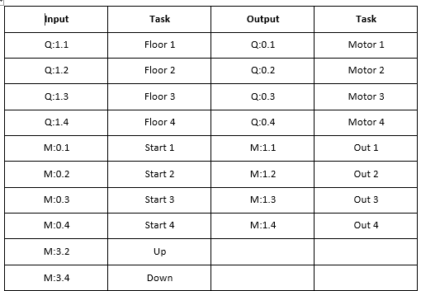
18.inputs/outputs

Slide 21
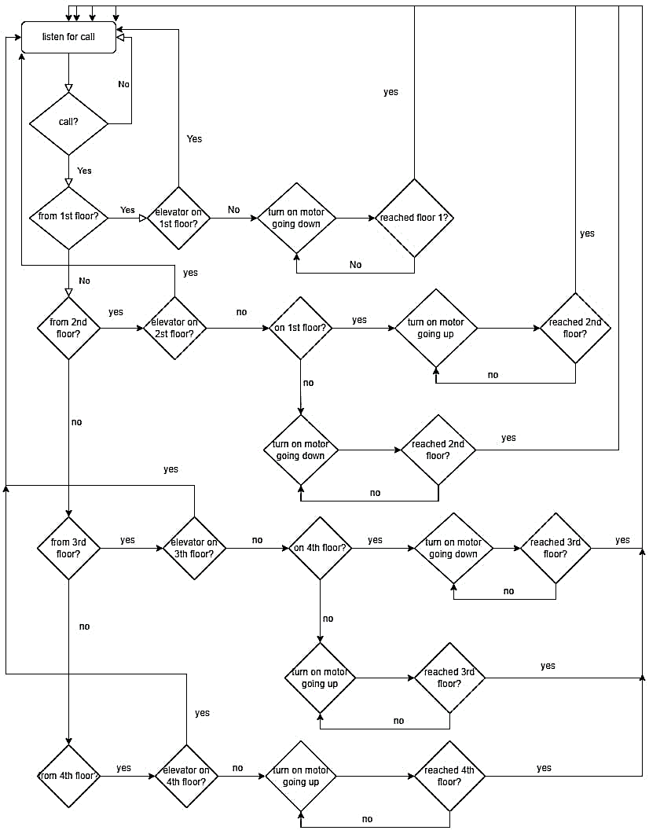
19.Plc modul

Slide 22
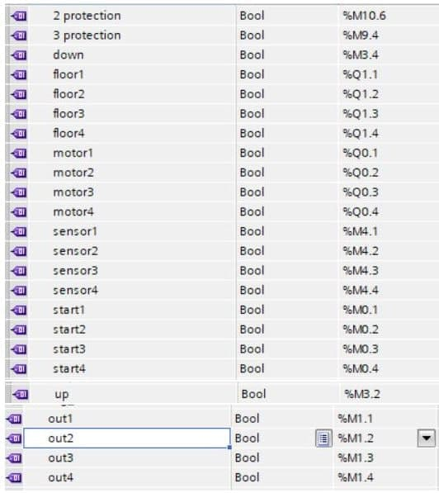
19&20.

Slide 23
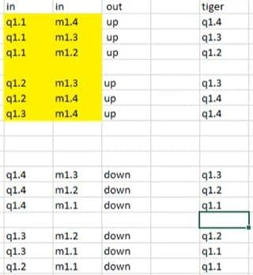
Priorities:

Slide 24
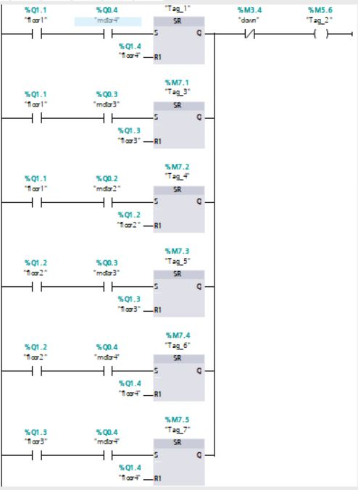
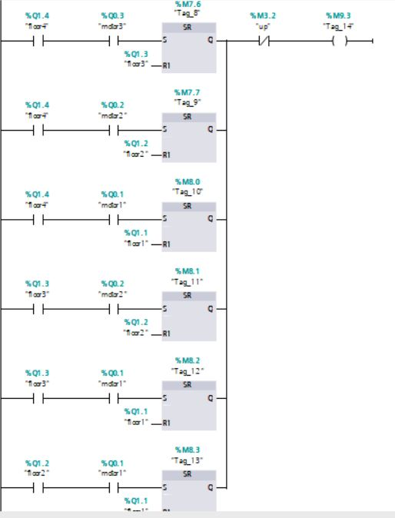
19 & 20. LADDER DIAGRAM
Top Floor Priority: Bottom Floor Priority:

Slide 25
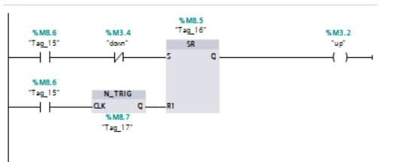
19 & 20. LADDER DIAGRAM
when the elevator is moving up and you are on the second floor, it wants to go to the 4th floor. Then someone presses the first floor. This part of the diagram causes it to go to the 4th floor first and then return to the first floor.

Slide 26
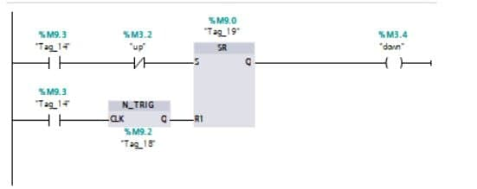
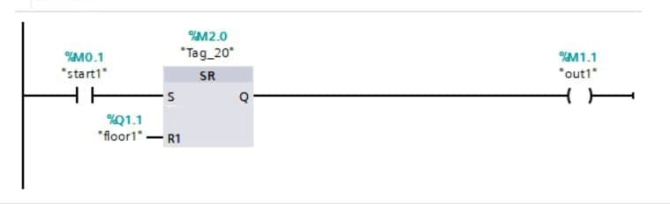
19 & 20. LADDER DIAGRAM
And similarly the elevator is moving down and you are on the 3th floor, it wants to go to the 1th floor. Then someone presses the 4th floor. This part of the diagram causes it to go to the 1th floor first and then return to the 4th floor.
To start moving the first floor:

Slide 27
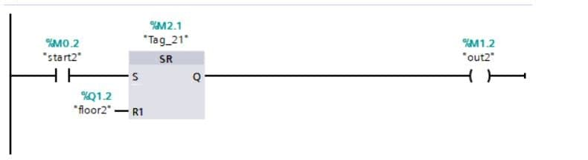
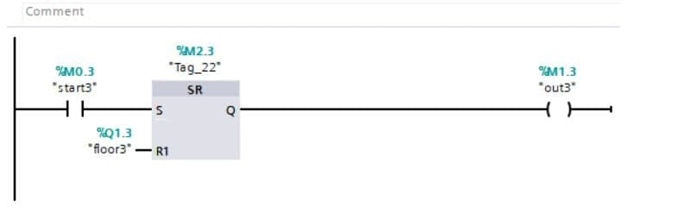
19 & 20. LADDER DIAGRAM
Start of 2nd floor:
Start of 3rd floor:

Slide 28
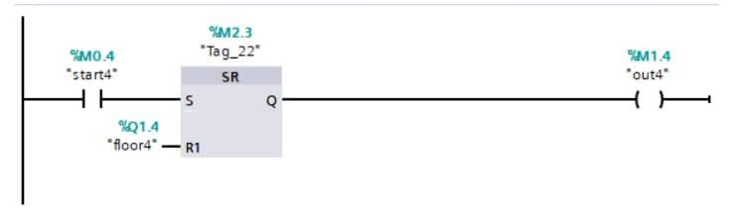
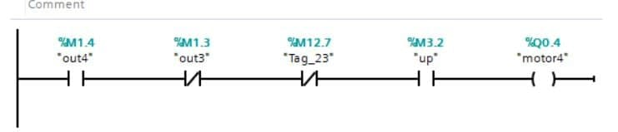
19 & 20. LADDER DIAGRAM
Start of 4th floor:
Start the motor for 4th floor

Slide 29
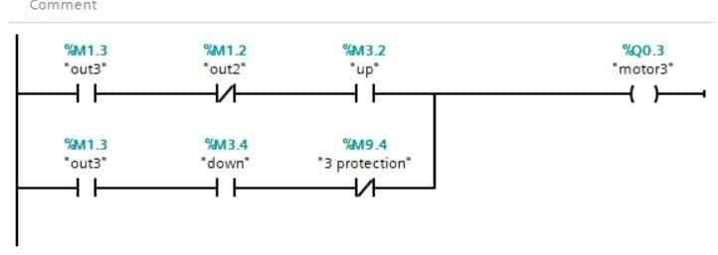
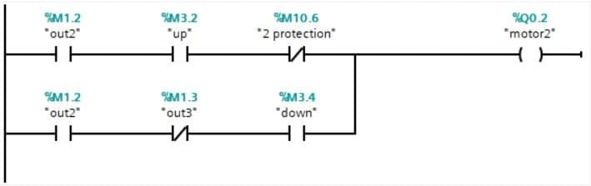
19 & 20. LADDER DIAGRAM
Start the motor for 3rd floor
Start the motor for 2nd floor

Slide 30
19 & 20. LADDER DIAGRAM
Start the motor for 3rd floor
Start the motor for 2nd floor

Slide 31
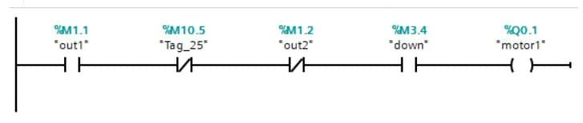
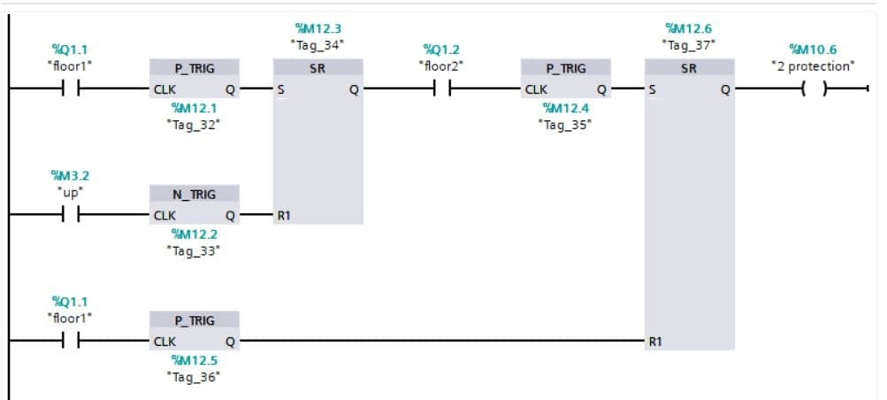
19 & 20. LADDER DIAGRAM
Start the motor for 1st floor
Second floor protection: Suppose we are on the way back to the second floor, we press the first floor button and then the second floor button, first we go to the first floor then we go back to the second floor.

Slide 32
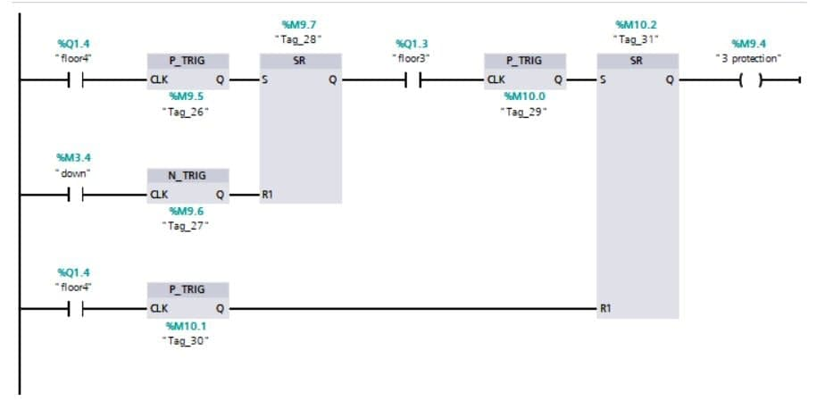
19 & 20. LADDER DIAGRAM
The same thing happens for the third floor.

