Slide 1
In the name of god
implementing Controller for the RRR robot

Slide 2
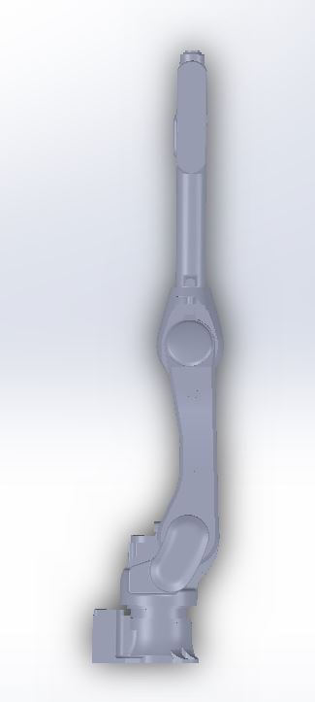
specifications
Type: articulated robot
Degree of freedom: 3

Slide 3
specifications
Servo motors: MG996R & MG90S
Motion range: 270 & 270 & 270
Microcontroller: Ardoino UNO
Motor driver: L298

Slide 4

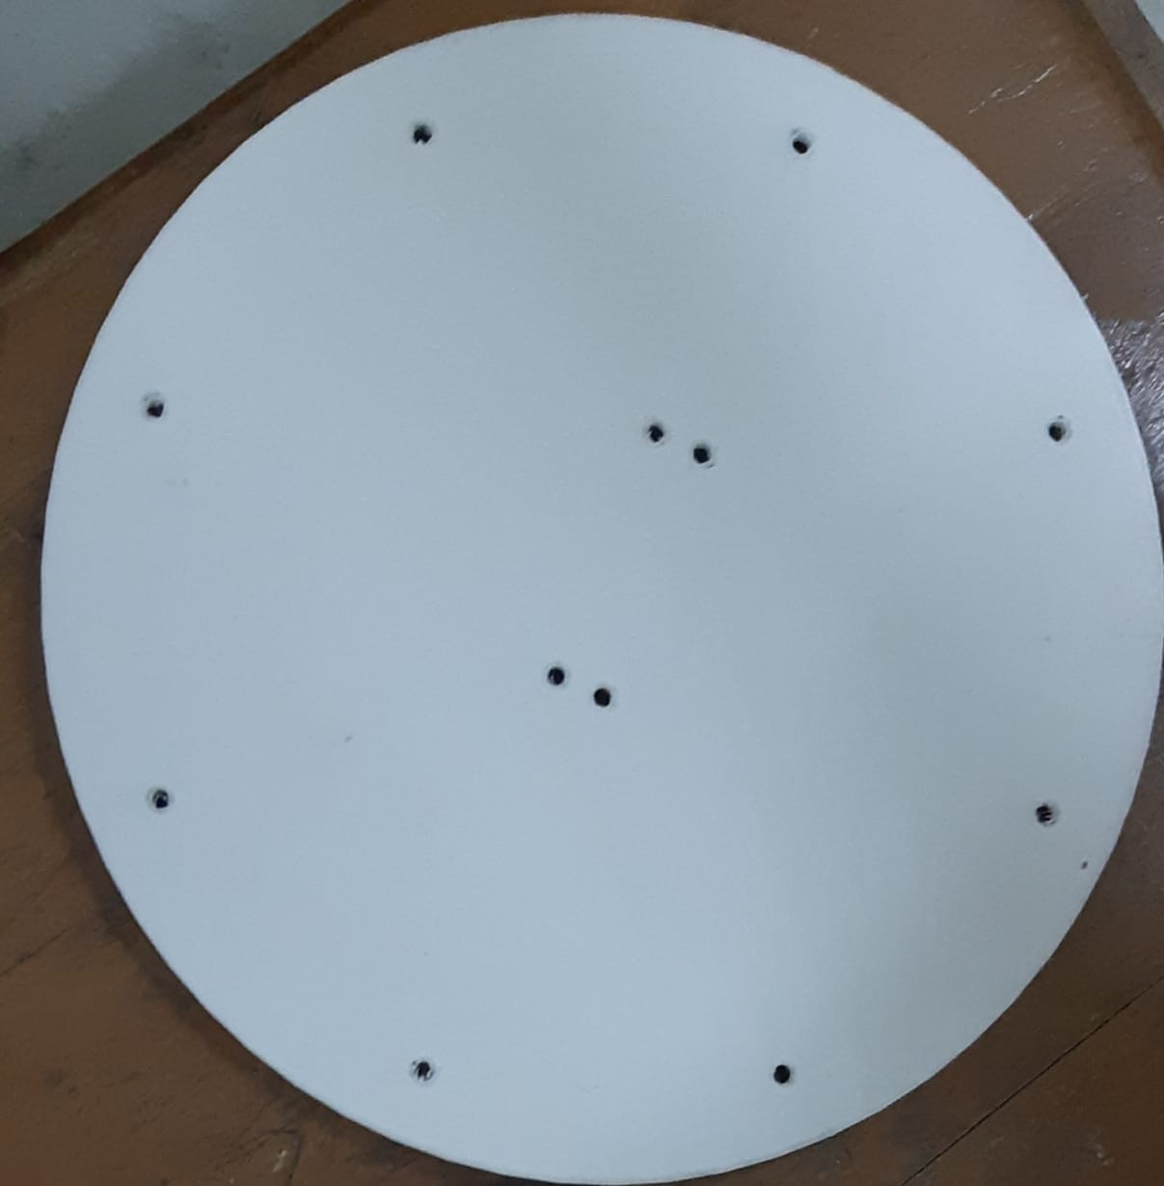
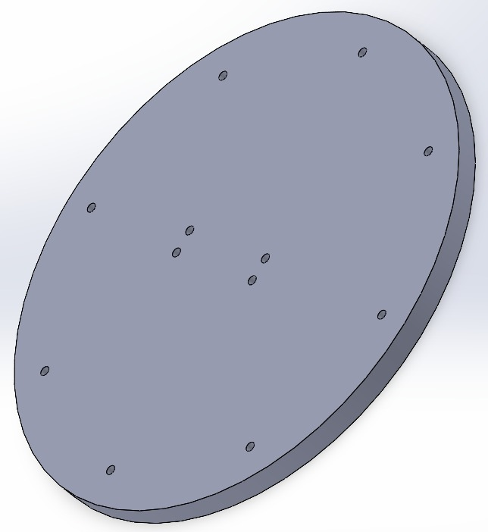
parts

Slide 5
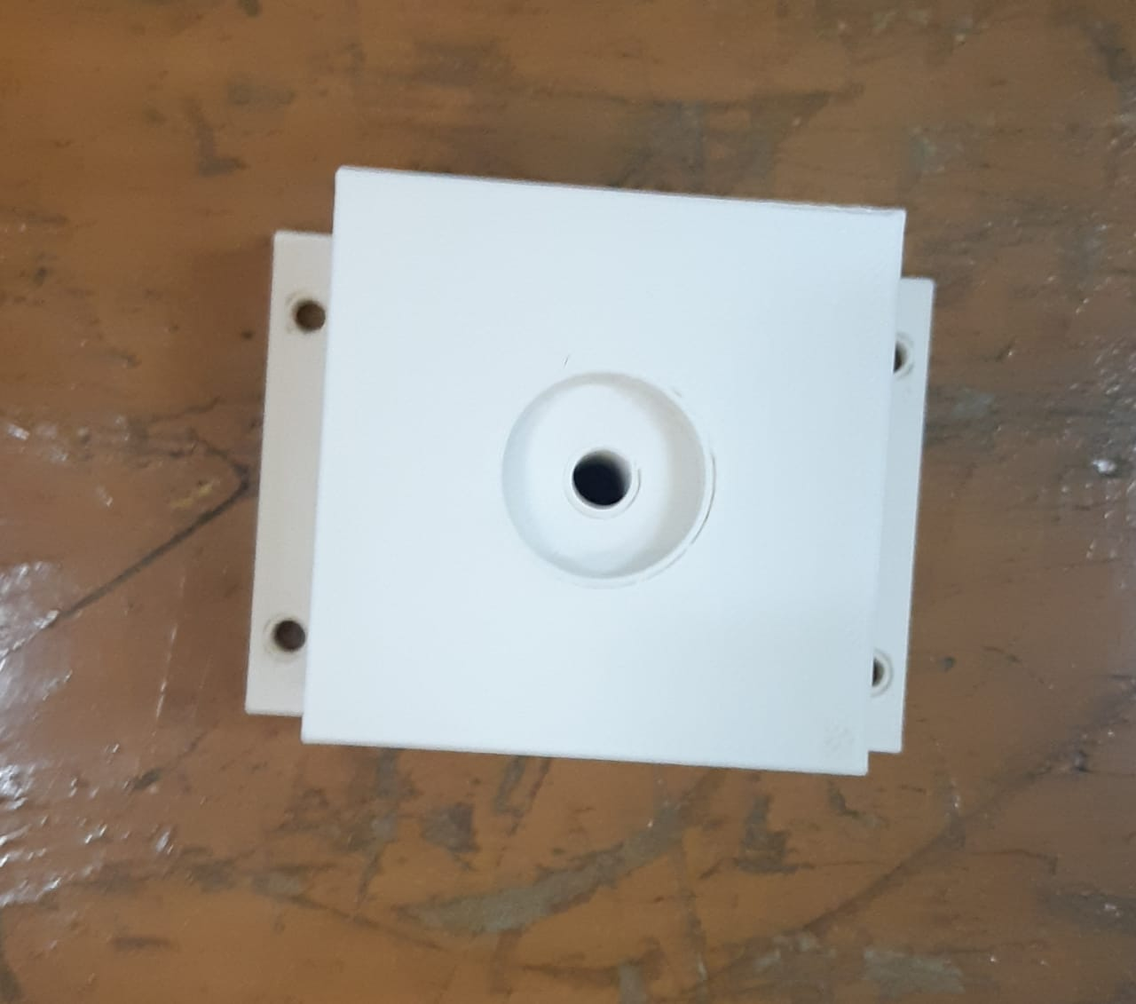
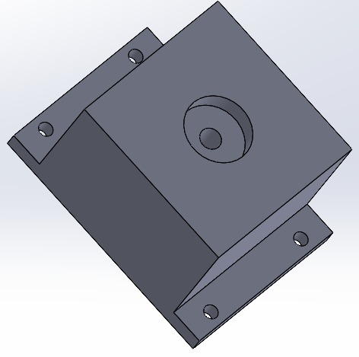
parts

Slide 6
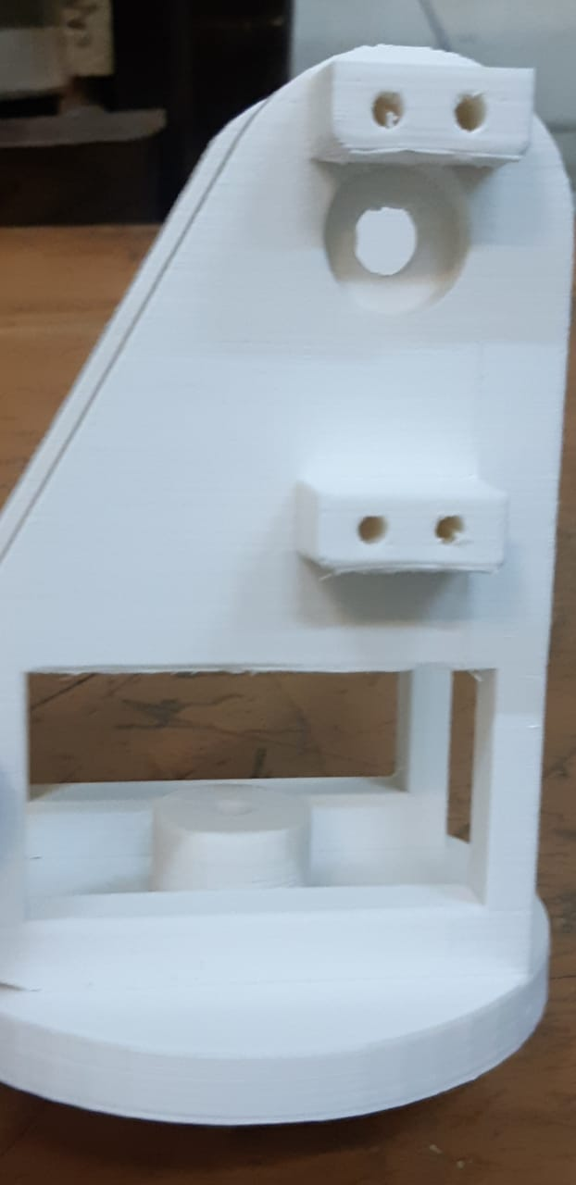
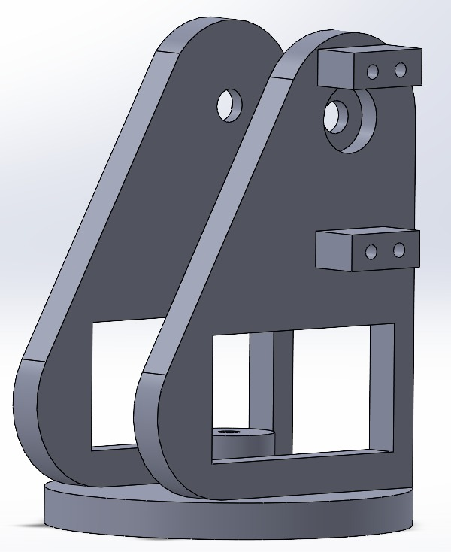
parts

Slide 7
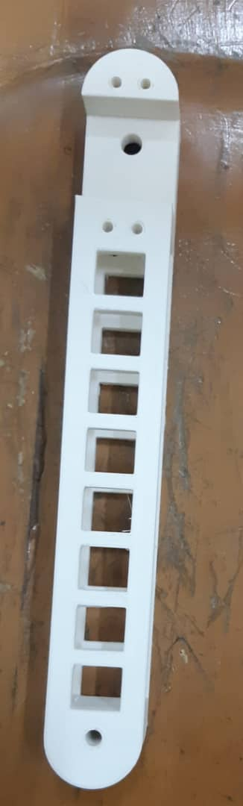
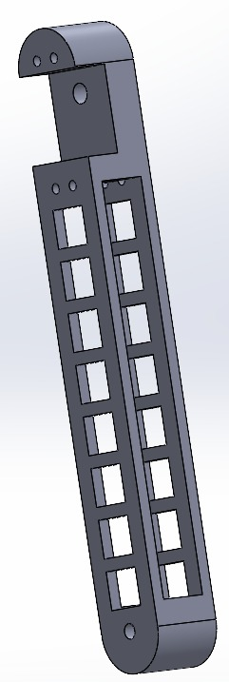
parts

Slide 8
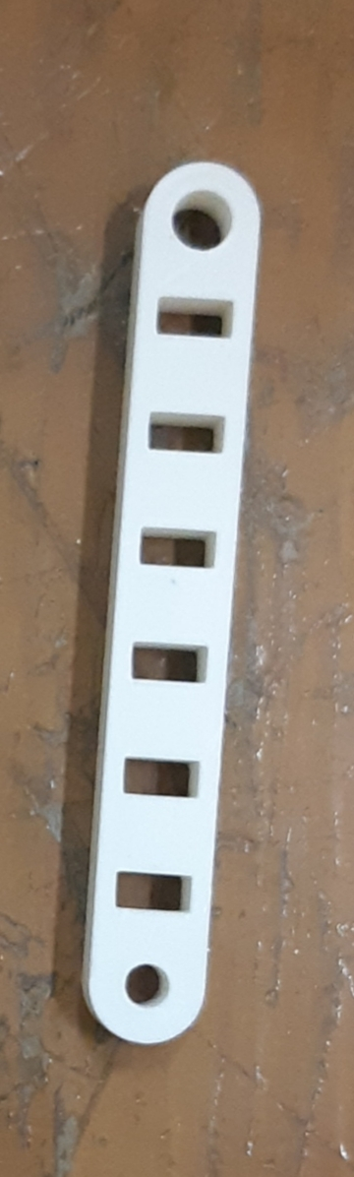
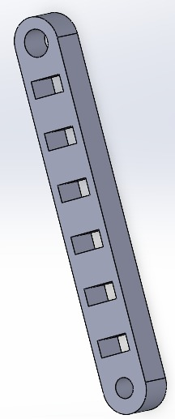
parts

Slide 9
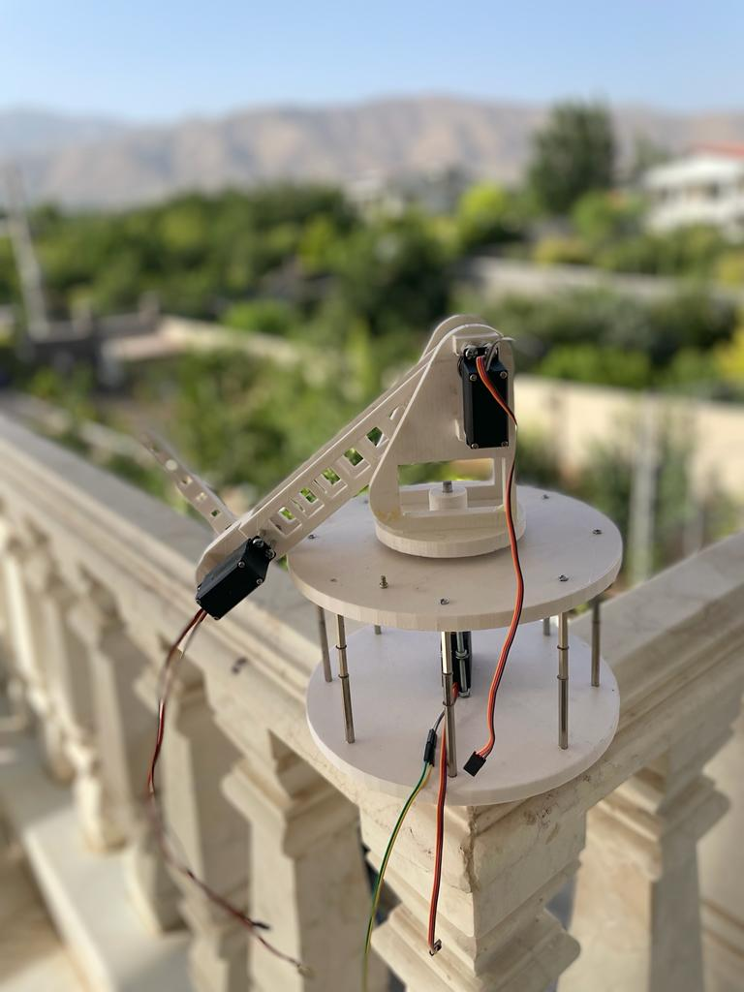
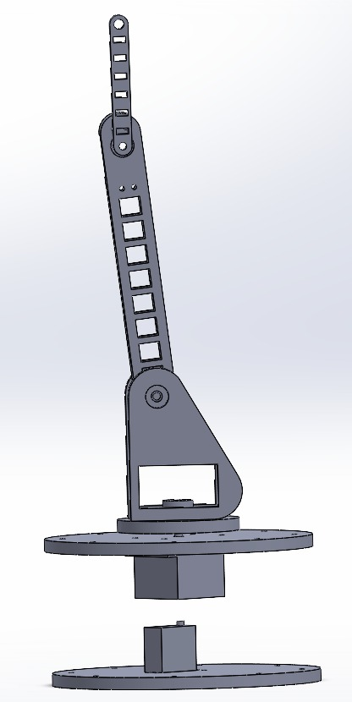
parts

Slide 10
Feedback loop
sp
controller
servo
+
-

