Slide 1


Federated Learning
Florent Jakubowski
IA pour le biomédical

Slide 2
Goals of Federated Learning
Federated Learning and Centralization: Federated learning allows the training of machine learning models without the need to centralize training data, addressing issues of data privacy and security.
Building Common Models: This approach enables multiple actors to build a common, robust model without sharing their data, while managing access rights to heterogeneous data.
Applications and Regulations: Having become the standard for complying with new regulations on private data, federated learning has applications across various industries like defense, telecommunications, the Internet of Things, and medicine.
IA pour le biomédical

Slide 3
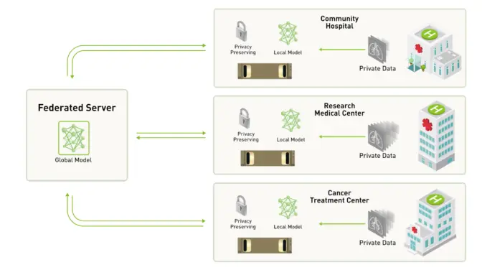
En pratique
source : NVDIA Blog
IA pour le biomédical

Slide 4
Federated Learning challenges
Federated Learning is a distributed learning paradigm with two key challenges that differentiate it from traditional distributed optimization:
(1) systems heterogeneity : significant variability in terms of the systems characteristics (varying computing, storage, and network connectivity) on each device (Edge iot device to servers) in the network. training process has to be robust enough for all the failures and limitations of the nodes in the network
(2) statistical heterogeneity : non-identically distributed data across the network. The training performance may vary significantly according to the unbalancedness of local data samples as well as the probability distribution of the training examples at each node.
IA pour le biomédical

Slide 5
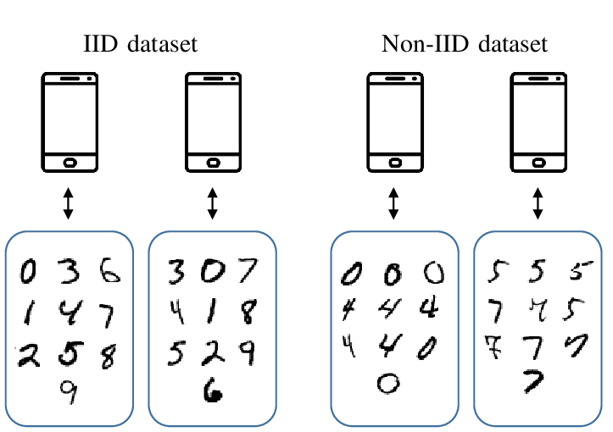
Independent and Identically distributed data
IA pour le biomédical

Slide 6
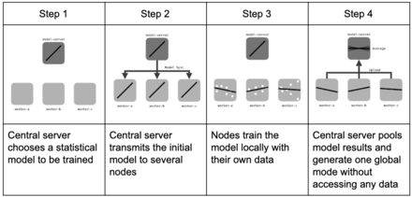
Iterative Learning
source : Wikipedia
IA pour le biomédical

Slide 7
Iterative Learning
local epochs
n Iterations
IA pour le biomédical

Slide 8

Comment agréger les modèles ?
Où 𝑚 est le nombre total de client,
p𝑘 >= 0,
Σ de k allant de 1 à 𝑚 des p𝑘 = 1,
𝐹𝑘 fonction objectif (loss function) local du client 𝑘,
𝐹 fonction de coût globale.
source : Wikipedia
IA pour le biomédical

Slide 9

Federated Averaging
Federated Averaging, Konečný, J., McMahan, et al. (2016). Federated learning: Strategies for improving communication efficiency. arXiv preprint arXiv:1610.05492.
On définit la contribution de chaque client comme :
où n𝑘 est le nombre d’observations chez le client k et n le nombre total d’observations.
IA pour le biomédical

Slide 10

Fedprox
FEDERATED OPTIMIZATION IN HETEROGENEOUS NETWORKS, Tian Li, and al. (2020).
On définit la contribution de chaque client comme :
où 𝐹𝑘 fonction objectif (loss function) local du client 𝑘,
µ constante de pénalité
w paramètres (poids)
wt paramètres globales du modèle à l’instant t
Cas particulier avec µ = 0 on retrouve FedAvg.
IA pour le biomédical

Slide 11
Fedprox
Theoretically, convergence guarantees are provided for the FedProx framework when learning over data.
Empirical evaluation validates the theoretical analysis and demonstrates the improved robustness and stability of FedProx for learning in heterogeneous networks.
In highly heterogeneous settings, FedProx demonstrates significantly more stable and accurate convergence behavior relative to FedAvg, improving absolute robust empirical performance for federated learning in heterogeneous networks
source : https://arxiv.org/pdf/1812.06127.pdf
IA pour le biomédical

