Slide 1

The Impact of Facial Expression and Head Orientation on Personality Perception
Melike Kara(22203094)
Supervisor: Uğur Güdükbay

Slide 2

Bilkent University/CS-390
1. Introduction
What Prior Work Shows
Why Do Facial Expressions and Head Pose Matter for Personality Perception?
1
Prior research in social computing and affective computing shows that facial expressions, gaze, and head motion play a central role in how personality is perceived in video-based interactions.
Motivation
  People rapidly form personality impressions from non-verbal cues such as facial expressions and head orientation.
  These impressions play a crucial role in social interaction, trust, and communication.
  With the rise of video-based communication, virtual humans, and neural rendering, understanding these cues has become increasingly important.
2
Several studies demonstrate that personality traits—particularly Extraversion—can be predicted from facial expressions in conversational videos and vlogs. These works establish strong correlations between non-verbal behavior and perceived personality. However, these approaches are primarily observational:
  they analyze naturally occurring videos
  multiple factors (identity, speech content, expression, pose) vary simultaneously
  causal interpretation is therefore limited
3
As a result, it remains unclear which specific non-verbal cues actually drive changes in personality perception, and to what extent they do so independently.

Slide 3
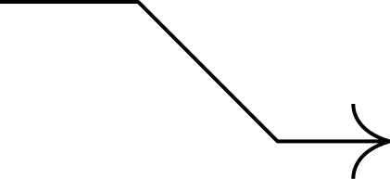
Bilkent University/CS-390
2.1 Related Works
Personality Perception from Facial Behavior
  Cognitive neuroscience shows that the human visual system processes static facial features (identity) separately from dynamic cues such as facial expression and head pose, using specialized neural pathways.
  Research in social perception demonstrates that:
    Facial appearance and expression lead to systematic Big Five personality impressions
    These impressions emerge rapidly and consistently, even without linguistic or biographical information
  According to the 2D model of face evaluation, personality impressions are largely organized around:
    Valence (intentions, trustworthiness)
    Dominance (power, physical capability)
  Dynamic nonverbal cues play a critical role:
    Facial motion and head orientation influence perceived personality
    Even neutral faces can convey different social meanings depending on orientation
  Personality perception is strongly shaped by dynamic facial cues, not only static facial appearance.

Slide 4
Bilkent University/CS-390
2.2 Related Works
Neural Talking-Heads and Face Reenactment
Neural Talking-Heads & Controlled Face Reenactment
  Recent advances in neural talking-head synthesis and face reenactment enable:
    identity-preserving facial animation
    motion transfer driven by audio or source video
    realistic expression and head pose control
  Modern approaches typically:
    disentangle identity appearance and facial motion in latent space
    rely on unsupervised keypoints, local transforms, or dense motion fields
    ensure temporal coherence and expressive realism
  Recent reaearchs increasingly emphasize social interaction:
    Interactive talking–listening behaviors
    Socially meaningful nonverbal cues in conversational settings

Slide 5
Bilkent University/CS-390
2.2 Related Works
Neural Talking-Heads and Face Reenactment
Limitation of Prior Work
Our Contribution
Most prior systems:
    vary multiple cues simultaneously (expression, pose, audio, identity)
This makes it difficult to determine:
    whether perceived personality differences arise from
      facial motion itself
      dentity or linguistic content
      or synthesis artifacts
We adopt a controlled, ceteris-paribus design:
  fixed identity, audio, lighting, background, and duration
  isolated manipulation of facial expression and head orientation
Our work aim to establish causal links between isolated nonverbal cues and personality perception.

Slide 6
Bilkent University/CS-390
3.Stimuli Generation
Base Identity
  A single identity is used throughout the study
  Reference images:
    neutral facial expression, uniform lighting, head-only portrait views (frontal and left)
  Identity images selected from CMU Multi-PIE
    controlled capture conditions
    consistent background and illumination
Using a single identity sacrifices generalizability but provides a clean experimental setup, allowing perceptual differences to be attributed directly to dynamic nonverbal cues rather than static facial appearance.

Slide 7
Bilkent University/CS-390
3.Stimuli Generation
Driving Videos & Emotion Selection
  Facial motion sourced from RAVDESS:
    professionally acted emotional speech
    natural facial motion and head dynamics
  Audio removed to eliminate emotional tone of voice
  Clips are around 3-4 seconds
  Four emotional expresions selected:
    Anger, Happiness, Sadness, Surprise
  Driving clips manually chosen to ensure:
    clear emotional dominance
    comparable duration and expressive intensity

Slide 8
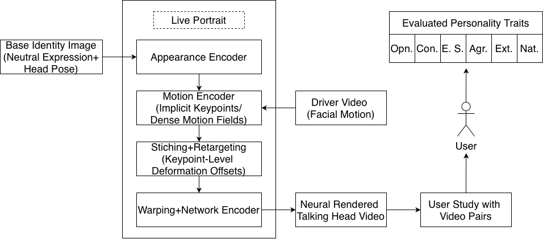
Bilkent University/CS-390
3.Stimuli Generation
Neural Reenactment
  Talking-head videos generated using LivePortrait
  Model disentangles:
    identity-specific appearance
    facial expression and head orientation
  Motion transfer achieved via:
    dense motion fields
    implicit keypoints
  High-fidelity reenactment minimizes:
    expression smoothing
    rendering artifacts
    uncanny valley effects
Design Choice:
Perceived personality should be driven by social cues, not synthesis artifacts.
Fig. 1. Overview of the neural reenactment pipeline based on LivePortrait.

Slide 9
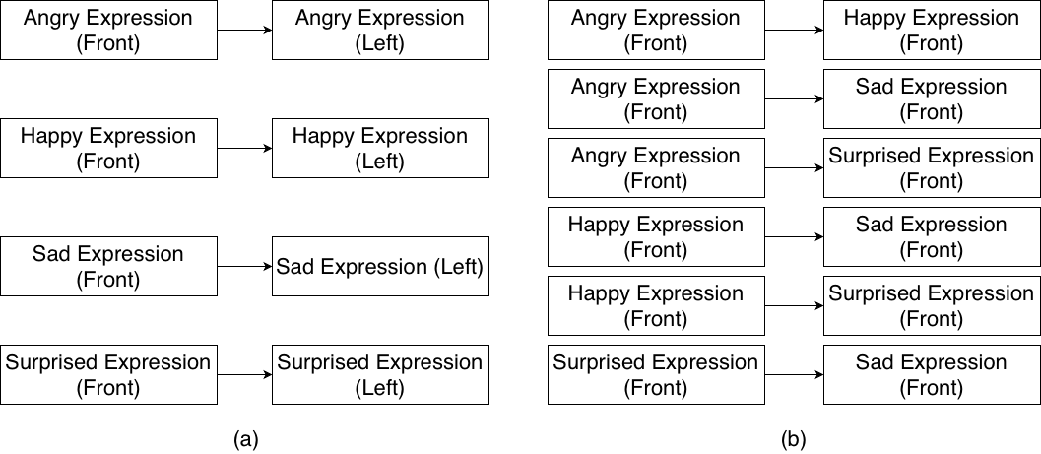
Bilkent University/CS-390
3.Stimuli Generation
Pair Construction (Ceteris Paribus)
From 8 base conditions, we construct 10 comparison pairs:
  Same emotion, different head pose (4 pairs)
    frontal vs. left-facing
    isolates head orientation
  Different emotion, same head pose (6 pairs)
    frontal view only
    isolates facial expression
  Presentation controls:
    randomized pair order
    randomized left–right placement
Outcome:
Each comparison isolates one visual factor at a time, enabling interpretation.
Fig. 2. Pair construction strategy used in the user study.

Slide 10
Bilkent University/CS-390
4.Experiments
Study Design
  Forced-choice pairwise comparison paradigm
  Participants compare two neural-rendered talking-head videos at a time
  Each comparison isolates one visual factor (expression or head pose)
Procedure
  Web-based interface with informed consent
  Participants complete all tasks sequentially
  Each video pair evaluated on 6 dimensions:
    Openness
    Conscientiousness
    Extraversion
    Agreeableness
    Emotional Stability
    Naturalness (control)
  Forced-choice answers:
    Left / Equal / Right
Participants
  N = 80 participants recruited via Prolific
  Location: UK & US
  Fluent in English
  Desktop / laptop usage required

Slide 11
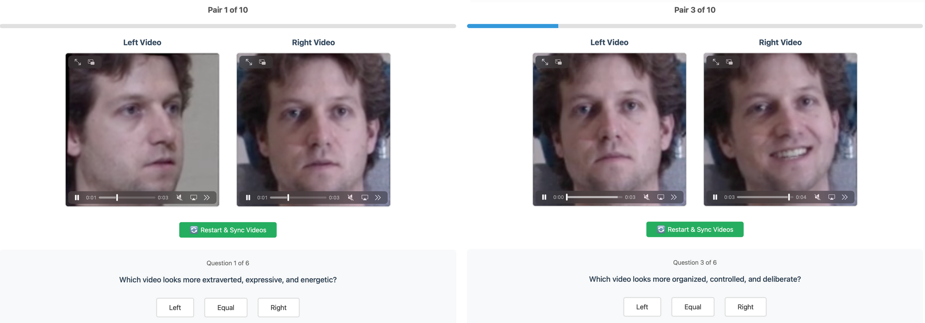
Bilkent University/CS-390
4.Experiments
Fig. 3. Screenshots from the user study: a pair with the same expression (left) and different poses, and different expressions with a frontal view (right).

Slide 12
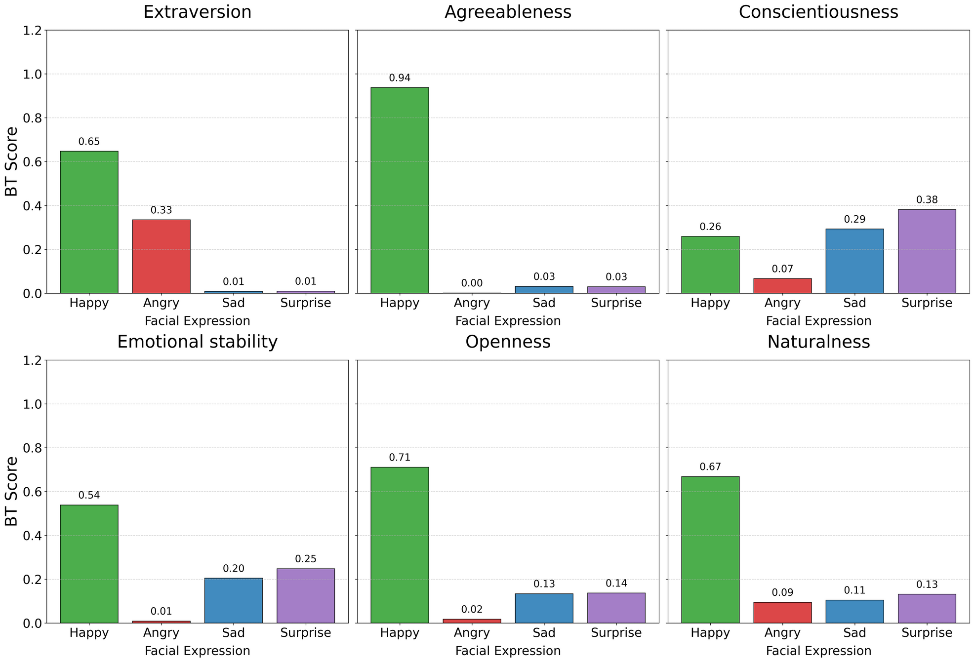
Bilkent University/CS-390
5.Analysis and Results
Bradley–Terry Analysis
  We apply Bradley–Terry modeling to obtain probabilistic rankings of facial expressions for each trait.
  Results reveal a clear dominance of happy expressions for positive social traits:
    Agreeableness: BT = 0.94
    Openness: BT = 0.71
    Strong effects also observed for:
      Extraversion
      Emotional Stability
  Key insight:
  Happy expressions are the strongest indicator of positive personality perception in neural-rendered faces.

Slide 13
Bilkent University/CS-390
5.Analysis and Results
Arousal vs. Valence
  Angry expressions also score relatively high in Extraversion (BT = 0.33), despite being negatively valenced.
  This suggests:
    High emotional arousal, rather than positivity alone, contributes to perceived extraversion.
Conscientiousness & Naturalness
  Unlike other traits Surprise scores highest for conscientiousness (BT = 0.38).
  Happy expressions are perceived as the most natural, but do not dominate conscientiousness.
Interpretation:
Participants did not simply select the most natural-looking videos, indicating no halo effect.

Slide 14
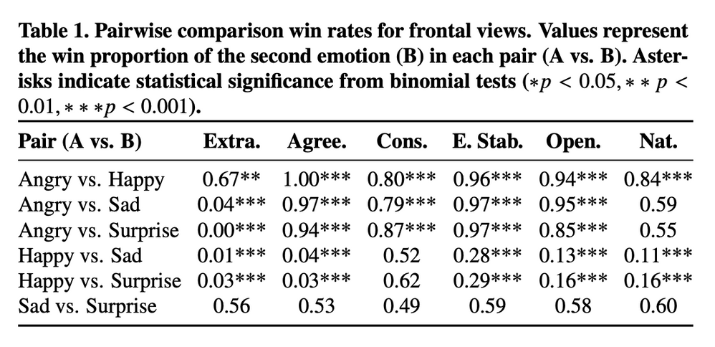
Bilkent University/CS-390
5.Analysis and Results
Pairwise Comparisons & Head Orientation Effects
Pairwise Emotion Comparisons
  Binomial tests confirm:
    Happy expressions dominate Angry and Sad expressions especially for:
      Agreeableness
      Emotional Stability
  Example:
    Happy vs. Angry:
      Agreeableness = 1.00*
      Emotional Stability = 0.94*
  Sad vs. Surprise:
    No significant differences across traits (p > 0.05)
    → Nearly indistinguishable personality profiles

Slide 15
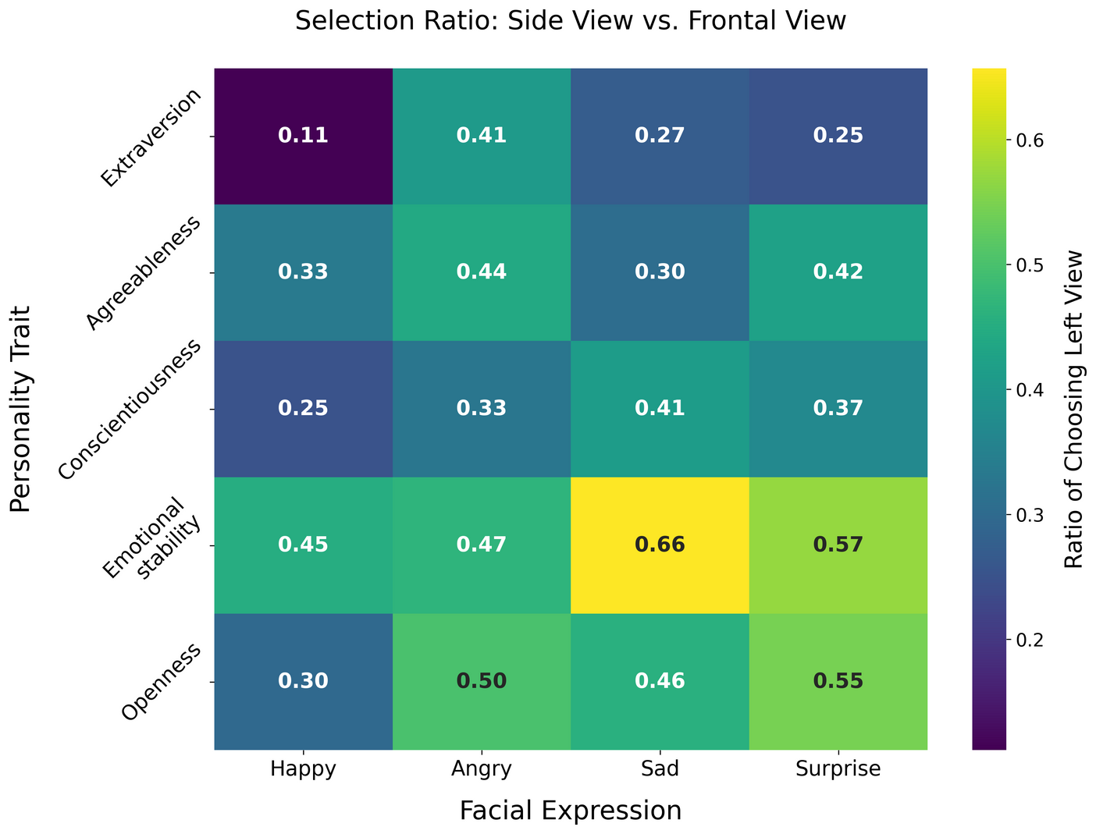
Bilkent University/CS-390
5.Analysis and Results
Influence of Head Orientation
  Comparing frontal vs. left-facing views under identical expressions:
    Frontal view perceived as more:
      Extraverted
      Emotionally stable (in most cases)
  Exception: For sad expressions, left-facing orientation favored for emotional stability.
  Head orientation does not carry a fixed social meaning. Its effect depends on both the underlying emotional expression and the personality trait being judged

Slide 16
Bilkent University/CS-390
6.Conclusion and Future Work
Conclusion
  We studied personality perception in neural-rendered talking-head videos using:
    4 facial expressions
    2 head orientations
    controlled pairwise comparisons
  Key findings:
    Facial expression is the primary driver of perceived personality
      Happy expressions dominate:
        Extraversion
        Agreeableness
        Emotional Stability
    Sad and surprised expressions are perceived as conceptually similar
    Head orientation interacts with expression:
      Frontal view → more extraverted
      Side view → higher emotional stability, especially for sad and surprised expressions
    Participants rely on dynamic nonverbal cues, not perceived naturalness
Personality perception emerges from dynamic changes in expression and head pose, not from static realism.

Slide 17
Bilkent University/CS-390
6.Conclusion and Future Work
Design Implications
  Findings can be translated into automated design rules for:
    animation
    games
    virtual agents
  Example:
    switch from frontal → side view when expressing sadness
    use high-energy expressions + frontal view to emphasize extraversion and agreeableness
Future Work
  Integrate auditory cues (voice, prosody, dialogue), especially for:
    conscientiousness, which is weakly conveyed visually
  Study longer interactions to examine:
    temporal stability of personality perception
    adaptation effects over time
  Extend beyond short-term exposure and single identity

Slide 18
Bilkent University/CS-390
Thank you for listening me
Q&A

