Slide 1
Electric Vehicle Population Analysis
Auto-generated via Python

Slide 2
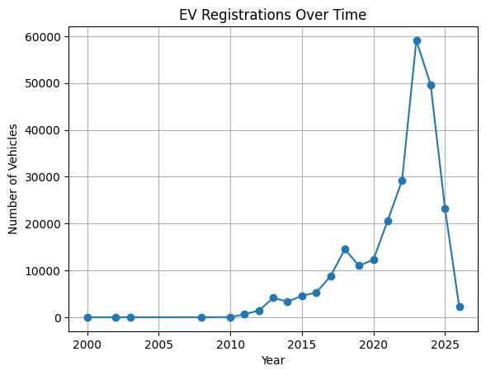
EV Registrations Over Time

Slide 3
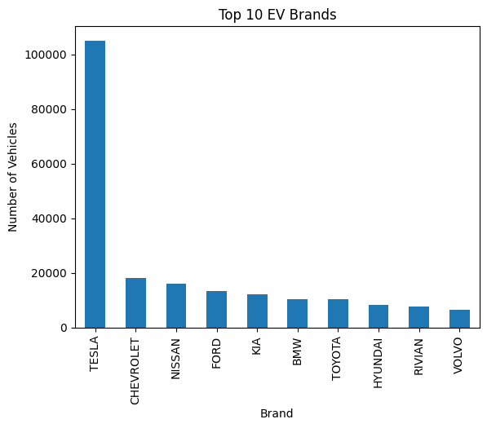
Top 10 EV Brands

Slide 4
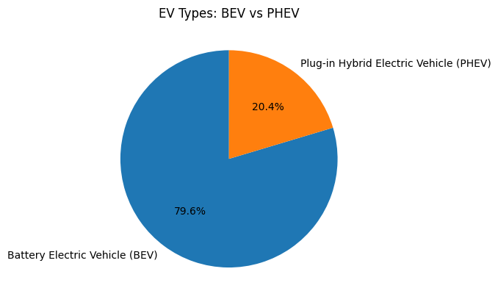
EV Types: BEV vs PHEV

Slide 5
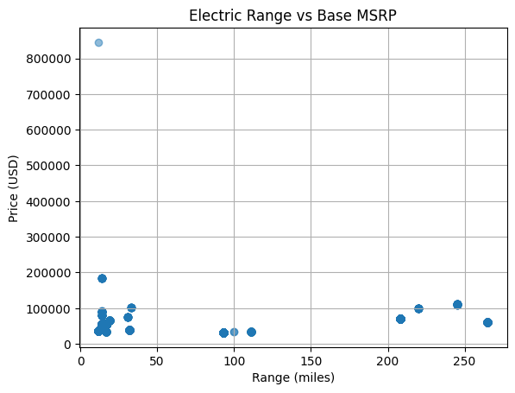
Electric Range vs Base MSRP

