Slide 1

Electric Vehicle Population Analysis
Data exploration and automated reporting with Python

Slide 2
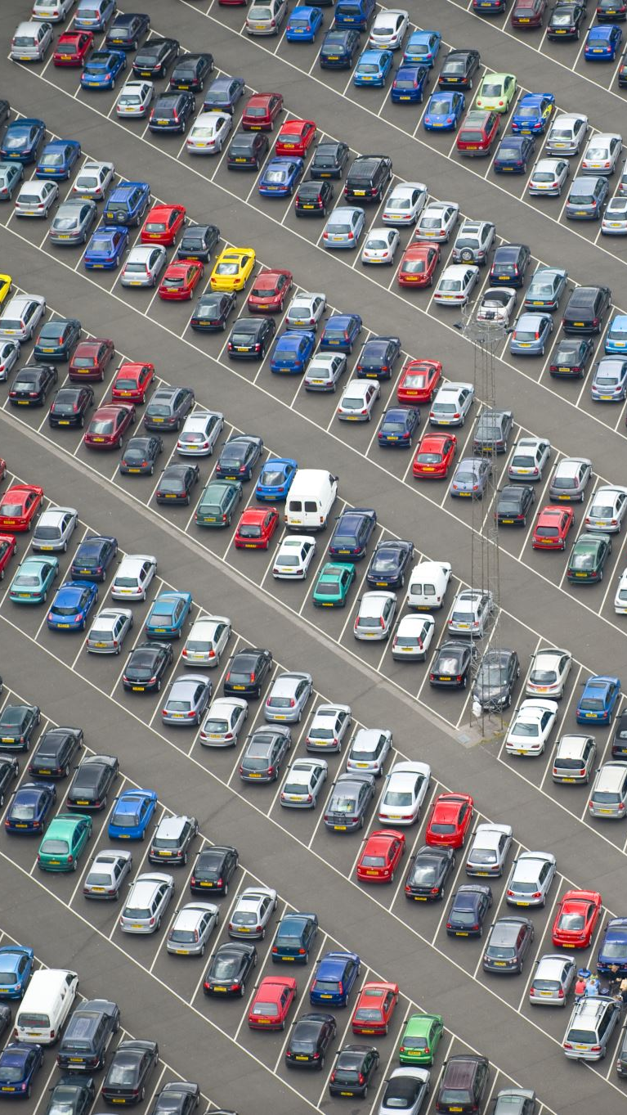
Introduction
Dataset: ~250,000 rows of EV registrations
Time span: 2000–2023
Goal: Explore EV adoption trends, brand distribution, vehicle types, and the link between electric range and price
Tools: Python (pandas, matplotlib, python-pptx)

Slide 3
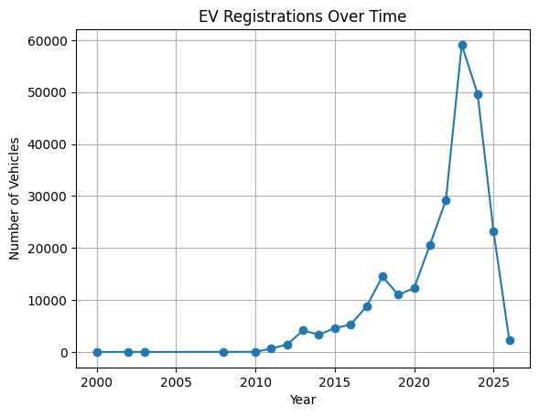
EV Registrations Over Time Strong growth after 2015 Peak around 2022 Clear upward trend showing rapid EV adoption

Slide 4
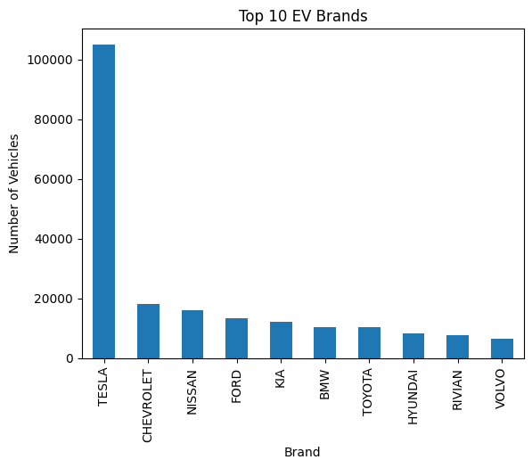
Tesla dominates with a large share Nissan and Chevrolet follow, but much smaller Ford, BMW, Kia also appear in the top list

Slide 5
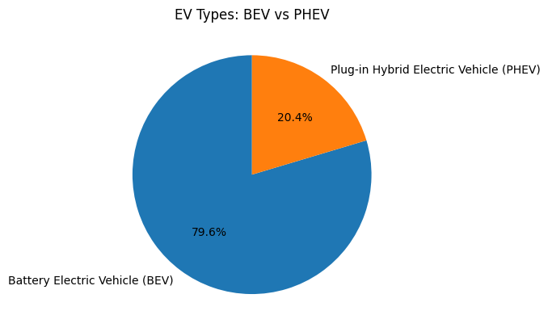
BEV vs PHEV Battery Electric Vehicles (BEVs) ≈ 80% Plug-in Hybrids (PHEVs) ≈ 20% Full electric cars clearly dominate the dataset

Slide 6
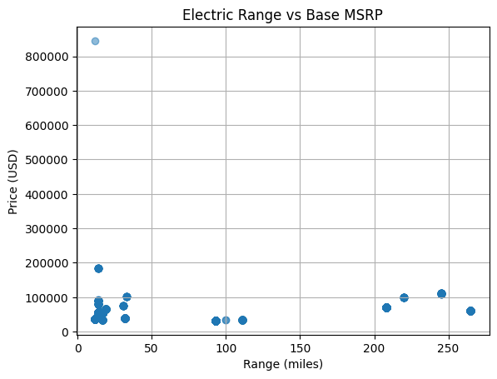
Most EVs cluster at affordable price ranges with moderate range
High-range vehicles often come with higher MSRP
Shows expected positive correlation between price and performance

Slide 7
Conclusion
EV adoption is accelerating rapidly after 2015
Tesla is the clear market leader
BEVs dominate over PHEVs
Price tends to increase with higher range
Demonstrated workflow: cleaning → analysis → visualization → automated reporting

