Slide 1
Vehicle Detection and Classification from Images
Ali Şentaş & Melik Buğra Özçelik

Slide 2
Table of contents
01
02
03
04
Introduction
Detection
Overview
Progress in Vehicle Detection
Classification
Conclusion
Progress in Vehicle Classification
Next Steps

Slide 3
01
Introduction
3
7
5
0
9
Reminder of Our Project Goals

Slide 4
02
Detection
3
7
5
0
9
Progress in the Detection Task

Slide 5
Detection
5
6
7
0
8

Slide 6
03
Classification
3
7
5
0
9
Progress in the Classification Task

Slide 7
Classification
5
6
7
Dataset from TAU Vehicle Type Recognition Competition on Kaggle (https://www.kaggle.com/competitions/vehicle/data )
Normally, it consists of 17 classes, but only 6 are used (Motorcycle, Car, Bicycle, Van, Bus, Truck)
Dataset can be widened by combining other datasets or data augmentation
0
8

Slide 8
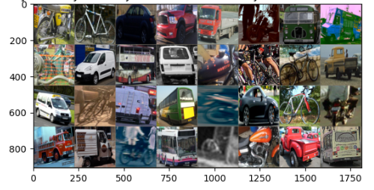
Classification
5
6
7
0
8

Slide 9
Classification
5
6
7
ResNet50 is chosen an experimental training has been done
The model seems to be trainable with default parameters
Next Steps:
Data augmentation
HP tuning for real training
Obtaining the metrics (Precision, recall, F1)
0
8

Slide 10
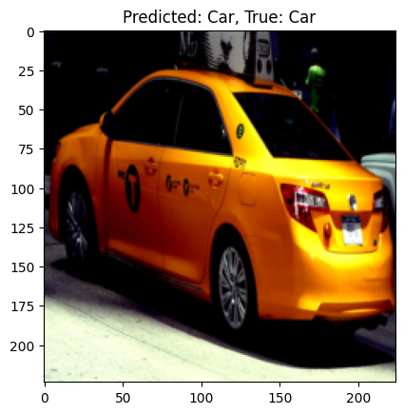
Classification
5
6
7
0
8

Slide 11
Thanks!
Q&A

