Slide 1
Vehicle Detection and Classification from Images
Ali Şentaş & Melik Buğra Özçelik

Slide 2
Table of contents
01
02
03
04
Introduction
Detection
Overview
Progress in Vehicle Detection
Classification
Conclusion
Progress in Vehicle Classification
Next Steps

Slide 3
01
Introduction
3
7
5
0
9
Reminder of Our Project Goals

Slide 4
02
Detection
3
7
5
0
9
Progress in the Detection Task

Slide 5
Detection
5
6
7
0
8

Slide 6
03
Classification
3
7
5
0
9
Progress in the Classification Task

Slide 7
Classification
5
6
7
Dataset is changed to output of detection tas
Microbus, Bus, Sedan, Minivan, Truck, SUV
Can be widened with the dataset from TAU Vehicle Type Recognition Competition on Kaggle (https://www.kaggle.com/competitions/vehicle/data )
0
8

Slide 8
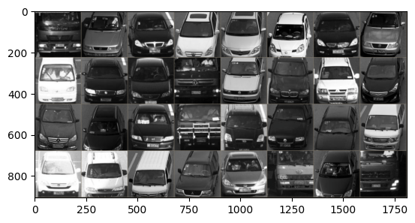
Classification
5
6
7
0
8

Slide 9
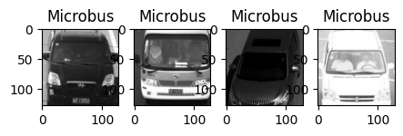
Classification
5
6
7
0
8

Slide 10
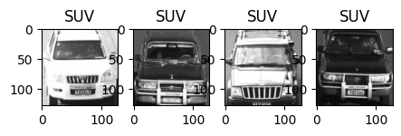
Classification
5
6
7
0
8

Slide 11
Classification
5
6
7
0
8

Slide 12
Classification
5
6
7
ResNet50 is trained
Dataset was splitted into train, validation and test sets
Train and validation are concatenated and 5-fold cross validation is applied
Then the evaluation has been done on test set, acquiring the evaulation metrics:
0
8

Slide 13
Classification
5
6
7
ResNet50 is trained with only retraining the output fc layer
Input images are normalized and transformed for consistency with ImageNET data
3e-4 is chosen as learning rate and 32 is chosen as batch size after some experiments
Dataset was splitted into train, validation and test sets
Train and validation are concatenated and 5-fold cross validation is applied, 20 epochs for each
Then the evaluation has been done on test set, acquiring the evaulation metrics:
0
8

Slide 14
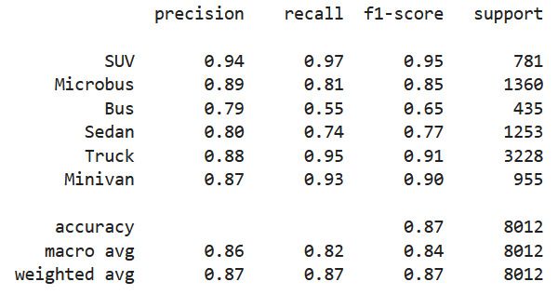
Classification
5
6
7
0
8

Slide 15
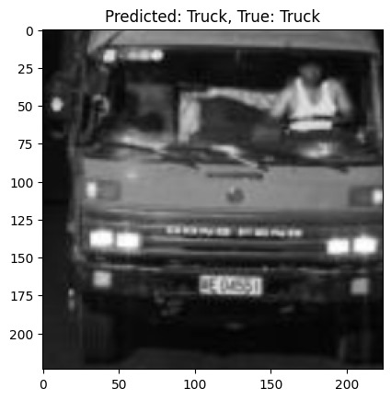
Classification
5
6
7
0
8

Slide 16
Thanks!
Q&A

