Slide 1

Vehicle Detection and Classification from Images
Ali ŞENTAŞ
Melik Buğra ÖZÇELİK

Slide 2



Agenda
Introduction
Project Overview
Executive Summary
Project Description
Impact of Solution
SOTA
Risk Assessment
Project Scope
Milestones and Deliverables

Slide 3




Introduction
Relevance to autonomous driving.
Importance of CV in detecting the traffic actors.
Use of deep learning-based CV techniques.

Slide 4

Project Overview
Course: BLG 506E Computer Vision
Title: Vehicle Detection and Classification from Images
Authors: Melik Buğra ÖZÇELİK and Ali ŞENTAŞ
Proposal Date: 13.11.2023

Slide 5
Executive Summary
Focus on classifying vehicles in images using computer vision (CV) models.
Utilize transfer learning with pre-trained CV models.
Divided responsibilities: Vehicle detection by Ali Şentaş and classification by Melik Buğra Özçelik.

Slide 6
Project Description
Goal: Implement a robust vehicle detection and classification system.
Application in advanced driver-assistance systems (ADAS) and autonomous driving.
Utilization of open-source datasets for training.

Slide 7
Impact of Solution
Improvement in vehicle safety.
Aid to driver assistance systems in detecting vehicles.
Potential to save lives by preventing accidents.

Slide 8
State of the Art
Traditional and current methodologies in vehicle detection.
Two-stage solutions like R-CNNs.
One-stage solutions like YOLO.

Slide 9
Risk Assessment
Risks: Limited data, low-quality datasets, overfitting, underfitting, slow performance.
Contingency plans for each identified risk.

Slide 10
Risk Assessment
Possible Risk | Risk Reason | Contingency Plans
Limited data | Dataset | Augment the available data by means such as rotating images or adding noise.
Low quality dataset | Dataset | Find better datasets
Low model accuracy | Model training | Tune hyperparameters, find best performing ones
Overfitting | Model training | Add regularization such as dropout layers and/or simplify model
Underfitting | Model training | Increase the amount of data, tune hyperparameters
Slow performance | Model evaluation | Use simpler, less resource hungry models or use stronger GPUs

Slide 11
Milestones and Deliverables
Details of Work Breakdown Structure (WBS).
Work Packages and tasks out of scope.

Slide 12
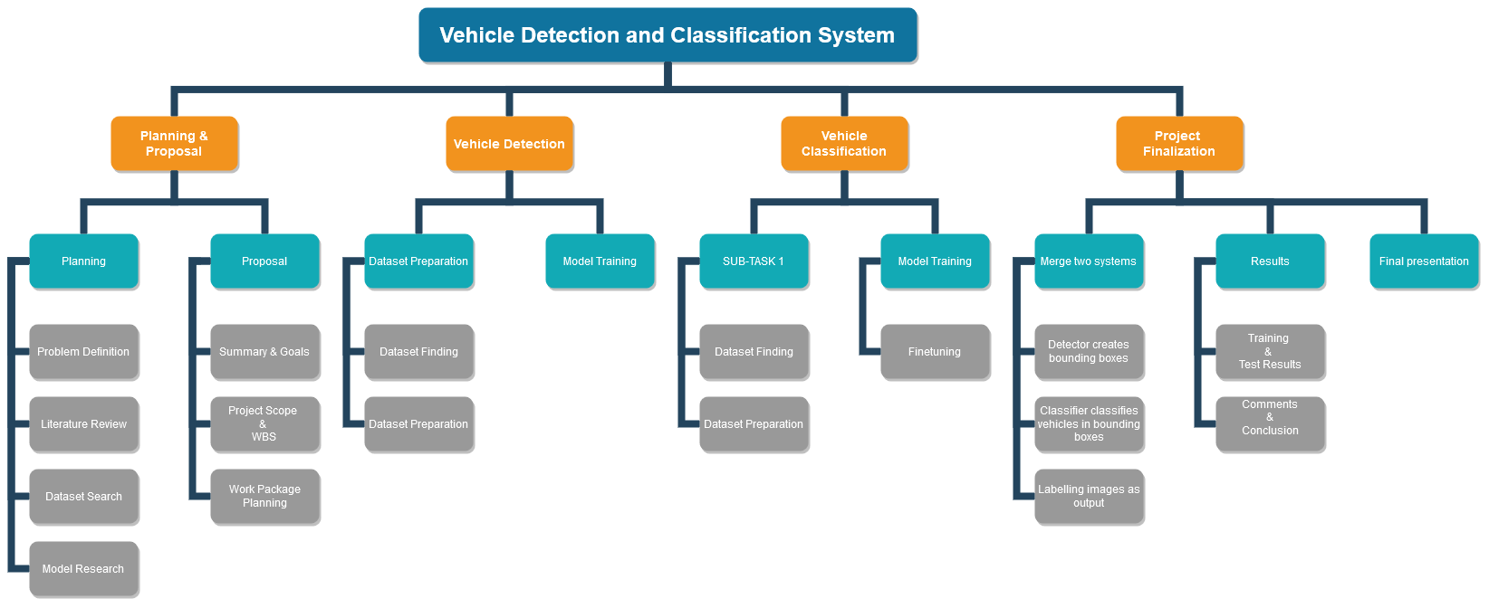
Risk Assessment

Slide 13


Team
Ali Şentaş
Melik Buğra Özçelik
Vehicle Detection
Vehicle Classification

Slide 14

Summary
The project aims to leverage vision models, employing transfer learning techniques to accurately detect and classify vehicles in various images. This project is crucial for its potential applications in advanced driver-assistance systems (ADAS) and autonomous driving technologies.

Slide 15


Thank You

