Slide 1
Capstone III Presentation
Project: Analysis of Energy Efficiency
Presented by : D.A. Melike Karaman Yilmaz
Notes:
Hello , My name is melike. Welcome to my presentation on Energy efficiency.

Slide 2
Introduction
Energy saving is one of the most important issues today. The efficient use of resources is very important in terms of not only providing us an economic profit, but also leaving a good world for future generations. This dataset provides insights into energy efficiency meter evaluated projects for residential existing homes in New York state from 2007-2012 With this study, I wanted to see if there is any correlation between total project cost and energy bill savings, the cost of the energy efficiency project from region to region, and what is the effect of the size of the house on the cost.
Notes:
Energy saving is one of the most important issues today. The efficient use of resources is very important in terms of not only providing us an economic profit, but also leaving a good world for future generations. This dataset provides insights into energy efficiency meter evaluated projects for residential existing homes in New York state from 2007-2012 With this study, I wanted to see if there is any correlation between total project cost and energy bill savings, the cost of the energy efficiency project from region to region, and what is the effect of the size of the house on the cost.

Slide 3
The Dataset
Column name | Description
Project County | The county in which the project was completed. (String)
Project City | The city in which the project was completed. (String)
Project ZIP | The ZIP code in which the project was completed. (String)
Climate Zone | The climate zone in which the project was completed. (String)
Weather Station | The weather station used to normalize the energy usage data. (String)
Weather Station-Normalization | The method used to normalize the energy usage data. (String)
Project Completion Date | The date the project was completed. (Date)
Customer Type | The type of customer the project was completed for. (String)
Size of Home | The size of the home in which the project was completed. (Integer)
Volume of Home | The volume of the home in which the project was completed. (Integer)
Number of Units | The number of units in the home in which the project was completed. (Integer)
Year Home Built | The year the home in which the project was completed was built. (Integer)
Total Project Cost ($) | The total cost of the project. (Integer)
Contractor Incentive ($) | The incentive given to the contractor for completing the project. (Integer)
Total Incentives ($) | The total incentives given for the project. (Integer)
Amount Financed Through Program ($) | The amount of money financed through the program for the project. (Integer)
Estimated Annual Electric Savings (kWh) | The estimated annual electric savings in kWh. (Integer)
Estimated Annual Gas Savings (MMBtu) | The estimated annual gas savings in MMBtu. (Integer)
Estimated First Year Energy Bill Savings ($) | The estimated first year energy bill savings in dollars. (Integer)
Baseline Electric (kWh) | The baseline electric usage in kWh. (Integer)
Baseline Gas (MMBtu) | The baseline gas usage in MMBtu. (Integer)
Reporting Electric (kWh) | The reported electric usage in kWh. (Integer)
Reporting Gas (MMBtu) | The reported gas usage in MMBtu. (Integer
This dataset provides energy efficiency meter evaluated data from 2007-2012 for residential existing homes (one to four units) in New York State.
There are 3651 records across 37 fields, but there are only 10 fields being used in this analysis, as follows:
Data Source.
Capstone Notebook.
Notes:
This dataset provides energy efficiency meter evaluated data from 2007-2012 for residential existing homes (one to four units) in New York State.
There are 3651 records across 37 fields, but there are only 10 fields being used in this analysis, as follows:

Slide 4
The Research Questions
There are two questions that will be addressed in this analysis.
1) Is there a correlation between total project cost and estimates first year energy bill savings.?
2) Does the location or size of house affect the project cost?

Slide 5

The Hypotheses
There are two hypotheses related to the previous research questions, as follows:
Hypothesis #1: The total project cost and electric saving are correlated. This means that resident in NYC who invest in energy saving project are likely to save more in electric bills.
Hypothesis #2: House size and location have an impact on project cost. There will be significant difference observed.
Notes:
Before I started to analyse my hypothesis, I cleaned and organized my data. I had 2 sets of similar columns, I changed the name of the columns and used it for a different purpose.I searched 2007 and 2012 electricity prices in NYC from the internet. I determined the average kWh as 23 cents. I had this calculated in the Electric saving column I just created.In a separate column, I calculated how many years they would receive the investment of the project. It rounded the electric saving column to 2 decimals and the investment return column to one decimal.

Slide 6
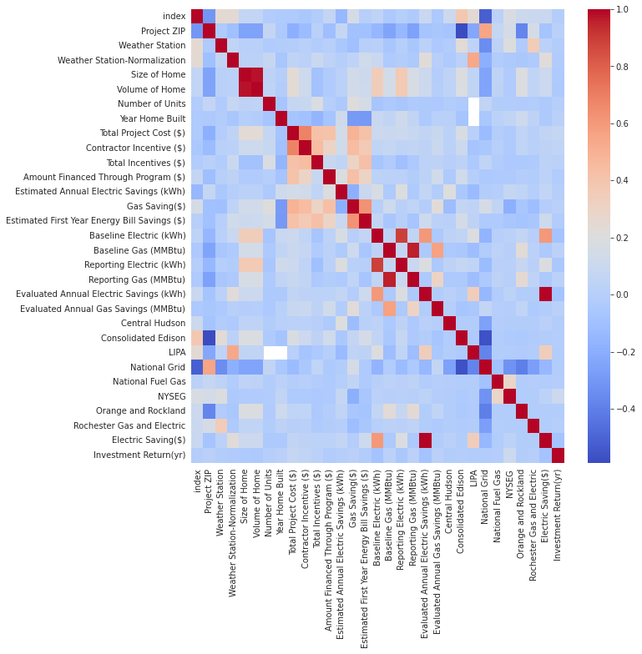
Exploring The Data: Visualization of correlation
Notes:
Here I have created the Visualization of correlations matrix of all avaible fields.

Slide 7
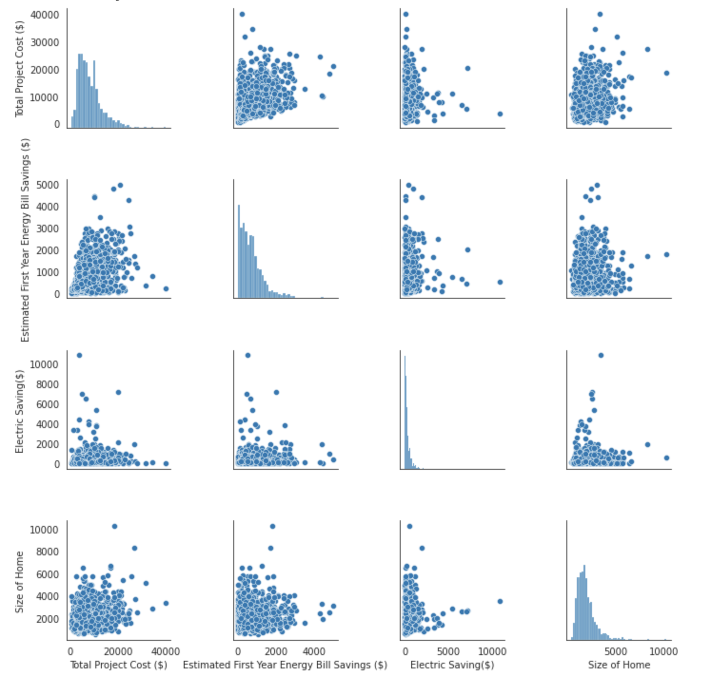
Exploring The Data: The Pairplot
Notes:
The pairplot lets us compare total project cost and other variables on a scatterplot to see the correlation.

Slide 8
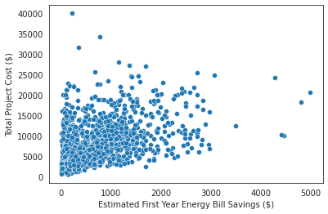
The Analyses Hypothesis#1: Correlation between Total project cost and Estimated first year energy bill savings.
There is a moderate correlation between total project cost and estimates first year energy bill savings.
Correlation : 0.4181290103469127
P-value : 1.8428229737226183e-64
Reject the null. There is a statistically significant linear relationship between Total Project Cost and Estimated first year energy bill savings.
Notes:
Yes. There is a moderate correlation between total project cost and estimates first year energy bill savings. The pearson r test allows us to see if there is a signficant linear relationship. If the correlation is between 0.3 to 0.5 there is a moderate linear relationship. We Reject the null. There is a statistically significant linear relationship between Total Project Cost and Estimated first year energy bill savings.

Slide 9
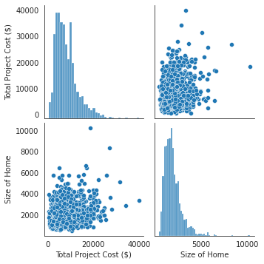
The Analyses Hypothesis#2: House size and location have an impact on project cost.
There is a correlation between total project cost and size of house.
Correlation : 0.23854413433450813
P-value : 7.947106446556325e-21
Reject the null. There is a minor statistically significant linear relationship between Total Project Cost and size of house..
Notes:
Yes. There is a correlation between total project cost and size of house.We Reject the null. There is a minor statistically significant linear relationship between Total Project Cost and size of house.Also….

Slide 10
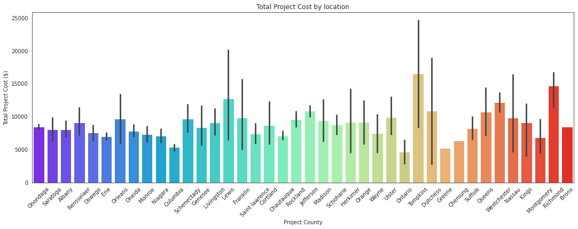
Location vs Total Project Cost
Notes:
Does the location affect the project cost? I Created a bar chart to see the effect of the region on the project price. So I could be able to compare the project cost according to the region.As you can see in the chart below, Tompkins county has the highest numbers. So, location is affect the projecy cost.

Slide 11
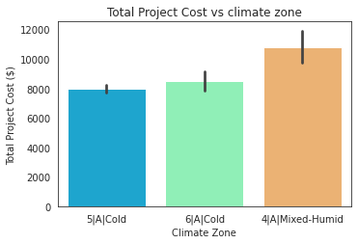
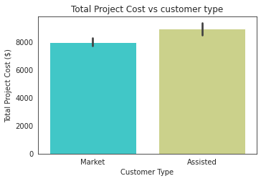
Other Analyses
Notes:
Visualization of comparison is breaked into several for good visualization. So, as we see on the first chard most mixed humid climate zone has more total project cost. And on the other chart, it shows as both customer type is very close to each other but ASSISTED IS little bit higher.

Slide 12
Recommendations
The electric saving increases as the investment is made in the project. For the future residential customer, I can say that the investment they will make will most likely pay off for them. However, in how many years the investments will return, may be the subject of future research.
Apart from that, I found that the size of the house is effective on the project cost, and the investment costs differ according to the location.
Also, I observed that Market customers are less than assisted customers and that the mixed-Humied climate zone is the most costly.
Notes:
After review, here are some recommendations based on the analysis. I found this energy efficient project successful.
My obvervation is that the electric saving increases as the investment is made in the project.For the future residential customer, I can say that the investment they will make will most likely pay off for them. However, in how many years the investments will return, may be the subject of future research.
Apart from that, I found that the size of the house is effective on the project cost, and the investment costs differ according to the location. Also, I observed that Market customers are less than assisted customers and that the mixed-Humied climate zone is the most costly.

Slide 13

Thank You
Melike Karaman Yilmaz
Notes:
Thank you for listening me. Please feel free to ask any questions you may have.

