Slide 1
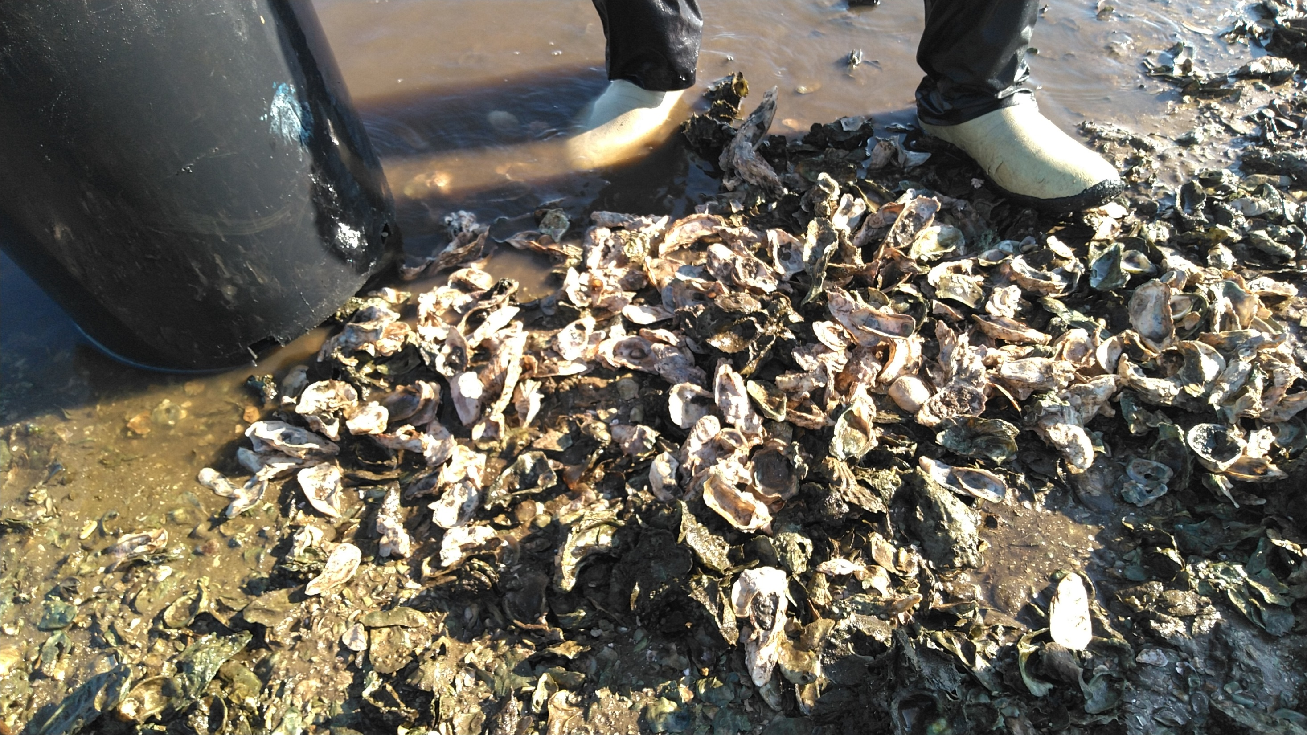
Cultch mass summary
16 reefs (4 in each density quartile)
4 samples at each bar = 64 total samples
Concerns:
-Delay between density/mass measurements (oyster growth, mortality, recruitment, harvest over the ~9 months between these two sample types)
-Gear bias between transect (density) and quadrat (mass) measurements
-Given intrareef density variation, random quadrats sometimes on a very different density location than transects on same reef. Grouping reefs into density categories based on transect data may not be appropriate.
-Smaller seive size (5cm) still allows many large shells to pass through (see pic)
-These concerns likely prohibit any meaningful density-cultch analysis
-If proceeding with analysis, glm

Slide 2
Most interesting result in my opinion: More total reef in area closed to harvest (t-test, P<0.05) , but variable (red circle)

Slide 3
Raw cultch mass data (same density used for 4 cultch mass samples on each reef)

Slide 4
Sum of all cultch mass samples per reef, comparing 4 vs 2 samples, showing quartiles

Slide 5
Sum of all cultch mass samples per reef, comparing 4 vs 2 samples, showing strata

Slide 6
Small vs Large Cultch comparison, showing density quartile
Low and High Density reefs (quartile 1 and 4) appear to show best relationship

Slide 7
Small vs Large Cultch comparison, showing density quartile
Low and High Density reefs (quartile 1 and 4) appear to show best relationship
(* indicates linear model P<0.05)

Slide 8
Small vs Large Cultch comparison, showing harvest strata
Poor relationship

