Slide 1




Big Changes in the Big Bend: A data management and shoreline analysis study
Melissa Moreno
Dr. Pine, Dr. Mossa, Dr. Adams
& Joseph Aufmuth
Major: Interdisciplinary Ecology

Slide 2
Chapter 1 ESTABLISHING A PROGRESSIVE DATA MANAGEMENT WORKFLOW FOR BIOLOGICAL DATA TO INFORM ADAPTIVE MANAGEMENT DECISIONS

Slide 3
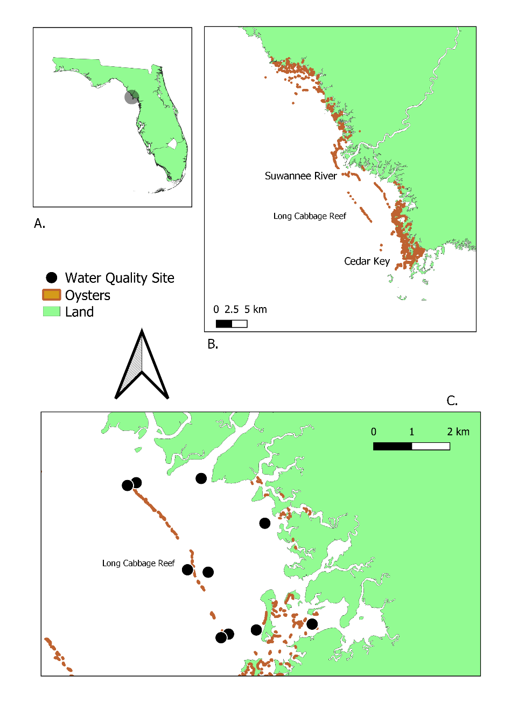

Slide 4
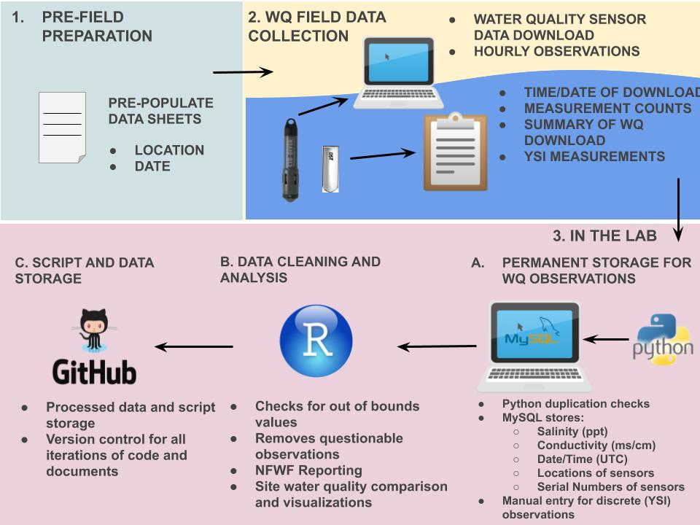
Notes:
Extensive details on the MySQL import process are provided in the project management library (Moreno et al., 2020, MYSQL workflow for the LCR Oyster Project). A step-by-step guide and overview are provided below (Figure 1-4):
1. Datasheets are standardized and include pre-populated fields, including the location and date to minimize error.
2. Water quality hourly sensor observations are downloaded in the field to a field laptop, while simultaneously notes are made on paper datasheets related to field weather conditions and equipment status. Water quality observations using the YSI device are also taken and recorded on the same datasheet.
3.A. Water quality sensor files are then uploaded into a secure University of Florida internal server. A trigger starts the Python import process into the MySQL relational database, which permanently stores raw files as an archive. The YSI measurements (recorded by hand in the filed) are manually entered into our MySQL relational database in its appropriate table.
3.B. QA/QC R scripts pull and process the water quality observations to check for flatlined or out of bound measurements (i.e., outside of expected range).
3.C. Processed data, edited scripts, and documents are then stored and updated unto GitHub. Standardized GitHub workflows are used during collaborative projects to ensure proper version control utility (Moreno et al., 2020, GitHub Workflow for the LCR Oyster Project).

Slide 5
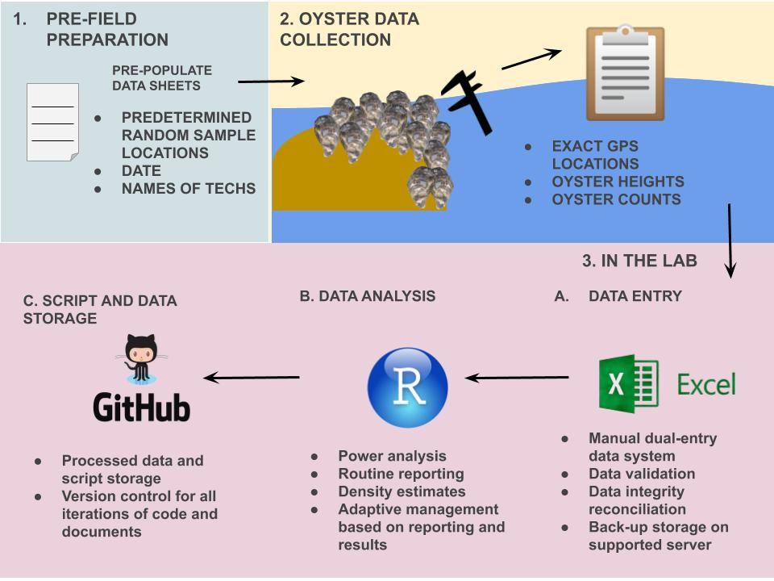
Notes:
Detailed information on the dual data entry system using a structured data packet is available in the data entry documentation for the Lone Cabbage project (Moreno et al., 2020, Data Packet Structure for the LCR Oyster Project). Several of these entry processes are similar to those in the water quality workflow and will only be briefly reviewed where (Figure 1-5):
1. Datasheets are standardized before going in the field include pre-populated fields including the location and date to minimize error.
2. In the field, counts of oysters are recorded by team members on datasheets by hand.
3.A. In the lab, data are entered using a dual entry system. Data validation tools are used to ensure that the data entered are within range and standardized (e.g., site location, capitalization, appropriate oyster height range, etc.).
3.B. Standard R scripts are used to estimate oyster densities (e.g., population abundances), and power analyses are done using these data as they are entered to inform field sampling efforts within the field season.
3.C. Processed data, scripts, and documents are then stored in GitHub. Standardized GitHub workflows are used during collaborative projects to ensure proper version control utility.

Slide 6
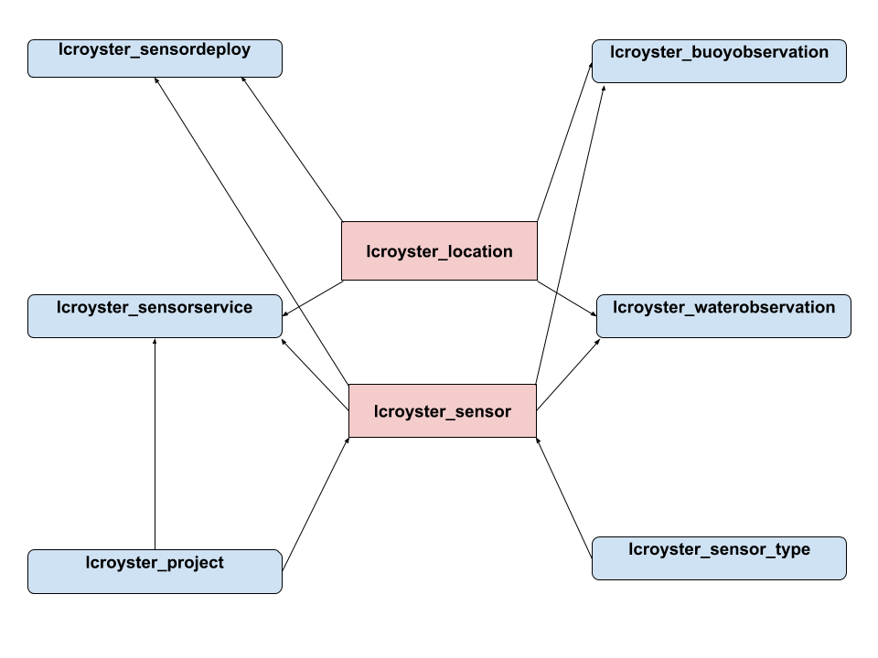

Slide 7
Chapter 2- TAILORING GITHUB FOR ECOLOGY

Slide 8
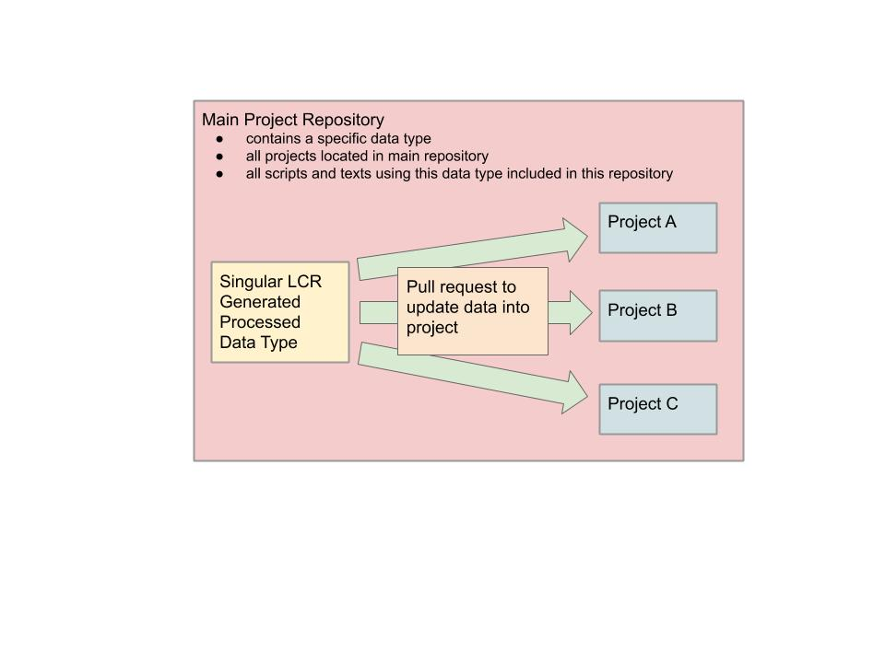
Notes:
Figure 2-1. Visualization of our main project repository structure and various projects in the same repository. The visual box encompasses all of the projects, code, and text belonging to a single data collection type. Multiple projects were located in a single repository, usually discernable by separated folders. Confusion arose when projects used scripts and data from other projects without proper documentation.

Slide 9
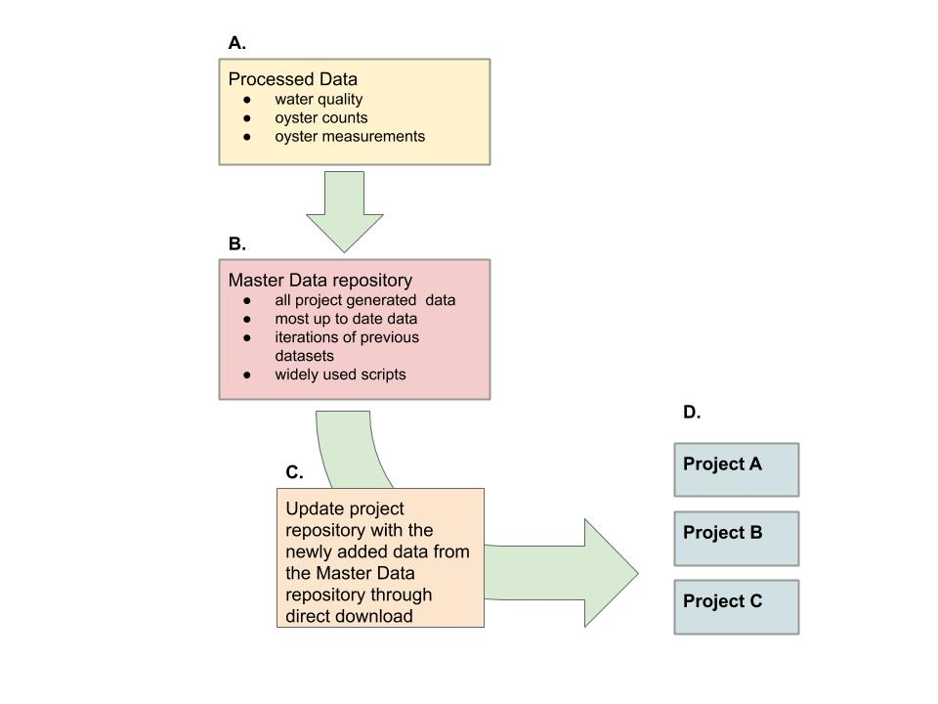
Notes:
Figure 2-2. New LCR project workflow, which describes how project repositories update to work with newly added data. A) Data are processed and cleaned via MySQL or scripts, B) Data are updated to the master data repository, reviewed, and approved by LCR project admins, C) Project repositories update their repository data by downloading the data directly from the master data repository, D) Project repositories conducting individual analysis on LCR datasets with newly downloaded data, ready for reporting and analysis.

Slide 10
File Type | Naming Convention | Example | Definition
Project Repository | study_location_projectsummary | bird_bb_monitoring | Big Bend camera and survey bird monitoring project
Scripts | lowercase, no uppercase (snake case) nor all caps, all names with separate words need to include an underscore ( _ ) and no spaces, no dates in the names unless it helps with the descriptions of the content, script file names should be descriptive and concise. Scripts that have a single output should be named similarly to their file type output. | discharge_1941_2018_quantile.R | R script which reports quantiles from river discharge from 1941 to 2018
Figures | study_location_type_summary.filetype | oys_lco8a_map_transect.tiff | oyster transect on reef element LCO8A map in a tiff image
Tables | study_location_summary.filetype | wq_lcr_inshore_vs_offshore.csv | LCR water quality inshore and offshore comparison
Data | every dataset file is required to be in lowercase, no uppercase (camelCase) nor all caps, all names with separate words need to include an underscore ( _ ) with no spaces, no dates in the names unless it helps with the descriptions of the content | discharge_1941_2018.csv | River discharge data from 1941 to 2018 in a text file
Notes:
Table 2-1. Table of naming conventions for file types, example, and description of the example

Slide 11
Chapter 3 A DIGITAL SHORELINE ANALYSIS SYSTEM (DSAS) APPLIED ON SANDY SHORELINE CHANGES IN DEER ISLAND, FL

Slide 12
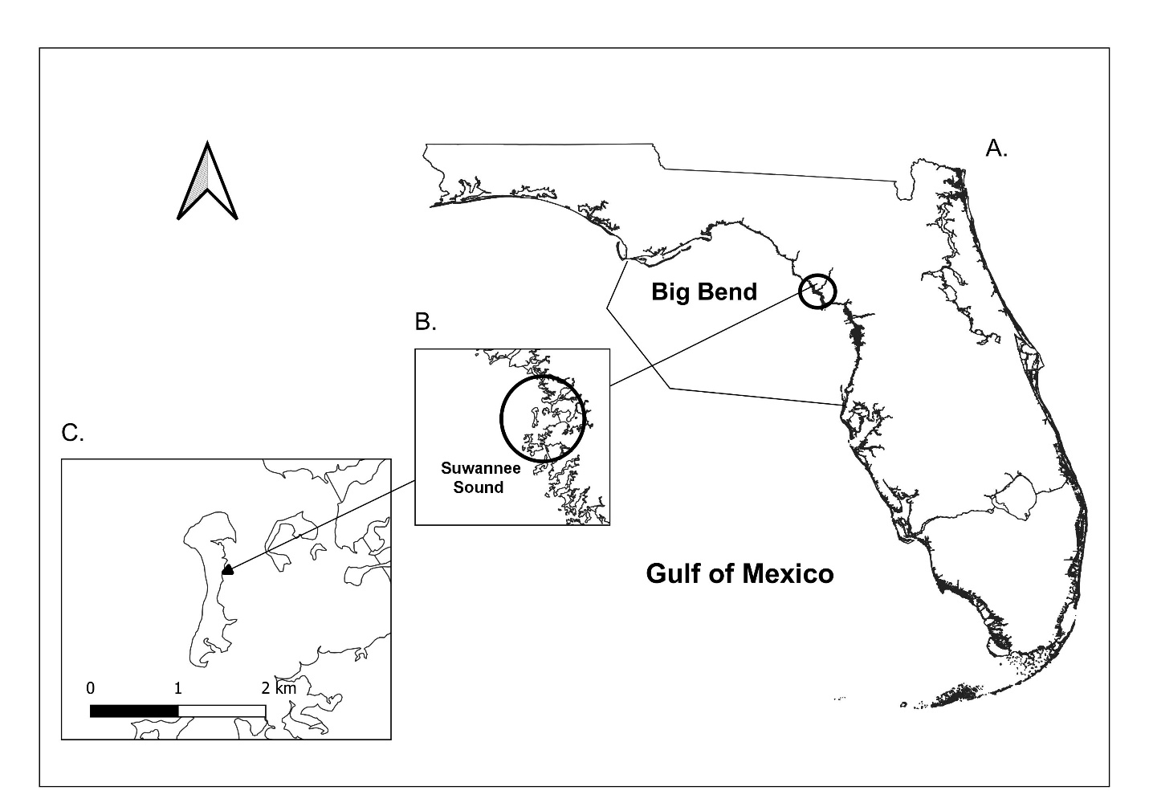
Study
Site

Slide 13
Impacts to Study Site
In recent decades, the rate of SLR in many regions of the world has increased, most likely due to changing. This acceleration in SLR and the observed impacts on coastal environments.
Sandy shorelines are unstable.
Seavey et al., (2011) documented the loss of about 66% of the offshore (most westward) intertidal oyster bars between Corrigan’s Reef and Horseshoe Beach.
It has been documented that:
shoreline changes in the west coast of Florida are commonly eroding
storms, sea-level rise, and wave action possibly contribute to erosion
beach nourishment may provide a way to combat erosional effects temporarily.
Notes:
The unstable nature of unstable sand shorelines can create a harsh environment for biota, necessitating unique adaptations to this volatile environment (Brown & McLachlan, 2002). Sand shorelines accumulate sediment accretion by wave deposited particles of sand, mixed sand, quartz, or silica.

Slide 14
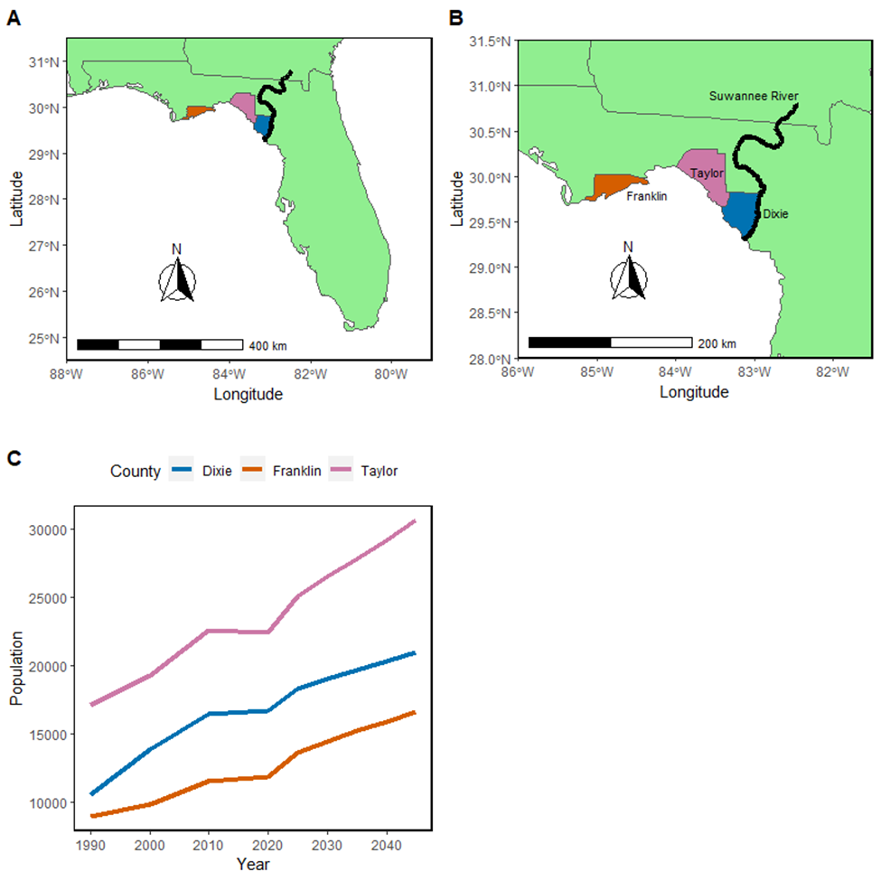
Reason for Effort
Residents have reported that Deer Island has changed in recent decades both in shape and area.
Weather events have been documented to have caused damaged to nearby shorelines.
Interest in protecting natural biodiversity in the area.
Human populations are expected to increase in the next 20 years, possible developments along shoreline.
Figure 3-1
Notes:
Figure 3-1. A) Map of Florida with Dixie, Franklin, and Taylor counties identified along with the Suwannee River; B) Zoomed in map of the study area with Dixie, Franklin, and Taylor counties identified along the Suwannee River; C) Projection human population data for Dixie, Franklin and Taylor counties 1990-2045 (Bureau of Economic and Business Research, 2021)

Slide 15
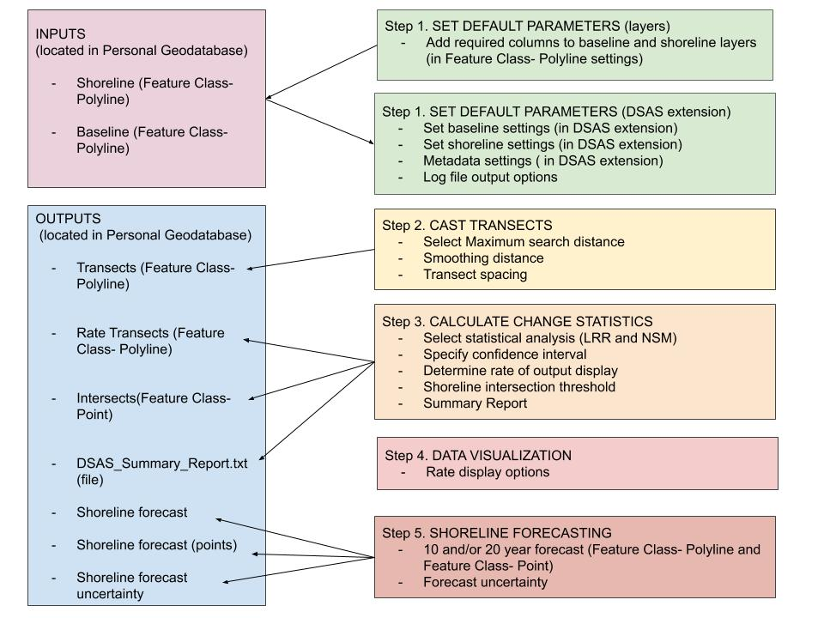
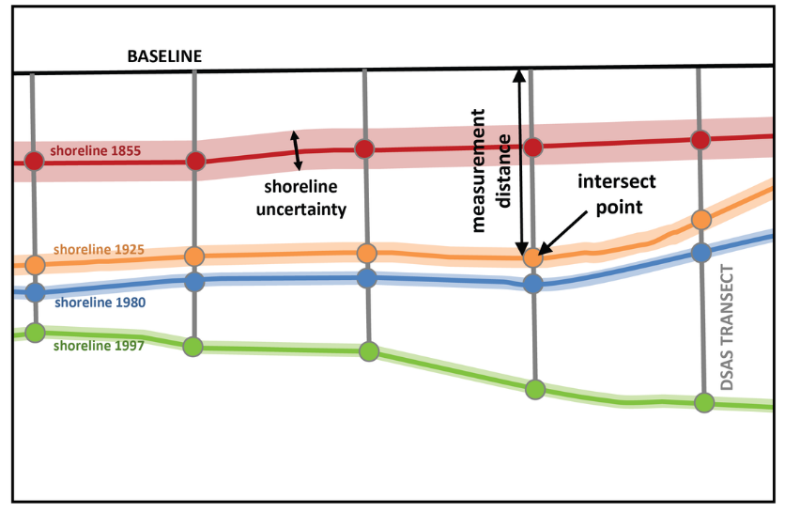
Notes:
Figure 3-4. Example of DSAS transect casting (https://www.usgs.gov/centers/whcmsc/science/digital-shoreline-analysis-system-dsas?qt-science_center_objects=0#qt-science_center_objects)
Figure 3-5. Modified DSAS components and operational workflow (“Digital Shoreline Analysis System (DSAS) Version 5.0 User Guide.”, 2021).

Slide 16
Date | Median River Discharge (m^3/s) Station ID= 02323500 | Observed weather | Metadata (USGS Earth Explorer)
January 20, 1994 | Value= 274.9 | Avg Temp (C)- 3.41 Precipitation (cm)- 0.00 Max Wind Speed (KPH)- 19.31 | Entity ID: DI00000000018672 (found in DOQ) Map Projection UTM Projection Zone 17N Datum NAD83 Resolution 1.0 Units METER Number of Bands 3 Sensor Type RGB
December 30, 1998 | Value= 180.37 | Avg Temp (C)- 9.30 Precipitation (cm)- 0.00 Max Wind Speed (KPH)- 25.75 | Entity ID: DI00000001164809 (found in DOQ) Map Projection UTM Projection Zone 17N Datum NAD83 Resolution 1.0 Units METER Number of Bands 3 Sensor Type RGB
November 02, 2007 | Value= 66.5 | Avg Temp (C)- 19.31 Precipitation (cm)- 0.00 Max Wind Speed (KPH)- 22.53 | Entity ID: N_2908356_NW_17_1_20071102 (found in NAIP) Map Projection UTM Projection Zone 17N Datum NAD83 Resolution 1.0 Units METER Number of Bands 3 Sensor Type CIR
September 19, 2010 | Value= 120.0 | Avg Temp (C)- 25.32 Precipitation (cm)- 0.00 Max Wind Speed (KPH)-24.14 | Entity ID: M_2908356_NW_17_1_20100919 (found in NAIP) Map Projection UTM Projection Zone 17N Datum NAD83 Resolution 1.0 Units METER Number of Bands 4 Sensor Type CNIR
Date | Median River Discharge (m^3/s) Station ID= 02323500 | Observed weather | Metadata (USGS Earth Explorer)
October 13, 2013 | Value= 232.2 | Avg Temp (C)- 22.13 Precipitation (cm)- 0.00 Max Wind Speed (MPH)- 10 | Entity ID: M_2908356_NW_17_1_20131013 (found in NAIP) Map Projection UTM Projection Zone 17N Datum NAD83 Resolution 1.0 Units METER Number of Bands 4 Sensor Type CNIR
November 12, 2015 | Value= 171.9 | Avg Temp (C)- 19.27 Precipitation (cm)- 0.00 Max Wind Speed (KPH)- 16.09 | Entity ID: M_2908356_NW_17_1_20151112 (found in NAIP) Map Projection UTM Projection Zone 17N Datum NAD83 Resolution 1.0 Units METER Number of Bands 4 Sensor Type CNIR
October 26, 2017 | Value= 226.3 | Avg Temp (C)- 12.60 Precipitation (cm)- 0.00 Max Wind Speed (KPH)- 14.48 | Entity ID: M_2908356_NW_17_1_20171026 (found in NAIP) Map Projection UTM Projection Zone 17N Datum NAD83 Resolution 1.0 Units METER Number of Bands 4 Sensor Type CNIR
November 10, 2019 | Value = 146.9 | Avg Temp (C)- 14.12 Precipitation (cm)- 0.00 Max Wind Speed (KPH)- 11.27 | Entity ID: M_2908356_NW_17_060_20191110 (found in NAIP) Map Projection UTM Projection Zone 17N Datum NAD83 Resolution 0.60 Units METER Number of Bands 4 Sensor Type CNIR
Notes:
Table of metadata for each aerial image used in this analysis including date, median river discharge, observed weather, and additional imagery metadata. River discharge information is calculated by data from https://tidesandcurrents.noaa.gov/ at Cedar Key, Florida Station 8727520, and observed weather provided by www.wunderground.com. Imagery metadata are provided by USGS Earth Explorer, https://earthexplorer.usgs.gov/.

Slide 17
DSAS PARAMETERS
100-m buffer around the merged shoreline shapefile
the east side of the buffer was used as the baseline (transects from the baseline were cast from east to west)
transects were spaced at 20-m intervals
2000-m search for suitable shorelines was done adjacent to the transect
smoothing distance of 500-m
Notes:
(1) 100 m buffer around the merged shoreline shapefile
(2) the east side of the buffer was used as the baseline (transects from the baseline were cast from east to west)
(3) transects were spaced at 20-m intervals; the minimum transect spacing allowed by DSAS based on the small size of the study site
(4) 2000-m search for suitable shorelines was done adjacent to the transect; search distance looked for shorelines 2000 meters away from the baseline
(5) a smoothing distance of 500-m was specified; a smoothing distance is a user-specified smoothing value that can facilitate an orthogonal transect intersect by preventing transects from intersecting with one another when there is a curve in the baseline, and the larger the smoothing distance, the more likely to produce uniform transect orientations, which is recommended for smaller shorelines

Slide 18
Methods
Linear Rate of Regression
A LRR of shoreline change can be found by fitting a least-squares regression line to all points for every shoreline in a transect.
Net Shoreline Movement
The NSM measures the distance between the oldest shoreline (e.g., 2019) and the youngest shoreline (e.g., 1994) for each casted transect measured in meters.
Beta Shoreline Forecasting
Version 5.0 of DSAS (v5.0) has a tool in development that takes observed rates of shoreline change and predicts future shoreline change, assuming a similar rate of change as observed, for periods 10 or 20 years into the future.
Notes:
A LRR of shoreline change can be found by fitting a least-squares regression line to all points for every shoreline in a transect. The parameters for the regression were found by minimizing the sum of squares between observed and expected points and the key regression parameter of interest was the slop which equals the rate of change estimated by the LRR. The LRR calculation can be used regardless of accuracy or trends (“Digital Shoreline Analysis System (DSAS) Version 5.0 User Guide.”). This method may be susceptible to outlier effects and tends to underestimate the rate of change compared to other statistics used by DSAS (e.g., End Point Rate (EPR)).
In contrast to LRR, NSM calculations only require baseline position shoreline and the last shoreline position to (two shorelines) interpret shoreline shape change. The NSM measures the distance between the oldest shoreline (e.g., 2019) and the youngest shoreline (e.g., 1994) for each casted transect measured in meters. The NSM estimate provides information on the magnitude (area) and direction of shoreline change (whether erosion or accretion is occurring) and by default a measure of uncertainty associated with the NSM estimates (90% confidence intervals).
Version 5.0 of DSAS (v5.0) has a tool in development that takes observed rates of shoreline change and predicts future shoreline change, assuming a similar rate of change as observed, for periods 10 or 20 years into the future. These predictions are made using Kalman filter (Kalman, 1960) to join shoreline positions with model-derived positions to predict a future shoreline position (Long and Plant 2012). The Kalman filter methodology is initialized with the linear regression rate calculated by DSAS. Using the linear regression I used the DSAS extension to estimate the shoreline position and rate of every 10th of a year (e.g, year 10 and year 20). The DSAS extension also estimates the positional uncertainty at each time step. It also estimates the positional uncertainty at each time step. Critically, this methodology assumes that the linear rate of regression from the shoreline positions analyzed will be a reasonable approximation for the position of future shorelines.
In statistics and control theory, Kalman filtering, also known as linear quadratic estimation (LQE), is an algorithm that uses a series of measurements observed over time, containing statistical noise and other inaccuracies, and produces estimates of unknown variables that tend to be more accurate than those based on a single measurement alone, by estimating a joint probability distribution over the variables for each timeframe. The filter is named after Rudolf E. Kálmán, one of the primary developers of its theory.

Slide 19
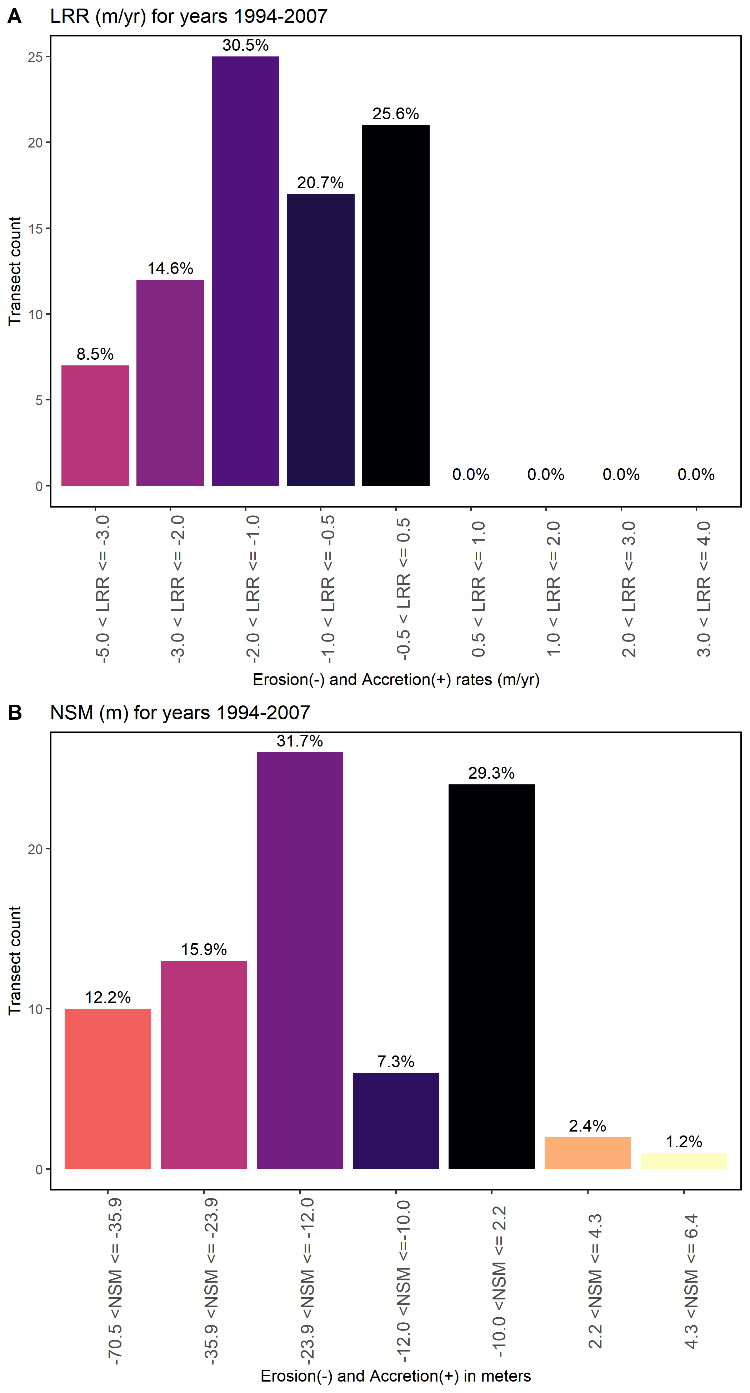
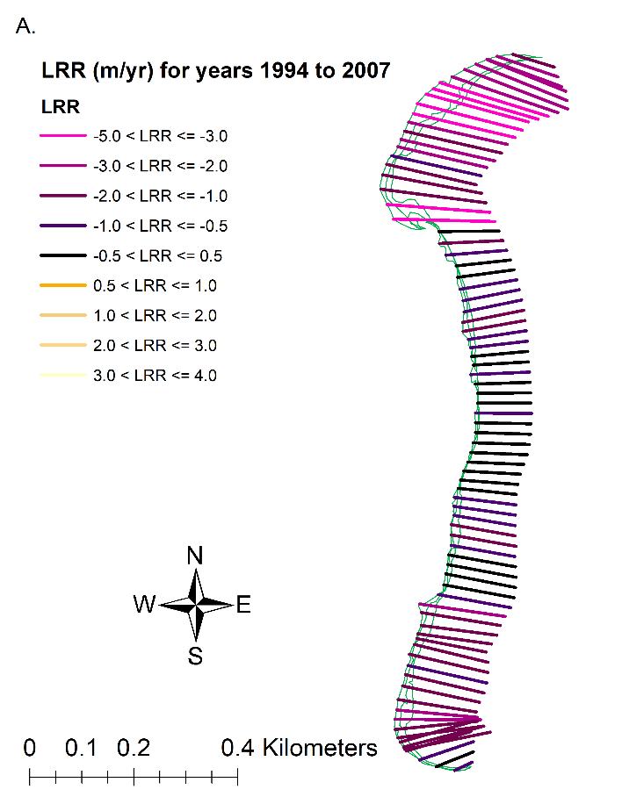
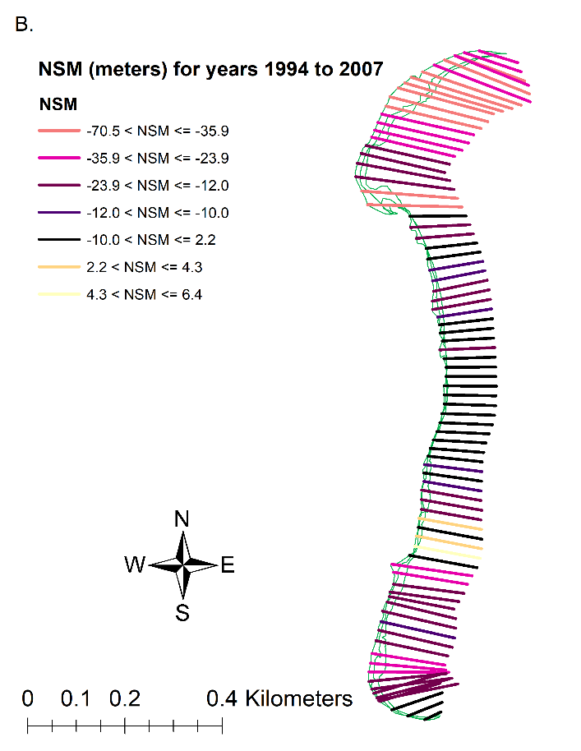
1994 to 2007
Notes:
Figure 3-7. Results of DSAS model results for the years 1994 to 2007. The transects (n= 82) display where shoreline erosion and accretion have been modeled. The shorelines (green) include digitized shorelines for the years 1994 to 2007 in this figure. A) Linear Regression Rates model (m/yr) displaying transects with legend colors corresponding to Figure 3-8, A. B) Net Shoreline model (meters) displaying transects with legend colors corresponding to Figure 3-8, B.
Figure 3-8. Figure of the DSAS statistics for the years 1994 to 2007. The total amount of transects calculated by DSAS is 82. Results are displayed in the percentage of transects in each bin where erosion is negative x-values and accretion is positive x-values. A) LRR model results with bar colors corresponding to Figure 3-7, A, B) NSM model results with bar colors corresponding to Figure 3-7, B.
Overall, both models suggest that between 1994 and 2007, Deer Island changed in the area due to erosional processes, with the highest erosion rates near the north and south end of the shoreline. Both models also suggest that the most frequently calculated rate/distance is the rates/distance with intermediate erosion.

Slide 20
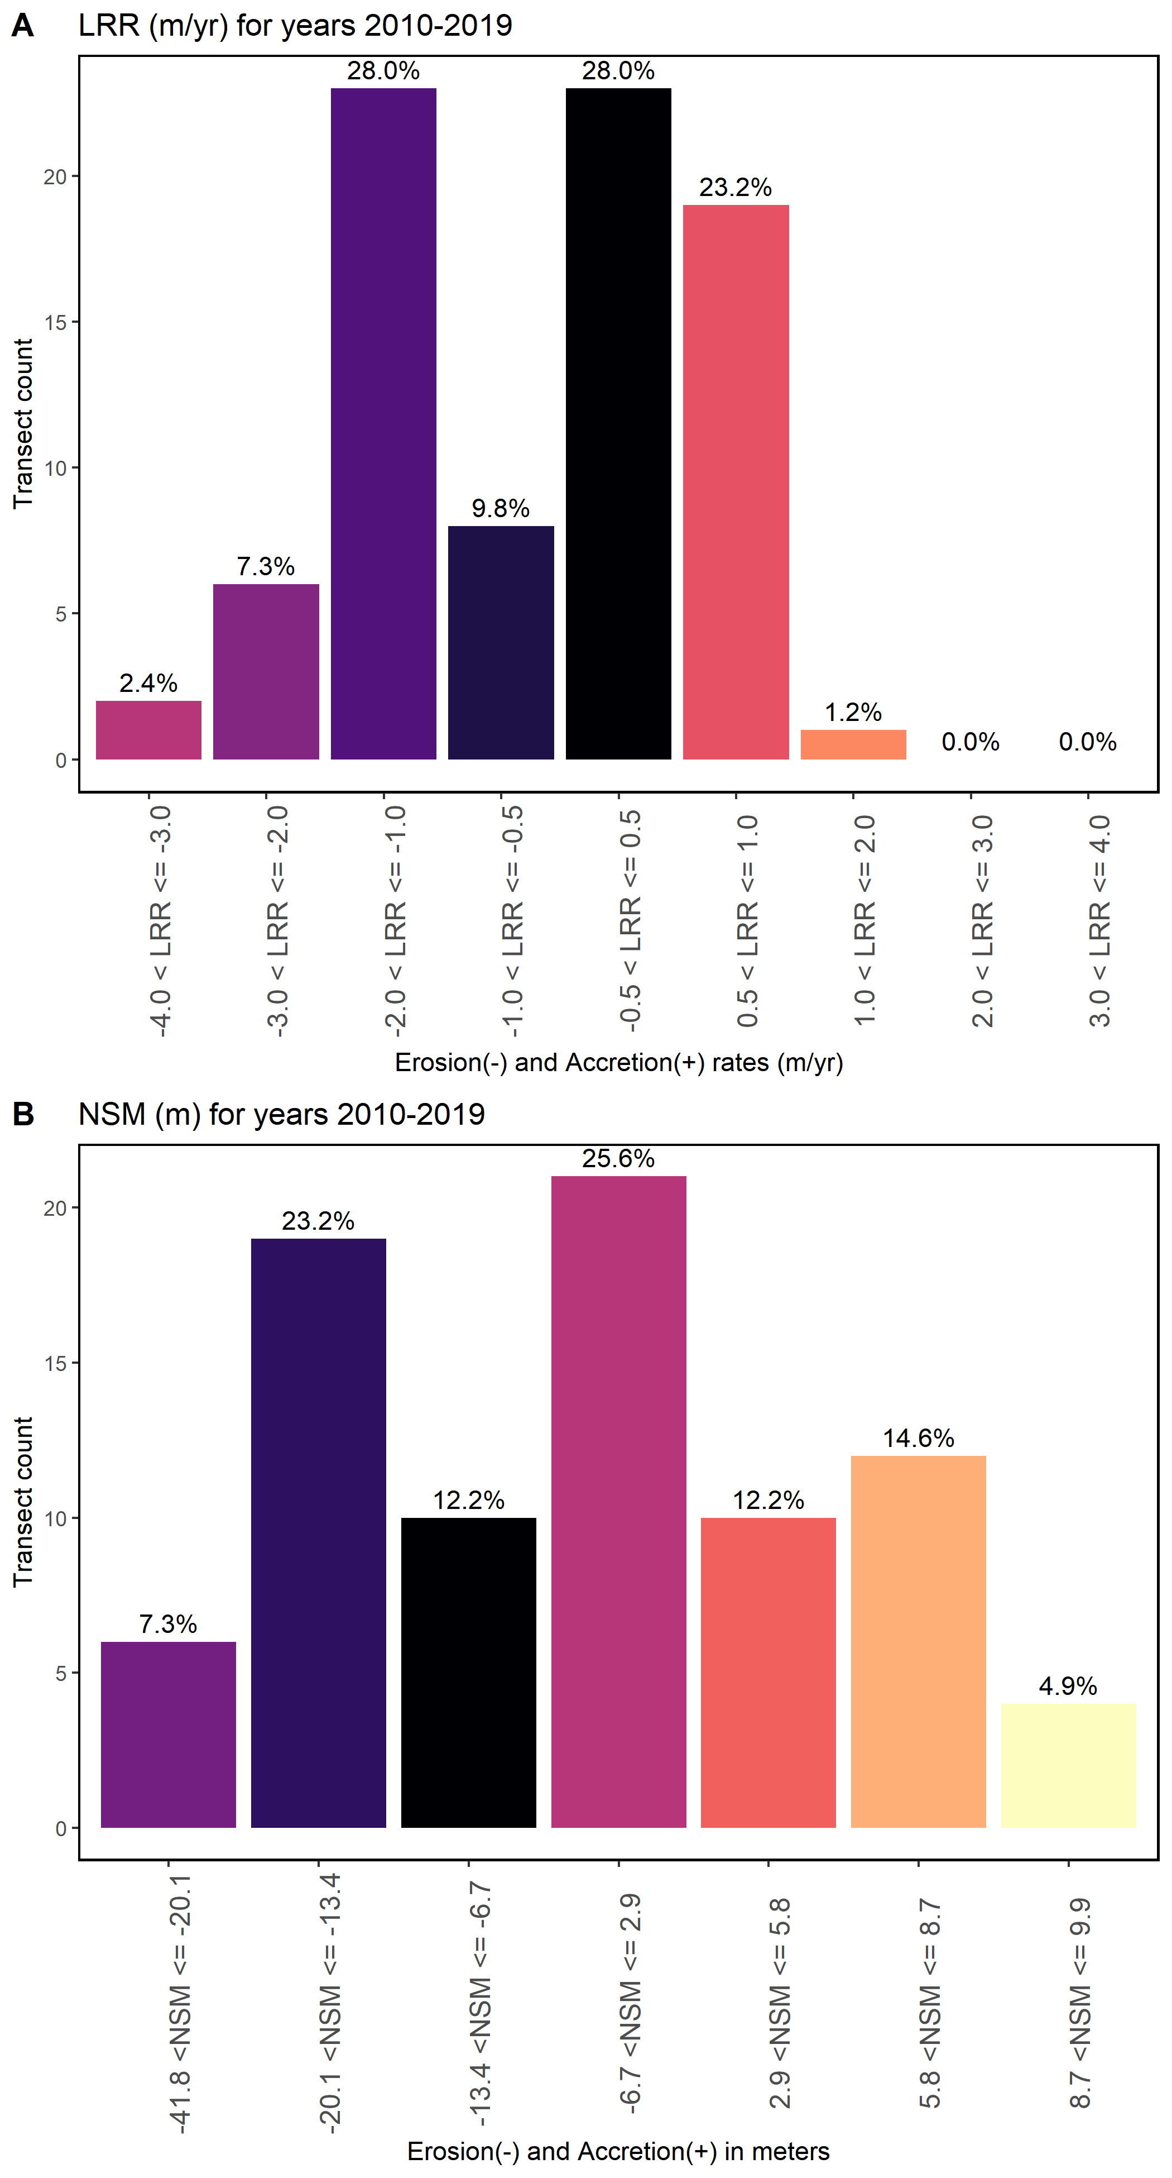
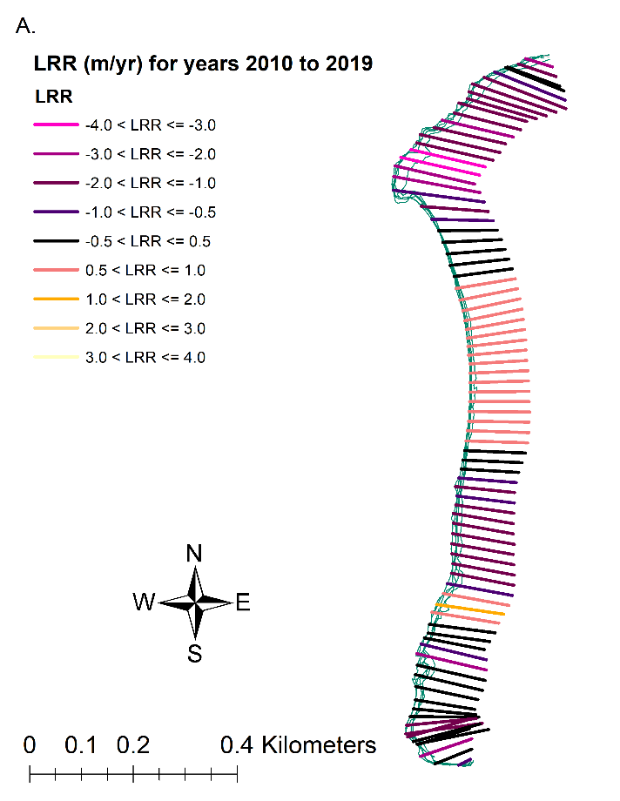
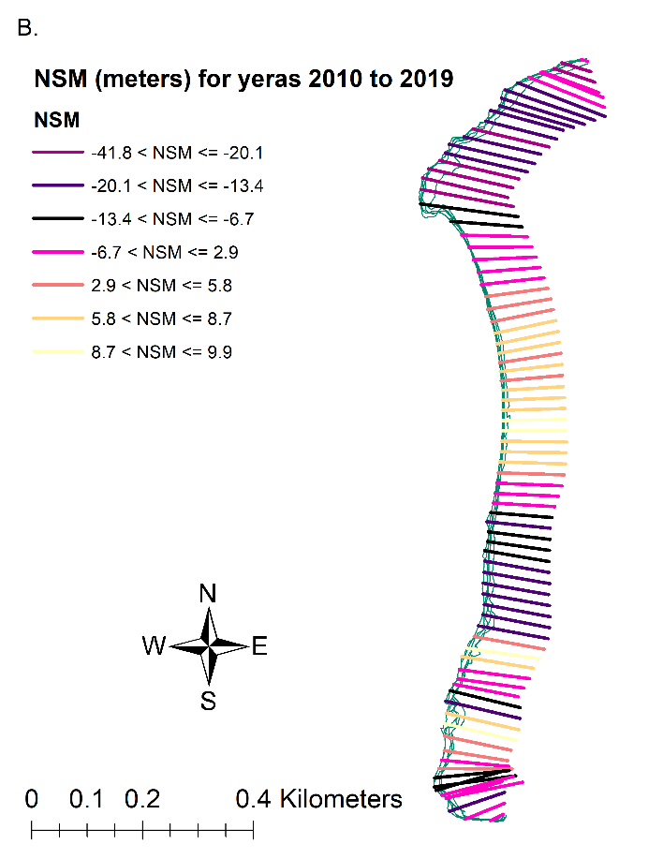
2010 to 2019
Notes:
Figure 3-9. Results of DSAS model results for the years 2010 to 2019. The transects (n= 82) display where shoreline erosion and accretion have been modeled. The shorelines (green) include digitized shorelines for the years 2010 to 2019 in this figure. A) Linear Regression Rates model (m/yr) displaying transects with legend colors corresponding to Figure 3-10, A. B) Net Shoreline model (meters) displaying transects with legend colors corresponding to Figure 3-10, B.
Figure 3-10. Figure of the DSAS statistics for the years 2010 to 2019. The total amount of transects calculated by DSAS is 82. Results are displayed in the percentage of transects in each bin where erosion are negative x-values and accretion are positive x-values. A) LRR model results with bar colors corresponding to Figure 3-9, A, B) NSM model results with bar colors corresponding to Figure 3-9, B.
Overall, both methods suggest that between 2010 and 2019, Deer Island mostly changed around the area due to erosional processes with some accretional instances. Both methods also suggest that the most frequently calculated rate/distance is the rates/distance that reflect mild erosion and mild accretion.

Slide 21
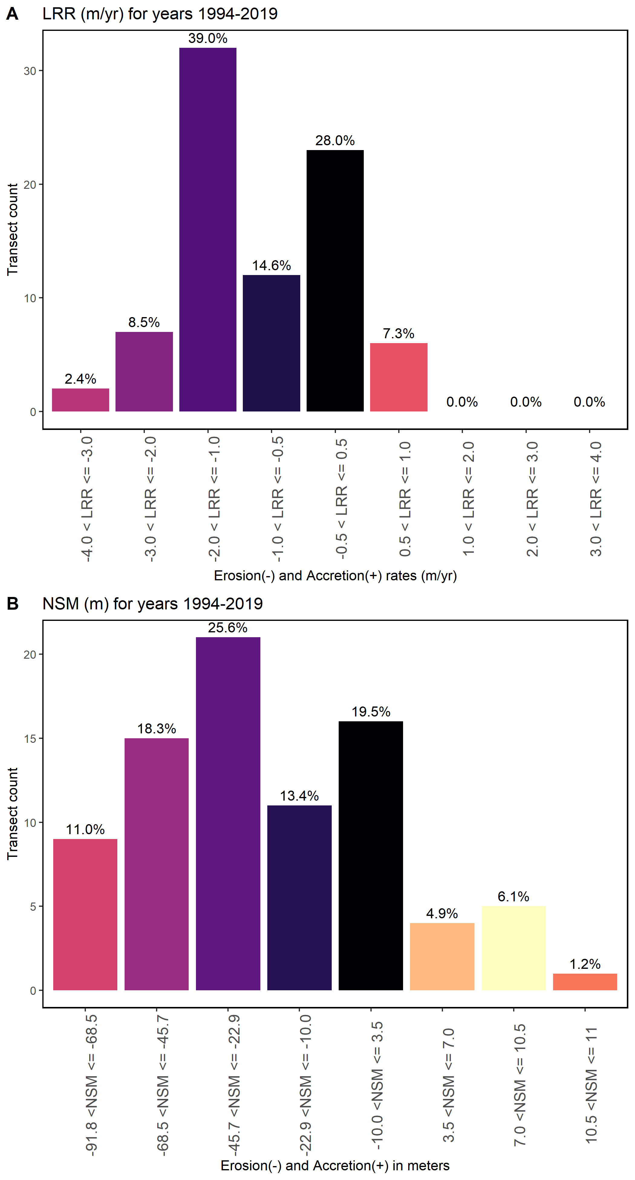
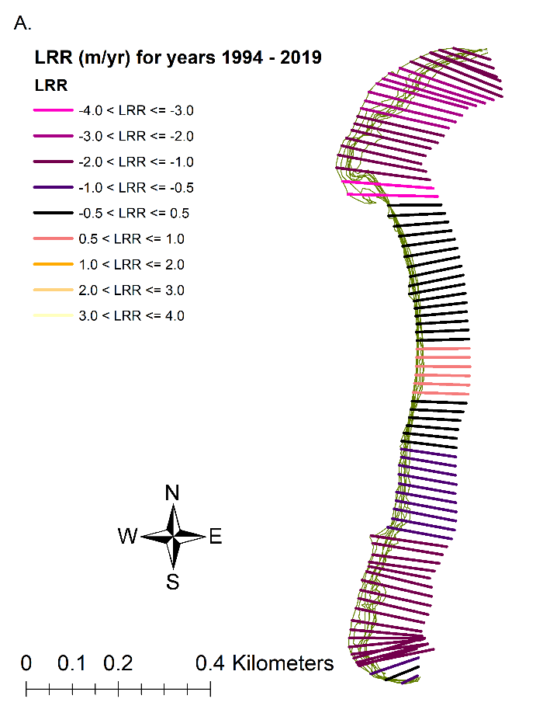
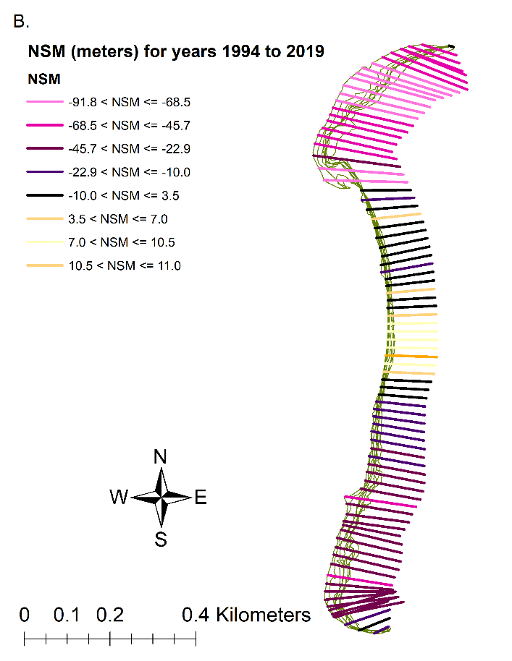
1994 to 2019
Notes:
Figure 3-11 Results of DSAS model results for years 1994 to 2019. The transects (n= 82) display where shoreline erosion and accretion have been modeled. The shorelines (green) include digitized shorelines for the years 1994 to 2019 in this figure. A) Linear Regression Rates model (m/yr) displaying transects with legend colors corresponding to Figure 3-12, A. B) Net Shoreline model (meters) displaying transects with legend colors corresponding to Figure 3-12, B.
Figure 3-12. Figure of the DSAS statistics for the years 1994 to 2019. The total amount of transects calculated by DSAS is 82. Results are displayed in the percentage of transects in each bin where erosion is negative x-values and accretion is positive x-values. A) LRR model results with bar colors corresponding to Figure 3-11, A, B) NSM model results with bar colors corresponding to Figure 3-11, B.

Slide 22
Summary Statistic | Value
Total number of transects (counts) | 82
Average distance (meters) | -29.1
Number of transects with negative distance (counts) | 67
Percent of all transects that have a negative distance | 81.70%
Maximum negative distance (meters) | -91.71
Maximum negative distance (transect ID #) | 12
Average of all negative distances (meters) | -36.83
Number of transects with a positive distance | 15
Percent of all transects that have a positive distance | 18.29%
Maximum positive distance (meters) | 10.91
Maximum positive distance (transect ID #) | 44
Summary Statistic | Value
Total number of transects (counts) | 82
Average rate (m/yr) | -0.95
Average of the confidence intervals associated with rates | 0.49
Reduced n (number of independent transects) | 900.00%
Uncertainty of the average rate using reduced n | 0.17
Average rate with reduced n uncertainty (m/yr) | -0.95 +/- 0.17
Number of erosional transects (counts) | 63
Percent of all transects that are erosional | 76.83%
Percent of all transects that have statistically significant erosion | 69.51%
Maximum value erosion (m/yr) | -3.32
Maximum value erosion (transect ID #) | 22
Average of all erosional rates (m/yr) | -1.33
Number of accretional transects (counts) | 19
Percent of all transects that are accretional | 23.17%
Percent of all transects that have statistically significant accretion | 10.98%
Maximum value accretion (m/yr) | 0.62
Maximum value accretion (transect ID #) | 44
Average of all accretional rates (m/yr) | 0.31
Table 3-3. Summary statistics calculated by DSAS, Distance: NSM (Net Shoreline Movement) for years 1994 to 2019
Table 3-4. Summary statistics calculated by DSAS, RATE: LRR (Linear Regression Rate) for years 1994 to 2019

Slide 23
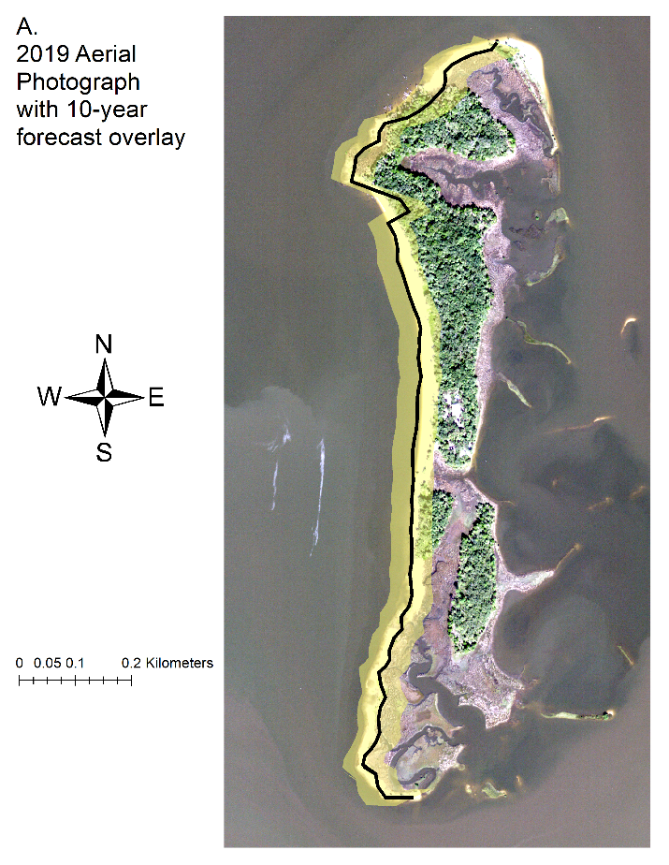
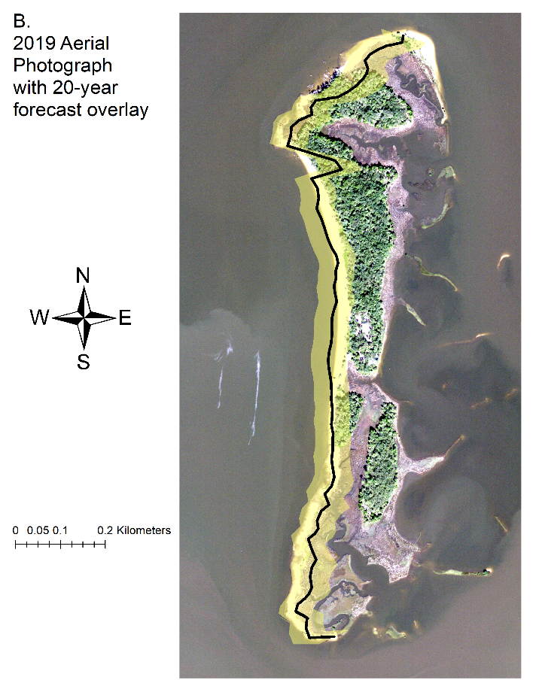
Beta Shoreline Forecasting Analysis for 10 and 20-Year Prediction
Notes:
Figure 3-13. DSAS shoreline prediction forecast. Modeled Shorelines are located on the west side of each panel. A) Shoreline forecast for a 10-year prediction (thick black line) and its uncertainty (yellow shaded region) overlayed aerial imagery (2019) to display the predicted shoreline loss in comparison to the latest imagery selected. B) Shoreline forecast for a 20-year prediction (thick black line) and its uncertainty (yellow shaded region) overlayed aerial imagery (2019) to display the predicted shoreline loss in comparison to the latest imagery selected.
The 10-year prediction (Figure 3-13, A) demonstrates the potential of uniformity of erosion, particularly in the center and south end of Deer Island. The north end of Deer Island has an area south of the shoreline bulge that is projected to be eroded by the 10-year prediction. The 20-year prediction (Figure 3-13, B) is very similar to the 10-year prediction model, but with more drastic erosion in the north and south. A summary of the 10- and 20- year shoreline predictions suggest that erosion may occur on the north and south ends of the western shoreline of Deer Island, with some accretion located around the center of the island.

Slide 24
Discussion
Deer Island shoreline features have eroded over two periods of time, both 1994-2007 and 2010-2019.
The number of transects examined for change on Deer Island had a higher number of transects demonstrating erosional events in 1994-2007 than in 2010-2019.
(1994) is taken one year after a severe winter storm (March 1993) that is known to have caused considerable changes in shoreline features
The observed overall net loss of Deer Island shoreline could result in loss of habitat used by wildlife resources, including shorebirds.
It is interesting to note that although the overall shoreline experienced erosion, evidence of accretion may have occurred in the center of the Deer Island shoreline over all time periods (Table 3-3)
A source of uncertainty may arise due to the missing imagery years of 2007- 2008 and 2011- 2012. If those missing years were available for analysis, it may provide important information to assist with interpreting the true erosion differences between these two time periods.
Sea level rise may be the dominant feature driving changes in shoreline features along Deer Island.
Storm and storm clusters may significantly impact barrier island morphology in this area with direct stormwind and tide impacts along with changes to wave energy (e.g., low wave energy).

Slide 25
Conclusion
Data management workflows are imperative to every ecological project.
Best practice is to create workflows prior to data collection.
Also best practice to consider workflows for each employee.
Ecological project workflows should include a way to save iterations of changing project files and data using version control software.
Workflows and documentation allow for repeatable science.

Slide 26
Acknowledgments:
Committee members for guiding me through the rigorous thesis process: Dr. William E. Pine III, Dr. Joann Mossa, Dr. Peter Adams, and Joseph Aufmuth.
I would like to thank the administrators in my department SNRE, K. Ramesh Reddy and Karen Bray.
I thank the University of Florida Academic Research and Consulting Services for teaching and encouraging me to learn more in the field of data science.
I also thank the National Fish and Wildlife Foundation for funding the Lone Cabbage Reef project. I also like to thank all the technicians, research coordinators, and administrators on the Lone Cabbage Reef project that collected, observed and gathered data.
I would also like to thank any faculty, student, or administrator that kept me motivated to continue working and learning through my program.

