Slide 1
Low (Medium/Moderate) Resolution Satellite Imagery (MODIS)
Mel Moreno

Slide 2
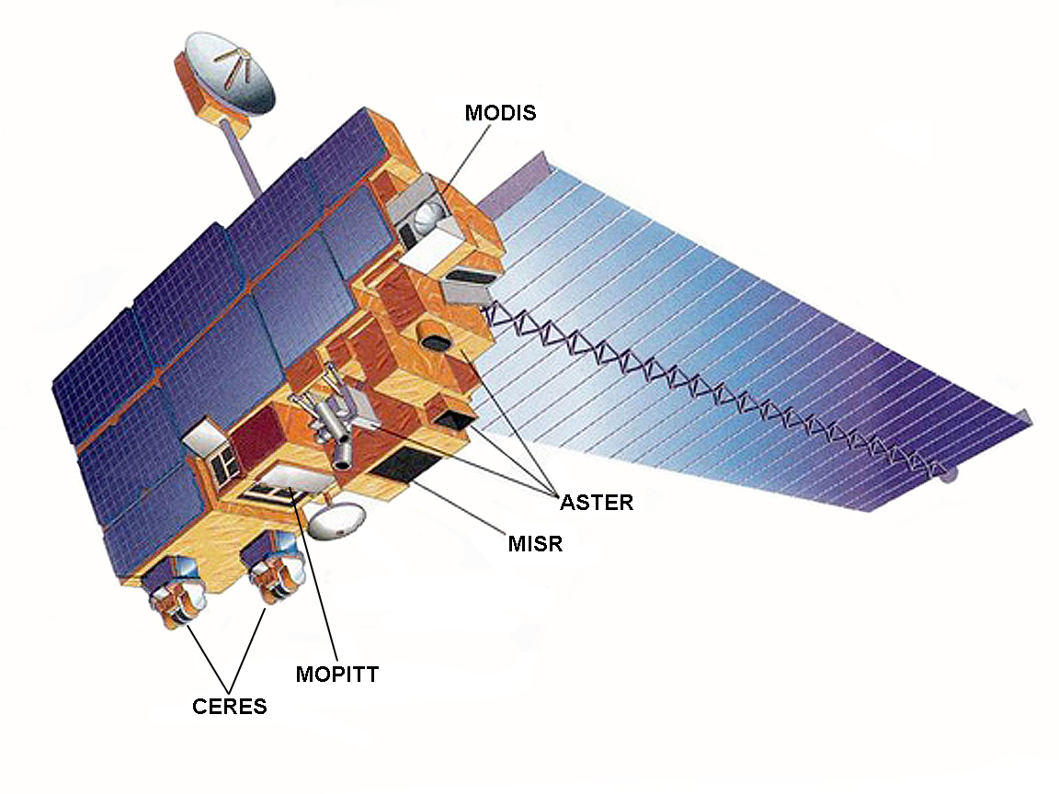
History
The EOS Terra satellite was launched on December 18, 1999, by NASA.
It contains 5 remote sensing instruments
MODIS, ASTER, MISR, CERES, MOPPIT
These instruments were designed to address many research topics.
It is on board the EOS Aqua satellite, which launched in May, 2002.

Slide 3
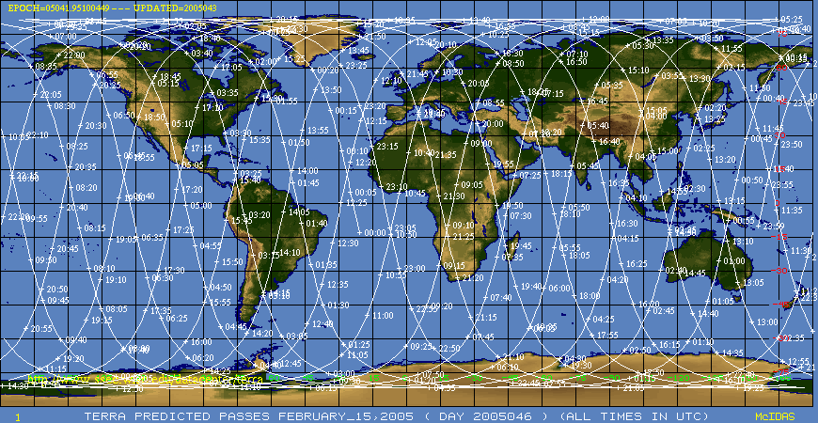
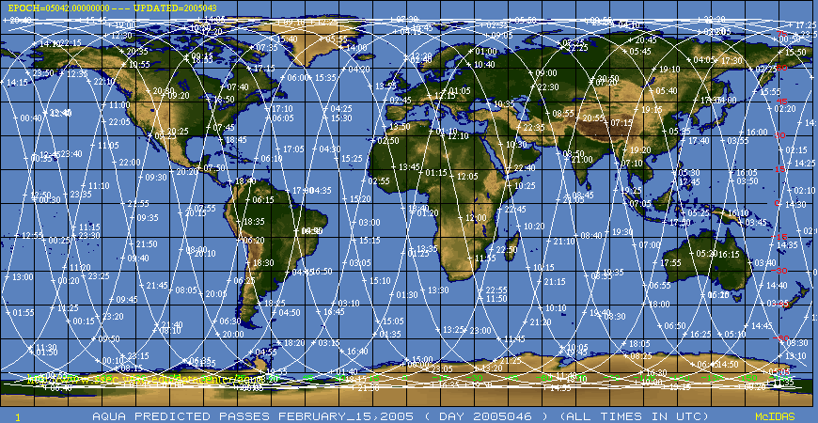
Terra vs Aqua
Sun-synchronous
Near-polar circular orbit
Timed to cross the equator from N to S, descending
10:30 A.M
Sun-synchronous
Near-polar circular orbit from S to N, ascending
1:30 P.M
Notes:
Notice slight differences in paths

Slide 4
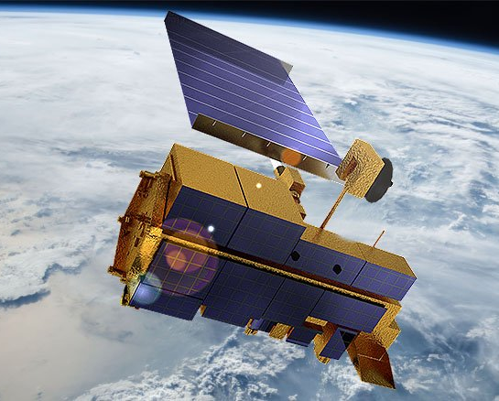
Specifications
MODIS:
Has 36 bands from 0.405 to 14.385 micrometers
Collects data at 250-m, 500-m, and 1-km spatial resolutions
Views the entire surface of the Earth every 1-2 days, can have 1 kilometer resolution, making observations in 36 spectral bands of :
land and ocean surface temperature
Primary productivity
Land-surface cover
Clouds
Aerosols
Water vapor
Temperature profiles
Fire

Slide 5
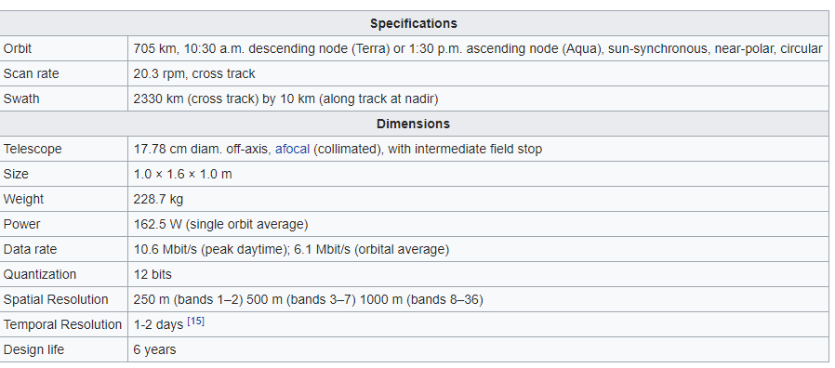
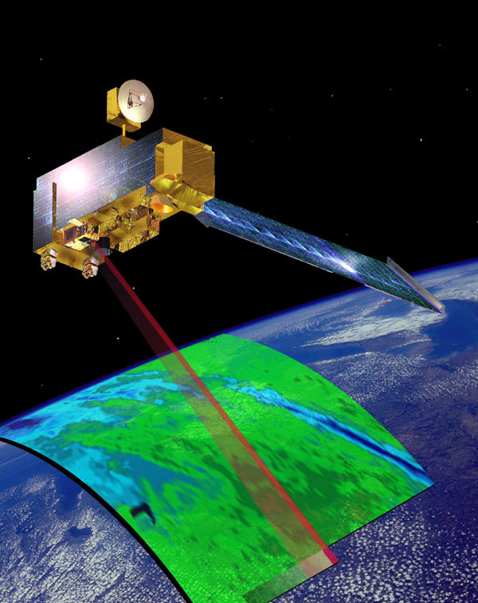
Specifications cont…
Figure 1- Information provided by Wikipedia, https://en.wikipedia.org/wiki/Moderate_Resolution_Imaging_Spectroradiometer

Slide 6
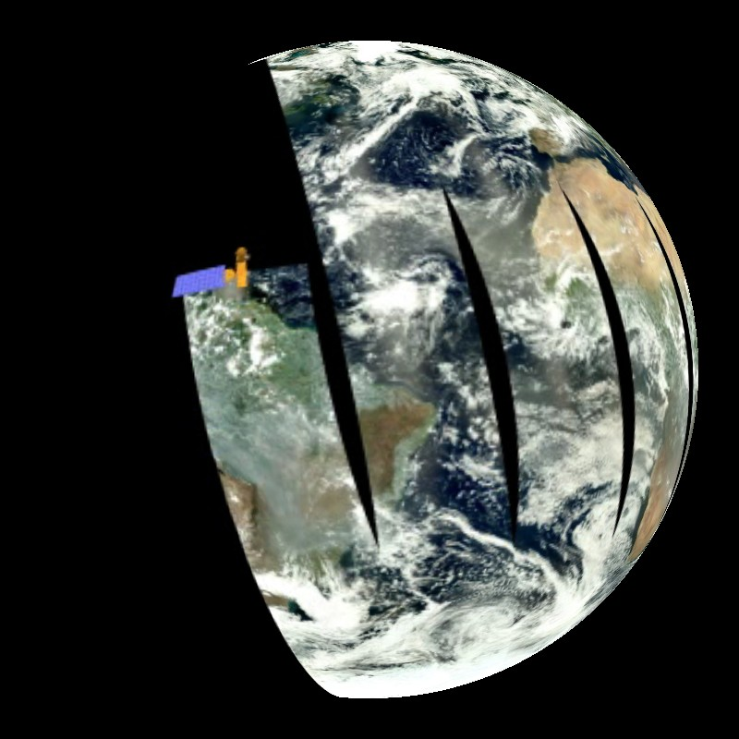
Applications
MODIS has high temporal resolution data are useful to track changes in the landscape over time.
monitoring of vegetation health by means of time-series analyses with vegetation indices
long term land cover changes (e.g. to monitor deforestation rates)
water inundation from pluvial, riverine, or sea level rise flooding in coastal areas
change of water levels of major lakes
the detection and mapping of wildland fires in the United States.
Provides long-term observations to derive enhanced knowledge of global dynamics and processes occurring on the surface of the Earth and it n the low atmosphere.
Modis is in a 705-km Sun- synchronous orbit.
Modis obtains a high radiometric resolution image of daylight-reflected solar radiation and day/night thermal emission over all regions of the Earth.

Slide 7
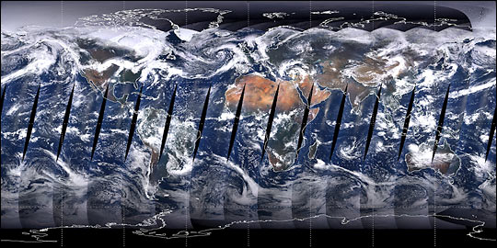
Applications cont…
Modis is a whiskbroom scanning imaging radiometer consisting of a cross-track scan mirror, collecting optics, and asset of linear detector arras with spectral interference filters located in four focal planes.
Healthy vegetation absorbs much of the green radiant flux, meaning that the vegetated areas are in dark tones.
Notes:
a. The whiskbroom motions. There is a comparison image at the top, that shows the different scanning techniques.
b. Image of how the whiskbroom captures the image.

Slide 8
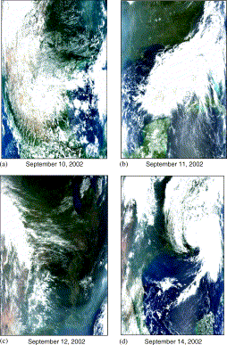
Applications contd…
CSR plus monitoring from MOD are using MODIS to detect and track migration of pollutants in TX.
Measuring continental haze
Gradients of pollution
Application on 150 counties
Ground-base observations, ground truthing
Notes:
Applications of MODIS satellite data and products for monitoring air quality in the state of Texas
-The Center for Space Research (CSR), in conjunction with the Monitoring Operations Division (MOD) of the Texas Commission on Environmental Quality (TCEQ), is evaluating the use of remotely sensed satellite data to assist in monitoring and predicting air quality in Texas.
Fig. 1. MODIS imagery sequence shows continental haze originates in the central US and enters Texas precipitating a health alert in over 150 counties on 13 September 2002. Geographic boundaries of these data are more evident in panels shown in Figs. 2(a)–(c).

Slide 9
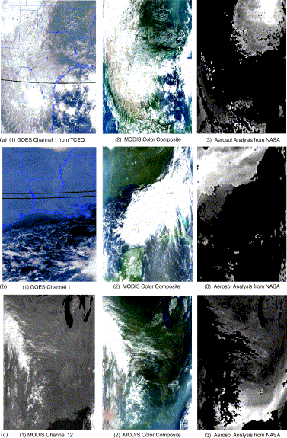
CSR believes the use of MODIS imagery and aerosol data products satisfies success criteria . Clearly the results of this case study demonstrate that the use of EOS data or products:
•
improves dramatically the manual detection of pollution compared to use of existing GOES data routinely available at TCEQ,
•
enhances the ability to exploit existing (surface-based) data routinely available at TCEQ,
•
extends the period in which an air pollution event or residuals of an event can be monitored by TCEQ personnel, and
•
provides increased knowledge into the severity (based upon optical thickness values which qualitatively reflect variations in pollution concentration) and the extent (based upon aerial coverage) of a pollution event.
Notes:
Fig. 2. (a) GOES Channel 1 in
Panel (1) shows no indication of mid-continental haze at 1700 UTC on 10 September 2002. However, a color composite of MODIS bands at 1720UTC (red=0.645, green=0.555, and blue=0.469 μm) in
Panel (2) reveals this pollution as a “blue” cloud over Arkansas (top right corner of scene). The MODIS MOD04 aerosol product in
Panel (3) accurately detects this pollution, i.e. lighter gray-shades denote higher aerosol optical thickness values.
(b) MODIS Band 12 (centered at 0.565 μm) in Panel (1) is representative of visible data collected by GOES satellites and shows no indication of mid-continental haze on 11 September 2002.
However, a color composite of MODIS bands at 1625 UTC in Panel (2) reveals this pollution as a “blue” cloud.
The MODIS MOD04 aerosol product (best reports for land and ocean) in Panel (3) shows the horizontal extend of the pollution and the relative concentration, with optical depths exceeding unity. Again, lighter gray-shades denote higher aerosol optical thickness values. (c) Since GOES was not available from TCEQ, MODIS Band 12 is in Panel (1), MODIS color composite for 1705 UTC in Panel (2), and MODIS aerosol analysis from NASA in Panel (3).
The MODIS MOD04 aerosol product shows the continental haze continues to be advected by strong northeasterly winds into Texas, since gray-shades denote higher aerosol optical thickness values. TCEQ issues a health alert for 150 counties in Texas on 12 September 2002.
https://www.sciencedirect.com/science/article/pii/S1352231003001286

Slide 10
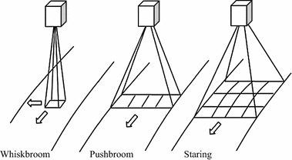
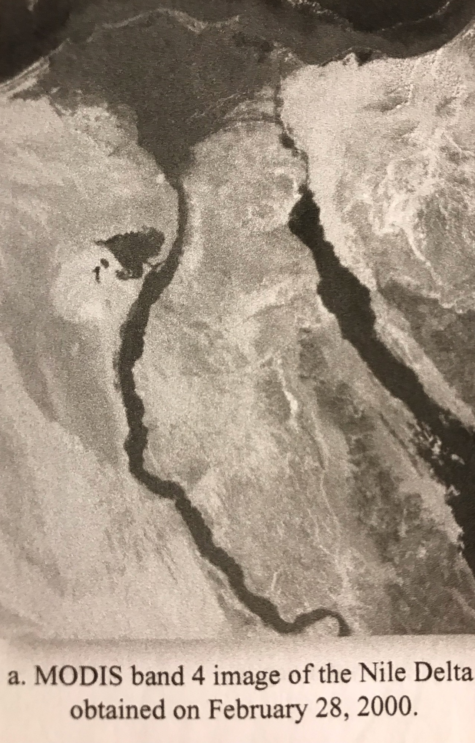
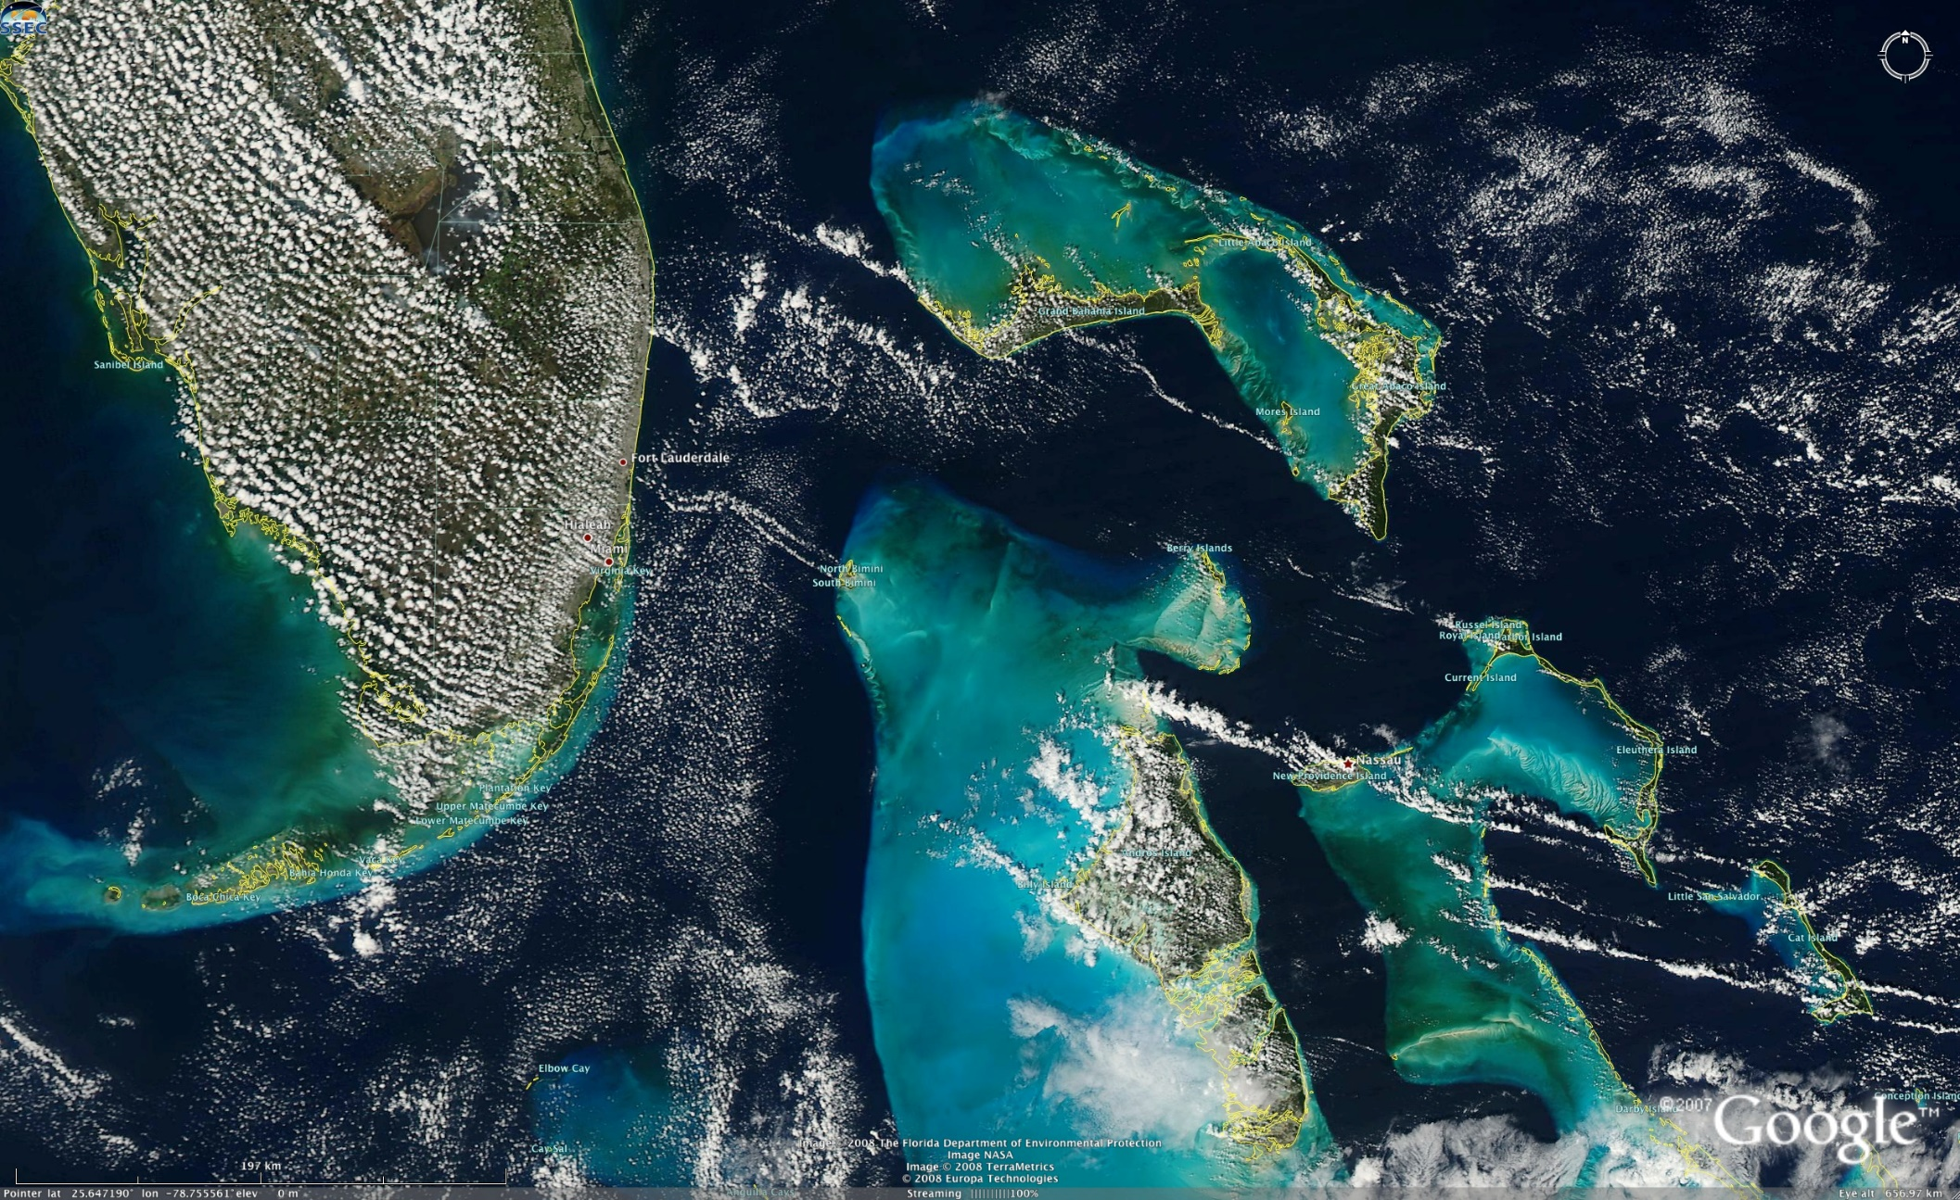
Samples
Notes:
Notice the dark vegetation. Nile Delta , the Nile River and much of the red Sea. Band 4 has a spatial resolution of 500 x 500 micrometers
True color image displayed using Google Earth, show variation in color of the water in the Bahamas, 2008, light blue is shallow banks, darker blue is deeper water, can see clouds http://cimss.ssec.wisc.edu/goes/blog/archives/600
(top) comparison technique for scanning methods

Slide 11
Credits
Images
https://www.ssec.wisc.edu/~scottb/080205_modis_bahamas.jpg
https://www.nasa.gov/mission_pages/terra/spacecraft/index.html
https://sos.noaa.gov/datasets/polar-orbiting-aqua-satellite-and-modis-swath/
https://eos.com/modis-mcd43a4/
https://lpdaac.usgs.gov/dataset_discovery/modis
Introductory Digital Image processing- Figure 2-45
Resources
https://en.wikipedia.org/wiki/Moderate_Resolution_Imaging_Spectroradiometer
Introductory Digital Image processing, Jensen, 3rd edition
http://cimss.ssec.wisc.edu/goes/blog/archives/600
https://nsidc.org/data/modis/terra_aqua_differences
https://www.sciencedirect.com/science/article/pii/S1352231003001286

