Slide 1
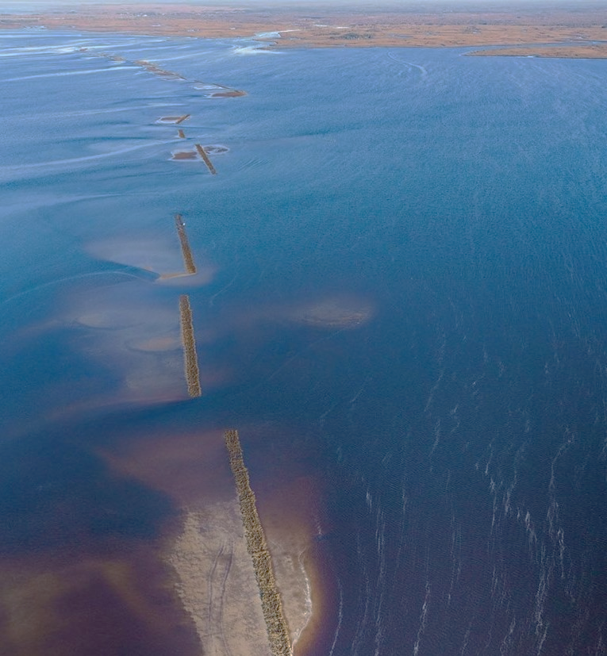
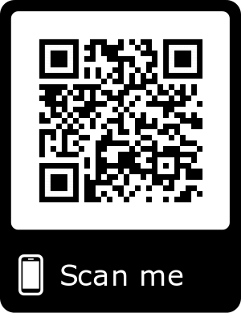


Introduction:
“Living data” are defined as data which are continuously collected and are critical to this type of adaptive learning to inform restoration and management actions. These informed adaptations can be small such as shifting the location of an autonomous sensor, to larger changes including restoration practices or revamping of sampling programs because of low statistical power. Living data are challenging to work with from a data management perspective because the data (by design) change as new data are collected.
Project overview:
The Lone Cabbage Reef (LCR) restoration project is a large restoration effort in the eastern Gulf of Mexico funded by NFWF-GEBF. The project’s primary goal is to restore historical oyster reefs so that they may be plastic to sea level rise, and fluctuations in river discharge. This project generates data from multiple sources including continuous autonomous water quality data from sensors and observations of oyster populations from field biologists. These data are generated at different time frequencies with sensor data obtained at hourly time intervals from multiple spatial locations and biological data collected at discrete time intervals from multiple spatial locations.
Objectives:
In this chapter, I will document how the basic elements of the LCR restoration project water quality and biological data associated with oyster populations are managed. The objective is to develop and implement a data management workflow, which starts at the data collection point (i.e physical data sheet if required) and ends at the visualization/ interpretation of collected data from different data streams. I will document how these data are recorded, data quality assurance/quality control procedures, data checking (anomalous values), data visualization, and data releases for analyses using multiple software tools. This chapter provides an example of a living data project can function to inform an ongoing, long-term restoration project and serve as an example for other projects with data collection efforts.
Human collected data:
For the Lone Cabbage Reef (LCR) project, observational data collected in the field primarily consists of counts and size measurements of oysters from line transects among randomly selected oyster reefs delineated into strata based on specific research questions, which are then recorded on waterproof paper data sheets. To reduce chance of field errors and save time while in the field, I will work to develop and improve data workflow by providing guidance on pre-populating datasheets when possible with basic information including, date and location following data naming standards and field protocols.
Sensor collected data:
Sensor collected data differs from human collected data, in that sensor data are measurements recorded by an instrument automatically. These types of data are a common component of many large-scale observation platforms that may record environmental or biological data continuously, and then make these observations available for use at set time intervals or through “live” feeds.
QA/QC during data entry:
Paper data sheets to electronic records
The process of transferring data from paper datasheets to electronic form that, which will make it compatible to a computer for data analyses, is a common source of potential errors.
Transfer electronic records from sensor to database
When individually collected sensor data files are transported back to the lab these files must be checked for errors and the data amended to an existing database to provide a continuous record of the water quality observations of interest (Figure, box B2). I will develop a three-step process where:
Step 1. Working with UF Library team, I will develop Python code that will distinguish files from each of the two types of sensors that make up the water quality sensor array (Star-Oddi or Diver), based on proper file naming convention.
Step 2. Python code will then check for errors in these data including duplicate observations or data from a sensor that does not have an “identity” in our database. As an example, all active and functioning sensors which are deployed in the field are stored in a data table in our MySQL database, where the start day, time, and location are recorded. If the data file list of sensors does not match the list of active sensors known in the database, then an error message will be reported.
Step 3. MySQL will import all checked and correct observations in their appropriate tables.
Data analysis, figures and tables:
Once data are standardized and available for use in the computer, basic visualization of the data via graphs and figures is a key next step for data checking and the beginning of the analyses. I will develop a group of data visualization products to be used both to check data from field collections and water quality sensors. These figures will be integrated with the living data such that as data are entered into the database and after they pass initial QA/QC the figures will be automatically updated to allow visual assessments of the recorded data
Version Control:
Version control is defined as a software that allows for the saving and management of changes in content, documents, and other developmental information. The focus of version control is to confirm that changes in content are intended and planned. Version control is “a tool for managing changes to a set of files” (Huang and Gonzalez 2016,http://swcarpentry.github.io/git-novice/). Version control can be incorporated into a data workflow using software such as Github.
Proper Storage
I propose that the data workflow for both data and code scripts be separated into two modes. The first mode is “development” mode, meaning that the data are currently undergoing a QA/QC process. The second mode is “production” mode, where the processed data are ready to be analyzed. Github repositories will only have publicly available production data and scripts Raw sensor data files will not be found in these repositories.
Decision-making:
This information will be useful for (1) increasing efficiency in the LCR project. The LCR project involves a large restoration project as well as integration of historical data from two other sampling epochs. Because a single data management workflow was not used across these epochs, significant effort has been required to standardize existing data. By establishing a data workflow at the beginning of the LCR restoration epoch, the data will be managed in a common structure over the life of the project. These productive data are used to make decisions in future conservation efforts. Having precise knowledge of biological data interpretations, will ensure both time and money are being used efficiently. (2) This data workflow will inform a variety of short-term decisions that must be made to adaptively improve the ongoing LCR monitoring efforts.
Big Changes in the Big Bend:
A Data Management Story
Managing large biological datasets requires a great deal of planning and designing prior to data collection.

