Slide 1
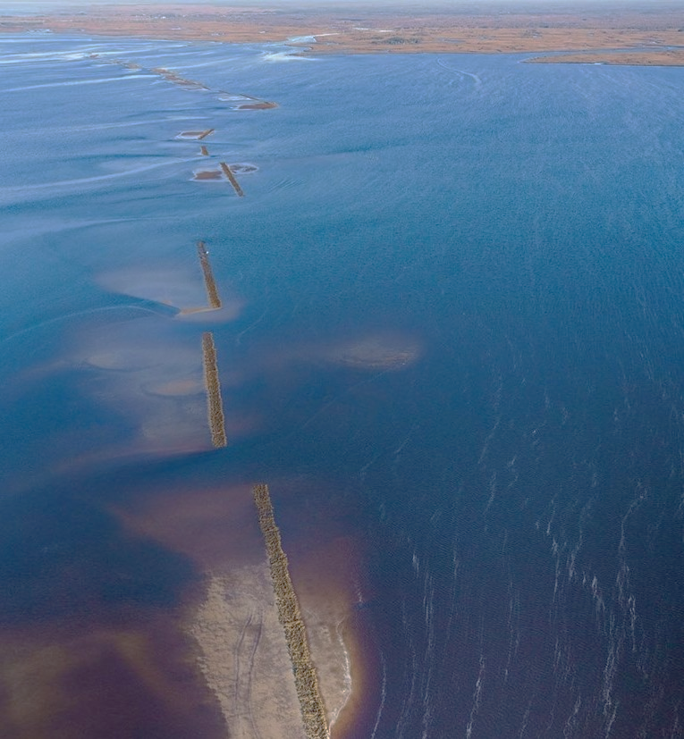



Project overview:
The Lone Cabbage Reef (LCR) restoration project is a large restoration effort in the eastern Gulf of Mexico funded by NFWF-GEBF. The project’s primary goal is to restore historical oyster reefs so that they may be plastic to sea level rise, and fluctuations in river discharge. This project generates data from multiple sources including continuous autonomous water quality data from sensors and observations of oyster populations from field biologists. These data are generated at different time frequencies with sensor data obtained at hourly time intervals from multiple spatial locations and biological data collected at discrete time intervals from multiple spatial locations.
Introduction:
“Living data” are defined as data which are continuously collected and are critical to this type of adaptive learning to inform restoration and management actions. These informed adaptations can be small such as shifting the location of an autonomous sensor, to larger changes including restoration practices or revamping of sampling programs because of low statistical power. Living data are challenging to work with from a data management perspective because the data (by design) change as new data are collected.
Objectives:
Develop and implement a data management workflow, which starts at the data collection point (i.e physical data sheet if required) and ends at the visualization/ interpretation of collected data from different data streams.
I will document how these data are recorded, data quality assurance/quality control procedures, data checking (anomalous values), data visualization, and data releases for analyses using multiple software tools.
Implementing a modern data workflow:
Creating and automating a data management workflow for living data is an emerging skill for natural resource professionals. More than ever, data management is recognized as a core skill for biologists and ecologists (Hampton et al. 2017).
Data Collection:
One of the goals of a successful data management plan is to minimize errors in data collected. Often, the first step in the data collection process is transcribing an observation in the field to paper or electronic data sheets for analyses back in the lab. This simple effort of recording the data in the field is the first opportunity to introduce errors in the data collection process.
Double data entry
Reconciling errors
Pre-populate data sheets information (dates, coordinates, locations)
QA/QC during data entry:
Paper data sheets to electronic records
The process of transferring data from paper datasheets to electronic form that, which will make it compatible to a computer for data analyses, is a common source of potential errors.
Transfer electronic records from sensor to database
When individually collected sensor data files are transported back to the lab these files must be checked for errors and the data amended to an existing database to provide a continuous record of the water quality observations of interest:
Step 1. Developing a workflow to import data into a database, to store, manage, and check.
Step 2. Create a series of checks to ensure data integrity.
Data analysis, figures and tables:
Once data are standardized and available for use in the computer, basic visualization of the data via graphs and figures is a key next step for data checking and the beginning of the analyses. These figures will be integrated with the living data such that as data are entered into the database and after they pass initial QA/QC the figures will be automatically updated to allow visual assessments of the recorded data
Version Control:
Version control is defined as a software that allows for the saving and management of changes in content, documents, and other developmental information. The focus of version control is to confirm that changes in content are intended and planned. Version control is “a tool for managing changes to a set of files” (Huang and Gonzalez 2016,http://swcarpentry.github.io/git-novice/).
Proper Storage
Storing data in appropriate locations, with folder and file naming convention standards.
Decision-making:
This information will be useful for (1) increasing efficiency in the LCR project. By establishing a data workflow at the beginning of the LCR restoration epoch, the data will be managed in a common structure over the life of the project. These productive data are used to make decisions in future conservation efforts. Having precise knowledge of biological data interpretations, will ensure both time and money are being used efficiently. (2)
Big Changes in the Big Bend:
A Data Management Story
Managing and analyzing large biological datasets requires a great deal of planning and designing prior to data collection.

