Slide 1
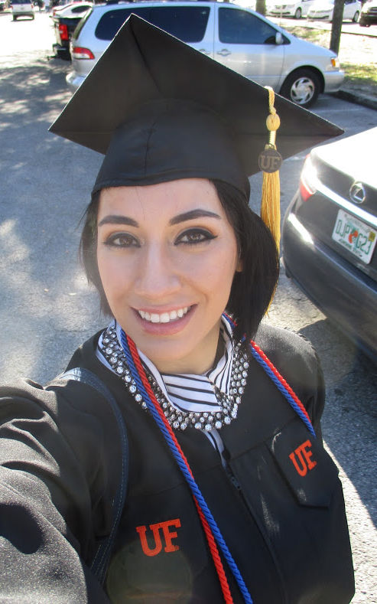
Mel Moreno
Wife
Student
Data Scientist

Slide 2
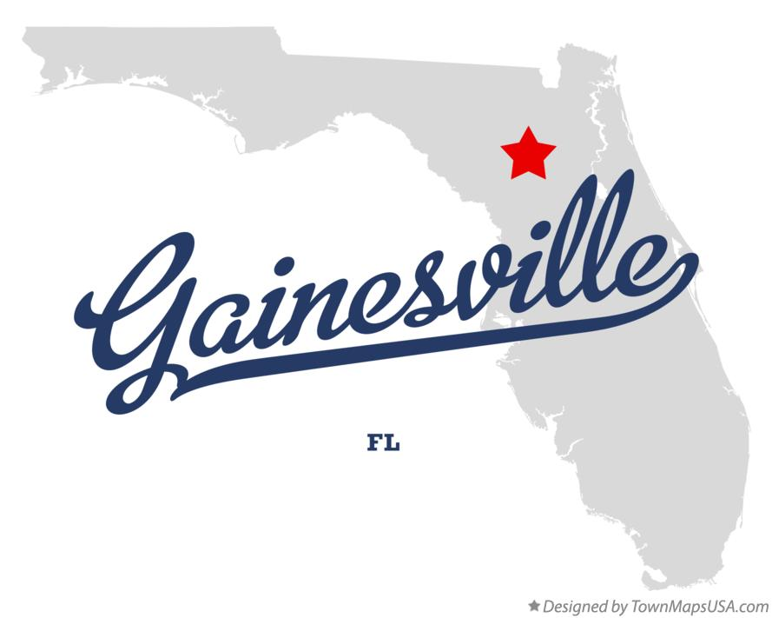
Where am I located?
I am located in Gainesville, FL.
I am originally from Miami, FL.

Slide 3
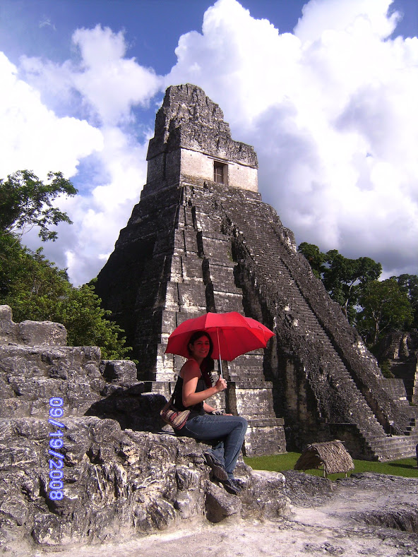
What is your background?
I’m Cuban/ Guatemalan. My background is growing up in Miami, and living a few years in Utah. Really glad to be back in Florida.

Slide 4


What program are you in?
B.S in WEC, UF
M.S in SNRE, concentration Geography

Slide 5
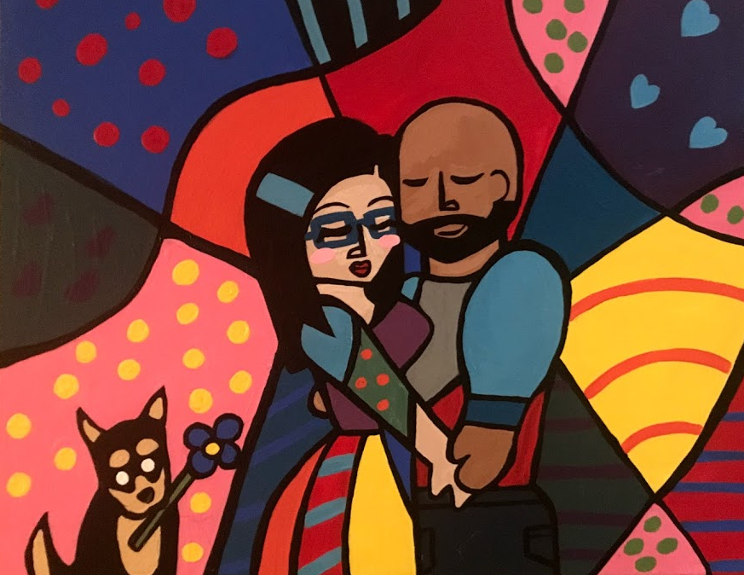
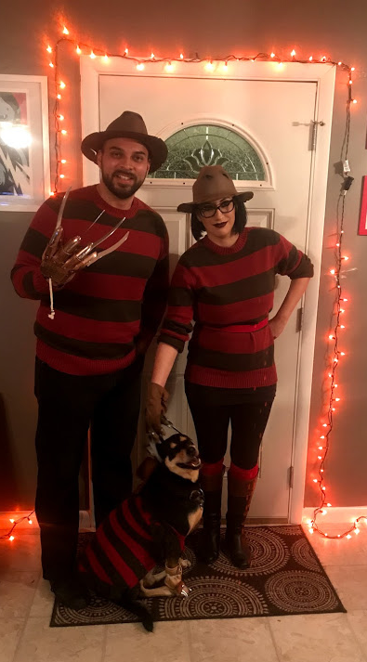
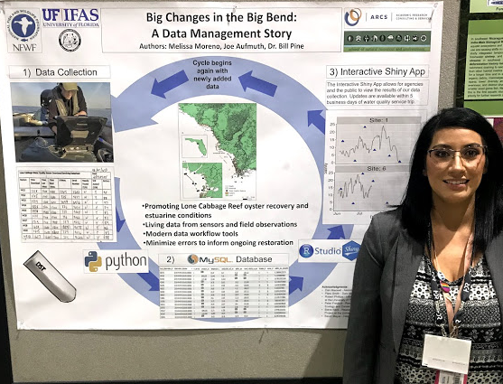

Interesting Things about me?
I love to paint and draw.
I love Halloween.
I love makeup and everything makeup related.
I love watching foreign films.
I like to code.

