Slide 1




Big Changes in the Big Bend: A data management and shoreline analysis study
Melissa Moreno
Dr. Pine, Dr. Mossa, Dr. Adams
& Joseph Aufmuth
Major: Interdisciplinary Ecology

Slide 2
Chapter 1 – ESTABLISHING A PROGRESSIVE DATA MANAGEMENT WORKFLOW FOR BIOLOGICAL DATA TO INFORM ADAPTIVE MANAGEMENT DECISIONS

Slide 3
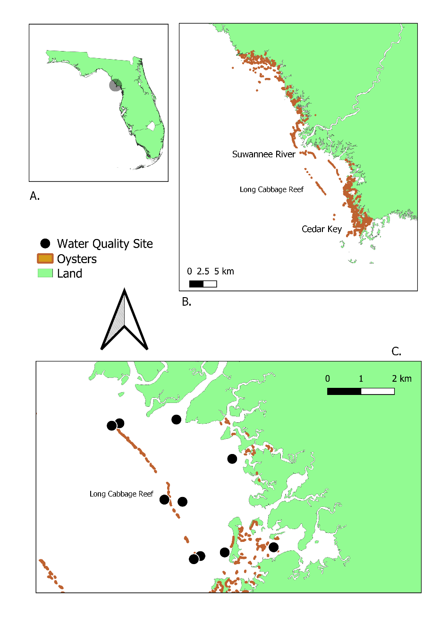

Slide 4
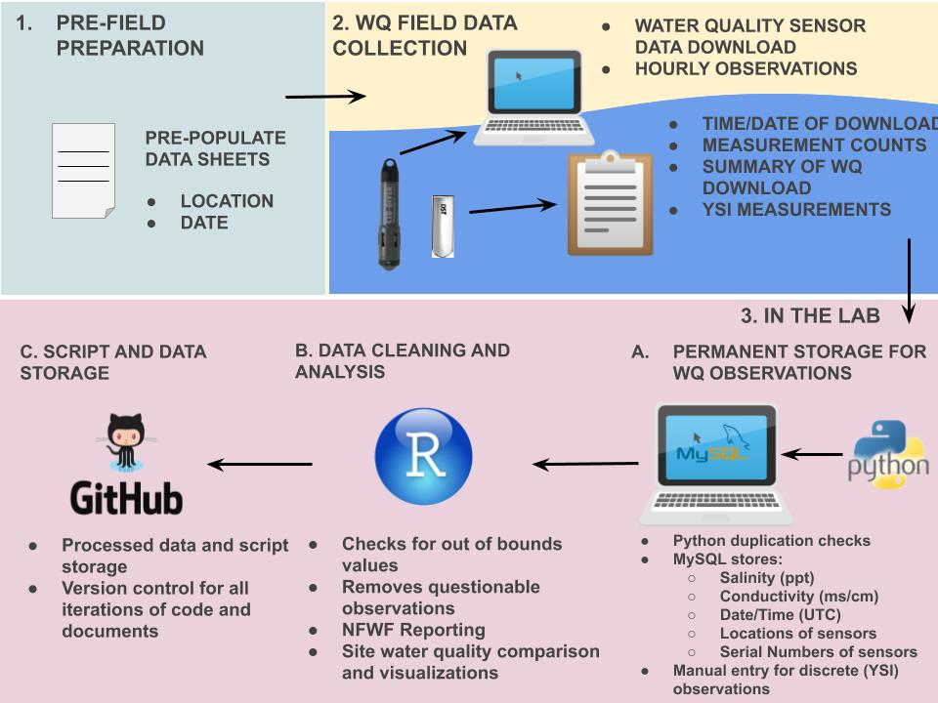

Slide 5
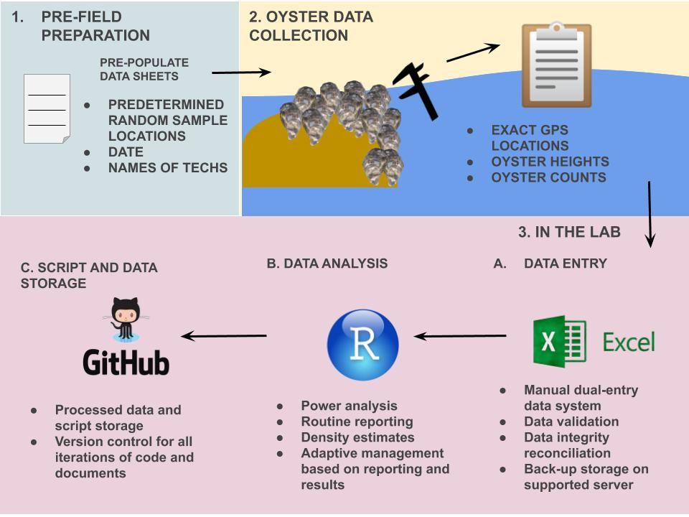

Slide 6
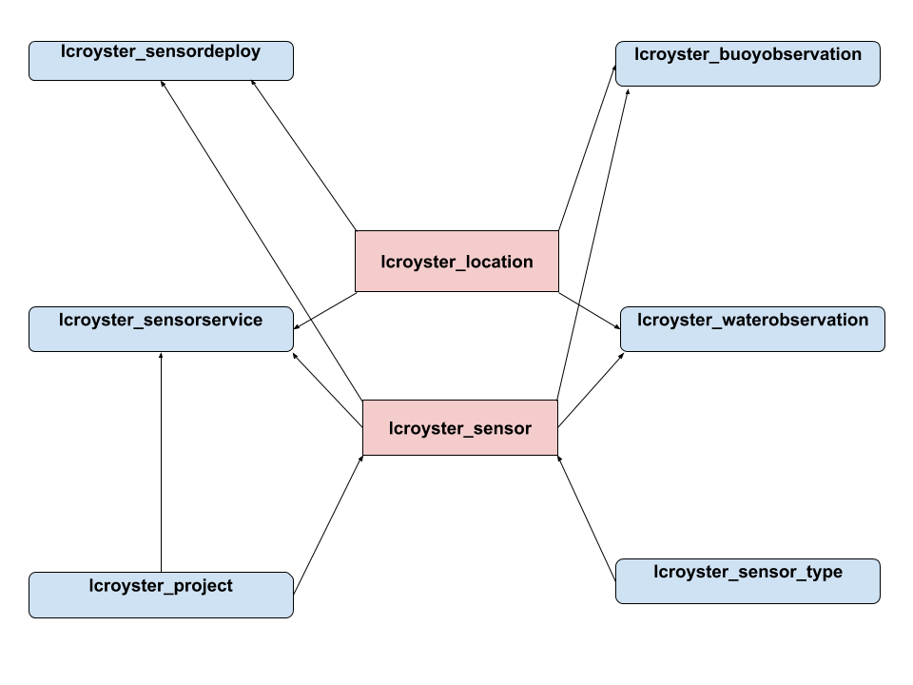

Slide 7
Chapter 2- TAILORING GITHUB FOR ECOLOGY

Slide 8
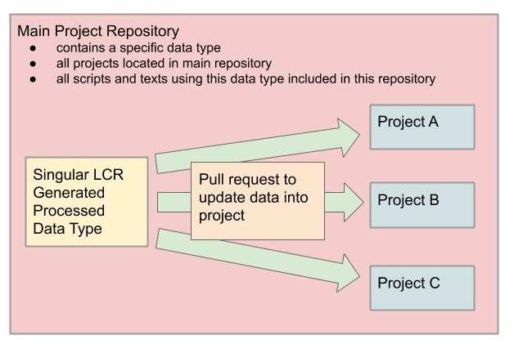

Slide 9
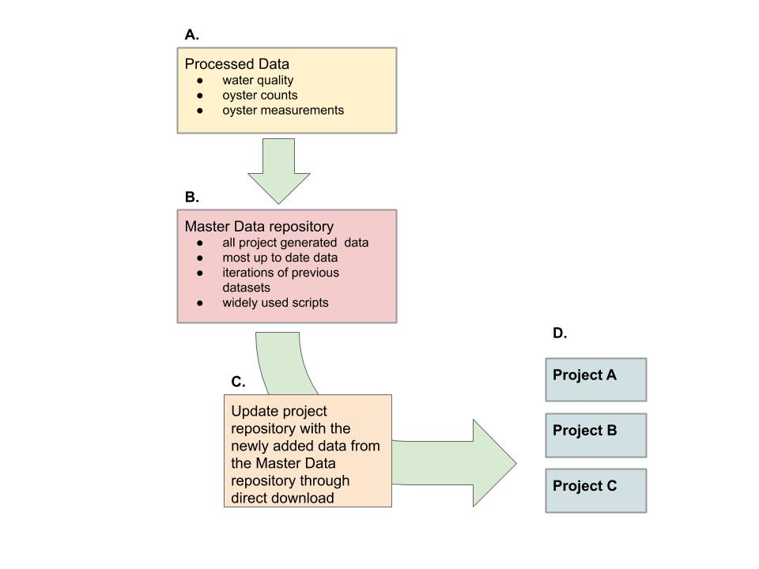

Slide 10
File Type | Naming Convention | Example | Definition
Project Repository | study_location_projectsummary | bird_bb_monitoring | Big Bend camera and survey bird monitoring project
Scripts | lowercase, no uppercase (snake case) nor all caps, all names with separate words need to include an underscore ( _ ) and no spaces, no dates in the names unless it helps with the descriptions of the content, script file names should be descriptive and concise. Scripts that have a single output should be named similarly to their file type output. | discharge_1941_2018_quantile.R | R script which reports quantiles from river discharge from 1941 to 2018
Figures | study_location_type_summary.filetype | oys_lco8a_map_transect.tiff | oyster transect on reef element LCO8A map in a tiff image
Tables | study_location_summary.filetype | wq_lcr_inshore_vs_offshore.csv | LCR water quality inshore and offshore comparison
Data | every dataset file is required to be in lowercase, no uppercase (camelCase) nor all caps, all names with separate words need to include an underscore ( _ ) with no spaces, no dates in the names unless it helps with the descriptions of the content | discharge_1941_2018.csv | River discharge data from 1941 to 2018 in a text file

Slide 11
Chapter 3- A DIGITAL SHORELINE ANALYSIS SYSTEM (DSAS) APPLIED ON SANDY SHORELINE CHANGES IN DEER ISLAND, FL

Slide 12
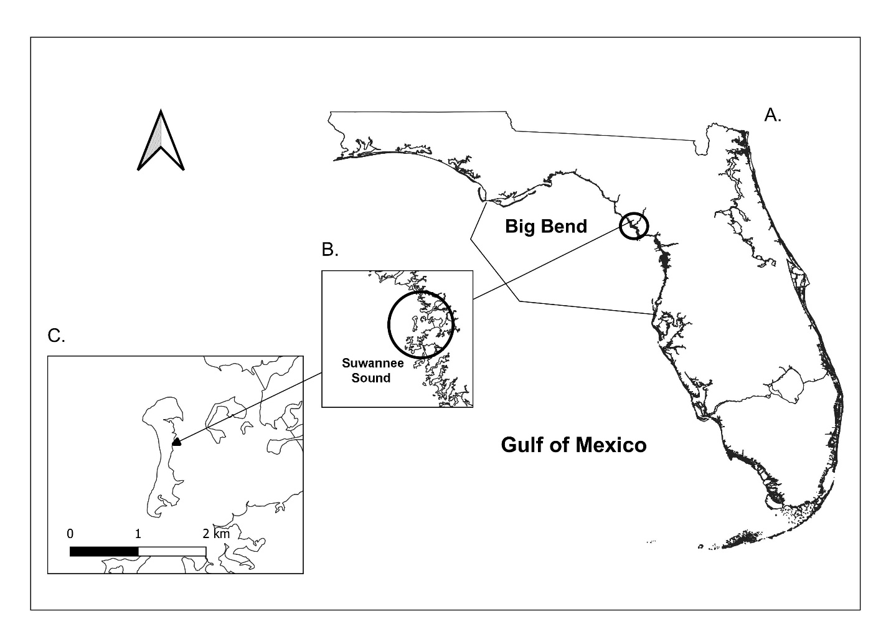

Slide 13
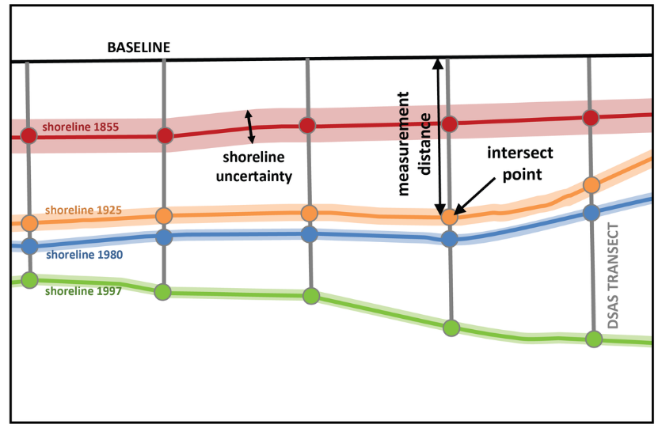
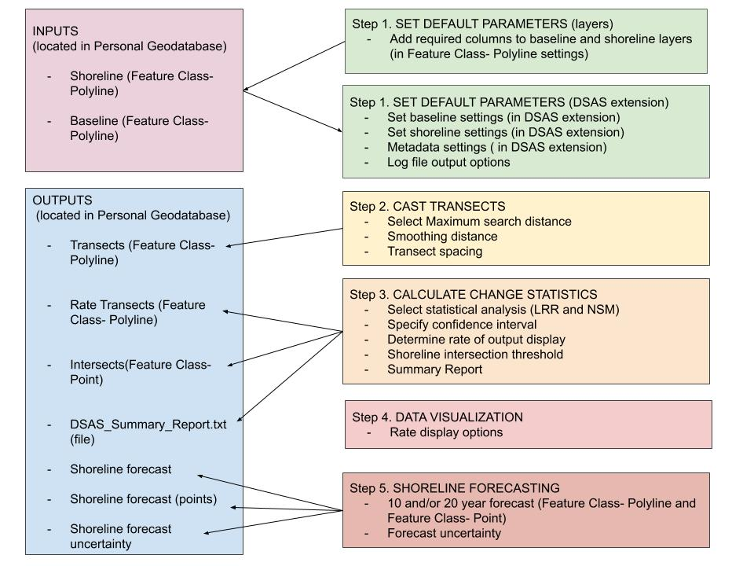

Slide 14
After I selected and pre-processed NAIP imagery, the DSAS analyses were completed using the following parameter specifications:
(1) 100 m buffer around the merged shoreline shapefile
(2) the east side of the buffer was used as the baseline (transects from the baseline were cast from east to west)
(3) transects were spaced at 20-m intervals; the minimum transect spacing allowed by DSAS based on the small size of the study site
(4) 2000-m search for suitable shorelines was done adjacent to the transect; search distance looked for shorelines 2000 meters away from the baseline
(5) a smoothing distance of 500-m was specified; a smoothing distance is a user-specified smoothing value that can facilitate an orthogonal transect intersect by preventing transects from intersecting with one another when there is a curve in the baseline, and the larger the smoothing distance, the more likely to produce uniform transect orientations, which is recommended for smaller shorelines

Slide 15
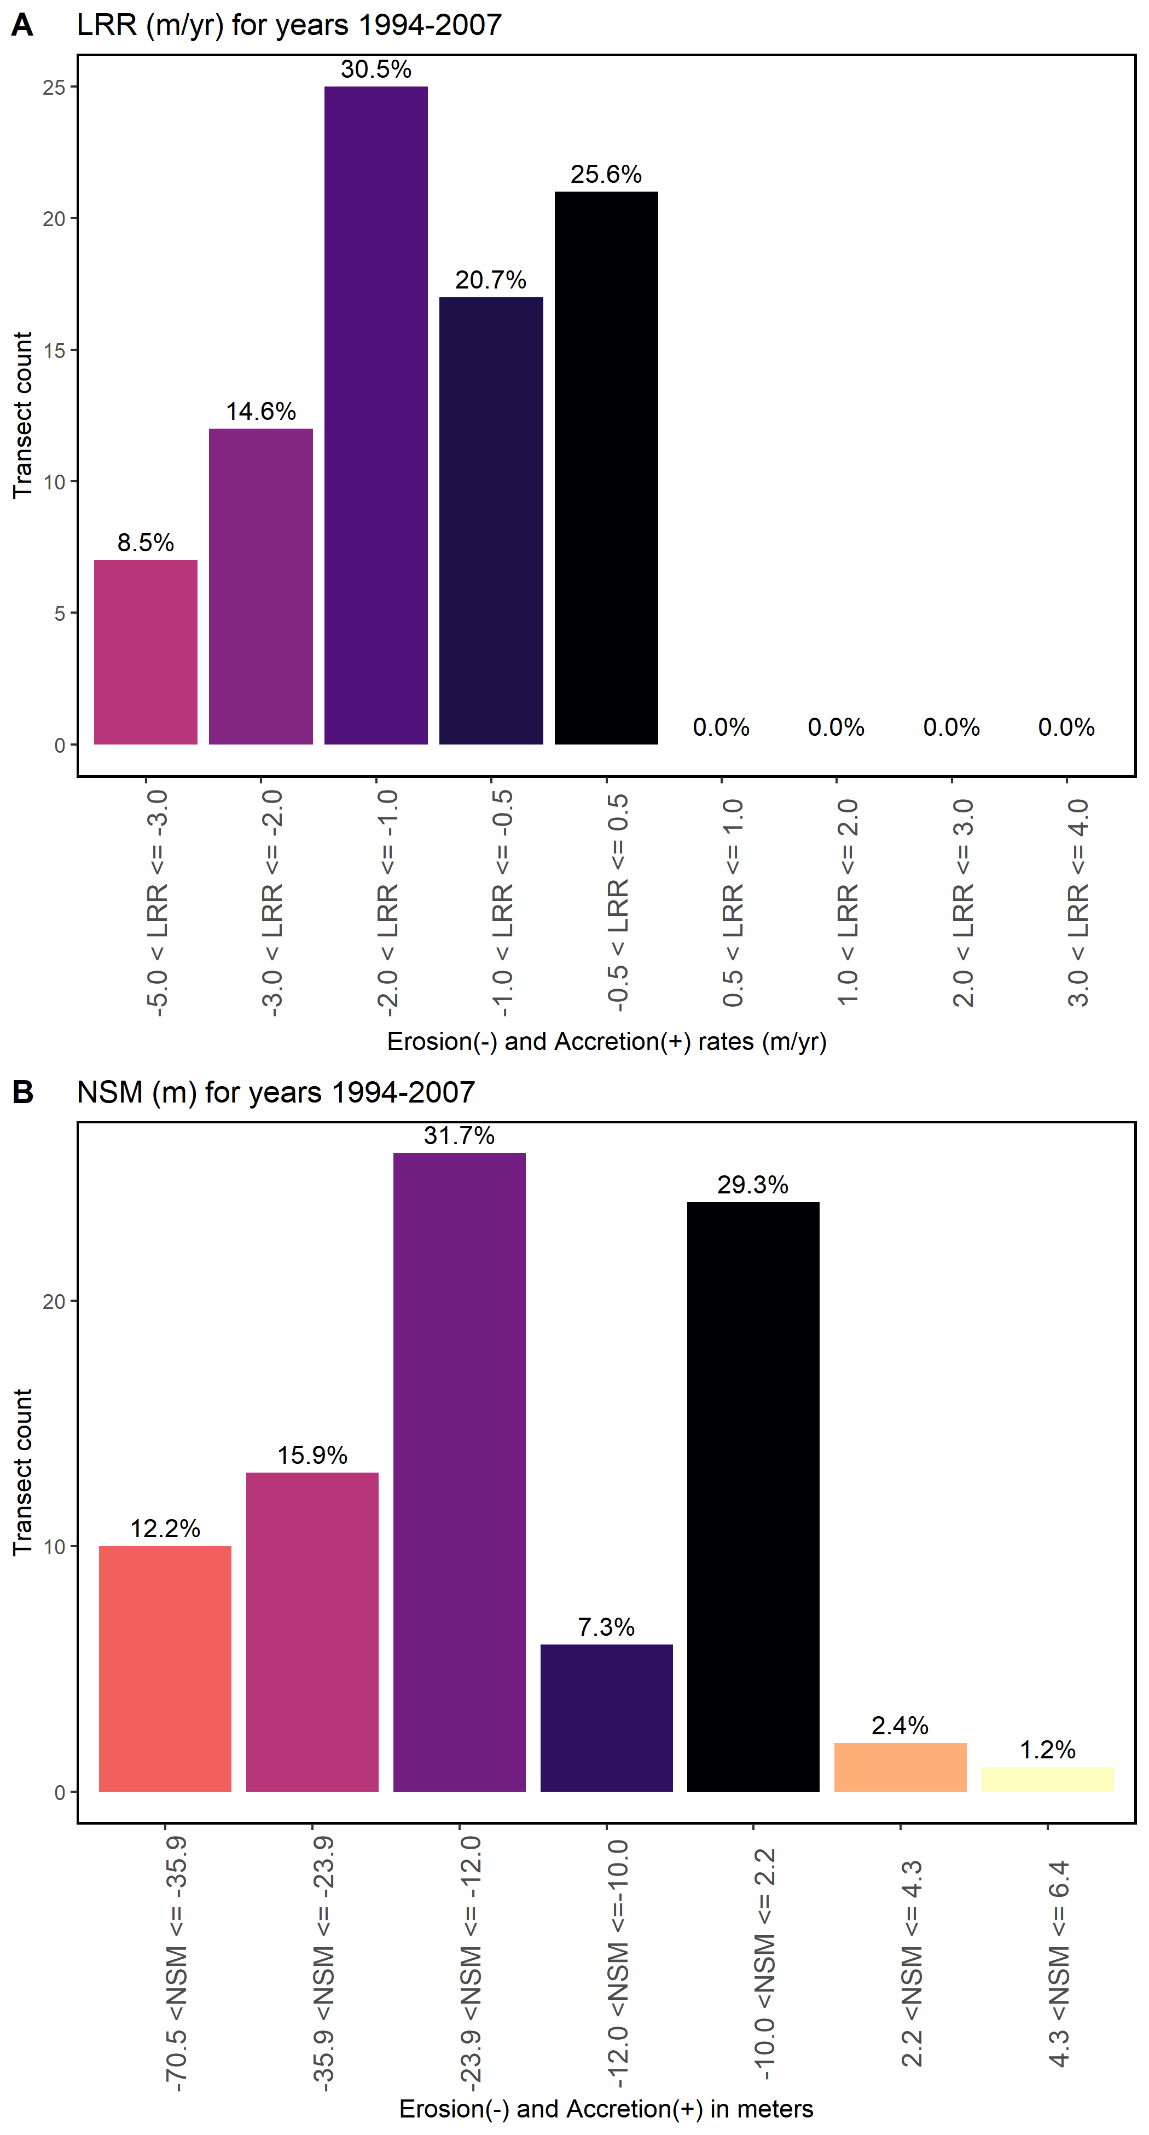
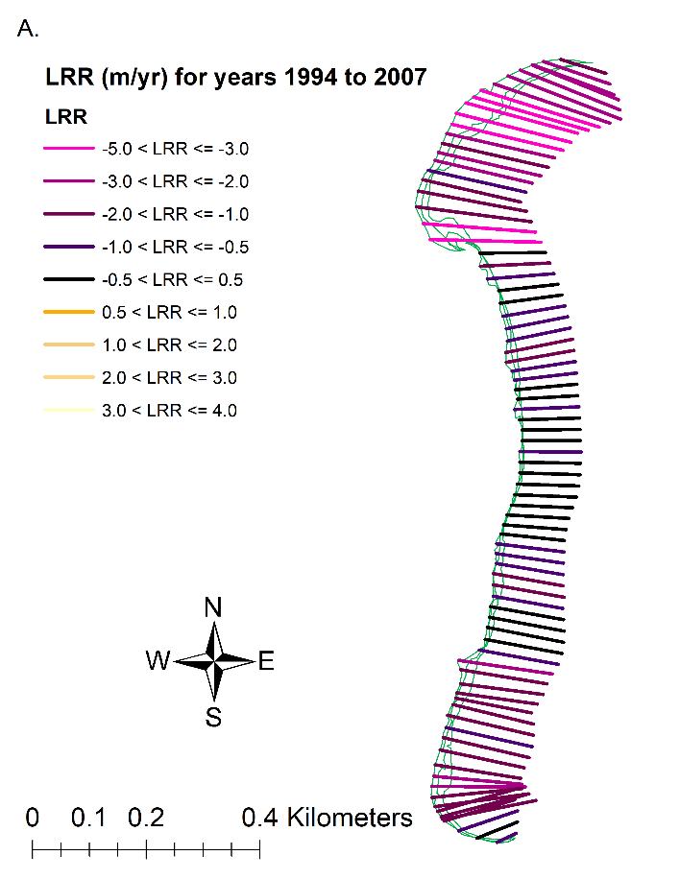
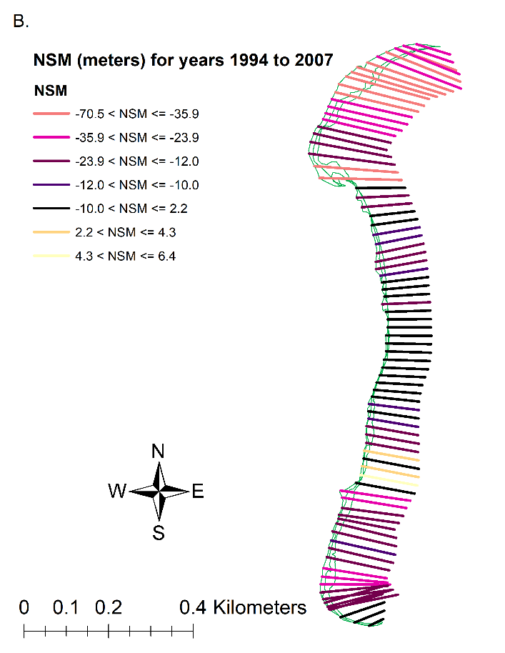

Slide 16
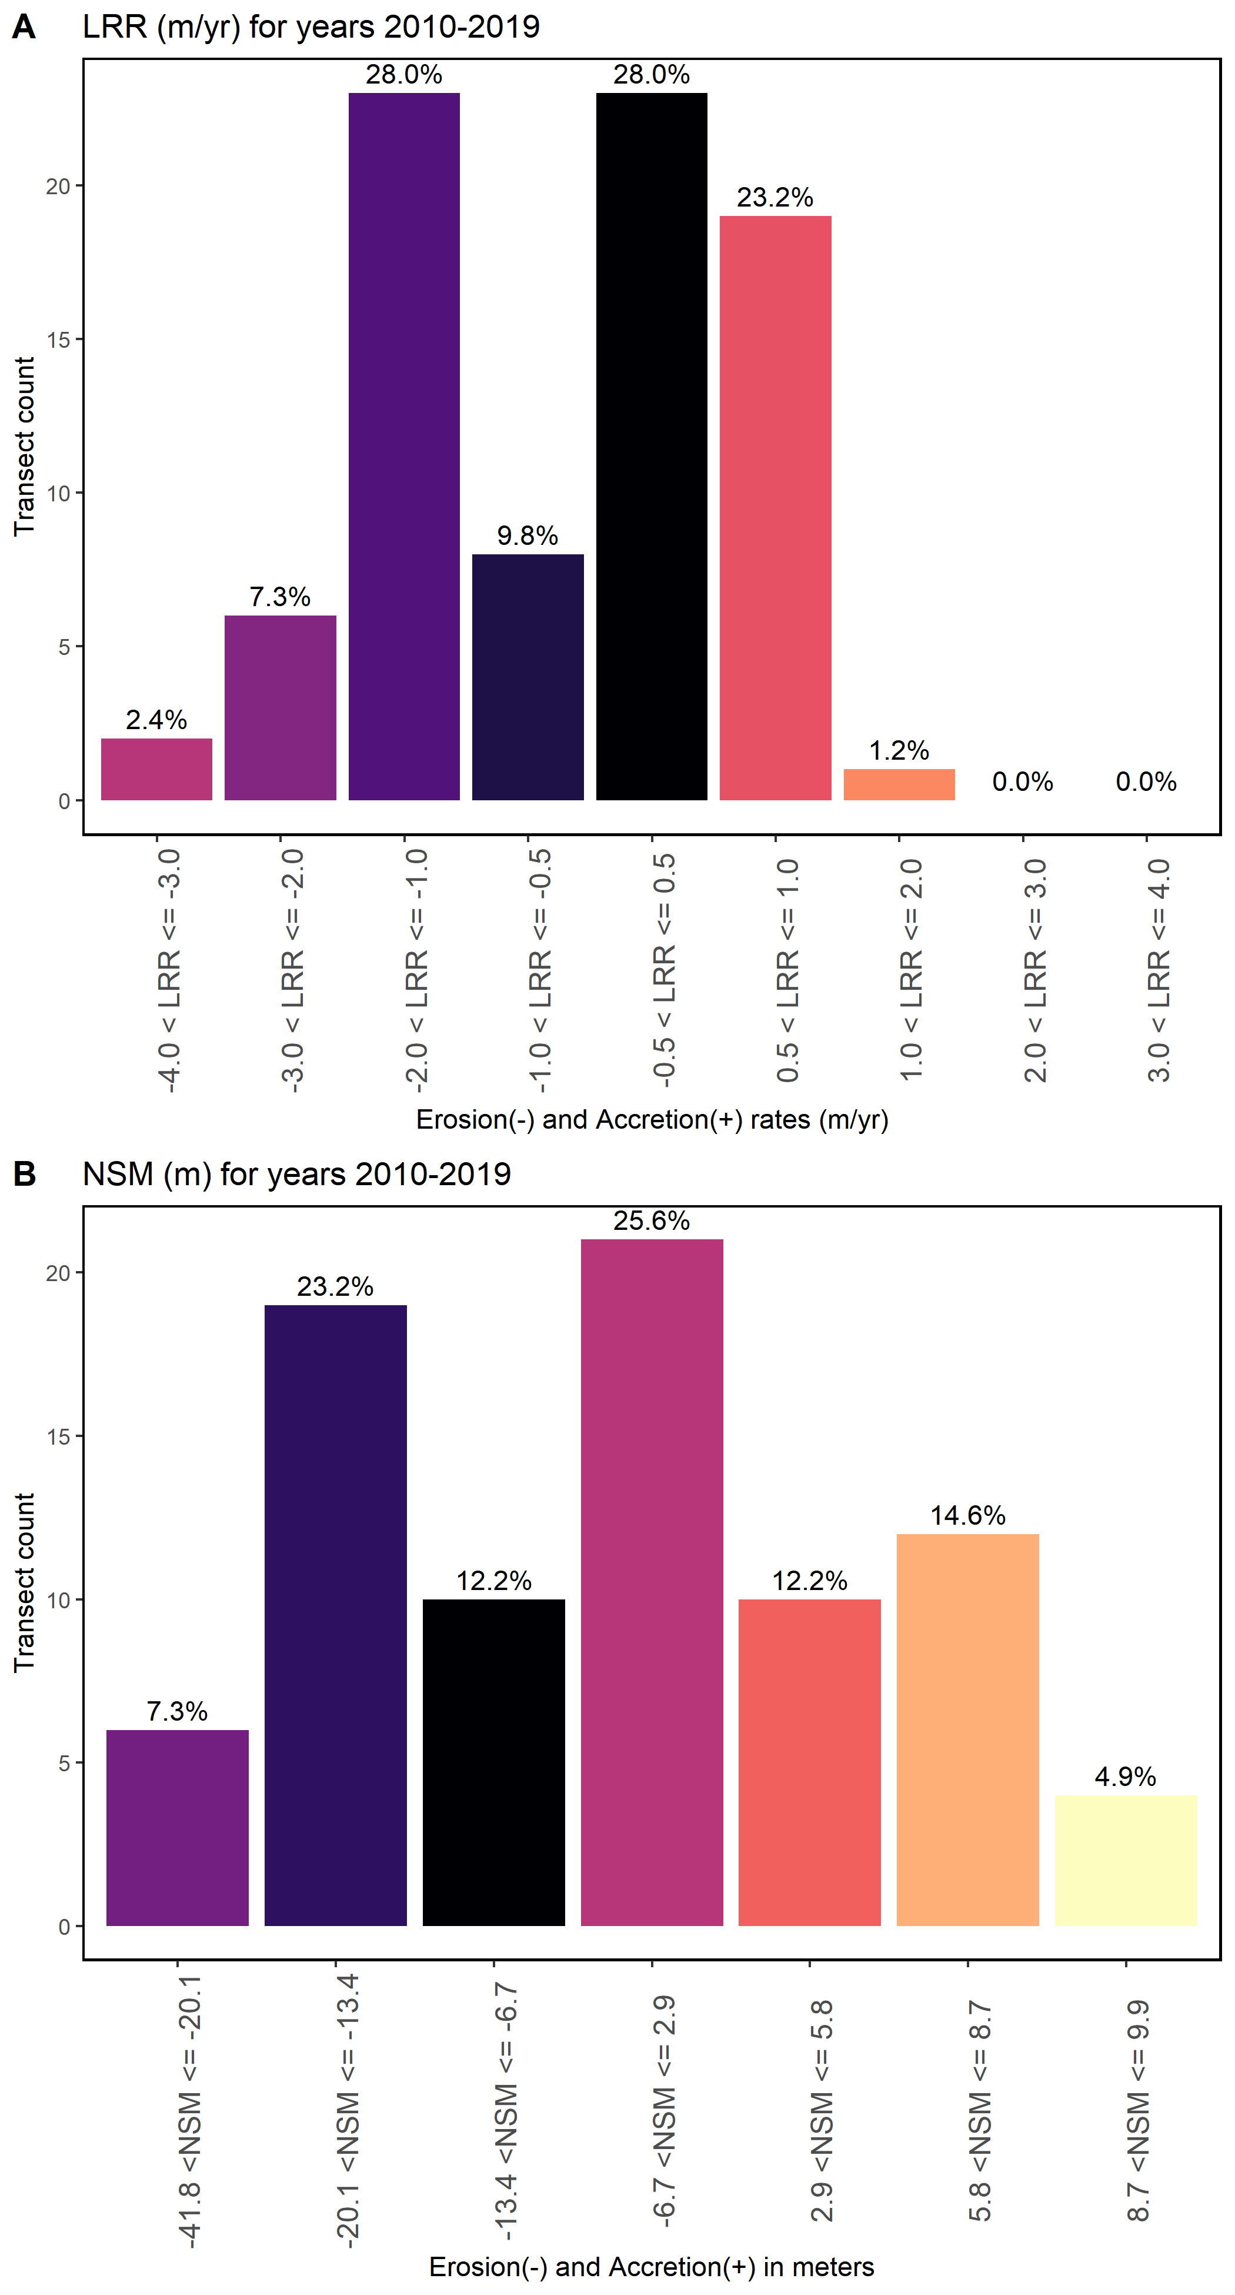
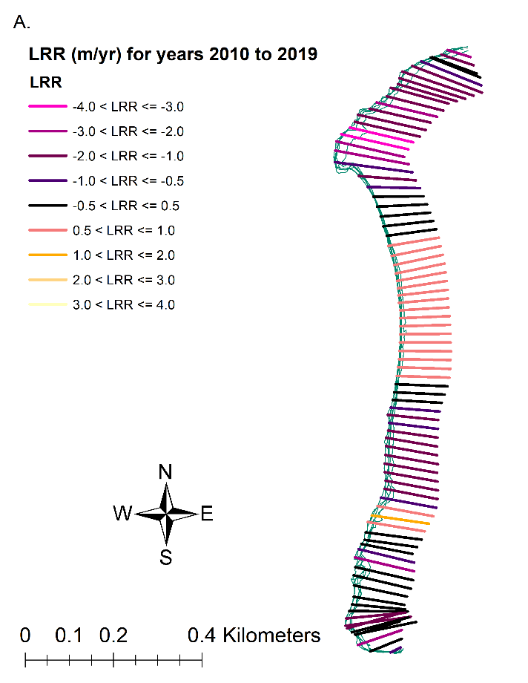
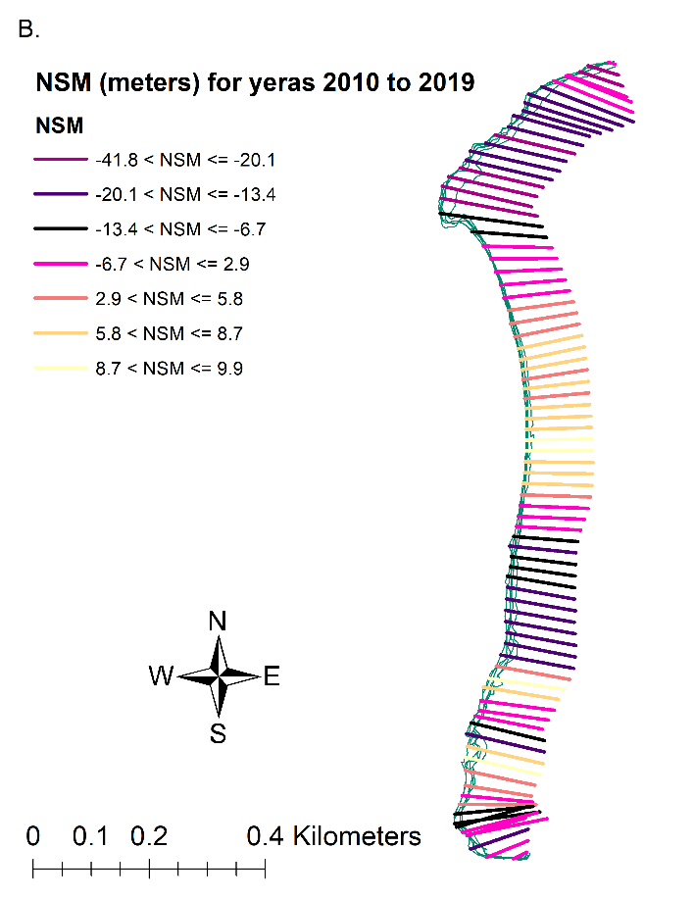

Slide 17
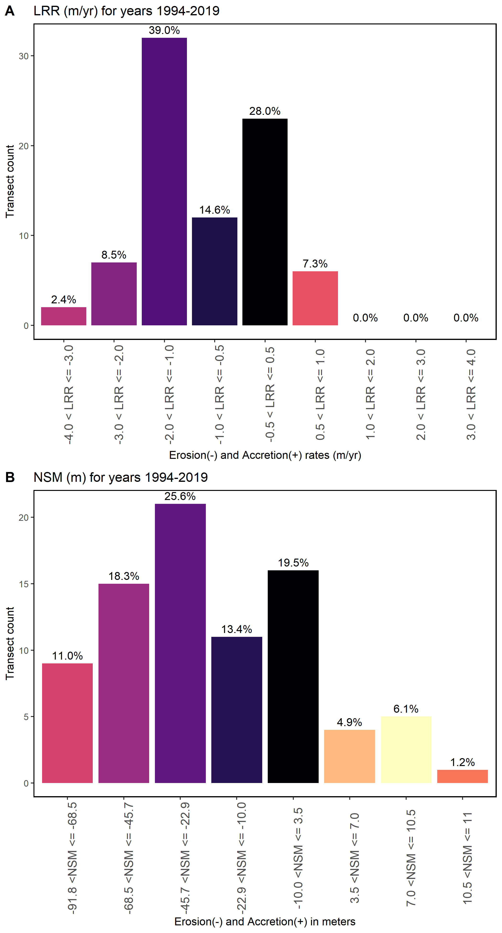
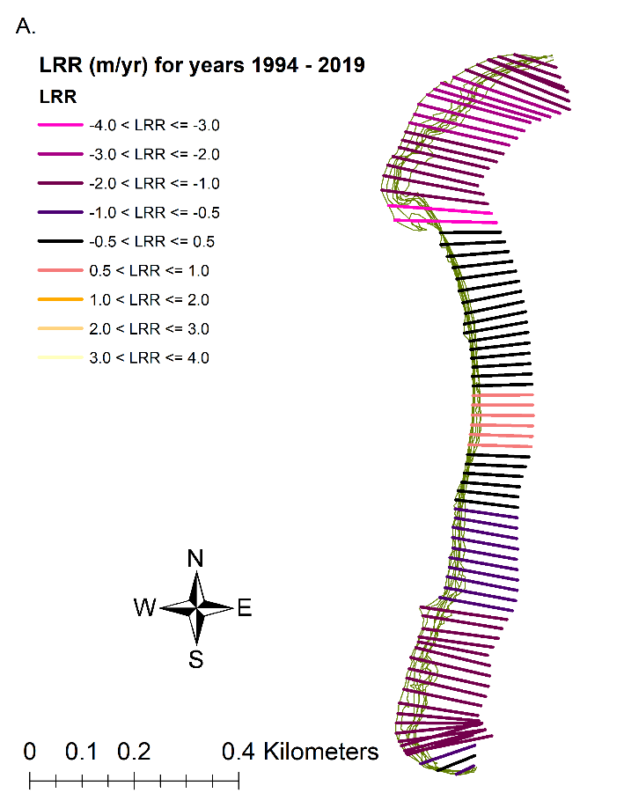
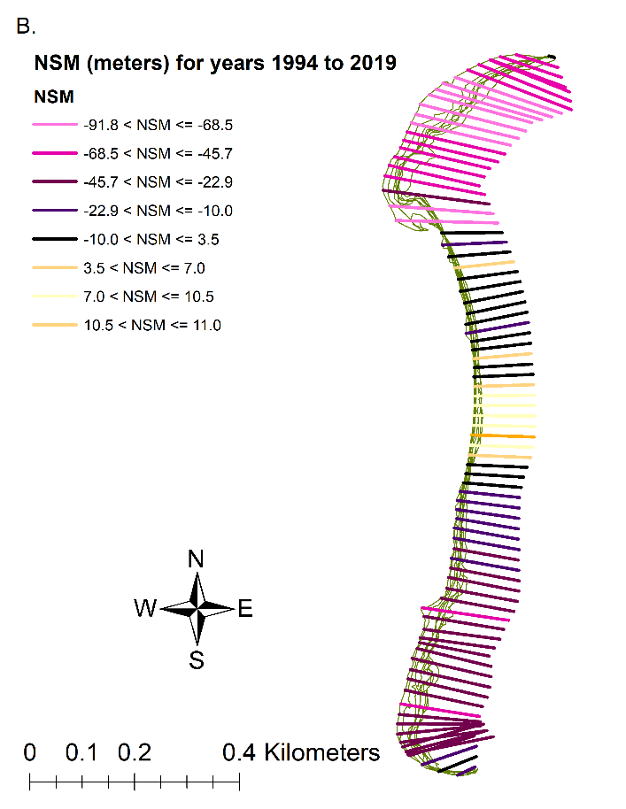

Slide 18
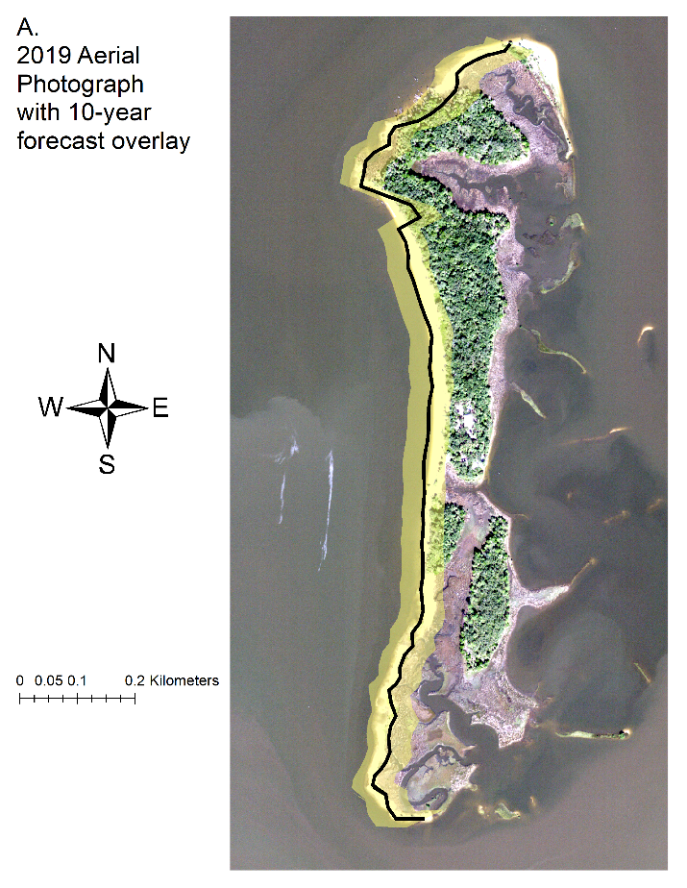
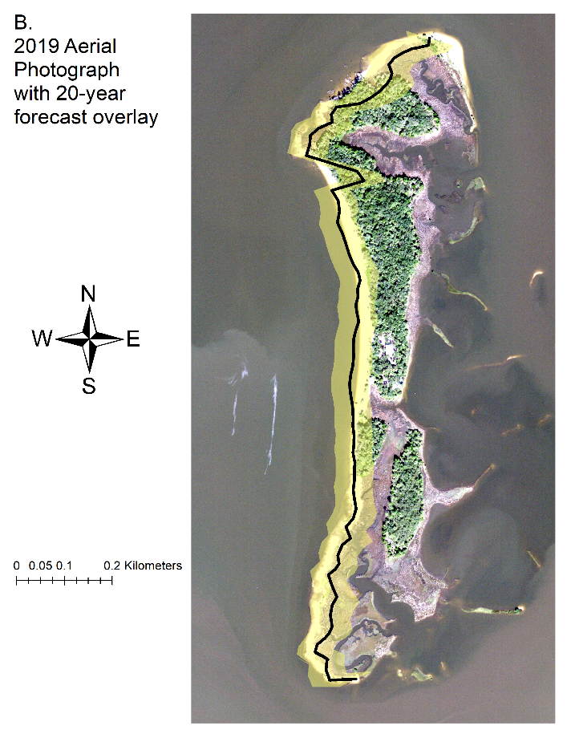

Slide 19
Summary Statistic | Value
Total number of transects (counts) | 82
Average distance (meters) | -29.1
Number of transects with negative distance (counts) | 67
Percent of all transects that have a negative distance | 81.70%
Maximum negative distance (meters) | -91.71
Maximum negative distance (transect ID #) | 12
Average of all negative distances (meters) | -36.83
Number of transects with a positive distance | 15
Percent of all transects that have a positive distance | 18.29%
Maximum positive distance (meters) | 10.91
Maximum positive distance (transect ID #) | 44
Summary Statistic | Value
Total number of transects (counts) | 82
Average rate (m/yr) | -0.95
Average of the confidence intervals associated with rates | 0.49
Reduced n (number of independent transects) | 900.00%
Uncertainty of the average rate using reduced n | 0.17
Average rate with reduced n uncertainty (m/yr) | -0.95 +/- 0.17
Number of erosional transects (counts) | 63
Percent of all transects that are erosional | 76.83%
Percent of all transects that have statistically significant erosion | 69.51%
Maximum value erosion (m/yr) | -3.32
Maximum value erosion (transect ID #) | 22
Average of all erosional rates (m/yr) | -1.33
Number of accretional transects (counts) | 19
Percent of all transects that are accretional | 23.17%
Percent of all transects that have statistically significant accretion | 10.98%
Maximum value accretion (m/yr) | 0.62
Maximum value accretion (transect ID #) | 44
Average of all accretional rates (m/yr) | 0.31
Table 3-3. Summary statistics calculated by DSAS, Distance: NSM (Net Shoreline Movement) for years 1994 to 2019
Table 3-4. Summary statistics calculated by DSAS, RATE: LRR (Linear Regression Rate) for years 1994 to 2019

Slide 20
Conclusion

Slide 22
Thanks to:

