Slide 1




Big Changes in the Big Bend: A data management story
Melissa Moreno
Dr. Pine, Dr. Mossa, Dr. Adams
& Joseph Aufmuth
Major: Interdisciplinary Ecology

Slide 2
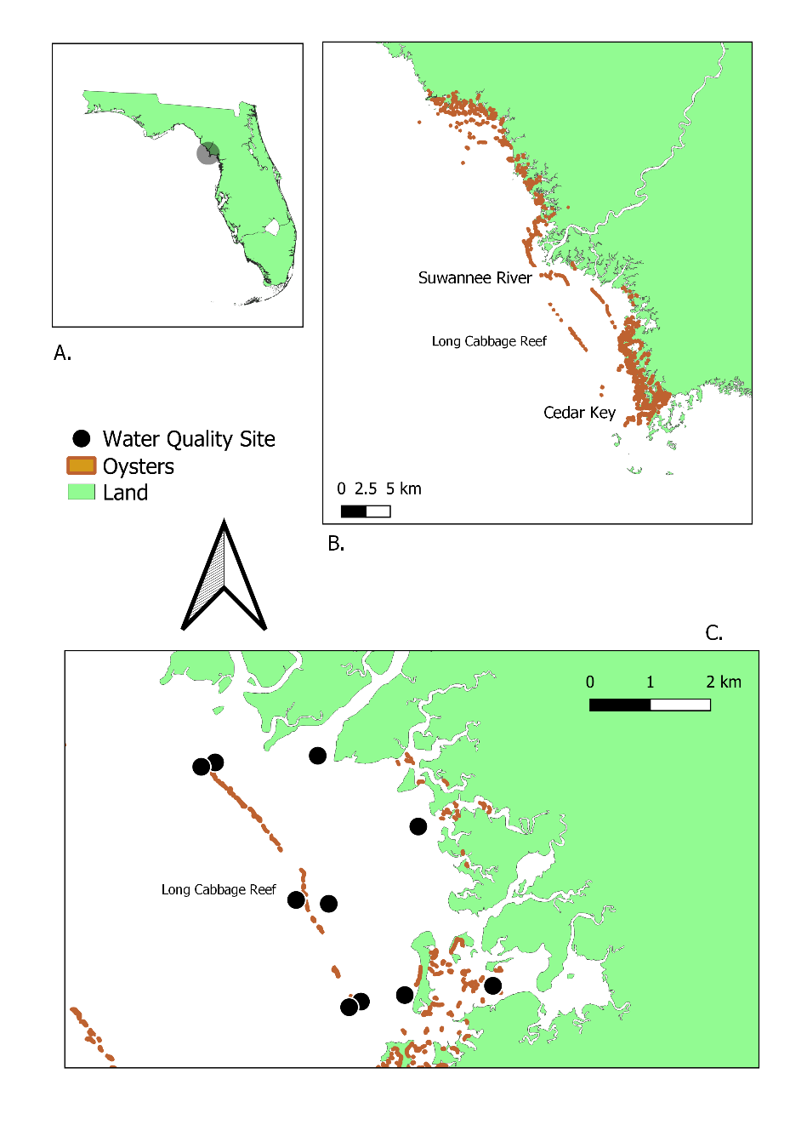
The problem
Tracking sensors as they are replaced in the fixed sites located around the Lone Cabbage reef
Keeping a record of all sensors purchased for the project
Notes:
Water quality location map.
A) Lone Cabbage Reef area;
B) Florida coastline between identifying Suwannee Sound river mouth, Lone Cabbage Reef, and Cedar Key, FL;
C) Lone Cabbage Reef with water quality sites identifies (black circles). The oyster shapefile used in this map is from a sampling effort in 2001.

Slide 3
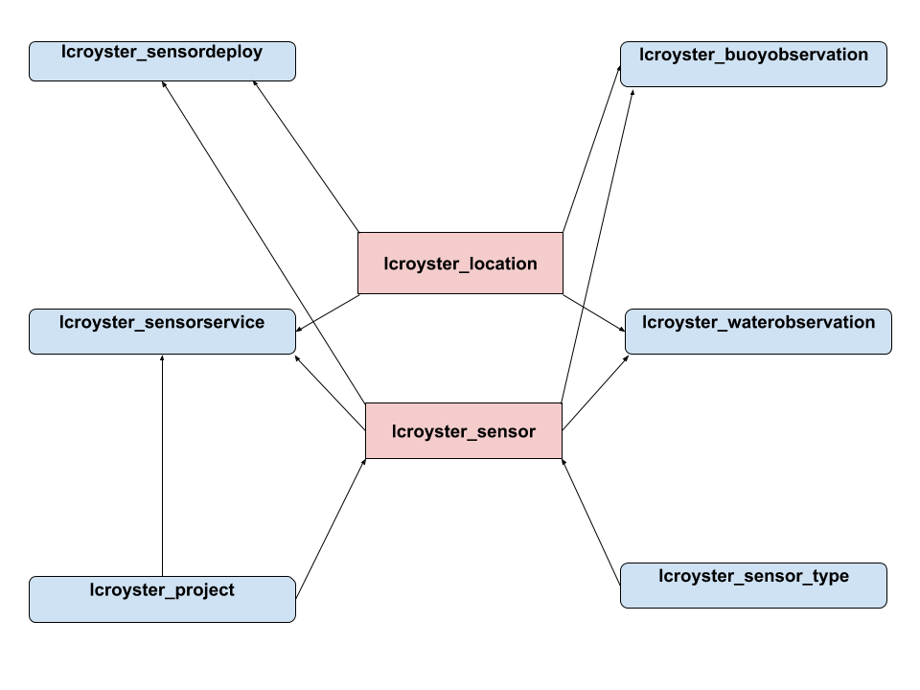
The Solution
Dedicated username and password controls to maintain access to the MySQL database to track access and database changes.
Store water quality data in specific tables where the sensor serial number and location must be predefined before importing the sensor observations.
These pre-definitions allow us to track which sensors are in which location at a specific time.

Slide 4
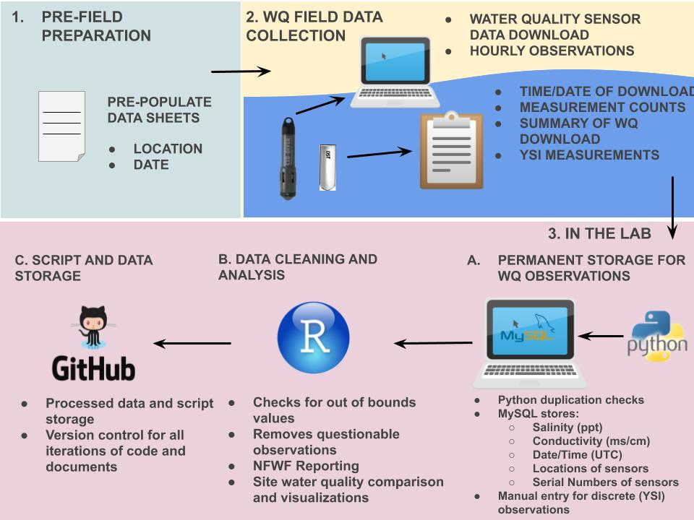
The
Workflow

Slide 5
The Conclusion
Work with your PIs, team members, and specialists to come up with the best way to manage ecological data, prior to collection.
Create, document, and train members on using the workflow.
Communicate with the team with updates or problems with workflow. Communication is key!

