Slide 1
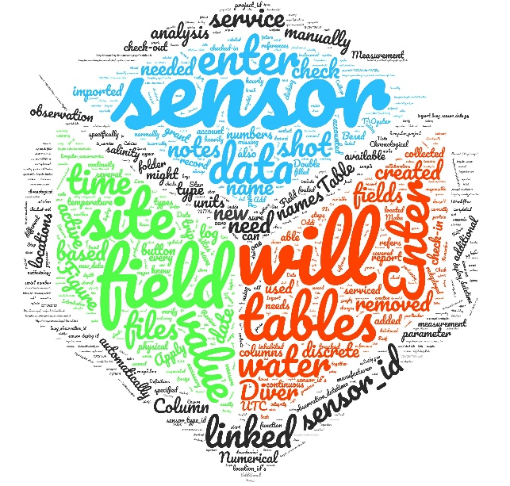

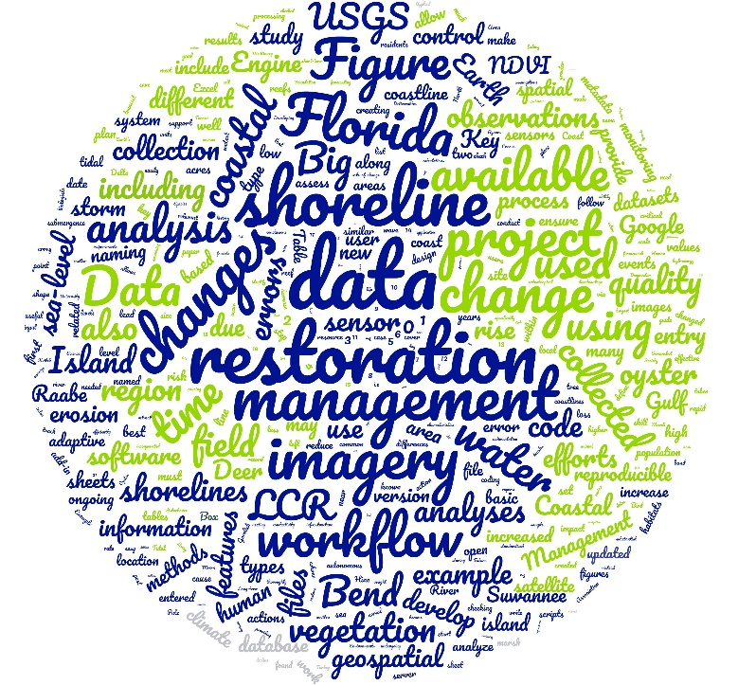

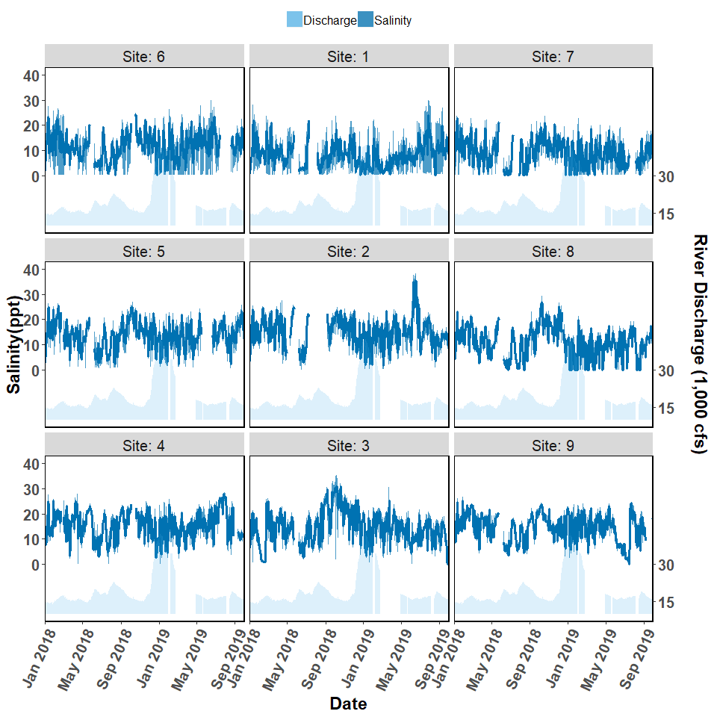
What is Mel up to?
Project Responsibilities
Workflow Thesis,
expanding into Geospatial analysis
TA Responsibilities

