Slide 1
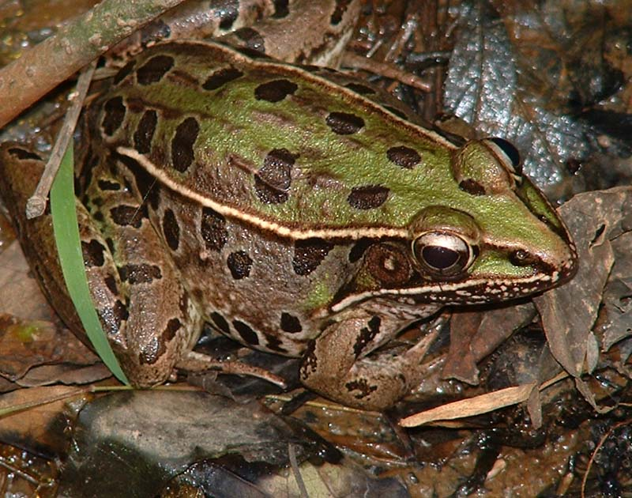
Atrazine and Leopard Frogs
Grant Proposal
Himanshu Rambhai | Melissa Moreno | Colleen davoli

Slide 2
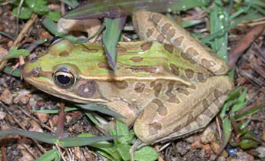
Introduction
Atrazine is one of the most widely used pesticides in the world
Rain can cause runoff that contaminates far away areas
Atrazine is known to be a potent endocrine disruptor
Most commonly absorbed through the skin of amphibians
Causes feminization of males
Frogs don’t migrate

Slide 3
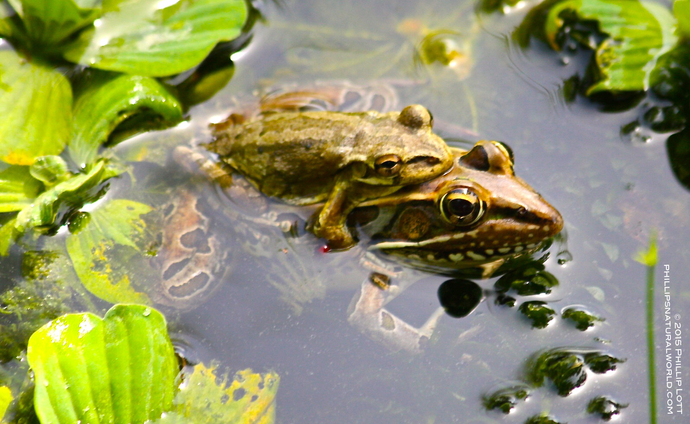
Study System
Florida Leopard Frog
Found near brackish waters of ponds or estuaries
Breed during the winter, and spring
Mid-Size frog with key features
Eats insects, crayfish, and other aquatic vertebrates
Assume that gradual atrazine exposure will accelerate natural selection

Slide 4
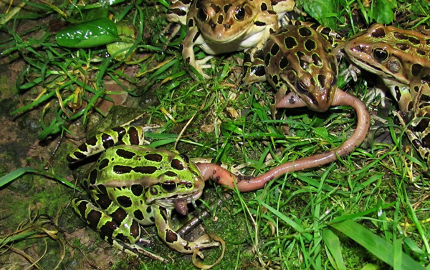
Study System
Ultimately determine at what concentration of atrazine do the negative effects manifest
Great number of sugar cane farms in Florida
Will the Florida Leopard Frog adapt to higher concentrations?
What will happen to other aquatic wildlife?

Slide 5
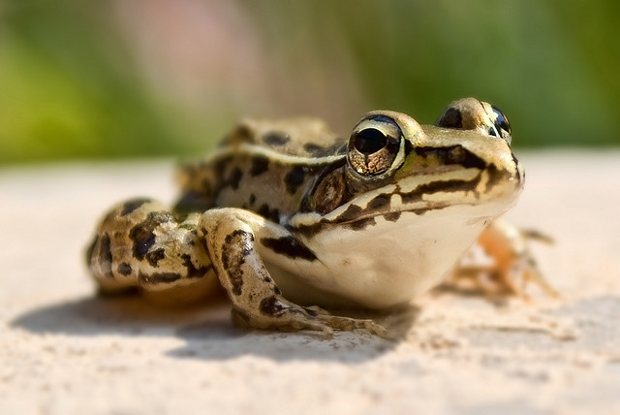
Experiment
10 Year period
3 controlled experiments
Monitoring: atrazine levels, birth rates, survival rates, growth patterns, reproductive success, and genome sequencing
Capture wild Florida leopard frogs exposed to low levels of atrazine
Breed atrazine free frogs for experiment
Enclose organisms to prevent predation from happening

Slide 6
Experiment
3 groups: Control, slow gradient, fast gradient
Control positioned at high point of hill
Slow gradient is lower
Fast gradient is lowest
Atrazine levels tested using standard analytical chemistry
Birthrates, survival rates, growth patterns, and reproductive success monitored physically
Genome sequencing using PCR and NCBI sequence comparisons

Slide 7
1.
2.
3.
1. Control | 2. Slow Gradient | 3. Fast Gradient

Slide 8
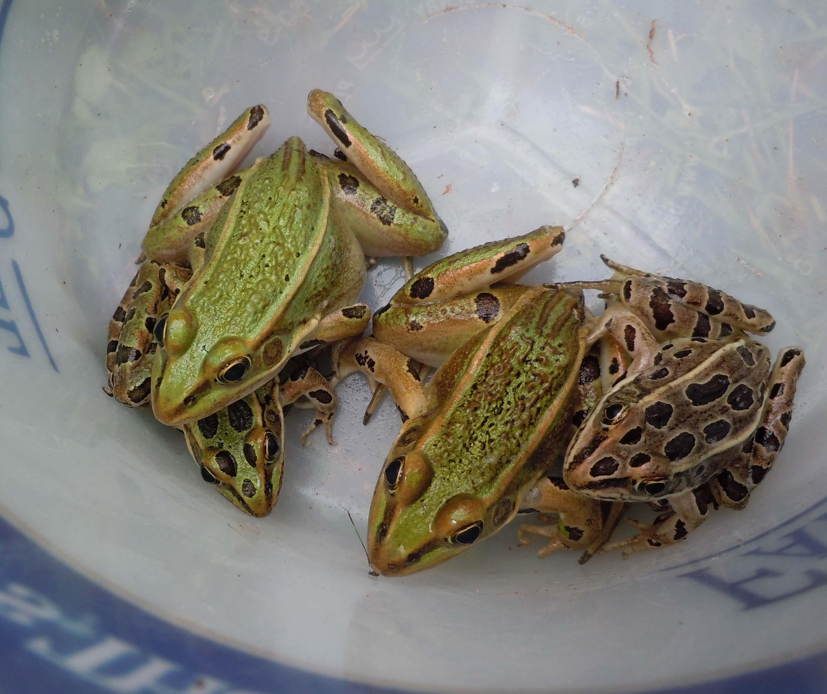
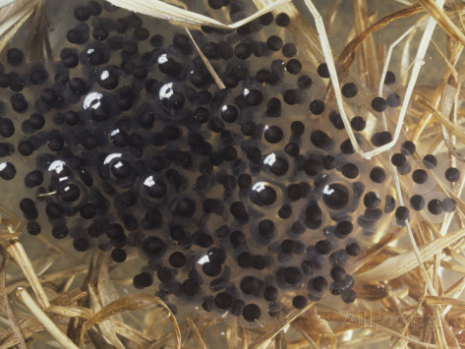
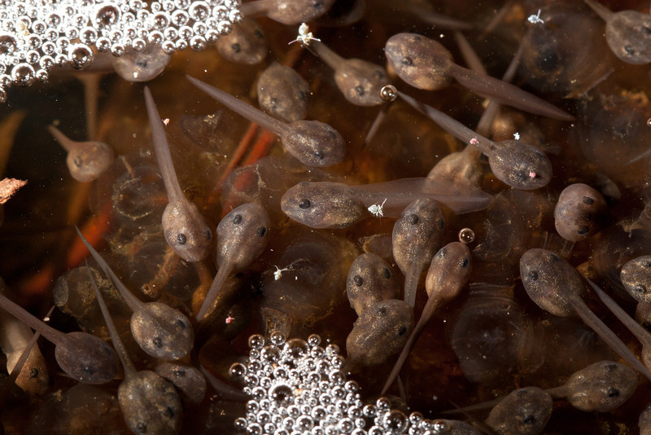
Experiment - Results
Frogs with a higher atrazine tolerance occurring due to mutations in genes
Or death of our entire frog population

Slide 9
Works Cited
Bridges, C.M. Long-term effects of pesticide exposure at various life stages of the southern leopard frog (Rana sphenocephala) (Archives of Environmental Contamination & Toxicology, Vol. 39: 91-96, 2000)
Du Preez, L. H., Kunene, N., Everson, G. J., Carr, J. A., Giesy, J. P., Gross, T. S., … Van Der Kraak, G. J. (2008). Reproduction, larval growth, and reproductive development in African clawed frogs (Xenopus laevis) exposed to atrazine. Chemosphere, 71(3), 546–552. http://doi.org/10.1016/j.chemosphere.2007.09.051
Hayes, T. B., Anderson, L. L., Beasley, V. R., de Solla, S. R., Iguchi, T., Ingraham, H., … Willingham, E. (2011). Demasculinization and feminization of male gonads by atrazine: Consistent effects across vertebrate classes. The Journal of Steroid Biochemistry and Molecular Biology, 127(1), 64–73. http://doi.org/10.1016/j.jsbmb.2011.03.015
Oka, T., Tooi, O., Mitsui, N., Miyahara, M., Ohnishi, Y., Takase, M., … Iguchi, T. (2008). Effect of atrazine on metamorphosis and sexual differentiation in Xenopus laevis. Aquatic Toxicology, 87(4), 215–226. http://doi.org/10.1016/j.aquatox.2008.02.009
Hayes, T. B., et al. (2010). "Atrazine induces complete feminization and chemical
castration in male African clawed frogs (Xenopus laevis)." Proceedings of the National Academy of Sciences 107(10): 4612-4617.
Lim S, Ahn SY, Song IC, Chung MH, Jang HC, Park KS, et al. (2009) Chronic Exposure to the Herbicide, Atrazine, Causes Mitochondrial Dysfunction and Insulin Resistance. PLoS ONE 4(4): e5186. doi:10.1371/journal.pone.0005186
Nwani, C. D., et al. (2010). "Toxicity of the Herbicide Atrazine: Effects on Lipid Peroxidation and Activities of Antioxidant Enzymes in the Freshwater Fish Channa Punctatus (Bloch)." International Journal of Environmental Research and Public Health 7(8): 3298.
Houck, A. and S. K. Sessions (2006). "Research Article: Could atrazine affect the immune system of the frog, Rana pipiens?" BIOS 77(4): 107-112.

Slide 10
Works Cited
Kloas, W., et al. (2009). "Does Atrazine Influence Larval Development and Sexual Differentiation in Xenopus laevis?" Toxicological Sciences 107(2): 376-384.
Katagi, T. and K. Ose (2014). "Bioconcentration and metabolism of pesticides
and industrial chemicals in the frog." Journal of Pesticide Science 39(2): 55-68.
Hanlon, S. M. and R. Relyea (2013). "Sublethal Effects of Pesticides on Predator–Prey Interactions in Amphibians." Copeia 2013(4): 691-698.
Boone, M.D and James S.M, (2003). “ Interactions of an insecticide, herbicide, and natural stressors in amphibian community mesocosms,” Ecological Applications 13 (3); 829-841
Gendron, A.D and Marcogliese, D.J (2003). “ Exposure of leopard frogs to a pesticide mixture affects life history characteristics of the lungwoem Rhabdias ranae.” Conservation Ecology 135 (3): 469-476
McDaniel, T.V and Martin, P.A (2008), “Potential endocrine disruption of sexual development in free ranging male northern leopard frogs (Rana pipiens) and green frogs (Rana clamitans) from areas of intensive row crop agriculture.” Aquatic Toxicology 88 (4): 230-242
Boone, M.D (2005). “Juvenile frogs compensate for small metamorph size with terrestrial growth: Overcoming the effects of larval density and insecticide exposure.” Journal of Herpetology 39(3): 416-423
Janet Koprivnikar, Mark R. Forbes, and Robert L. Baker (2006) “EFFECTS OF ATRAZINE ON CERCARIAL LONGEVITY, ACTIVITY, AND INFECTIVITY.” Journal of Parasitology: 92(2): 306-311.

