Slide 1
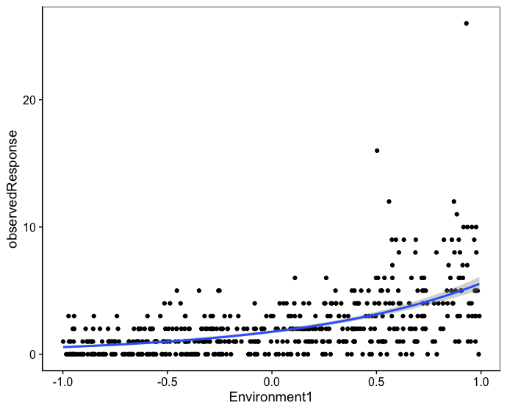
Poisson variance
Extra-Poisson variance (heteroscedasticity)

