Slide 1
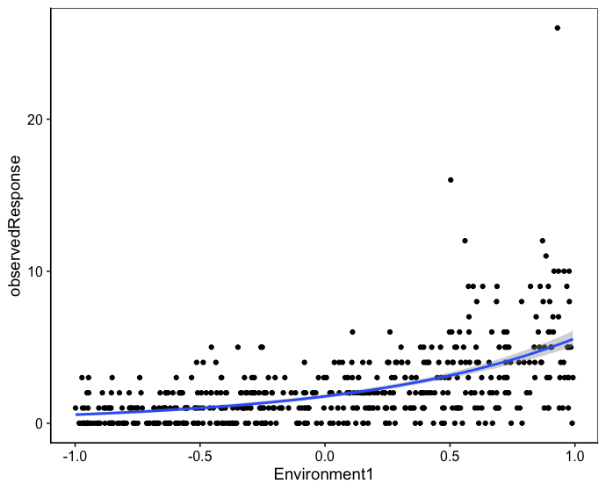
Poisson variance
Extra-Poisson variance – increases with Environment

Slide 2
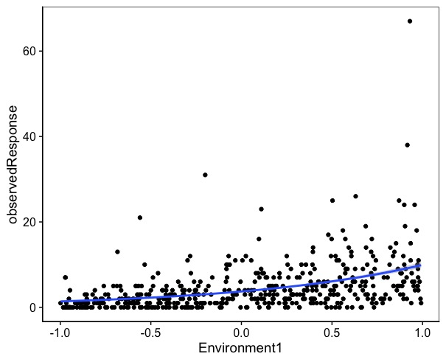
Poisson variance
Extra-Poisson variance

Slide 4
