Slide 1
Project 4: Machine Learning
Melina Hernandez-Estrada, Andrew Jessberger, Derrick Ngeyen, Patrick Karey

Slide 2
Problem
Predicting homeownership
Less common than previous generations
Is it possible to predict ownership given certain financial and demographic info

Slide 3
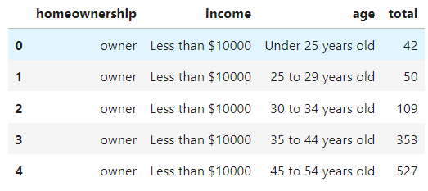
Dataset Information
Features:
Age
Income
Total sales
Target
Ownership

Slide 4
Results​

Slide 5
takeaways​

Slide 6
Issues faced
Difficult to find sufficient data, especially ownership
Large variety of influential factors presented challenge selecting features
Conversion from categorical to integer potentially compromises

Slide 7
Resources

Slide 8
THANK YOU

