Slide 1
Project 4: Machine Learning
Melina Hernandez-Estrada, Andrew Jessberger, Derrick Ngeyen, Patrick Karey

Slide 2
Problem
Predicting homeownership
Less common than previous generations
Is it possible to predict ownership given certain financial and demographic info

Slide 3
Preprocessing
Data collected from US Census Bureau
Years 2011-2021
Combined tables in SQL for final dataset
Tested data without renters
Converted categorical columns to integer reducing number of features

Slide 4
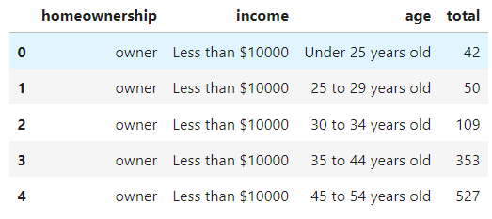
Dataset Information
Features:
Age
Income
Total sales
Target:
Ownership

Slide 5
Results​
Despite attempts at optimization accuracy score did not reach desired threshold
As years progressed, fewer homeowners across all age groups
Assumption is due to high inflation rates

Slide 6
takeaways​
Initial concerns about problem were confirmed
Very difficult metric to predict
More comprehensive statistical reports would make for easier predictions
Unfortunately not feasible due to information privacy and vast number of lenders
Results indicate politicians should take measures to make housing more affordable

Slide 7
Issues faced
Difficult to find sufficient data, especially ownership
Abundance of financial data (region, age group, demographic, etc.)
Large variety of influential factors presented challenge selecting features
Conversion from categorical to integer potentially compromises accuracy

Slide 8
Resources
https://www.census.gov/programs-surveys/ahs/data/interactive/ahstablecreator.html

Slide 9
THANK YOU

