Slide 1




Pearl (study)
flint
flint
Pearl (Match)

Slide 2




emerald
Emerald (match)
Jade
Jade
Notes:
Oddball_emerald_0938

Slide 3




sapphire
sapphire
tin
tin

Slide 4
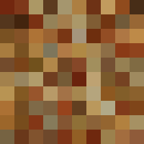
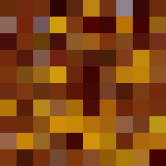
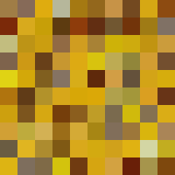
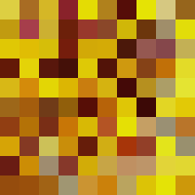
gelatin
Sandstone (oddball)

Slide 5



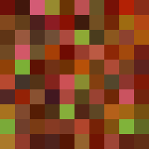
playdough
This one is super easy
Cobalt (oddball)

Slide 6




quartzite
shell

Slide 7

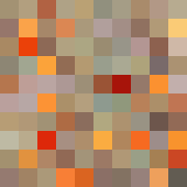


plastic
Emerald (oddball)

