Slide 1


Slide 2


Slide 3
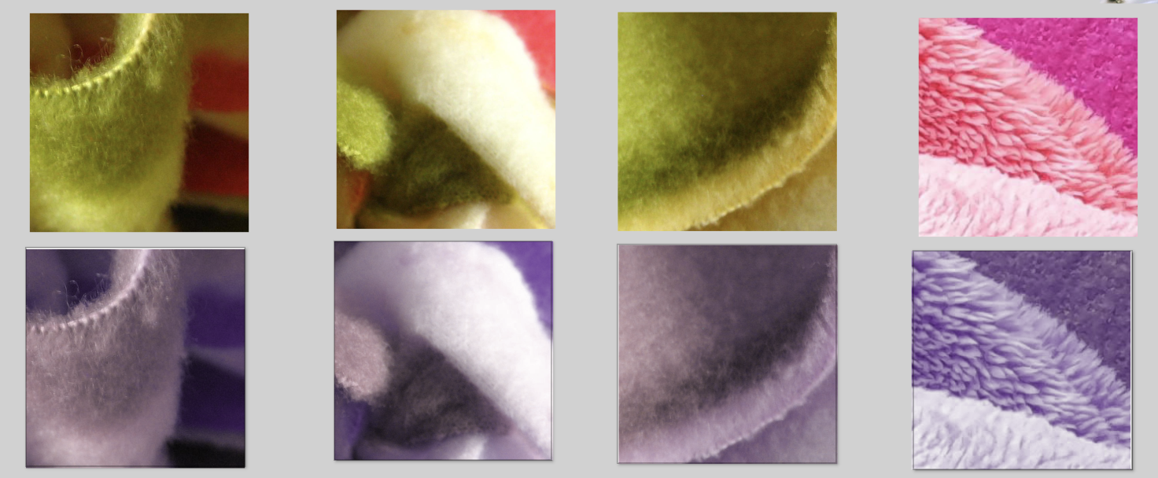


Slide 4



---

Slide 5
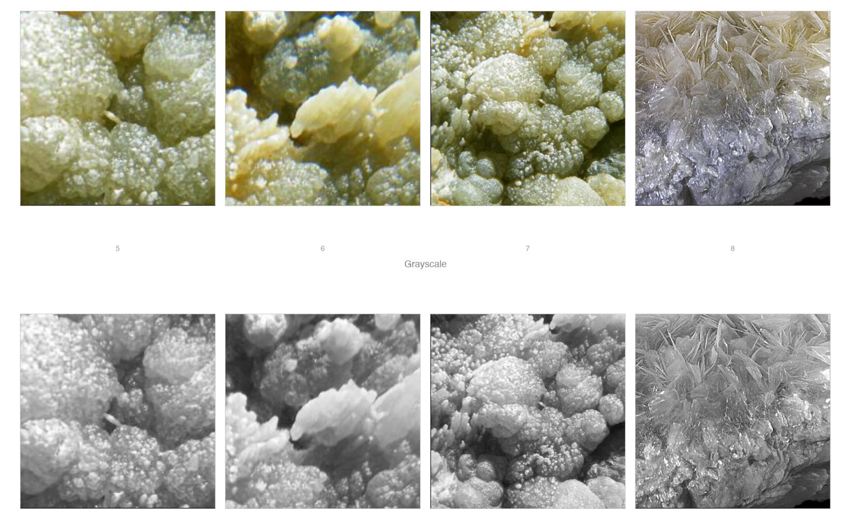

Slide 6

Notes:
Yellow-blue: duochrome

