Slide 1

Crime in the U.S.
Population density versus crime rates
Project Team:
Melinda Eudy
Cameron Farquhar
Markita Francis
Luis Rojas
Kelly Rose

Slide 2





overview
Project description
Conclusion
Data sources & data cleaning
Q&A
Analysis

Slide 3

Project description

Slide 4

Our hypothesis: Crime rates in the U.S. increase as population densities increase.
Research questions:
1) Which types of crimes are most prevalent based on population density?
2) Is there a correlation between population density and the following types of crimes?
Murder
Aggravated Assault
Rape
Larceny
Burglary
Vehicle Theft
Arson
Vehicle Robbery
3) Are there any trends regarding demographics and crime rates?

Slide 5

Data sources & data cleaning

Slide 6
Data sources:
Census.gov API (2017) – median income, population and density per US County
FBI Uniform Crime Report for 2017 API – crimes
FBI Uniform Crime Codebook (.csv)
FBI Crime Database API – age of offender and total crimes by county, latitude and longitude
Bureau of Justice Statistics – crime data *didn’t use
Data merge and clean:
Started with FBI UCR crime report: removed unneeded columns
Merged State and County Columns together
Merged FBI Crime UCR crime report with Codebook for County names
Census.gov API merged into the FBI Crime UCR by County
-----> Backed up after discovering our data was for a month and NOT the entire year
Merged FBI Age of offender and total crimes by county
Rearranged columns and column names to make the table more readable
Exported to csv file for work on charting

Slide 7
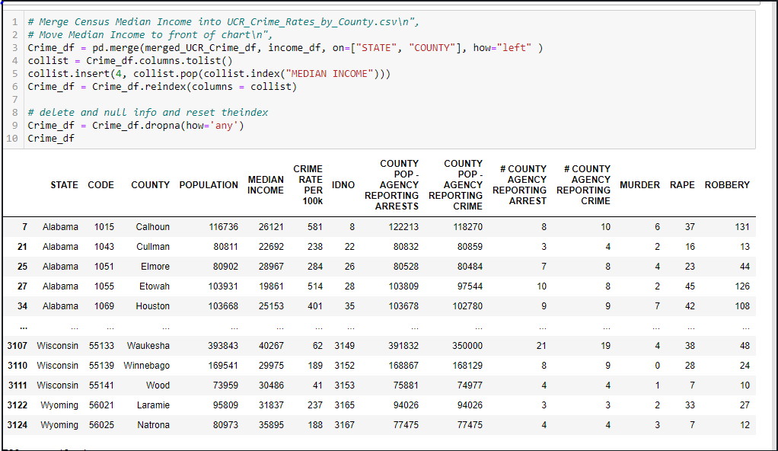
Merging of the Data Sources

Slide 8
Analysis

Slide 9

Analysis
We modeled the relationship between a dependent response -to be predicted-, and one or more explanatory/independent variables.
In our case the response variable is the number of crimes committed in 2017.
The explanatory variables are population density, offender age and median income of counties.
Steps:
Display general charts
Display categorical and numerical scatter plots
Look for trends

Slide 10
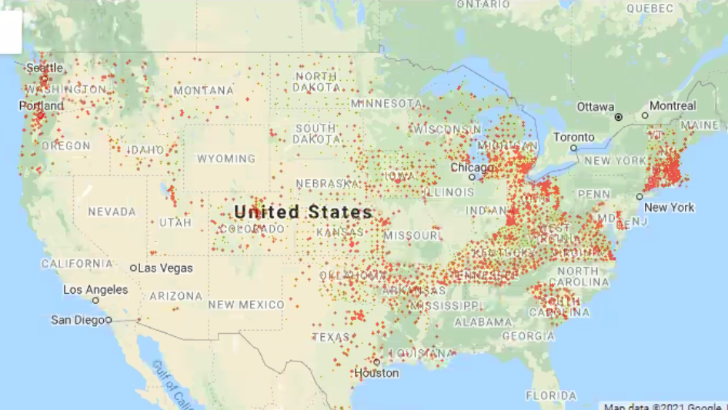
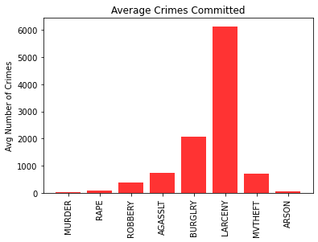
Which types of crimes are most prevalent based on population density?
Research question #1

Slide 11
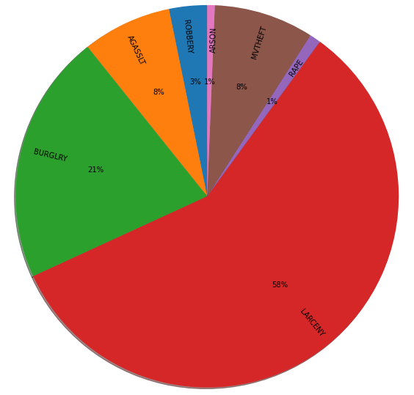
Which types of crimes are most prevalent based on population density?
Research question #1

Slide 12

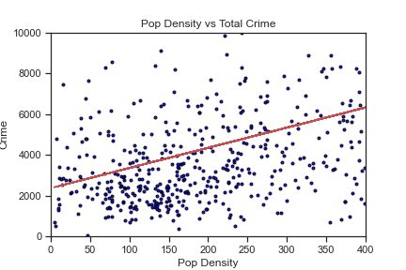
Is there a correlation between population density and the following types of crimes?
Research question #2
Violent crime
Property crime
Correlation coefficient: 0.54

Slide 13
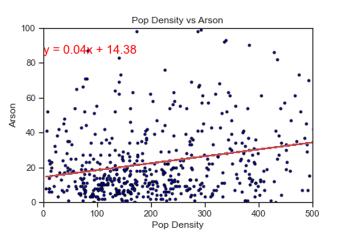
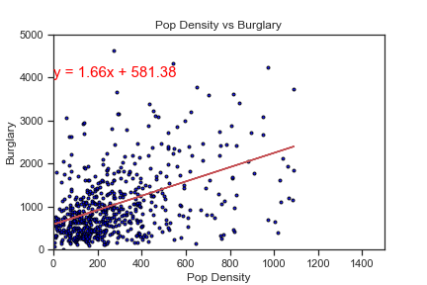
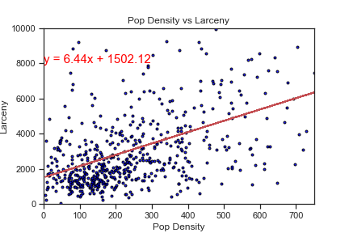
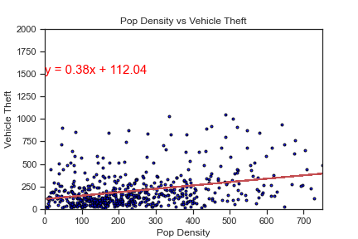
Property Crimes
Correlation Coefficients Arson : 0.38 Burglary : 0.42 Larceny : 0.55 Vehicle Theft : 0.41

Slide 14
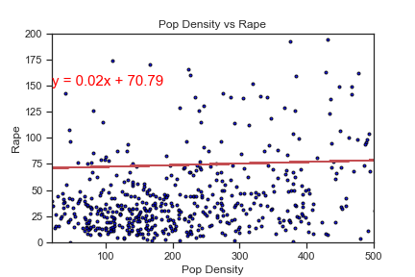
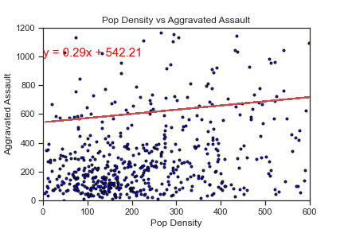
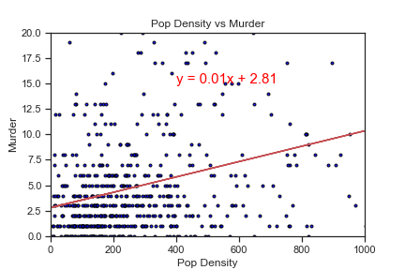
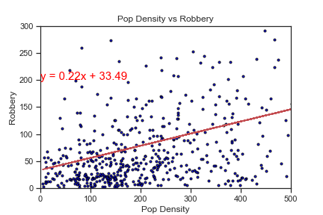
Violent crimes
Correlation Coefficients Aggravated Assault : 0.45 Rape: 0.3 Robbery: 0.45 Murder: 0.32

Slide 15
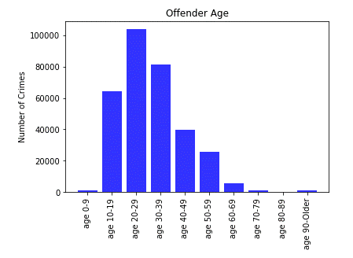
Are there any trends regarding demographics and crime rates?
Research question #3

Slide 16
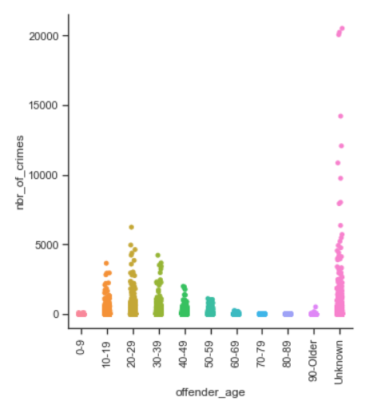
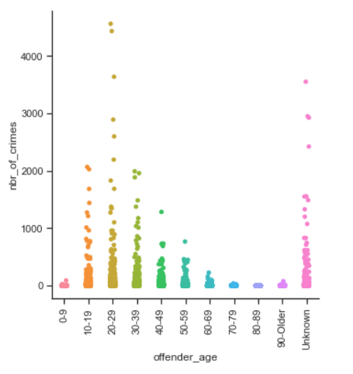
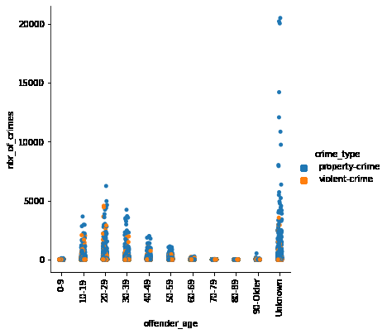
Non-Violent by Age
Violent by Age
Violent & Non-Violent by Age

Slide 17
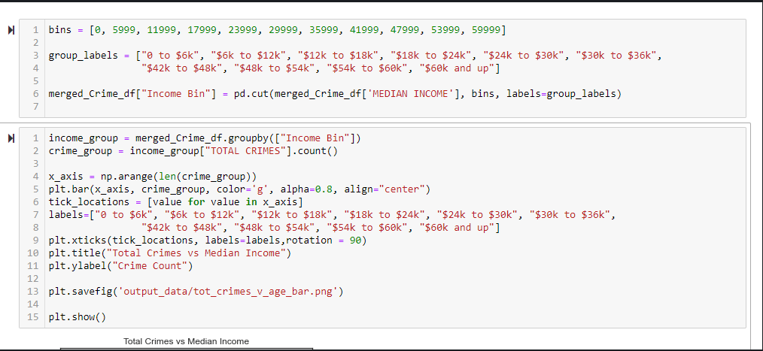
Are there any trends regarding demographics and crime rates?
Research question #3

Slide 18
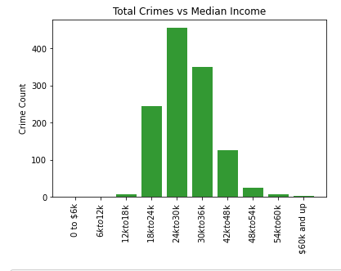
Are there any trends regarding demographics and crime rates?
Research question #3
The average amount of crimes committed in the top 5 richest counties in the U.S. was 7194.8, the national average was 10187.26

Slide 19
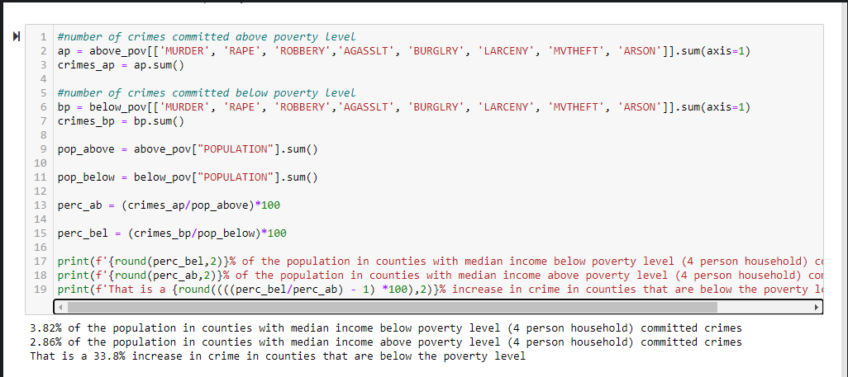

Slide 20
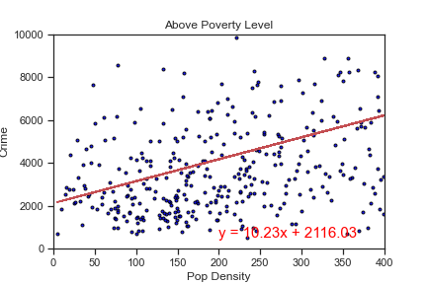
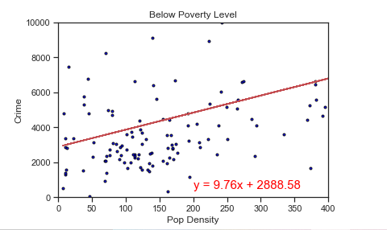
Correlation coefficient: 0.56
Correlation coefficient: 0.43

Slide 21
Conclusion

Slide 22
In conclusion…
Limitations
Data for the years of 2019-2020 incomplete, likely due to COVID-19. Used 2017-2018 as our sample set instead.
No shortage of data on this subject! Narrowing down the best reputable sources presented its challenges.
We are able to conclude that there is indeed a moderate correlation between crime rate escalation in areas that are more densely populated.
The majority of crimes in these areas are non-violent.
Most offenders are young, ranging from ages 20-39.
Remaining Questions?…

Slide 23
In conclusion…
If given more time what also might we find?
Are there any trends showing that specific crimes spike at certain times of the year? Holidays for instance? Nicer weather?
Do most victims of crimes know their offender or are most random?
Which crimes are most prevalent based on other demographic factors? i.e. Education in the county? Are these repeat offenders? first time offenders?
We would be able to include latitude, race, sex and ethnicity in the analysis
Using Time as a variable would have allowed us to identify more trends and make more predictions.

Slide 24
Q&A

