Slide 1
CDC R Workshop Day 1
Melinda Higgins, PhD

Slide 2
Workshop Layout
Workshop website
https://melindahiggins2000.github.io/CDC_RWorkshop_29_30july2020/
Github Repository
https://github.com/melindahiggins2000/CDCjuly2020
Rstudio.cloud https://rstudio.cloud/spaces/36397/join?access_code=sVkAKq5o45zIeUMI2EhDJps3PgY5NF28X5UELrOf

Slide 3
Rstudio.cloud
Go to https://rstudio.cloud/spaces/36397/join?access_code=sVkAKq5o45zIeUMI2EhDJps3PgY5NF28X5UELrOf

Slide 4
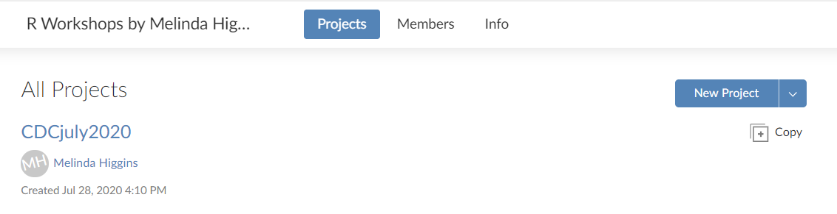
Rstudio.cloud
Click on project link

Slide 5
Rstudio.cloud

Slide 6
SAS
Components

Slide 7
SAS
Components
+
WORK Library

Slide 8
SAS
R
Components
Packages
+
WORK Library

Slide 9
SAS
R
Components
Packages
+
+
WORK Library
Global Environment

Slide 10
SAS
R
Components
Packages
+
+
WORK Library
Global Environment

Slide 11
SAS
R
Components
Packages
+
+
WORK Library
Global Environment

Slide 13
SAS
PROC SETINIT
PROC PRODUCT_STATUS
R
sessionInfo()
library()

Slide 14
SAS
PROC DATASETS
R
ls()

Slide 15
SAS
LIBNAME
DATA + SET
R
load()

Slide 16
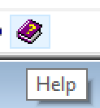
SAS
R
help()

Slide 18
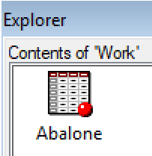
WORK Library
SAS
proc import datafile=‘abalone.csv'
out=abalone dbms=csv;
run;
R
library(readr)
abalone <-
readr::read_csv("abalone.csv")
Global Environment
> ls()
[1] "abalone"

Slide 19
WORK Library
SAS
proc import datafile=‘abalone.csv'
out=abalone dbms=csv;
run;
R
library(readr)
abalone <-
readr::read_csv("abalone.csv")
Global Environment
> ls()
[1] "abalone"

Slide 20
WORK Library
SAS
proc import datafile=‘abalone.csv'
out=abalone dbms=csv;
run;
R
library(readr)
abalone <-
readr::read_csv("abalone.csv")
Global Environment
> ls()
[1] "abalone"

Slide 21
WORK Library
SAS
proc import datafile=‘abalone.csv'
out=abalone dbms=csv;
run;
R
library(readr)
abalone <-
readr::read_csv("abalone.csv")
Global Environment
> ls()
[1] "abalone"

Slide 22
SAS
proc contents data=abalone;
run;
R
dim(abalone)
names(abalone)

Slide 23
SAS
proc contents data=abalone;
run;
R
str(abalone)

Slide 25
R
arrange(abalone, diameter)
abalone %>% arrange(diameter)

Slide 26
R
arrange(abalone, diameter)
abalone %>% arrange(diameter)

Slide 27
R
arrange(abalone, diameter)
abalone %>% arrange(diameter)

Slide 28
R
arrange(abalone, diameter)
abalone %>% arrange(diameter)
Load data → then → arrange it by variable

Slide 30
10 sec
0:10
0:09
0:08
0:07
0:06
0:05
0:04
0:03
0:02
0:01
0:00

Slide 31
0:00
0:01
0:02
0:03
0:04
0:05
0:06
0:07
0:08
0:09
0:10
STOP

Slide 32
10 sec slide
STOP

Slide 33
1 min
1:00
0:55
0:50
0:45
0:40
0:35
0:30
0:25
0:20
0:15
0:10
0:05
0:00

Slide 34
5 min
5:00
4:30
4:00
3:30
3:00
2:30
2:00
1:00
0:50
0:40
0:30
0:20
0:10
0:00

