Slide 1


Reproducibility with the Rmarkdown/Knitr Ecosystem
Melinda Higgins, PhD; Emory University, Professor
Dated 25 March 2021

Slide 2
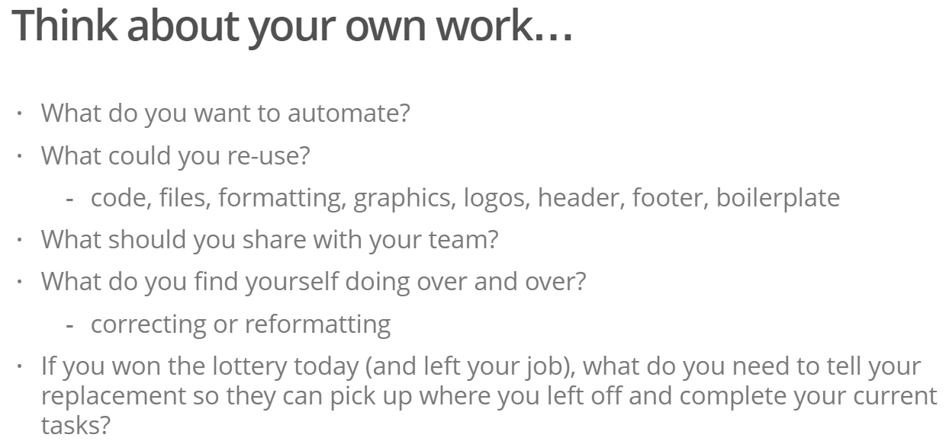

Slide 3
The big picture
text
data
Manuscript
Report
Slides
Website
Dashboard
Book
code
figures
tables

Slide 4
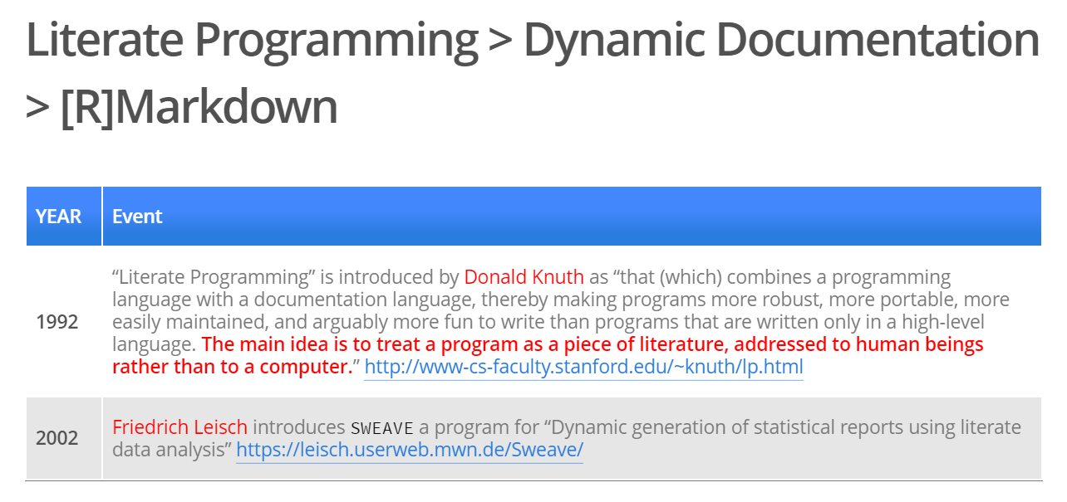
A (Brief) History of Literate programming

Slide 5
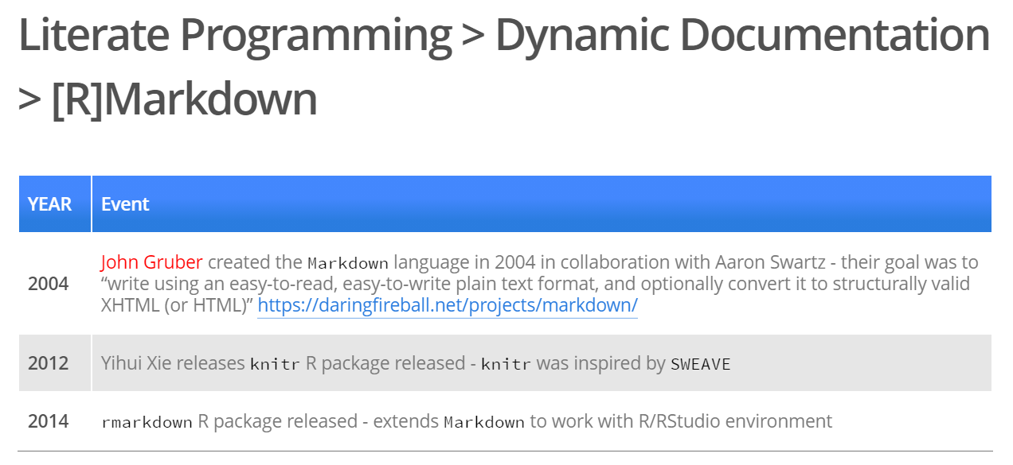

Slide 6
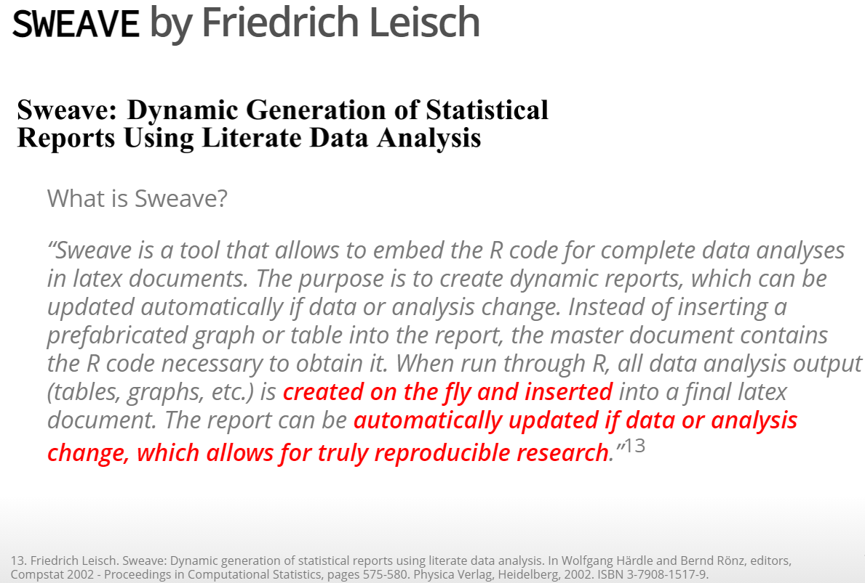

Slide 7
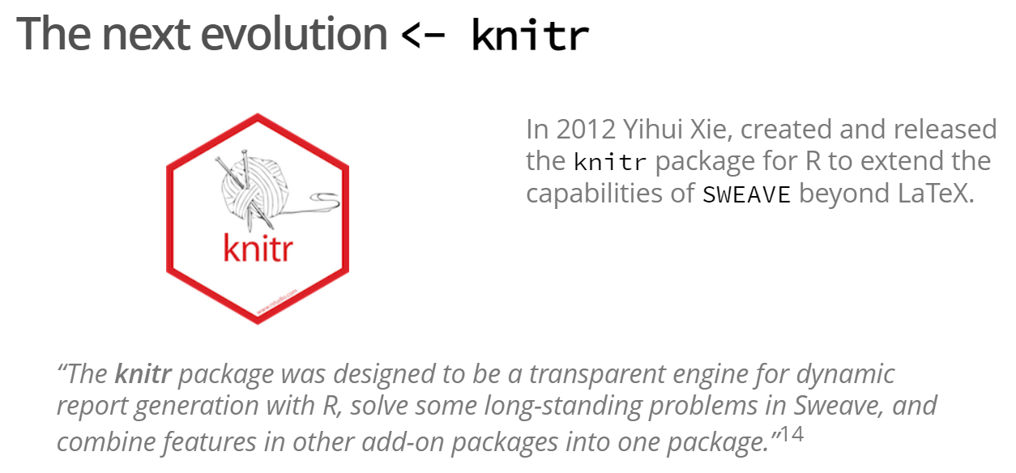
14: https://yihui.org/knitr/

Slide 8
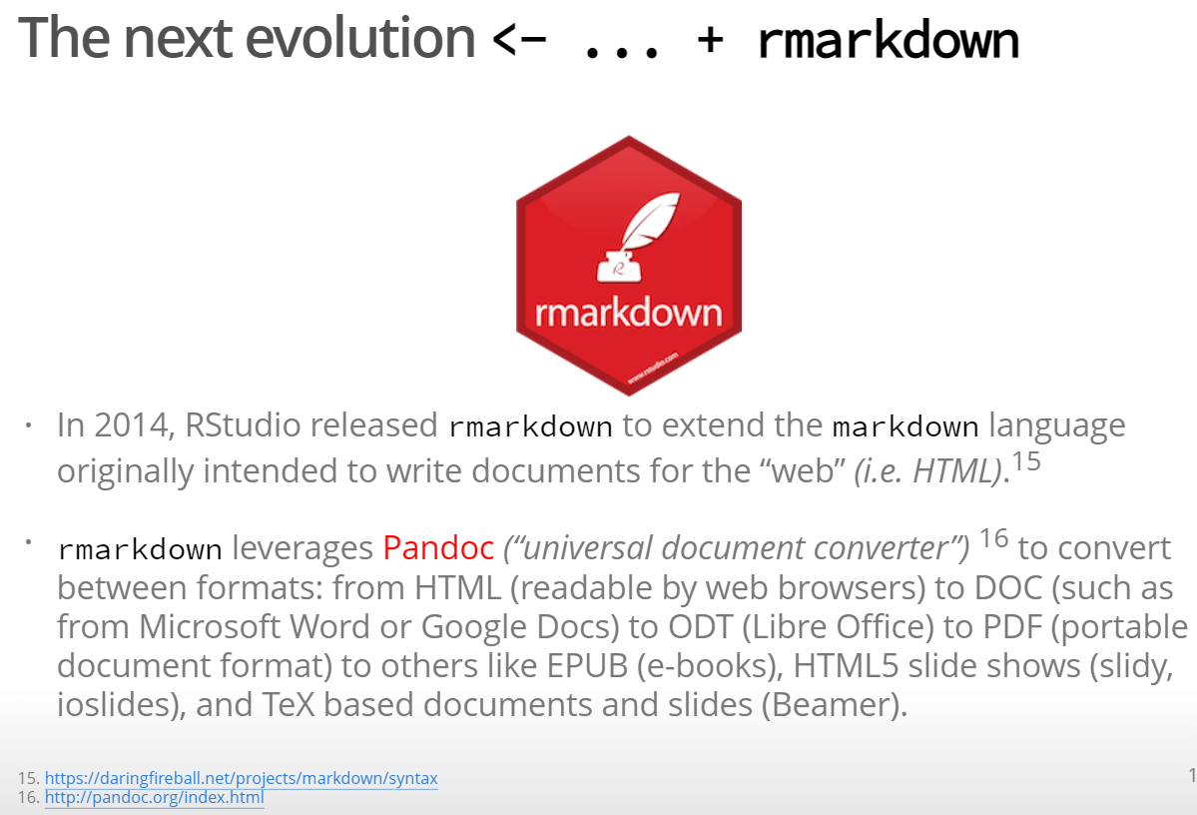

Slide 9
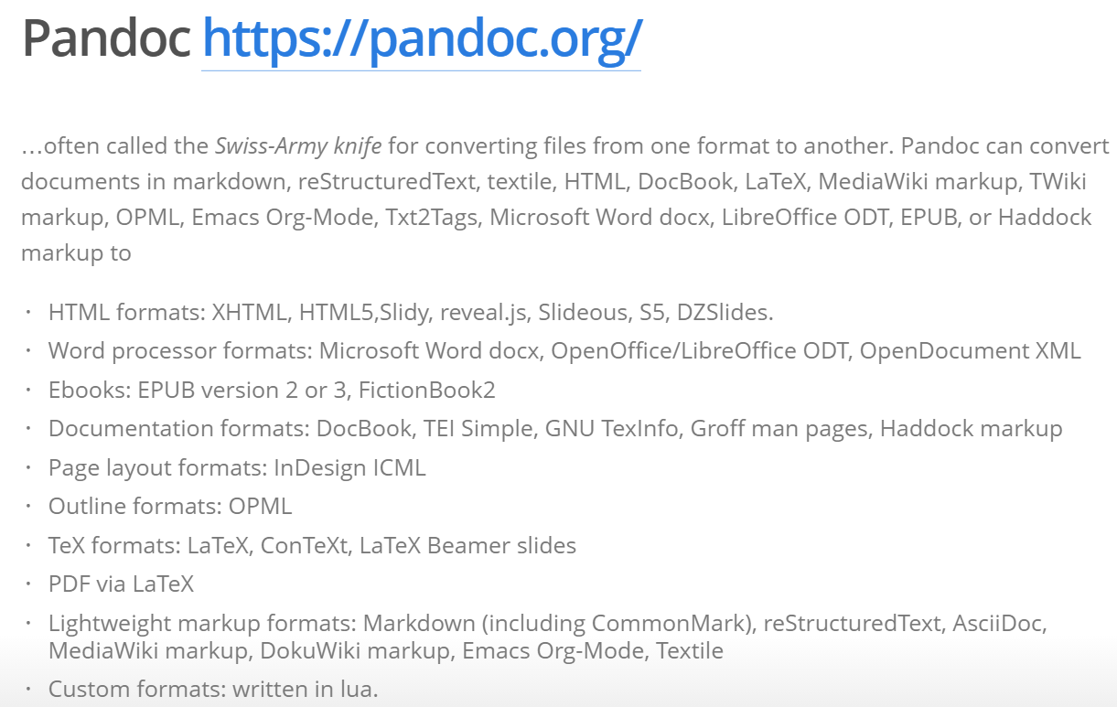

Slide 10
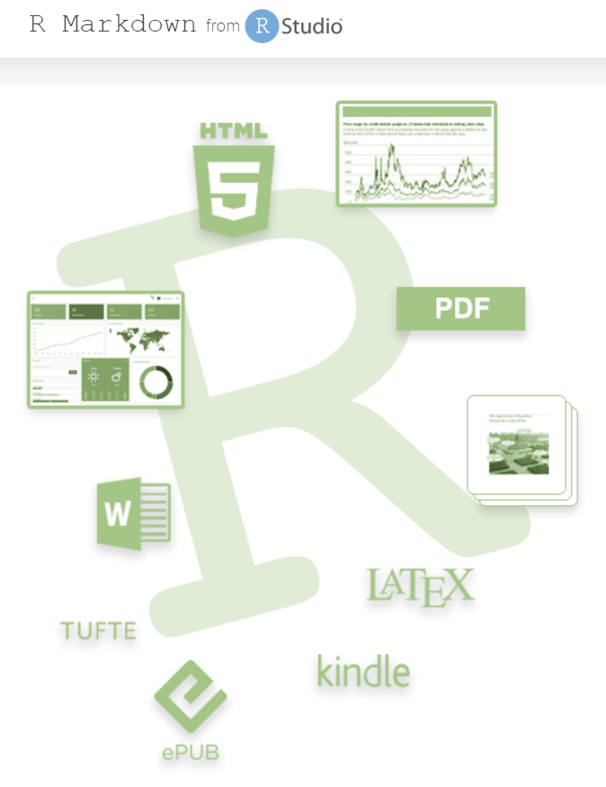
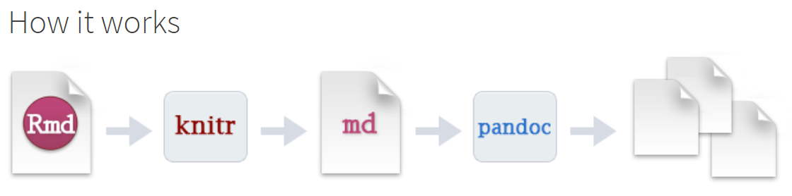
Rmarkdown (+ pandoc)
https://rmarkdown.rstudio.com/

Slide 11
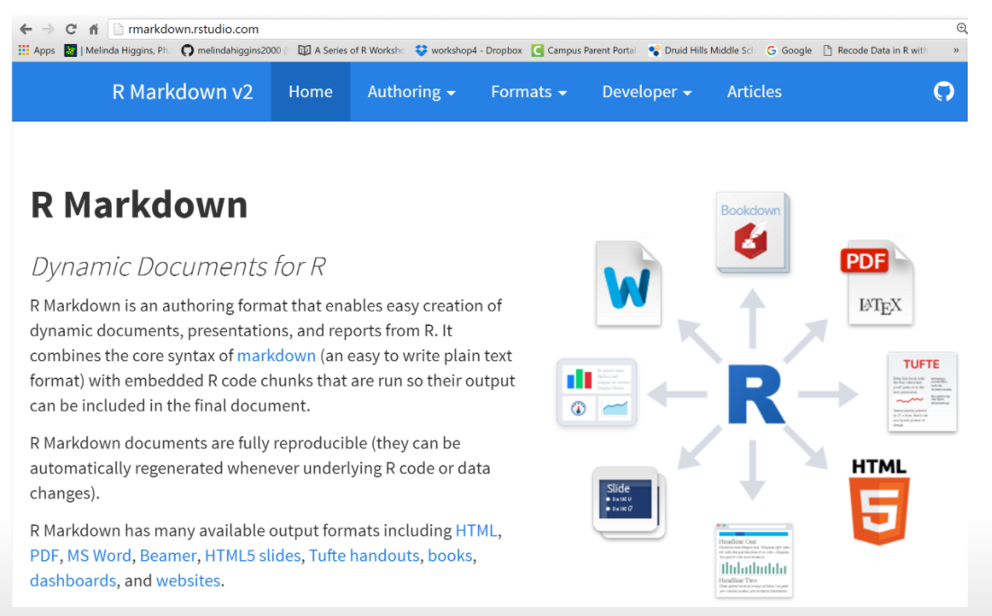
Rmarkdown “hub”

Slide 12
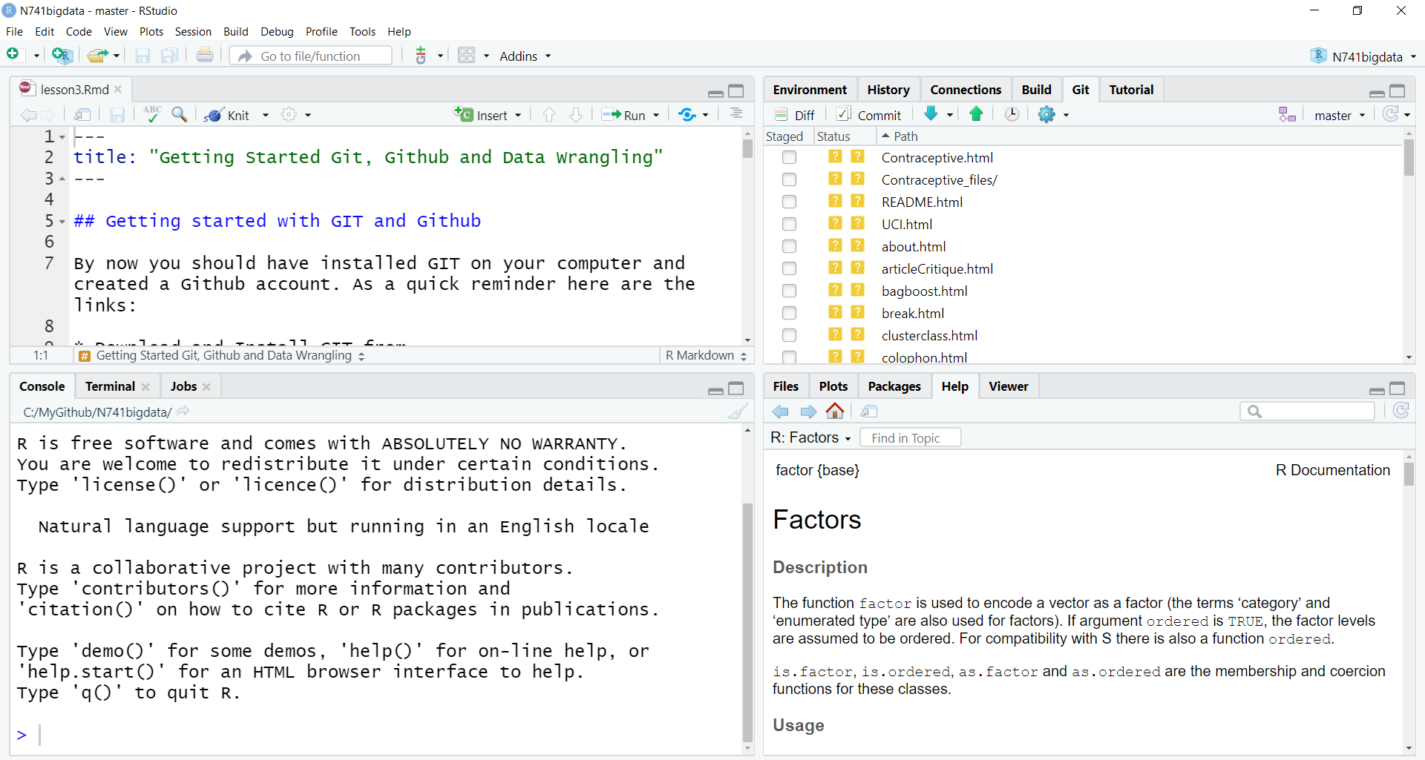
THE RSTUDIO IDE
R Scripts, RMD, …
Environment
History, GIT, …
CONSOLE
Files, Plots, Packages, Help, Other Output
Notes:
This is a snapshot of the Rstudio interface. Think of the IDE as the interface to manage everything you may want to do with the data, code, output and associated files and management of these for any given analysis project. There is a console window (bottom left) which has the command line for typing in commands one by one and viewing messages and output. At the top left – this is typically where files are created and viewed such R code scripts, Rmarkdown files, viewing data and more. The top right shows the current environment with data and other objects in memory, code history, Git version control tracking and other project management options. The bottom right shows the project files directory, the help window and more.

Slide 13
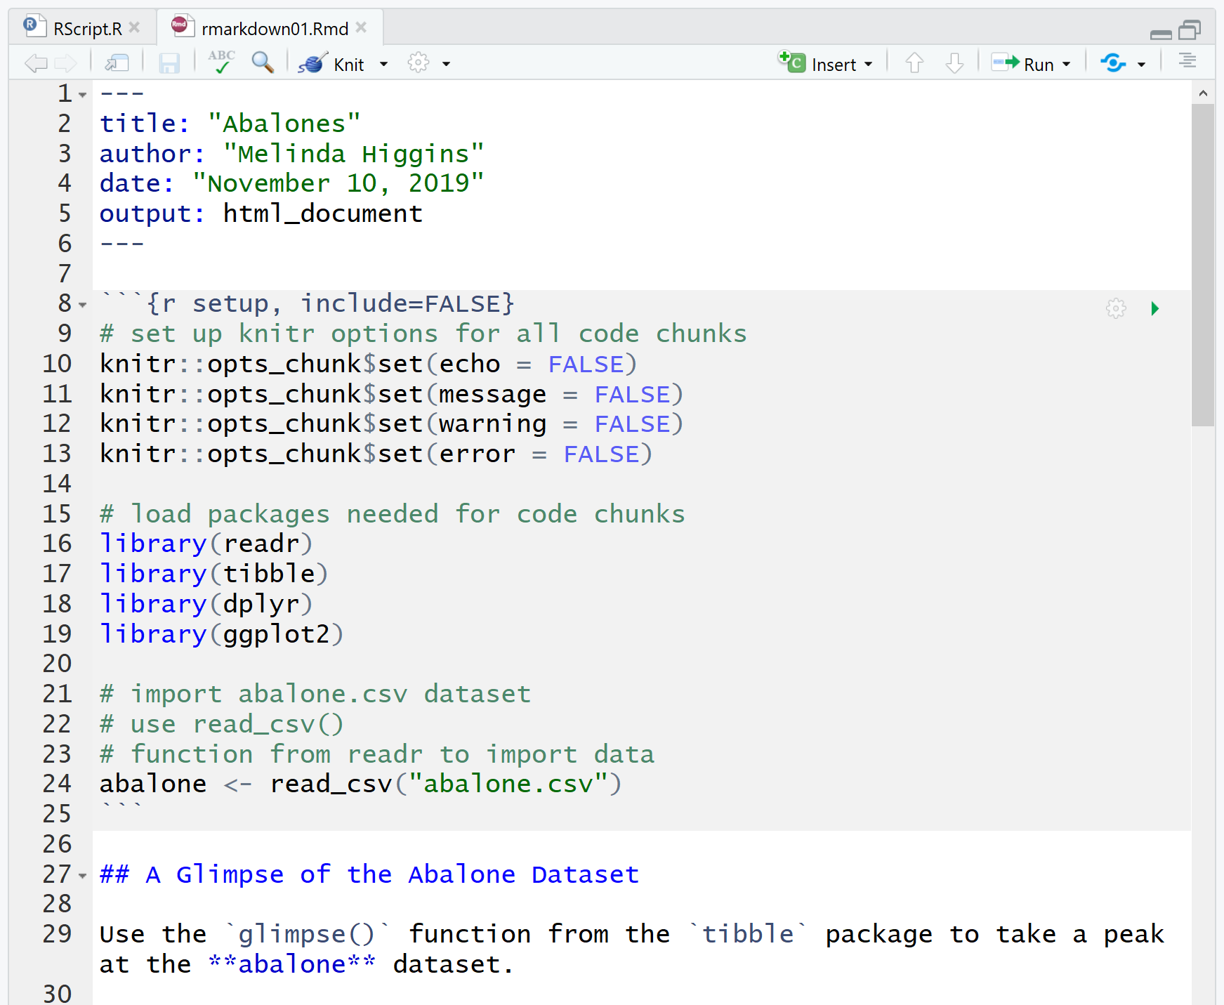
Rmarkdown
YAML
R CODE
CHUNK
“Marked” up text

Slide 14
Demos

Slide 15
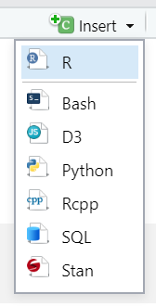
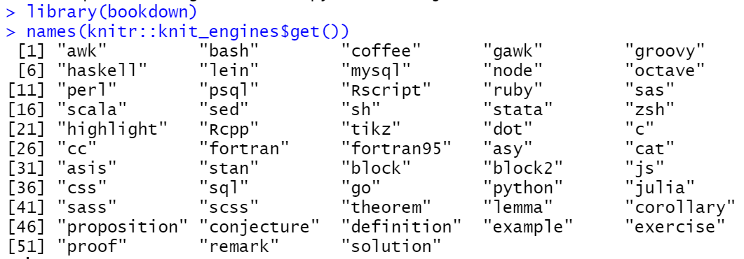
Not just for R anymore…

Slide 16
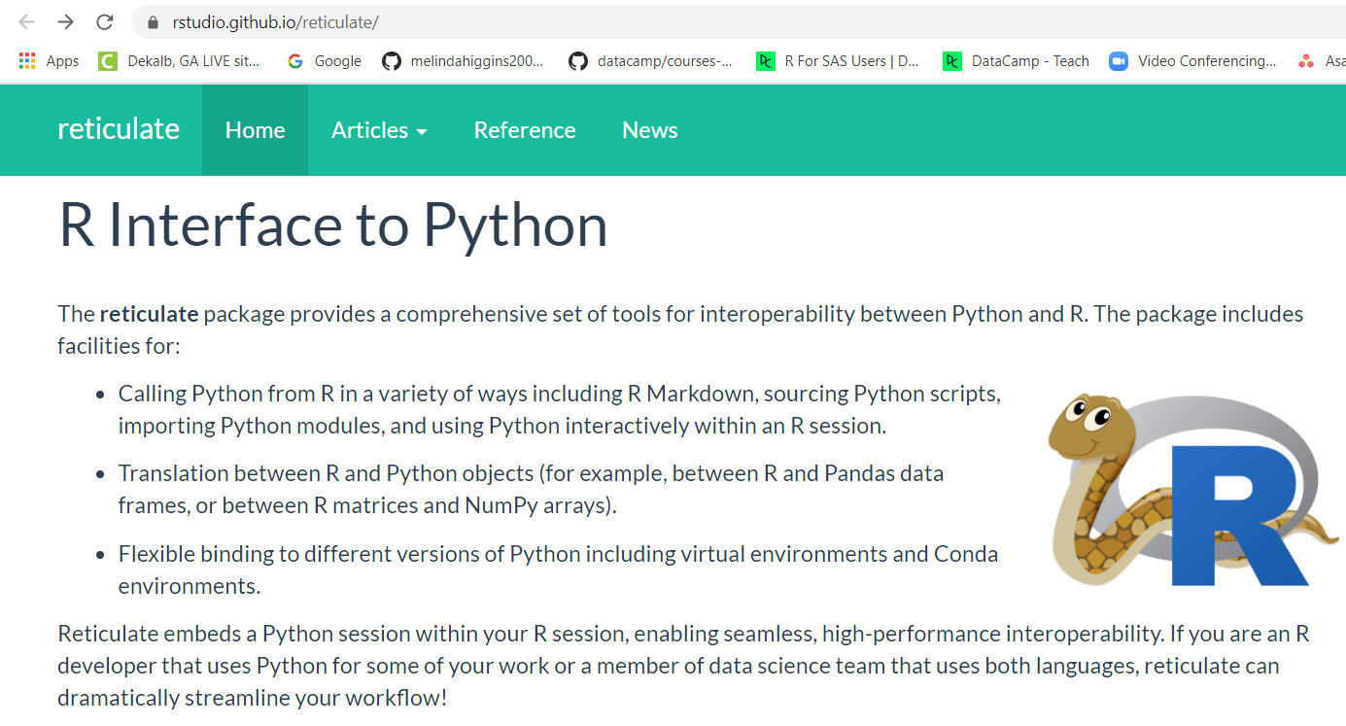

Slide 17
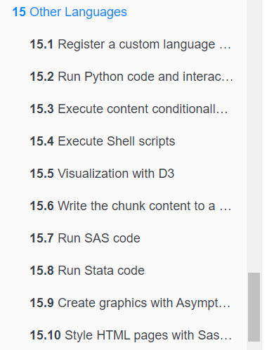
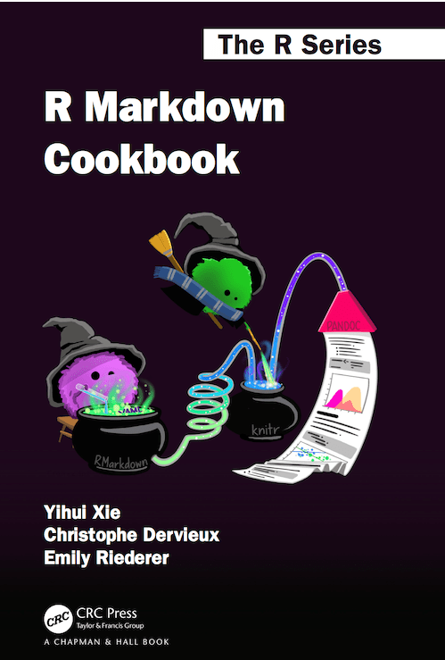
More than R and Python…
NOVEMBER
2020
https://bookdown.org/yihui/rmarkdown-cookbook/other-languages.html

Slide 18
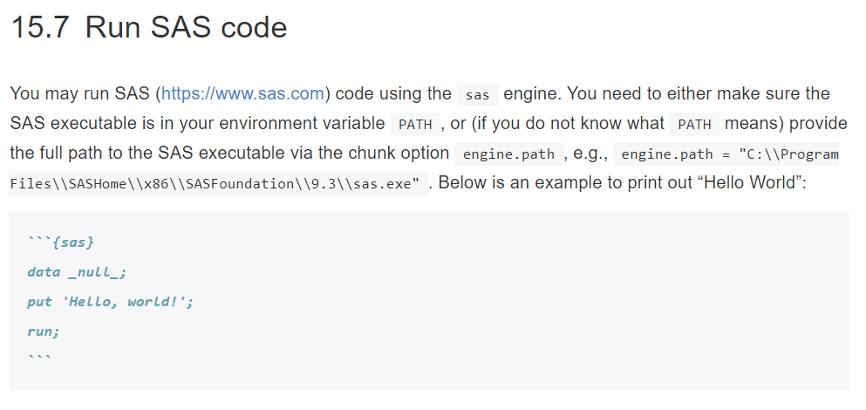
More than R and Python…
Also see
https://www.ssc.wisc.edu/~hemken/SASworkshops/Markdown/SASmarkdown.html
https://cran.r-project.org/web/packages/SASmarkdown/

Slide 19
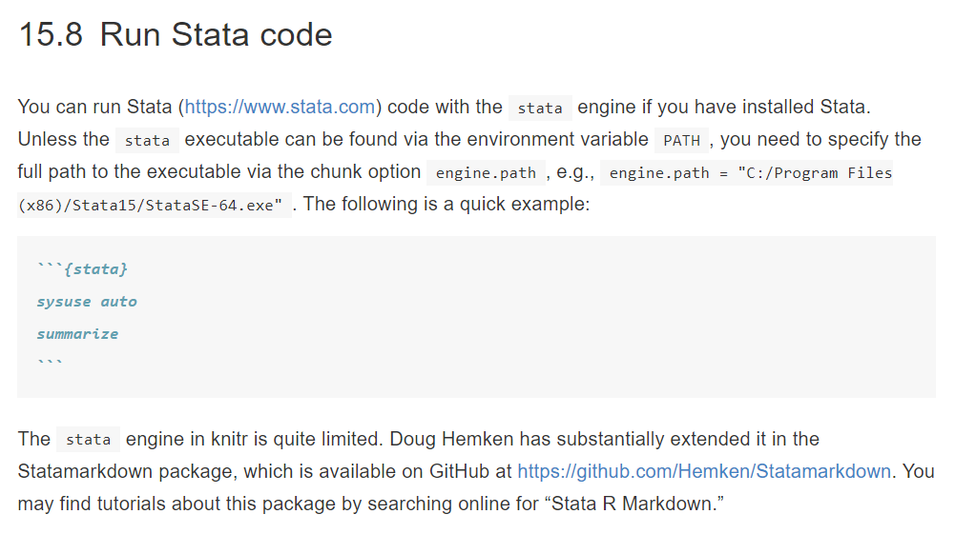
More than R and Python…

Slide 20
Questions?
My contact info:
Melinda.higgins@emory.edu
https://melindahiggins.netlify.app/

