Slide 1

Making reproducibility practical – Using rmarkdown and R (+ more …)
Melinda Higgins, PhD; Emory University, Professor

Slide 2
The big picture
text
data
Manuscript
Report
Slides
Website
Dashboard
Book
code
figures
tables

Slide 3
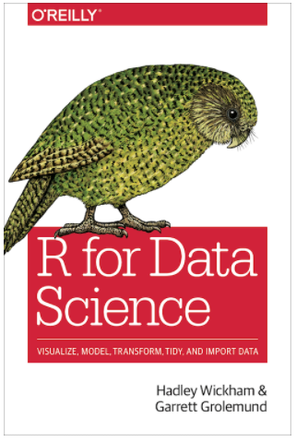
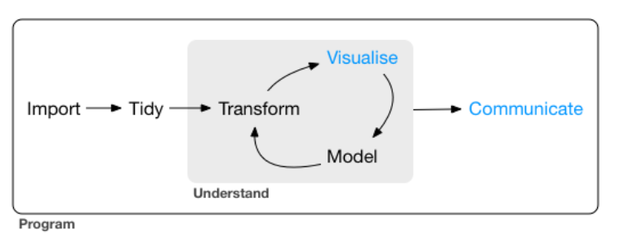
“Tidyverse” workflow
https://r4ds.had.co.nz/communicate-intro.html

Slide 4
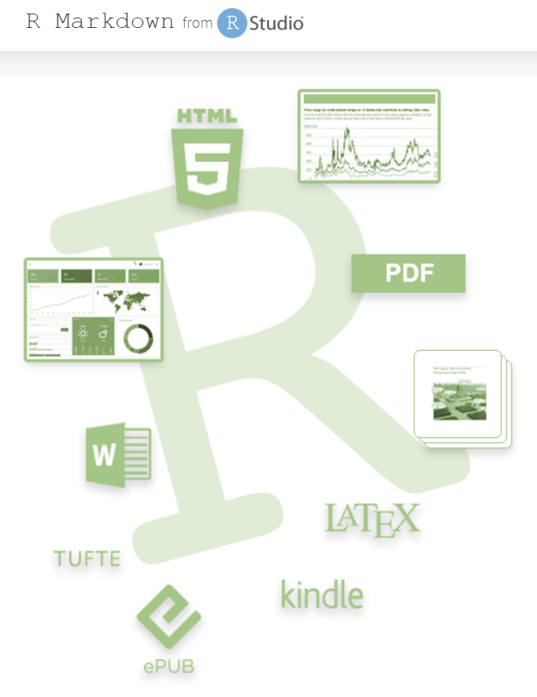
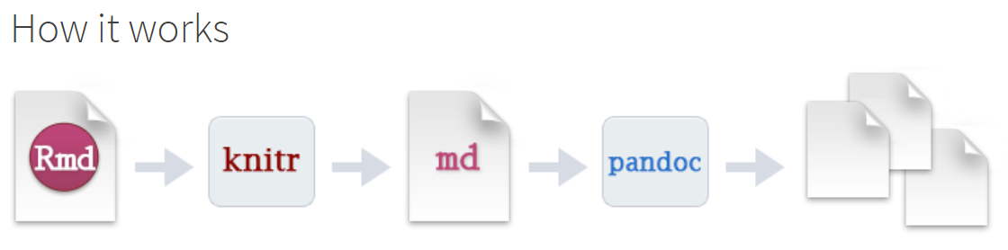
Rmarkdown (+ pandoc)
https://pandoc.org/
https://rmarkdown.rstudio.com/

Slide 5
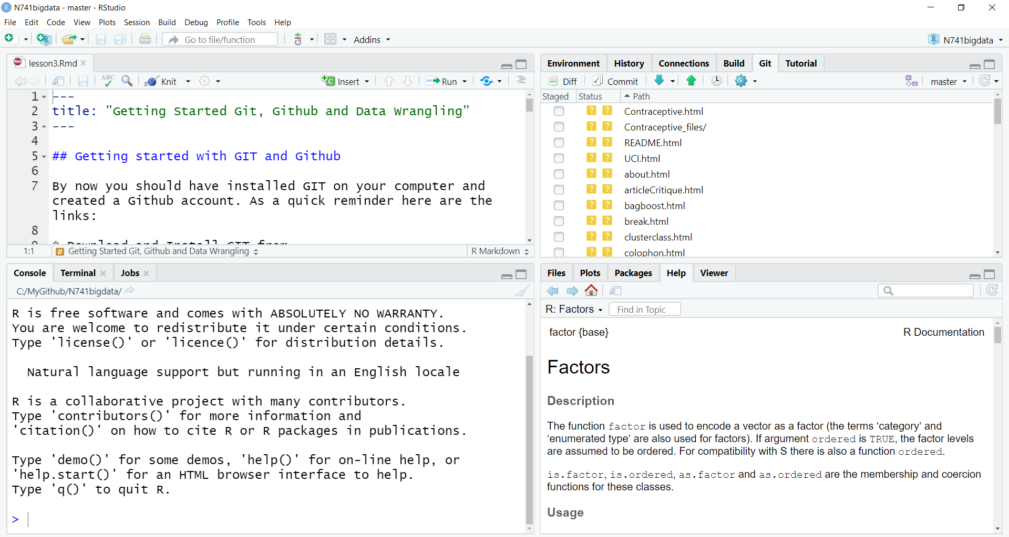
THE RSTUDIO IDE
R Scripts, RMD, …
Environment
History, GIT, …
CONSOLE
Files, Plots, Packages, Help, Other Output
Notes:
This is a snapshot of the Rstudio interface. Think of the IDE as the interface to manage everything you may want to do with the data, code, output and associated files and management of these for any given analysis project. There is a console window (bottom left) which has the command line for typing in commands one by one and viewing messages and output. At the top left – this is typically where files are created and viewed such R code scripts, Rmarkdown files, viewing data and more. The top right shows the current environment with data and other objects in memory, code history, Git version control tracking and other project management options. The bottom right shows the project files directory, the help window and more.

Slide 6
Short Demo

Slide 7
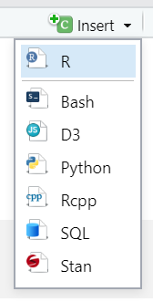
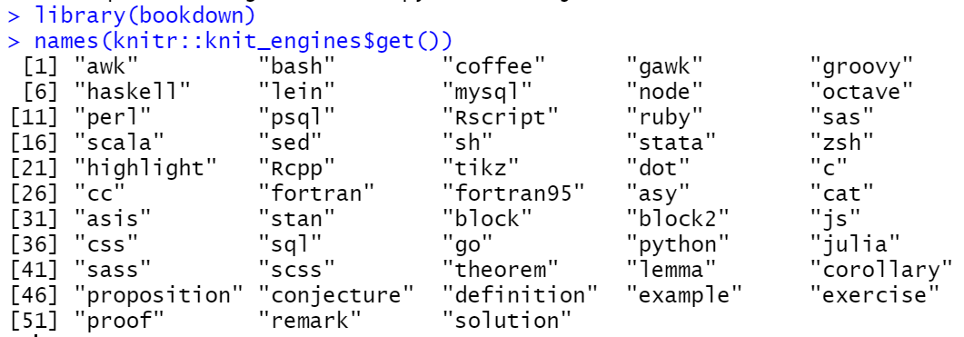
Not just for R anymore…

Slide 8
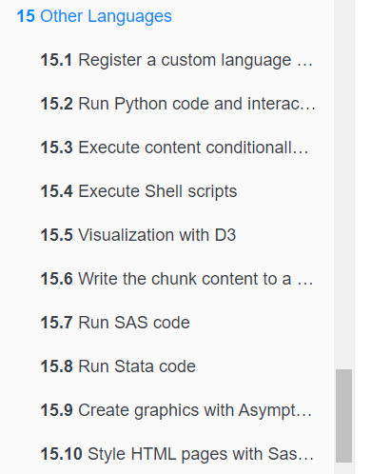

More than R and Python…
NOVEMBER
2020
https://bookdown.org/yihui/rmarkdown-cookbook/other-languages.html

Slide 9
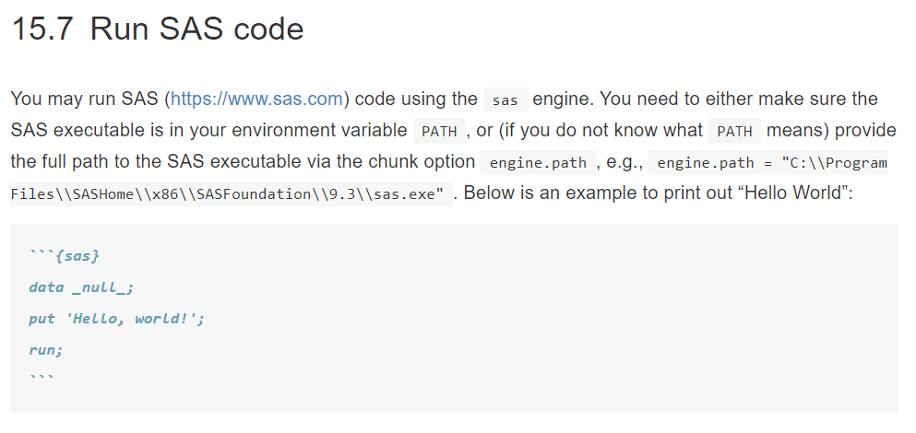
More than R and Python…
Also see
https://www.ssc.wisc.edu/~hemken/SASworkshops/Markdown/SASmarkdown.html
https://cran.r-project.org/web/packages/SASmarkdown/

Slide 10
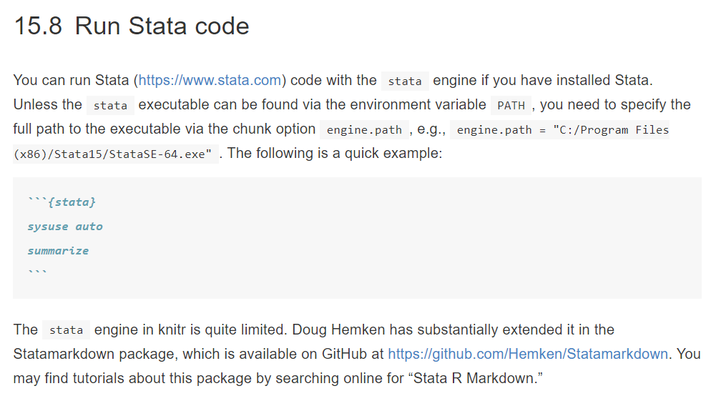
More than R and Python…

Slide 11
Modularization & Automation
Child Documents
Parameterized Reports

Slide 12
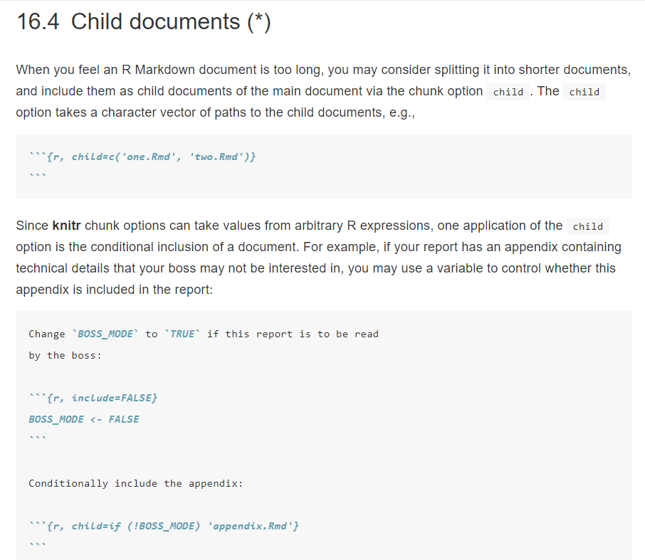
Customized based on Conditional Flags
https://bookdown.org/yihui/rmarkdown-cookbook/child-document.html

Slide 13
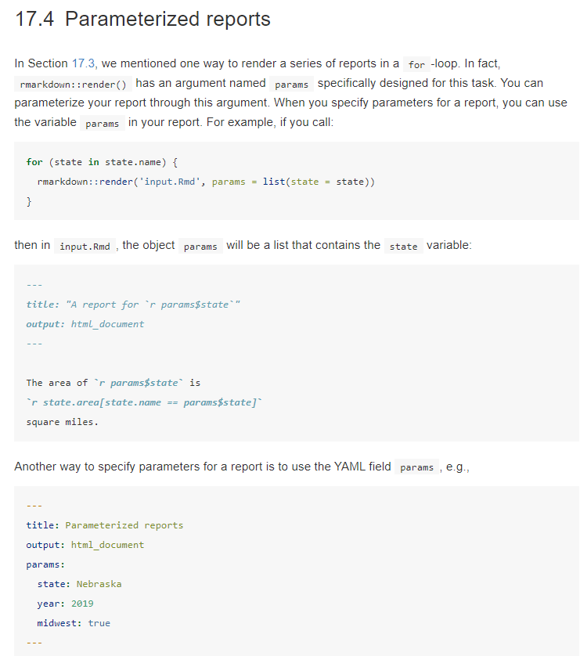
https://bookdown.org/yihui/rmarkdown-cookbook/parameterized-reports.html#

Slide 14
Checklist
Software (R, …)
Version Control
Environment
Workflow
Reproducible Research
Tidyverse vs/& Base R
R Packages
To GUI or not to GUI
Datasets, Data Sources
Data Sharing/Repositories
Resources
Notes:
This presentation will cover the following topics which provides a checklist to review if you are thinking of starting your own course on R, Rmarkdown or Reproducible Research.

Slide 15



Software
R https://cran.r-project.org/
Rstudio https://rstudio.com/products/rstudio/download/
Git https://git-scm.com/
Notes:
To get started, every student will need to install or have access to a computer with these 3 open source and FREE software packages. R is the programming language for data analysis and statistics. Rstudio is probably the number 1 integrated development environment or IDE for R. I strongly encourage using the Rstudio IDE for reasons that will be explained shortly. To use version control for managing projects and teaching reproducible research workflow principles, you will also need for the students to install GIT. The web links are provided here for all of these FREE software packages.

Slide 16


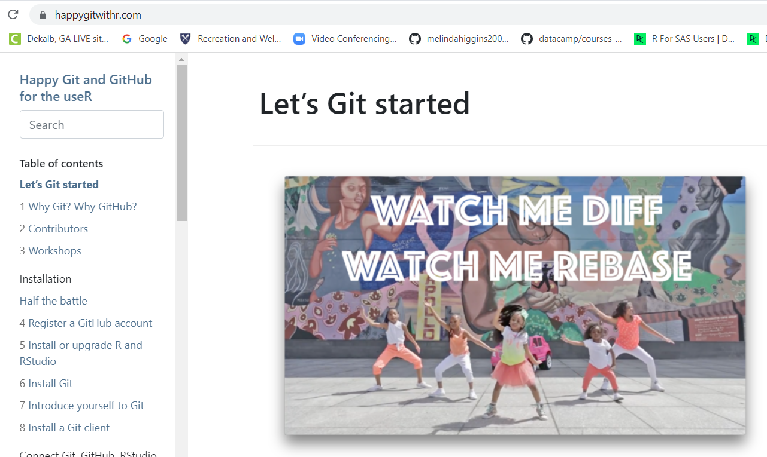
Version control
Github, https://github.com/
[Gitlab, https://about.gitlab.com/]
“Happy Git and GitHub for the UseR”
by Jenny Bryan, [https://happygitwithr.com/]
Notes:
A key component of reproducible research is being able to track all steps involved in an analysis including data sources, modification and all code steps used to produce the final analysis results. Using the GIT version control language is a great way to do this. GIT is FREE and open source. Both Github and Gitlab are cloud based repositories that use GIT for version control and tracking. Please go to these websites to learn more. An excellent book/user guide on how to set up GIT and Github for R projects is Happy Git and Github for the UseR by Jenny Bryan at the happygitwithr.com website. At the end of this presentation there are links provided for the educational resources provided for setting up version control for teaching purposes.

Slide 17
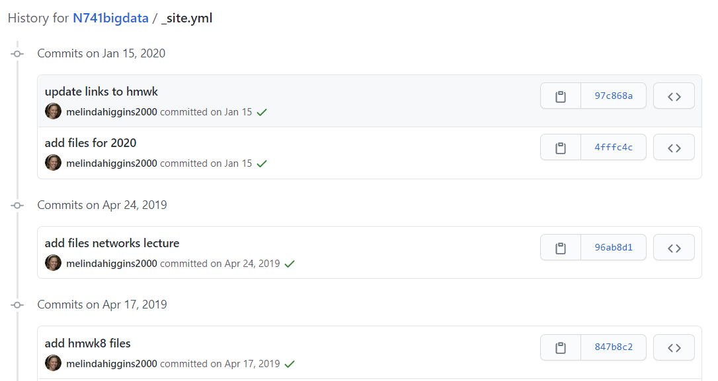
Notes:
Here is a screen shot of a file in one of my Github repositories. As you can see there is a date/time stamp of every change and update. The hyperlinks shown on the right can be clicked to take you back in time to what the entire repository looked like then. This is great for tracking all changes made to any file in the project directory. I was the only one making changes in this repository but if other people were making changes, you would also see who made each change. This is also great for teaching how to work in a team science environment.

Slide 18
Reproducible research
Start from day 1
All files for a given project: Github Rstudio project
Rmarkdown: data, code, document immediately linked
Use “knitr” and “Rmarkdown”
documents – HTML, PDF, DOC
slides – HTML (ioslides, slidy), PDF (Beamer)
others – e.g. dashboards
https://rmarkdown.rstudio.com/
Notes:
We have the students use version control from day 1. So they begin all of their exercises and projects by first creating a Github repository. Then when they create their project inside Rstudio, they create it using version control so that everything is automatically linked to Github. So, every file they create or change can be saved to a cloud repository and tracked. There are ways to do this within a private educational account so that each student’s work is secure. We also encourage our students to use Rmarkdown as their primary format for doing their analyses. R markdown combines all of the R code used for their data processing and analysis steps imbedded within their report document - their data and code and report text are seamlessly linked together in 1 place reinforcing reproducible research principles. There is a link here to learn more about Rmarkdown. Many different output formats are possible with Rmarkdown like HTML webpages, DOC and PDF documents, slide formats and others like dashboard. This gives the students a chance to explore multiple ways to disseminate and communicate their results.

Slide 19
Workflow
Create Github repo
Create Rstudio project – version control to Github
Create/Begin with Rmarkdown [https://rmarkdown.rstudio.com/]
Knit (check that everything is working)
Modify code and/or text in Rmarkdown, Knit
GIT: Add, Commit, Push
Refresh, check GIT and Github

Slide 20
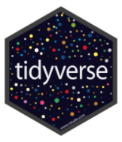
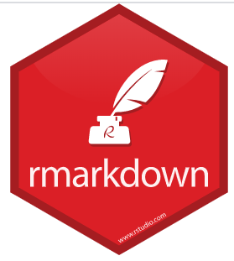


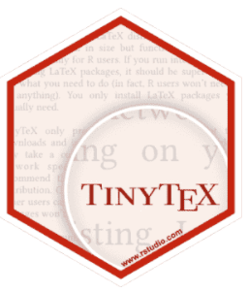
Helpful R packages
tidyverse – mainly dplyr, ggplot2, readr
foreign – importing of SAS, SPSS, Stata
Hmisc – lots of useful functions from Frank Harrell
arsenal – making nice tables (HTML, PDF and **WORD**)
knitr, Rmarkdown, printr, kablextra
tinytex - create PDFs without full LaTeX installation!!

Slide 21
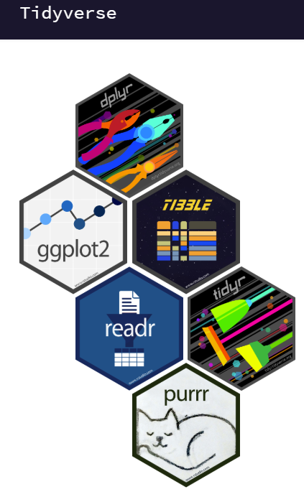
Tidyverse vs/& Base R
https://www.tidyverse.org/
Tidyverse – packages that work well together
dplyr - pipe %>% workflow
ggplot2 – build graphs with + layers
Base R
tibble data frames ≠ data.frame
data import haven vs foreign (SAS, SPSS or Stata files)
“haven labeled” variables
factors (pros and cons – useful to have both)
selecting variables (dplyr::select() and dplyr::pull() versus $ versus [,2] – useful to know all of these)
Notes:
A topic that is hotly debated is whether or not to teach only the tidyverse way of coding in R. The biggest advantage of teaching tidyverse is that #1 many people are using tidyverse now so it is helpful for the students to know these packages and #2 the pipe workflow follows a more natural language stepwise approach to programming which is easier to learn. However, the data frame format used by most of the tidyverse packages is a tibble data frame which sometimes does not work well with other R packages. There are also pros and cons of importing data from other formats like SAS, SPSS and Stata using haven which is part of tidyverse versus using the foreign package. The handling of labeled variables and factors can get tricky. However, teaching these does prepare the students for different issues they may run into in their future. Selecting variables and using them in other R packages and functions can also vary between tidyverse and base R. Again it is useful to cover both approaches.

Slide 22
To GUI or not to gui
no GUI – all code
every step is captured and documented
Rmarkdown always begins with clean environment supports reproducible research workflow
Notes:
A key principle of reproducible research is to capture every step of the data processing and analysis. When an Rmarkdown document compiles it always begins with an empty clean environment so the students are forced to be sure they have every step documented and specified. So, the goal is to avoid point-and-click menu based GUIs (graphical user interfaces).

Slide 23
To GUI or not to gui
GUIs - packages: rattle and Rcmdr
very helpful for beginners
provides insights into data mining
rattle, https://rattle.togaware.com/
saves all R code
Rcmdr, https://www.rcommander.com/
saves all R code
also creates a draft Rmarkdown file
Notes:
But there are 2 R packages which have graphical user interfaces with point and click menus that are very helpful to learn. Both of these packages provide menus to many R functions and options. Both save all of the R code and commands used to perform the analyses. R commander also creates a draft R markdown file that can be saved with all of the R code chunks used.

Slide 24
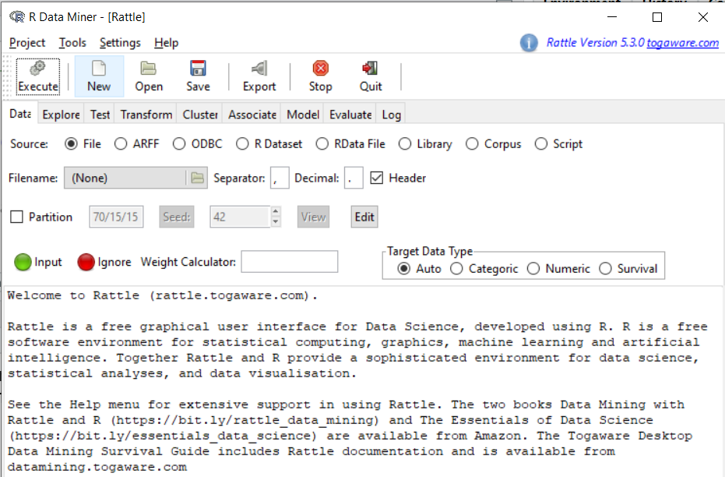
https://rattle.togaware.com/
Log has all R code generated by mouse clicks!!
Notes:
Rattle is especially useful for data mining since the data processing workflow is reflected in the TABs show here where you load the data, break it into training and testing datasets, explore the data and transform it if needed. And then you can look at using unsupervised clustering or associating methods or supervised methods of modeling. Then you evaluate those models. The log TAB is where all of the R code is captured.

Slide 25
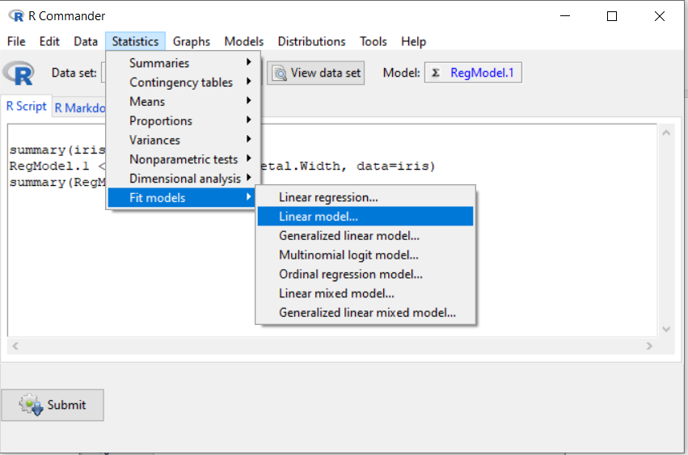
https://www.rcommander.com/
All R code generated by mouse clicks AND
Rmarkdown document created with R code chunks!!
Notes:
R commander also follows a flow of loading a dataset, and then exploring the data and creating models, using graphical visualizations along with model evaluation and more. As each command is executed the R commands are captured in both the R Script TAB and the R Markdown TAB.

Slide 26



Environment(s)/Container(s)
PC & Macs (also Linux)
Rstudio.cloud, https://rstudio.cloud/
** no longer free, tiered pricing **
Local R/Rstudio server
https://rstudio.com/products/rstudio/#rstudio-server
AWS, Docker, …
Notes:
For our course, all of our students have their own computers and can install and maintain software on their own laptops. About half have PCs and half have Mac’s. I’m a PC user and Dr. Hertzberg my co-instructor is a Mac user – so we cover both of these operating systems. We’ve debated about moving to cloud platforms like Rstudio.cloud, or having the student run an R/Rstudio instance on a virtual machine on AWS (amazon web services) or possibly also running our own Rstudio server. The advantage of using a cloud or server based platform is that everyone would be running R and Rstudio in the same exact environment – same operating system, same versions of R and Rstudio, which does help to problems that arise due to people using different operating systems and software versions. However, after the students leave our class, they will most definitely run into these problems when they try to use R and Rstudio on their own or in a team environment. So, we’ve decided to mostly stay with helping each student individually with any specific problems they run into with their software setup. Our classes are typically < 20 students so this is manageable. But for larger classes you may want to look into server or cloud based solutions.

Slide 27

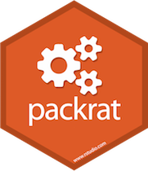


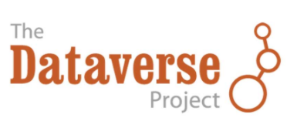
Other considerations
Code testing (testthat)
Package Management (packrat)
Continuous Integration
Data/Code Sharing - Repositories
Container &
Version “locking”

Slide 28
Data Resources, Security, sharing @ Emory
Data Resources @ Emory
https://researchdata.emory.edu/index.html
Data Security Policies @ Emory
https://it.emory.edu/security/awareness/archive/encrypt.html
Data Sharing/Publication
https://researchdata.emory.edu/share/repositories.html
Data Management Plan (DMP Tool)
https://researchdata.emory.edu/plan/dm-planning/write-dmp.html
Rigor and Reproducibility Lecture Series
https://guides.libraries.emory.edu/rigor-rep

Slide 29
resources
Happy Git and Github for the UseR, https://happygitwithr.com/
Stat 545, https://stat545.com/ and https://stat545.stat.ubc.ca/
Quick R, https://www.statmethods.net/
R Graphics Cookbook, https://r-graphics.org/ and http://www.cookbook-r.com/Graphs/

Slide 30
resources
Rstudio education, https://education.rstudio.com/
Datacamp for the classroom, https://www.datacamp.com/groups/education
Github education, https://education.github.com/
Gitlab for education, https://about.gitlab.com/solutions/education/
Mine Cetinkaya-Rundel, https://mine-cetinkaya-rundel.github.io/teach-r-online/ - also see ghclass R package for managing students in Github

Slide 31
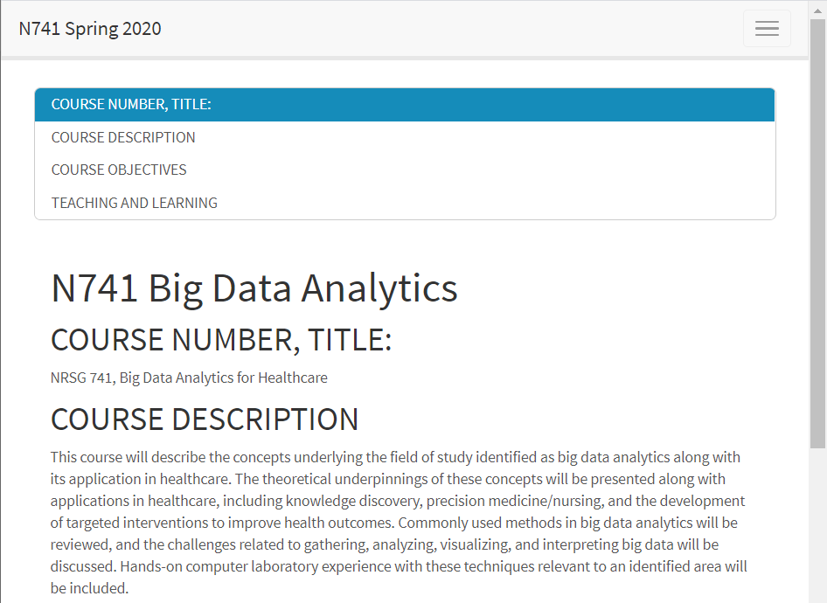
https://melindahiggins2000.github.io/N741bigdata/

Slide 32
Questions?
My contact info:
Melinda.higgins@emory.edu
https://melindahiggins.netlify.app/
http://nursing.emory.edu/faculty-and-research/directory/profile.html?id=980

