Slide 1
Chapter Annual Reports for 2019 - Summaries of Text Responses
Melinda Higgins, PhD; Vice-Chair District 5

Slide 2
2019 Annual Chapter Reports from 2019
The Excel file containing all of the 2019 Annual ASA Chapter Reports was downloaded from the ASA Leader Hub - under Annual Chapter Reports. Go to https://ww2.amstat.org/MembersOnly/chapterreportsnew/adminreportstatus_districts.cfm logged in with an ASA leader/officer account.

Slide 3
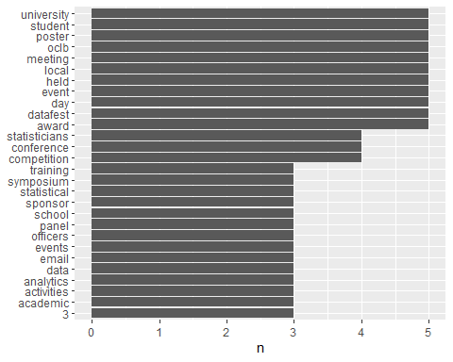
“Other Chapter Activities” - Most Used Single Words (> 2x)

Slide 4
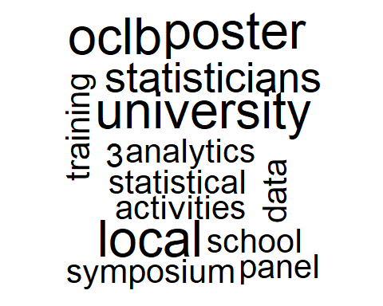
“Other Chapter Activities” - Single Words Wordcloud

Slide 5
“Other Chapter Activities” - Bigrams (top 2-words)
bigram | n
poster competition | 4
award event | 2
career day | 2
carleton university | 2
data fest | 2
email list | 2
panel discussion | 2
regular events | 2
science fair | 2
successfully held | 2
Other Chapter Activities - Bigram (2 word) Summary

Slide 6
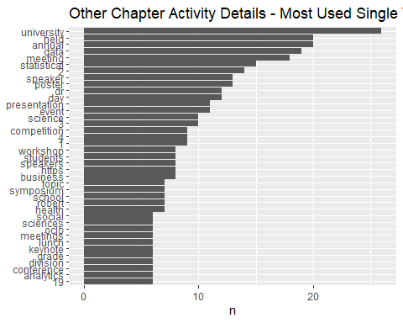
Other Chapter Activity Details - Most Used Single Words (> 5x)

Slide 7
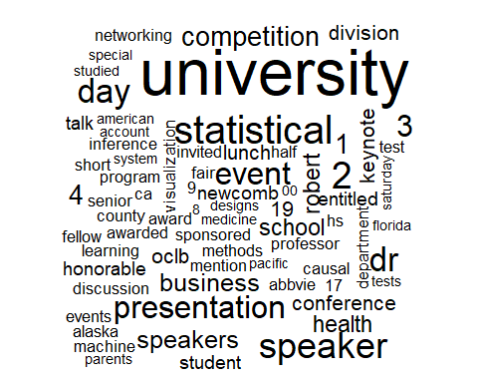
“Other Chapter Activity Details” - Single Words Wordcloud

Slide 8
“Other Chapter Activity Details” - Bigrams (top 2-words)
bigram | n
poster competition | 7
business meeting | 6
data science | 5
presentation entitled | 5
honorable mention | 4
machine learning | 4
newcomb fellow | 4
senior division | 4
11th grade | 3
causal inference | 3
division honorable | 3
engineering fair | 3
half day | 3
invited speaker | 3
pacific university | 3
poster session | 3
statistical methods | 3
Other Chapter Activity Details - Bigram (2 word) Summary

Slide 9
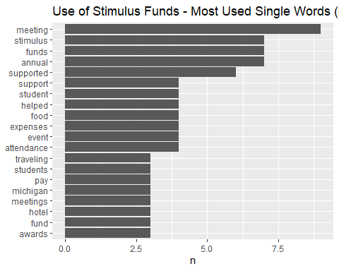
“Use of Stimulus Funds” - Most Used Single Words (> 2x)

Slide 10
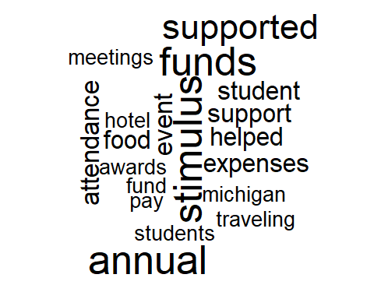
“Use of Stimulus Funds” - Single Words Wordcloud

Slide 11
“Use of Stimulus Funds” - Bigrams (top 2-words)
bigram | n
stimulus funds | 4
100 awards | 2
discussant event | 2
engineering fair | 2
funds supported | 2
hotel cost | 2
meetup site | 2
michigan science | 2
panel discussant | 2
research presentation | 2
spring meeting | 2
Use of Stimulus Funds - Bigram (2 word) Summary

Slide 12
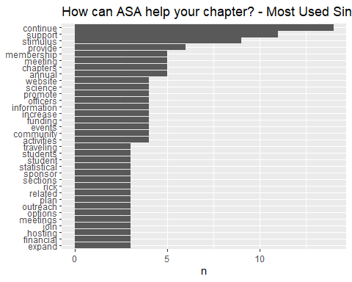
“How can ASA help your chapter?” - Most Used Single Words (> 2x)

Slide 13
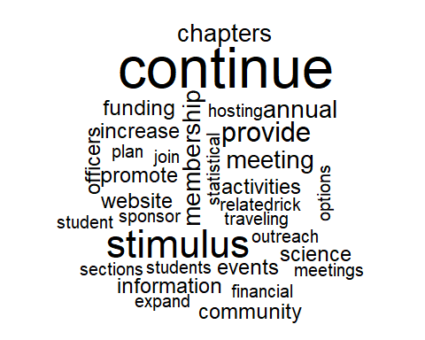
“How can ASA help your chapter?” - Single Words Wordcloud

Slide 14
“How can ASA help your chapter?” - Bigrams (top 2-words)
bigram | n
stimulus funding | 4
financial support | 3
outreach activities | 2
science fair | 2
stimulus fund | 2
stimulus funds | 2
How can ASA help your chapter? - Bigram (2 word) Summary

