Slide 1

RMarkdown
Melinda Higgins, PhD; Research Professor – Emory University
Alex Edwards, Research Informatics Analyst – Emory University

Slide 2
Rstudio cloud

Slide 3
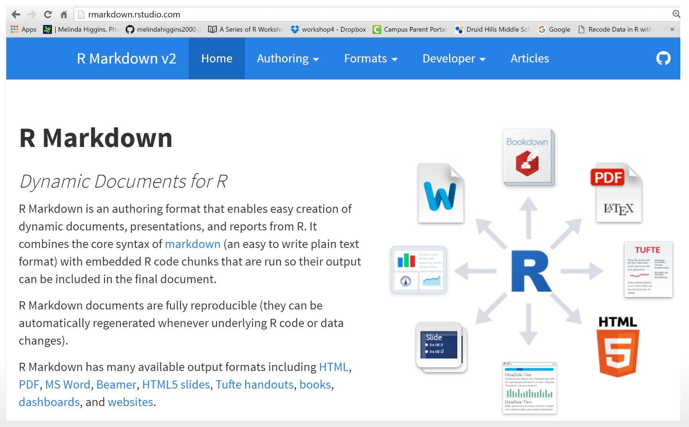
https://rmarkdown.rstudio.com/

Slide 4
Outline
Simple R script
Rmarkdown document
Rmarkdown Slides
Rmarkdown with custom parameters
Rmarkdown Dashboard

Slide 5
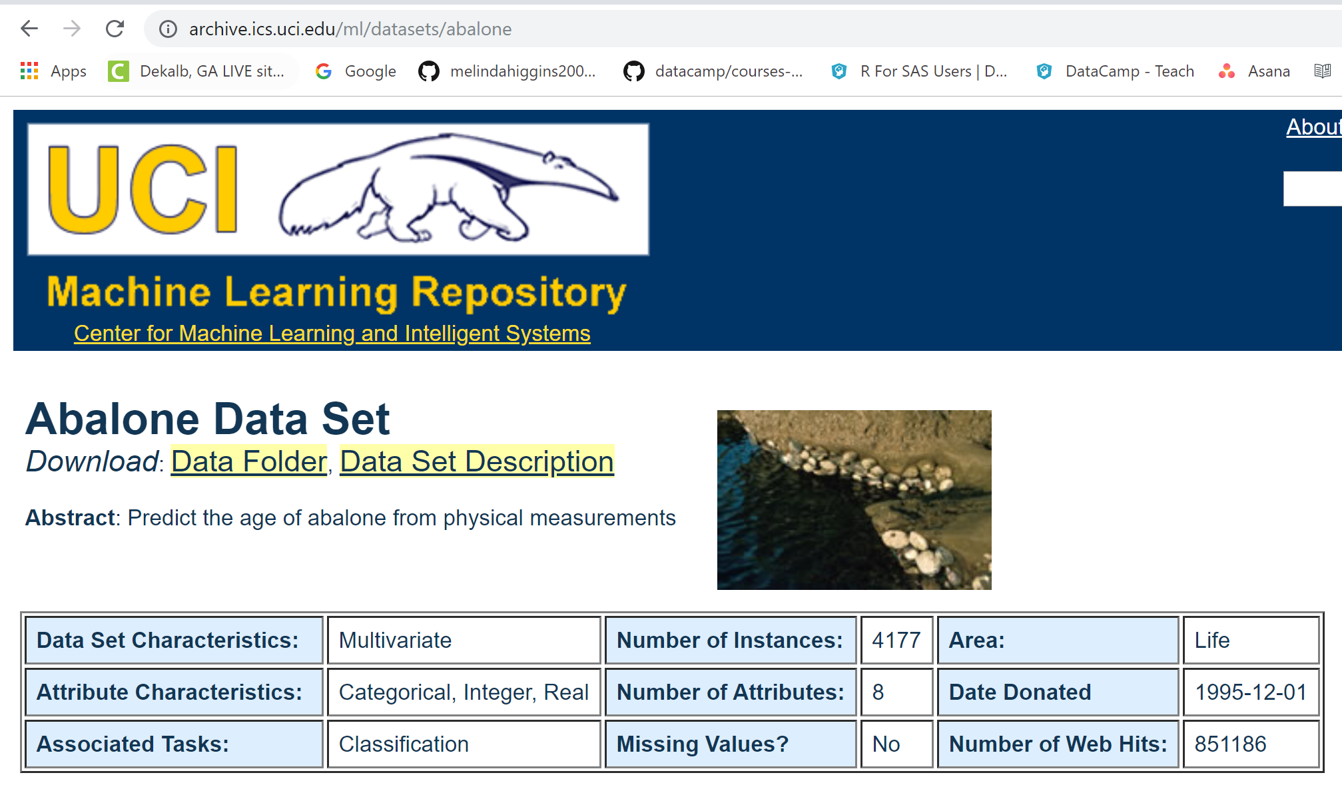
https://archive.ics.uci.edu/ml/datasets/abalone

Slide 6
R Script

Slide 7
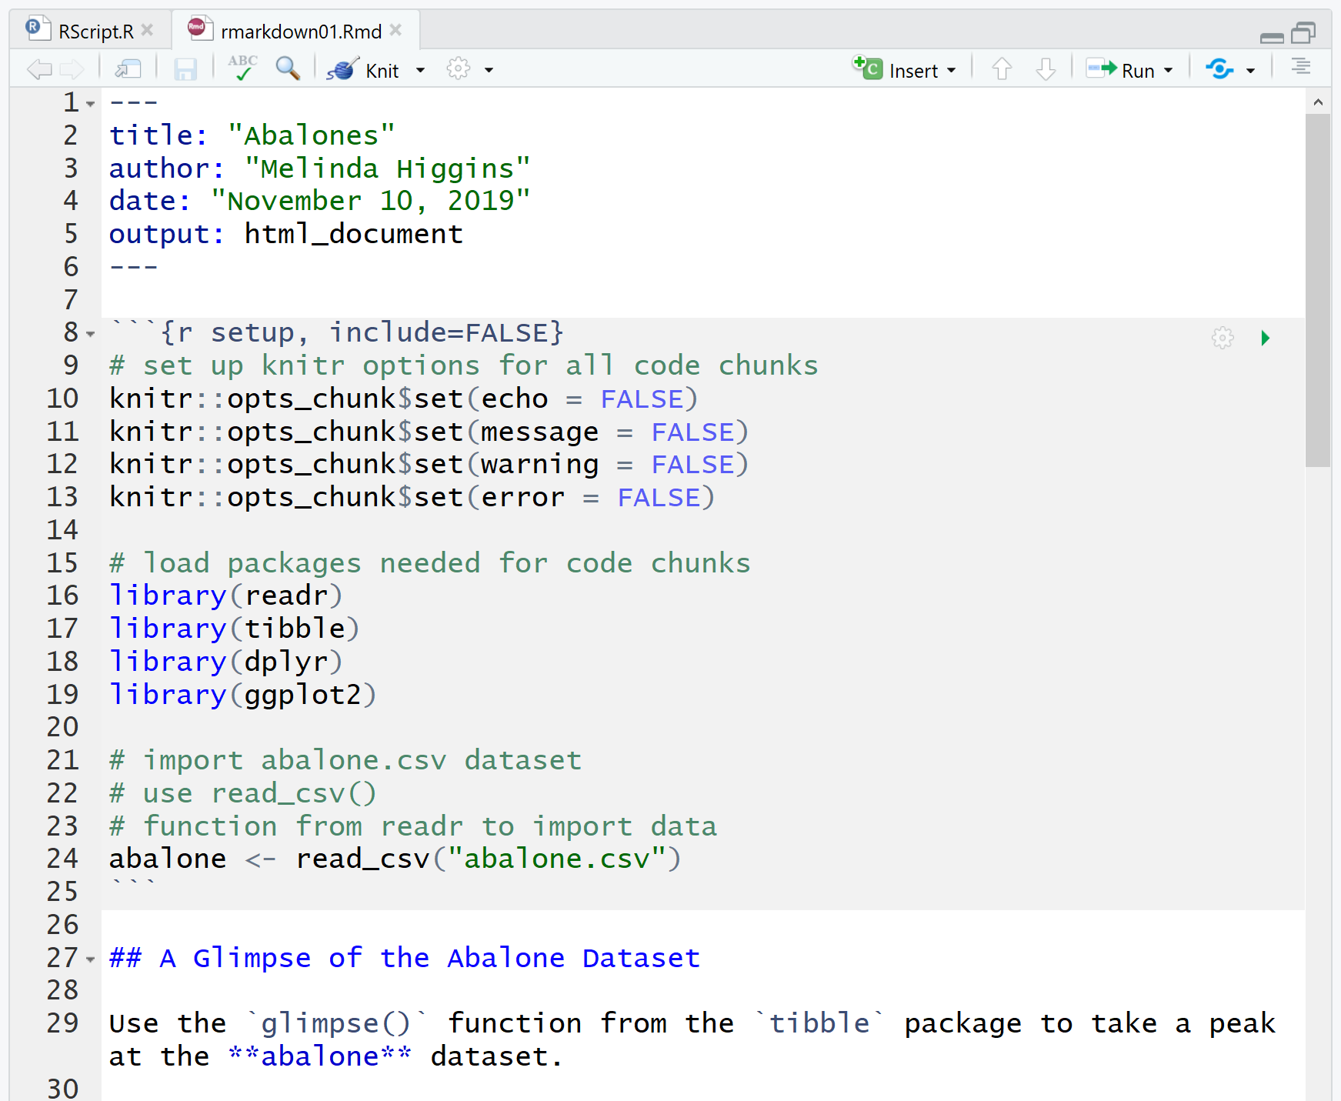
Rmarkdown
YAML
R CODE
CHUNK
“Marked” up text

Slide 8
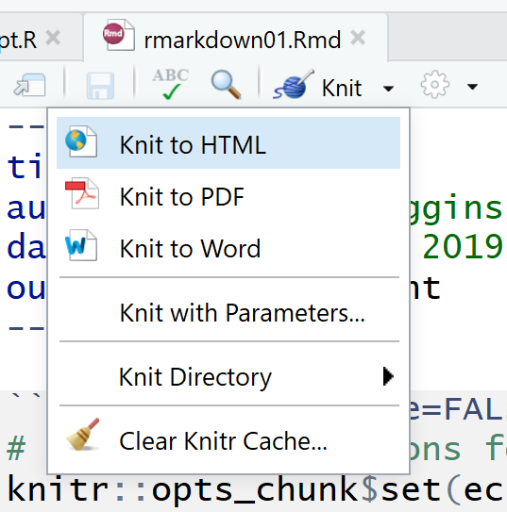
“KNIT” the document

Slide 9
Rmarkdown options

