Slide 1
A Practical Approach to Power, Effect Size and Sample Size & Introduction to PASS (Power Analysis and Sample Size software)
Melinda K. Higgins, Ph.D.

Slide 2
Data analysis
Research objectives
Reduce bedsores
Research questions
Does protocol A work better than protocol B for reducing bedsores?
Status Quo – Initial Assumption (Null hypothesis)
Protocol A and B produce same % bedsores
Where you want to go - Conclusion you’d like to reach (Alternative hypothesis)
Protocol A and B results in different % bedsores (one better than other)
Notes:
Your data analysis actually begins when you form your research questions and the associated hypotheses you plan to “test” to address your research objective(s) of interest.
For example your ultimate research objective may be to reduce bedsores. However, from a practical standpoint what you really want to compare is will a new or alternate procedure (or protocol or technology or method) reduce bedsores more than current practice.
To address this specific research question your hypothesis boils down to “is procedure A different (not equal to) procedure B”. Thus, the NULL hypothesis is assumed to be the STATUS QUO or rather this is the hypothesis you want to DISPROVE or REJECT (i.e. the procedures are the same – no difference) in favor of the ALTERNATIVE hypothesis (that the 2 procedures are different and one is better than the other by some non-zero amount).
This process of setting up your research question and forming your hypothesis GUIDE which statistical tests or models you will then run to TEST your hypothesis.
Also HYPOTHESIS TESTING forms the basis of logic for drawing conclusions and interpreting your statistical analysis results.

Slide 3
Framework for assessing the evidence
Threshold for assessing that outcome is real [SIGNIFICANCE]
What is the level at which you want to be sure that your result was not obtained by just pure chance?
Usually set at 1-5% level of chance, i.e. 95-99% confidence in results
How much “risk” you’re willing to live with
What is the level of “risk” assumed that you missed a real outcome [POWER] usually10-20%
BOTH critical to determine BEFORE the study is performed and any data collected

Slide 4
Framework for assessing the evidence
Once you determine the level of confidence you want to achieve and the amount of risk you’re willing to live with…
How large an outcome do you expect/hope to see? To achieve clinical relevance? To change practice? [EFFECT SIZE]
How large a SAMPLE SIZE is needed (given all of the above)
Time
Money/resource constraints

Slide 5
4 integrated keys
TRADEOFFS
Significance
Power
Effect size
Sample size
SIGNIFICANCE set BEFORE – confidence level desired for conclusions?
POWER set BEFORE – level of risk that you missed something
EFFECT SIZE - determined from data or estimated or stated from previous observations and clinical goals
SAMPLE SIZE is usually the MAIN option you can adjust within budget and study time constraints.

Slide 6
What constitutes evidence?
Big Sample Sizes in the 1000’s
Everything is statistically significant…
Is it clinically significant/relevant?
It is actionable?
Small Sample Sizes
Nothing statistically significant
But were clinically significant changes seen?
Was the difference due to the “intervention”/”treatment”? Or due to something else (that you measured or not)?

Slide 7
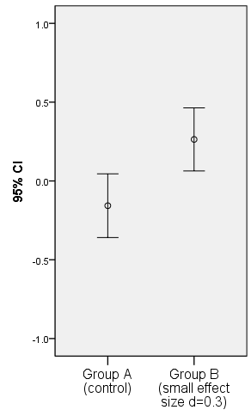
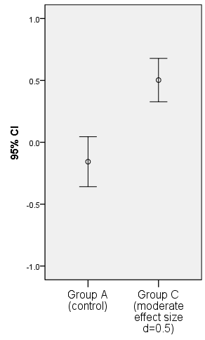
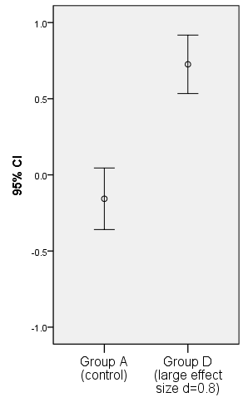
Visualize effect size – ERROR BARS
SMALL
MEDIUM
LARGE

Slide 8
Hypothesis Testing
USA Legal System: “We ASSUME that a person is INNOCENT until PROVEN GUILTY.”
Null Hypothesis (“Status Quo”)
H₀: Person = Innocent
Alternative Hypothesis (“What We’d Like to PROVE”)
H_{a}: Person = Guilty
“Burden of Proof” is on Prosecution [There has to be ENOUGH EVIDENCE to REJECT Innocence and CONCLUDE GUILT.]
Underlying Structure – we’d rather let a guilty person go free than send an innocent person to jail… more later…

Slide 9
From a Stats Point of View
Null Hypothesis [H₀]: The Hypothesis to be “Tested” – really this is what we want to reject in favor of the Alternative Hypothesis
Alternative Hypothesis [H_{a}]: The stated alternative to the null – really what we would like to “accept” and “conclude”
Hypothesis Test: The test performed to make the decision to either “Accept H_{a}” or “Not Reject H₀”
** NEVER ACCEPT THE NULL HYPOTHESIS ** Always State that “there was not enough evidence to reject the null hypothesis – this does NOT mean the Null Hypothesis is True. [Just because the prosecution could not prove their case does not mean the defendant is innocent.]

Slide 10
POWER – Some initial terms and definitions
H₀ is the Null Hypothesis (want to reject this to conclude H_{a} – the alternative hypothesis)
H_{a} is the Alternative Hypothesis (ideally this is the conclusion you want to reach)
If statistical significance is found (p-value < α), “You reject the null and accept the alternative hypothesis.”
If the test is NOT significant you state that “You can not reject the null hypothesis.”
YOU NEVER ACCEPT THE NULL HYPOTHESIS!!
** Research Design **
US Legal System

Slide 11
Types of “Error”
“Truth”
“H_{a} is True
(H₀ is false)”
“H₀ is True”

1-α
Confidence
Level
β
Type II error
Fail to
Reject H₀
“Result”
α
Type 1 error

POWER
1-β
Reject H₀,
Conclude H_{a}
Type I Error (α Significance Level): Rejecting the Null Hypothesis when it is in fact true
Type II Error (β): Not Rejecting the Null Hypothesis when it is in fact false.

Slide 12
Power – The logic
“Truth”
“H_{a} is True
(H₀ is false)”
“H₀ is True”
β
Type II error
Fail to
Reject H₀

“Result”
α
Type 1 error

POWER
Reject H₀,
Conclude H_{a}
Our focus is usually here – controlling Type I (α).
All tied together – Beta (β) depends upon Alpha (α)
POWER = 1 – β
A statistical test’s POWER is the probability of rejecting a false statistical null hypothesis (re: Statistica Textbook)

Slide 13
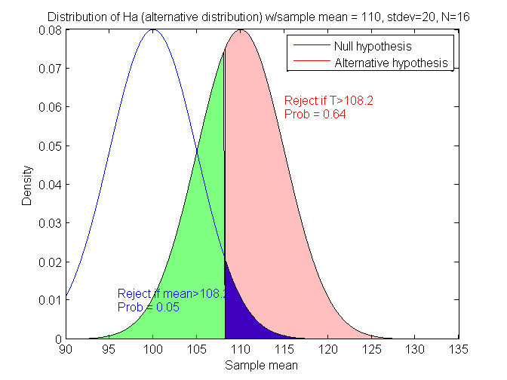
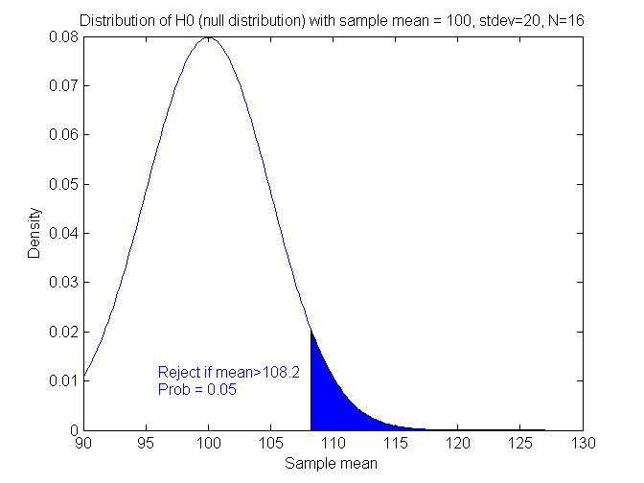
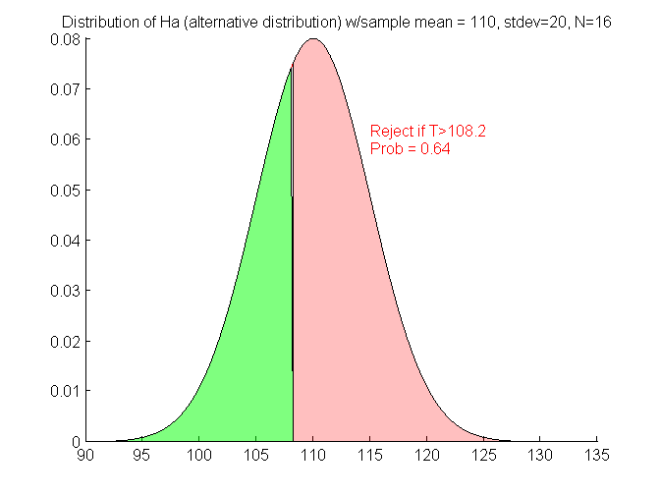
Power – The pictures
DISTRIBUTION UNDER ALTERNATIVE HYPOTHESIS
DISTRIBUTION UNDER NULL HYPOTHESIS
H₀ : μ₀=μ_{a}
H_{a} : μ₀<μ_{a}
β
Type II error
β
Type II error
1-β
POWER
1-β
POWER
α
Type 1 error
α
Type 1 error
Notice that everything depends on the “critical value” = 108.2, which depends on alpha (α)

Slide 14
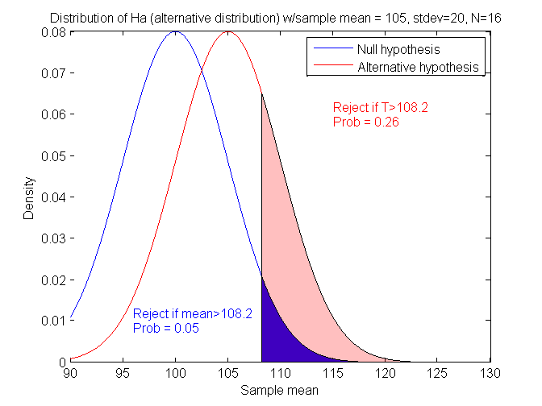
What if μ₀=100, μ_{a}=105 (σ_{x}=20 & N=16) ? Closer together – will power increase or decrease?
Power = 0.26 (previously was 0.64)
μ_{a}-μ₀=5 (previous difference = 10)

Slide 15
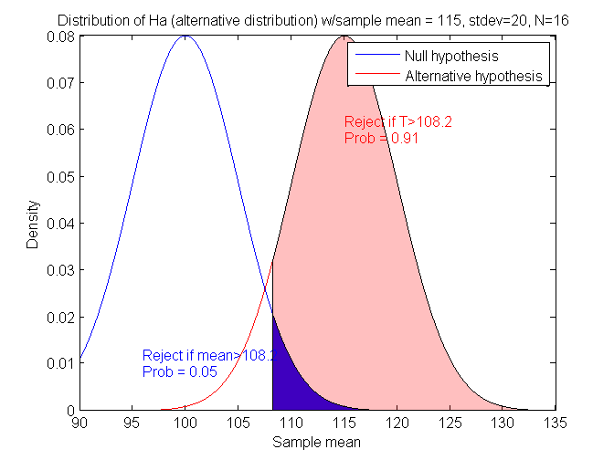
What if μ₀=100, μ_{a}=115 (σ_{x}=20 & N=16) ?
Power = 0.91 (was 0.64)
μ_{a}-μ₀=15 (previous difference = 10)

Slide 16
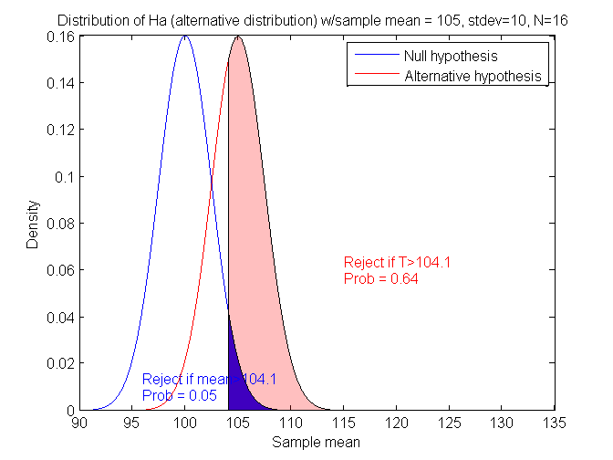
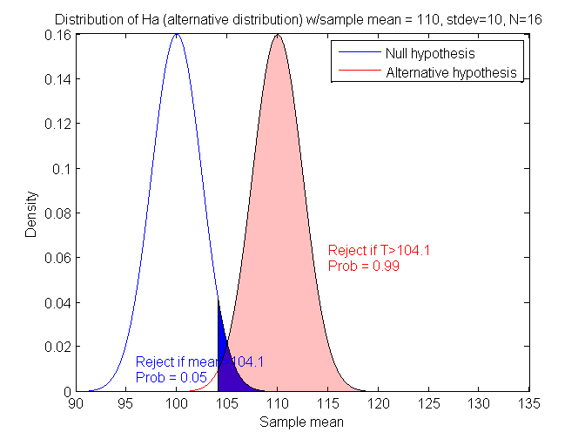
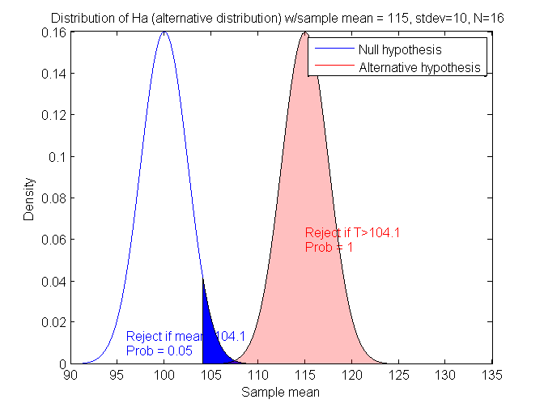
What if μ₀=100, μ_{a}=105 (σ_{x}=10, N=16) ? What if μ₀=100, μ_{a}=110 (σ_{x}=10, N=16) ? What if μ₀=100, μ_{a}=115 (σ_{x}=10, N=16) ?
Power = 0.64
Power = 0.99
Power = 1.00
If we decrease σ_{x}, will power go up or down?
The “effect” of increasing the difference between the means increases power, i.e. μ_{a}-μ₀ is related to “effect size” of this test.

Slide 17
Summary so far
This is for N=16, what if we have a different N (sample size)?
μ₀ | μ_{a} | μ_{a}-μ₀ | σ_{x} | Power
100 | 105 | 5 | 20 | 0.26
100 | 110 | 10 | 20 | 0.64
100 | 115 | 15 | 20 | 0.91
100 | 105 | 5 | 10 | 0.64
100 | 110 | 10 | 10 | 0.99
100 | 115 | 15 | 10 | 1.00

Slide 18
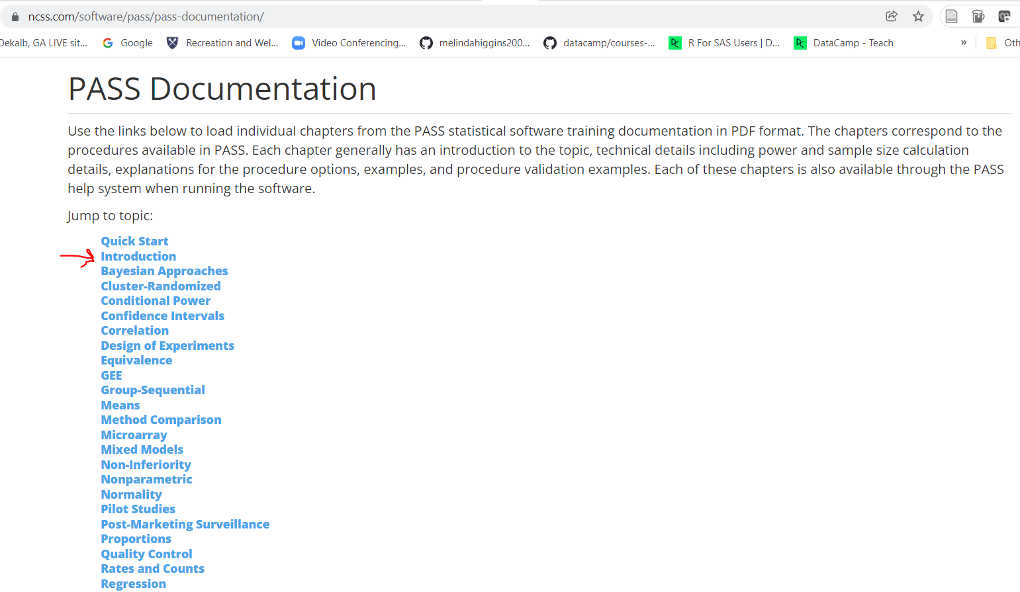
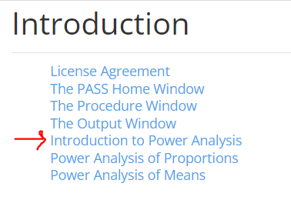
PASS Power Analysis Software
PASS – go to http://www.ncss.com/pass.html
download Trial for FREE, Annual License $695] but
documentation FREE, https://www.ncss.com/software/pass/pass-documentation/

Slide 19

G*Power Software - FREE
https://www.psychologie.hhu.de/arbeitsgruppen/allgemeine-psychologie-und-arbeitspsychologie/gpower

Slide 20
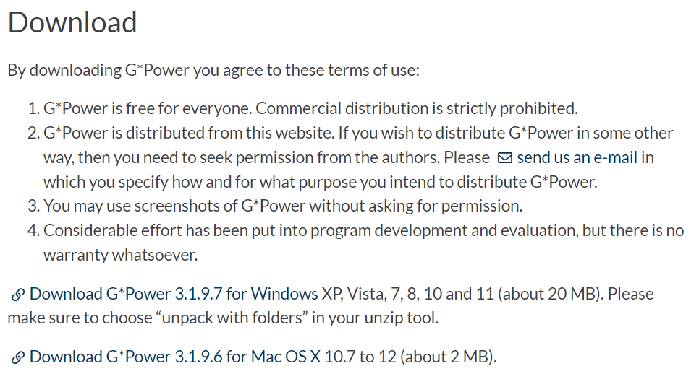
G*Power Software - FREE
https://www.psychologie.hhu.de/arbeitsgruppen/allgemeine-psychologie-und-arbeitspsychologie/gpower

Slide 21
Other Power Software
Power and Precision (BioStat) – go to http://www.power-analysis.com/
StudySize 3.0 – go to http://www.studysize.com/ [14-day FREE trial; $95 for StudySize 3.0 Academic]
“Russ Lenth's power and sample-size page” – go to http://www.math.uiowa.edu/~rlenth/Power/ [access JAVA applets online or download for FREE]
For a large list of available “Power, Sample Size and Experimental Design Calculations” – go to http://statpages.org/#Power

Slide 22
Hands-on exercises

Slide 23
Effect Size (for t-test) [Cohen, J. “Statistical Power Analysis for the Behavioral Sciences (2nd ed)” (1988)]
Example for t-test:
Cohen’s d
d = 0.2 “small”
meaning that the difference in the means is 20% as large as the “common” standard deviation. So, if the standard deviation in a particular measure is +/- 10, a small effect size would be a difference of 2.
d = 0.5 “medium”
d = 0.8 “large”
Use these numbers as guidelines for your study. Calculate an approximate ratio of the expected difference in means divided by a conservative (largest) estimate for the standard deviation.

Slide 24
Numeric Results for Two-Sample T-Test
Null Hypothesis: Mean1=Mean2. Alternative Hypothesis: Mean1<>Mean2
The standard deviations were assumed to be unknown and equal.
Allocation
Power N1 N2 Ratio Alpha Beta Mean1 Mean2 S1 S2
0.80003 1570 1570 1.000 0.05000 0.19997 0.000 0.100 1.000 1.000
0.80044 393 393 1.000 0.05000 0.19956 0.000 0.200 1.000 1.000
0.80138 176 176 1.000 0.05000 0.19862 0.000 0.300 1.000 1.000
0.80365 100 100 1.000 0.05000 0.19635 0.000 0.400 1.000 1.000
0.80146 64 64 1.000 0.05000 0.19854 0.000 0.500 1.000 1.000
0.80370 45 45 1.000 0.05000 0.19630 0.000 0.600 1.000 1.000
0.81165 34 34 1.000 0.05000 0.18835 0.000 0.700 1.000 1.000
0.80749 26 26 1.000 0.05000 0.19251 0.000 0.800 1.000 1.000
0.81211 21 21 1.000 0.05000 0.18789 0.000 0.900 1.000 1.000
0.80704 17 17 1.000 0.05000 0.19296 0.000 1.000 1.000 1.000
Since the standard deviation of each group = 1, and Mean1 (for the 1st group) is set = to 0, then Mean2 is the effect size of interest.
This table presents results for effect sizes from 0.1 to 1.0.
Thus, you need 393 per group (786 total) to “detect” an effect size of 0.2
and, you need 64 per group (128 total) to “detect” an effect size of 0.5

Slide 25
Remember that N1=N2, so the sample sizes represented here have to be doubled to estimate total sample sizes needed. So, for a sample size of 100+100 (200 total), we can “detect” an effect size of 0.4 (M2).

Slide 26
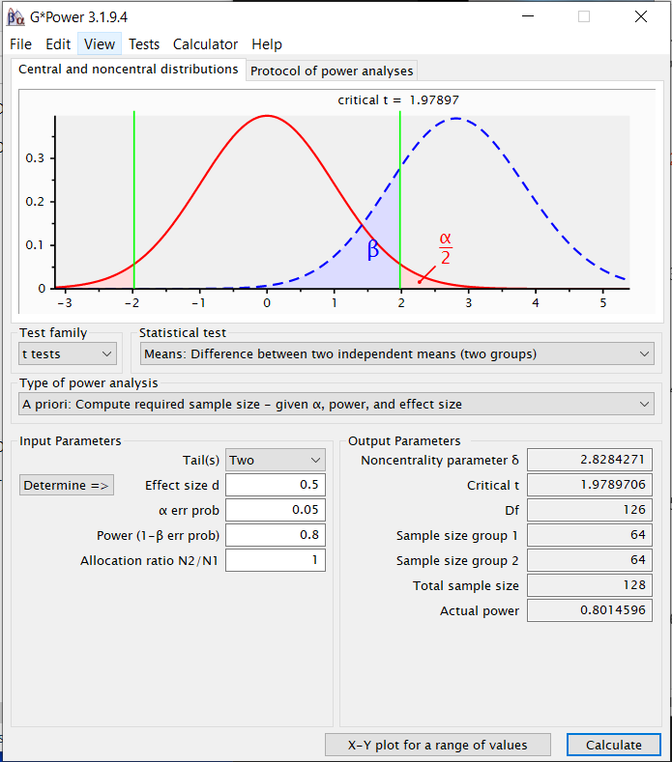
G*Power: Independent T-Test
G*Power:
Family:
T-Tests
Test:
Means Diff between 2
independent means
Type:
A Priori compute sample size
Tails: Two
Effect Size d:
(small) d=0.2
(mod) d=0.5
(large) d=0.8
Power: 0.80
Click CALCULATE
Also Try X-Y Plot for Range

Slide 27
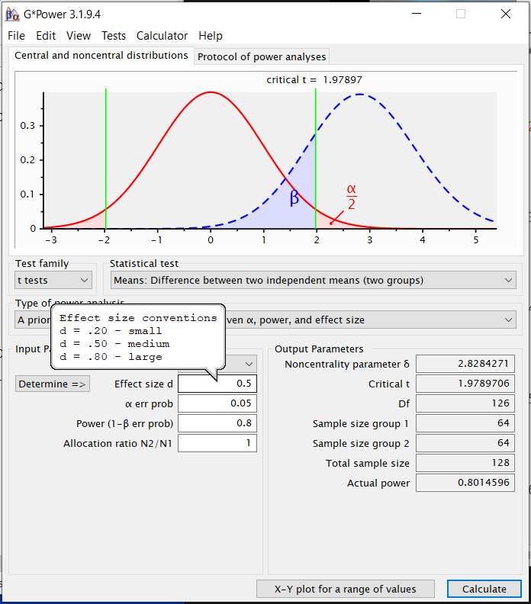
G*Power: Independent T-Test
G*Power:
Family:
T-Tests
Test:
Means Diff between 2
independent means
Type:
A Priori compute sample size
Tails: Two
Effect Size d:
(small) d=0.2
(mod) d=0.5
(large) d=0.8
Power: 0.80
Click CALCULATE
Also Try X-Y Plot for Range

Slide 28
Test | Effect Size | Sample Size for 5% Significance Level and 80% Power
2-group Independent T-test | d = 0.2 (small) d = 0.5 (mod) d = 0.8 (large) | 394*2 = 788 64*2 = 128 26*2 = 52

Slide 29
Effect Size for Chi-Square
Effect Size for Chi-Square test
Cohen’s “w”
w = 0.1 “small”
indicating that expected Chi-square will be 1% (0.01) of the total sample size (N); w² = (0.1)² = 0.01
w = 0.3 “medium”
w = 0.5 “large”
Use these numbers as guidelines for your study. Typically estimate a Chi-square from previous studies or pilot data.

Slide 30
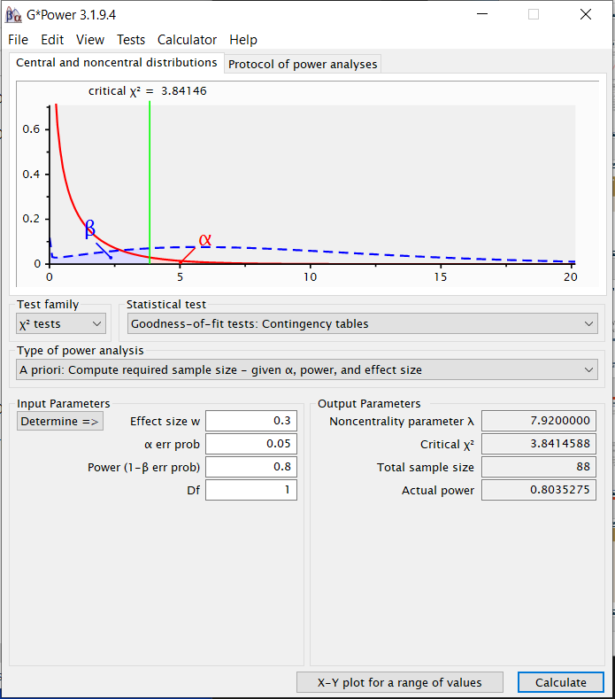
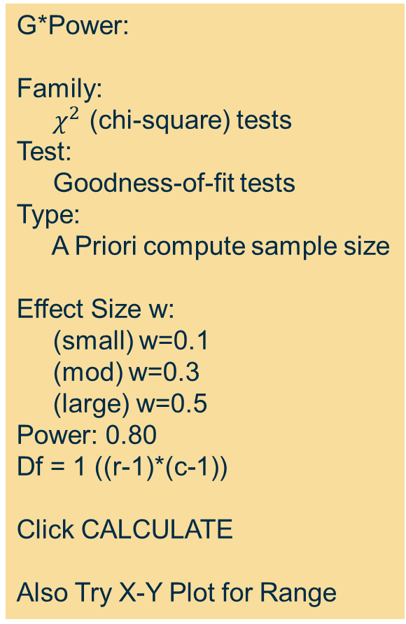
G*Power: Chi-square Test
G*Power:
Family:
$χ^{2}$ (chi-square) tests
Test:
Goodness-of-fit tests
Type:
A Priori compute sample size
Effect Size w:
(small) w=0.1
(mod) w=0.3
(large) w=0.5
Power: 0.80
Df = 1 ((r-1)*(c-1))
Click CALCULATE
Also Try X-Y Plot for Range

Slide 31
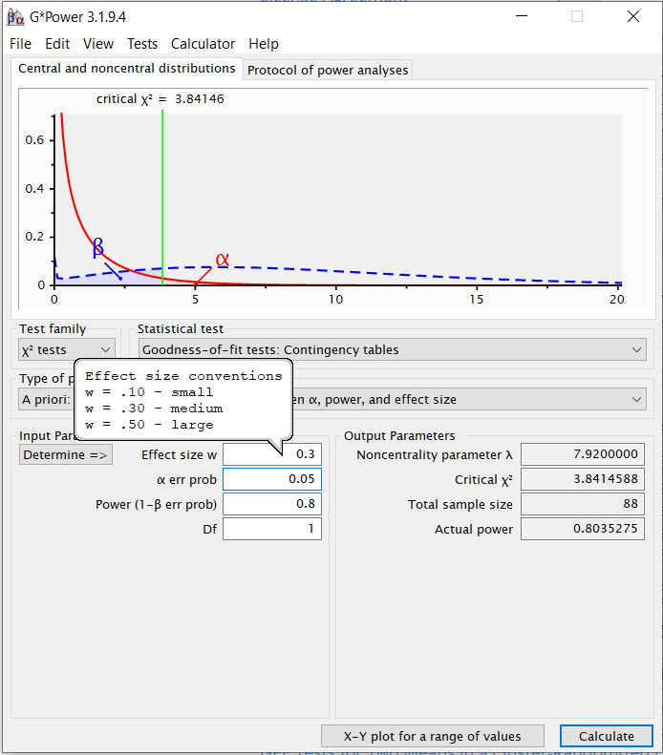
G*Power: Chi-square Test
G*Power:
Family:
$χ^{2}$ (chi-square) tests
Test:
Goodness-of-fit tests
Type:
A Priori compute sample size
Effect Size w:
(small) w=0.1
(mod) w=0.3
(large) w=0.5
Power: 0.80
Df = 1 ((r-1)*(c-1))
Click CALCULATE
Also Try X-Y Plot for Range

Slide 32
Test | Effect Size | Sample Size for 5% Significance Level and 80% Power
Chi-square test | (small) ω = 0.1 (df=1, for 2x2 table) ω = 0.1 (df=2, for 2x3 table) ω = 0.1 (df=3, for 2x4 table) (moderate) ω = 0.3 (df=1, for 2x2 table) ω = 0.3 (df=2, for 2x3 table) ω = 0.3 (df=3, for 2x4 table) (large) ω = 0.5 (df=1, for 2x2 table) ω = 0.5 (df=2, for 2x3 table) ω = 0.5 (df=3, for 2x4 table) | 785 964 1091 88 108 122 32 39 44

Slide 33
Effect Size (for Correlation/Regression) [Cohen, J. “Statistical Power Analysis for the Behavioral Sciences (2nd ed)” (1988)]
Correlation (r and r²) IS an Effect Size
“r”
r = 0.1 “small” r2=0.01
r = 0.3 “medium” r2=0.09
r = 0.5 “large” r2=0.25
Use these numbers as guidelines for your study.

Slide 34
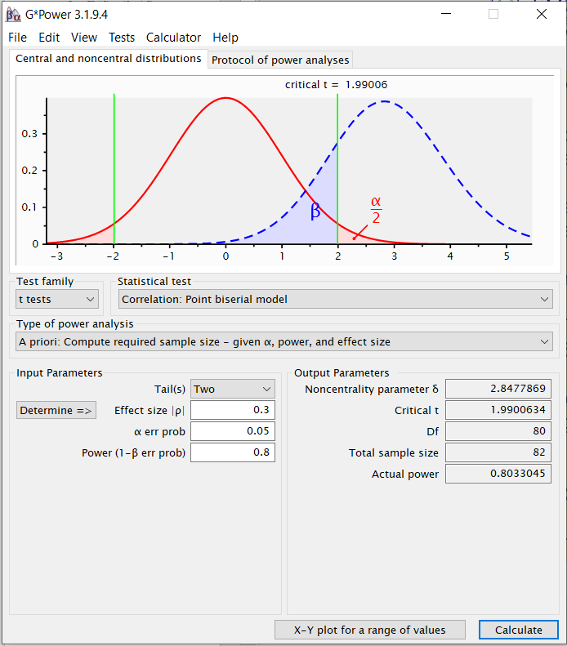
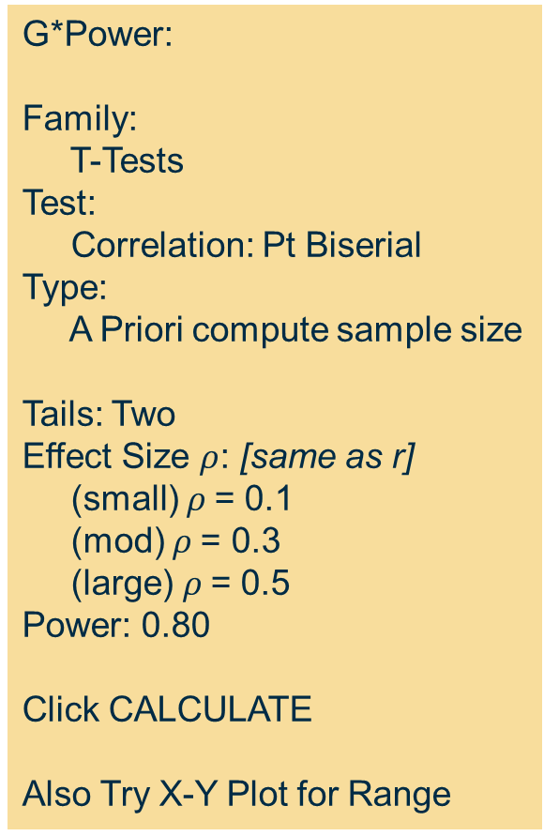
G*Power: Pearson’s Correlation
G*Power:
Family:
T-Tests
Test:
Correlation: Pt Biserial
Type:
A Priori compute sample size
Tails: Two
Effect Size $ρ$: [same as r]
(small) $ρ$= 0.1
(mod) $ρ$= 0.3
(large) $ρ$= 0.5
Power: 0.80
Click CALCULATE
Also Try X-Y Plot for Range

Slide 35
Test | Effect Size | Sample Size for 5% Significance Level and 80% Power
Pearson’s Correlation | r = 0.1 (sm) (r2=0.01) r = 0.3 (mod) (r2=0.09) r = 0.5 (large) (r2=0.25) | 779 82 26

Slide 36
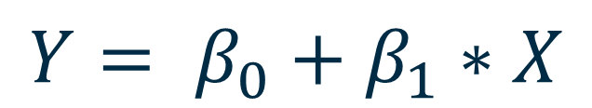
(Simple) Linear Regression
$$Y= β_{0}+β_{1}∗X$$
Slope for 1 predictor, 1 outcome = correlation (r)

Slide 37
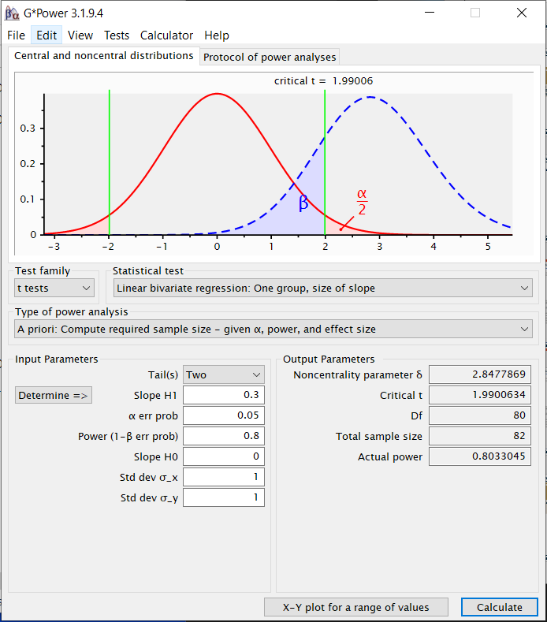
G*Power: Simple Linear Regression – via T-test
G*Power:
Family:
T-Tests
Test:
Linear Bivariate Reg:
One group, size of slope
Type:
A Priori compute sample size
Tails: Two
Effect Size Slope H1 (r):
(small) r=0.1
(mod) r=0.3
(large) r=0.5
Power: 0.80
Std dev for x and y = 1
Click CALCULATE
Also Try X-Y Plot for Range

Slide 38
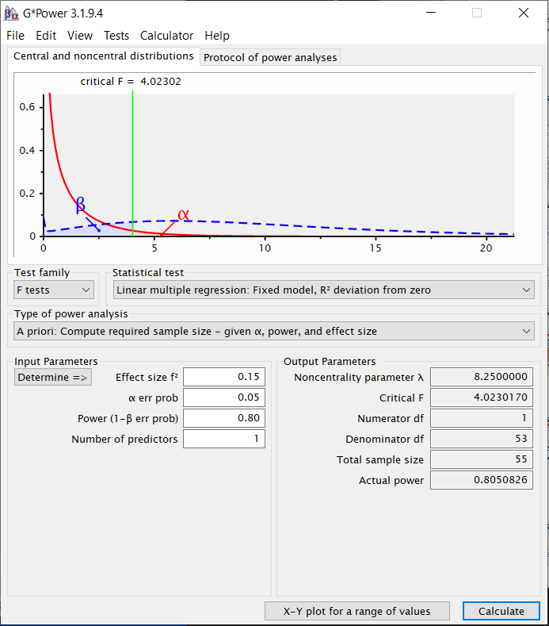
G*Power: Simple Linear Regression – via F-test
G*Power:
Family:
F-Tests
Test:
Linear multiple reg:
Fixed model R2 deviation
Type:
A Priori compute sample size
Effect Size f²:
(small) f² = 0.02
(mod) f² = 0.15
(large) f² = 0.35
Power: 0.80
Number predictors: 1
Click CALCULATE
Also Try X-Y Plot for Range

Slide 39
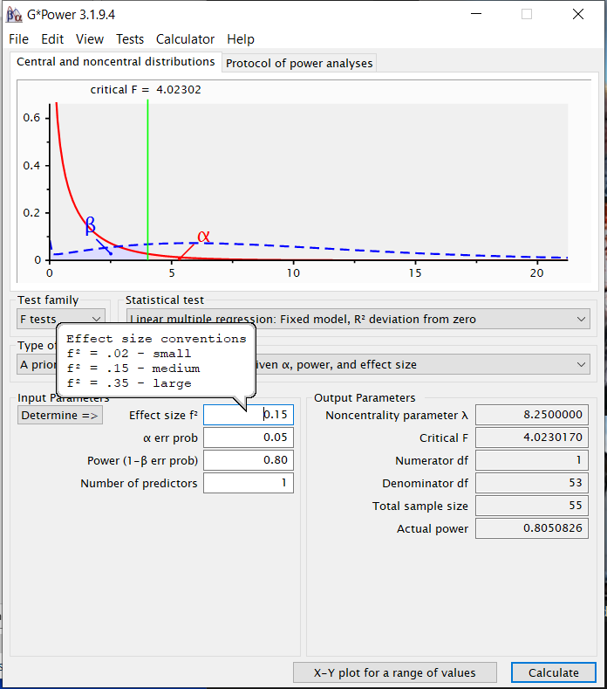
G*Power: Simple Linear Regression – via F-test
G*Power:
Family:
F-Tests
Test:
Linear multiple reg:
Fixed model R2 deviation
Type:
A Priori compute sample size
Effect Size f²:
(small) f² = 0.02
(mod) f² = 0.15
(large) f² = 0.35
Power: 0.80
Click CALCULATE
Also Try X-Y Plot for Range

Slide 40
Test | Effect Size | Sample Size for 5% Significance Level and 80% Power
Simple Linear Regression (1 predictor) | f² = 0.02 (sm) f² = 0.0989 (r=0.3, r2=0.09) f² = 0.15 (mod) f² = 0.35 (large) | 395 82 55 25

Slide 41
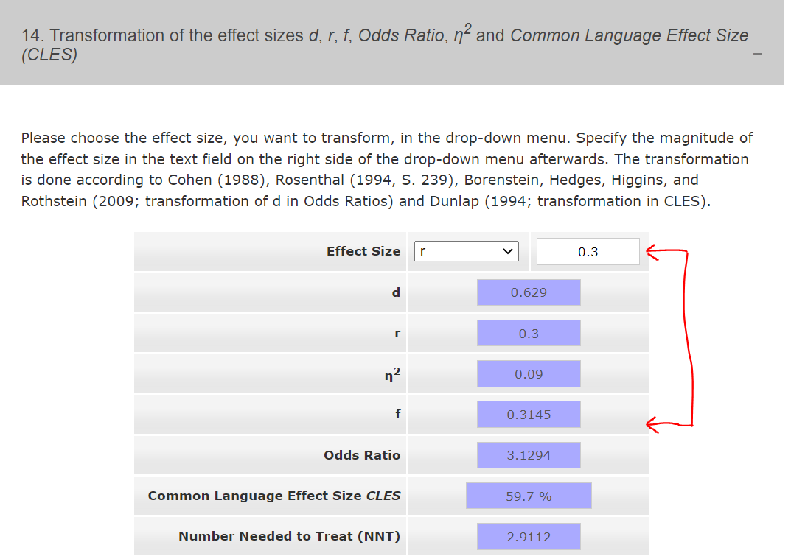
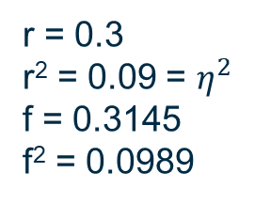
https://www.psychometrica.de/effect_size.html - see #14
r = 0.3
r² = 0.09 = $η^{2}$
f = 0.3145
f² = 0.0989

Slide 42
Sample Size recommendations
Number of model parameters (p) (usually number of predictors) < n
Rules of thumb: typically assume moderate effect sizes at 5% level of significance (alpha = Type I error = 0.05) and 80% power (Type II error = 0.20)
N => p*10 – sample size is 10x larger than number of predictors/parameters in model
Green (1991) for overall model fit: N => 50 + 8p – for 5 predictors you need 90+ subjects
Green (1991) for testing individual predictors: N => 104 + p – so for 5 predictors you need 109+ subjects
Khamis and Kepler (2010): N => 20 + 5p – for 5 predictors you’d need 45 – consider this a minimum when power estimates are not feasible
Need larger sample size when DV skewed, more measurement errors, smaller effect sizes

Slide 43
Power, Sample Size, Effect Size – G*Power
Given effect sizes f²=0.02 (small), 0.15 (moderate), 0.35 (large)
Green (1991):
N => (8/f²) + (p-1)
For p=5, f²=0.02, N => 404
For p=5, f²=0.15, N => 57.3 ~ 58
For p=5, f²=0.35, N => 26.9 ~ 27
Better yet – use software like G*Power

Slide 44
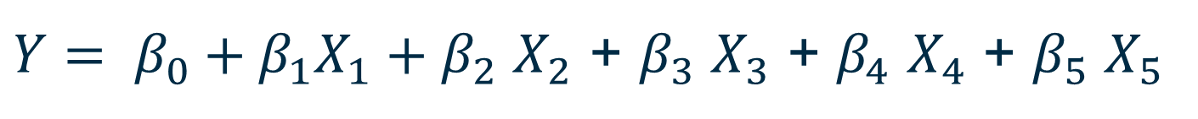
Linear Regression: Change in “r2”
$Y= β_{0}+β_{1}X_{1}+β_{2}$ $X_{2}$ + $β_{3}$ $X_{3}$ + $β_{4}$ $X_{4}$ + $β_{5}$ $X_{5}$
Suppose we want a final model with 5 predictors:
Where we are “controlling for” 3 covariates
And testing the significance of 2 predictors AFTER controlling for the first 3
You are interested in the CHANGE in r2 for the 2 tested predictors

Slide 45
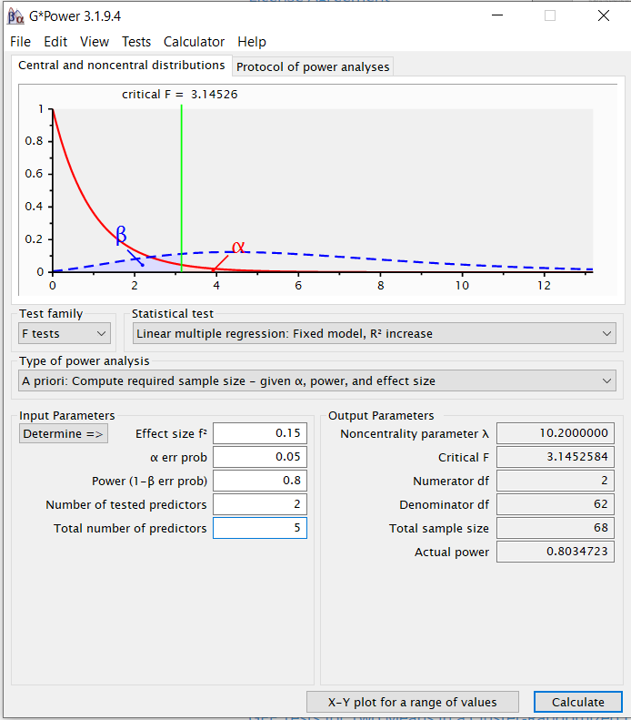
G*Power: Multiple Linear Regression – change in R2
G*Power:
Family:
F-Tests
Test:
Linear multiple reg:
Fixed model R2 increase
Type:
A Priori compute sample size
Effect Size f²:
(small) f² = 0.02
(mod) f² = 0.15
(large) f² = 0.35
Power: 0.80
Tested predictors: 2
TOTAL predictors: 5

Slide 46
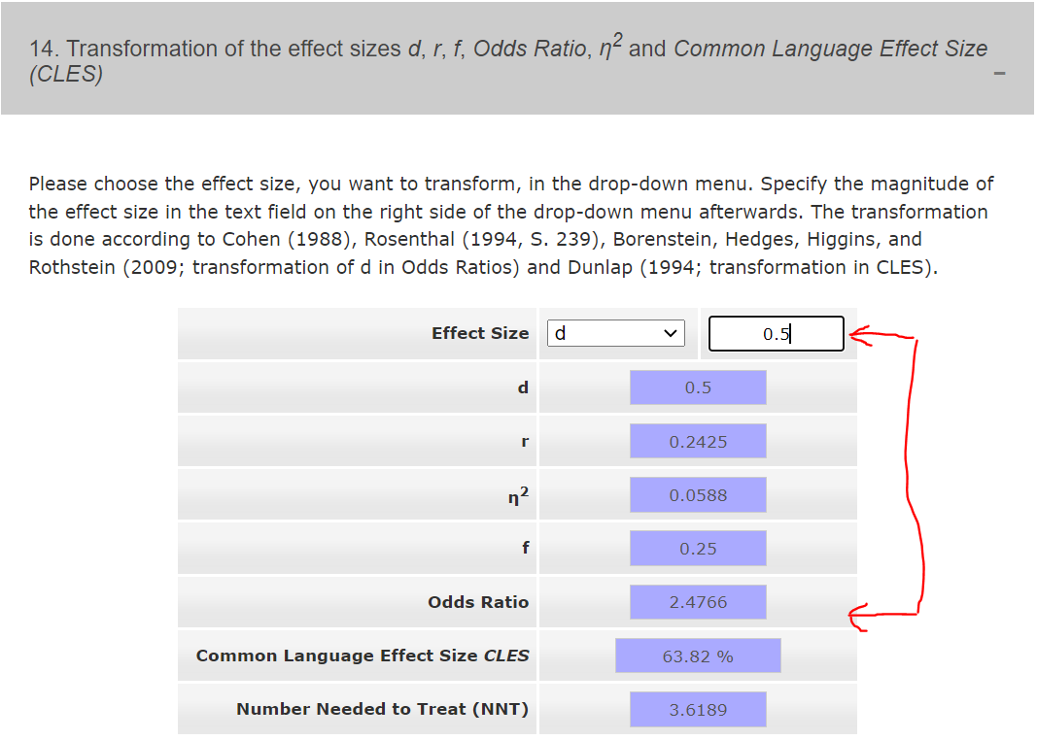
Logistic Regression

Slide 47
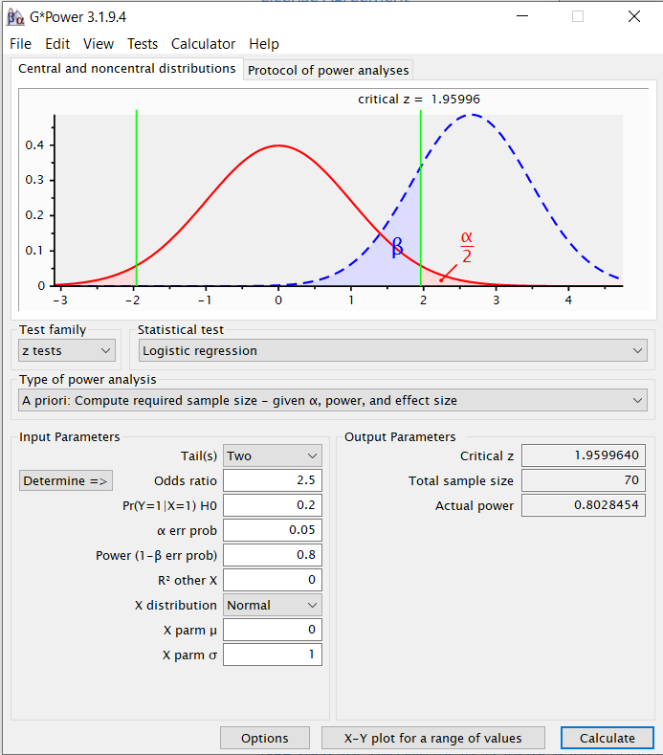
G*Power: Simple Linear Regression – via F-test
G*Power:
Family:
z Tests
Test:
Logistic Regression
Type:
A Priori compute sample size
Tails: Two
Odds Ratio: 2.5 (mod)
Pr(Y=1|X=1)H0 = 0.2
Power: 0.80
[keep defaults]
Click CALCULATE
Also Try X-Y Plot for Range

Slide 48
Test | Effect Size | Sample Size for 5% Significance Level and 80% Power
Logistic regression | Pr(Y=1 | X=1) H0 = 0.2 OR = 1.4 (~ d=0.2, sm) OR = 2.5 (~ d=0.5, mod) OR = 4.3 (~ d=0.8, lge) | 442 70 36
Note: It is good to know the probability of (proportion of) your sample that will have your outcome of interest. The smaller this probability, the larger your sample needs to be.
Pr(Y=1 | X=1) H0 = 0.2 = 20% of your sample has your outcome of interest. This can be/will often be a limiting factor. E.g. for the sample size of 36, only 7 people would have the outcome of interest…

Slide 49
Summary/Points to Remembers
Never accept the null hypothesis. Always state, “We can not reject the null hypothesis.”
Always design your “experiment” to reject the null hypothesis in order to accept the alternative (i.e. what you want to prove), given statistical significance is achieved.
Identify the statistical test(s) appropriate for testing your hypothesis(es).
Use the most conservative (largest) sample size estimate given your “effect size” of interest (i.e. clinically significant not statistically significant).

Slide 50
VIII. Statistical Resources and Contact Info
Contact
Dr. Melinda Higgins
Melinda.higgins@emory.edu
Office: 404-727-5180 / Mobile: 404-434-1785

