Slide 1
“Mediation vs. Moderation”
Melinda K. Higgins, Ph.D.
21 November 2008

Slide 2
Outline
Introduction
Covariates
Moderators – definitions/explanations
Mediators – definitions/explanations
Moderators – examples [SPSS and Interaction!]
Mediators – examples [SPSS and AMOS]
References

Slide 3
Introduction
Var1
“other variables”
Var2
IV
DV
Var3…
We want to establish and understand the relationship between the IV and the DV.
However, there are usually “other variables” that have to be considered which may change/alter the IV→DV relationship:
Covariates
Moderators
Mediators

Slide 4
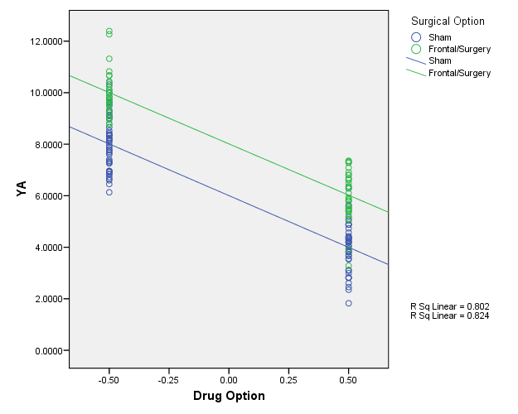
Covariates
We discussed Covariates in the last lecture – we put these into the model first (“control for”), but assume no further involvement (i.e. assume NO INTERACTIONS).
Slopes are parallel,
y-intercept changes

Slide 5
Moderators
“A moderator is an independent variable that affects the strength or direction of the association between another independent variable and an outcome variable. [Bennett]”
“A moderator is a 3rd variable that modifies a causal effect.”
“ A moderation effect is a causal model that postulates “when” or “for whom” an independent variable most strongly (or weakly) causes a dependent variable (i.e. modifying the strength or direction). …
“A simple analogy is a dimmer that adjusts the strength of a switch on the lighting.”
“… the moderation effect is more commonly known as the statistical term “interaction” effect [Wu, Zumbo]”
Mod
IV
DV

Slide 6
Mediators
“A mediator is a variable that specifies how the association occurs between an IV and a DV. A mediator effect is only tested when there is a significant direct effect between the IV and the DV, but there is a possibility that a mediator variable conceptually occurs “between” the IV and DV. [Bennett]”
“A mediator is a 3rd variable that links a cause and an effect.”
Mediator is a causal model that explains the process of “why” and “how” a cause-and-effect happens. … In other words, the IV is presumed to cause the mediator and the mediator causes the DV. [Wu, Zumbo]”
Med
a
b
IV
c
DV
c’

Slide 7
Moderators – “Interactions”
IV
** See Baron, Kenny (1986)
a
Block 1
Mod
b
DV
c
IV x Mod
Block 2
DV = intercept + a(IV) + b(Mod) + c(IV x Mod)
Y = β₀ + β₁X₁ + β₂X₂ + β₁₂X₁X₂ + ε
Step 1 – enter IV and Mod into model – may or may not be significant
Step 2 – add interaction term – see if “c” or β₁₂ is significant

Slide 8
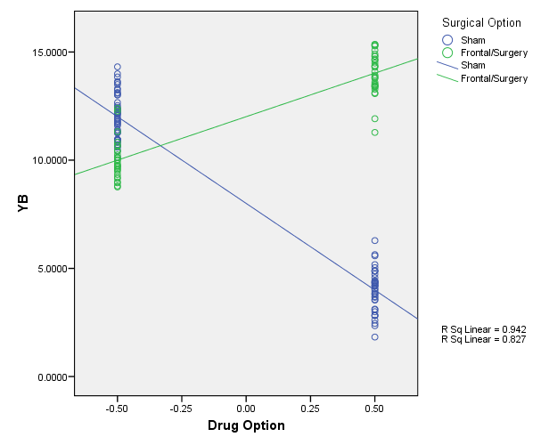
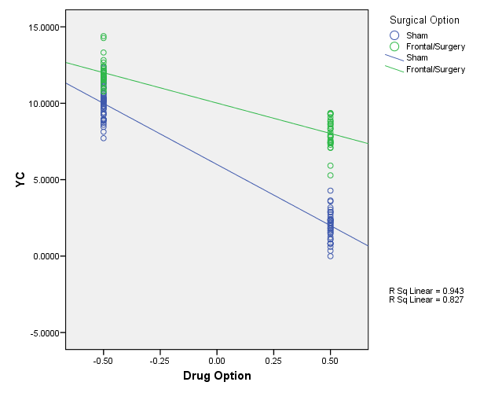
Moderators - Interactions
Moderators can be either categorical or continuous and can “interact” with either categorical or continuous IVs.
The resulting interaction effect can change either the magnitude of the slope, change its sign (positive to negative) or both.

Slide 9
Example [Cohen, Cohen, et.al. 2003]
250 subjects:
DV = Endurance
IV = Age (centered)
Mod = Previous Years of Vigorous Physical Exercise (centered)
Age
a
Block 1
Exercise
b
Endurance
c
Age x Exercise
Block 2
“centering” – i.e. subtracting the “grand mean” prevents “spurious relationships.”

Slide 10
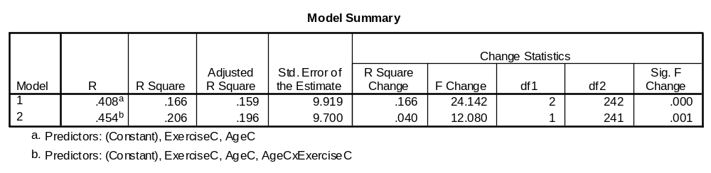
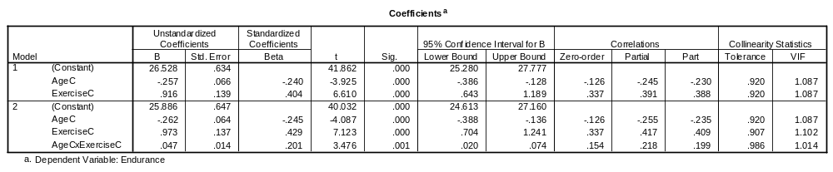
SPSS Regression Output

Slide 11
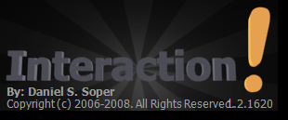
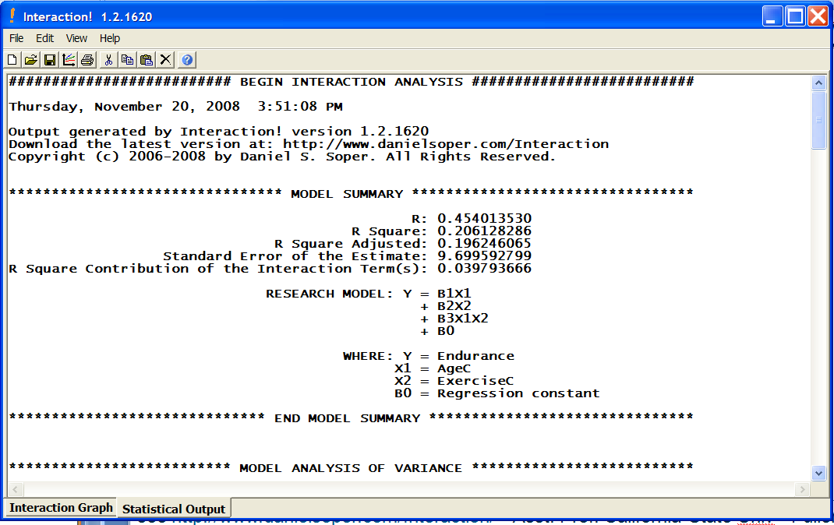
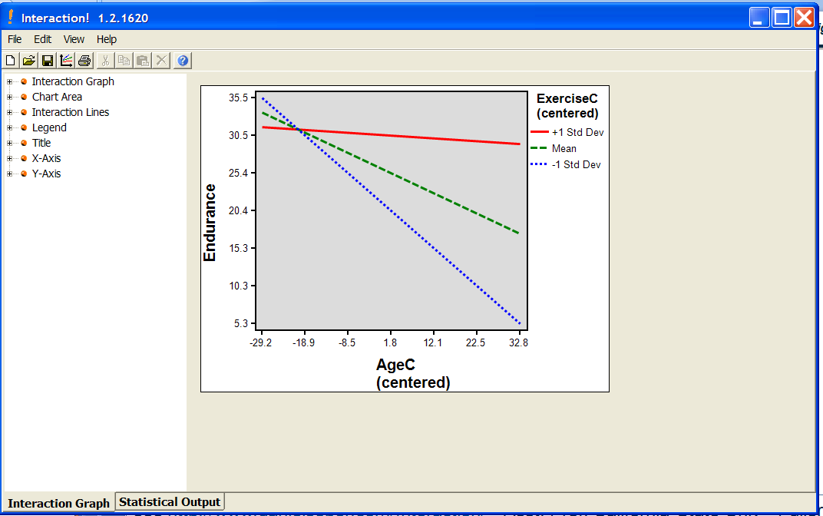
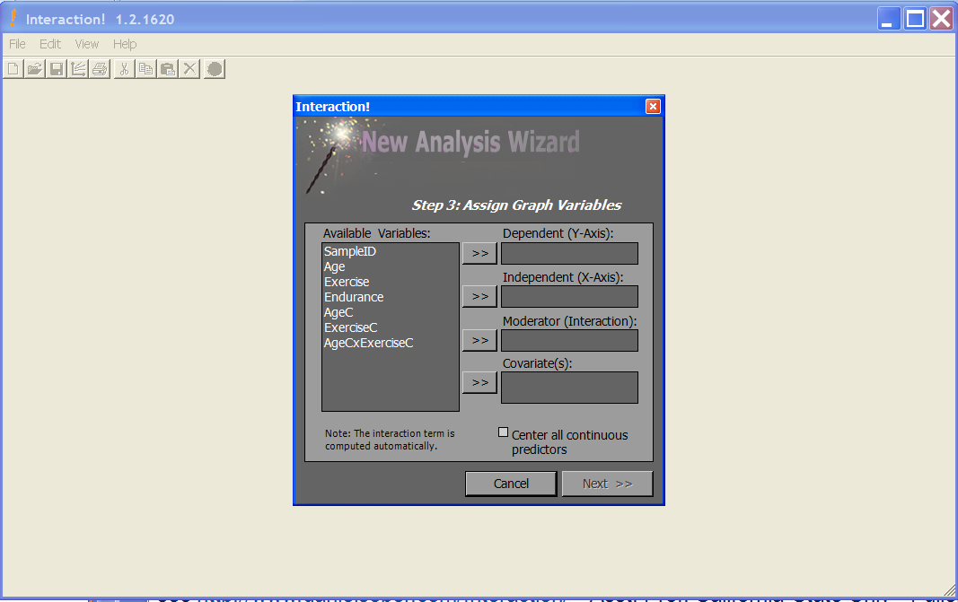
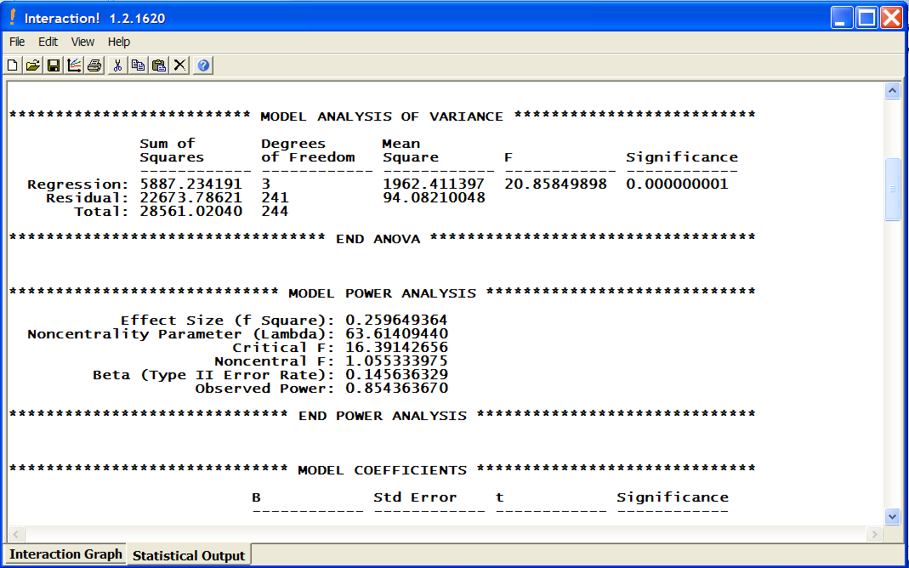
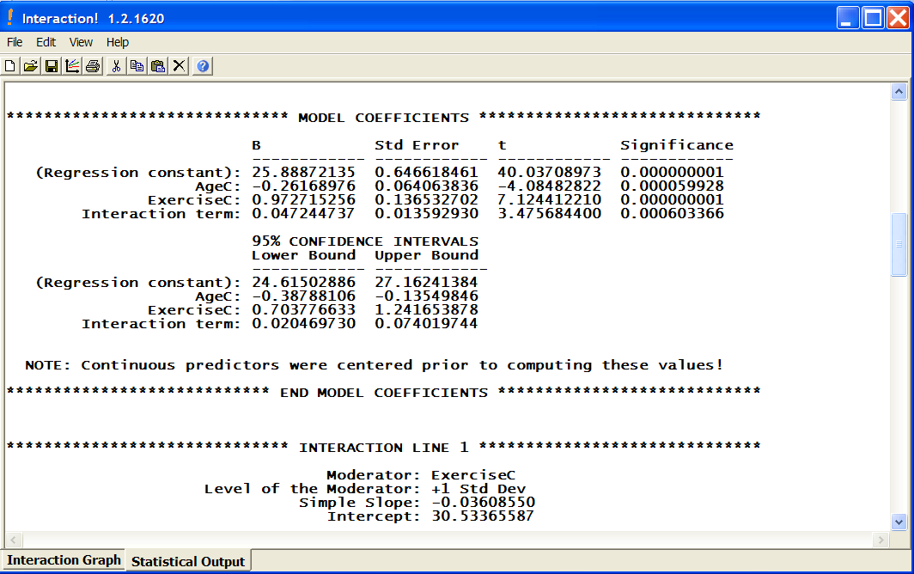
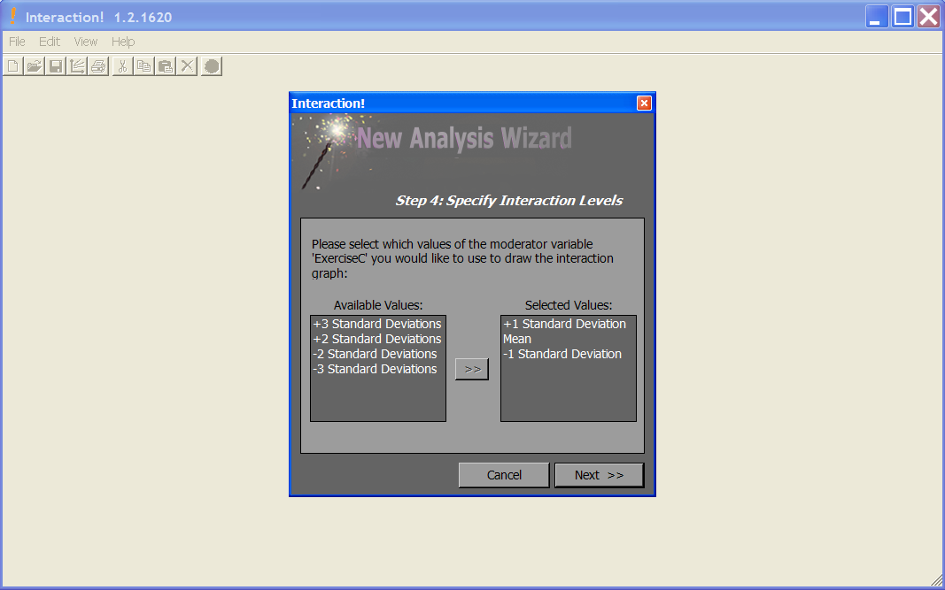
“Interaction” – $5 software
see http://www.danielsoper.com/Interaction/ - Asst. Prof. California State Univ - Fullerton

Slide 12
Mediators – How to test for …
[Preacher, Hayes] – 3 approaches:
(1) Baron, Kenny:
(i) Y = i₁ + cX
(ii) M = i₂ + aX
(iii) Y = i₃ + c’X + bM
(2) Sobel Test
(i) calculate ab (assumption Normal Distribution)
(ii) calculate s_{ab} = sqrt (b²s_{a}² + a²s_{b}² + s_{a}²s_{b}²)
(iii) divide ab/s_{ab} → compare to N(0,1) critical values
(3) Bootstrap sampling distribution for ab
“suffers from low power”
Med
a
b
IV
c
DV
c’

Slide 13
Example [Preacher,Hayes]
Attribution
a
b
Therapy
c
Satisfaction
c’
“An investigator is interested in the effects of a new cognitive therapy on life satisfaction after retirement. Residents of a retirement home diagnosed as clinically depressed are randomly assigned to receive 10 sessions of a new cognitive therapy or an alternative method. After session 8, the “positivity of attributions” the residents make for a recent failure experience is assessed. After session 10, the residents are given a measure of life satisfaction (questionnaire).”

Slide 14
SPSS Macro [Preacher, Hayes]:
Runs all 3 – Baron/Kenny, Sobel and Bootstrap
Open dataset
Open sobel_spss.sps – syntax file with macro – “select all” and click run
Open new syntax window – run
  sobel y=satis / x=therapy / m=attrib / boot=5000.
(4) WAIT!!!! It will seem like SPSS has locked up – but it is still running!!
See http://www.comm.ohio-state.edu/ahayes/sobel.htm

Slide 15
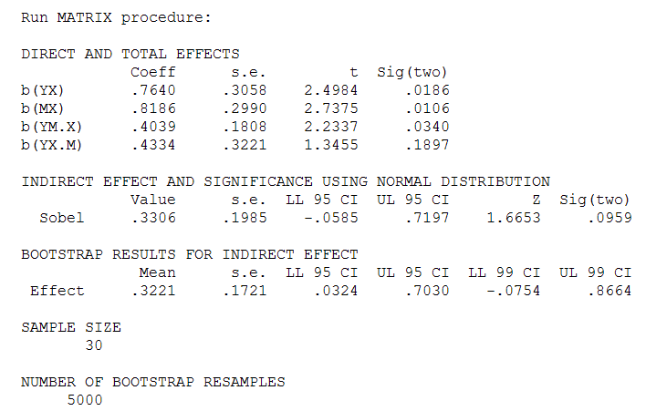
Baron/Kenny – YES mediator
c
a
b
SOBEL – NO mediator
c’
ab
ab – “boot”
Bootstrap – YES mediator

Slide 16
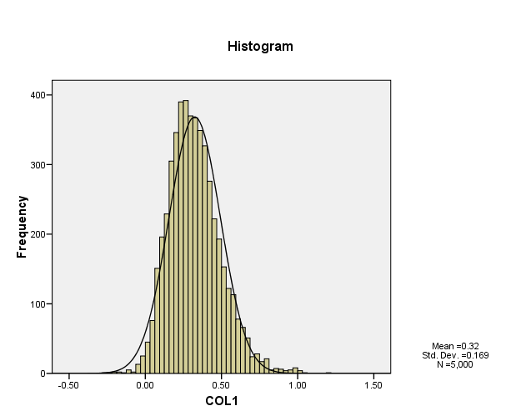
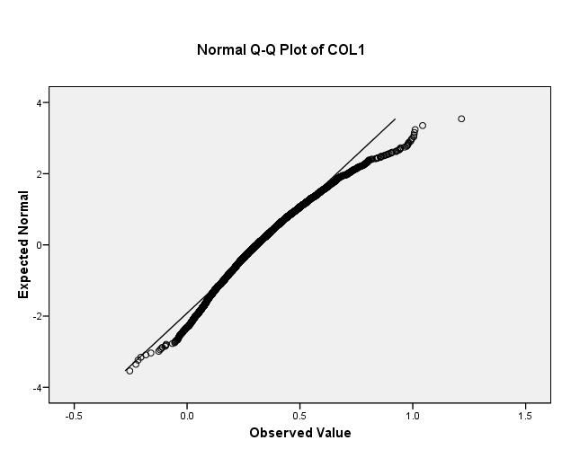
“ab” distribution – Sobel
Need for Bootstraping

Slide 17
Results – SPSS Macro
Therapy
c=.7640
Satisfaction
Attribution
a=.8186
b=.4039
Therapy
Satisfaction
c’=.4334
** not sig
(Baron/Kenny) C’ is not significantly different from 0 (pval=0.1897)
(Sobel) ab = 0.3306 95% CI = [-0.0585, 0.7197] not significant
(Bootstrap) ab = 0.3205 95% CI = [ 0.0334, 0.7008] significant

Slide 18
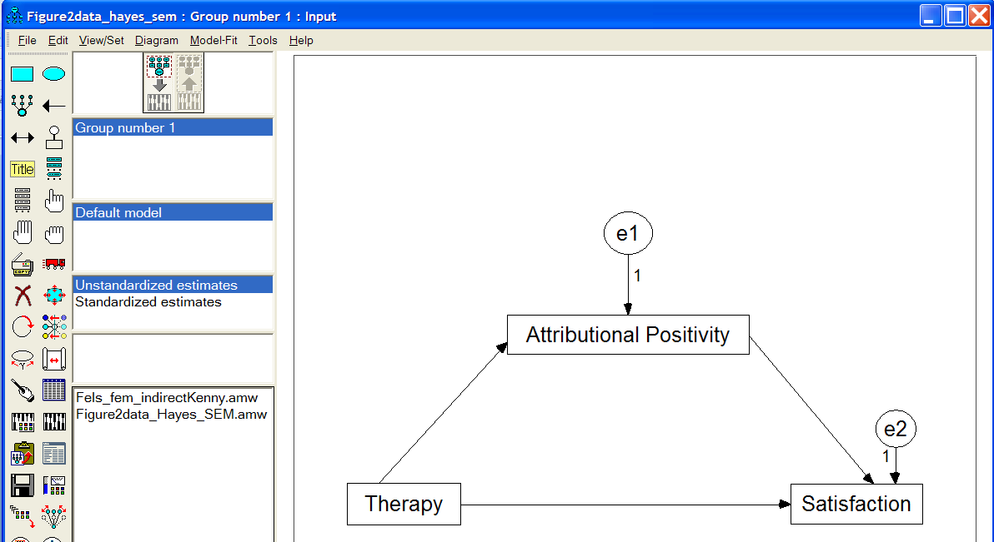
Example (cont’d) – Mediation Using Structural Equation Modeling (SEM) via AMOS
See http://davidakenny.net/cm/mediate.htm and tutorial (video and sound) at http://amosdevelopment.com/video/indirect/flash/indirect.html

Slide 19
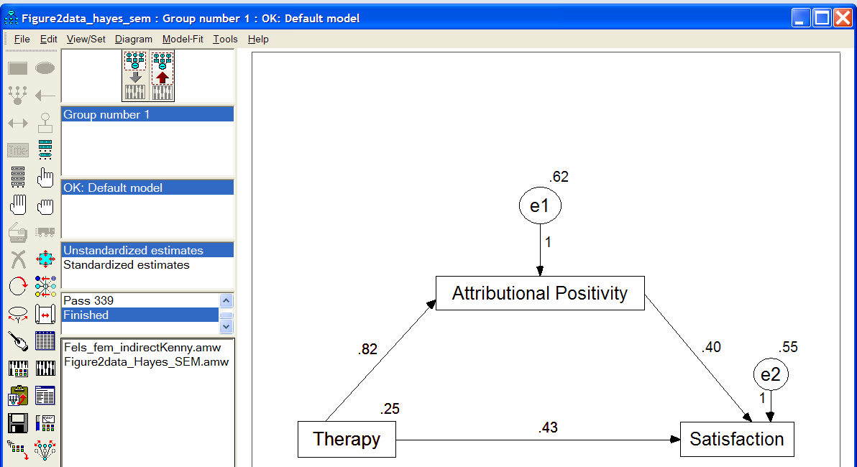
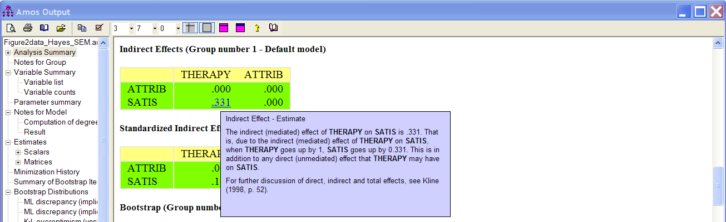
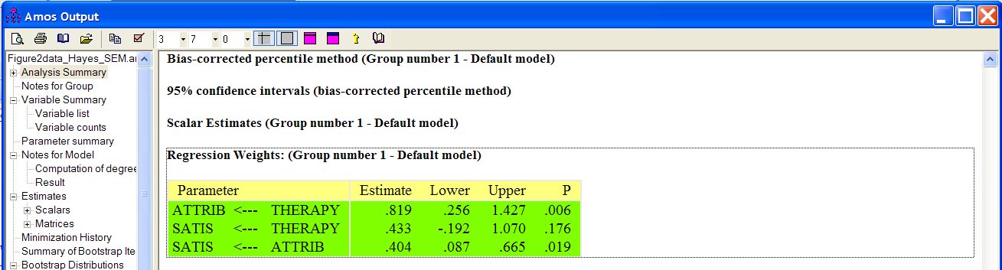
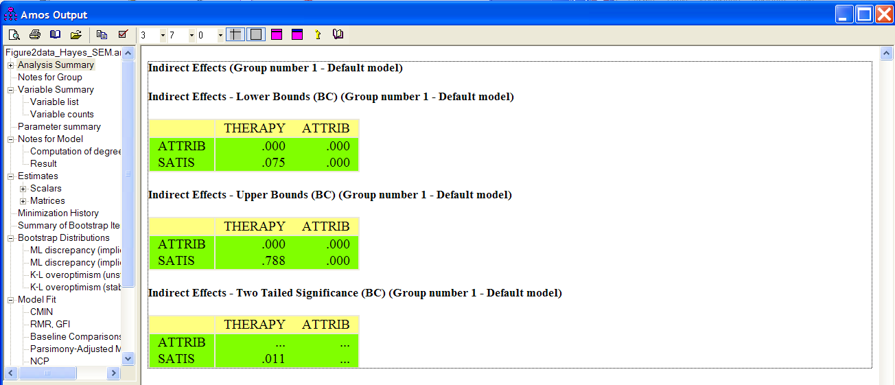
SEM (cont’d)
AMOS-boot 95%CI [0.075, 0.788]
Macro-boot 95%CI [0.0334, 0.7008]

Slide 20
Summary
Moderator
“interaction”
affects strength or
direction of IV-DV
explains "when" or
"for whom"
modifies a causal effect
Mediator
only tested then there is a
significant effect between
IV-DV
specifies how the association
occurs BETWEEN IV-DV
explains "why" and "how"
links a cause (IV) and
effect (DV)

Slide 21
References
Bennett, Jill. “Mediator and Moderator Variables in Nursing Research: Conceptual and Statistical Differences.” Research in Nursing and Health, 23, 2000, pp. 415-420.
Wu, Amery; Zumbo, Bruno. “Understanding and Using Mediators and Moderators.” Social Indicators Research, 87 (3), July 2008, pp. 367-392. [DOI 10.1007/s11205-007-9143-1]
Baron, Reuben; Kenny, David. “The Moderator-Mediator Variable Distinction in Social Psychological Research: Conceptual, Strategic, and Statistical Considerations.” Journal of Personality and Social Psychology, 51 (6), 1986, pp. 1173-1182.
Preacher, Kristopher; Hayes, Andrew. “SPSS and SAS procedures for estimating indirect effects in simple mediation models.” Behavior Research Methods, Instruments and Computers, 36 (4), 2004, pp. 717-731.
Cohen, Jacob; Cohen, Patricia; West, Stephen; Aiken, Leona “Applied Multiple Regression/Correlation Analysis for the Behavioral Sciences” 3rd edition, Lawrence Erlbaum Associates Inc., 2003.

Slide 22
VIII. Statistical Resources and Contact Info
SON S:\Shared\Statistics_MKHiggins\website2\index.htm
[updates in process]
  Working to include tip sheets (for SPSS, SAS, and other software), lectures (PPTs and handouts), datasets, other resources and references
  Statistics At Nursing Website: [website being updated] http://www.nursing.emory.edu/pulse/statistics/
  And Blackboard Site (in development) for “Organization: Statistics at School of Nursing”
Contact
    Dr. Melinda Higgins
    Melinda.higgins@emory.edu
    Office: 404-727-5180 / Mobile: 404-434-1785

