Slide 1
“Longitudinal Data – Repeated Measures, Survival (Time to Event) and Cox Proportional Hazards Models”
Melinda K. Higgins, Ph.D.
18 April 2008

Slide 2
Outline
Repeated Measures
  RM-ANOVA - step-by-step (one-way univariate)
  “Profile Analysis” approach [Tabachnick & Fidell]
Time to Event
  Survival Analysis (Kaplan-Meier)
  Risk or Hazards Assessment of “covariates” (e.g. Cox Proportional Hazards Regression)

Slide 3
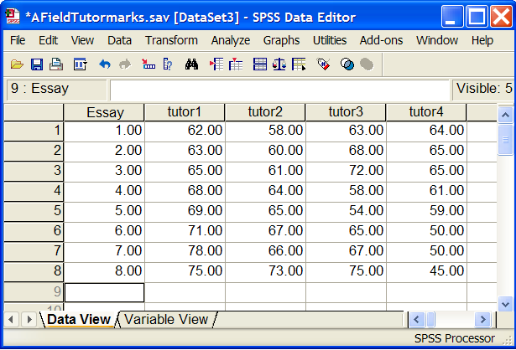
Repeated Measures
8 Essays (“subjects”)
4 Tutors (“repeated for essays”)
One-way Repeated Measures:
evaluate within-subject variance
evaluate difference across repeated measure
evaluate contrasts between levels of repeated measures
Post hoc tests and options (main effects tests)

Slide 4
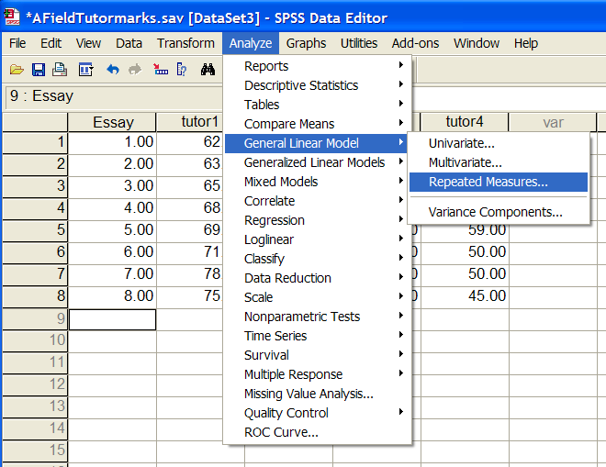
RM-ANOVA – set-up in SPSS

Slide 5
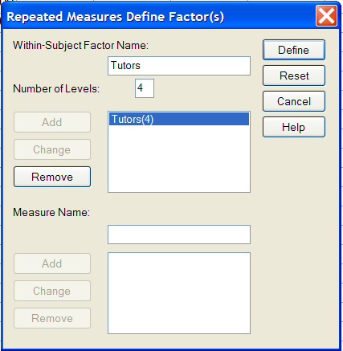
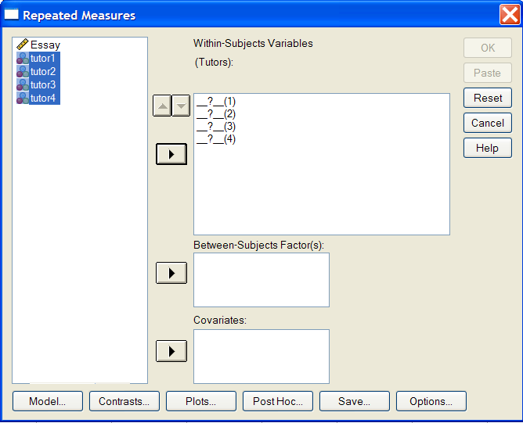
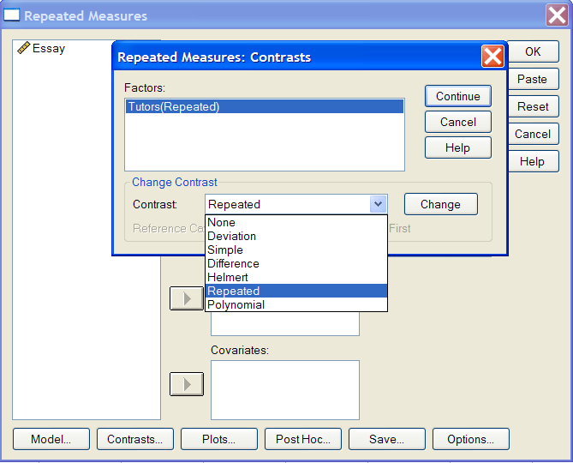
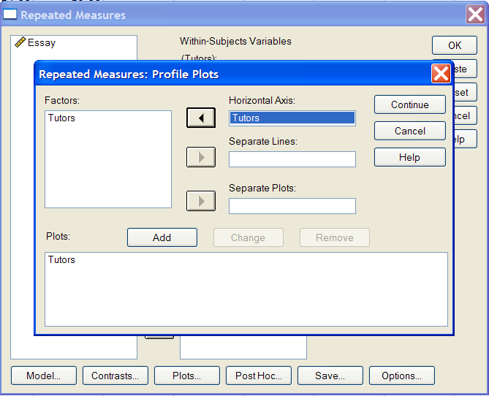
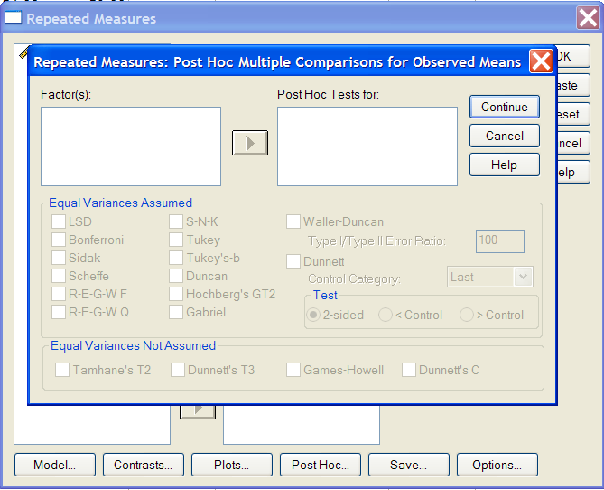
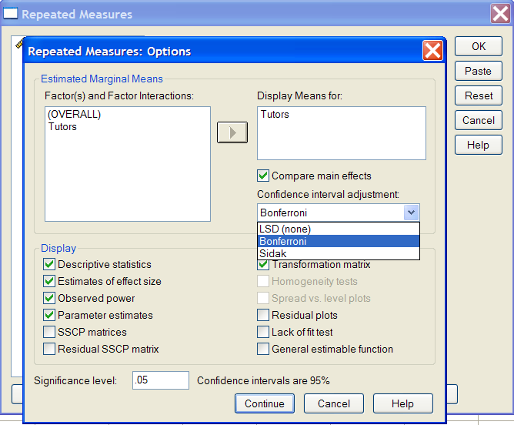
Type III SS – most common/default

Slide 6
Contrasts – Options
Deviation. Compares the mean of each level (except a reference category) to the mean of all of the levels (grand mean). The levels of the factor can be in any order.
Simple. Compares the mean of each level to the mean of a specified level. This type of contrast is useful when there is a control group. You can choose the first or last category as the reference.
Difference. Compares the mean of each level (except the first) to the mean of previous levels. (Sometimes called reverse Helmert contrasts.)
Helmert. Compares the mean of each level of the factor (except the last) to the mean of subsequent levels.
Repeated. Compares the mean of each level (except the last) to the mean of the subsequent level.
Polynomial. Compares the linear effect, quadratic effect, cubic effect, and so on. The first degree of freedom contains the linear effect across all categories; the second degree of freedom, the quadratic effect; and so on. These contrasts are often used to estimate polynomial trends.
Order is important
First example, we’ll use Repeated since there is no good “reference” level or category.

Slide 7
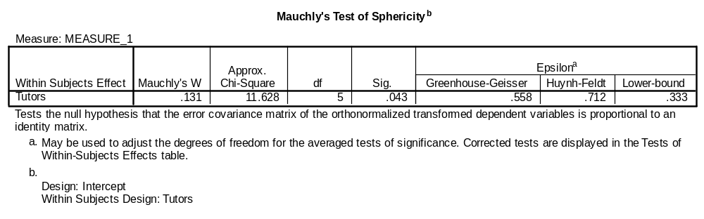
Evaluate Sphericity
Sphericity is the equality of variances of the differences b/t repeated measures
Use G-G, maybe …
If p-value < 0.05, be WARY of F-tests. But a few corrections exist - review Greenhouse-Geisser and Huynh-Feldt
Greenhouse-Geisser (G-G) – closer to 1, more homogeneous the differences (closer to sphericity) – compare to “lower-bound” [want closer to 1 than lower-bound] – “tends to be too conservative”
Huynh-Feldt (H-F) – if G-G>0.75 use H-F correction; if G-G<0.75 use G-G correction
(or take average of p-val between G-G and H-F)
Field, Andy; Discovering Statistics Using SPSS, 2nd ed.; SAGE Publications: London (2005).

Slide 8
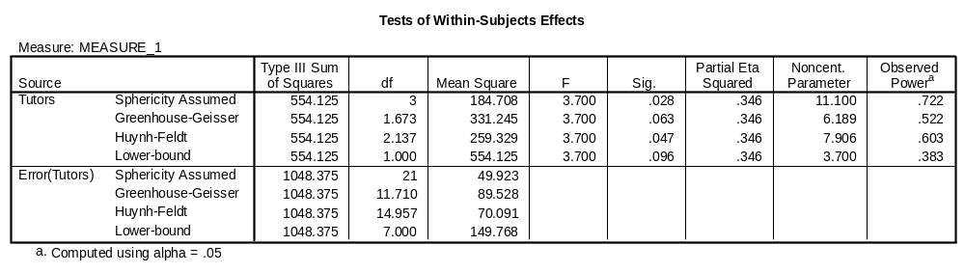
Main Repeated Measures Effects
(Tests of Within-Subjects)
Sphericity was violated, and the G-G correction was indicated, although it can “tend to be too conservative.
G-G indicates we should not reject Ho: no difference across within-subjects (between the tutors).
But the H-F is significant and indicates we should reject Ho.
A. Field suggest taking the average to get a p-val = (.063+.047)/2 = .055, do not reject Ho.

Slide 9
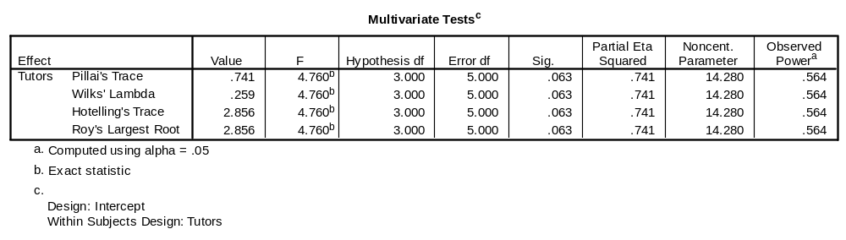
Also check Multivariate Tests
Now the p-value for all multivariate tests is 0.063, which definitely indicates that we should not reject Ho = “all tutors score the same.”
Ideally, the analysis stops here since we have concluded there is no significant difference across all of the tutors.
However, for completeness we can look at the contrasts results

Slide 10
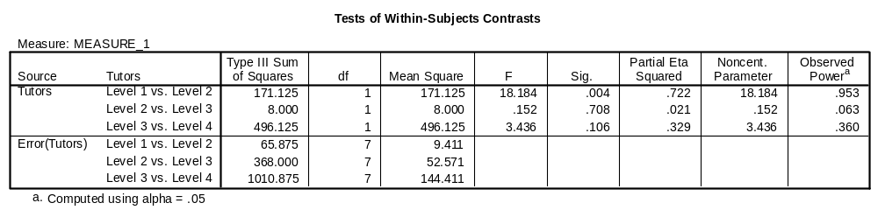
Contrasts
Only the difference between “Level 1 [Dr. Field]” and “Level 2 [Dr. Smith]” was significant. [Although this result would be ignored since the main effect test for tutor was non-significant and sphericity was violated.]
Look at the “Means Plot” as well as boxplots (“summaries of separate variables” for all of the tutors)

Slide 11
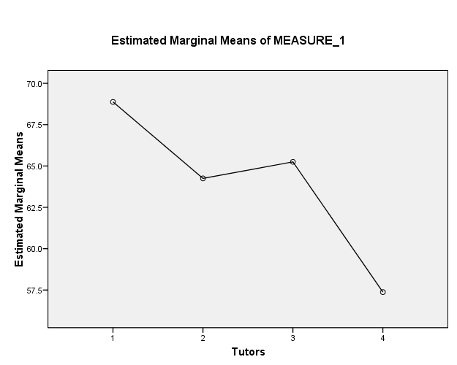
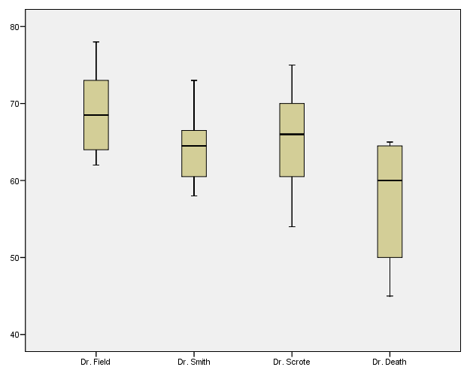
Means Plot and Boxplots
Tutors 1=Dr. Field; 2=Dr. Smith; 3=Dr. Scrote 4=Dr. Death

Slide 12
Mixed Design ANOVA
(Between-groups and Repeated Measures)
Wechsler Intelligence Scale for Children (WISC) – 11 subtests
Primary question: Do profiles of learning-disabled children on the WISC subtests differ if the children are grouped by the age of their playmates?
177 subjects
3 Age-groups (age of playmate) [younger, older, same age]
11 Subtests (“repeated” measured for every subject)
[Information; Comprehension; Arithmetic; Similarities; Vocabulary; Digit Span; Picture Completion; Picture Arrangement; Block Design; Object Assembly; Coding]
Mixed Design Repeated Measures:
evaluate between-group effects
evaluate within-subject variance
evaluate difference across repeated measure (“profiles”)
evaluate interactions between and within factors
optional comparisons
Between
Within – multiple DVs
Tabachnick, B. G.; Fidell, L. S. Using Multivariate Statistics (5th Ed.). Pearson Edu. Inc.: Boston, MA (2007).

Slide 13
“Profile” Analysis vs MANOVA
In “Profile” Analysis, the “repeated measures” (DVs) are all evaluated together.
  In MANOVA – the DVs are treated/evaluated directly.
In “Profile” Analysis, interactions between “repeated measures” and “between-group” factor(s) can be evaluated
  In MANOVA, since DVs are evaluated directly, no interactions can be evaluated.

Slide 14
“Profile” Analysis Goals/Aims
Major Question: Whether or not groups have different profiles on (over) a set of measures [note the scales of the “repeated measures” assumed to be the same]
Parallelism – do different groups have parallel profiles [i.e. is there interaction between the “Between-Group/Subjects” factor and “Within/Repeated Measures.”]
Levels Test – regardless of parallelism, does one group on average differ significantly from the others [Between-Subjects Main Effects]
Flatness – independent of groups, do all DVs/repeated measures elicit the same average response? [Within-Subjects Effects]

Slide 15
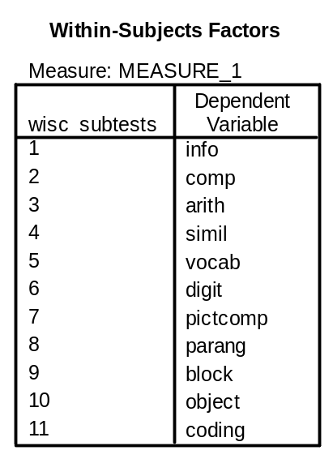
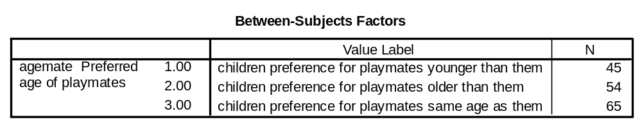
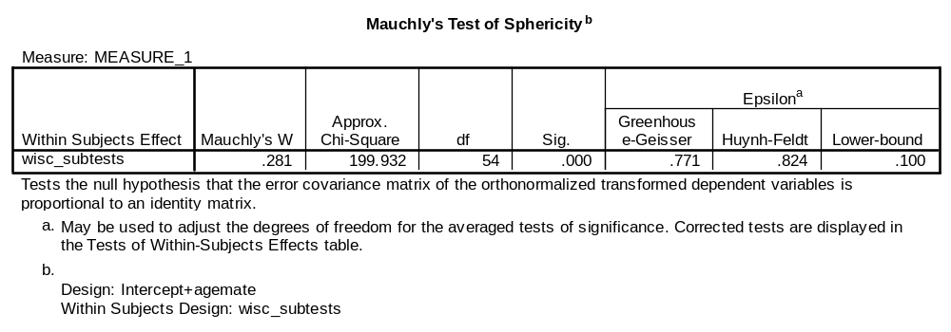
“Profile Analysis” of the WISC Data
Sphericity violated and G-G>0.75 – use H-F

Slide 16
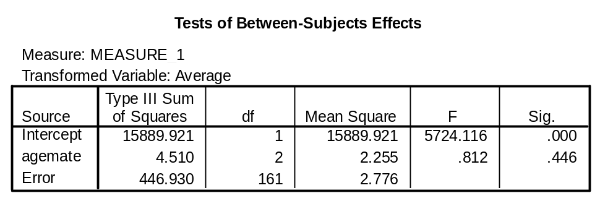
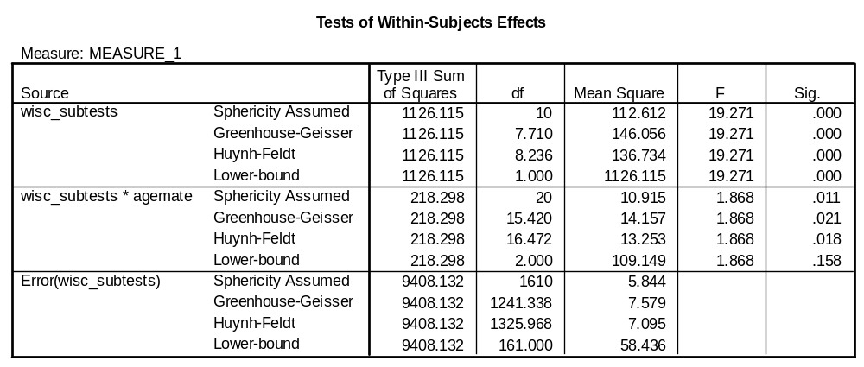
Levels Test – differences between agemate groups is not significant
Flatness Test – differences within (across) wisc_subtests (repeated measures) is significant
Parallel Test – there are significant interactions between wisc_subtests and agegroups [i.e. profiles are NOT parallel]

Slide 17
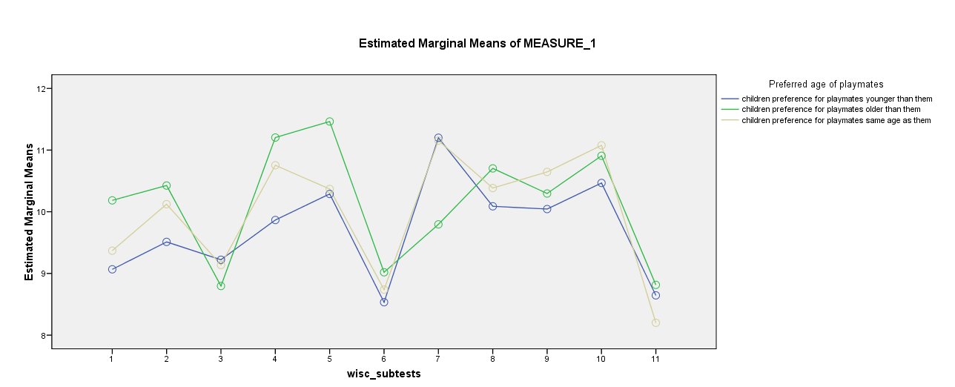
Means Plots – Compare Profiles
NOTE: If the Between-Subjects Effects are significant (Levels Test) – you can use these “profiles” as inputs for group classification via Discriminant Analysis

Slide 18
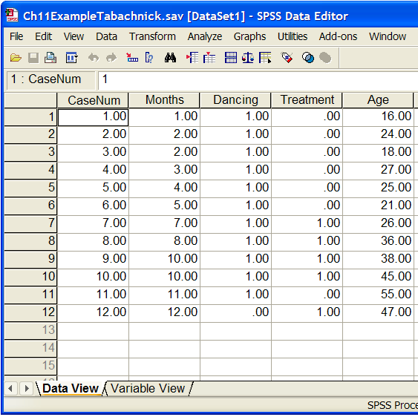
Time to Event – Survival Analysis
12 Subjects (very small sample!!)
“Event” – stopped dancing (=1)
2 Treatment Levels (0=control; 1=tmt)
Age when subject began dancing is a “covariate”
Look at Survival Curves
Kaplan-Meier (product-limit method) – group differences in survival times and/or proportions surviving at specific times
Cox Regression – prediction survival times from covariates

Slide 19
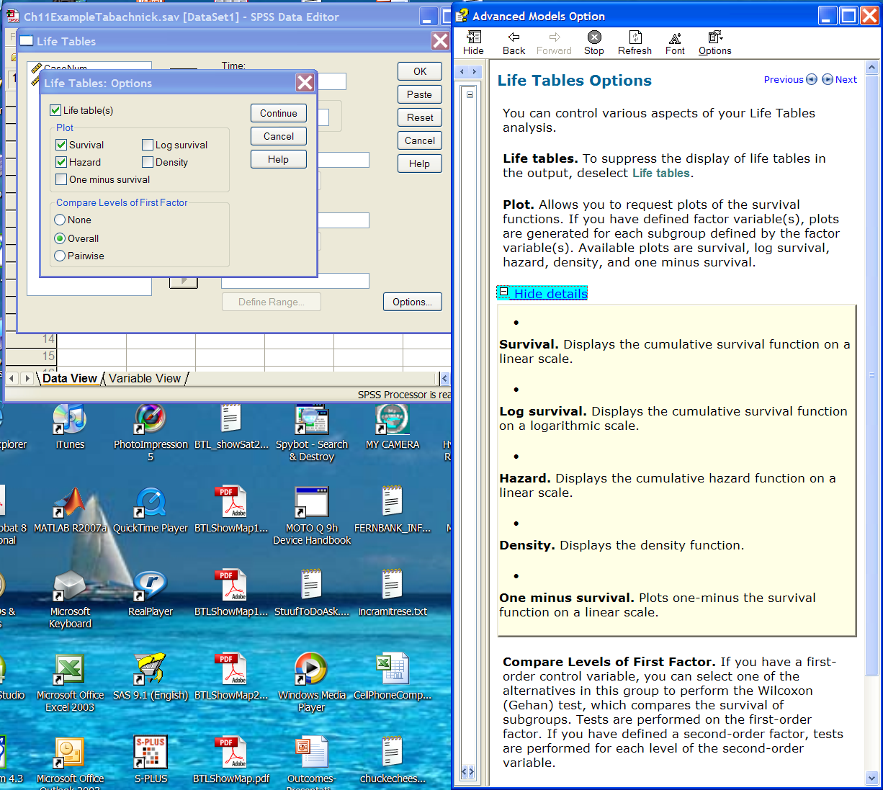
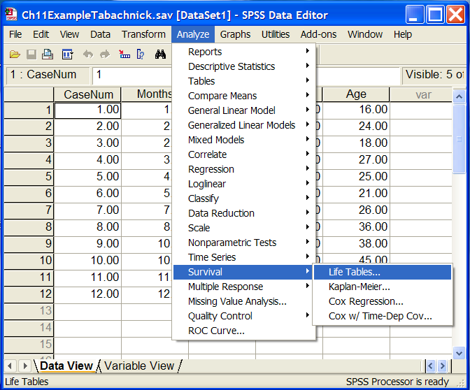
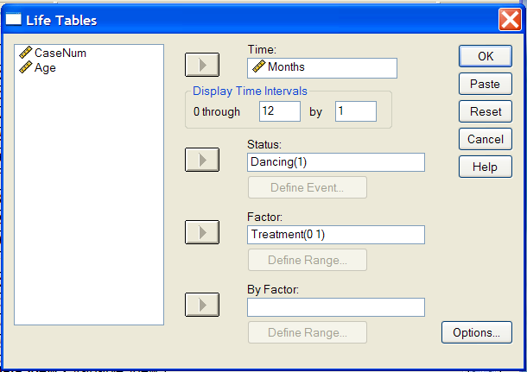

Slide 20
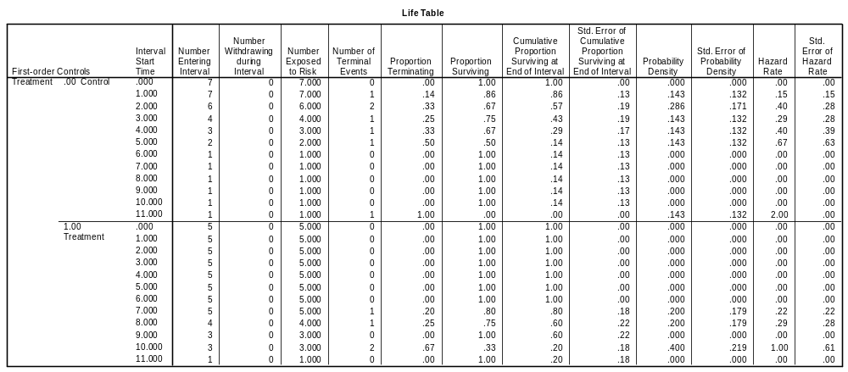
SURVIVAL
TABLE=Months BY Treatment(0 1)
/INTERVAL=THRU 12 BY 1
/STATUS=Dancing(1)
/PRINT=TABLE
/PLOTS ( SURVIVAL HAZARD )=Months BY Treatment
/COMPARE=Months BY Treatment .

Slide 21
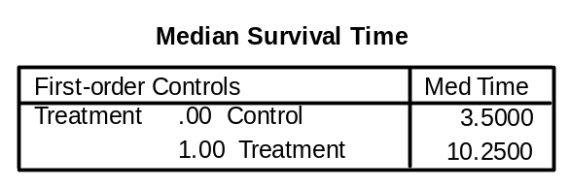
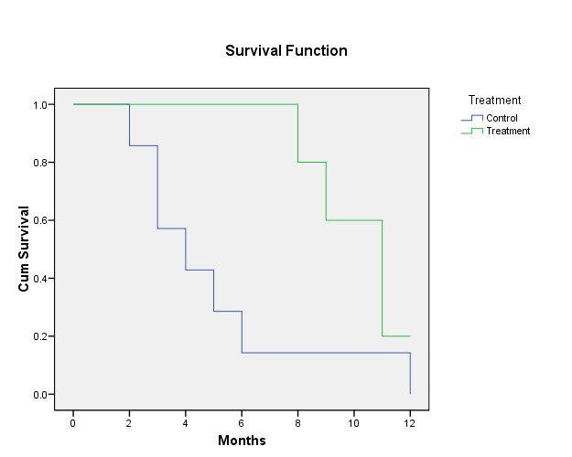
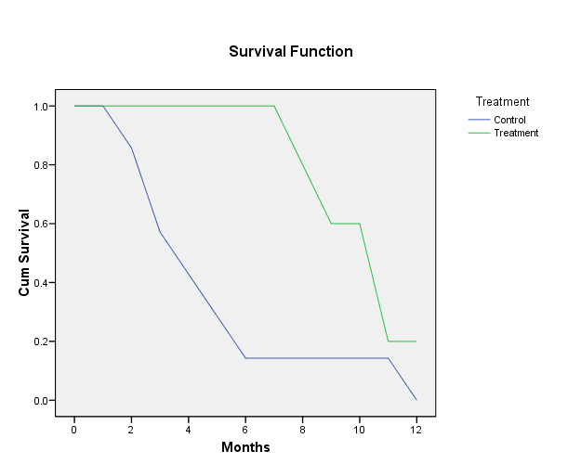
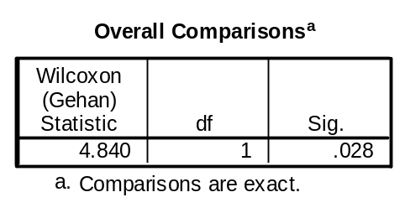
Median Survival Time Differ quite a bit
Line type = step
Line type = straight
Group differences are significant

Slide 22
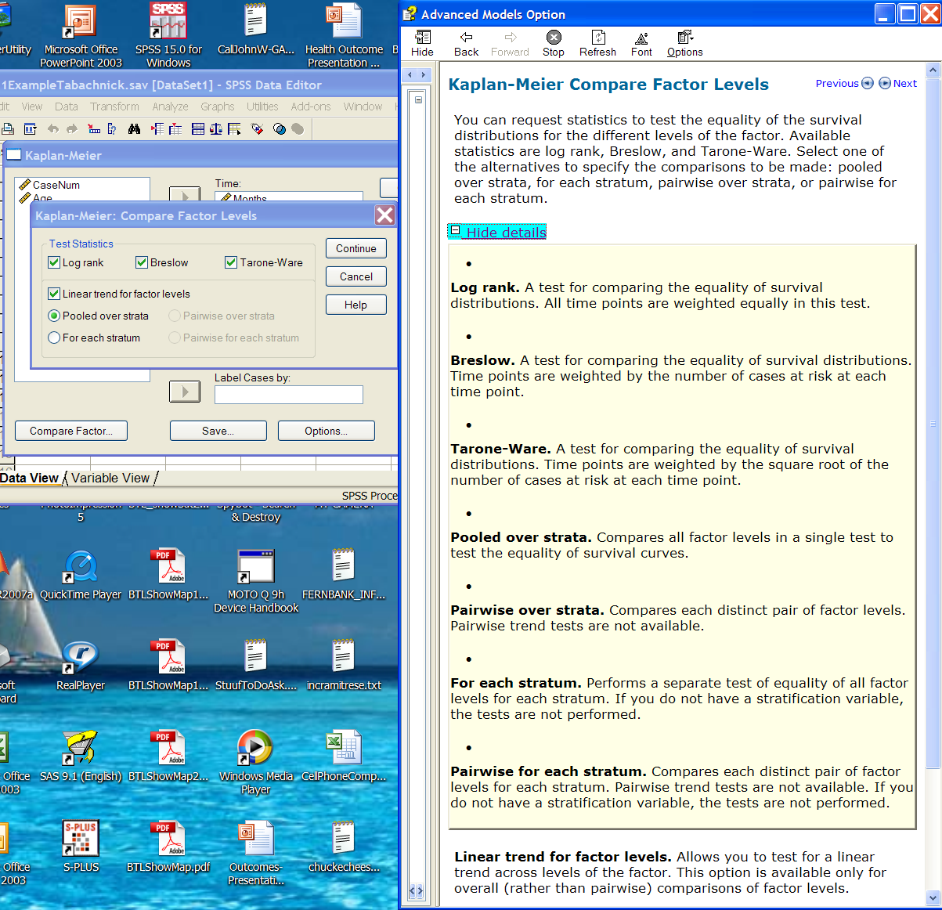
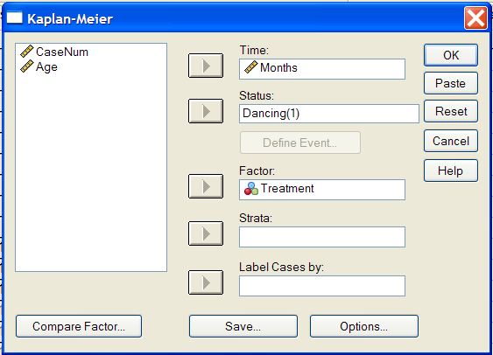
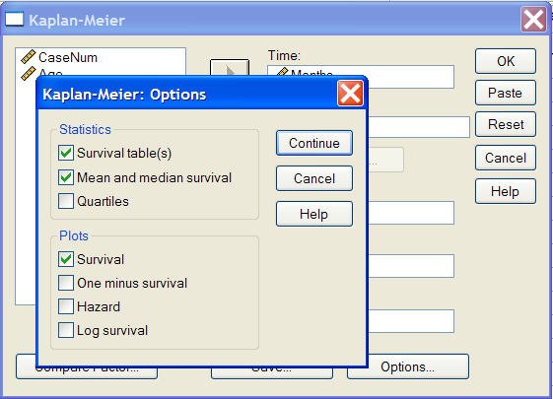
Kaplan-Meier
Group Differences Tested via χ²

Slide 23
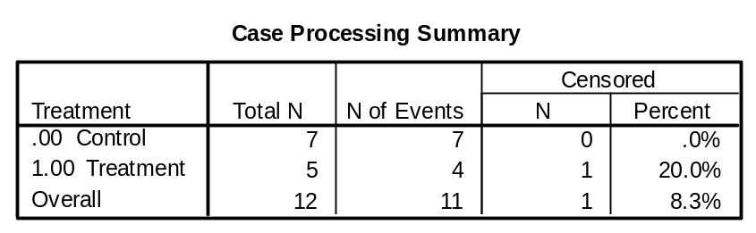
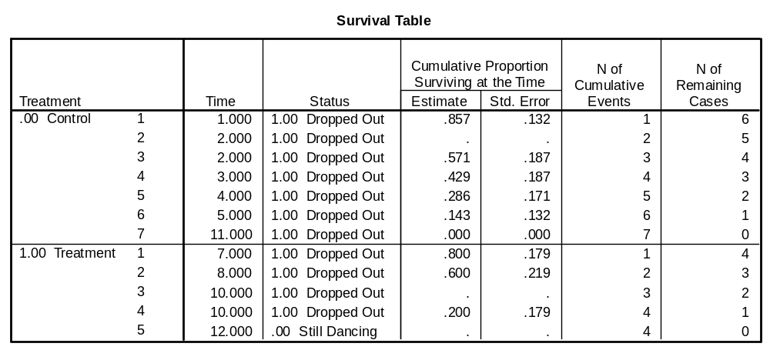
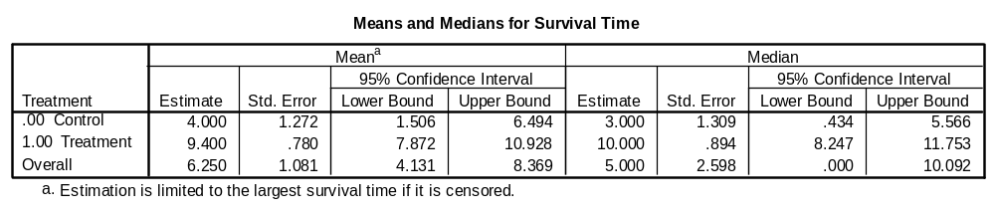
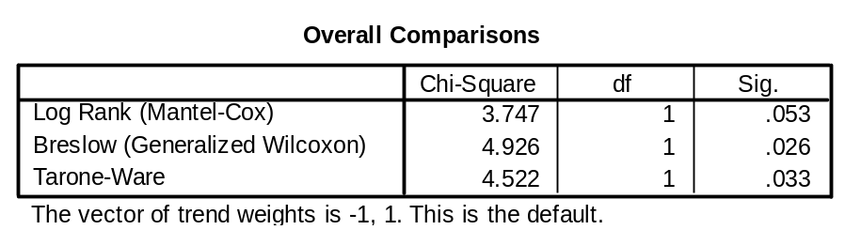

Slide 24
Cox Regression
Cox Proportional-Hazards Regression Model – models event rates as a log-linear function of predictors (called “covariates”).
The regression coefficients give the relative effect (or risk) of each “covariate” on the survivor function.
NOTE: “Covariates” are both the usual covariates, but also include independent predictors and group variables (treatment)

Slide 25
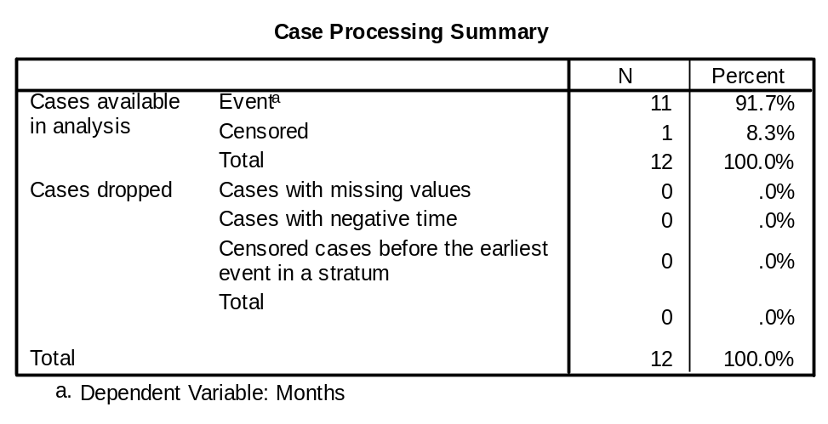
COXREG
Months /STATUS=Dancing(1)
/PATTERN BY Treatment
/CONTRAST (Treatment)=Indicator
/METHOD=ENTER Age /METHOD=ENTER Treatment
/PLOT SURVIVAL
/PRINT=CI(95) BASELINE
/CRITERIA=PIN(.05) POUT(.10) ITERATE(20) .

Slide 26
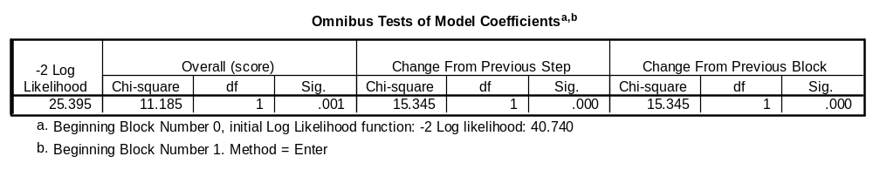
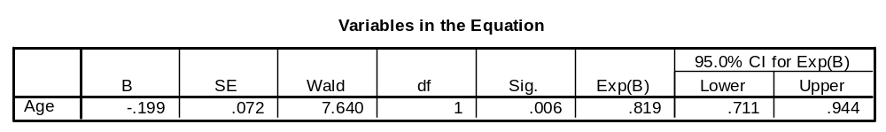

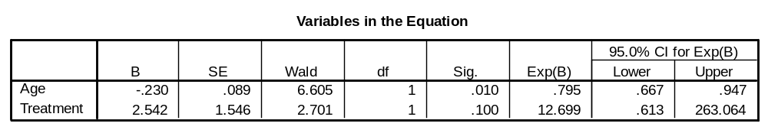
Block 1: Method = Enter
Exp(B) = “odds ratio/hazard ratio”
Age is a significant covariate (via both Wald and -2 Log Likelihood)
Block 2: Method = Enter
Age still a significant covariate (Wald)
But treatment is not (according to Wald which is better for smaller sample sizes)

Slide 27
VIII. Statistical Resources and Contact Info
SON S:\Shared\Statistics_MKHiggins
  Shared resource for all of SON – faculty and students
  Will continually update with tip sheets (for SPSS, SAS, and other software), lectures (PPTs and handouts), datasets, other resources and references
  Statistics At Nursing Website: [moving to main website] S:\Shared\Statistics_MKHiggins\website2\index.htm
  And Blackboard Site (in development) for “Organization: Statistics at School of Nursing”
Contact
    Dr. Melinda Higgins
    Melinda.higgins@emory.edu
    Office: 404-727-5180 / Mobile: 404-434-1785

Slide 28
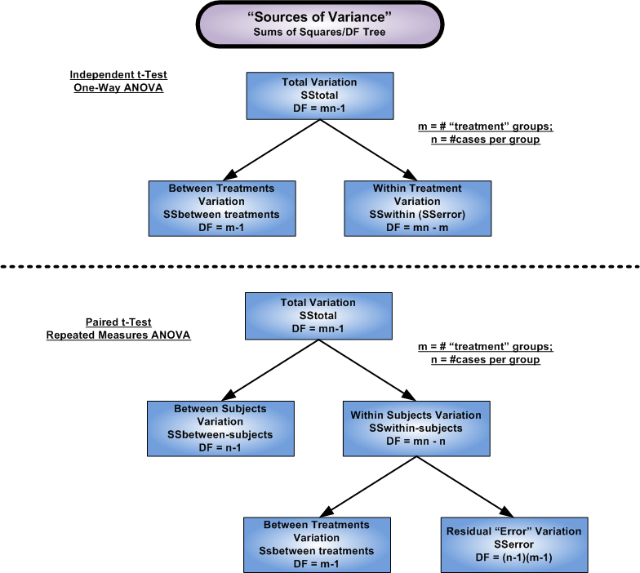
No way to evaluate within subject variation
“In a well-designed experiment, the only difference between the treatment group and the control group, chosen to represent a population of interest, is the treatment.”
p.304 Primer of Biostatistics, S.A. Glantz, 2002.

Slide 29
Sources of Variance (“SS/df tree”) – 2
SStotal
df=n
What you usually see as the “SSt”
SSmean
df=1
SScorr
df=n-1
SSfactor/model
df=p-1
SSresid
df=n-p
SSlof
df=f-p
SSpe
df=n-f

Slide 30

Finish SS/df tree for dataset
N=6; p=2; f=3
SStotal = Y’Y = 119.00 df = n = 6
SSmean = = 104.17 df = 1
SScorr = C’C = 14.833 df = n-1 = 5
SSfact = F’F = 6.2500 df = p-1 = 1
SSresid = R’R = 8.5833 df = n-p = 4
SSlof = L’L = 0.0833 df = f-p = 1
SSpe = P’P = 8.5000 df = n-f = 3
SStotal=119
df=6
SSmean=104.17
df=1
SScorr=14.833
df=5
SSfact=6.25
df=1
SSresid=8.5833
df=4
SSlof=0.0833
df=1
SSpe=8.5
df=3

