Slide 1


An Introduction to
&
Jordan Pelkmans, MSc.
Biostatistician
Office of Nursing Research

Slide 2
Resources
BNS Honors Program Statistical Support
  jordan.pelkmans@emory.edu
Free Online Book: Hands-On Programming with R
https://rstudio-education.github.io/hopr/index.html
Rstudio IDE Cheatsheet
RStudio IDE :: Cheatsheet
Code and Data used in today’s examples and other helpful resources

Slide 3
What is R?
R is an Open-Source Software for Statistical Analysis +
  An important part of Open Science and Reproducible Research!
  Freely available
R Foundation is a non-profit that maintains R and CRAN
  Large community of users and developers
  Allows for early adoption of cutting-edge statistics by loading add-on packages (more than 10,000 available!!!)
R is also a programming language
  Object based

Slide 4
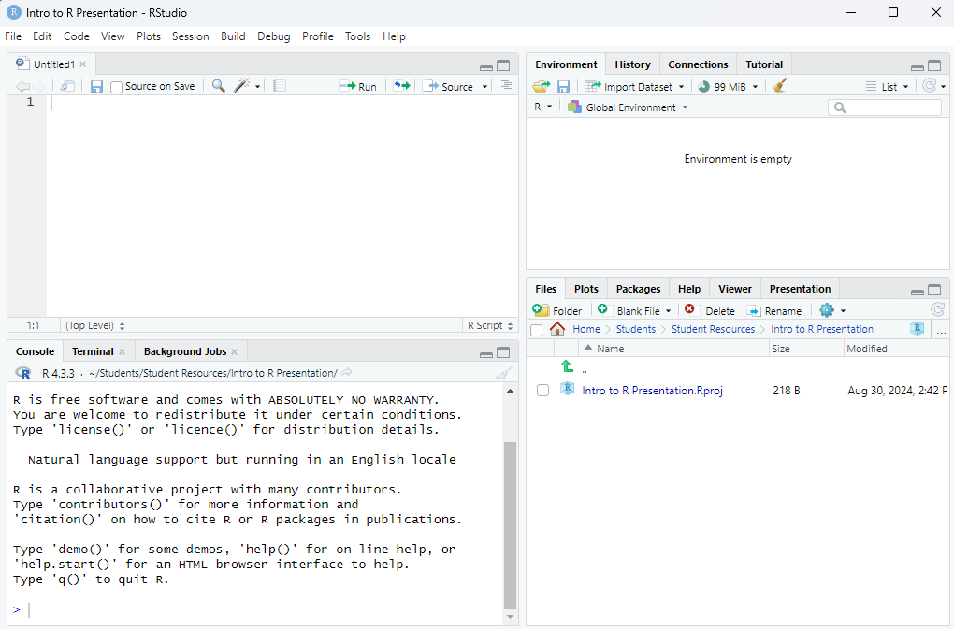
What is RStudio?
RStudio is an Integrated Development Environment (IDE)
  RStudio is also a GUI that makes R look the same on all operating systems
  Allows you to:
    Browse objects
    View file folders
    View installed packages
    Write and edit code
    View output, charts, and graphs

Slide 5
Let’s Dive In!
Some tips:
Don’t be nervous. You’re not going to break anything (permanently). Do not fear the red text!
What to do if you get red text (in this order):
    Read it! Sometimes the solution is right there in the error message.
    Google it! The best coders are great Googlers.
    Ask your peers for help!
    E-mail me!
Make sure all your data, code files, and project file are in the same folder on your computer
Always save your code!
    To make sure your results are reproducible
    To make sure you can go back to code that runs if you break things.
    To save time in future projects – Reuse old code when you can!!

Slide 6
Bonus: R Markdown
Make reproducible documents with tables and figures in R!
Quick Example if we have time

Slide 7
Thank you!
&
Reach out if you have questions or need help!
Jordan.Pelkmans@emory.edu

