Slide 1

Moving nursing beyond p<.05
March 20, 2020

Slide 2





Presenters
Matthew Hayat, PhD
Professor of Biostatistics
School of Public Health
Byrdine F. Lewis College of Nursing and Health Professions
Georgia State University
Martina Mueller, PhD
Professor of Biostatistics
College of Nursing
Department of Public Health Sciences (Joint)
Medical University of South Carolina
Melinda Higgins, PhD
Research Professor of Biostatistics
School of Nursing
Emory University
Michael Weaver, RN, PhD, FAAN
Professor of Biostatistics
Associate Dean for Research and Scholarship
College of Nursing
University of Florida
Mary Dooley, MS
Research Associate
College of Nursing
Medical University of South Carolina

Slide 3
Outline
Statistics in Nursing Research and Education
Classical Hypothesis & Significance Testing
The ASA Movement
Recommendations for Change

Slide 4
Statistics in Nursing Research and Education
Background
We are members of a community of statisticians and quantitative methodologists involved in nursing education and research
Our group includes faculty in academic nursing programs, statistics reviewers for nursing research journals, statistics educators who teach nursing students, and statistics collaborators on nursing research studies
Members of our group have participated in expert panel discussions and presentations at international statistics conferences about the use of statistics in nursing research and education
-Add about diversity of members…

Slide 5
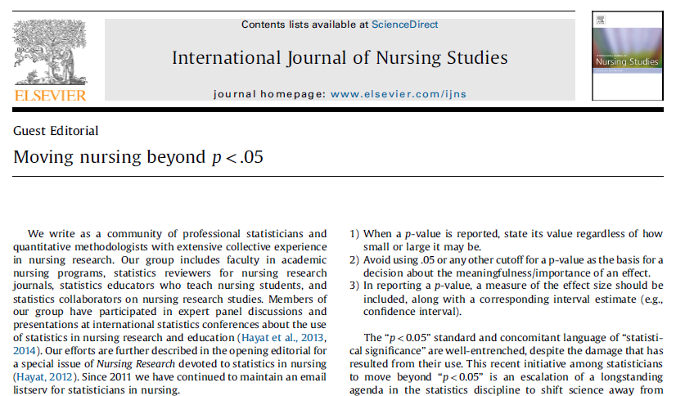
Statistics in Nursing Education and Research
Moving Nursing Beyond p<.05
Our work was recently published as a guest editorial:
This has also been published in Nursing Outlook, Research in Nursing & Health, Research and Theory for Nursing Practice
Hayat, M.J., Staggs, V.S., Schwartz, T.A., Higgins, M., Azuero, A., Budhathoki, C., Chandrasekhar, R., Cook, P., Cramer, E., Dietrich, M.S., Garnier-Villarreal, M., Hanlon, A., He, J., Hu, J., Kim, M., Mueller, M., Nolan, J.R., Perkhounkova, Y., Rothers, J., Schluck, G., Su, X., Templin, T.N., Weaver, M.T., Yang, Q., Ye, S. (2019). Moving nursing beyond p < .05. International Journal of Nursing Studies.

Slide 6




The ASA Movement

Slide 7
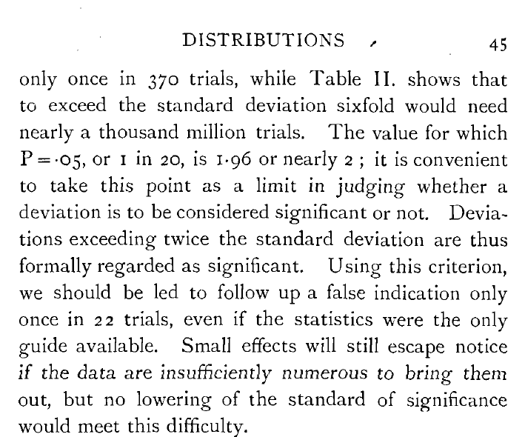
1925: Fisher, R. A. (1925), Statistical Methods for Research Workers, Edinburgh: Oliver & Boyd.
And so it began …

Slide 8
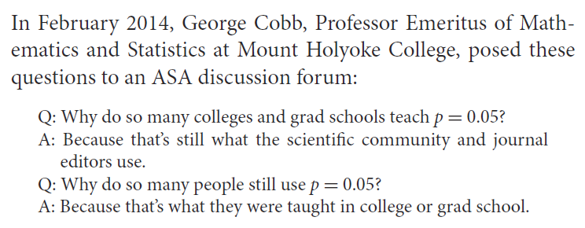

So, why do/did we do it?
… and on and on the vicious spiral continued …

Slide 9
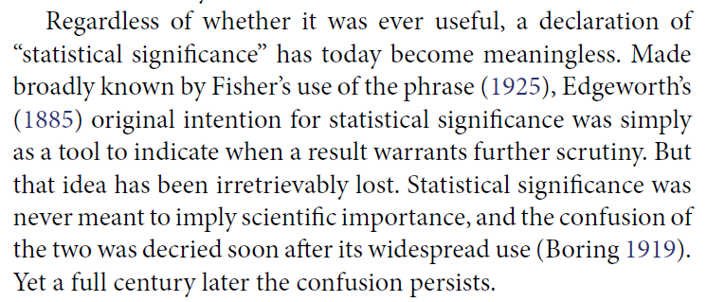
Warnings about p-values have been around a long time (100+ years)

Slide 10
What exactly is a p-value?
Probability that the computed statistic based on the observed data is larger than what would be expected given that the NULL hypothesis is true
This tell us NOTHING about the data quality, effect size, importance, random chance, whether the null (Ho) hypothesis is true, …
P(statistic from data > critical value | Ho)

Slide 11

The trouble with p-values
From “The trouble with tribbles” Star-trek episode 15, season 2, 1967

Slide 12
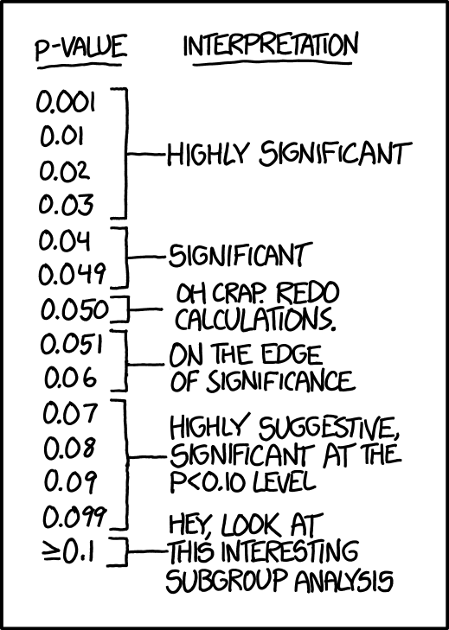
YEA! Published!!
Grey Area…
BUMMER! Not Published??
And publication bias was born…
https://xkcd.com/1478/

Slide 13
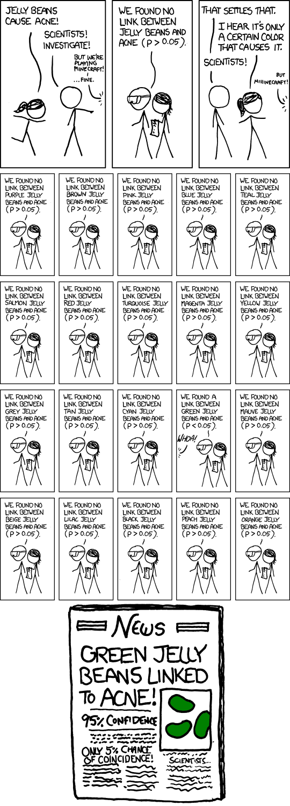
https://xkcd.com/882/
19 colors found p>.05, not significant, except for …
P-hacking

Slide 14
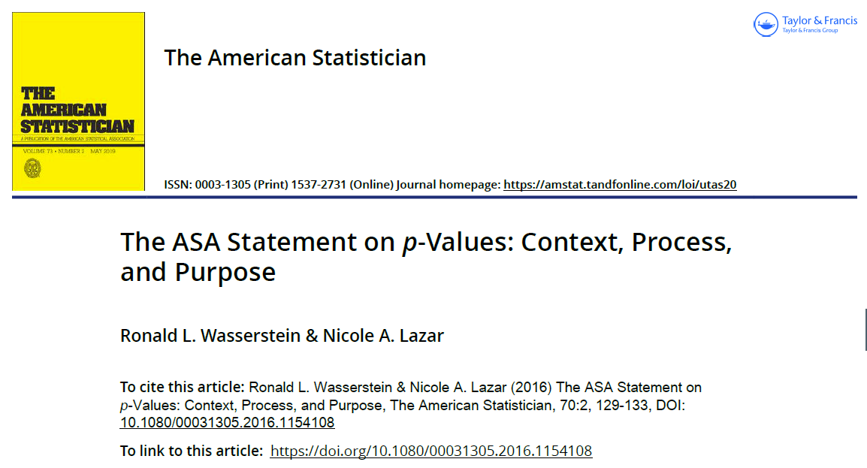
2016

Slide 15
ASA 6 Principles for p-values
DO indicate data incompatible with model
DO NOT measure probability hypothesis is true
Should NOT be used as basis for policy decisions

Slide 16
ASA 6 Principles for p-values
Require full reporting and transparency (for proper inference)
Is NOT an effect size, nor indication of importance
Is NOT a measure of evidence

Slide 17
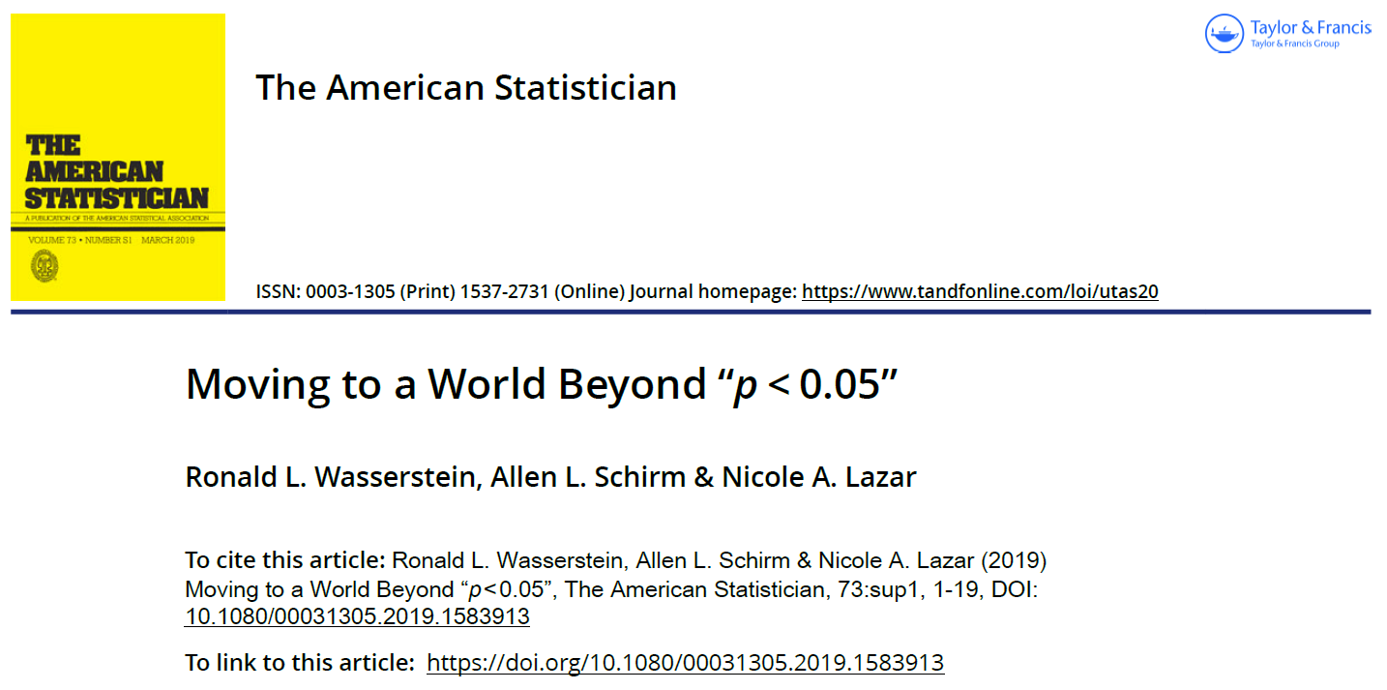
2019

Slide 18
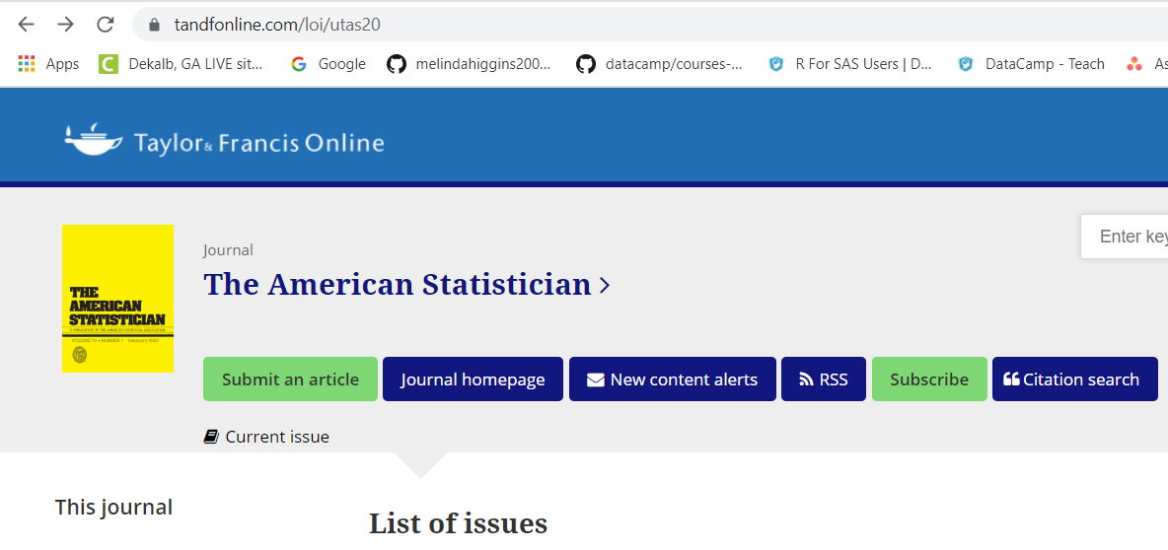
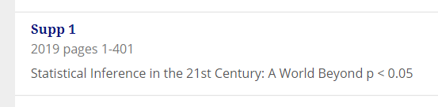
44 papers, 400+ pages!!
https://www.tandfonline.com/toc/utas20/73/sup1?nav=tocList
Open Access – many written with practical advice but some with more in depth technical details

Slide 19
ASA - Don’t’s
Don’t base conclusions solely on “statistically significant”
Don’t believe that an association exists just because it was statistically significant.
Don’t believe that an association is absent just because it was not statistically significant.

Slide 20
ASA - Don’t’s
Don’t believe that the p-value is the probability that the hypothesis is true.
Don’t conclude scientific importance based on statistical significance
DON’T SAY “STATISTICALLY SIGNIFICANT”

Slide 21
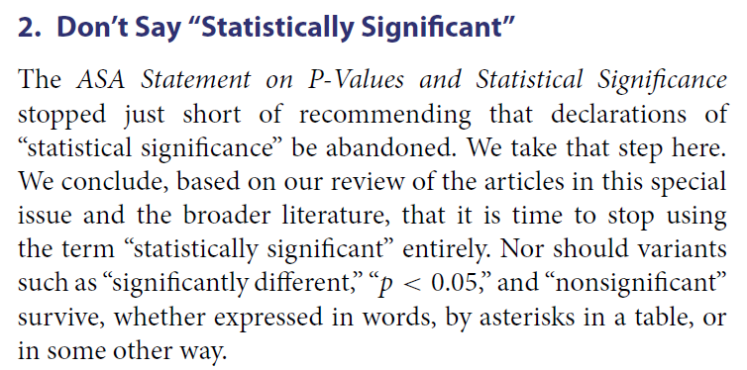
STOP !
STOP Saying/Writing
“Statistically
Significant”
However, still report p-values, BUT don’t use dichotomous decision making …

Slide 22
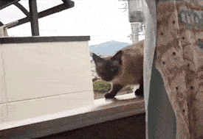
There is hope
Don’t jump off a cliff just yet…

Slide 23

P-values are a result not the end goal

Slide 24
Common sense
meaningful differences
  A1c reduced from 12 to 8.4
  We see an improvement of 30%
meaningful thresholds
  A1c >> 6 – still diabetes

Slide 25


It’s not all about p<.05
sample size – would you change practice
  based on 15 or 20 observations?
  based on only one or a few studies?

Slide 26
Case(s) in Point
Question: Is subcutaneous heparin more effective than intravenous heparin (initial treatment of DVT)?
Hommes, et.al. (1992) Annals of Internal Medicine, 116: 279-284
  Odds Ratio 0.62
  95% CI [0.39, 0.98]
  p < 0.05: Yes, subcutaneous heparin more effective than intravenous heparin
Messori, et.al. (1993) Annals of Internal Medicine, 118: 77-78.
  Odds Ratio 0.61
  95% CI [0.298, 1.251]
  p > 0.05, No, subcutaneous heparin is not (significantly) more effective than intravenous heparin
Findings are “opposite” (in statistical significance, but OR similar)
McShane, B., Gal, D. (2016). “Blinding us to the obvious? The effect of statistical training on the evaluation of evidence,” Management Science, 62 (6), 1707-1718

Slide 27
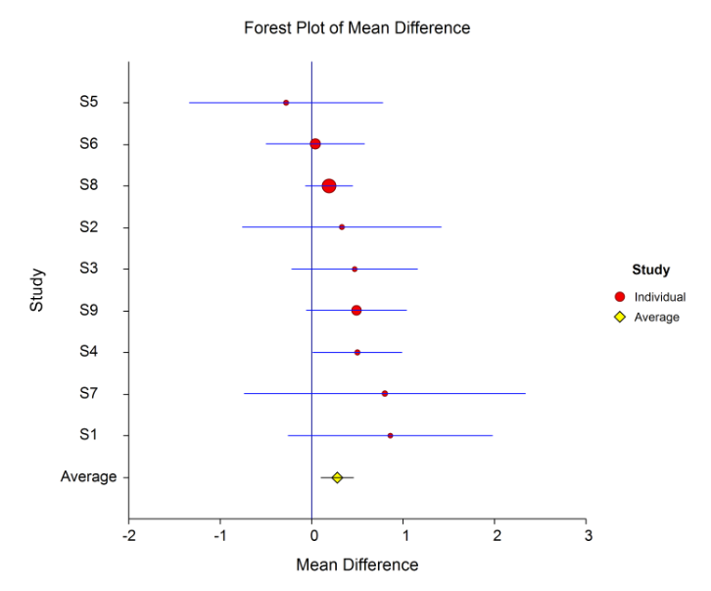
Meta-Analysis – multiple studies

Slide 28
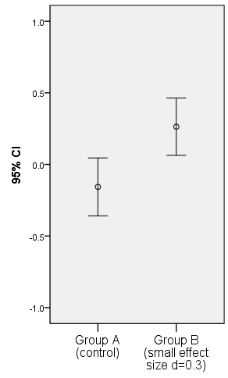
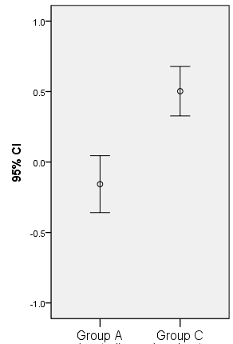
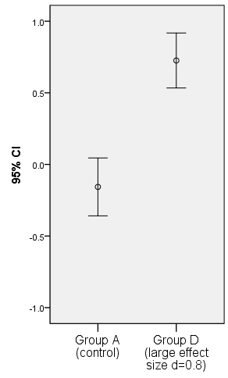
It’s not all about p<.05: Effect Size
How big is the difference relative to the variability?
SMALL
MEDIUM
LARGE
d = 0.3
d = 0.5
d = 0.8

Slide 29
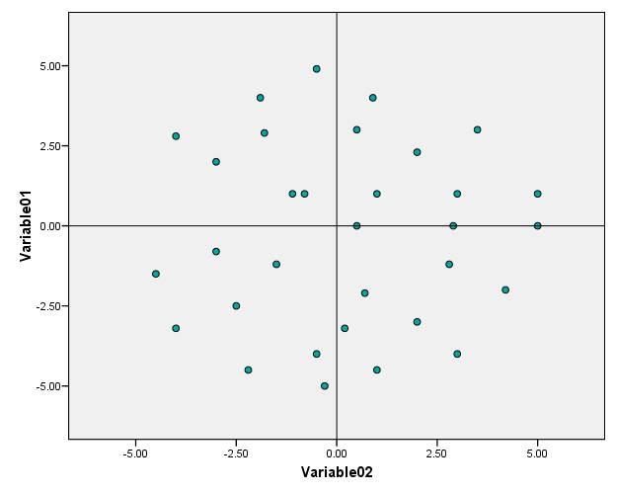
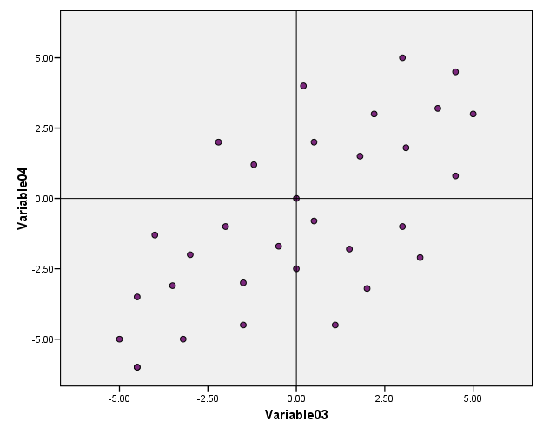
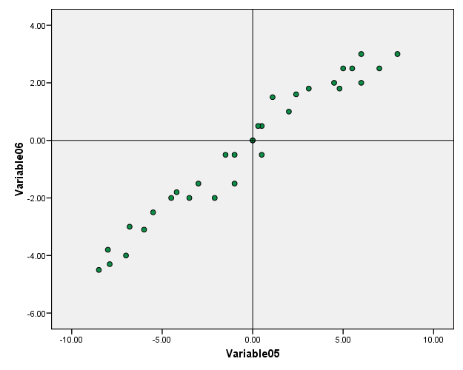
Effect Size: Correlation
R=.016
R=.667
R=.979

Slide 30
Effect Sizes - Examples
Statistical Test or Model | Effect Size | Small | Medium | Large
T-test | Cohen’s d | 0.2 | 0.5 | 0.8
Correlation | r | 0.1 | 0.3 | 0.5
Chi-square test | ω | 0.1 | 0.3 | 0.5
ANOVA | Cohen’s f | 0.1 | 0.25 | 0.4
Linear Regression Model | r2 | 0.01 | 0.09 | 0.25
Linear Regression Coefficients | Standardized Beta β | 0.1 | 0.3 | 0.5
Logistic Regression | Odds Ratio | 1.4 | 3.6 | 4.3
https://www.psychometrica.de/effect_size.html

Slide 31
What to do?
Effect sizes
Confidence intervals
Prediction intervals
Interpret against thresholds
Clinically meaningful
Scientific importance

Slide 32
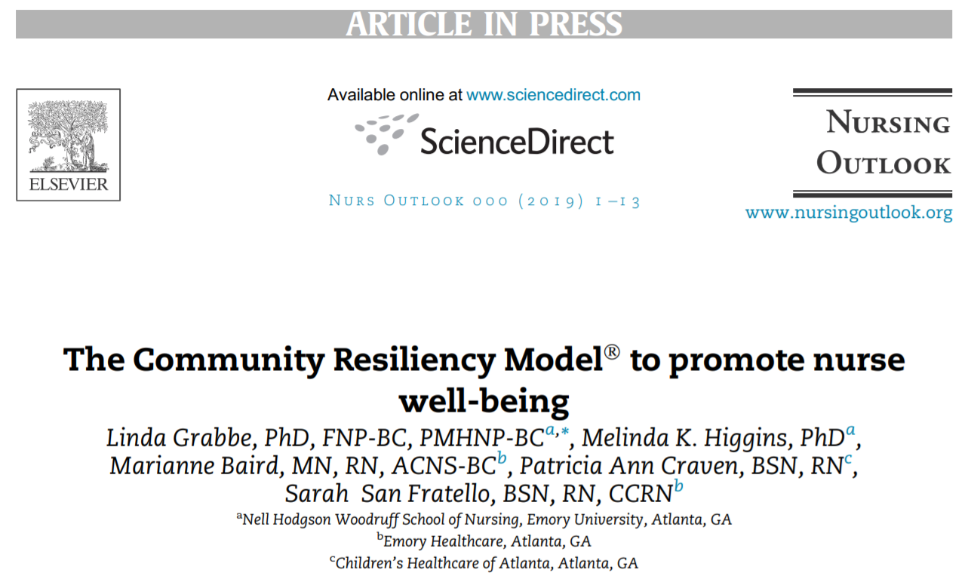
Recent Example – Nursing Outlook

Slide 33

