Slide 1
Abalone Report
Melinda Higgins

Slide 2
Summary Statistics of Abalones’ - Dimensional Measurements
 | Overall (N=4177)
length
Mean (SD) | 0.524 (0.120)
Range | 0.075 - 0.815
diameter
Mean (SD) | 0.408 (0.099)
Range | 0.055 - 0.650
height
Mean (SD) | 0.140 (0.042)
Range | 0.000 - 1.130

Slide 3
Summary Statistics of Abalones’ - Weight Measurements
 | Overall (N=4177)
wholeWeight
Mean (SD) | 0.829 (0.490)
Range | 0.002 - 2.825
shuckedWeight
Mean (SD) | 0.359 (0.222)
Range | 0.001 - 1.488
visceraWeight
Mean (SD) | 0.181 (0.110)
Range | 0.000 - 0.760
shellWeight
Mean (SD) | 0.239 (0.139)
Range | 0.002 - 1.005

Slide 4
Abalone Dimensional Measurements by Sex
 | F (N=1307) | I (N=1342) | M (N=1528) | Total (N=4177) | p value
length |  |  |  |  | < 0.001
Mean (SD) | 0.579 (0.086) | 0.428 (0.109) | 0.561 (0.103) | 0.524 (0.120)
Range | 0.275 - 0.815 | 0.075 - 0.725 | 0.155 - 0.780 | 0.075 - 0.815
diameter |  |  |  |  | < 0.001
Mean (SD) | 0.455 (0.071) | 0.326 (0.088) | 0.439 (0.084) | 0.408 (0.099)
Range | 0.195 - 0.650 | 0.055 - 0.550 | 0.110 - 0.630 | 0.055 - 0.650
height |  |  |  |  | < 0.001
Mean (SD) | 0.158 (0.040) | 0.108 (0.032) | 0.151 (0.035) | 0.140 (0.042)
Range | 0.015 - 1.130 | 0.000 - 0.220 | 0.025 - 0.515 | 0.000 - 1.130

Slide 5
Abalone Weight Measurements by Sex
 | F (N=1307) | I (N=1342) | M (N=1528) | Total (N=4177) | p value
wholeWeight |  |  |  |  | < 0.001
Mean (SD) | 1.047 (0.430) | 0.431 (0.286) | 0.991 (0.471) | 0.829 (0.490)
Range | 0.080 - 2.657 | 0.002 - 2.050 | 0.015 - 2.825 | 0.002 - 2.825
shuckedWeight |  |  |  |  | < 0.001
Mean (SD) | 0.446 (0.199) | 0.191 (0.128) | 0.433 (0.223) | 0.359 (0.222)
Range | 0.031 - 1.488 | 0.001 - 0.773 | 0.006 - 1.351 | 0.001 - 1.488
visceraWeight |  |  |  |  | < 0.001
Mean (SD) | 0.231 (0.098) | 0.092 (0.063) | 0.216 (0.105) | 0.181 (0.110)
Range | 0.021 - 0.590 | 0.000 - 0.440 | 0.003 - 0.760 | 0.000 - 0.760
shellWeight |  |  |  |  | < 0.001
Mean (SD) | 0.302 (0.126) | 0.128 (0.085) | 0.282 (0.131) | 0.239 (0.139)
Range | 0.025 - 1.005 | 0.002 - 0.655 | 0.005 - 0.897 | 0.002 - 1.005

Slide 6
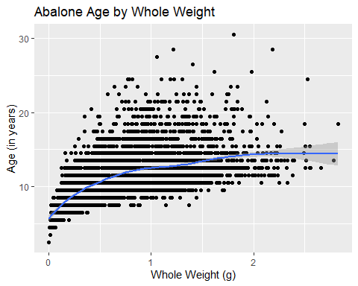
Plot of Abalone Age by wholeWeight

Slide 7
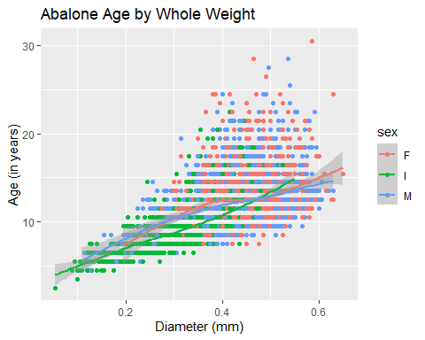
Plot of Abalone Age by diameter - by sex - Option 1
Create a plot of abalone age by diameter in mm. Show the plot by sex - Option 1 add a color by sex or Option 2 a facet_wrap().

Slide 8
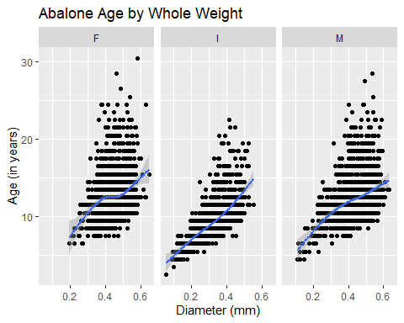
Plot of Abalone Age by diameter - by sex - Option 2
Create a plot of abalone age by diameter in mm. Show the plot by sex - Option 1 add a color by sex or Option 2 a facet_wrap().

