Slide 1



Github
PULL
PUSH
Local

Slide 2
Github
PULL
Local

Slide 3
Github
PUSH
Local

Slide 4








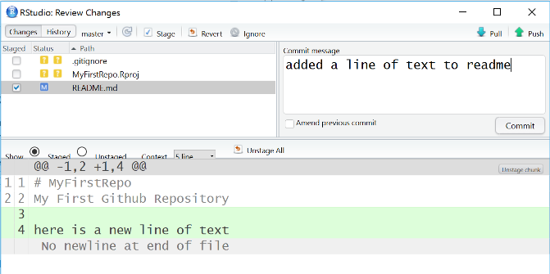
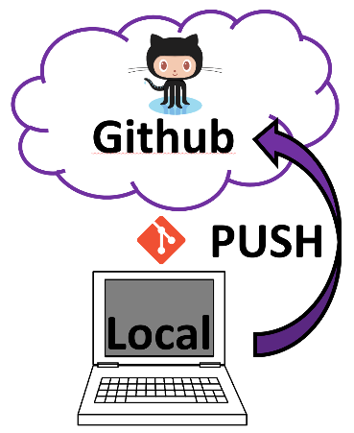

Add Items to
Shopping Cart
Add/”Stage”
Files to Commit
Review Commit
Add comment
Review Order
PUSH to
Repository
Place Order

