Slide 1
R for SAS Users
Melinda Higgins
https://statisticalhorizons.com/seminars/r-sas-users/

Slide 2
2-day Workshop
Day 1:
  10:30 - 12:30 am
    30 minute break
  1:00 – 3:00 pm
Day 2:
  10:30 - 12:30 am
    30 minute break
  1:00 - 3:00 pm
All Times EDT (Eastern Daylight Time = UTC-4)

Slide 3
Workshop Resources
GoogleDrive
  https://drive.google.com/drive/folders/17oCzxX6KnqswFcrtzXuaUh8iAJh7tttx?usp=sharing
WEBSITE:
  https://tinyurl.com/r4sas-sept2026
H.E.L.P. Dataset and “SAS and R” Book
  https://nhorton.people.amherst.edu/sasr2/datasets.php
  https://nhorton.people.amherst.edu/sasr2/

Slide 4
Compare R and SAS
R
SAS
Bare Bones (89MB)
Takes up little memory
Powerful base packages included
FREE/Open Source
Add “packages” as you go – only “load” what you need at that time
Have to buy base $$ & Large (20GB+)
Almost always have to buy add-ons, gets expensive $$
Must know what you want ahead of time
Sometimes end up with more than you need

Slide 5
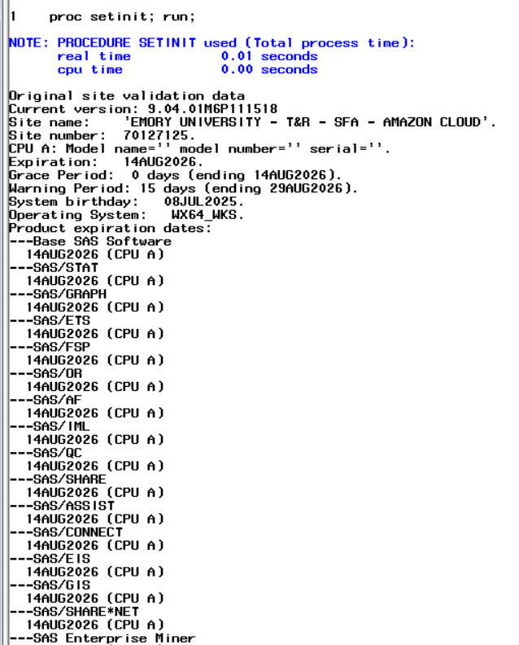
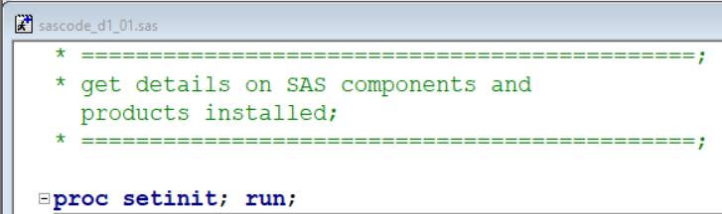
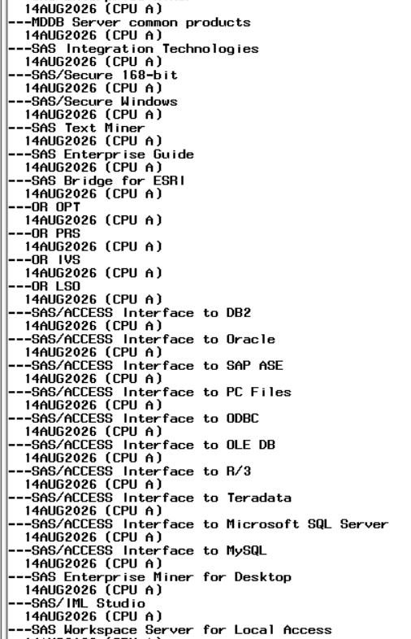
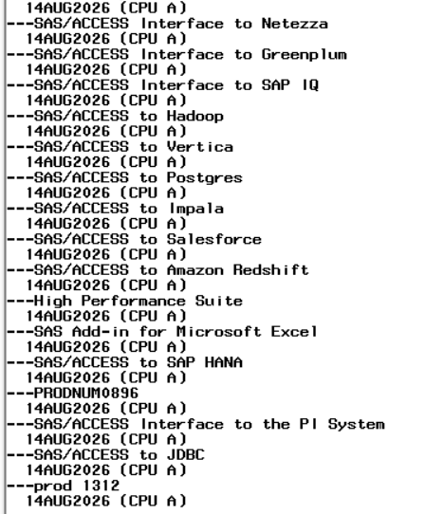
My Current SAS License Includes:

Slide 6
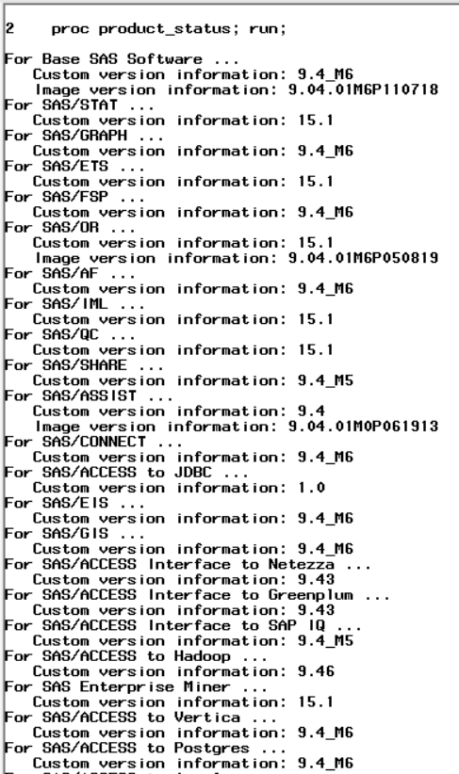
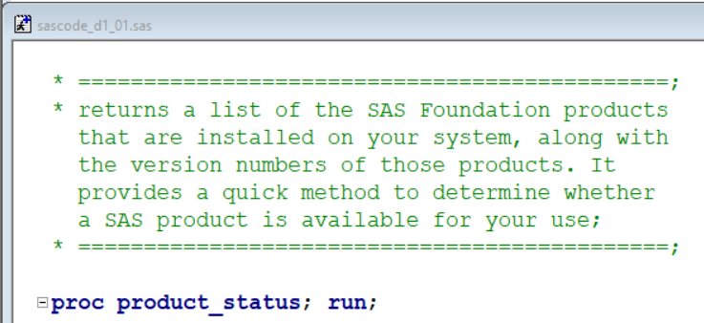
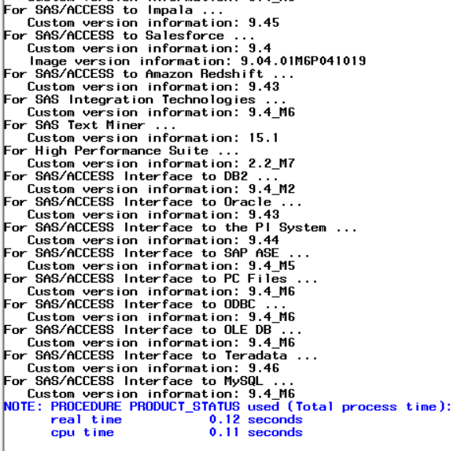
SAS Software Components

Slide 7
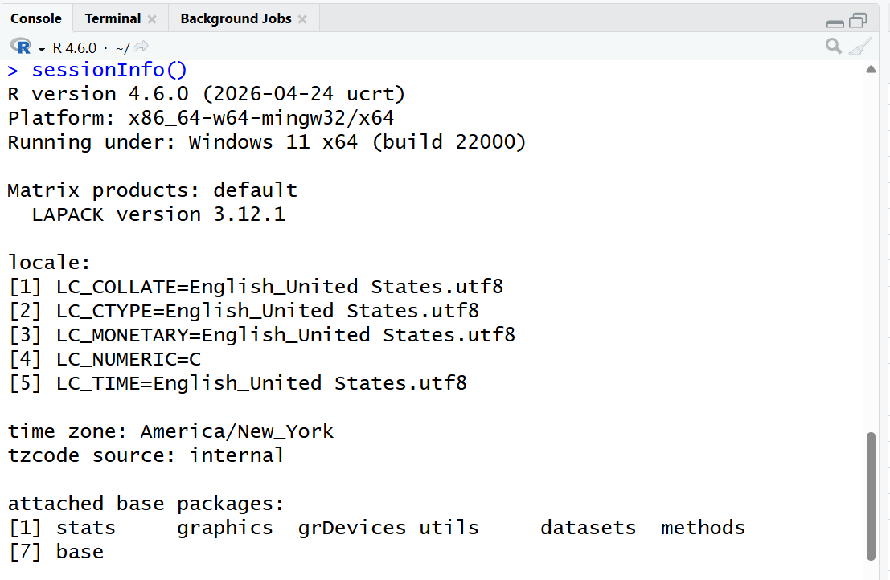
My Current R - Base Installation
Only 7 Base Packages

Slide 8
Interfaces – SAS Base; SAS Studio

Slide 9
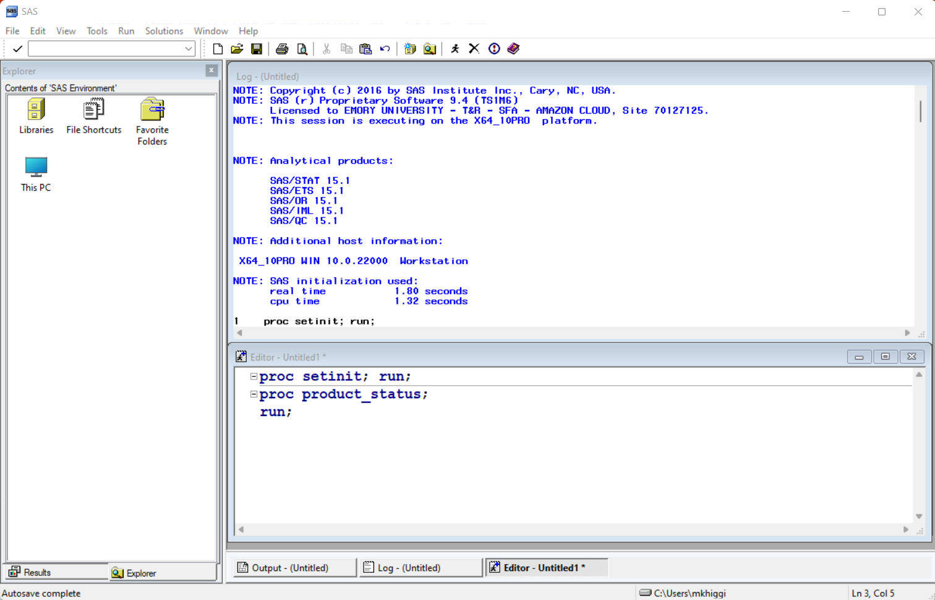
Basic SAS
IDE Interface

Slide 10
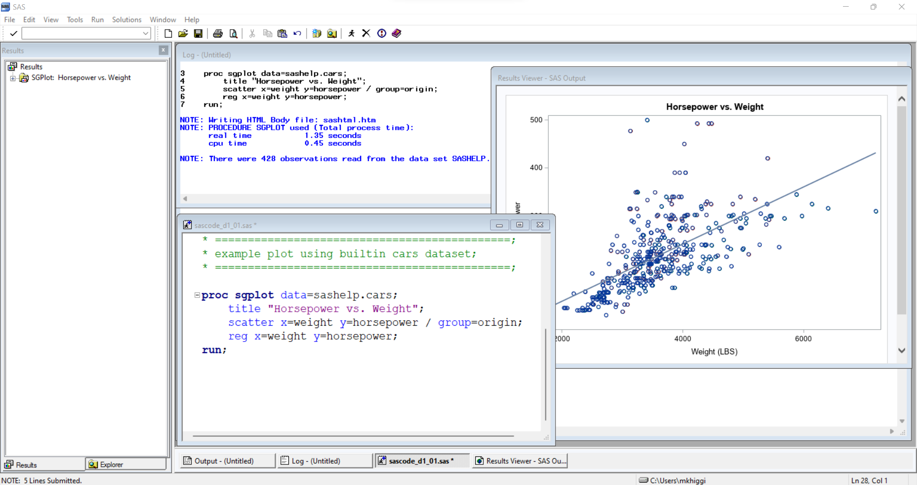
Output LOG
Results
SAS Program Script

Slide 11
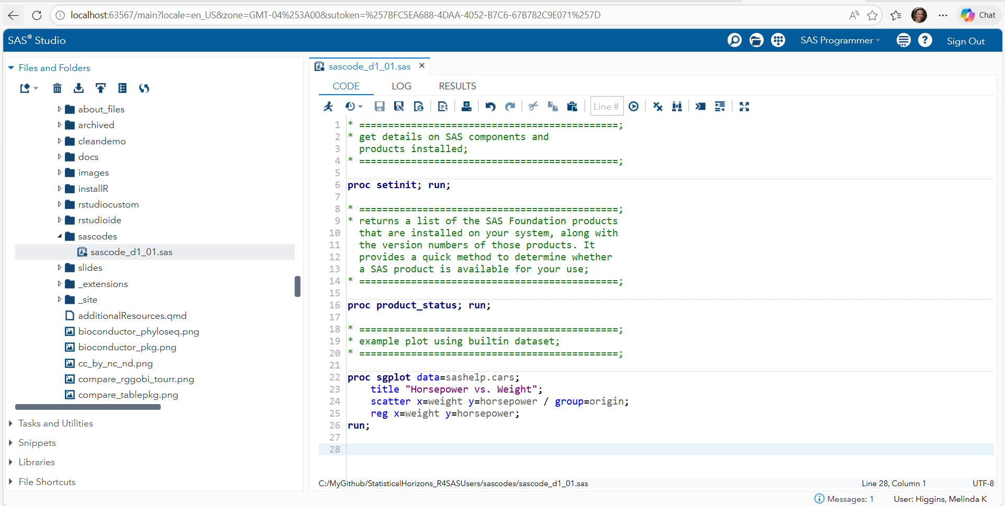
SAS Studio Interface IDE/GUI
SAS Program
Script

Slide 12
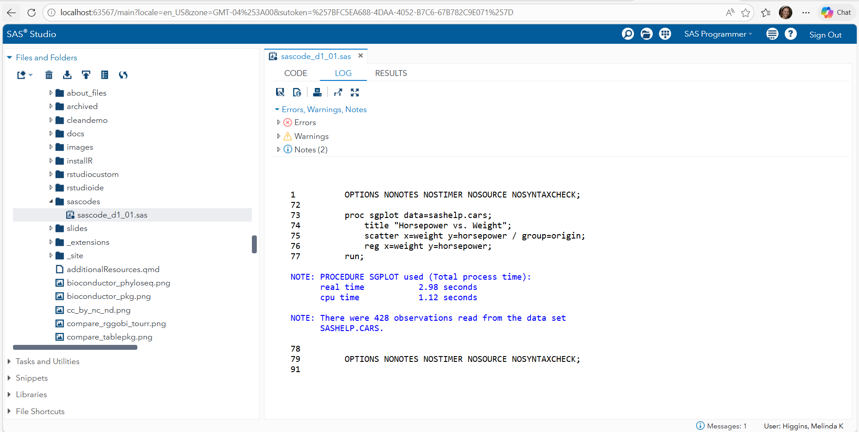
SAS Studio Interface IDE/GUI
Output LOG

Slide 13
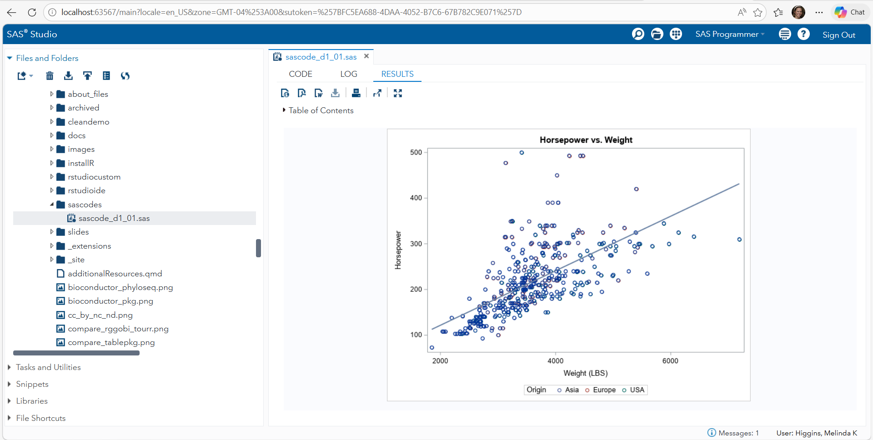
SAS Studio Interface IDE/GUI
Results

Slide 14
Interfaces – R Basic; Rstudio IDE; Positron
R (from CRAN) – FREE – comes with a basic programming interface
  https://cran.r-project.org/
Rstudio is an IDE = Integrated Development Environment
  https://posit.co/download/rstudio-desktop
Positron is the next evolution of programming interfaces
  https://positron.posit.co/
  Learn more, https://positron.posit.co/migrate-rstudio-compare.html

Slide 15
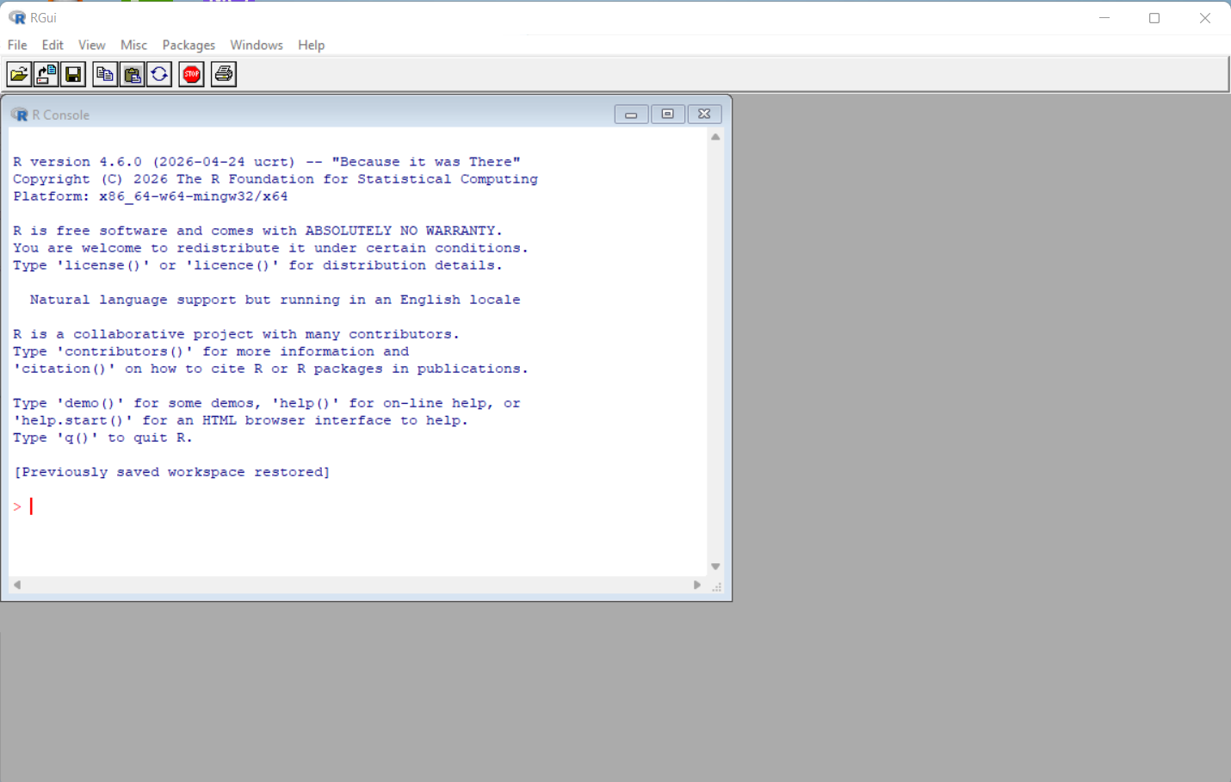
R Basic Interface

Slide 16
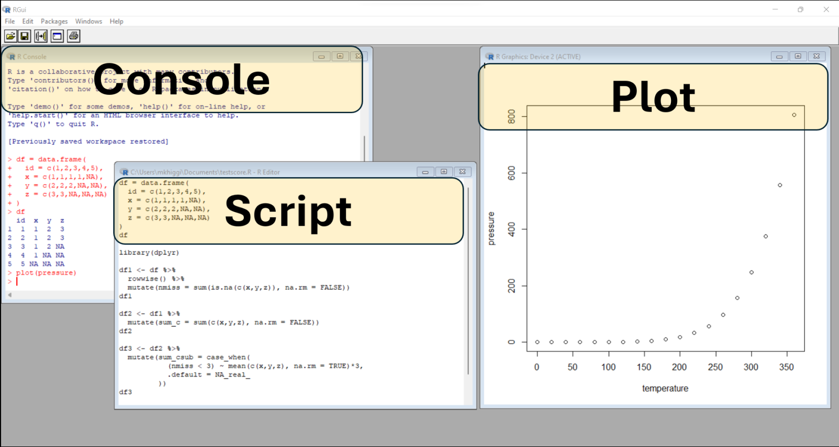
R Basic Interface – similar to SAS Basic Interface

Slide 17
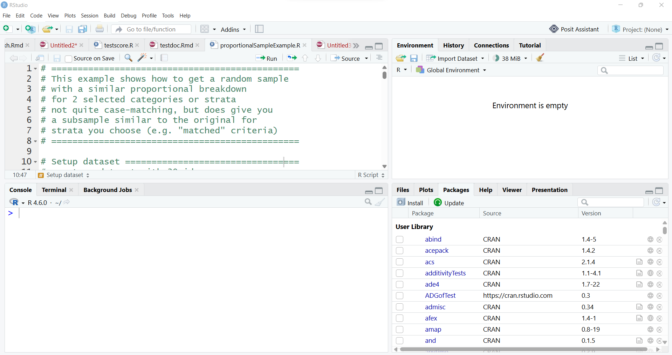
Rstudio IDE
Source,
Scripts, RMD, …
Environment,
History, …
Console,
Terminal,
Background Jobs
Files, Plots, Packages,
Help, Viewer,…

Slide 18
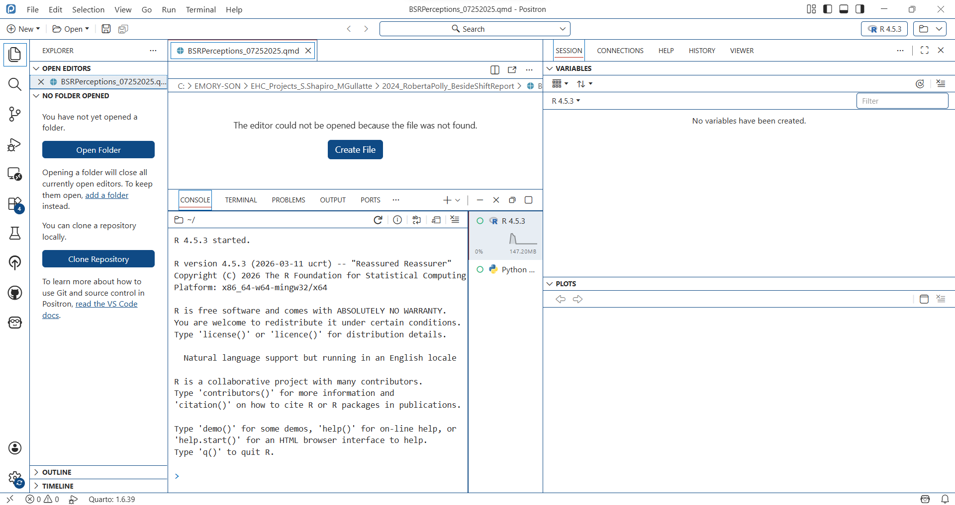
Positron IDE

Slide 19
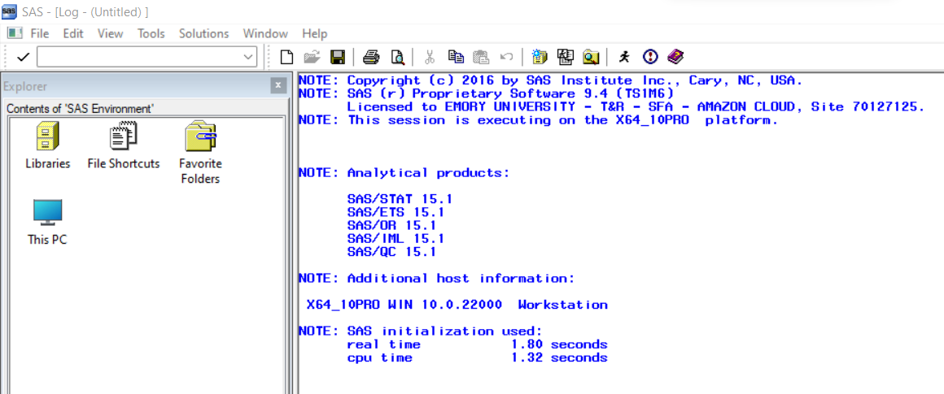
SAS Session
SAS Version and
Local System Details
Products Included
Operating System

Slide 20
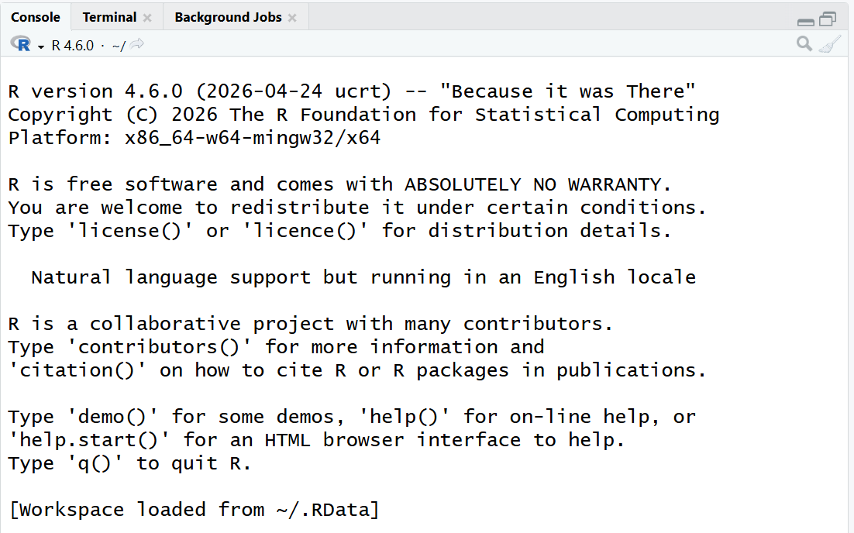
R Session – Details on Start

Slide 21
R Session – sessionInfo()
R Version
Operating System
Local Details
7 Base Packages

Slide 22
SAS
R
Components
Packages
+
+
WORK Library
Global Environment

Slide 23
SAS
PROC SETINIT
PROC PRODUCT_STATUS
R
sessionInfo()
library()

Slide 24
Open RStudio

Slide 25
Exercise 1:
Look at session details
Create new project “R4SASUsers”: File/New Project
Put all files for R For SAS Users into this folder

Slide 26
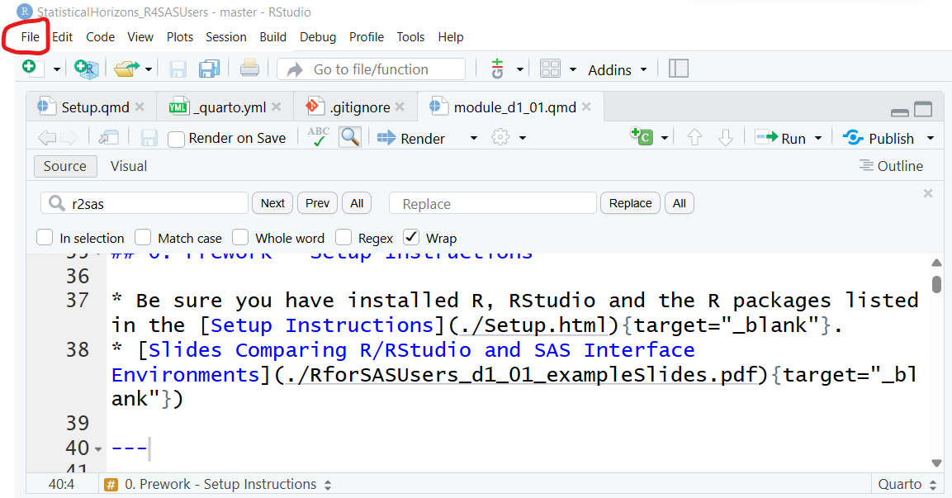

Slide 27
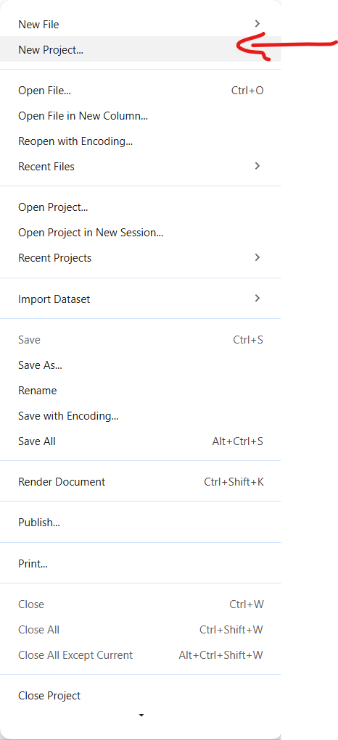
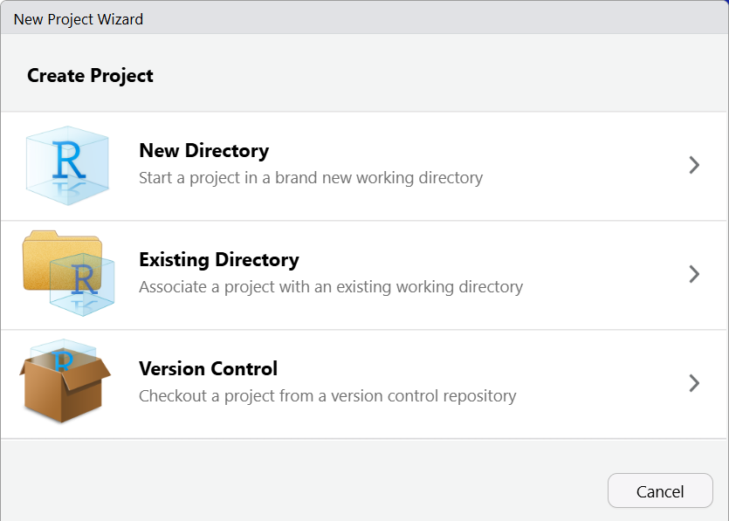

Slide 28
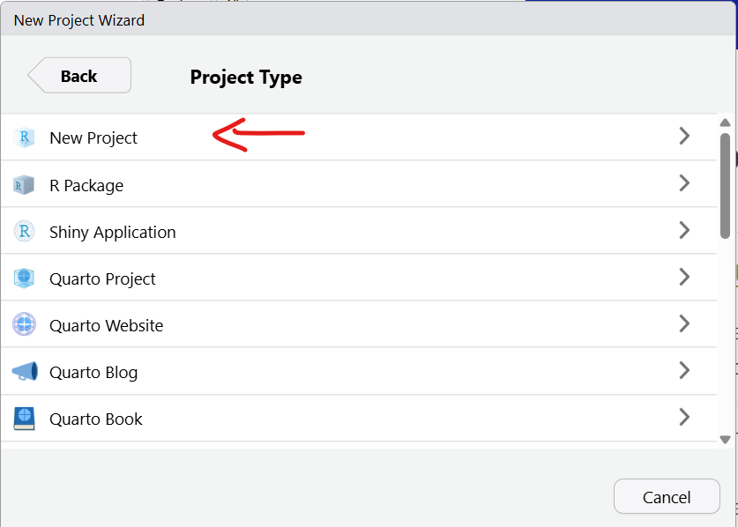
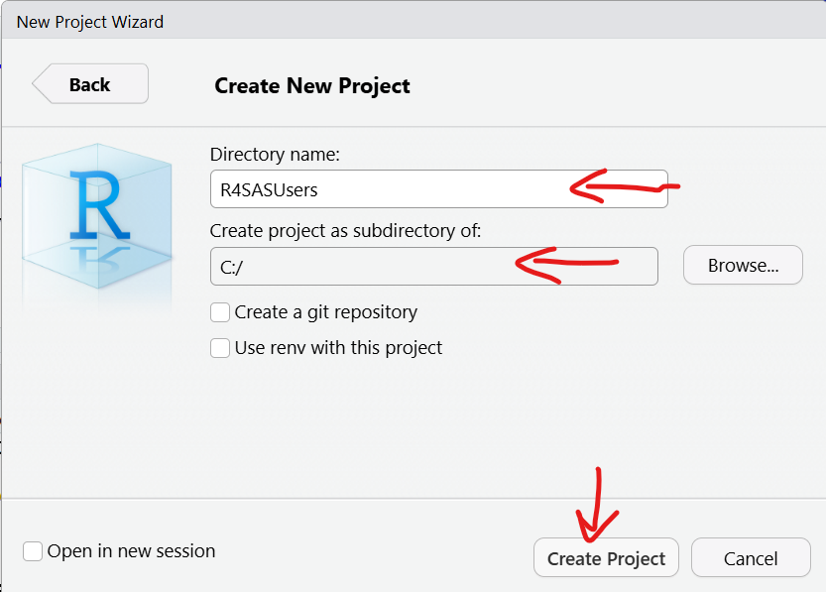

Slide 29
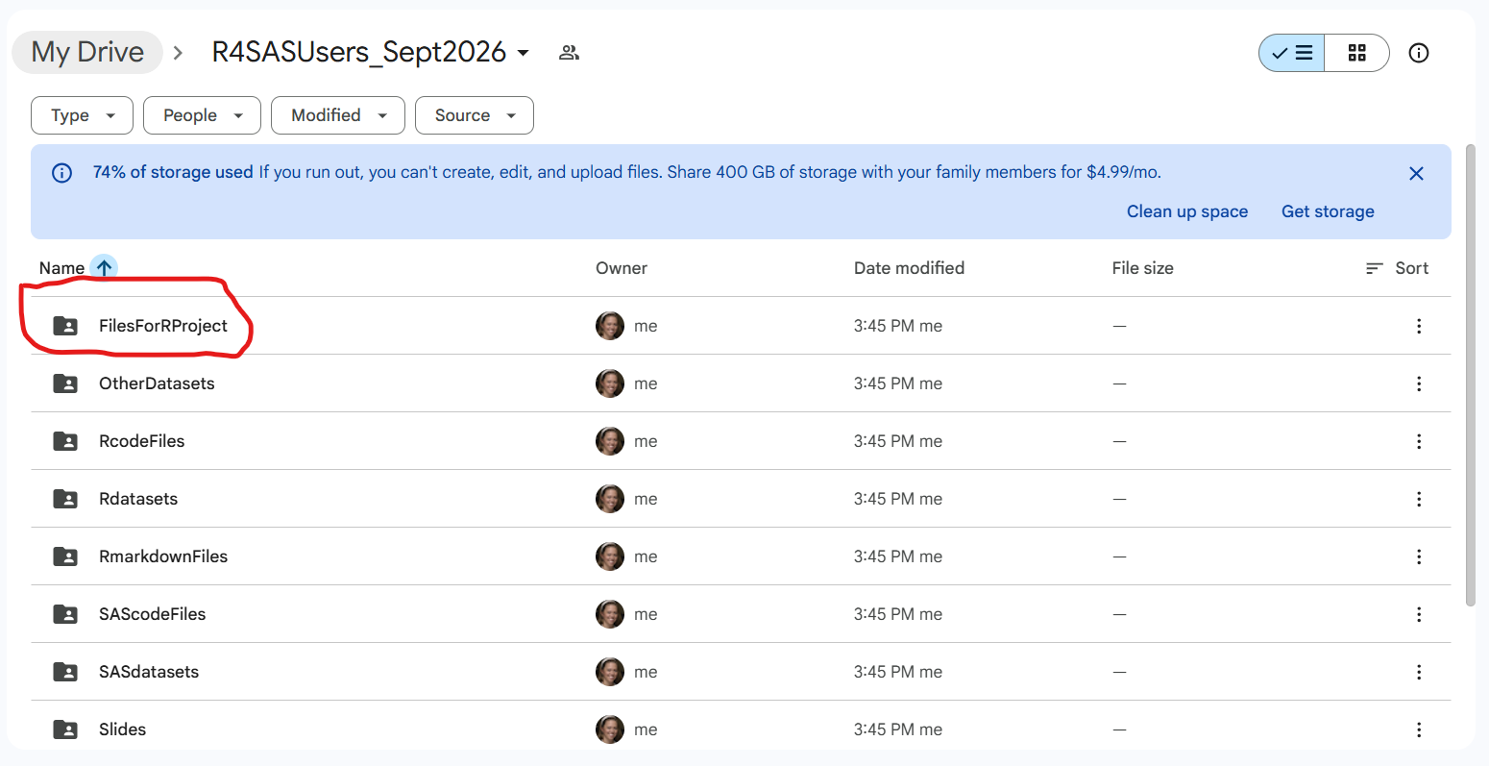
Get Files From GoogleDrive Folder

Slide 30
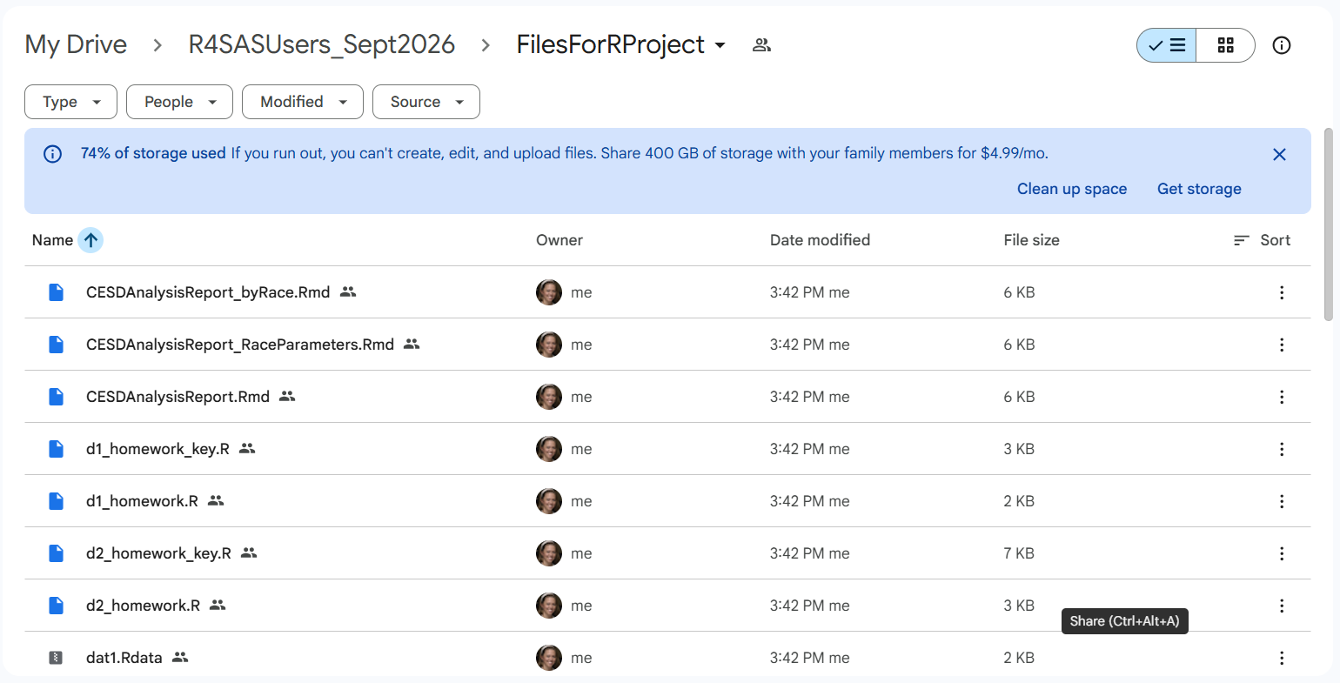
Get Files From GoogleDrive Folder

Slide 31
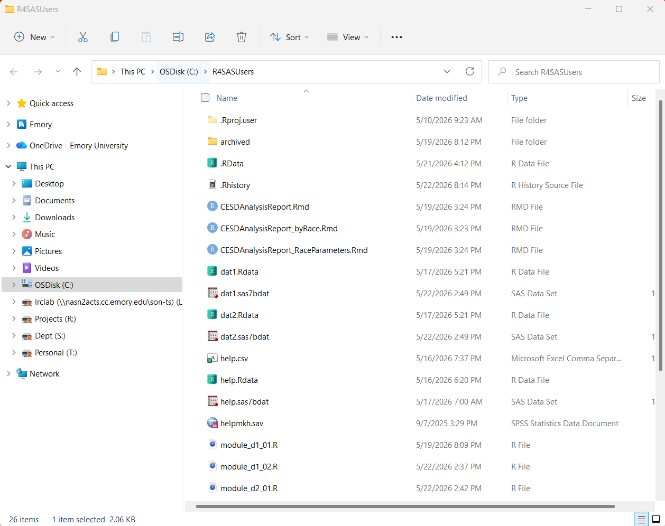
Put Files Into This Folder

Slide 32
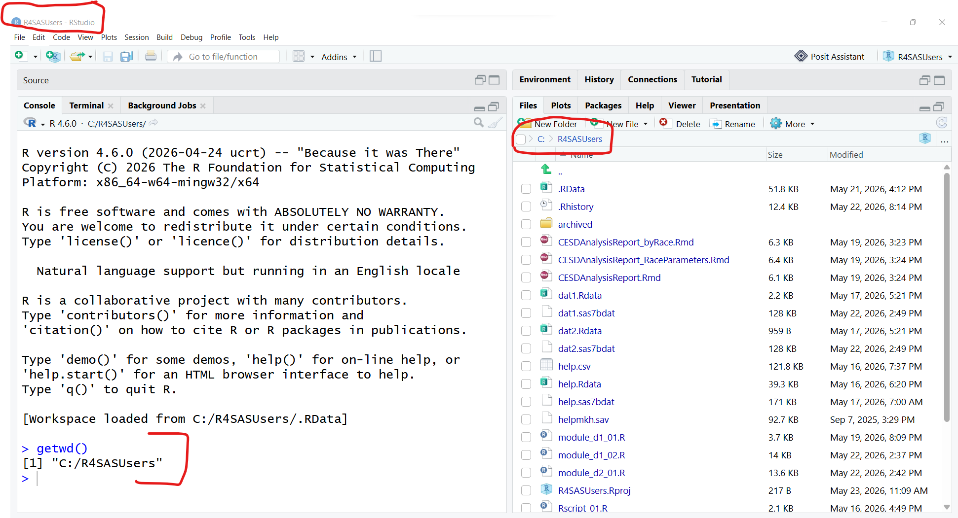
Project Folder

