Slide 1
R for SAS Users
Melinda Higgins
https://statisticalhorizons.com/seminars/r-sas-users/

Slide 2
2-day Workshop: May 28-29, 2026
Day 1:
  10:30 - 12:30 am
    30 minute break
  1:00 - 3:00 pm
Day 2:
  10:30 - 12:30 am
    30 minute break
  1:00 - 3:00 pm
All Times EDT (Eastern Daylight Time = UTC-4)

Slide 3
Workshop Resources
GoogleDrive
  See Statistical Horizons Course Link
SLACK:
  https://r-for-sas-users-sh.slack.com
WEBSITE:
  https://tinyurl.com/r2sasusers
H.E.L.P. Dataset and “SAS and R” Book
  https://nhorton.people.amherst.edu/sasr2/datasets.php
  https://nhorton.people.amherst.edu/sasr2/

Slide 4
Compare R and SAS
R
SAS
Bare Bones (89MB)
Takes up little memory
Powerful base packages included
FREE/Open Source
Add “packages” as you go – only “load” what you need at that time
Have to buy base $$ & Large (20GB+)
Almost always have to buy add-ons, gets expensive $$
Must know what you want ahead of time
Sometimes end up with more than you need

Slide 5
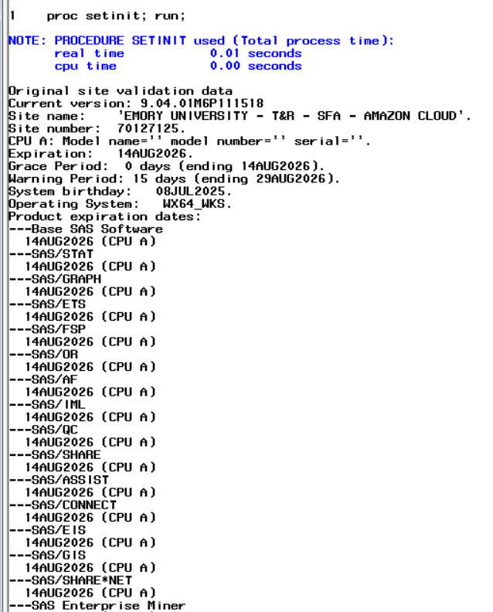
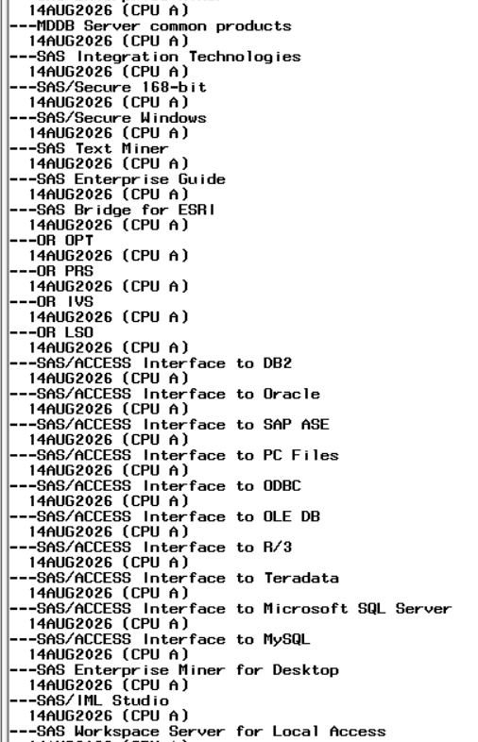
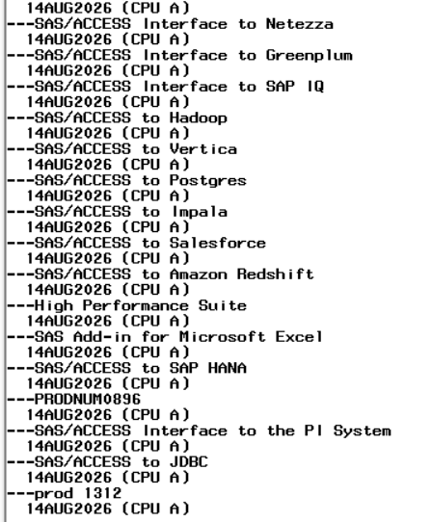
My Current SAS License Includes:

Slide 6
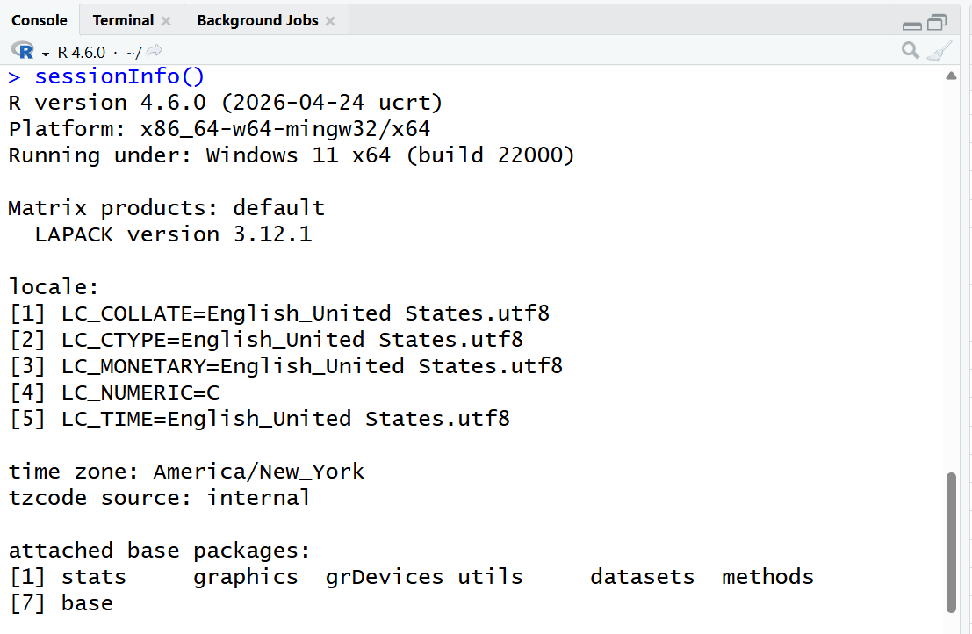
My Current R - Base Installation
7 Base Packages

Slide 7
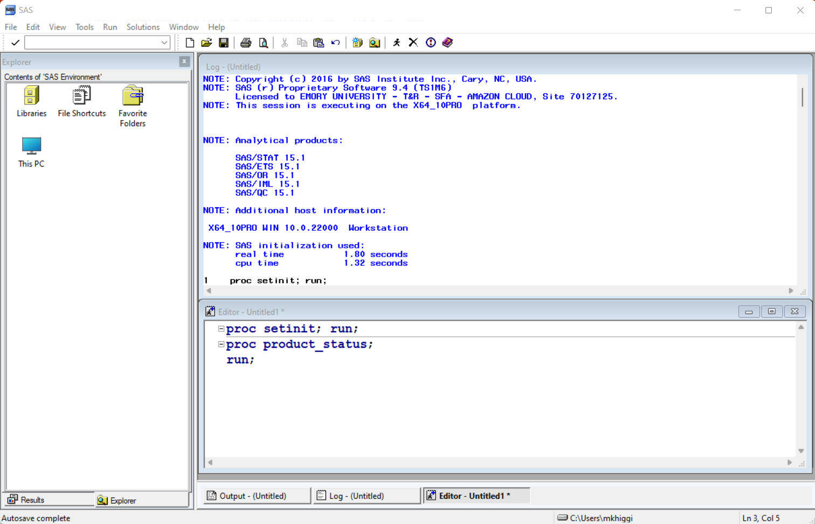
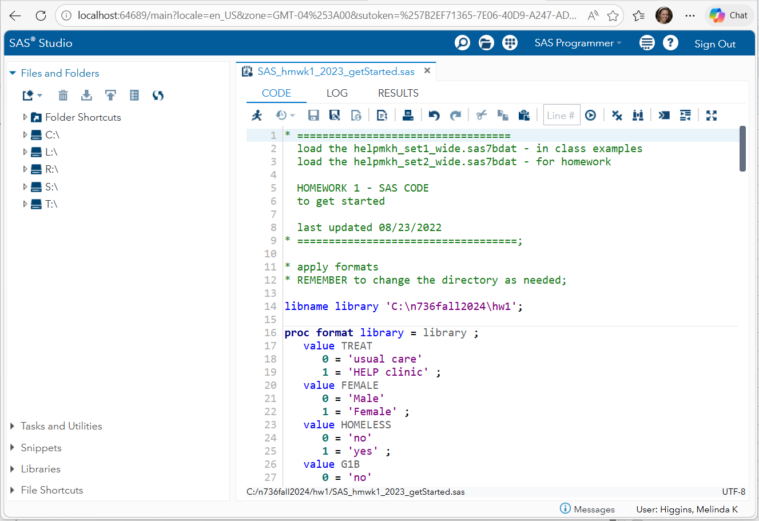
Interfaces – SAS Base; SAS Studio
Basic SAS Interface
SAS Studio Interface
IDE/GUI

Slide 8
Interfaces – R Basic; Rstudio IDE; Positron
R (from CRAN) – FREE – comes with a basic programming interface
  https://cran.r-project.org/
Rstudio is an IDE = Integrated Development Environment
  https://posit.co/download/rstudio-desktop
Positron is the next evolution of programming interfaces
  https://positron.posit.co/
  Learn more, https://positron.posit.co/migrate-rstudio-compare.html

Slide 9
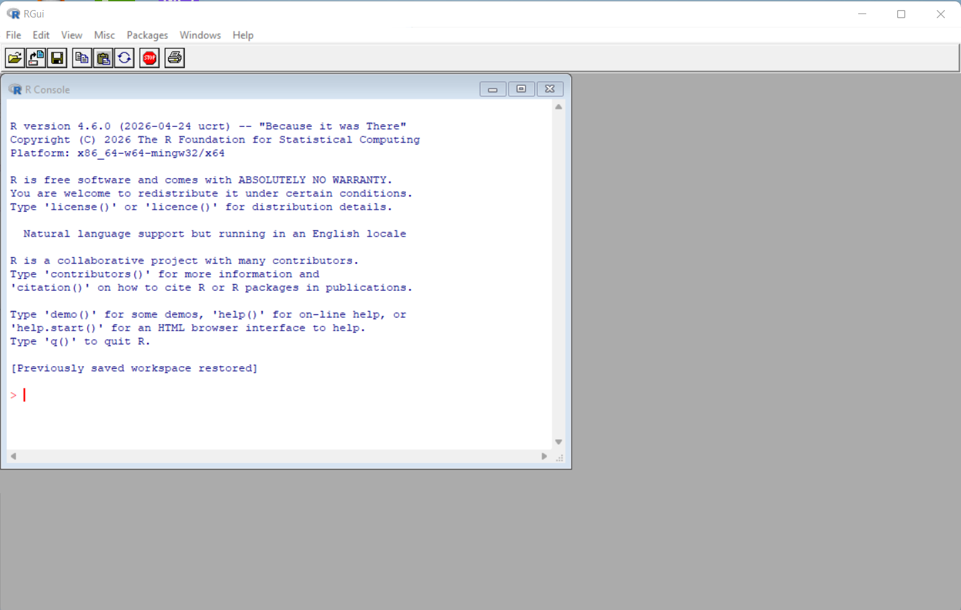
R Basic Interface

Slide 10
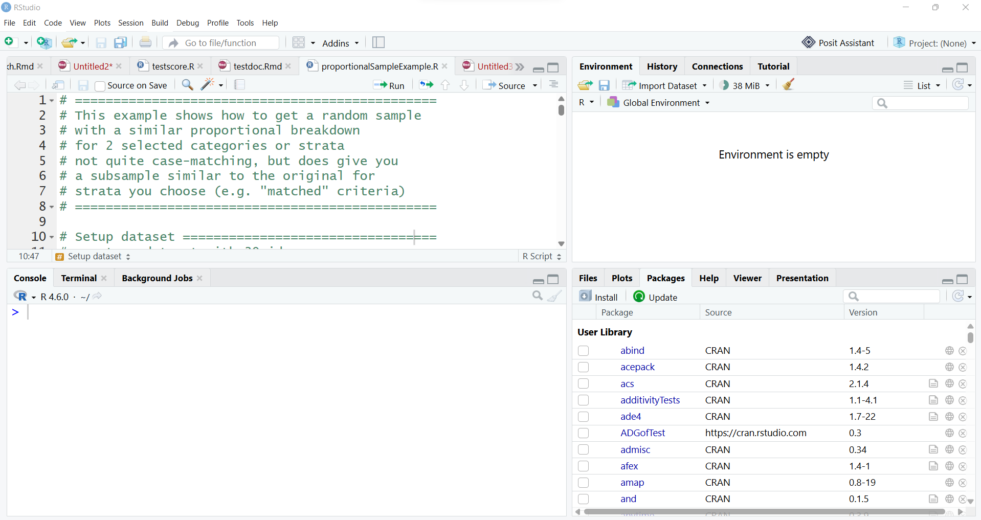
Rstudio IDE

Slide 11
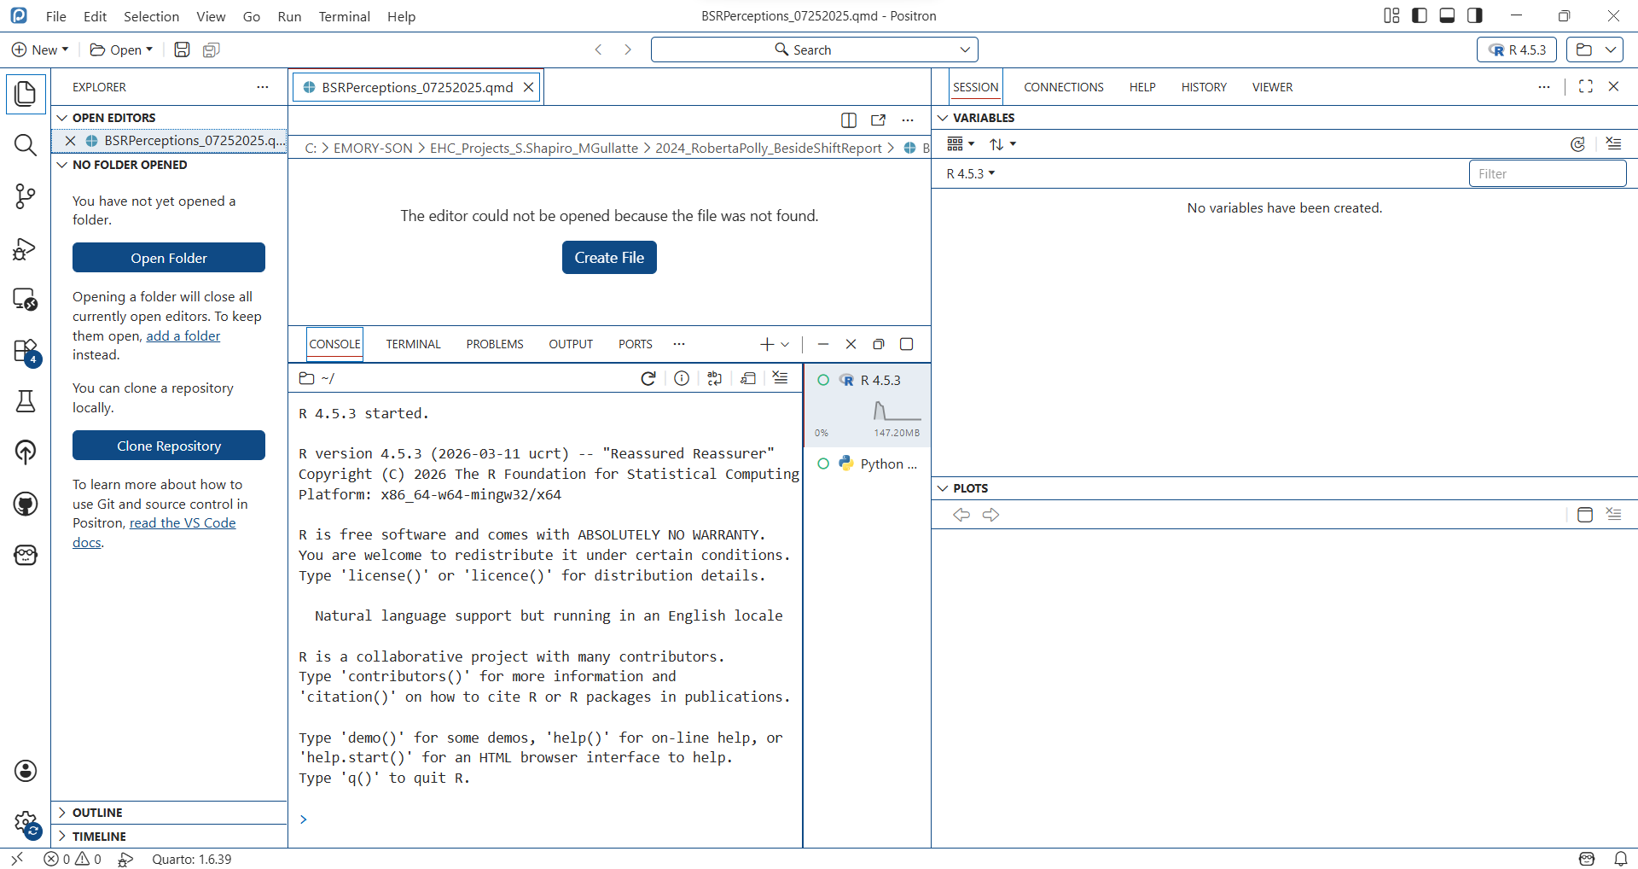
Positron IDE

Slide 12
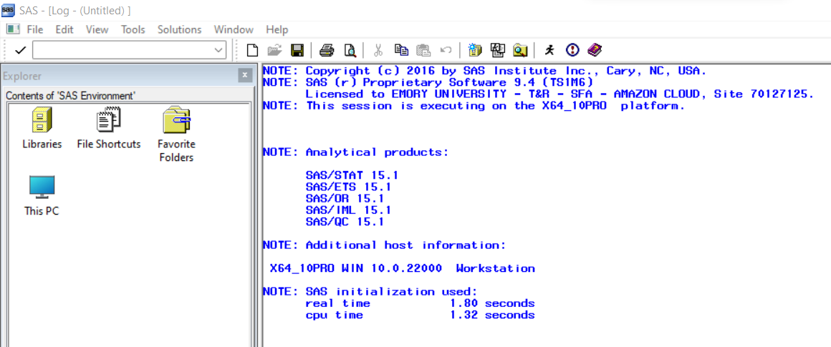
SAS Session

Slide 13
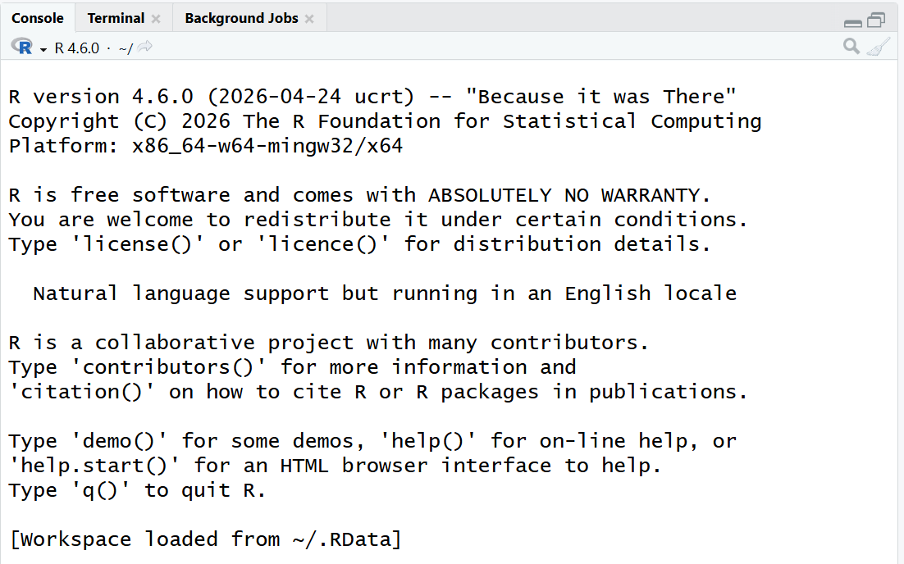
R Session – Details on Start

Slide 14
R Session – sessionInfo()
R Version
Operating System
Local Details
7 Base Packages

Slide 15
Open RStudio

Slide 16
Exercise 1:
Look at session details
Create new project “R4SASUsers”
Put all files for R For SAS Users into this folder

Slide 17
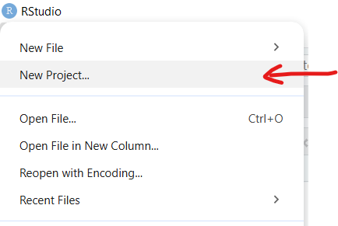
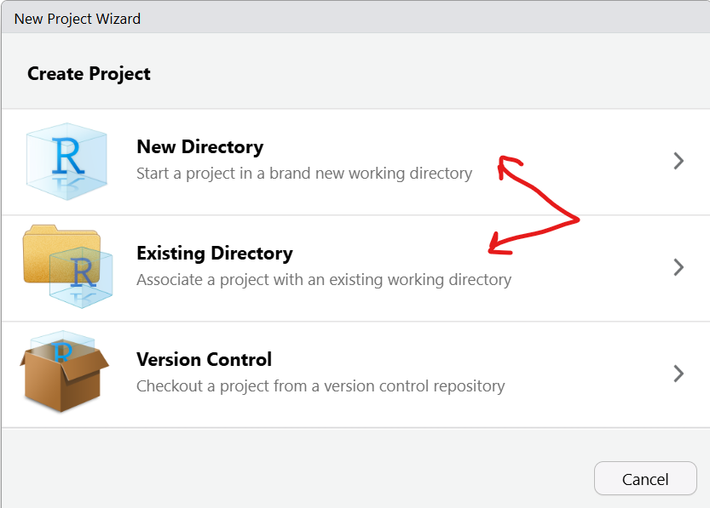

Slide 18
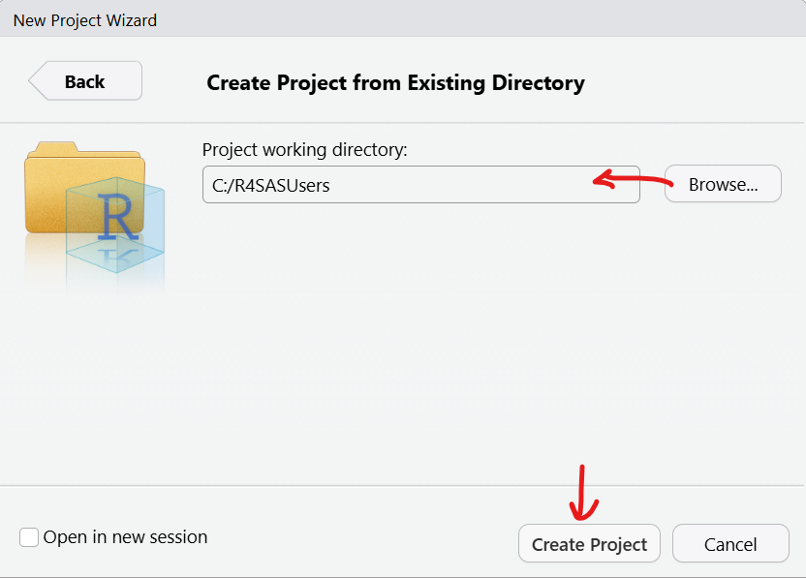

Slide 19
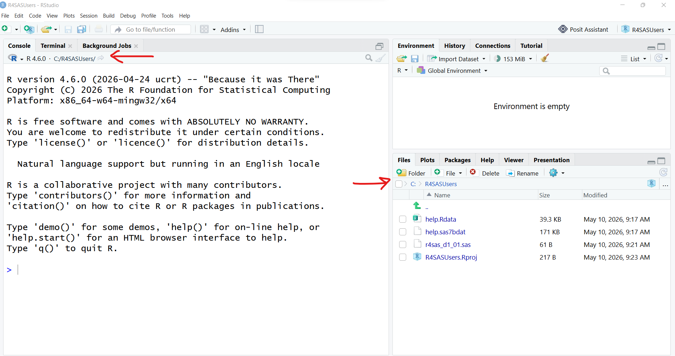

Slide 20
