Slide 1
R for SAS Users
Melinda Higgins
https://statisticalhorizons.com/seminars/r-sas-users/

Slide 2
2-day Workshop: May 28-29, 2026
Day 1:
  10:30 - 12:30 am
    30 minute break
  1:00 - 3:00 pm
Day 2:
  10:30 - 12:30 am
    30 minute break
  1:00 - 3:00 pm
All Times EDT (Eastern Daylight Time = UTC-4)

Slide 3
Workshop Resources
GoogleDrive
  See Statistical Horizons Course Link
SLACK:
  https://r-for-sas-users-sh.slack.com
WEBSITE:
  https://tinyurl.com/r4sasusers
H.E.L.P. Dataset and “SAS and R” Book
  https://nhorton.people.amherst.edu/sasr2/datasets.php
  https://nhorton.people.amherst.edu/sasr2/

Slide 4
Compare R and SAS
R
SAS
Bare Bones (89MB)
Takes up little memory
Powerful base packages included
FREE/Open Source
Add “packages” as you go – only “load” what you need at that time
Have to buy base $$ & Large (20GB+)
Almost always have to buy add-ons, gets expensive $$
Must know what you want ahead of time
Sometimes end up with more than you need

Slide 5
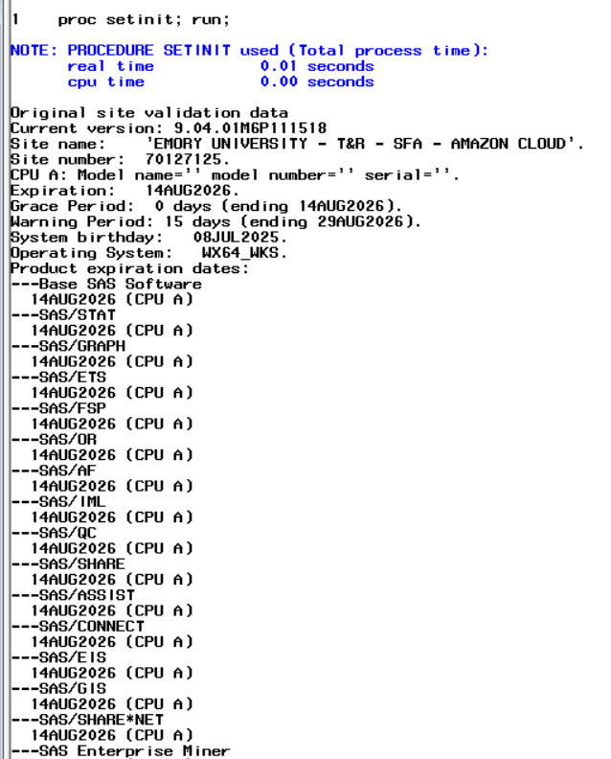
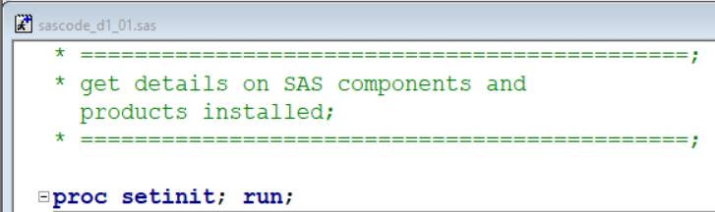
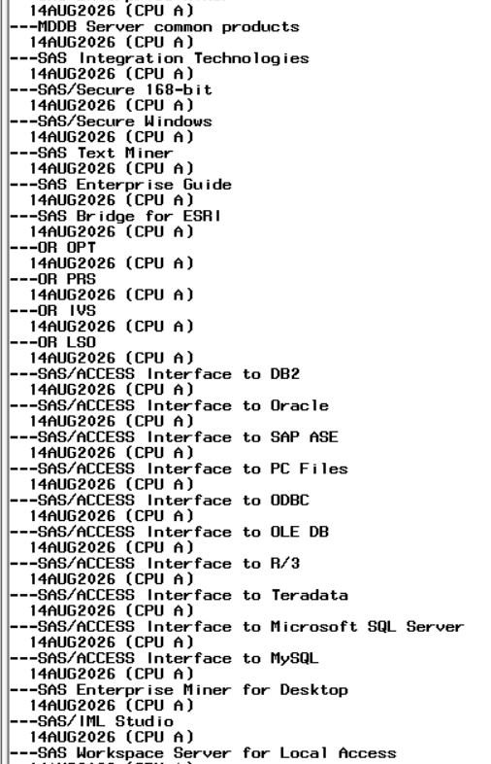
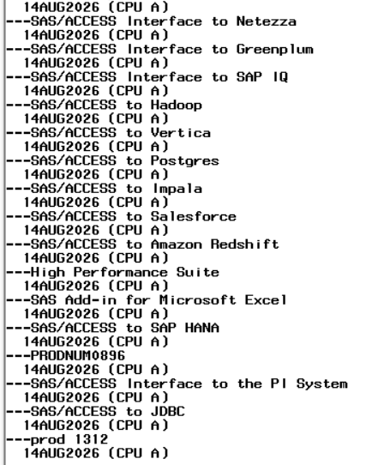
My Current SAS License Includes:

Slide 6
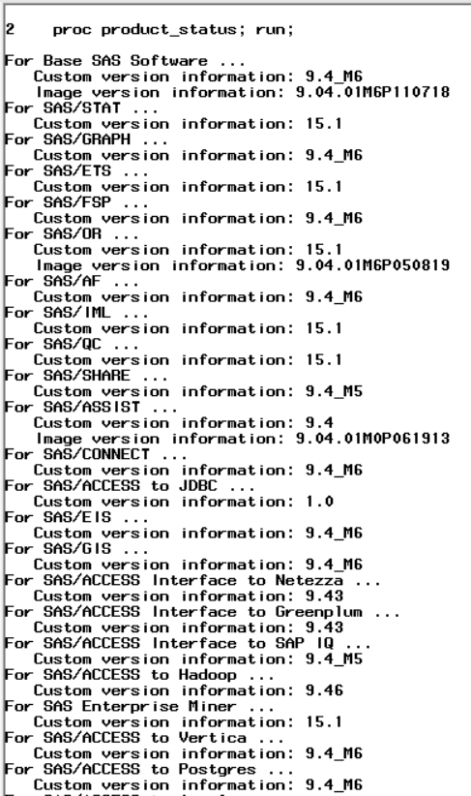
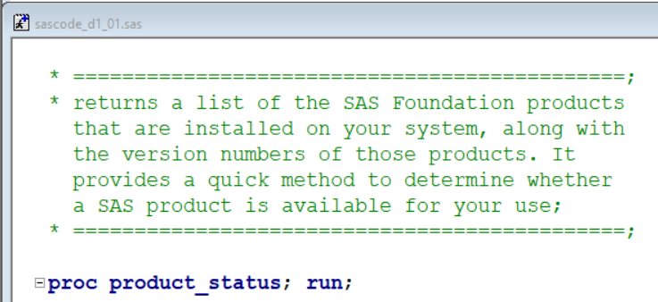
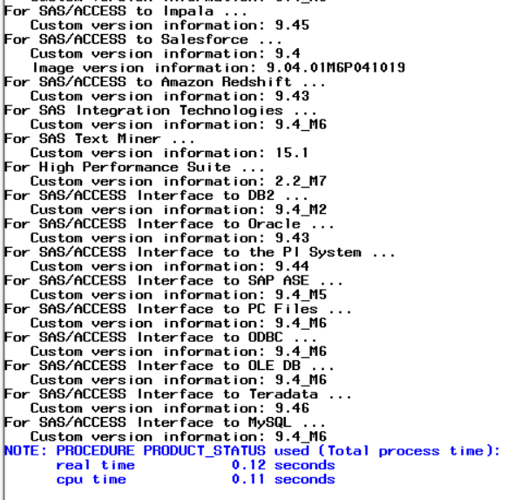
SAS Software Components

Slide 7
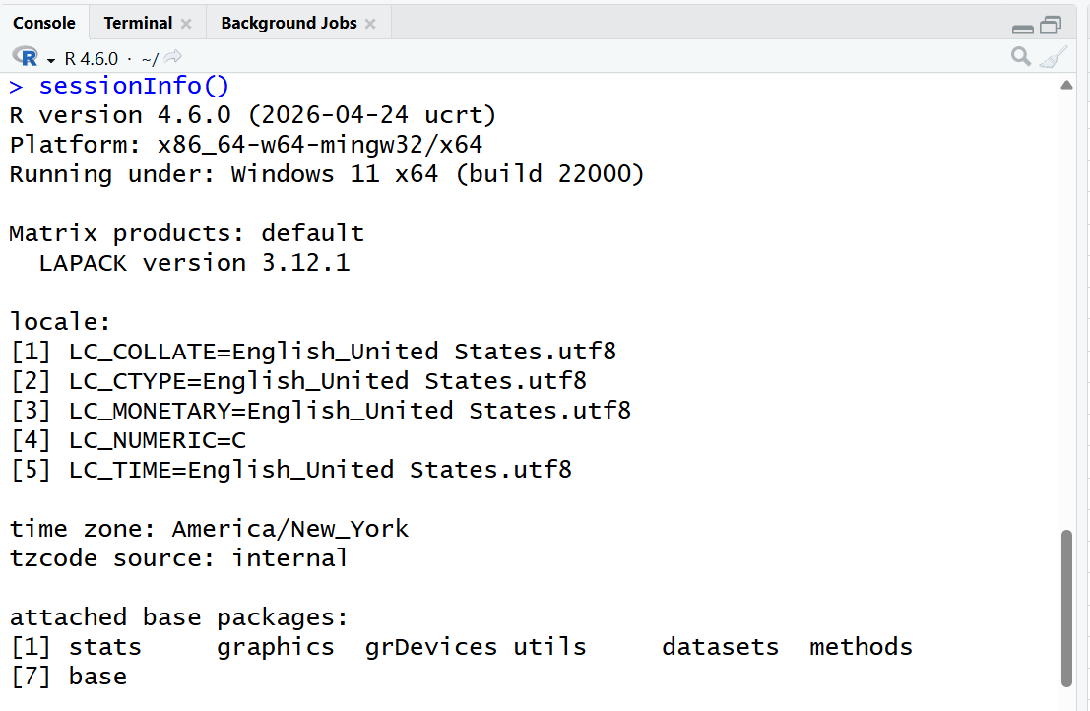
My Current R - Base Installation
Only 7 Base Packages

Slide 8
Interfaces – SAS Base; SAS Studio

Slide 9
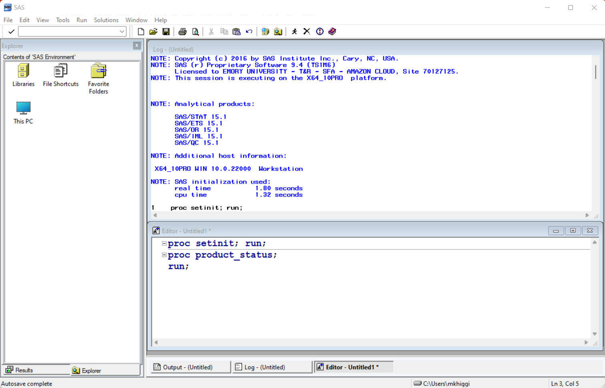
Basic SAS
IDE Interface

Slide 10
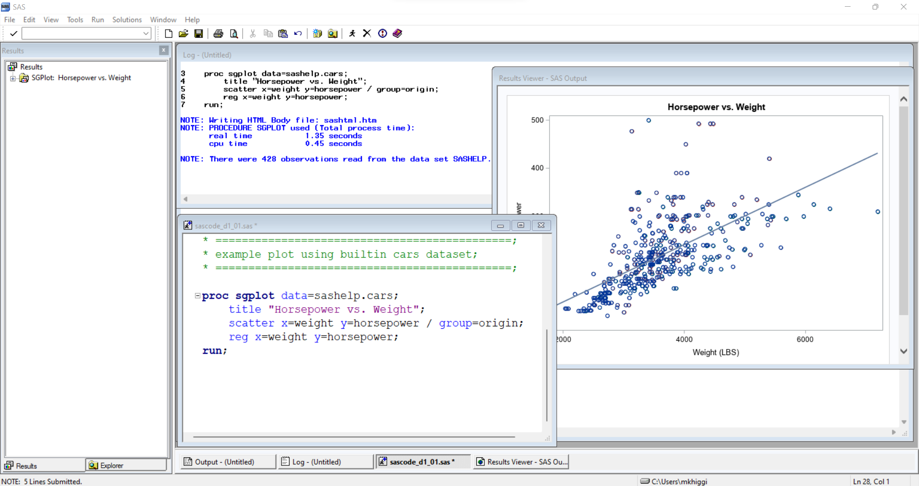
Output LOG
Results
SAS Program Script

Slide 11
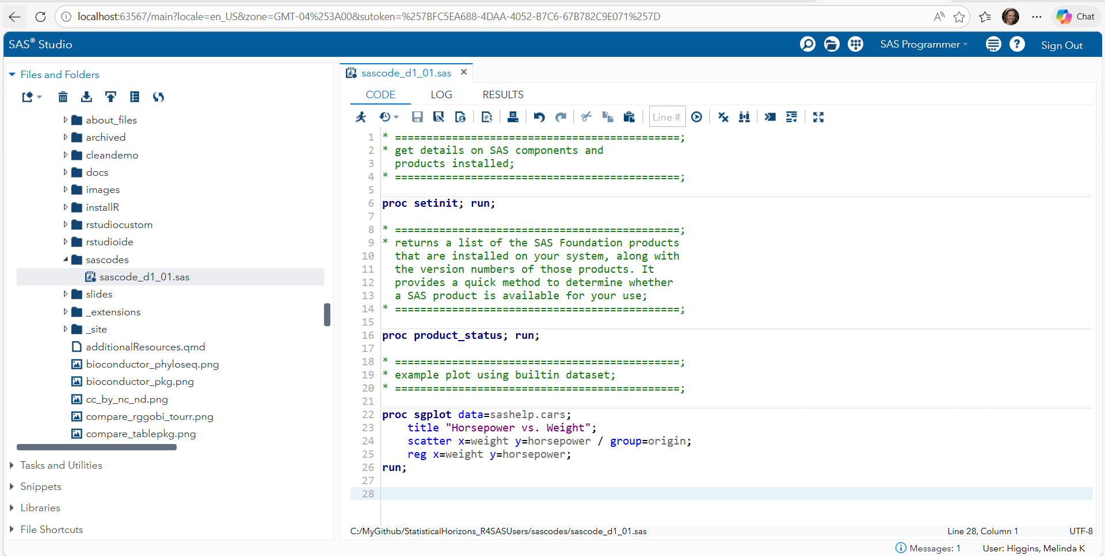
SAS Studio Interface IDE/GUI
SAS Program
Script

Slide 12
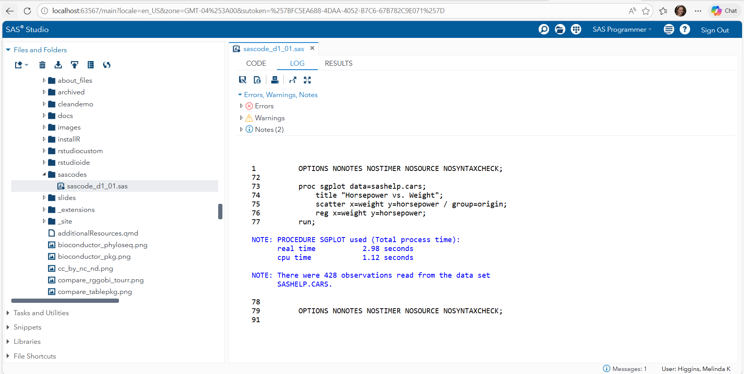
SAS Studio Interface IDE/GUI
Output LOG

Slide 13
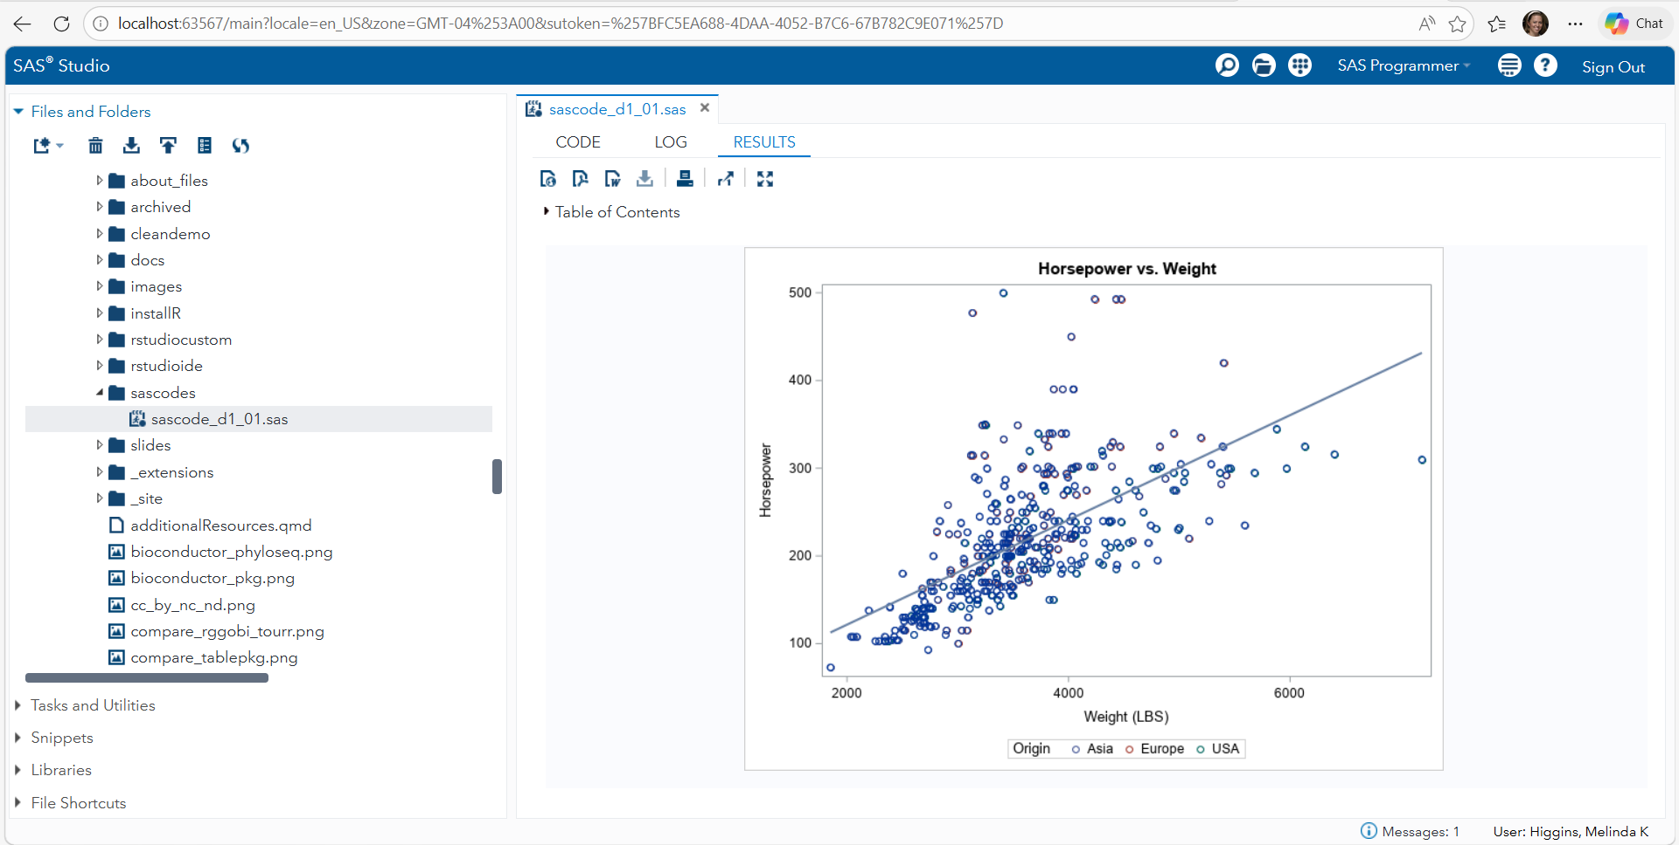
SAS Studio Interface IDE/GUI
Results

Slide 14
Interfaces – R Basic; Rstudio IDE; Positron
R (from CRAN) – FREE – comes with a basic programming interface
  https://cran.r-project.org/
Rstudio is an IDE = Integrated Development Environment
  https://posit.co/download/rstudio-desktop
Positron is the next evolution of programming interfaces
  https://positron.posit.co/
  Learn more, https://positron.posit.co/migrate-rstudio-compare.html

Slide 15
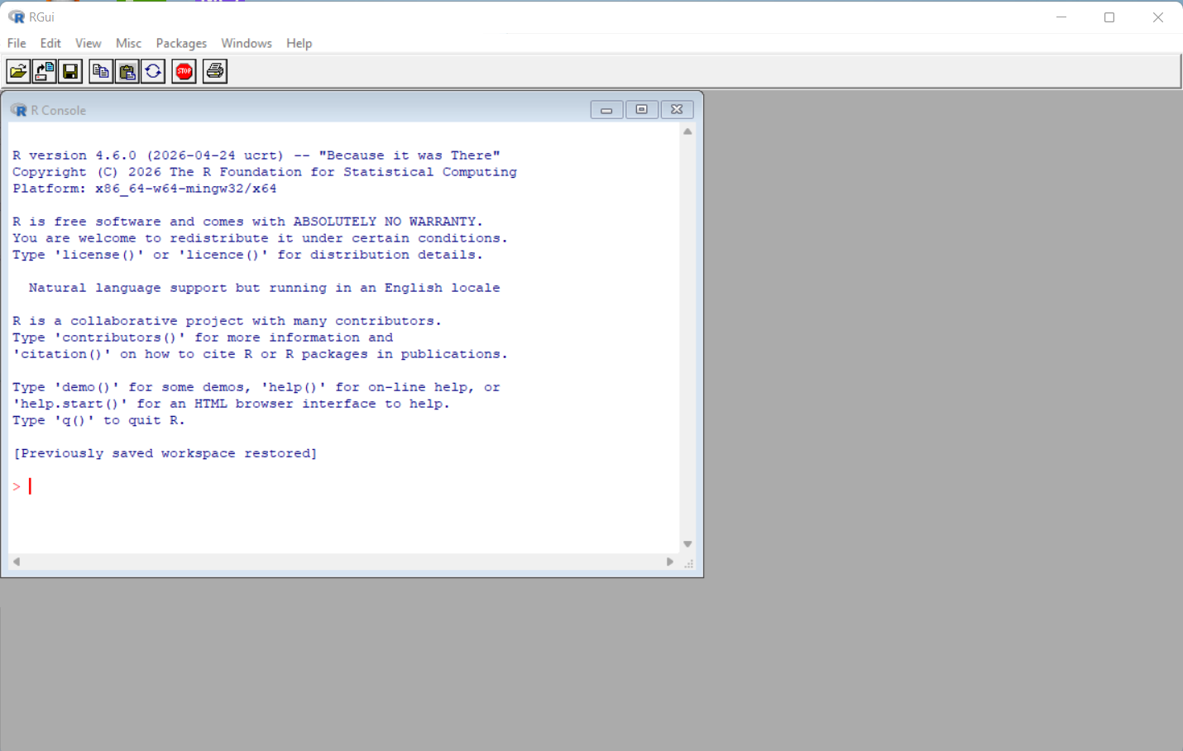
R Basic Interface

Slide 16
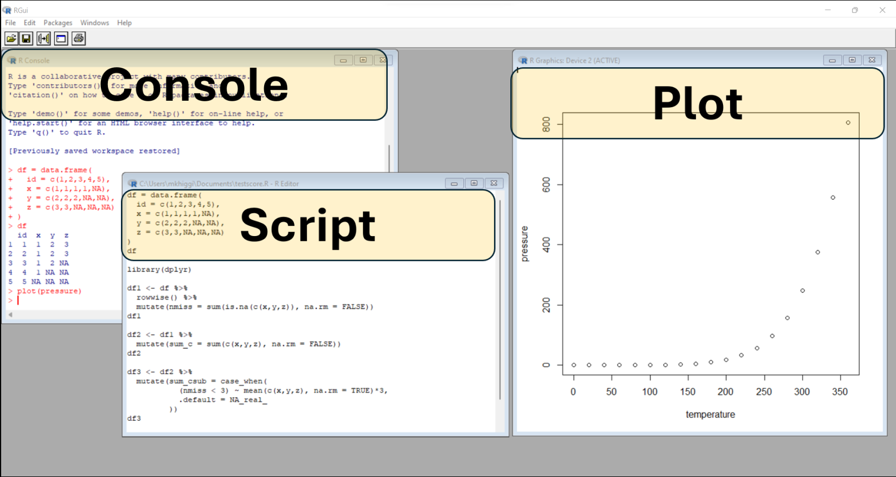
R Basic Interface – similar to SAS Basic Interface

Slide 17
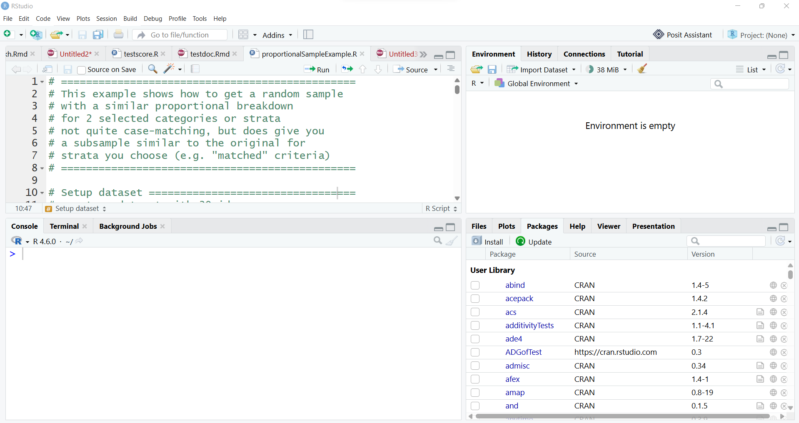
Rstudio IDE
Source,
Scripts, RMD, …
Environment,
History, …
Console,
Terminal,
Background Jobs
Files, Plots, Packages,
Help, Viewer,…

Slide 18
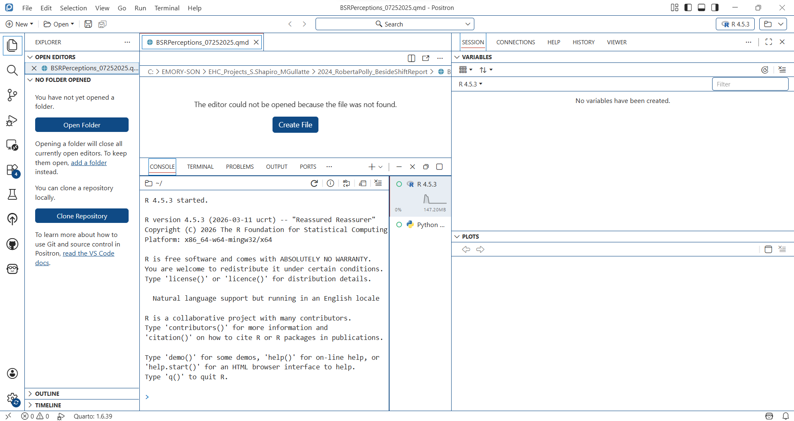
Positron IDE

Slide 19
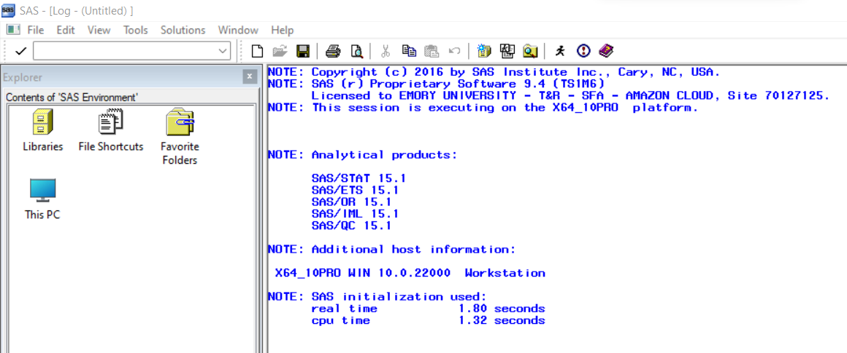
SAS Session
SAS Version and
Local System Details
Products Included
Operating System

Slide 20
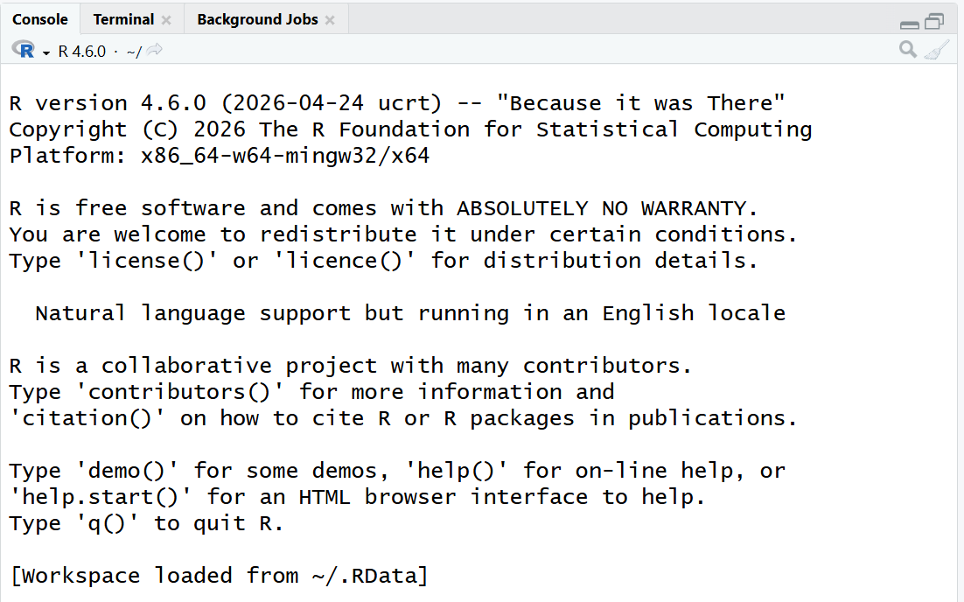
R Session – Details on Start

Slide 21
R Session – sessionInfo()
R Version
Operating System
Local Details
7 Base Packages

Slide 22
Open RStudio

Slide 23
Exercise 1:
Look at session details
Create new project “R4SASUsers”: File/New Project
Put all files for R For SAS Users into this folder

Slide 24
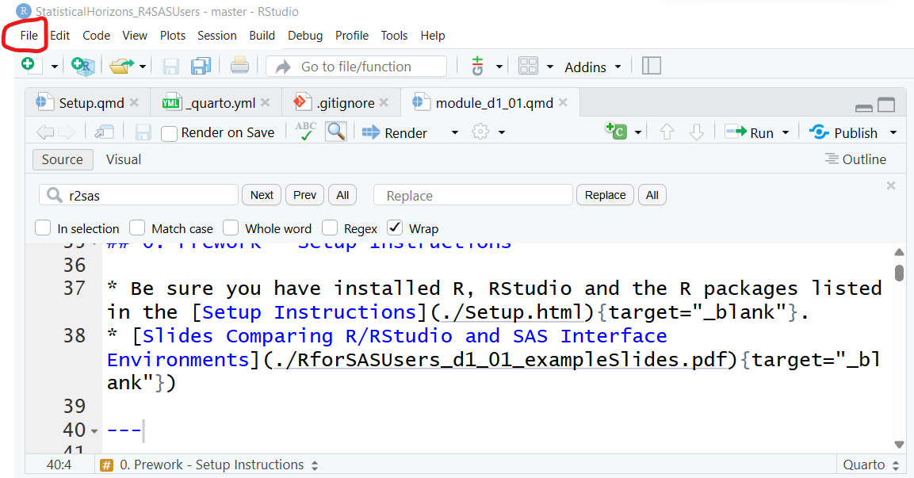

Slide 25
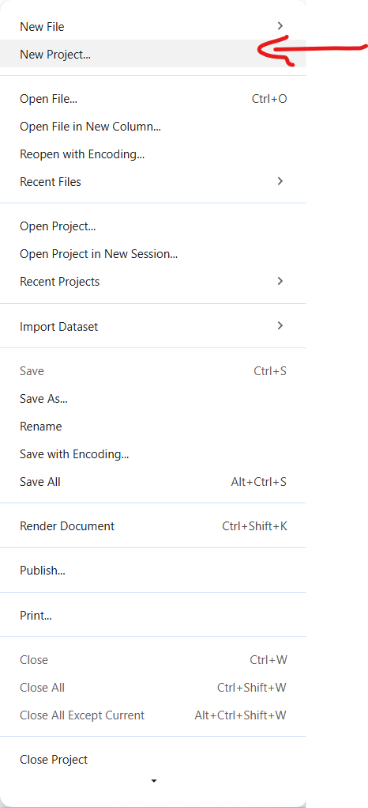
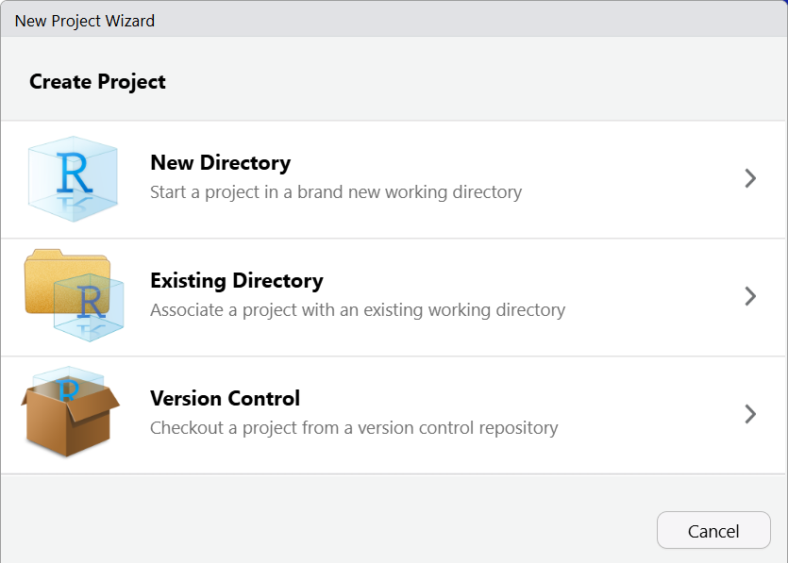

Slide 26
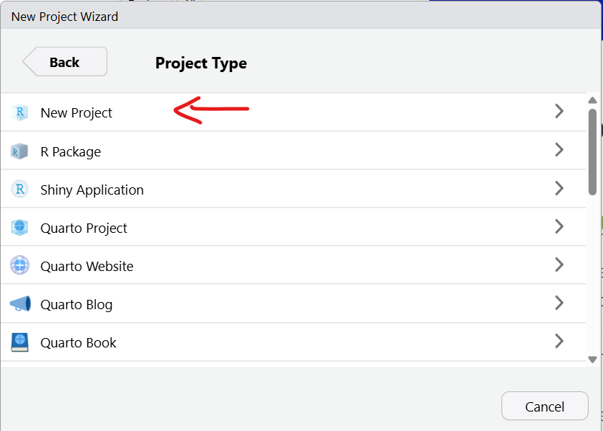
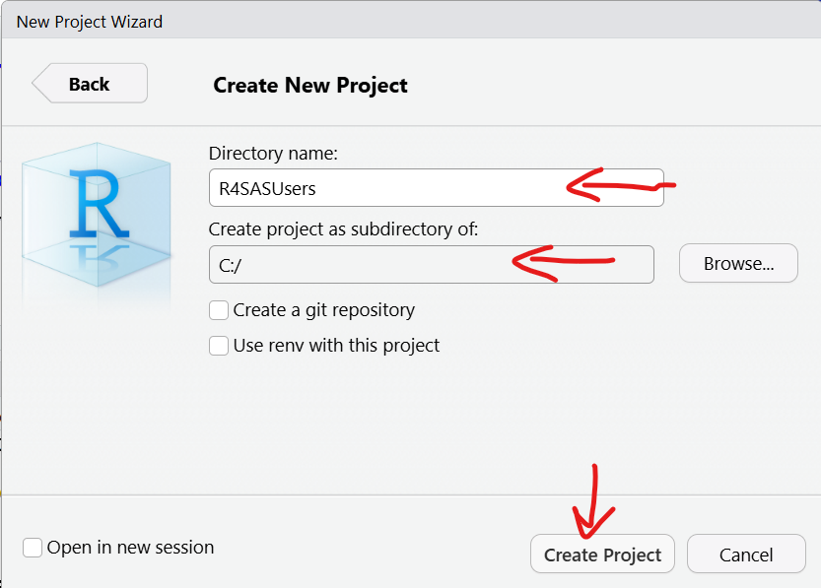

Slide 27
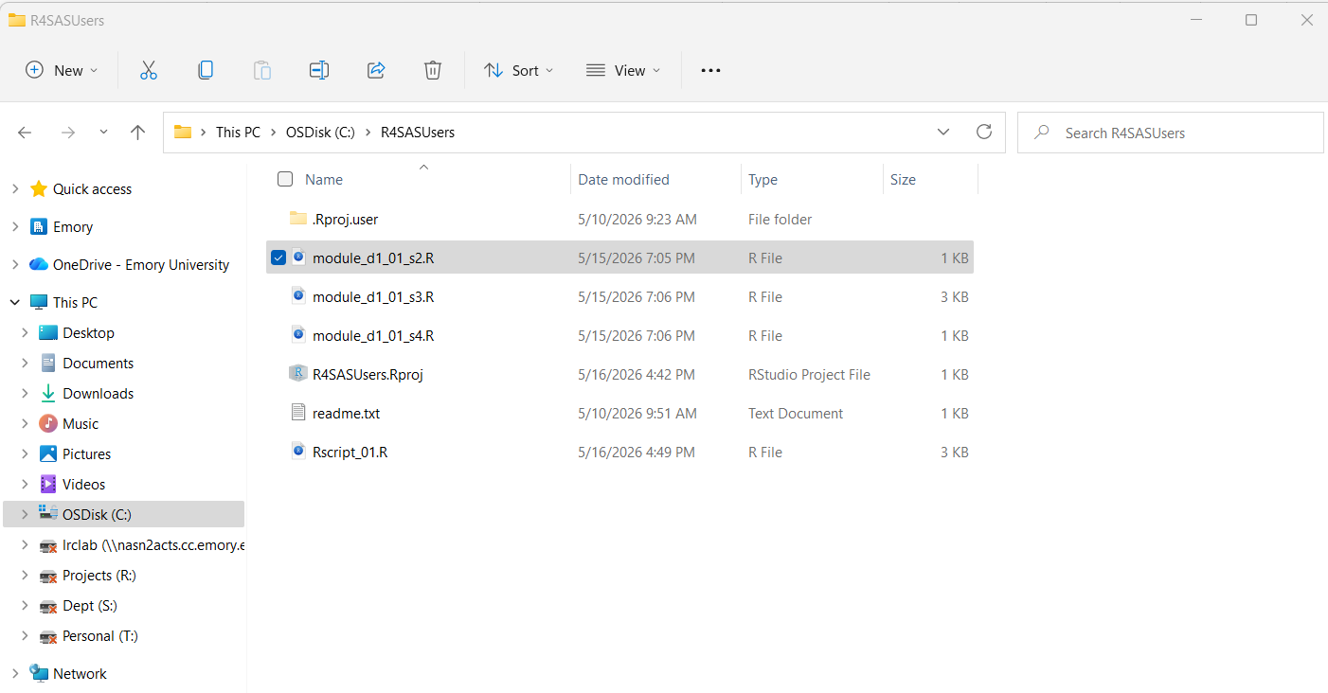
Put Files Into This Folder

Slide 28
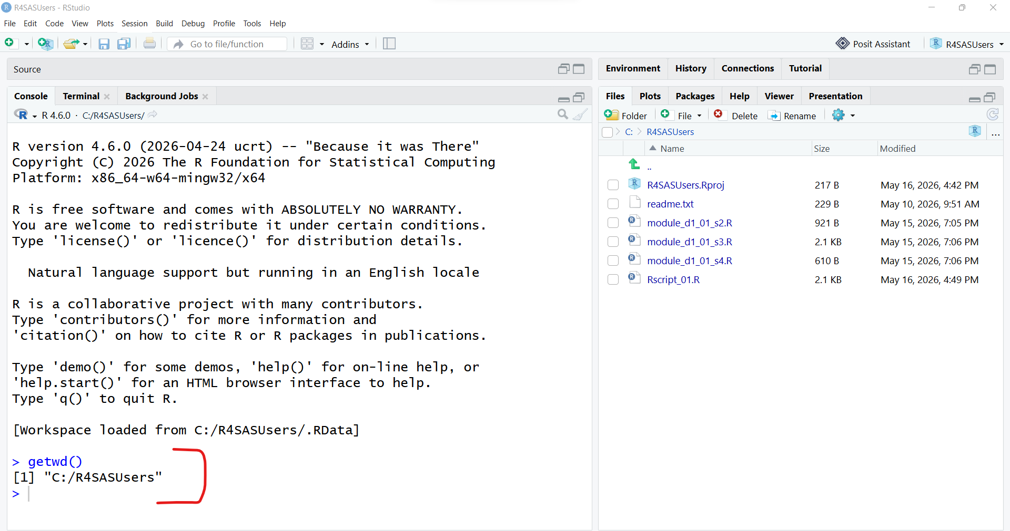
Project Folder

