Slide 1


Multivariate Modeling Health Outcomes Research Oct 21, 2025
Wenhui (Vivian) Zhang, PhD, MS (Statistics),
Research Assistant Professor,
Nell Hodgson Woodruff School of Nursing, Emory University
Notes:
GEE: https://towardsdatascience.com/an-introduction-to-generalized-estimating-equations-bc7dee570478
Bootstrapping: https://www.youtube.com/watch?v=Xz0x-8-cgaQ

Slide 2
Overview
Review
Multivariate regression (multivariable?)
Mediator and moderator
Multilevel modeling
Multivariable/variate analysis
Multivariate matching
Q&A

Slide 3
Review
Descriptive statistics
Chi square test, t-test/ANOVA, correlation
Linear regression
Logistic regression
Survival analysis (cox regression, time-varying covariates)
Propensity score matching
Weight, complex survey analysis
Generalized estimating equations (correlated repeated observations of the same patients over time/body parts, other clustering)
Assumptions?
Notes:
https://www.stata.com/features/survival-analysis/
Dignam JJ, Zhang Q, Kocherginsky M. The use and interpretation of competing risks regression models. Clin Cancer Res. 2012 Apr 15;18(8):2301-8. doi: 10.1158/1078-0432.CCR-11-2097. Epub 2012 Jan 26. PMID: 22282466; PMCID: PMC3328633. https://www.ncbi.nlm.nih.gov/pmc/articles/PMC3328633/
In Cox regression, you focus on the survival function, which indicates the probability of surviving beyond a given time. In competing-risks regression, you instead focus on the cumulative incidence function, which indicates the probability of the event of interest happening before a given time.
GEE: https://towardsdatascience.com/an-introduction-to-generalized-estimating-equations-bc7dee570478

Slide 4
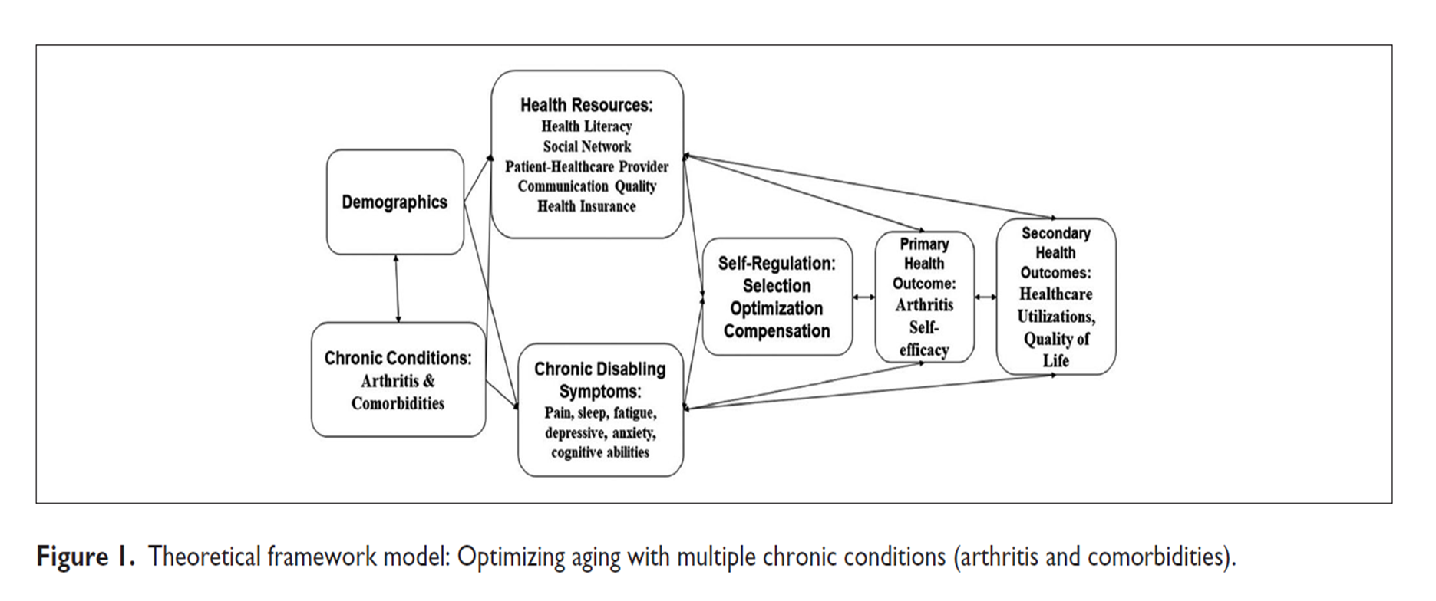
Multivariable regression
Multiple linear regression
Forward
Backward
Stepwise
Block
(Schneider et al., 2010)
4

Slide 5
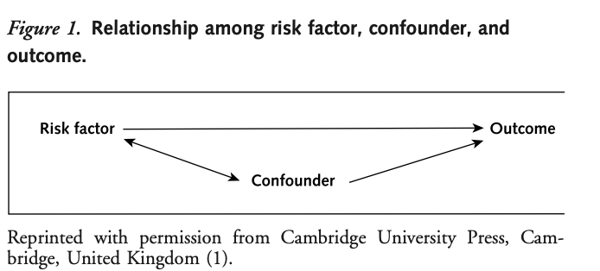
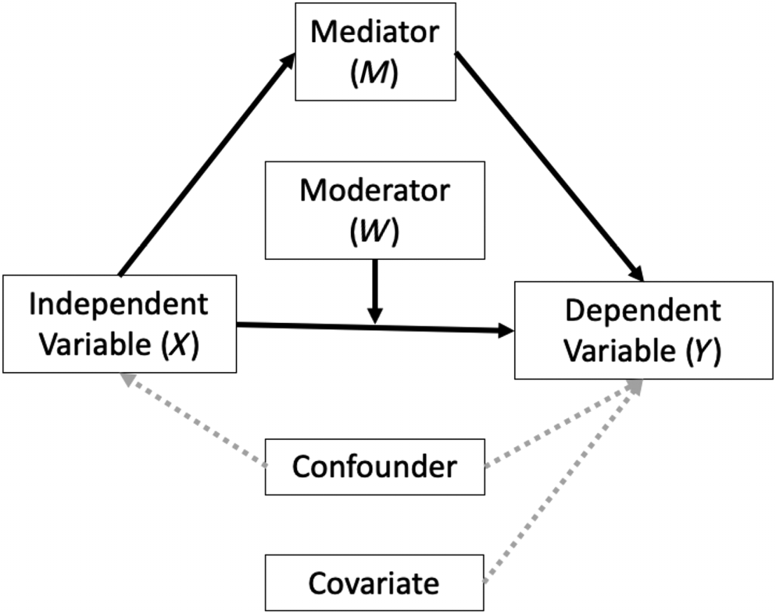
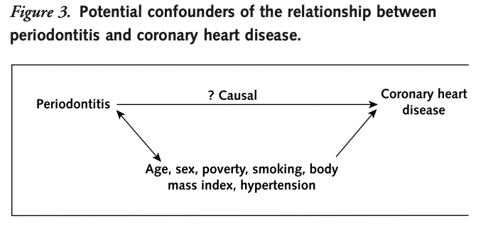
Confounder
5

Slide 6
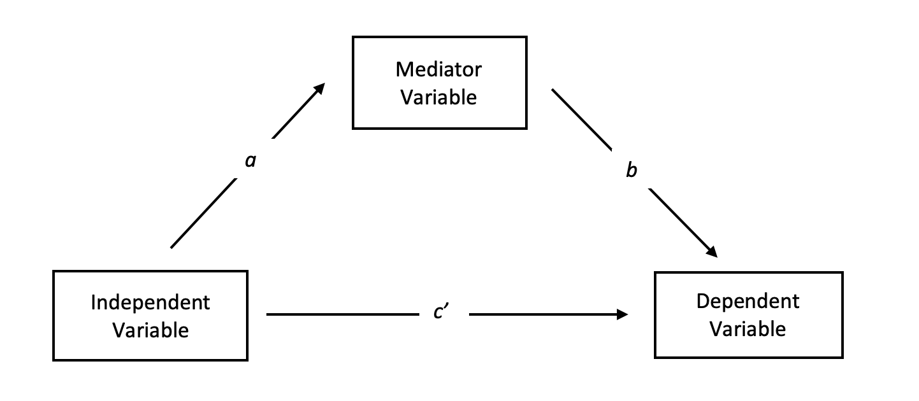
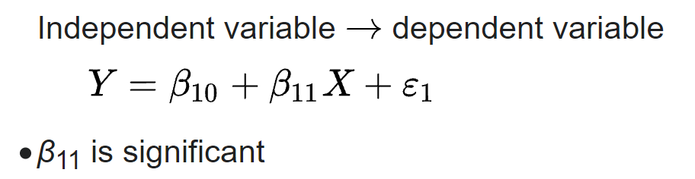
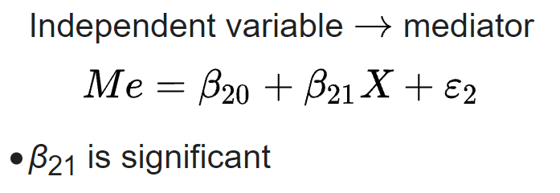
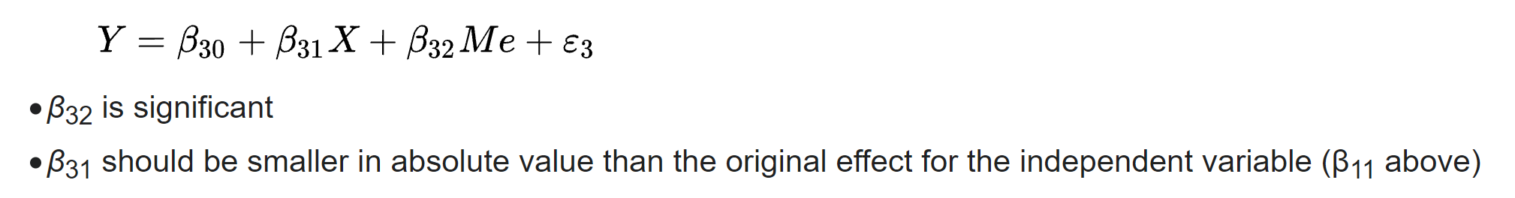
Mediator
Step 1:
Step 2:
Step 3:
Direct versus indirect effects, full versus partial mediation
Hayes process (SPSS): https://www.processmacro.org/index.html
(MacKinnon, 2008; Baron & Kenny, 1986; Hayes, 2009; Sobel, 1982; Robins & Greenland,1992)
6

Slide 7
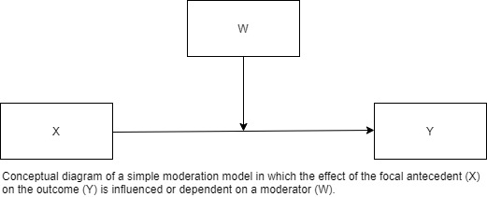
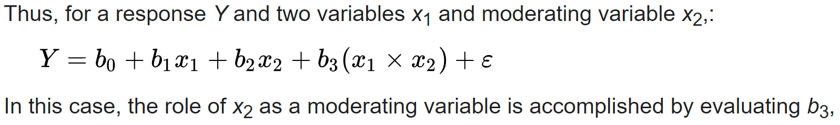
Moderator
(Cohen et al., 2003)
7

Slide 8
Examples
Mediator: class attendance
Moderator: baseline comorbidity, self-efficacy
Mediation analyses help us understand how active ingredients and mechanisms of action combine to produce change in a treatment target
Moderation analyses help us determine which circumstances, contexts, or individual characteristics might make that treatment most beneficial
(Becker et al., 2020)
8
Notes:
Morrow EL, Duff MC, Mayberry LS. Mediators, Moderators, and Covariates: Matching Analysis Approach for Improved Precision in Cognitive-Communication Rehabilitation Research. J Speech Lang Hear Res. 2022 Nov 17;65(11):4159-4171. doi: 10.1044/2022_JSLHR-21-00551. Epub 2022 Oct 28. PMID: 36306506; PMCID: PMC9940892. https://www.ncbi.nlm.nih.gov/pmc/articles/PMC9940892/

Slide 9
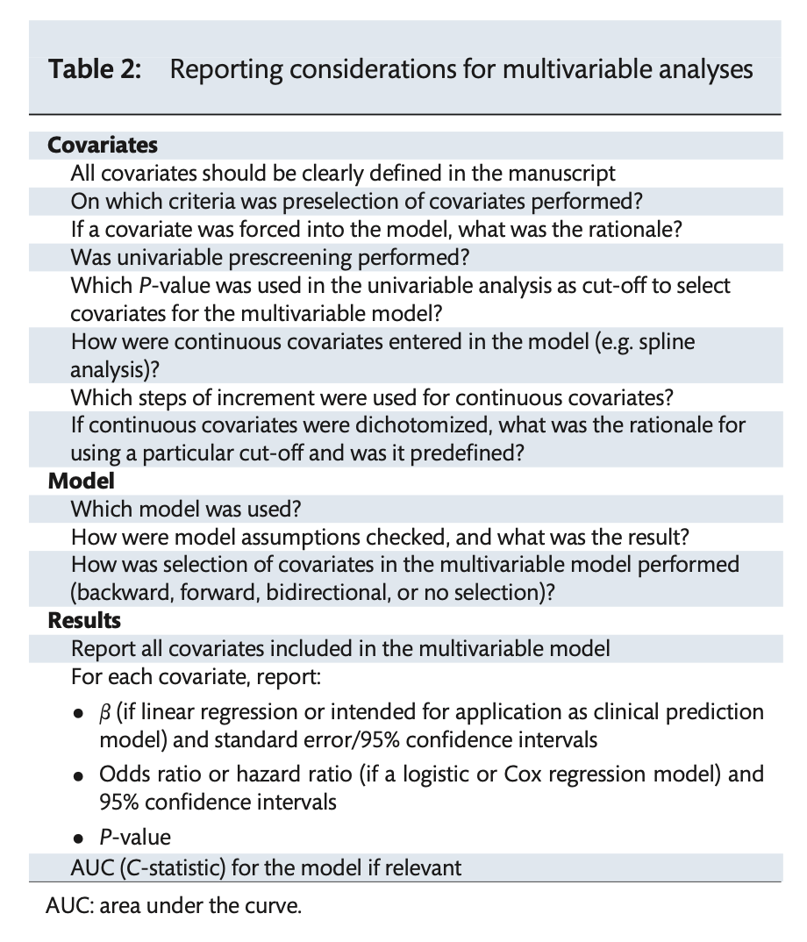
9

Slide 10
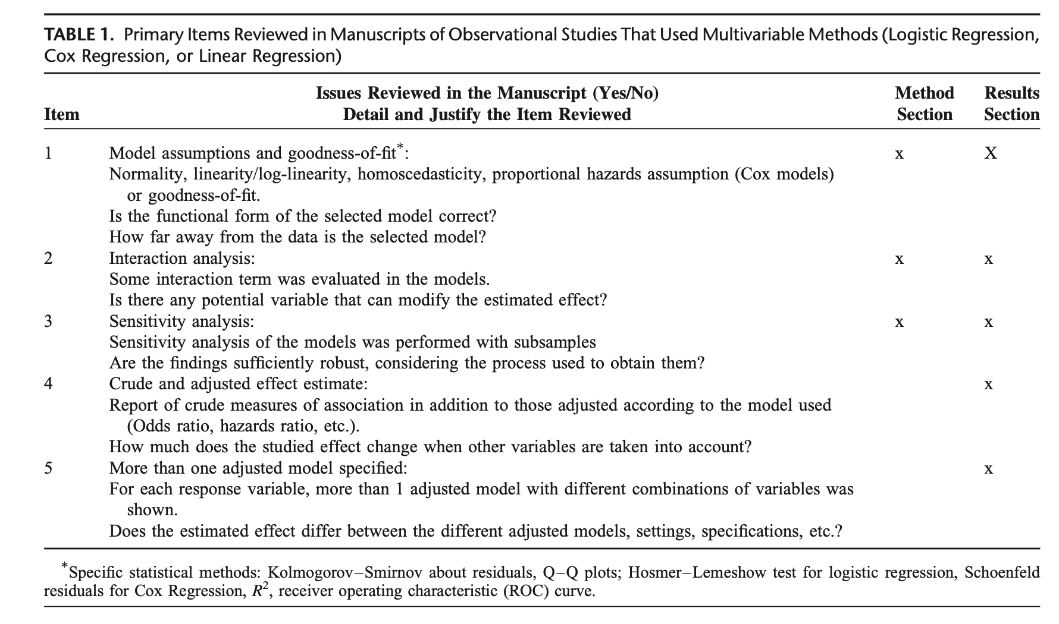
Quality Reporting of Multivariable Regression Models in Observational Studies
10

Slide 11
Multivariate analysis
One-way MANOVA: model two or more dependent variables that are continuous with one or more categorical predictor variables
Discriminant Function Analysis: determine the minimum number of dimensions needed to describe group differences
Canonical Correlation Analysis
Multivariate Multiple Regression
11
Notes:
https://stats.oarc.ucla.edu/other/dae/

Slide 12
GEE correlation structures
Independent
Exchangeable: correlation between observations at two-time points is equal for any two-time points, just one additional parameter α
Autoregressive: correlation between observations follows an autoregressive structure. AR-1 correlation matrix - month 1 and 2 α and month 1 and 3 α², month 1 and 4 α³ …
Unstructured
12
Notes:
https://towardsdatascience.com/an-introduction-to-generalized-estimating-equations-bc7dee570478
https://www.youtube.com/watch?v=diXAmukwY2w

Slide 13
Multi-level modeling
Hierarchical linear models, linear mixed models, mixed-effect models…
Data with nested sources of variability: units at a lower level or micro units (e.g., individuals) nested within units at a higher level or macro units (e.g., groups)
Simultaneous examination of the effects of group-level and individual-level variables on individual-level outcomes while accounting for the non-independence of observations within groups
Fixed effect, random effect, mixed model
Longitudinal data analysis
Meta-analysis
13
Notes:
Diez Roux AV. A glossary for multilevel analysis. J Epidemiol Community Health. 2002 Aug;56(8):588-94. doi: 10.1136/jech.56.8.588. PMID: 12118049; PMCID: PMC1732212. https://pubmed.ncbi.nlm.nih.gov/12118049/

Slide 14
Multi-level modeling
Fixed effect: Regression coefficients (intercepts or covariate effects) that are not allowed to vary randomly across higher-level units
Random effect: Vary randomly around an overall mean
Mixed model: contain a mixture of FIXED EFFECTS (or fixed coefficients) and RANDOM EFFECTS (or random coefficients).
14
Notes:
McNeish D, Stapleton LM, Silverman RD. On the unnecessary ubiquity of hierarchical linear modeling. Psychol Methods. 2017 Mar;22(1):114-140. doi: 10.1037/met0000078. Epub 2016 May 5. PMID: 27149401. https://pubmed.ncbi.nlm.nih.gov/27149401/Links to an external site.

Slide 15
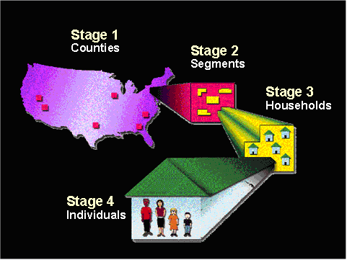
Complex survey analysis: NHANES
Sample weight
Oversampling
R package: nhanesA
15
Notes:
NHANESA: https://cran.r-project.org/web/packages/nhanesA/index.html

Slide 16
Multivariable/variate analysis
Multiple linear regression
Logistic regression
Moderator, mediator
Multi-level modeling
Meta-analysis, meta-regression
Machine learning
Factorial ANOVA, ANCOVA, MANOVA, Repeated Measures ANOVA (RMANOVA)
Factor analysis
Cluster/classification analysis
Path analysis
Structural equation modeling
Network analysis
…
16

Slide 17
Multivariate matching
Multivariate analysis
Regression
Classification
Matching
Ratio, fixed versus variable number of controls
n, m, α, β
Bias and variance trade-offs
(Ming & Rosenbaum, 2000; Silber et al., 2015; Wu et al., 2008)
17

Slide 18
Questions? Thank you!
Notes:
https://www.youtube.com/watch?v=Q81RR3yKn30
https://www.youtube.com/watch?v=NGf0voTMlcs
https://www.youtube.com/watch?v=1dKRdX9bfIo
CRAN task views: https://cran.r-project.org/web/views/

Slide 19
References
Baron, R. M., & Kenny, D. A. (1986). The moderator–mediator variable distinction in social psychological research: Conceptual, strategic, and statistical considerations. Journal of Personality and Social Psychology, 51(6), 1173–1182. https://doi.org/10.1037/0022-3514.51.6.1173
Becker, H., Stuifbergen, A. K., Zhang, W., & Sales, A. C. (2020). Moderator effects in intervention studies. Nursing research, 69(1), 62–68. https://doi.org/10.1097/NNR.0000000000000398
Burke, R. E., Jones, C. D., Hosokawa, P., Glorioso, T. J., Coleman, E. A., & Ginde, A. A. (2018). Influence of nonindex hospital readmission on length of stay and mortality. Medical care, 56(1), 85–90. https://doi.org/10.1097/MLR.0000000000000829
Cohen, J., Cohen, P., West, S. G., & Aiken, L. S. (2003). Applied multiple regression/correlation analysis for the behavioral sciences (3rd ed.). Lawrence Erlbaum Associates Publishers.
Hayes, A. F. (2009). Beyond Baron and Kenny: Statistical mediation analysis in the new millennium. Communication Monographs, 76(4), 408–420. https://doi.org/10.1080/03637750903310360
Hayes, A. F. (2021). The PROCESS macro for SPSS, SAS, and R. https://www.processmacro.org/index.html
MacKinnon, D. P. (2008). Introduction to Statistical Mediation Analysis. New York: Erlbaum.
19

Slide 20
References
Ming, K., & Rosenbaum, P. R. (2000). Substantial gains in bias reduction from matching with a variable number of controls. Biometrics, 56(1), 118–124. https://doi.org/10.1111/j.0006-341x.2000.00118.x
Robins, J. M., & Greenland, S. (1992). Identifiability and exchangeability for direct and indirect effects. Epidemiology (Cambridge, Mass.), 3(2), 143–155. https://doi.org/10.1097/00001648-199203000-00013
Schneider, A., Hommel, G., & Blettner, M. (2010). Linear regression analysis: part 14 of a series on evaluation of scientific publications. Deutsches Arzteblatt international, 107(44), 776–782. https://doi.org/10.3238/arztebl.2010.0776
Silber, J. H., Rosenbaum, P. R., Kelz, R. R., Gaskin, D. J., Ludwig, J. M., Ross, R. N., Niknam, B. A., Hill, A., Wang, M., Even-Shoshan, O., & Fleisher, L. A. (2015). Examining causes of racial disparities in general surgical mortality: hospital quality versus patient risk. Medical care, 53(7), 619–629. https://doi.org/10.1097/MLR.0000000000000377
Sobel, M. E. (1982). Asymptotic confidence intervals for indirect effects in structural equation models. Sociological Methodology, 13, 290–312. https://doi.org/10.2307/270723
Wu, B. U., Johannes, R. S., Kurtz, S., & Banks, P. A. (2008). The impact of hospital-acquired infection on outcome in acute pancreatitis. Gastroenterology, 135(3), 816–820. https://doi.org/10.1053/j.gastro.2008.05.053
Yakusheva, O., Weiss, M. E., Bobay, K. L., Costa, L., Hughes, R. G., Hamilton, M., Bang, J., & Buerhaus, P. I. (2019). Individual nurse productivity in preparing patients for discharge is associated with patient likelihood of 30-day return to hospital. Medical care, 57(9), 688–694. https://doi.org/10.1097/MLR.0000000000001170
20

