Slide 1
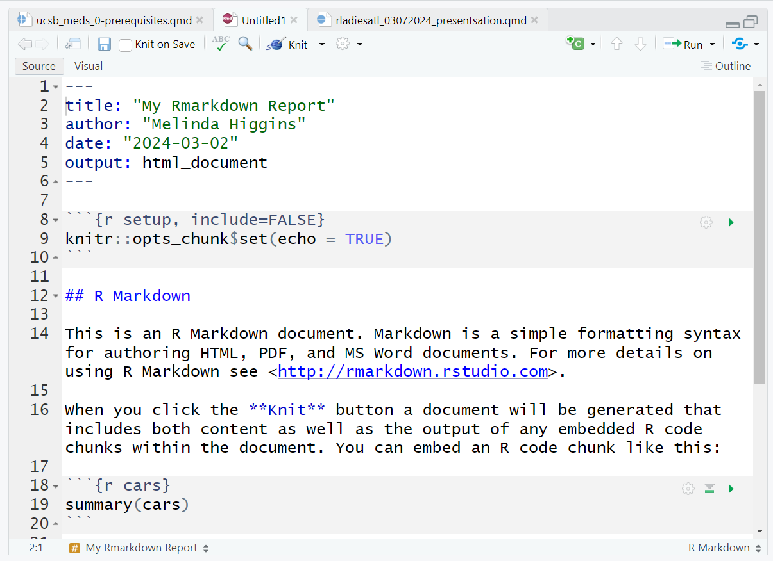
YAML

Slide 2
R Code
Chunks

Slide 3
Marked
up text

Slide 4
YAML
R Code
Chunks
Marked
up text

Slide 6
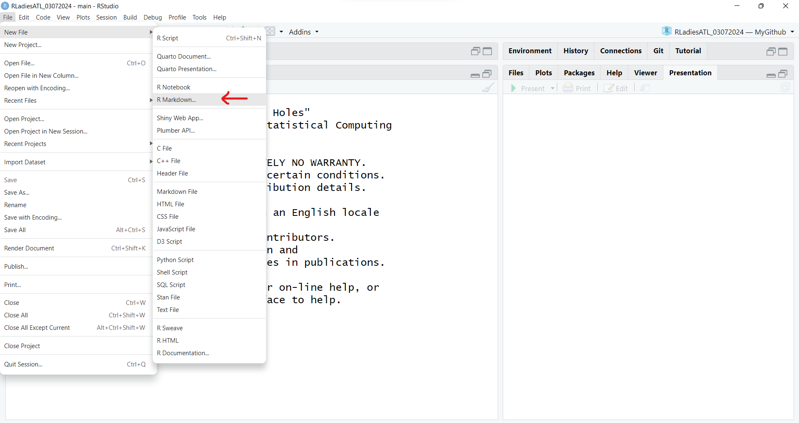

Slide 7
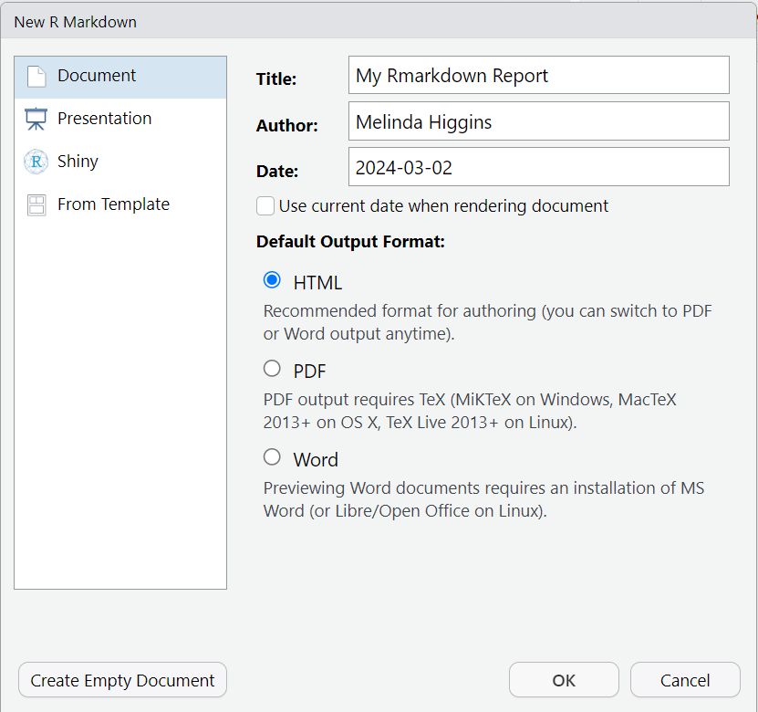

Slide 8
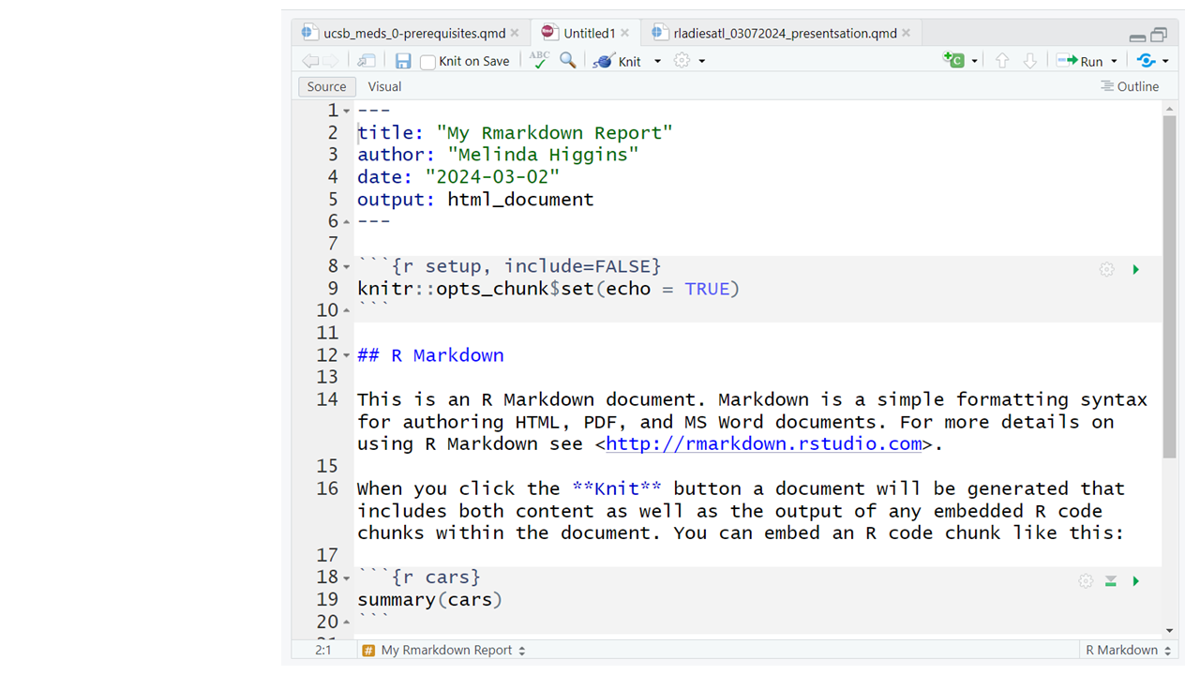

Slide 9
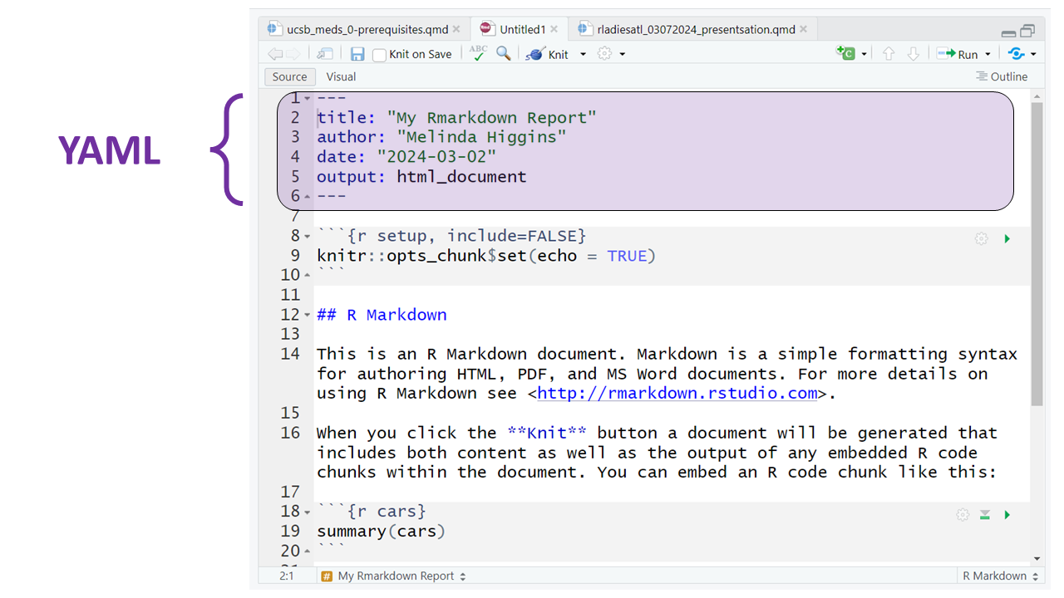

Slide 10
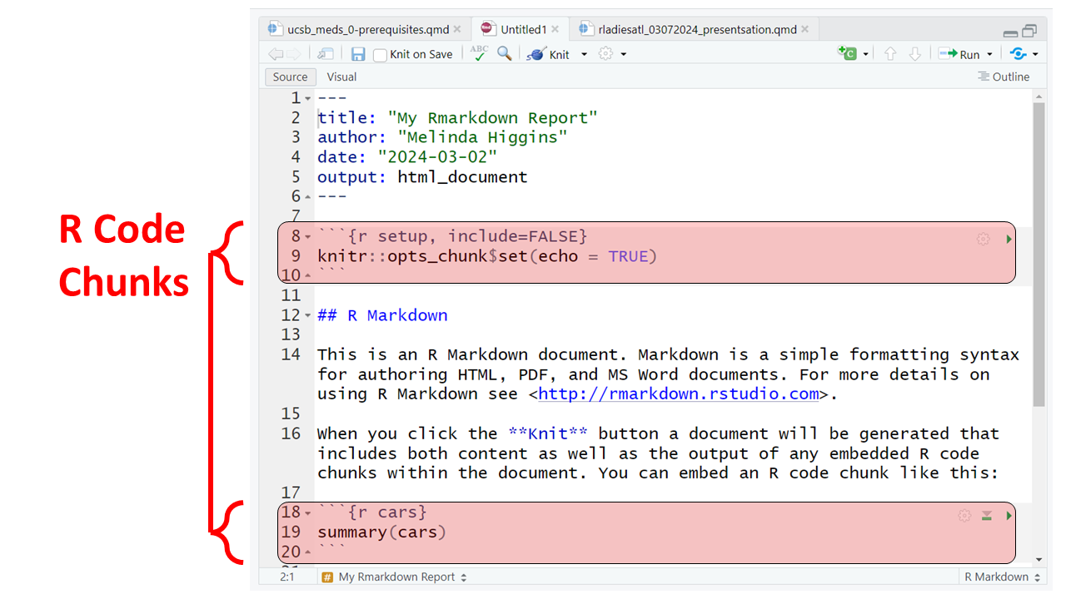

Slide 11
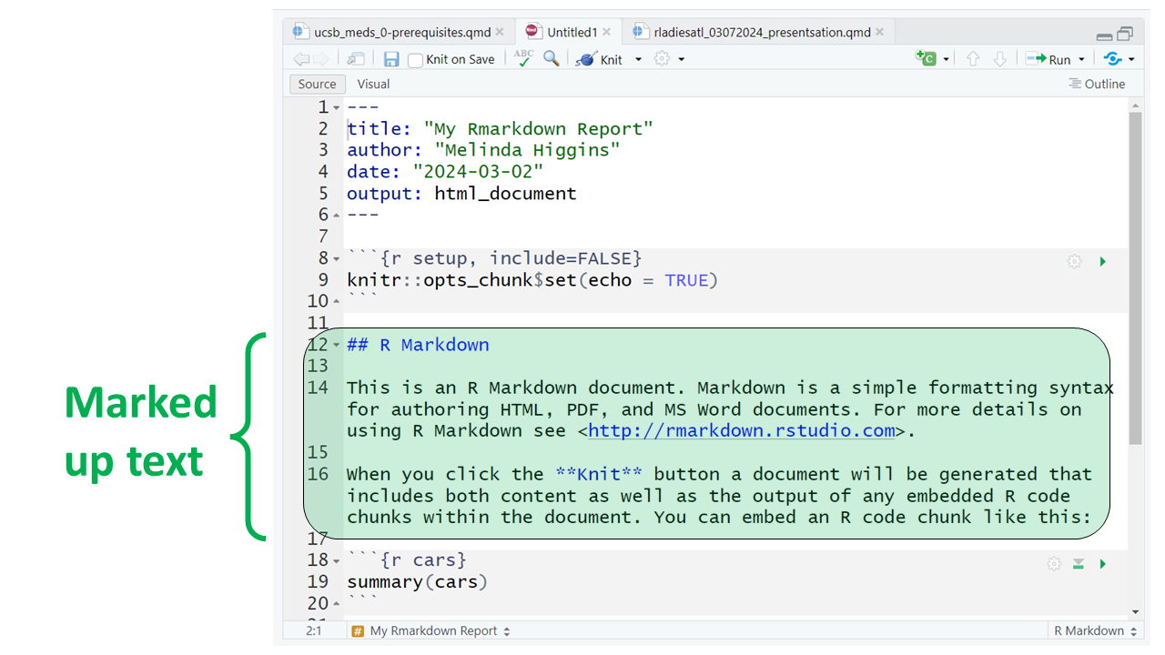

Slide 12
