Slide 1
Latent Variables (Variates) and Multicollinearity
“Good or Bad?”
Comparisons between Principal Components Analysis,
Factor Analysis and Discriminant Analysis
Melinda K. Higgins, Ph.D.
12 October 2007

Slide 2
Outline
Multicollinearity
Latent Variates
IRIS Dataset Described and Visualizations
Principal Components Analysis
Factor Analysis
Discriminant Analysis
Summary
Statistical Resources and Help

Slide 3
I. Multicollinearity
Multicollinearity exists when there is a strong correlation between two or more variables (predictors) in a regression (and other) model. Perfect collinearity exists when at least one variable is a perfect linear combination of the others, e.g. correlation coefficient = 1.*
DISADVANTAGES:
POOR INTERPRETATION
  For two perfectly correlated variables, their associated regression coefficients (“b”) are interchangeable.
UNSTABLE PREDICTION MODEL
  As the collinearity between two variables increases so does the standard error of the “b”s.
REJECTION OF GOOD PREDICTORS
  High levels of multicollinearity increase the probability that a good predictor variable will be found non-significant and rejected from the model.
ADVANTAGES:
SIMPLIFY MODEL
  When two variables are highly correlated one of them may be deleted from the model without loss of prediction capability.
IDENTIFY UNDERLYING CONSTRUCTS
  The presence of multicollinearity can indicate that there is an underlying “construct” or “latent” variable which may be important for understanding and interpretability.
REDUCE MODEL DIMENSIONALITY
  Rather than deleting one of the “redundant” highly correlated variables, they can both (all) be replaced with their underlying “latent” variable (reduce the “dimensionality” of the model).
*Field, Andy. Discovering Statistics Using SPSS, 2nd Ed., SAGE Publications, London, 2005, p. 174.

Slide 4
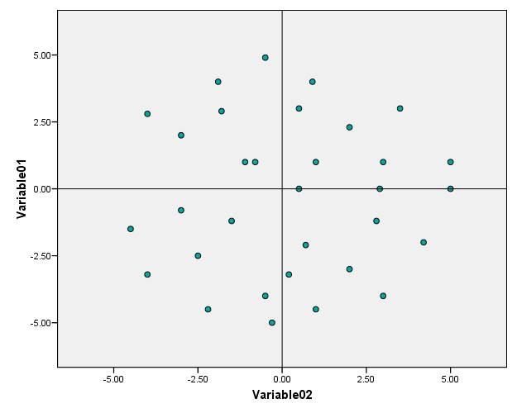
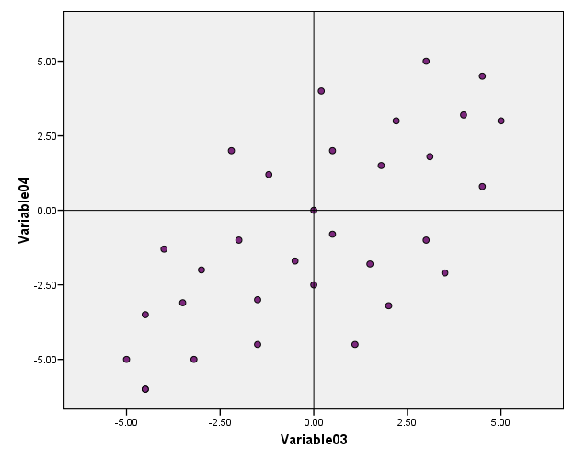
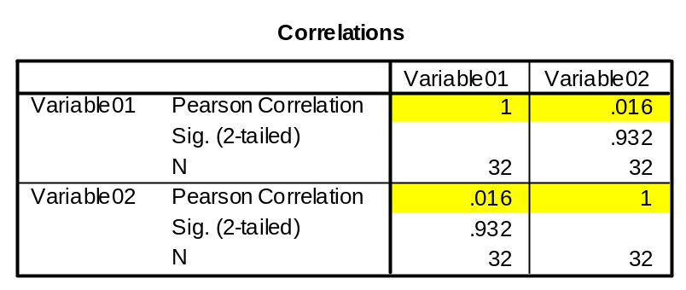
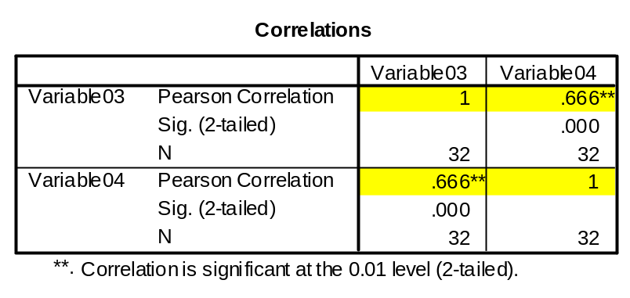
I. Multicollinearity
Begin with Correlation Matrix
Almost 0 Correlation
Medium Correlation

Slide 5
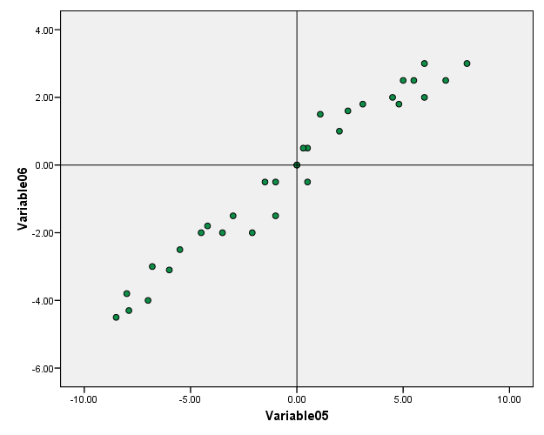

I. Multicollinearity
Now that we have “measured the extent” of the multicollinearity …
– how do we “extract” the underlying “latent variates?”
Almost Perfect (1) Correlation

Slide 6
II. Latent Variates
What are they? – Latent Variates are things/constructs which are present but which can not be measured directly.
  For example, psychologists might want to measure “burnout” (person working long periods of time on a project suddenly funds themselves devoid of motivation and inspiration), but this can not be measured directly. Instead, stress levels, depression, and creativity (number of ideas during some period of time) might be measured instead.
USES:
Understand the “structure” of the variables
  (e.g. Spearman and Thurston used Factor Analysis to understand the latent variate “intelligence”)
Construct a questionnaire to measure “latent variate”
  (e.g. develop a questionnaire to measure “burnout”)
Reduce the dataset to a more manageable size
  (e.g. replace stress, depression and creativity variables with one “burnout” variate/measure”)

Slide 7
II. Latent Variates
How do we “measure the extent of” and then “extract” the Latent Variates?
Find the Eigenvalues and Eigenvectors of the Correlation* Matrix
What are Eigenvectors
and Eigenvalues?
λ2
υ2
υ1
Eigenvectors (υ) are the major and minor axes (2D) of the “ellipsoid” encompassing the variability in the data
Eigenvalues (λ) are the lengths of these axes across the “ellipsoid”
λ1
* NOTE: The Covariance and SSCP Matrices are also sometimes used

Slide 8
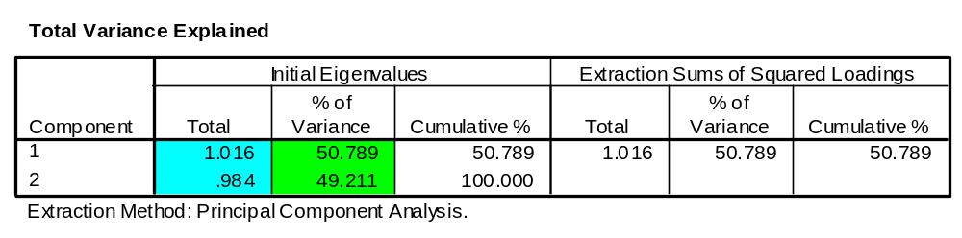

Eigenvalues
1.016
0.334
0.984
A
1.666
B

Slide 9

Eigenvalues (cont’d)
Other important indicators of multicollinearity (stuff you’ll see in statistics software)
Condition Index = λmax/ λmin
  Increases with increasing multicollinearity
    (A) Cond Index = 1.0325
    (B) Cond Index = 5.0006
    (C) Cond Index = 94.2381
Determinant (of Correlation Matrix)
  Decreases with Condition Index. As Determinant →0, the Correlation Matrix can not be inverted and error messages will be displayed.
    (A) Determinant = 0.9997
    (B) Determinant = 0.5555
    (C) Determinant = 0.0416
1.979
C
0.021

Slide 10
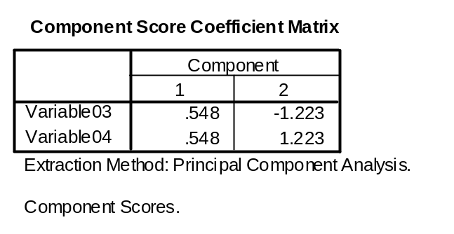
Eigenvectors
[Previously] Eigenvectors (υ) are the major and minor axes (2D) of the “ellipsoid” encompassing the variability in the data
The eigenvectors are also the new “latent variates” which are linear combinations of the original variables (var1, var2, …)
Latentvar1 = υ11(Var1) + υ12(Var2)
Latentvar2 = υ21(Var1) + υ22(Var2)
0.334
1.666
B
Latentvar1 = 0.548(Var03) + 0.548(Var04)
Latentvar2 = -1.223(Var03) +1.223(Var04)
Scores Loadings (Coefficients or Weights)

Slide 11
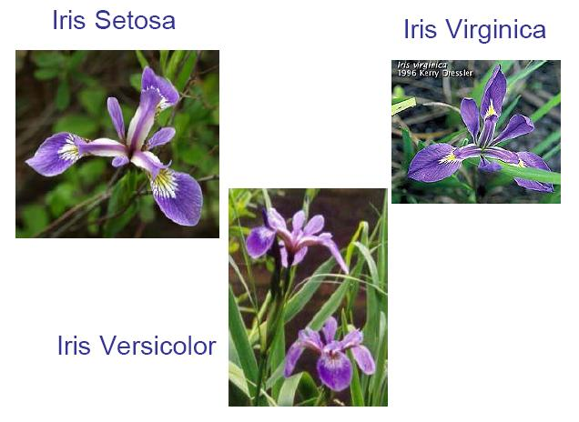
III. IRIS Dataset
Fisher, R.A. “The Use of Multiple Measurements in Taxonomic Problems,” Annals of Eugenics, 1936, 7, 179-188.

Slide 12
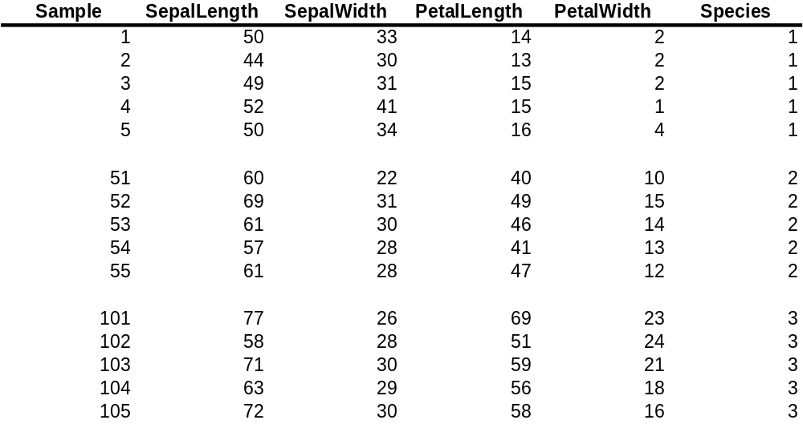
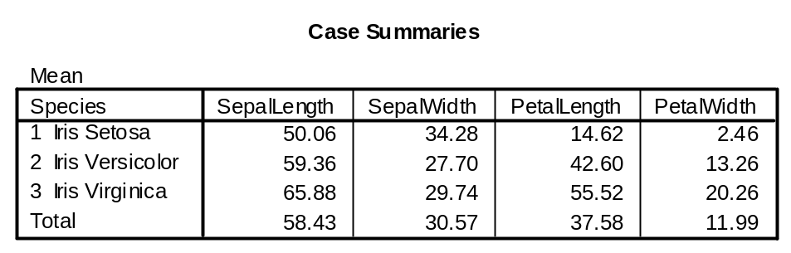
III. IRIS Dataset
Iris Dataset
3 Species (50 samples each)
  Iris Setosa
  Iris Versicolor
  Iris Virginica
4 Features
  Sepal Length
  Sepal Width
  Petal Length
  Petal Width
Data Table (150 x 4)
1 … 50
51 … 100
101 … 150
Notice that Petal Length and Petal Width changes
(increases) quite a bit from Species 1 < 2 < 3
Notice also that as the flowers get bigger, the Sepal
Width gets a little smaller (Species 2 < 3 < 1)

Slide 13
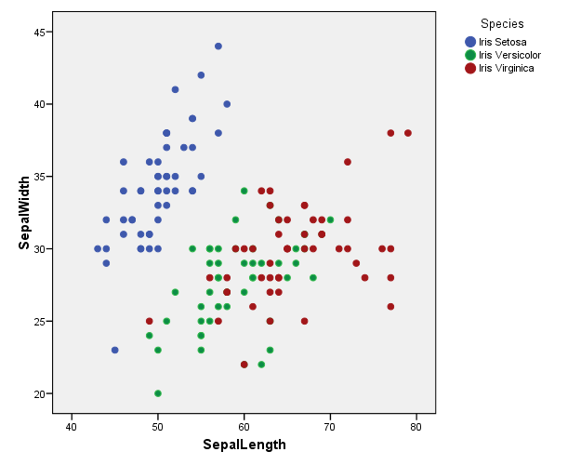
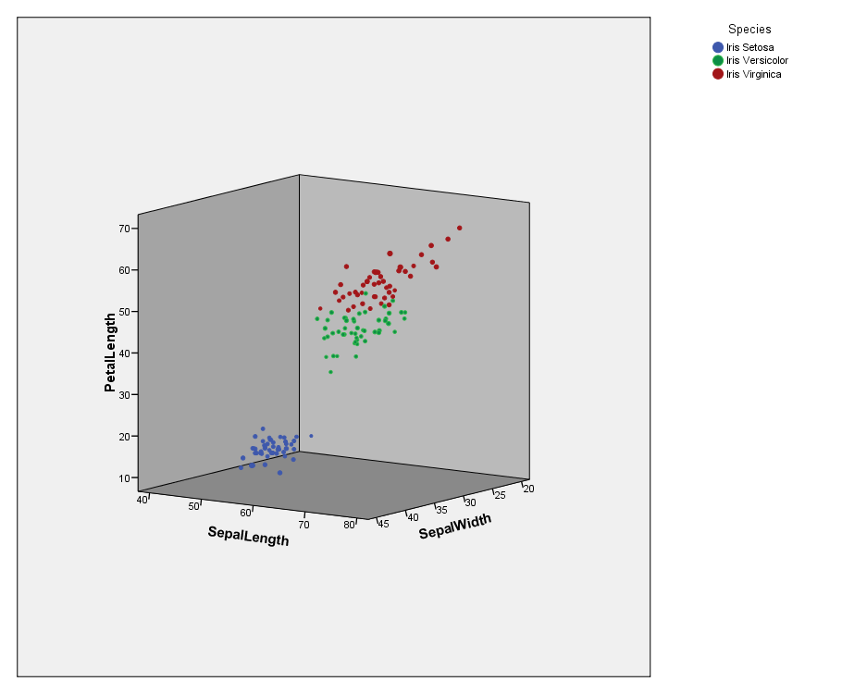
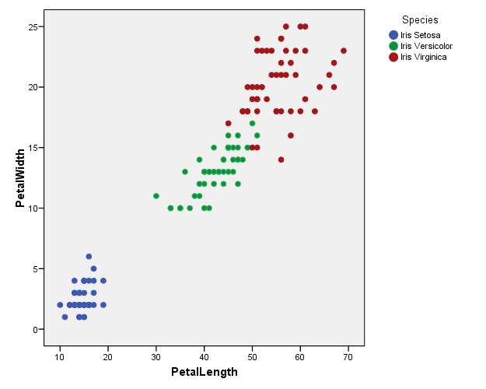
Make Plots – Visualize the Data

Slide 14
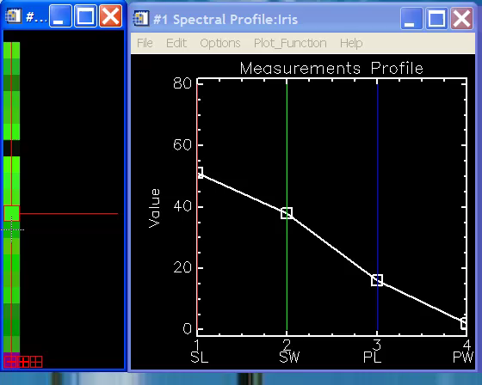
View All Variables at once – Look for Patterns
Samples Shown as “Pixels”
Profile Plots of SL, SW, PL, PW
Note changes in “pattern/profile” from
“green/species 1” to “purple/species 2”

Slide 15
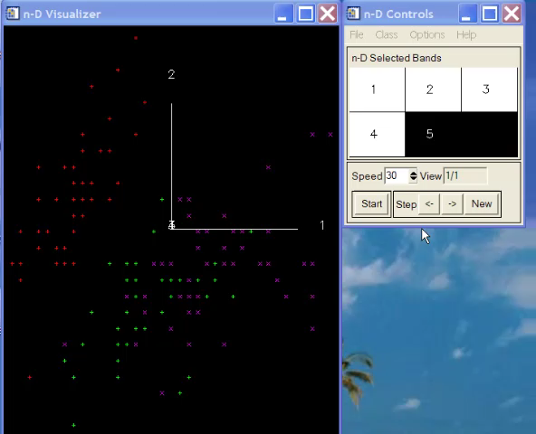
How to View Patterns in Multiple Dimensions
(e.g. > 3 variables)
Red = Iris Setosa
Green = Iris Versicolor
Purple = Iris Virginica
Axis 1 = Sepal Length
Axis 2 = Sepal Width
Axis 3 = Petal Length
Axis 4 = Petal Width

Slide 16
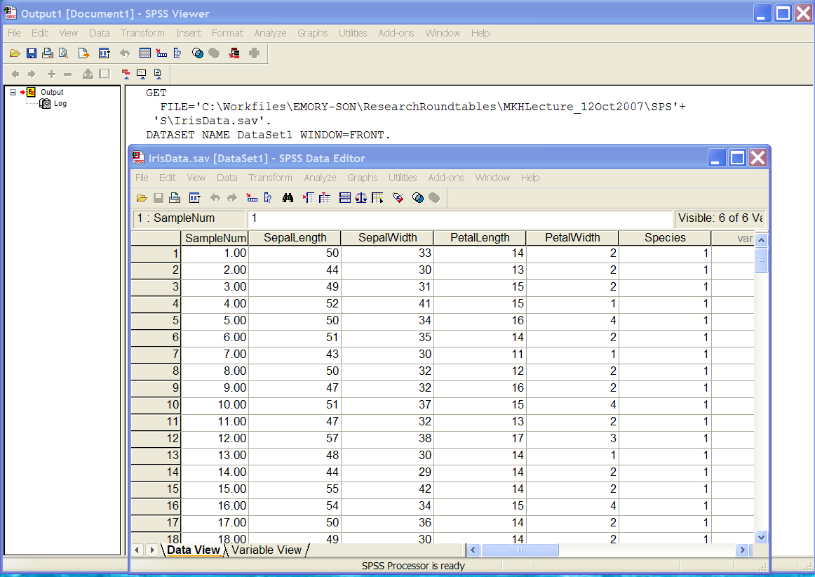
III. IRIS Dataset
Open IrisData.sav @ S:\Shared\Statistics_MKHiggins\ResearchRoundtables\Lecture_12Oct2007

Slide 17
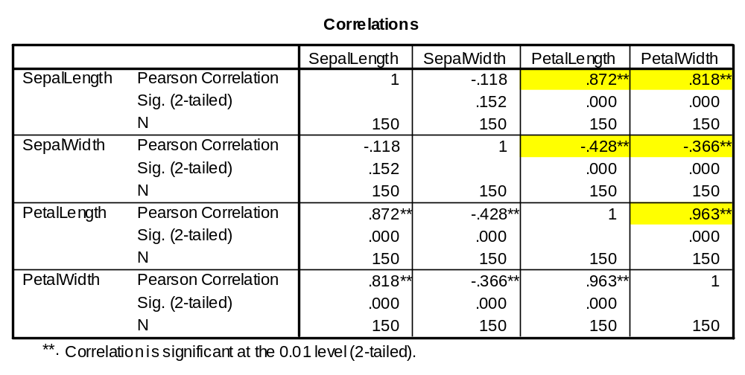
Run Bivariate Correlation
Notice that Petal Length and Petal Width are highly correlated (>0.8) with Sepal Length as well as each other and significant
Notice that Petal Length and Petal Width are significantly negatively correlated with Sepal Width
Notice that Sepal Length is also negatively correlated with Sepal Width, not significant

Slide 18
Axis Rotation
IV. Principal Components Analysis
Extraction of the Latent Variates – simple orthogonal (perpendicular, 90º) rotation of original variables
“Given a set of p-variate observations, determine a rotated axis such that the variable (latent variate) thereby defined as a linear combination of the original p variables has maximum variance.”*
θ
i.e. find the eigenvectors and eigenvalues of the correlation matrix
*Tatsuoka, M. Multivariate Analysis, 2nd Ed., MacMillan Publishing Co., New York, 1971, p. 128.

Slide 19
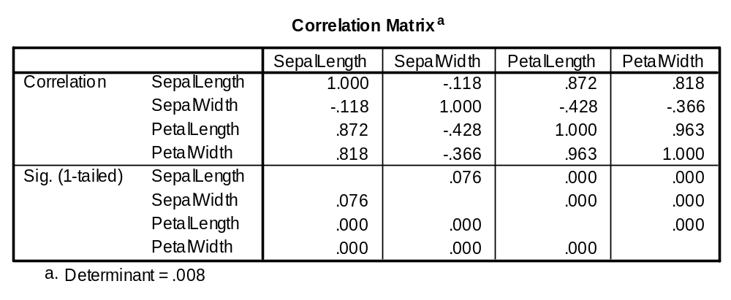
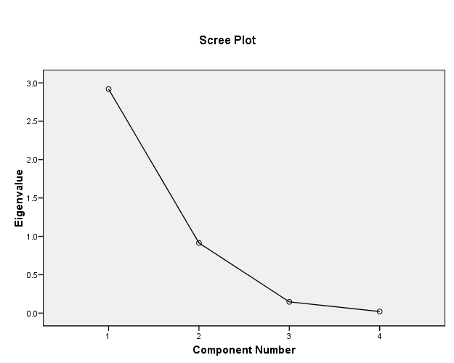
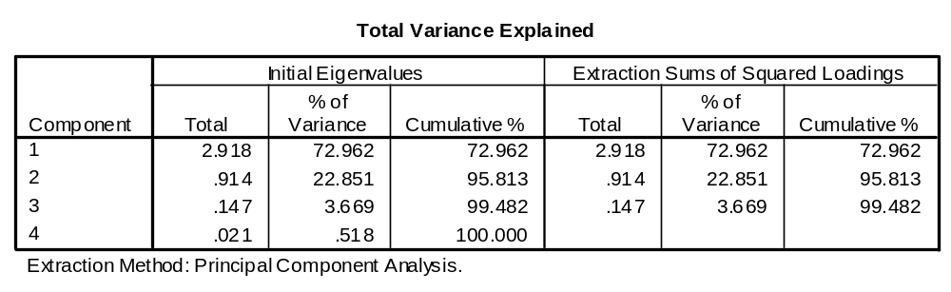
IV. Principal Components Analysis
Also indicates high multicollinearity
Keep 2 “components” – accounts for 95% of variance

Slide 20
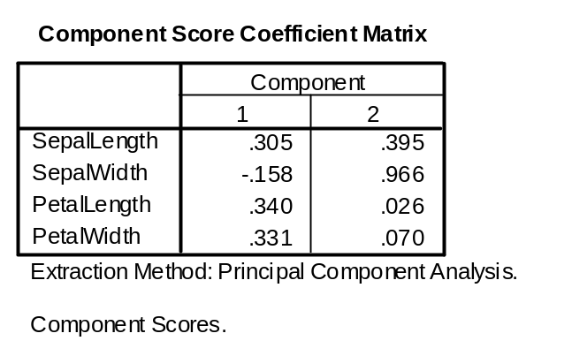
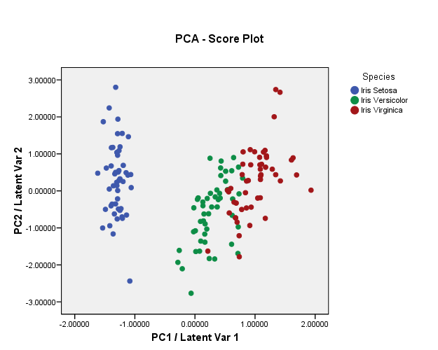
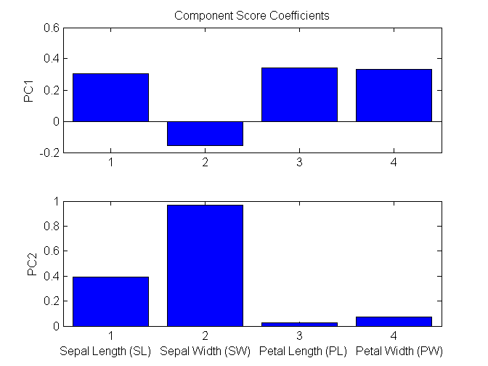
IV. PCA – Plotting the Data on the Latent Variates (“Score Plots”)
Going from 4 dimensions (SL,SW,PL,PW)
to only 2 (PC1,2) !!
PC 1 = 0.305(SL) –0.158(SW) + 0.340(PL) + 0.331(PW)
PC 2 = 0.395(SL) +0.966(SW) + 0.026(PL) + 0.070(PW)
Latent Variates called PC’s
Loading Plots

Slide 21
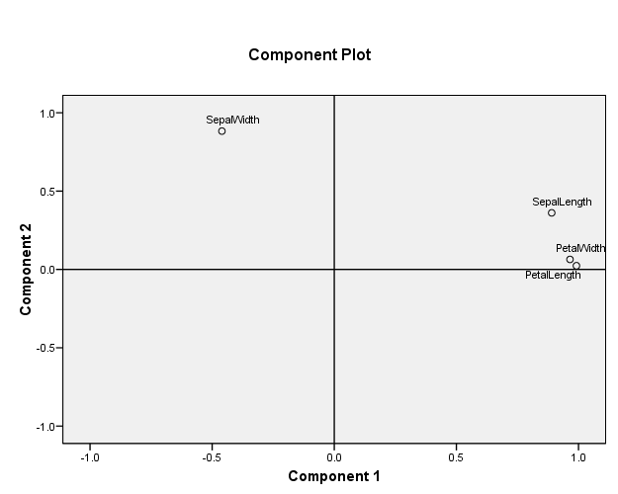
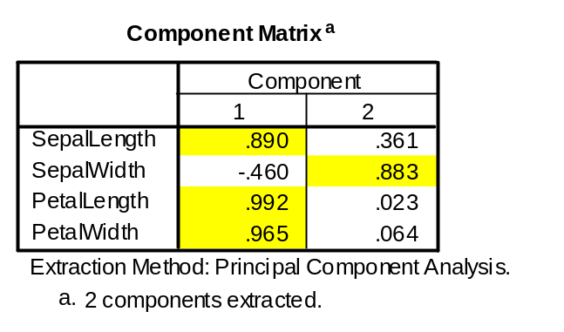
IV. PCA – Understanding the
Latent Variates
Another kind of “Loading Plot”
What if we “rotated” these Principal Components to better separate out the original variables and align them more distinctly with the 2 Latent Variates (e.g. hopefully making them more interpretable).

Slide 22
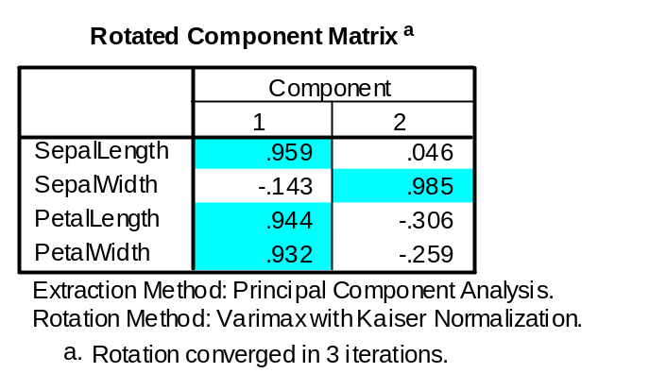
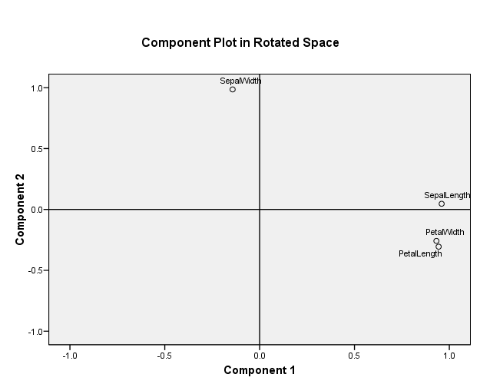
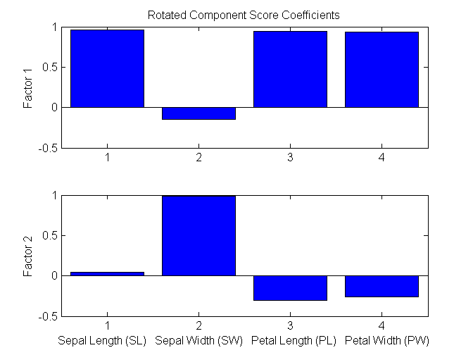
V. Factor Analysis
Improving “Interpretation” through Rotation
Varimax Rotation – orthogonal (rigid) rotation
2 “constructs”
Factor 1 = “Flower Size”
Factor 2 = “Sepal Width”
Latent Variates called Factors

Slide 23
VI. Discriminant Analysis
GOAL – to extract latent variates (“discriminants”) which maximize the separation of the classification groups (e.g. maximize the between group variance to the within group variance).
Advantages
  Extracted model can be used to “classify” new samples/subjects
  Data reduction possible through extracted discriminants
  Extracted latent variates DO NOT have to be orthogonal (90º) to one another – results are usually oblique axes
Disadvantages
  Requires apriori knowledge of “group classifications”
  Requires training set of data to establish model (more samples needed)

Slide 24
VI. Discriminant Analysis
Discriminant Analysis attempts to “discriminate” between a set of K groups by maximizing the between groups variance to the within groups variance.
θ
θ is NOT 90º, this is an illustration of the apparent “pull apart”
Essentially we are trying to find a new set of axes (most likely not orthogonal to each other) which “pull” the groups apart.
θ

Slide 25
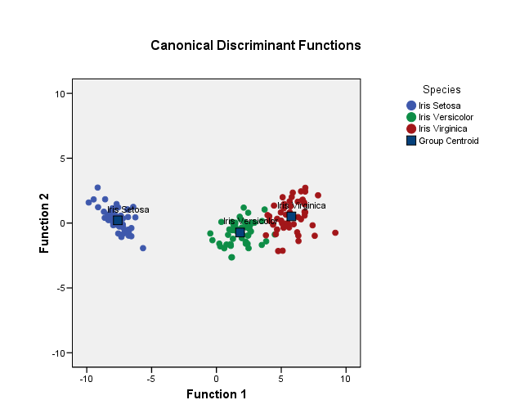
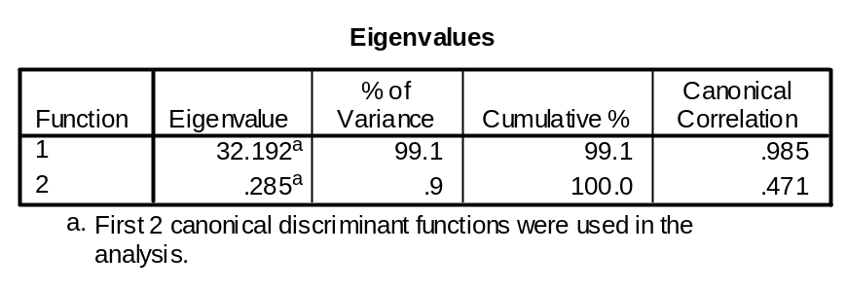
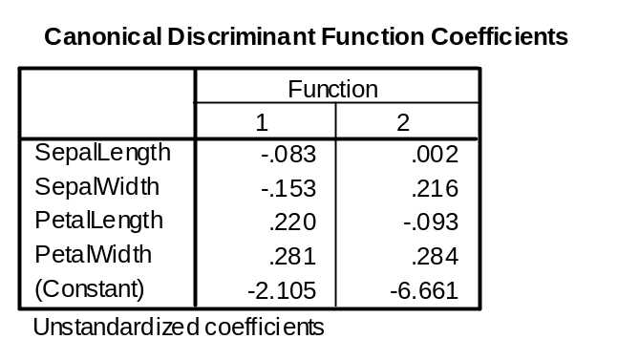
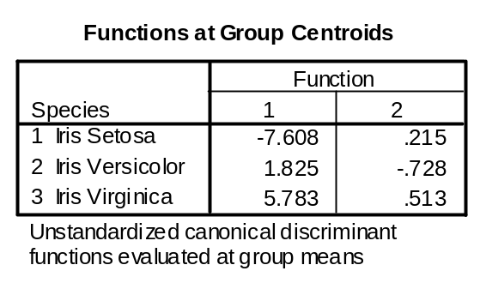
VI. Discriminant Analysis

Slide 26
VII. Summary
Visualize your data
  Make bivariate (2D) and trivariate (3D) plots
  Look for patterns in samples/subjects across all variables
Run a bivariate correlation
  look for significant correlations and correlations close to 1.0
  Pay attention to the “signs” (positive, negative)
Principal Components Analysis
  Useful for extracting eigenvalues and eigenvectors
  Initial first-step to understanding how many latent variates there may be in the data
  May not yield interpretable latent variates

Slide 27
VII. Summary
Factor Analysis
  Multiple options for rotating initial principal components such that the extracted latent variates optimally separate different constructs (e.g. better individual correlations between original variables and latent variate) – better interpretability
  Helps to optimize design of questionnaires seeking measurement of underlying constructs
Discriminant Analysis
  Useful for optimizing separation of known groups and/or sample clusters
  Orthogonality not required
  Apriori knowledge required for group classification and training set required (e.g. more samples needed)

Slide 28
VIII. Statistical Resources and Help
SON S:\Shared\Statistics_MKHiggins
  Shared resource for all of SON – faculty and students
  Will continually update with tip sheets (for SPSS, SAS, and other software), lectures (PPTs and handouts), datasets, other resources and references
  Website in development S:\Shared\Statistics_MKHiggins\website2\index.htm
Contact
  Dr. Melinda Higgins
  Melinda.higgins@emory.edu
  Office: 404-727-5180 / Mobile: 404-434-1785

