Slide 1
“Research Design, Sources of Variance & Initial Discussion of Intent to Treat”
Melinda K. Higgins, Ph.D.
11 April 2008

Slide 2
Sources of Variance – 1
All data
Can of
“averages”
Variations
Relationships
Residuals
Lack of Fit
Pure Error

Slide 3
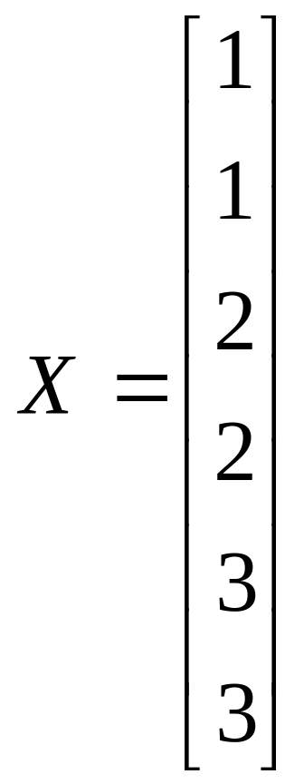
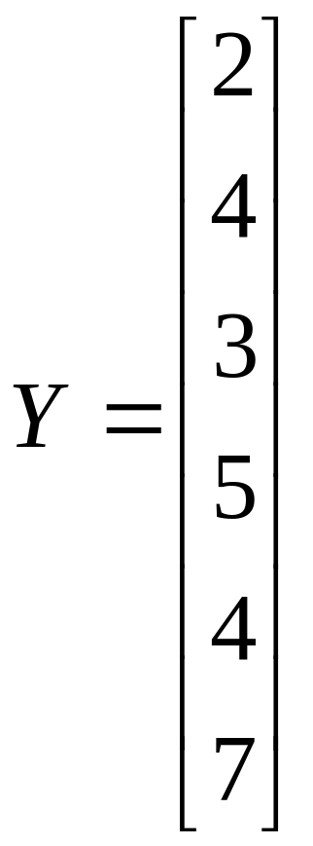
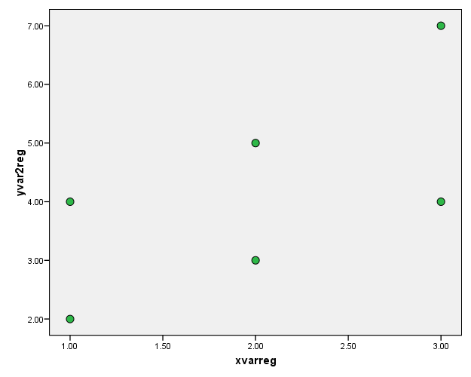
Collection of Data

Slide 4
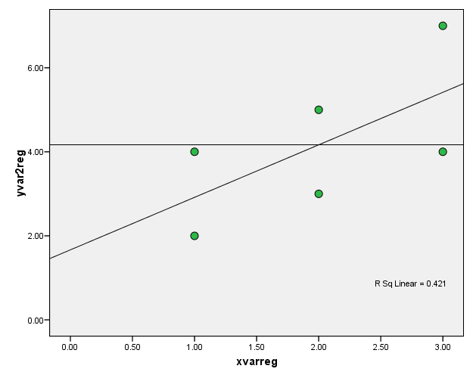



Breakdown Sources of Variance (part 1)
Actual value
P
R
*
Avg response
L
C
Model Prediction
F
Avg of all data
J
Y
Y = data = avg all data = model prediction J = avg response at factor level
C = corrected for mean = Y- R = residual = Y- F = factor = -
L = “lack of fit” = J- P = “pure error” = Y-J

Slide 5

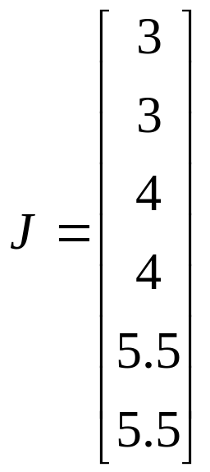
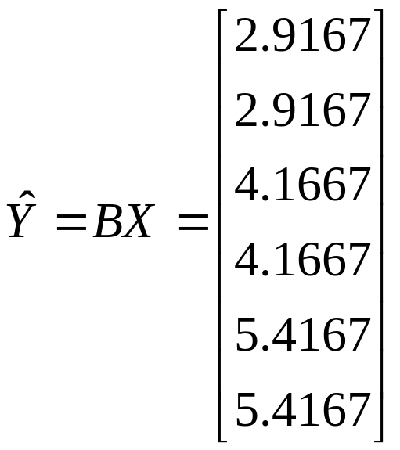
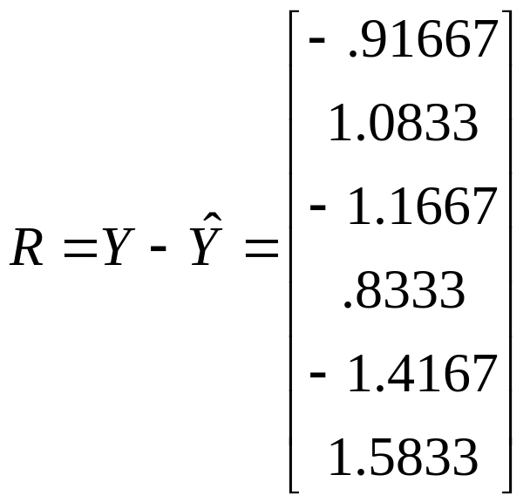
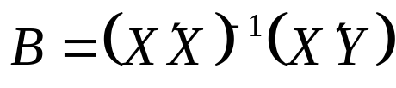
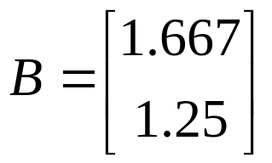
Solving Least-Squares Equations (1)
n = number of data points (samples = 6)
p = number of parameters in model (int and slope = 2)
f = number of factor levels (3 “levels” of X)

Slide 6
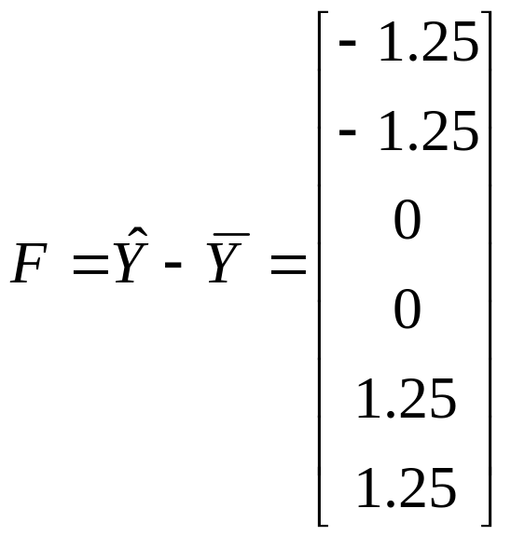
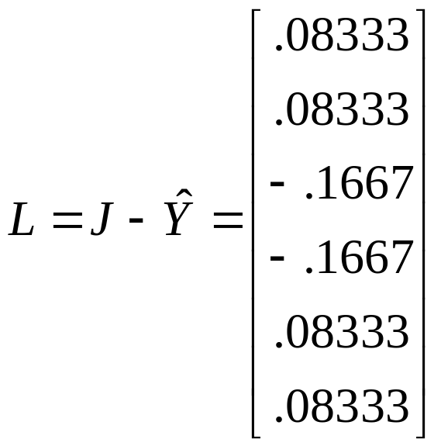
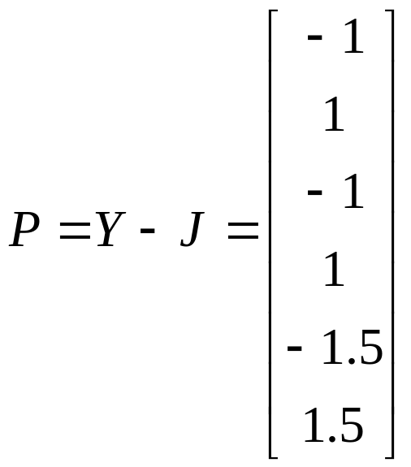
Solving Least-Squares Equations (2)

Slide 7
Sources of Variance (“SS/df tree”) – 2
SStotal
df=n
What you usually see as the “SSt”
SSmean
df=1
SScorr
df=n-1
SSfactor/model
df=p-1
SSresid
df=n-p
SSlof
df=f-p
SSpe
df=n-f

Slide 8

Finish SS/df tree for dataset
N=6; p=2; f=3
SStotal = Y’Y = 119.00 df = n = 6
SSmean = = 104.17 df = 1
SScorr = C’C = 14.833 df = n-1 = 5
SSfact = F’F = 6.2500 df = p-1 = 1
SSresid = R’R = 8.5833 df = n-p = 4
SSlof = L’L = 0.0833 df = f-p = 1
SSpe = P’P = 8.5000 df = n-f = 3
SStotal=119
df=6
SSmean=104.17
df=1
SScorr=14.833
df=5
SSfact=6.25
df=1
SSresid=8.5833
df=4
SSlof=0.0833
df=1
SSpe=8.5
df=3

Slide 9
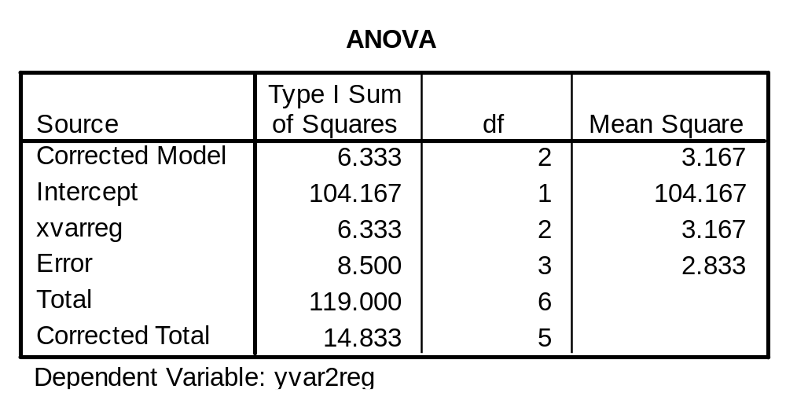
SPSS Results –
Part 1 (variance components)
Variance Components Estimation
/Analyze/General Linear Model/Variance Components
SSmean
SSpe
SStotal
SScorr
But where are SSfact, SSresid, and SSlof?

Slide 10
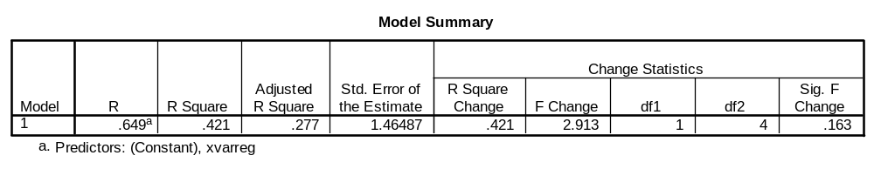
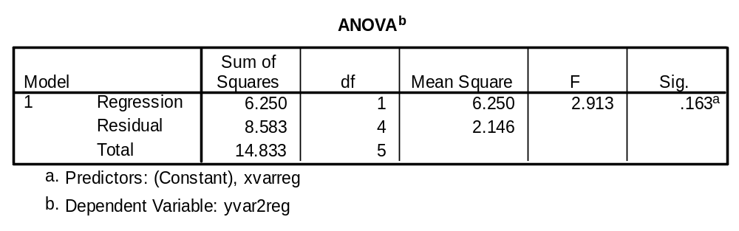
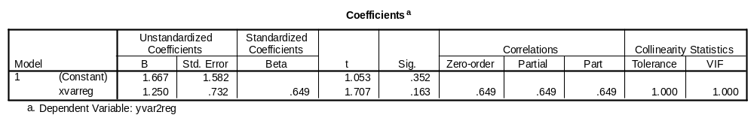
SPSS Results – Part 2 (Regression)
SSfact
SSresid
SScorr
… and SSlof? SSlof = SSresid-SSpe = 8.583-8.5 = 0.08333

Slide 11
VIII. Statistical Resources and Contact Info
SON S:\Shared\Statistics_MKHiggins
  Shared resource for all of SON – faculty and students
  Will continually update with tip sheets (for SPSS, SAS, and other software), lectures (PPTs and handouts), datasets, other resources and references
  Statistics At Nursing Website: [moving to main website] S:\Shared\Statistics_MKHiggins\website2\index.htm
  And Blackboard Site (in development) for “Organization: Statistics at School of Nursing”
Contact
    Dr. Melinda Higgins
    Melinda.higgins@emory.edu
    Office: 404-727-5180 / Mobile: 404-434-1785

