Slide 1
A Practical Approach to Power, Effect Size and Sample Size
&
Hands-on Workshop for PASS (Power Analysis and Sample Size software)
Melinda K. Higgins, Ph.D.
9 February 2009

Slide 2
Outline
Terms and Definitions
Logic & Pictures
Hypotheses About One Mean (Example and Intro to PASS)
Types of Hypotheses
PASS Overview – software introduction and manuals
Examples:
  Proportions (Two-way contingency tables/Chi-square Tests)
  Means (One, Two-Independent and Two-Paired)
  Correlations (Pearson’s R & Intraclass (ICC))
Summary & Statistical Power Software List (links & $)
Contact Info

Slide 3
POWER – Some initial terms and definitions
H₀ is the Null Hypothesis (want to reject this to conclude H_{a} – the alternative hypothesis)
H_{a} is the Alternative Hypothesis (ideally this is the conclusion you want to reach)
If statistical significance is found (p-value < α), “You reject the null and accept the alternative hypothesis.”
If the test is NOT significant you state that “You can not reject the null hypothesis.”
YOU NEVER ACCEPT THE NULL HYPOTHESIS!!
** Research Design **
US Legal System

Slide 4
Power – The logic
“Truth”
“H_{a} is True
(H₀ is false)”
“H₀ is True”
β
Type II error
Fail to
Reject H₀

“Result”
α
Type 1 error

POWER
Reject H₀,
Conclude H_{a}
Our focus is usually here – controlling Type I (α).
All tied together – Beta (β) depends upon Alpha (α)
POWER = 1 – β
A statistical test’s POWER is the probability of rejecting a false statistical null hypothesis (re: Statistica Textbook)

Slide 5
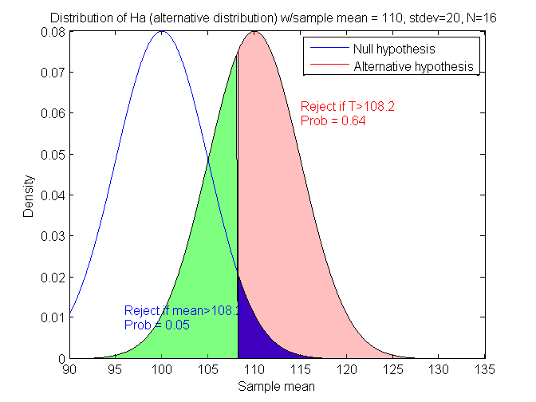
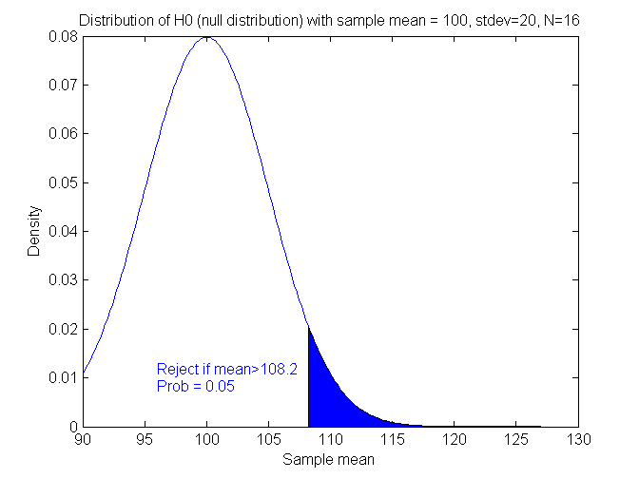
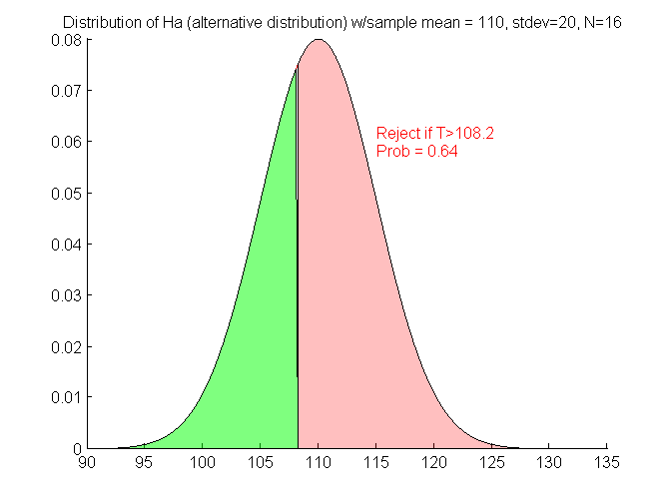
Power – The pictures
DISTRIBUTION UNDER ALTERNATIVE HYPOTHESIS
DISTRIBUTION UNDER NULL HYPOTHESIS
H₀ : μ₀=μ_{a}
H_{a} : μ₀<μ_{a}
β
Type II error
β
Type II error
1-β
POWER
1-β
POWER
α
Type 1 error
α
Type 1 error
Notice that everything depends on the “critical value” = 108.2, which depends on alpha (α)

Slide 6
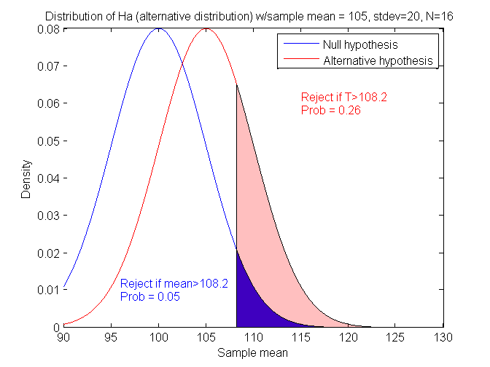
What if μ₀=100, μ_{a}=105 (σ_{x}=20 & N=16) ?
Closer together – will power increase or decrease?
Power = 0.26 (previously was 0.64)
μ_{a}-μ₀=5 (previous difference = 10)

Slide 7
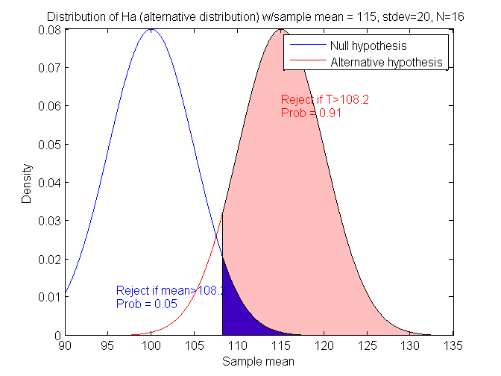
What if μ₀=100, μ_{a}=115 (σ_{x}=20 & N=16) ?
Power = 0.91 (was 0.64)
μ_{a}-μ₀=15 (previous difference = 10)

Slide 8
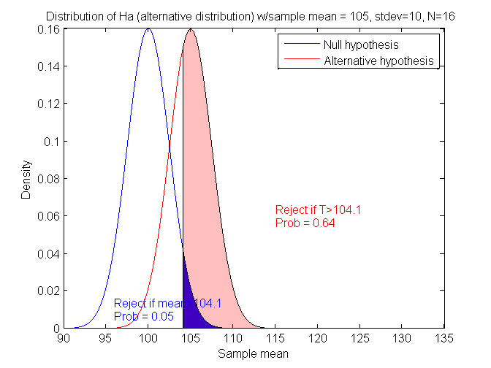
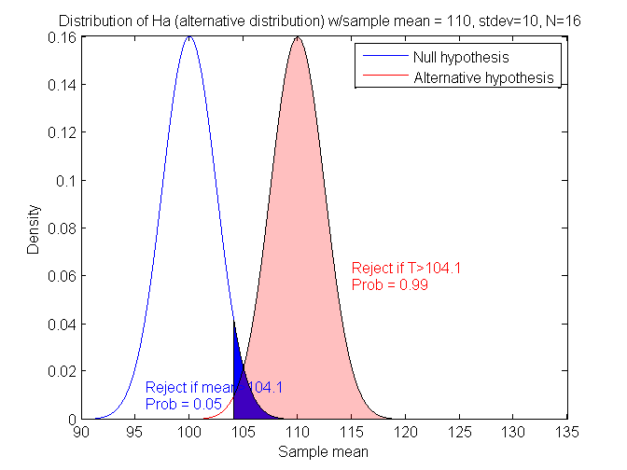
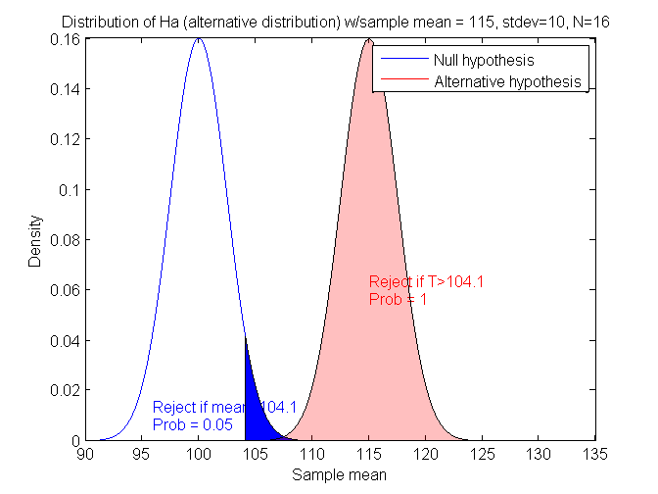
What if μ₀=100, μ_{a}=105 (σ_{x}=10, N=16) ?
What if μ₀=100, μ_{a}=110 (σ_{x}=10, N=16) ?
What if μ₀=100, μ_{a}=115 (σ_{x}=10, N=16) ?
Power = 0.64
Power = 0.99
Power = 1.00
If we decrease σ_{x}, will power go up or down?
The “effect” of increasing the difference between the means increases power, i.e. μ_{a}-μ₀ is related to “effect size” of this test.

Slide 9
Summary so far
This is for N=16, what if we have
a different N (sample size)?
μ₀ | μ_{a} | μ_{a}-μ₀ | σ_{x} | Power
100 | 105 | 5 | 20 | 0.26
100 | 110 | 10 | 20 | 0.64
100 | 115 | 15 | 20 | 0.91
100 | 105 | 5 | 10 | 0.64
100 | 110 | 10 | 10 | 0.99
100 | 115 | 15 | 10 | 1.00

Slide 10
PASS Results – 1 Mean (page 1)
Numeric Results for One-Sample T-Test
Null Hypothesis: Mean0=Mean1 Alternative Hypothesis: Mean0<Mean1
Known standard deviation.
Effect
Power N Alpha Beta Mean0 Mean1 S Size
0.63876 16 0.05000 0.36124 100.0 105.0 10.0 0.500
0.25951 16 0.05000 0.74049 100.0 105.0 20.0 0.250
0.99074 16 0.05000 0.00926 100.0 110.0 10.0 1.000
0.63876 16 0.05000 0.36124 100.0 110.0 20.0 0.500
0.99999 16 0.05000 0.00001 100.0 115.0 10.0 1.500
0.91231 16 0.05000 0.08769 100.0 115.0 20.0 0.750
References
Machin, D., Campbell, M., Fayers, P., and Pinol, A. 1997. Sample Size Tables
for Clinical Studies, 2nd Edition. Blackwell Science. Malden, MA.
Zar, Jerrold H. 1984. Biostatistical Analysis (Second Edition). Prentice-Hall.
Englewood Cliffs, New Jersey.
Notice – Effect Size depends on BOTH the difference between μ₀ and μ_{a} and the standard deviation

Slide 11
PASS Results – 1 Mean (page 2)
Report Definitions
Power is the probability of rejecting a false null hypothesis. It should be close to one.
N is the size of the sample drawn from the population. To conserve resources, it
should be small.
Alpha is the probability of rejecting a true null hypothesis. It should be small.
Beta is the probability of accepting a false null hypothesis. It should be small.
Mean0 is the value of the population mean under the null hypothesis. It is arbitrary.
Mean1 is the value of the population mean under the alternative hypothesis. It is
relative to Mean0.
Sigma is the standard deviation of the population. It measures the variability in the
population.
Effect Size, |Mean0-Mean1|/Sigma, is the relative magnitude of the effect
under the alternative.
Summary Statements
A sample size of 16 achieves 64% power to detect a difference of 5.0 between the null hypothesis mean of 100.0 and the alternative hypothesis mean of 105.0 with a known standard deviation of 10.0 and with a significance level (alpha) of 0.05000 using a one-sided one-sample t-test.
** Can Cut and Paste This into Proposals!! **

Slide 12
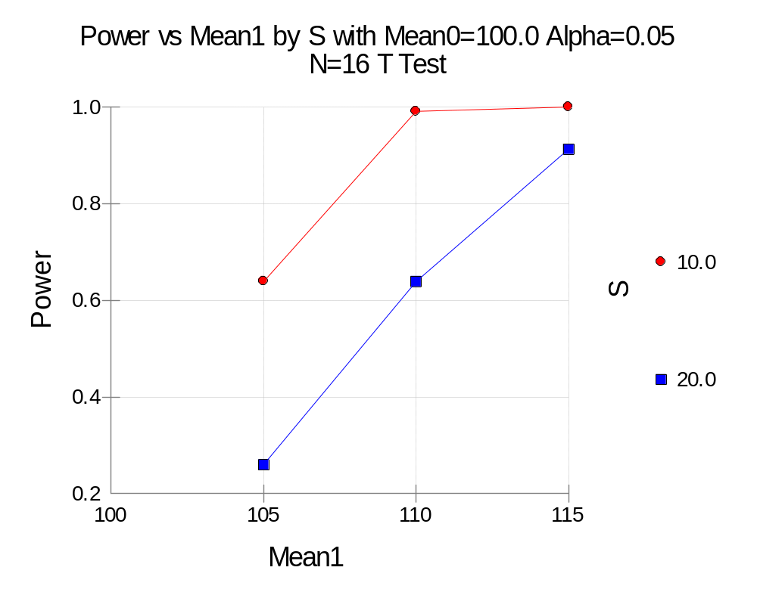
PASS Results – 1 Mean (page 3)
Power increases as “effect size” increases.
Power increases as standard deviation decreases.

Slide 13
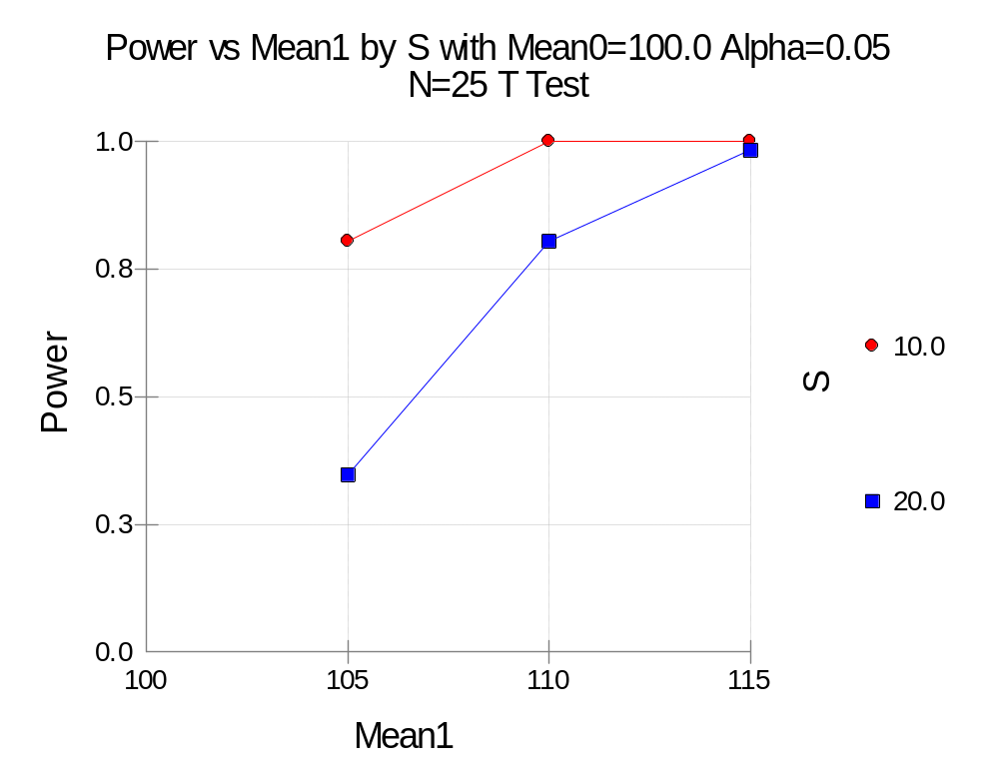
PASS Results – What about for N=25?
Will Power go up or down?
Power increases as sample size increases.

Slide 14
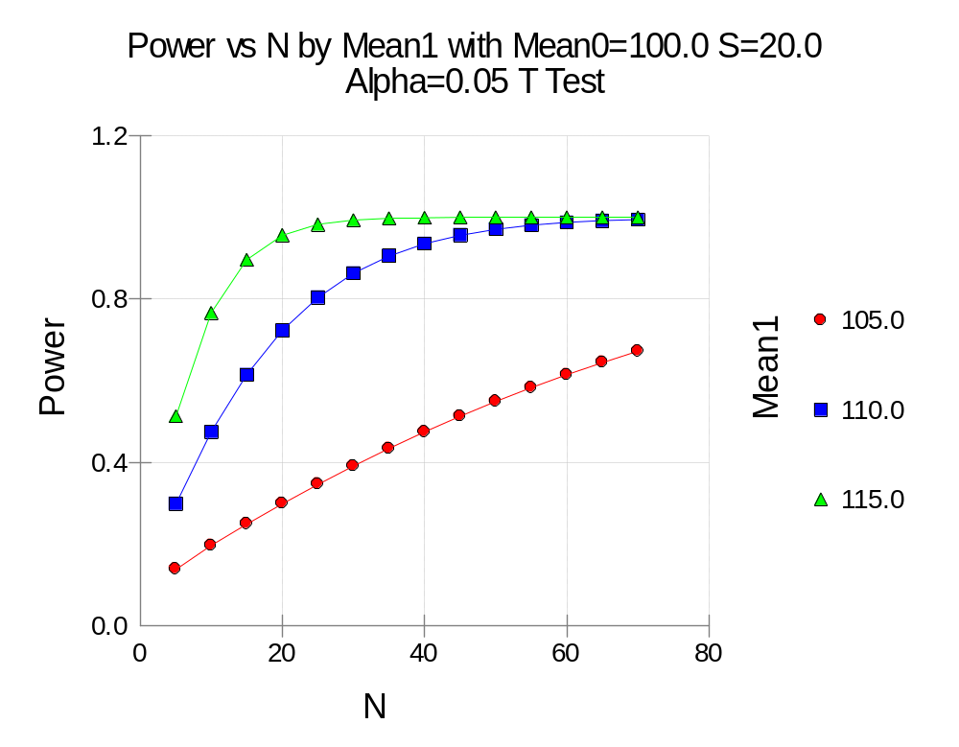
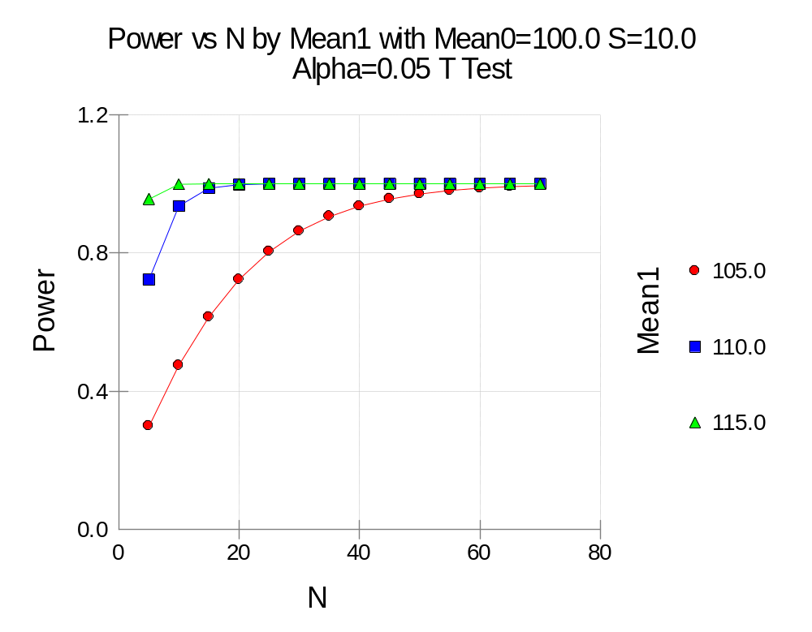
Sample Size to Achieve Power
Power = 80% when N=25, for
Mean0=100, Stdev=20 for Mean1=110
Vs Power = 80% when N=25, for
Mean0=100, Stdev=10 for Mean1=105

Slide 15
Effect Size and the Alternative Hypothesis:
** Subtle but Key Concepts **
Typically the alternative hypothesis (H_{a}) gives the direction of the difference from the null hypothesis (H₀) but not how different.
  H₀: μ₀=μ_{a} versus H_{a}: μ₀≠μ_{a}; μ₀<μ_{a}; or μ₀>μ_{a}
Thus, the power is calculated at specific alternative values. These values should be considered as values at which the power is calculated and NOT AS THE TRUE value.
Effect size is the change in the parameter of interest that is to be detected (NOT the actual change seen).
Clinical significance Vs. Statistical significance
  (e.g. is a difference of 3 yrs in age important? 2 lbs of weight loss? – adult vs. baby)

Slide 16
Types of Hypotheses
** Terminology Used in PASS **
Inequality Hypothesis (two values unequal)
  Two-sided Inequality
  One-sided Inequality (no preference specified)
  One-sided Non-inferiority (one not worse than another)
  One-sided Superiority (one better than another by specified amount)
Equivalence (no difference within specified margin)
Most Common

Slide 17
Inequality Hypothesis: Two-sided and One-sided (no preference)
[NOTE: Symbol “p” used – logic applies to both proportions (p) and means (μ) alike]
Two-sided
  H₀: [p₁-p₂ = 0] versus
  H_{a}: [p₁-p₂≠0] OR [p₁-p₂ < 0] OR [p₁-p₂ > 0]
One-sided (no preference, e.g. p₁-p₂=δ=0)
  H₀: [p₁-p₂ ≤ 0] versus H_{a}: [p₁-p₂ > 0]
  OR H₀: [p₁-p₂ ≥ 0] versus H_{a}: [p₁-p₂ < 0]

Slide 18
Non-inferiority Hypothesis:
Special Case of One-sided (-δ)
[NOTE: The term “non-inferiority” is used to indicate that one treatment is not worse than another treatment within the “margin of equivalence” (δ > 0).]
One-sided
  H₀: [p₁-p₂ ≤ -δ] versus H_{a}: [p₁-p₂ > -δ]
  OR H₀: [p₁ ≤ p₂ - δ] versus H_{a}: [p₁ > p₂ - δ]

Slide 19
Superiority Hypothesis:
Special Case of One-sided (+δ)
[NOTE: The term “superiority” is used to indicate that one treatment is better than another treatment by more than a trivial amount called the “margin of equivalence” (δ > 0).]
One-sided
  H₀: [p₁-p₂ ≤ δ] versus H_{a}: [p₁-p₂ > δ]
  OR H₀: [p₁ ≤ p₂ + δ] versus H_{a}: [p₁ > p₂ + δ]

Slide 20
Equivalence Hypothesis
[NOTE: The term “equivalence” is used to represent tests designed to show that the “response rates” of two treatments do not differ by more than a trivial amount called the “margin of equivalence” (δ > 0).]
These tests are the REVERSE of the two-sided test.
Equivalence [δ_{L} < 0 (lower limit) and δ_{U} > 0 (upper limit), these are the “equivalence limits”]
  H₀: [p₁-p₂ ≤ δ_{L}] OR H₀: [p₁-p₂ ≥ δ_{U}]
  versus H_{a}: [δ_{L} ≤ (p₁-p₂) ≤ δ_{U}]

Slide 21
Types of Power Analyses:
Pre-study
  Determine the sample size (N) based on alpha and beta (and effect size of interest)
Post-study (post hoc questions)
  What sample size would have been needed to detect a specific effect size? (effect size of interest – not what was seen)
  What is the smallest effect size that could be detected with this sample size? (the size at the end of the study)
  What was the power of the test procedure(s)? [Note: Multiple statistical tests can be employed]

Slide 22
PASS Intro and Examples
PASS Layout
PASS Manuals [1432 pages total]
  User’s Guide – I “Quick Start, Proportions, and ROC Curves”
  User’s Guide – II “One Mean, Two Means, and Cross-Over Designs”
  User’s Guide – III “ANOVA, Multiple Comparisons, Simulator, Variances, Survival Analysis, Correlations, Regression, and Helps”
PASS Examples:
  Section 250 – Many Proportions: Chi-Square Test
  Section 400 – One Mean: Inequality (Normal) ← PREVIOUS EXAMPLE
  Section 400 – Example 4 – Difference of Two-Paired Means
  Section 430 – Two Independent Means: Inequality (Normal)
  Section 800 – Correlations: One (Pearson) Correlation
  Section 810 – Correlations: Intraclass Correlation (ICC)

Slide 23
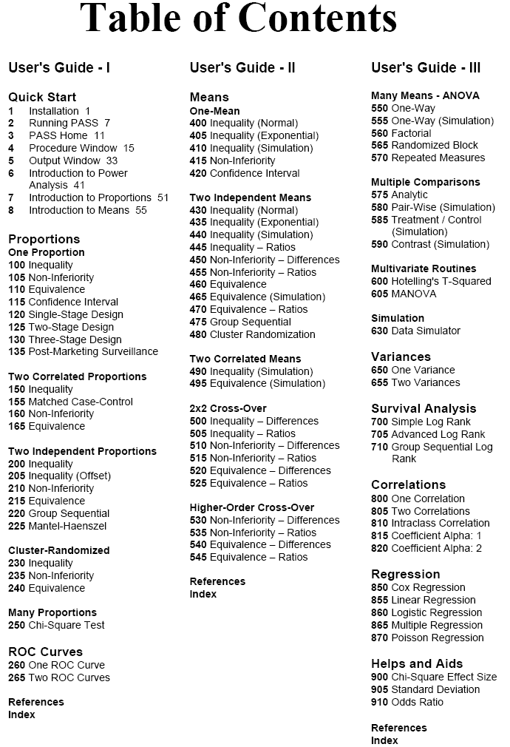
Everyone should read
Will be addressed within other statistical lectures
Similar to Means
(400-495)
Quality Measures
Estimation of “Nuisance Parameters”

Slide 24
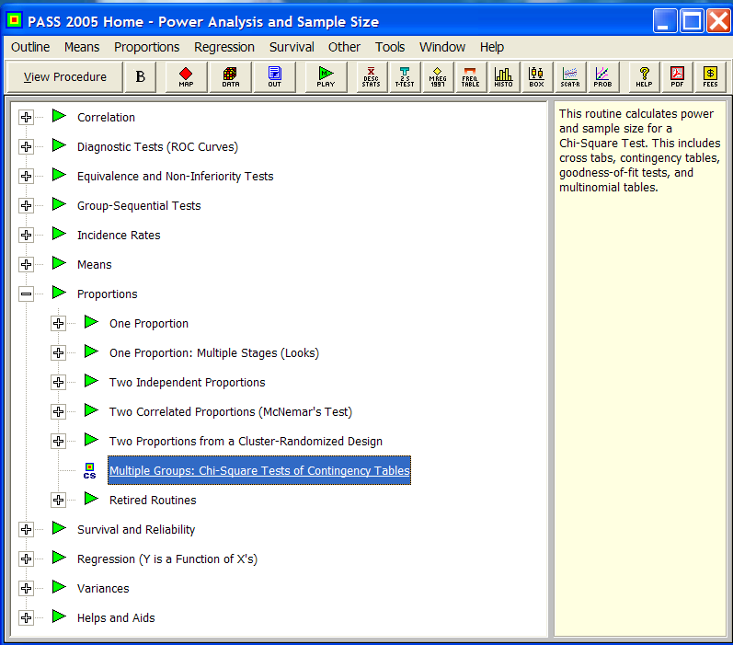
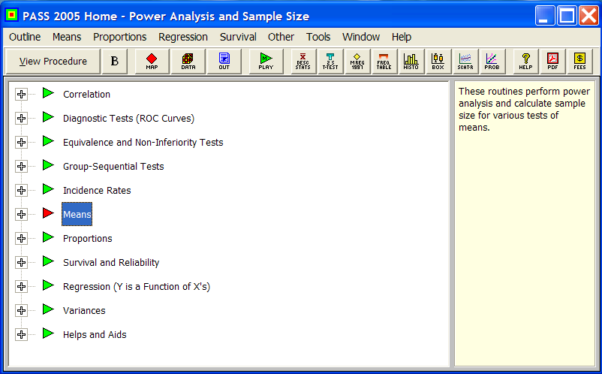

Slide 25
Section 250 – Chi-Square Tests
(Two-way contingency tables)
Two possible tests
  Chi-square “goodness of fit” test
  Chi-square “test for independence” [*most common*]
Parameters
  DF – degrees of freedom = (r-1)(c-1)
  W (effect size)
  N (sample size)
  Alpha (significance level)
  Beta (1 – Power)

Slide 26
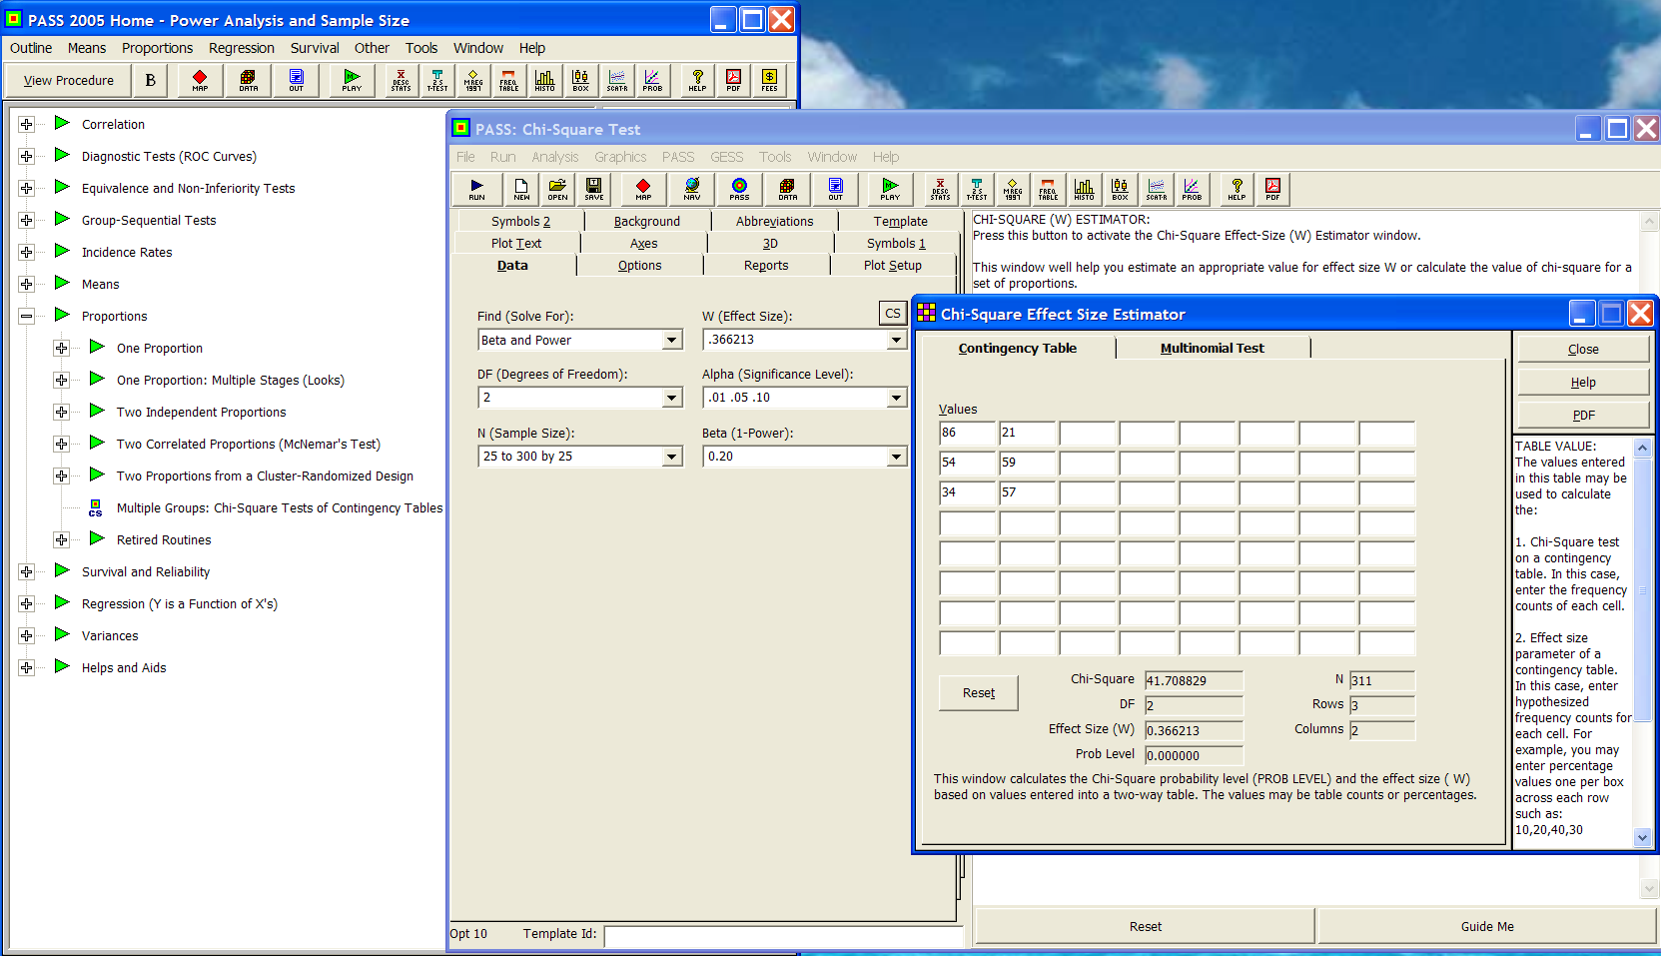
0.366213
.01 .05 .10
Beta and Power
2
25 to 300 by 25
.2
In Favor of Proposition A?
Political Party | YES | NO
Democrats | 86 | 21
Republicans | 54 | 59
Others | 34 | 57

Slide 27
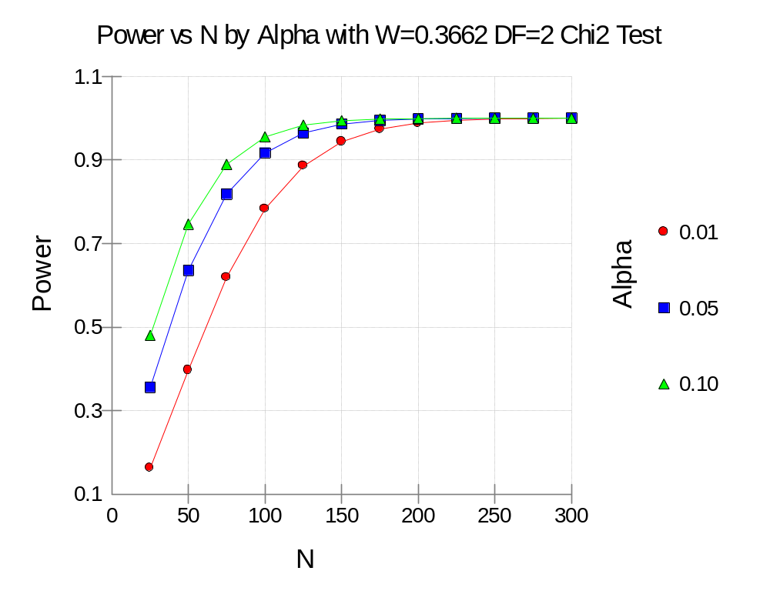
Summary Statement
A sample size of 75 achieves 81% power to detect an effect size (W) of 0.3662 using a 2 degrees of freedom Chi-Square Test with a significance level (alpha) of 0.05000.

Slide 28
Section 400 – Example 4 – Difference of
Two-Paired Means: Inequality
Setup:
Weight Loss – Pre vs. Post Exercise Program – Past experiments of this type have had standard deviations of 10-15 lbs. The researcher wants to detect a difference of 5 lbs or more (either way). Alpha values of 0.01 and 0.05 will both be evaluated. Beta is set to 0.20 (for 80% power). What sample size is needed?
Parameters
  Find = N
  Mean0 = 0
  Mean1 = 5
  N (this is the find setting)
  StdDev = 10 12.5 15 (unknown)
Parameters (cont’d)
  Population size = infinite
  Alt Hypothesis = Ha: Mean0 <> Mean 1
  Nonparametric adjustment (ignore)
  Alpha = 0.01 0.05
  Beta = 0.20

Slide 29
Numeric Results for One-Sample T-Test
Null Hypothesis: Mean0=Mean1 Alternative Hypothesis: Mean0<>Mean1
Unknown standard deviation.
Effect
Power N Alpha Beta Mean0 Mean1 S Size
0.80939 51 0.01000 0.19061 0.0 5.0 10.0 0.500
0.80778 34 0.05000 0.19222 0.0 5.0 10.0 0.500
0.80434 77 0.01000 0.19566 0.0 5.0 12.5 0.400
0.80779 52 0.05000 0.19221 0.0 5.0 12.5 0.400
0.80252 109 0.01000 0.19748 0.0 5.0 15.0 0.333
0.80230 73 0.05000 0.19770 0.0 5.0 15.0 0.333
Summary Statements
A sample size of 51 achieves 81% power to detect a difference of -5.0 between the null hypothesis mean of 0.0 and the alternative hypothesis mean of 5.0 with an estimated standard deviation of 10.0 and with a significance level (alpha) of 0.01000 using a two-sided one-sample t-test.

Slide 30
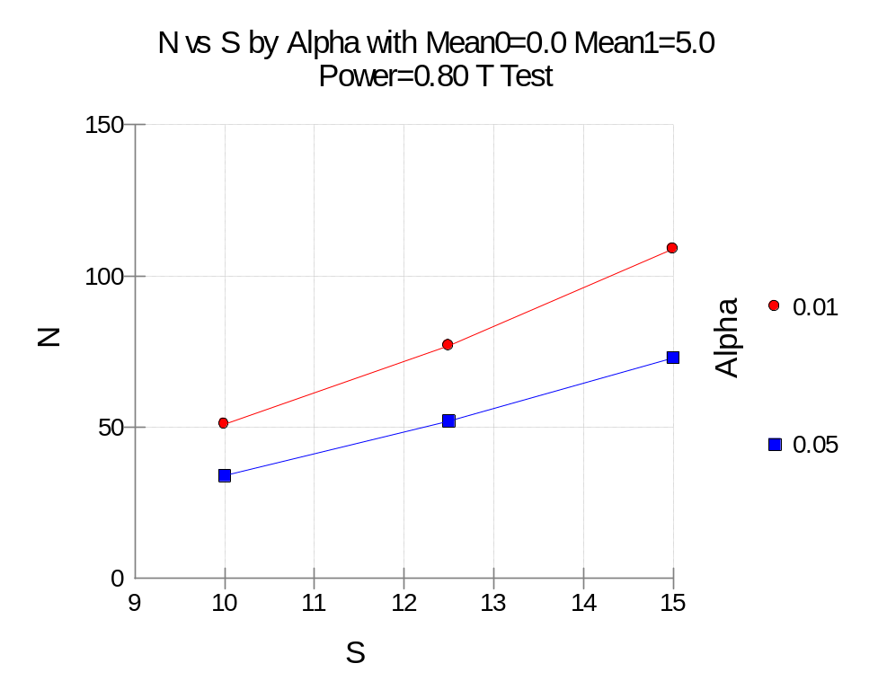

Slide 31
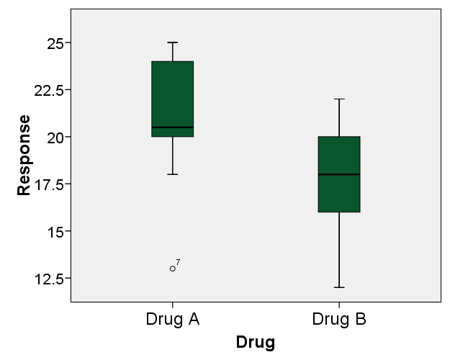
Section 430 – Two Independent Means:
Inequality (Normal)
Setup:
A clinical trial was run to compare the effectiveness of two drugs (results below). Calculate power for various sample sizes and alpha = 0.01 and 0.05 (given each group’s sample mean and stddev).
Subject | Drug A | Drug B
1 | 21 | 15
2 | 20 | 17
3 | 25 | 17
4 | 20 | 19
5 | 23 | 22
6 | 20 | 12
7 | 13 | 16
8 | 18 | 21
9 | 25 | 20
10 | 24 | 19
Mean | 20.9 | 17.8
Std Dev | 3.665 | 3.011

Slide 32
Two Independent Means
Parameters
  Find = Beta
  Mean1 = 20.9
  Mean2 = 17.8
  N1 = 5 to 50 by 5
  N2 = Use R
  R = 1 [N1=N2]
  Alt Hyp = Ha: Mean1 <> Mean2
Parameters (cont’d)
  Nonparametric Adjustment (ignore)
  Alpha = .01 .05
  Beta (ignored since this is find setting)
  S1 = 3.67 [“Helps” Button]
  S2 = 3.01
  Known SD (unchecked)
  [Axes TAB] Vertical Range: Set Min=0, Max=Data

Slide 33
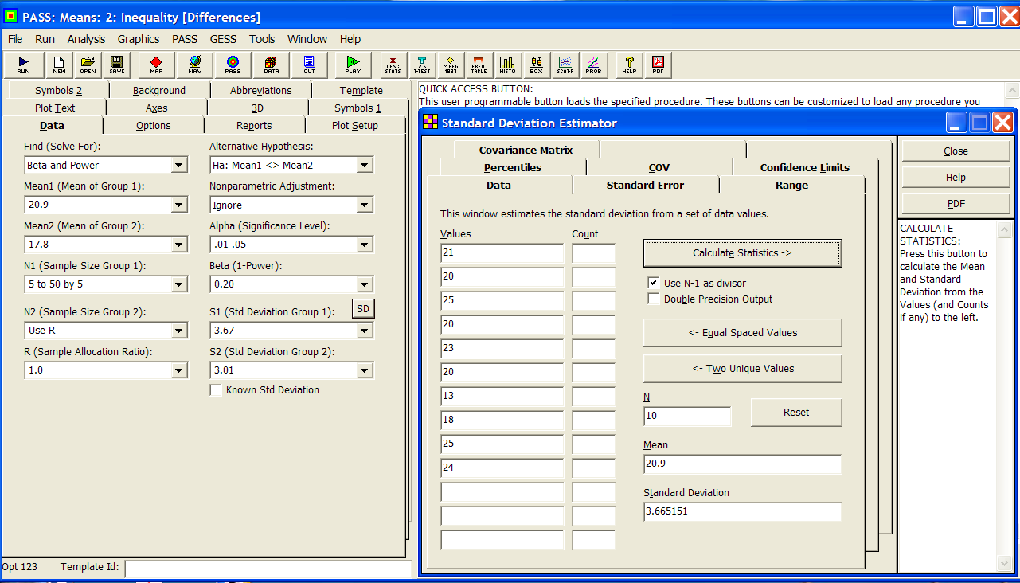

Slide 34
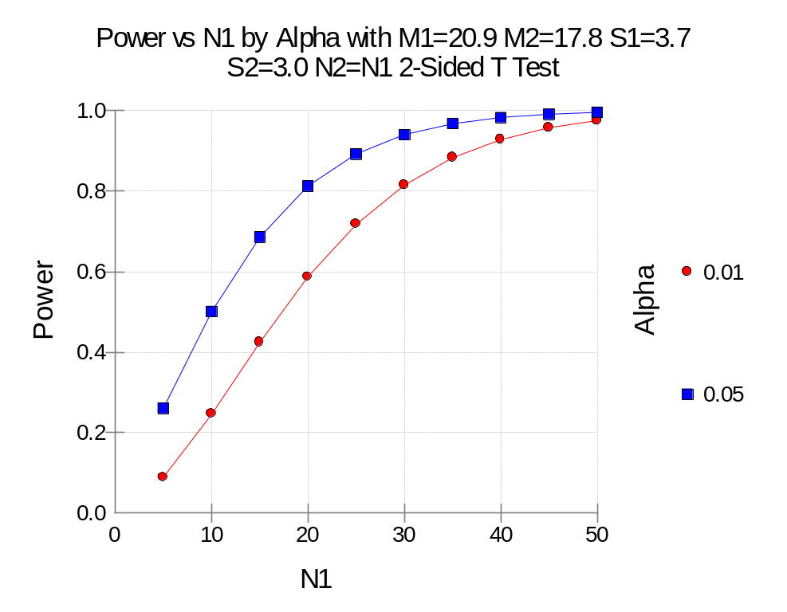
Summary Statements
Group sample sizes of 20 and 20 achieve 81% power to detect a difference of 3.1 between the null hypothesis that both group means are 20.9 and the alternative hypothesis that the mean of group 2 is 17.8 with estimated group standard deviations of 3.7 and 3.0 and with a significance level (alpha) of 0.05000 using a two-sided two-sample t-test.

Slide 35
Section 800 – Correlations:
One (Pearson) Correlation
Setup: Baseline correlation among dyads (Patient-Family Caregiver) by item within an instrument ranged from 0.1 to 0.8. A follow-on trial is planned to test a “treatment” to improve (increase) correlation (congruency) among the dyads (ideally improving correlation for the worst items).
Given a sample size of approximately 40 dyads (reasonable to expect from past recruitment experience), what is the statistical power? And what effect sizes (change in correlation) can be detected?
How large a sample size is required at 80% power to detect smaller improvements in correlation (0.1-0.2).

Slide 36
One (Pearson) Correlation
Parameters
  Find = Beta and Power
  R0 = 0.1 [lowest seen in baseline (control) group]
  R1 = 0.2 to 0.9 by 0.1 (potential improvements)
  N = 20 to 200 by 20
  Alt Hyp: Ha: R0 <> R1
  Alpha = 0.05
  Beta (ignored, this is the find setting)

Slide 37
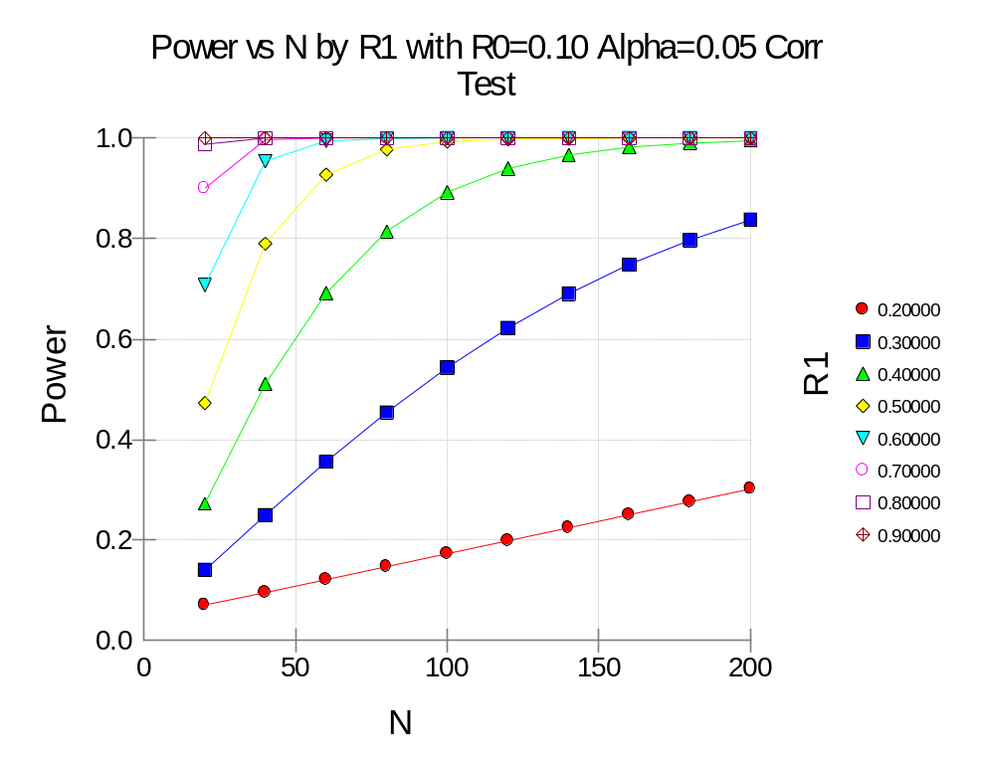
Summary Statements
A sample size of 40 achieves 78.9% power to detect a difference of -0.40000 between the null hypothesis correlation of 0.10000 and the alternative hypothesis correlation of 0.50000 using a two-sided hypothesis test with a significance level of 0.05000.
A sample size of 180 achieves 79.6% power to detect a difference of -0.2 (R0=0.1, R1=0.3).

Slide 38
Section 810 – Intraclass Correlation:
How large a sample size is needed to detect an increase from an initial (baseline) ICC of H0: 0.01 versus Ha: 0.05 to 0.9 by 0.05 to achieve 80% power?
Parameters needed:
  Find = K [K=number of subjects]
  Alpha = 0.05
  Beta = 0.20
  R0 (ICC0) = 0.01
  R1 (ICC1 > ICC0) = 0.05 to 0.90 by 0.05
  K (this is the find setting)
  N (number of observations per subject) = 2
ALWAYS READ DOCUMENTATION BEWARE OF SYMBOL DIFFERENCES

Slide 39
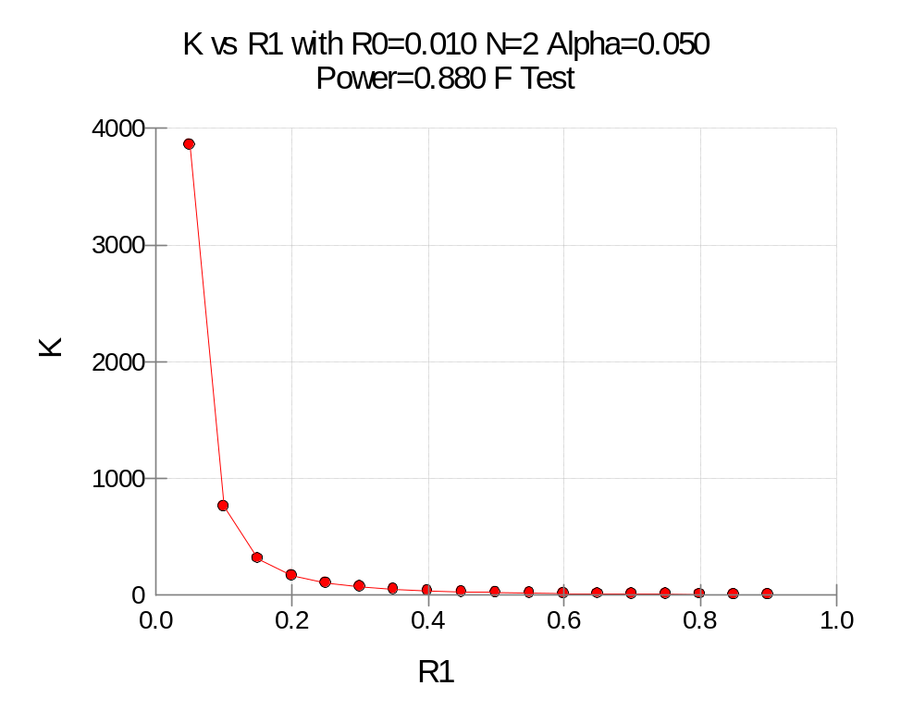
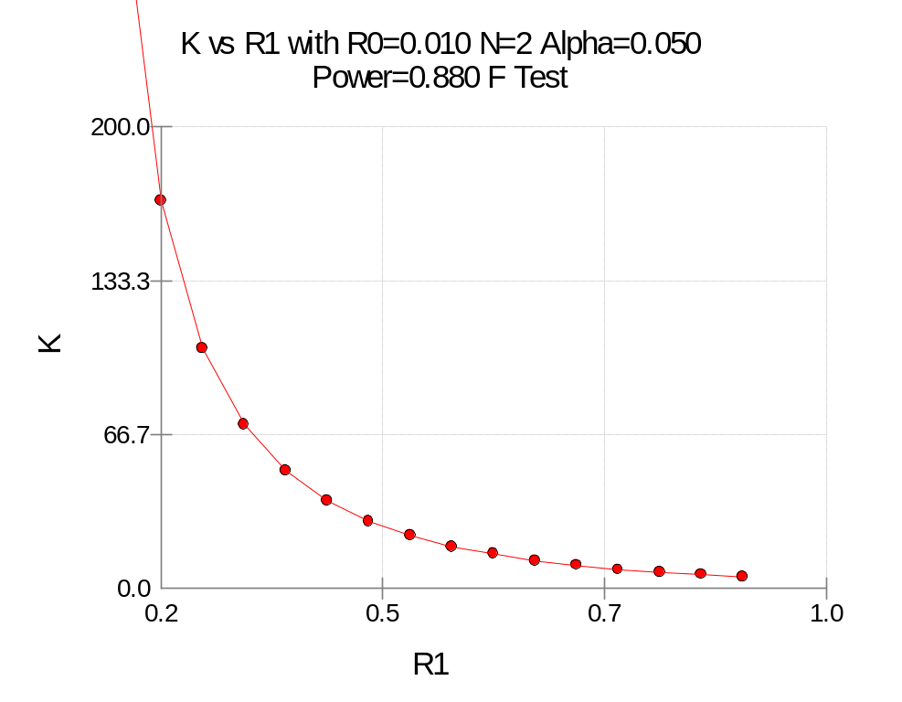
Summary Statements
A sample size of 51 subjects with 2 observations per subject achieves 80% power to detect an intraclass correlation of 0.350 under the alternative hypothesis when the intraclass correlation under the null hypothesis is 0.010 using an F-test with a significance level of 0.05000.

Slide 40
Summary/Points to Remembers
Never accept the null hypothesis. Always state, “We can not reject the null hypothesis.”
Always design your “experiment” to reject the null hypothesis in order to accept the alternative (i.e. what you want to prove), given statistical significance is achieved.
Identify the statistical test(s) appropriate for testing your hypothesis(es).
Use the most conservative (largest) sample size estimate given your “effect size” of interest (i.e. clinically significant not statistically significant).

Slide 41
PASS and Other Power Software
PASS – go to http://www.ncss.com/pass.html [PASS 2008 single academic license = $749.95 (upgrade from PASS 2005 is $349.95); 7-day FREE trial]
BioStat – go to http://www.power-analysis.com/ [academic perpetual license $595]
StudySize – go to http://www.studysize.com/ [14-day FREE trial; $129 for StudySize 2.0]
G*Power – go to http://www.psycho.uni-duesseldorf.de/aap/projects/gpower/ [FREE]
“Russ Lenth's power and sample-size page” – go to http://www.math.uiowa.edu/~rlenth/Power/ [access JAVA applets online or download for FREE]
For a large list of available “Power, Sample Size and Experimental Design Calculations” – go to http://statpages.org/#Power

Slide 42
VIII. Statistical Resources and Contact Info
SON S:\Shared\Statistics_MKHiggins
  Shared resource for all of SON – faculty and students
  Will continually update with tip sheets (for SPSS, SAS, and other software), lectures (PPTs and handouts), datasets, other resources and references
  Statistics At Nursing Website: S:\Shared\Statistics_MKHiggins\website2\index.htm
    http://www.nursing.emory.edu/pulse/statistics/
Contact
  Dr. Melinda Higgins
  Melinda.higgins@emory.edu
  Office: 404-727-5180 / Mobile: 404-434-1785

