Slide 1
Demystification of Important Research Concepts Covariates, Confounding, Moderators and Mediators
Drenna Waldrop-Valverde, Ph.D.
Associate Professor
Melinda K. Higgins, Ph.D.
Associate Professor
25 January 2013

Slide 2
Outline
Introduction
Covariates
Confounders
Moderators
Mediators
Summary Comparison
References

Slide 3
Introduction
Var1
“other variables”
Var2
Main Variable(s) [IV]
Outcome(s) [DV]
Var3…
We want to establish and understand the relationship between the Main variable(s) [X] and the Outcome(s) [Y] of interest
Often, there are “other variables” that have to be considered which may change/alter the IV → DV relationship:
Covariates Confounders Moderators Mediators

Slide 4
Covariates
Main Variable(s) [IV]
No association
X
Outcome(s) [DV]
Covariate(s)
Covariates are associated with the Outcome(s)
Covariates are independent (not associated with) Main variable(s)
Covariates do not modify the association between the Main variable(s) and the Outcome(s)
Test for moderation – must not be significant
Must meet assumptions of “homogeneity of slopes” (parallel slopes)

Slide 5
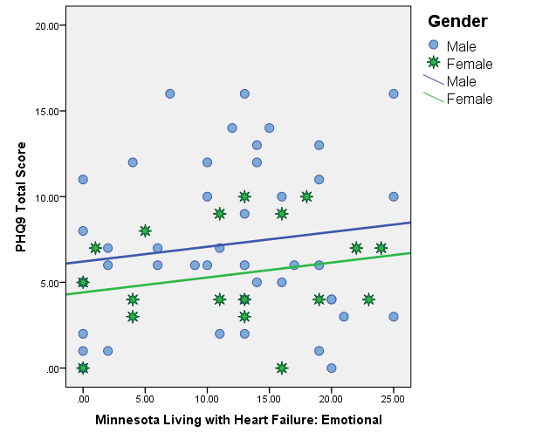
Covariates
Example of parallel lines for association between PHQ-9 and MLWHF-Emotional for Males and Females
Gender can be treated as a covariate.

Slide 6
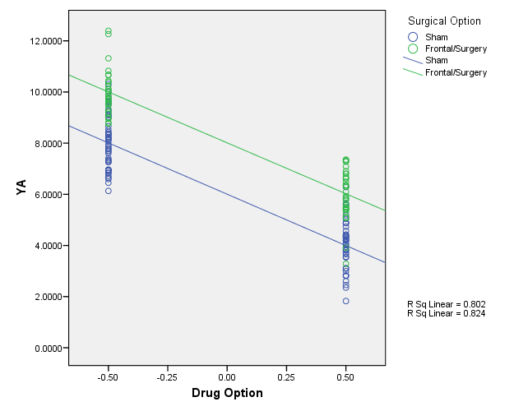
Covariates
Slopes are parallel
Covariate is associated with the outcome (Y)
** MUST ** check for parallel slopes FIRST (i.e. run test for interaction term or moderation FIRST – interaction term MUST be non-significant)

Slide 7
Confounders
Main Variable(s) [IV]
Significant
Association
Outcome(s) [DV]
Confounder(s)
Confounders are associated with the Outcome(s)
Confounders are highly (significantly) associated with Main variable(s)
Conceptually and statistically overlapped
Creates limitation of results and conclusions
Post-stratification and/or propensity score matching often not feasible
One focus of “feasibility” studies should be to identify potential confounding varables – used for stratification in future studies

Slide 8
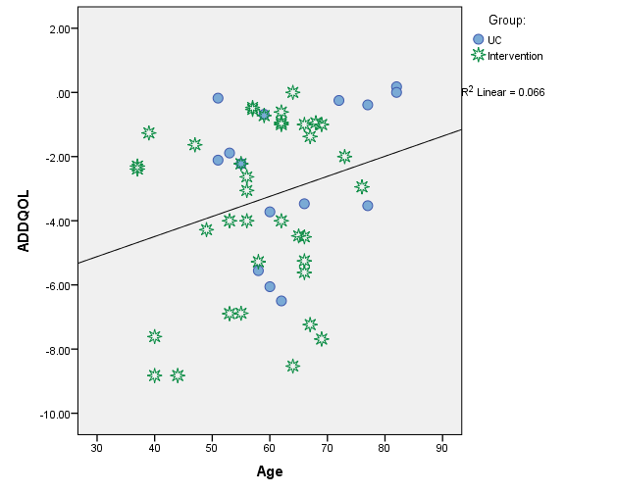
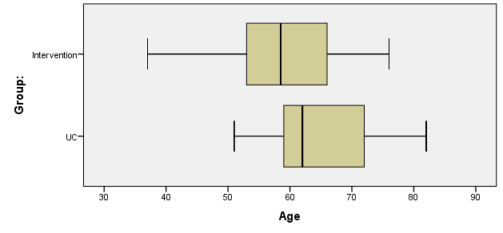
Confounders
Example association between Age and the ADDQOL
However, the subjects in the Intervention group are younger than the subjects in the Control (UC)
So, Age is confounded with the Group assignment
Future studies should ensure that Ages are equal across group (use stratification)
Smoking is associated with lung cancer and smoking is associated with alcohol use
Potential propensity score matching – requires large samples

Slide 9
Moderators and Mediators
“A mediator or moderator is a third variable that changes the association between an independent variable and an outcome variable” (Bennett, 2000)
Allows for a more precise understanding of the relationship between independent variables and outcome variables
The terms are NOT INTERCHANGEABLE
Different statistical methods for analysis of each

Slide 10
Moderators and Mediators
Definitional difference
A moderator is a separate independent variable
A mediator is predicted by the independent variable

Slide 11
Moderators and Mediators
Mediator-oriented research:
What is the mechanism of the relationship between the independent variable and the outcome variable? How? Why?
Moderator-oriented research:
When does a relationship occur between the independent variable and outcome variable?

Slide 12
Moderators
“A moderator is an independent variable that affects the strength or direction of the association between another independent variable and an outcome variable.” (Bennett, 2000)
A simple analogy is a dimmer that adjusts the strength of a switch on the lighting.
“… the moderation effect is more commonly known as the statistical term “interaction” effect” (Wu, Zumbo)

Slide 13
Moderator Models
Independent
Variable
Outcome
Variable
Moderator
Variable
Independent
Variable
Outcome
Variable
Moderator
Variable

Slide 14
Moderators
May be investigated when there is a weak or inconsistent relationship between independent variable and outcome variable
More interested in the independent variable than the moderator
May be an “external” influence on a person

Slide 15
Moderators – “Interactions”
IV
** See Baron, Kenny (1986)
a
Block 1
Mod
b
DV
c
IV x Mod
Block 2
DV = intercept + a(IV) + b(Mod) + c(IV x Mod)
Y = β₀ + β₁X₁ + β₂X₂ + β₁₂X₁X₂ + ε
Step 1 – enter IV and Mod into model – may or may not be significant
Step 2 – add interaction term – see if “c” or β₁₂ is significant

Slide 16
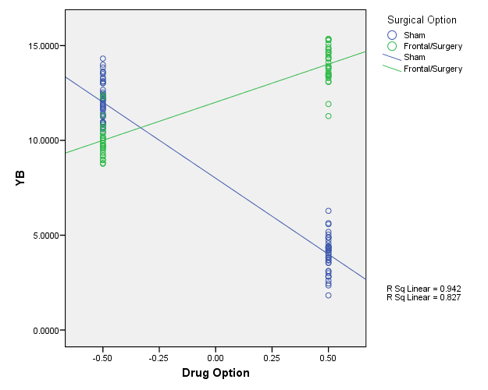
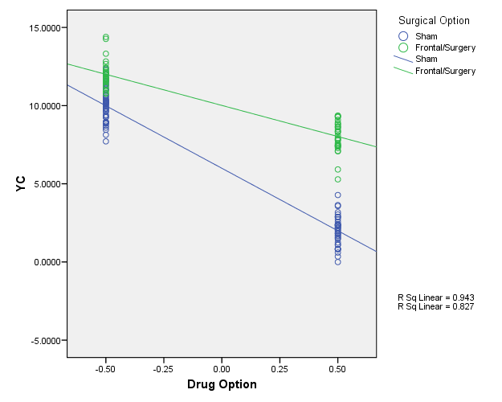
Moderators - Interactions
Moderators can be either categorical or continuous and can “interact” with either categorical or continuous IVs.
The resulting interaction effect can change either the magnitude of the slope, change its sign (positive to negative) or both.

Slide 17
Example [Cohen, Cohen, et.al. 2003]
DV = Endurance
IV = Age (centered)
Mod = Previous Years of Vigorous Physical Exercise (centered)
Age
a
Block 1
Exercise
b
Endurance
c
Age x Exercise
Block 2
“centering” – i.e. subtracting the “grand mean” prevents “spurious relationships.”

Slide 18
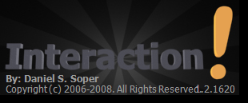
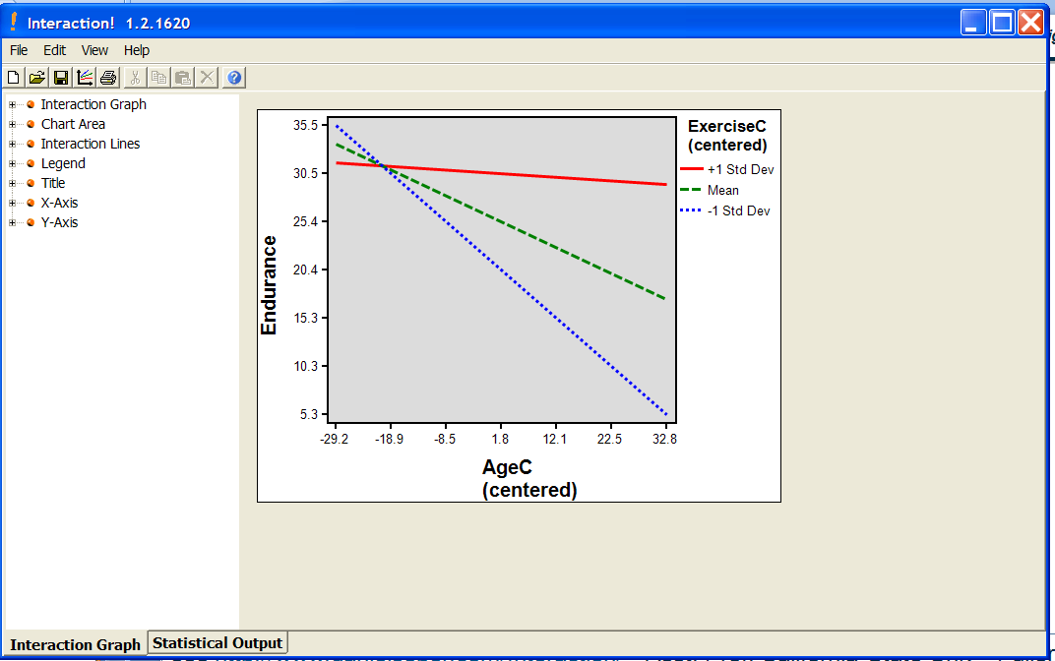
“Interaction” – $5 FREE software
see http://www.danielsoper.com/Interaction/ - Asst. Prof. California State Univ - Fullerton

Slide 19
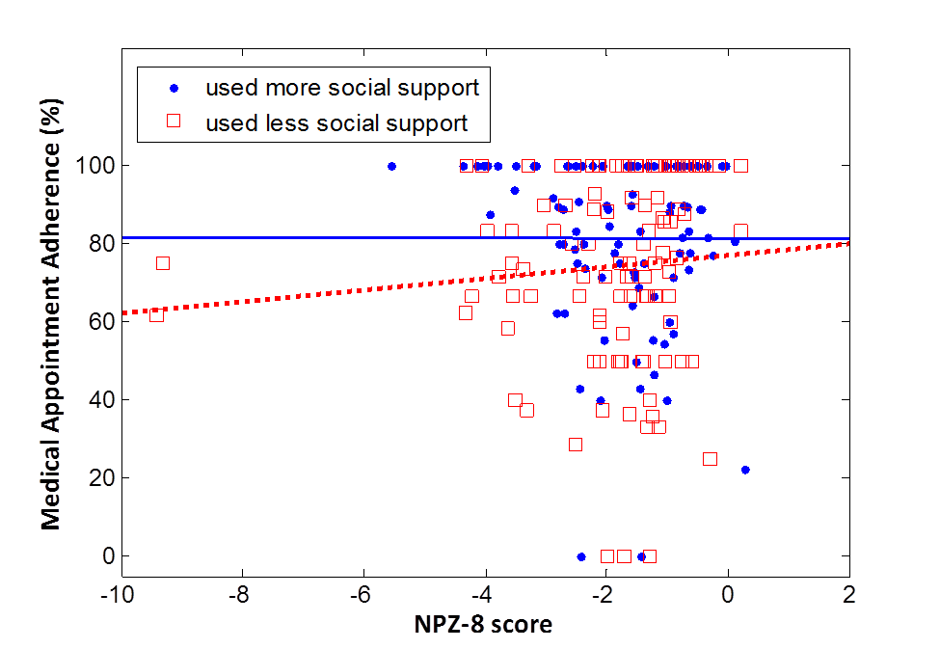
Moderation Example
Waldrop-Valverde et al., (under revision) showed that social support moderated the effect of cognitive impairment on appointment attendance
Cognitive impairment had a negative effect on appointment attendance if social support was used less

Slide 20
Mediators
A mediator specifies how/why an association occurs between an independent and dependent variable
A mediator effect only tested when there is a significant direct effect between the IV and the DV
Med
a
b
IV
c
DV
c’

Slide 21
Mediators – How to test for …
[Preacher, Hayes] – 3 approaches:
(1) Baron, Kenny:
(i) Y = i₁ + cX
(ii) M = i₂ + aX
(iii) Y = i₃ + c’X + bM
(2) Sobel Test
(i) calculate ab (assumption Normal Distribution)
(ii) calculate s_{ab} = sqrt (b²s_{a}² + a²s_{b}² + s_{a}²s_{b}²)
(iii) divide ab/s_{ab} → compare to N(0,1) critical values
(3) Bootstrap sampling distribution for ab
“suffers from low power”
Med
a
b
IV
c
DV
c’

Slide 22
MEDIATION ANALYSIS
Numeracy mediates the relationship between race and medication management
Numeracy
0.248**
0.662**
Race/Ethnicity
0.016
-.181*
Medication Management
**p < 0.001

Slide 23
Summary
 | Covariate | Confounder | Moderator | Mediator
Associated with IV | NO | YES | NO | YES
Associated with DV | YES | YES | Maybe | YES
Changes association between IV→DV | NO | NO | YES | YES
Sequence Order Important | NO | NO | NO | YES

Slide 24
References
Bennett, Jill. “Mediator and Moderator Variables in Nursing Research: Conceptual and Statistical Differences.” Research in Nursing and Health, 23, 2000, pp. 415-420.
Wu, Amery; Zumbo, Bruno. “Understanding and Using Mediators and Moderators.” Social Indicators Research, 87 (3), July 2008, pp. 367-392. [DOI 10.1007/s11205-007-9143-1]
Baron, Reuben; Kenny, David. “The Moderator-Mediator Variable Distinction in Social Psychological Research: Conceptual, Strategic, and Statistical Considerations.” Journal of Personality and Social Psychology, 51 (6), 1986, pp. 1173-1182.
Preacher, Kristopher; Hayes, Andrew. “SPSS and SAS procedures for estimating indirect effects in simple mediation models.” Behavior Research Methods, Instruments and Computers, 36 (4), 2004, pp. 717-731.
Cohen, Jacob; Cohen, Patricia; West, Stephen; Aiken, Leona “Applied Multiple Regression/Correlation Analysis for the Behavioral Sciences” 3rd edition, Lawrence Erlbaum Associates Inc., 2003.

Slide 25
EXTRA SLIDES BELOW…

Slide 26
Summary
Add comparison of Covariates and Confounding – UPDATE SLIDE
Moderator
“interaction”
affects strength or
direction of IV-DV
explains "when" or
"for whom"
modifies a causal effect
Mediator
only tested then there is a
significant effect between
IV-DV
specifies how the association
occurs BETWEEN IV-DV
explains "why" and "how"
links a cause (IV) and
effect (DV)

Slide 27
Covariates
We discussed Covariates in the last lecture – we put these into the model first (“control for”), but assume no further involvement (i.e. assume NO INTERACTIONS).
Slopes are parallel,
y-intercept changes

Slide 28
Moderators
“A moderator is an independent variable that affects the strength or direction of the association between another independent variable and an outcome variable. [Bennett]”
“A moderator is a 3rd variable that modifies a causal effect.”
“ A moderation effect is a causal model that postulates “when” or “for whom” an independent variable most strongly (or weakly) causes a dependent variable (i.e. modifying the strength or direction). …
“A simple analogy is a dimmer that adjusts the strength of a switch on the lighting.”
“… the moderation effect is more commonly known as the statistical term “interaction” effect [Wu, Zumbo]”
Mod
IV
DV

Slide 29
Mediators
“A mediator is a variable that specifies how the association occurs between an IV and a DV. A mediator effect is only tested when there is a significant direct effect between the IV and the DV, but there is a possibility that a mediator variable conceptually occurs “between” the IV and DV. [Bennett]”
“A mediator is a 3rd variable that links a cause and an effect.”
Mediator is a causal model that explains the process of “why” and “how” a cause-and-effect happens. … In other words, the IV is presumed to cause the mediator and the mediator causes the DV. [Wu, Zumbo]”
Med
a
b
IV
c
DV
c’

Slide 30
Moderators – “Interactions”
IV
** See Baron, Kenny (1986)
a
Block 1
Mod
b
DV
c
IV x Mod
Block 2
DV = intercept + a(IV) + b(Mod) + c(IV x Mod)
Y = β₀ + β₁X₁ + β₂X₂ + β₁₂X₁X₂ + ε
Step 1 – enter IV and Mod into model – may or may not be significant
Step 2 – add interaction term – see if “c” or β₁₂ is significant

Slide 31
Moderators - Interactions
Moderators can be either categorical or continuous and can “interact” with either categorical or continuous IVs.
The resulting interaction effect can change either the magnitude of the slope, change its sign (positive to negative) or both.

Slide 32
Example [Cohen, Cohen, et.al. 2003]
250 subjects:
DV = Endurance
IV = Age (centered)
Mod = Previous Years of Vigorous Physical Exercise (centered)
Age
a
Block 1
Exercise
b
Endurance
c
Age x Exercise
Block 2
“centering” – i.e. subtracting the “grand mean” prevents “spurious relationships.”

Slide 33
SPSS Regression Output

Slide 34
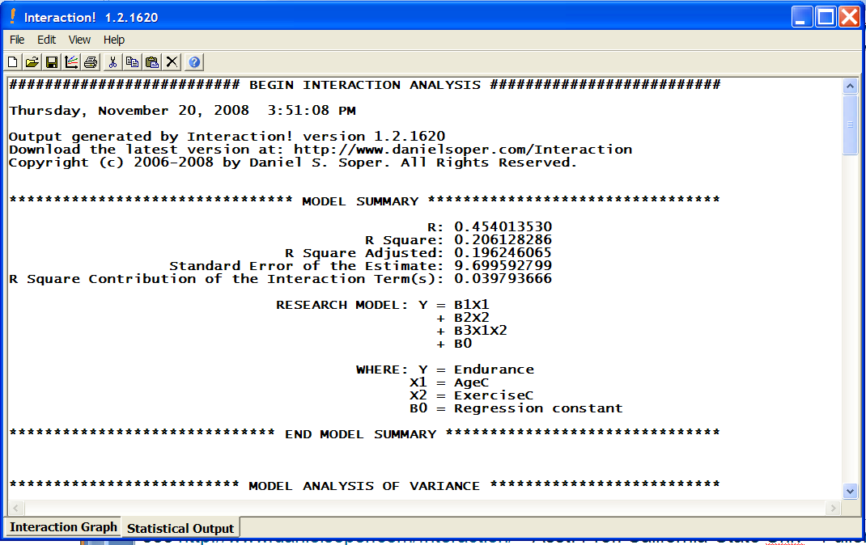
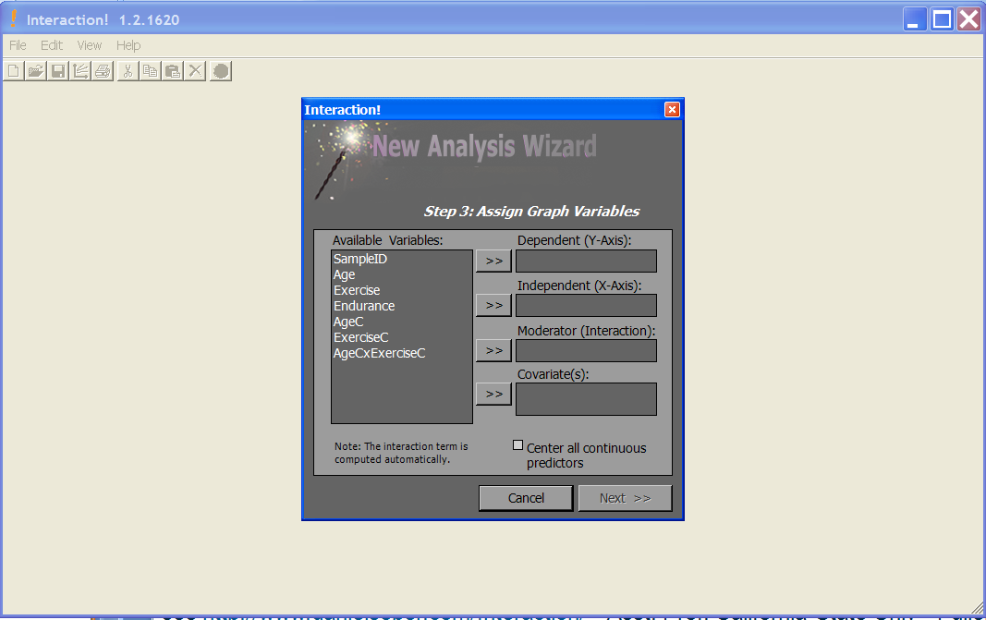
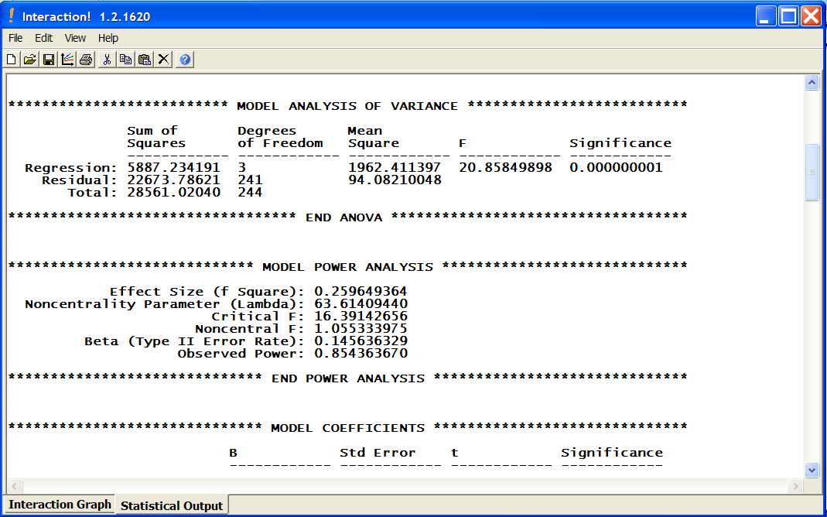
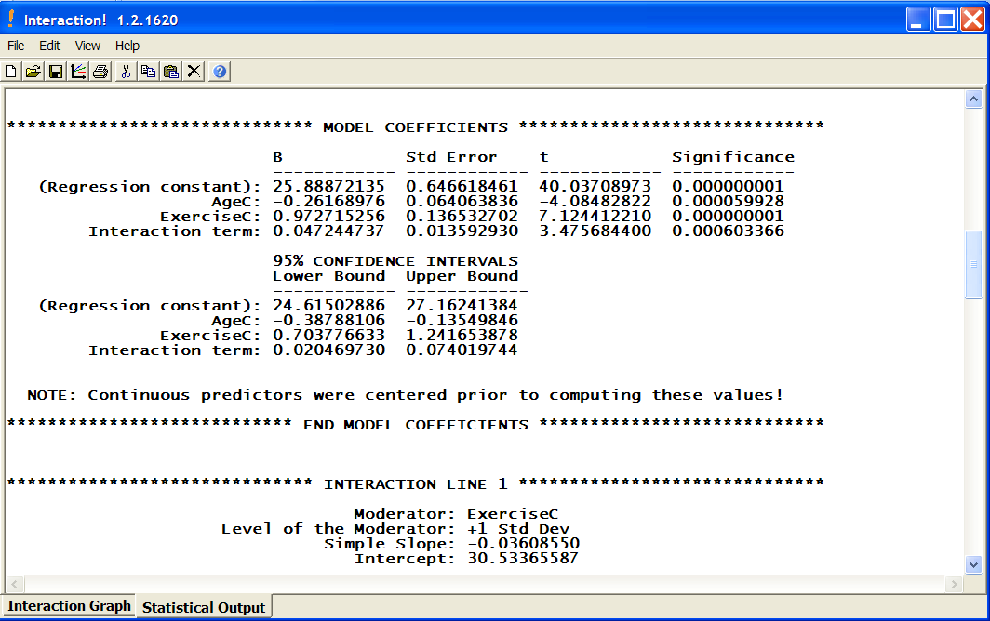
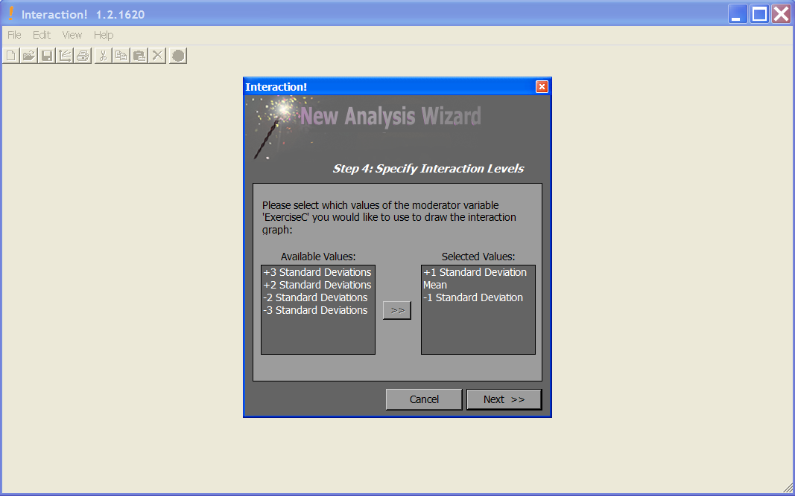
“Interaction” – $5 software
see http://www.danielsoper.com/Interaction/ - Asst. Prof. California State Univ - Fullerton

Slide 35
Mediators – How to test for …
[Preacher, Hayes] – 3 approaches:
(1) Baron, Kenny:
(i) Y = i₁ + cX
(ii) M = i₂ + aX
(iii) Y = i₃ + c’X + bM
(2) Sobel Test
(i) calculate ab (assumption Normal Distribution)
(ii) calculate s_{ab} = sqrt (b²s_{a}² + a²s_{b}² + s_{a}²s_{b}²)
(iii) divide ab/s_{ab} → compare to N(0,1) critical values
(3) Bootstrap sampling distribution for ab
“suffers from low power”
Med
a
b
IV
c
DV
c’

Slide 36
Example [Preacher,Hayes]
Attribution
a
b
Therapy
c
Satisfaction
c’
“An investigator is interested in the effects of a new cognitive therapy on life satisfaction after retirement. Residents of a retirement home diagnosed as clinically depressed are randomly assigned to receive 10 sessions of a new cognitive therapy or an alternative method. After session 8, the “positivity of attributions” the residents make for a recent failure experience is assessed. After session 10, the residents are given a measure of life satisfaction (questionnaire).”

Slide 37
SPSS Macro [Preacher, Hayes]: Runs all 3 – Baron/Kenny, Sobel and Bootstrap
Open dataset
Open sobel_spss.sps – syntax file with macro – “select all” and click run
Open new syntax window – run
sobel y=satis / x=therapy / m=attrib / boot=5000.
(4) WAIT!!!! It will seem like SPSS has locked up – but it is still running!!
See http://www.comm.ohio-state.edu/ahayes/sobel.htm

Slide 38
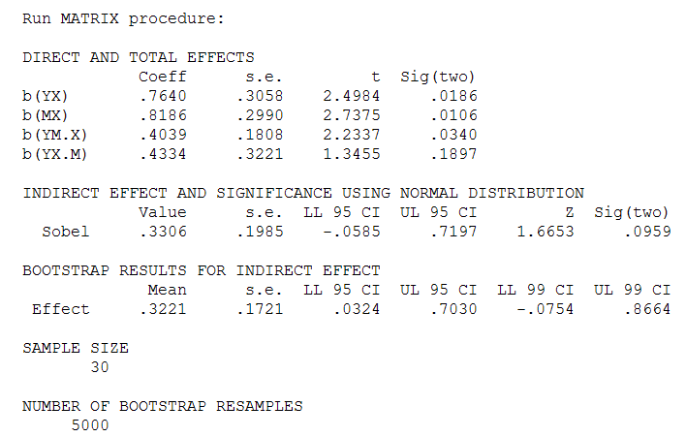
Baron/Kenny – YES mediator
c
a
b
SOBEL – NO mediator
c’
ab
ab – “boot”
Bootstrap – YES mediator

Slide 39
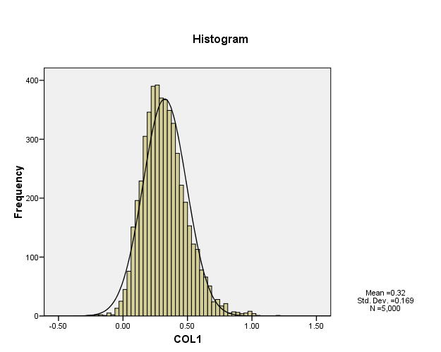
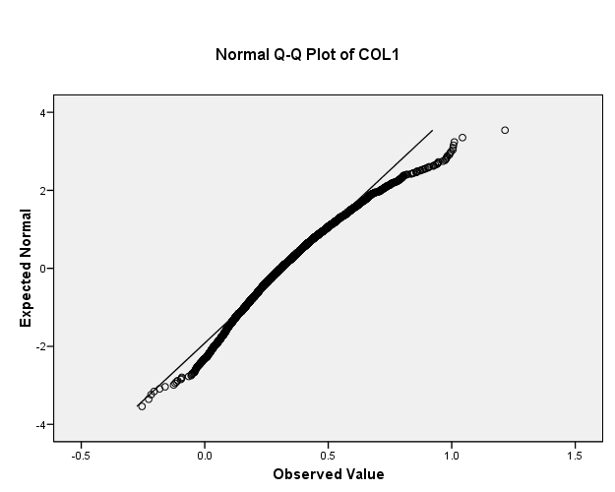
“ab” distribution – Sobel Need for Bootstraping

Slide 40
Results – SPSS Macro
Therapy
c=.7640
Satisfaction
Attribution
a=.8186
b=.4039
Therapy
Satisfaction
c’=.4334
** not sig
(Baron/Kenny) C’ is not significantly different from 0 (pval=0.1897)
(Sobel) ab = 0.3306 95% CI = [-0.0585, 0.7197] not significant
(Bootstrap) ab = 0.3205 95% CI = [ 0.0334, 0.7008] significant

Slide 41
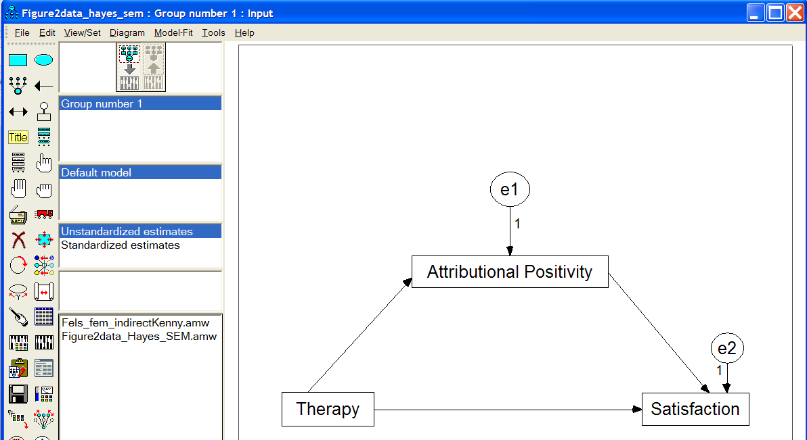
Example (cont’d) – Mediation Using Structural Equation Modeling (SEM) via AMOS
See http://davidakenny.net/cm/mediate.htm and tutorial (video and sound) at http://amosdevelopment.com/video/indirect/flash/indirect.html

Slide 42
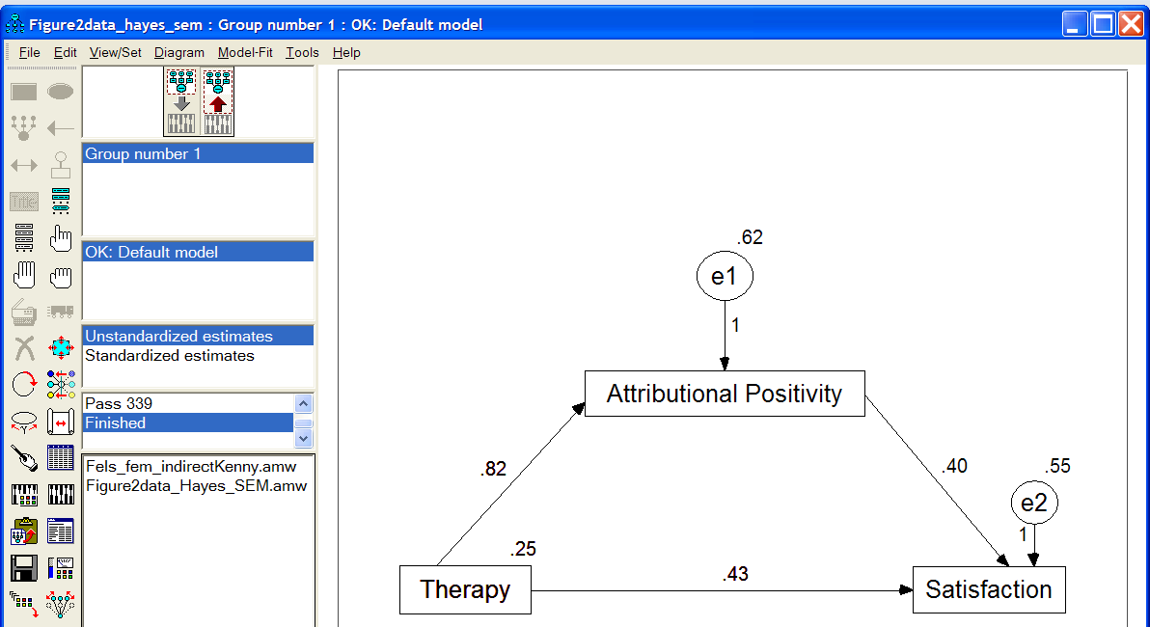
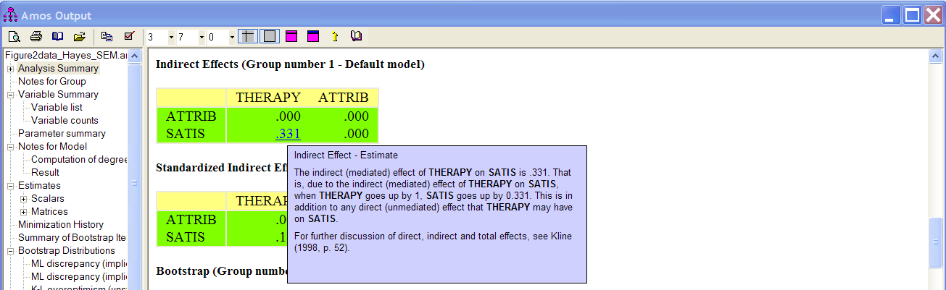
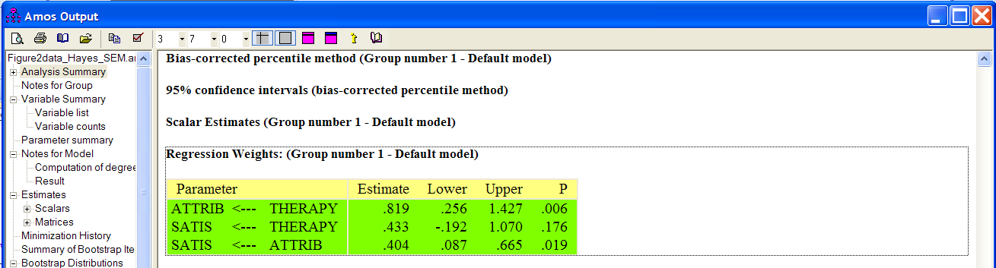
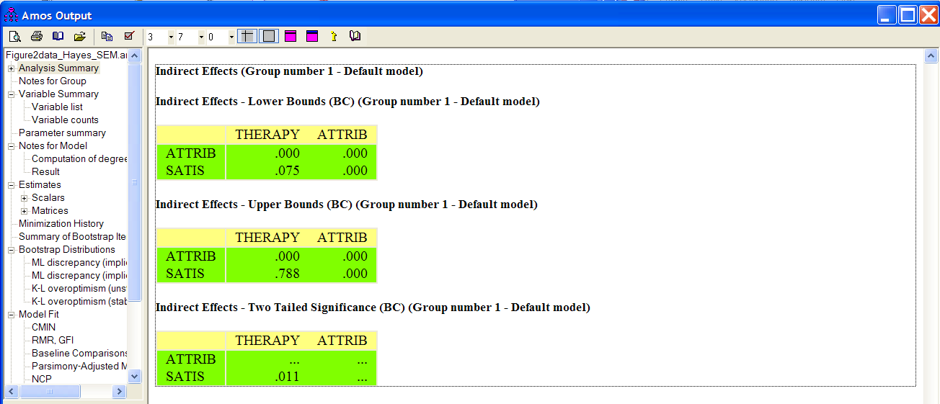
SEM (cont’d)
AMOS-boot 95%CI [0.075, 0.788]
Macro-boot 95%CI [0.0334, 0.7008]

Slide 43
Summary
Moderator
“interaction”
affects strength or
direction of IV-DV
explains "when" or
"for whom"
modifies a causal effect
Mediator
only tested then there is a
significant effect between
IV-DV
specifies how the association
occurs BETWEEN IV-DV
explains "why" and "how"
links a cause (IV) and
effect (DV)

Slide 44
References
Bennett, Jill. “Mediator and Moderator Variables in Nursing Research: Conceptual and Statistical Differences.” Research in Nursing and Health, 23, 2000, pp. 415-420.
Wu, Amery; Zumbo, Bruno. “Understanding and Using Mediators and Moderators.” Social Indicators Research, 87 (3), July 2008, pp. 367-392. [DOI 10.1007/s11205-007-9143-1]
Baron, Reuben; Kenny, David. “The Moderator-Mediator Variable Distinction in Social Psychological Research: Conceptual, Strategic, and Statistical Considerations.” Journal of Personality and Social Psychology, 51 (6), 1986, pp. 1173-1182.
Preacher, Kristopher; Hayes, Andrew. “SPSS and SAS procedures for estimating indirect effects in simple mediation models.” Behavior Research Methods, Instruments and Computers, 36 (4), 2004, pp. 717-731.
Cohen, Jacob; Cohen, Patricia; West, Stephen; Aiken, Leona “Applied Multiple Regression/Correlation Analysis for the Behavioral Sciences” 3rd edition, Lawrence Erlbaum Associates Inc., 2003.

Slide 45
VIII. Statistical Resources and Contact Info
SON S:\Shared\Statistics_MKHiggins\website2\index.htm
[updates in process]
Working to include tip sheets (for SPSS, SAS, and other software), lectures (PPTs and handouts), datasets, other resources and references
Statistics At Nursing Website: [website being updated] http://www.nursing.emory.edu/pulse/statistics/
And Blackboard Site (in development) for “Organization: Statistics at School of Nursing”
Contact
Dr. Melinda Higgins
Melinda.higgins@emory.edu
Office: 404-727-5180 / Mobile: 404-434-1785

