Slide 1
“Categorical Data Analysis
2x2 Chi-Square Tests and Beyond (Multiple Categorical Variable Models)”
Melinda K. Higgins, Ph.D.
6 April 2009

Slide 2
Categorical Data
Categorical data can be distinct groups (such as gender: male, female) or it can be due to some “split” of an originally continuous variable (such as BDI-II (Beck Depression Index) 0-13 not-depressed, above 14 is depressed).
Begin with 2 x 2 tables – understanding basics of Chi-square test and odds ratios
Underlying Logit model → more general Log-linear models
What if you have more than 2 categorical variables? Multiway Frequency Analysis (MFA) (or possibly Logistic Regression if one is a an outcome to predict)

Slide 3
2 x 2 Tables (Crosstabs) – Chi-square test
Example from A. Field “Discovering Statistics Using SPSS”
200 cats – goal: “teach them to line dance” ☺
2 variables:
  Training – food or affection as reward
  Dance – did they dance? (yes, no)
2 ways to enter data into SPSS:
  Raw data file 200 rows – 2 columns (training, dance)
  Using “weights”

Slide 4
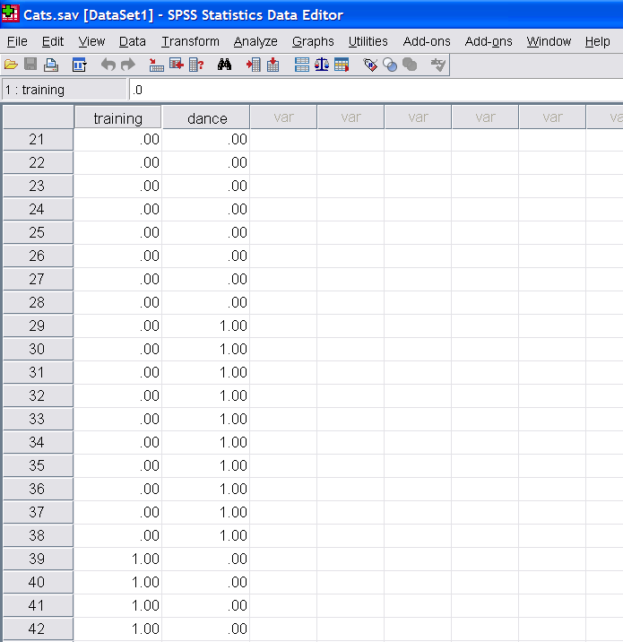
2 x 2: Raw Data

Slide 5
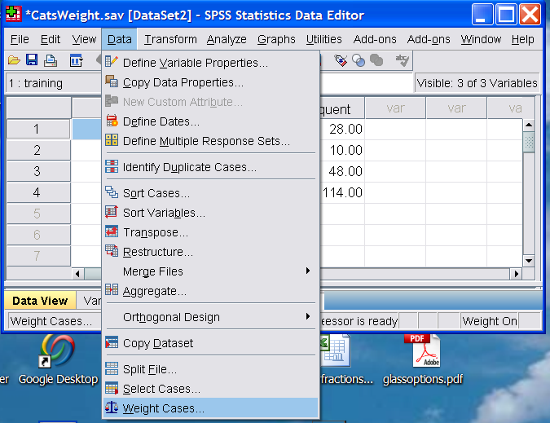
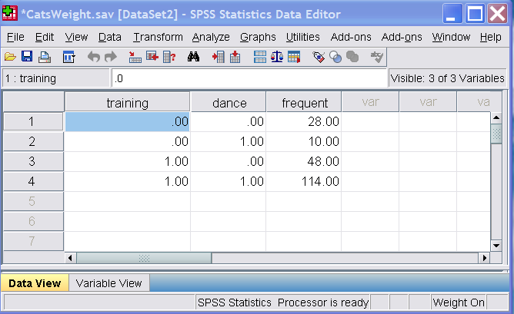
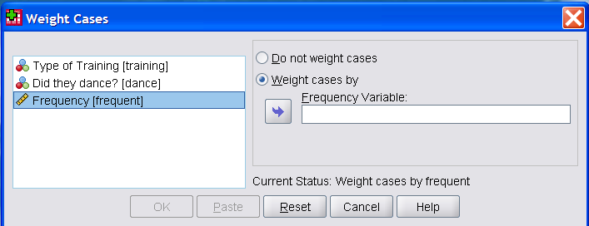
2 x 2: Using Weights

Slide 6
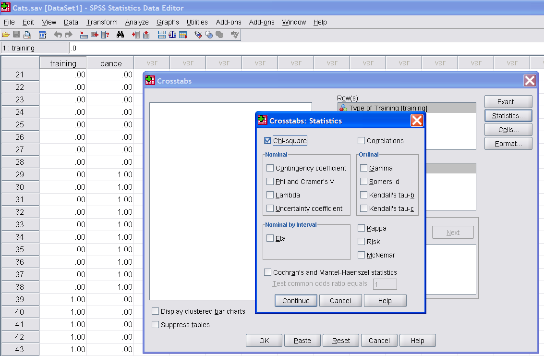
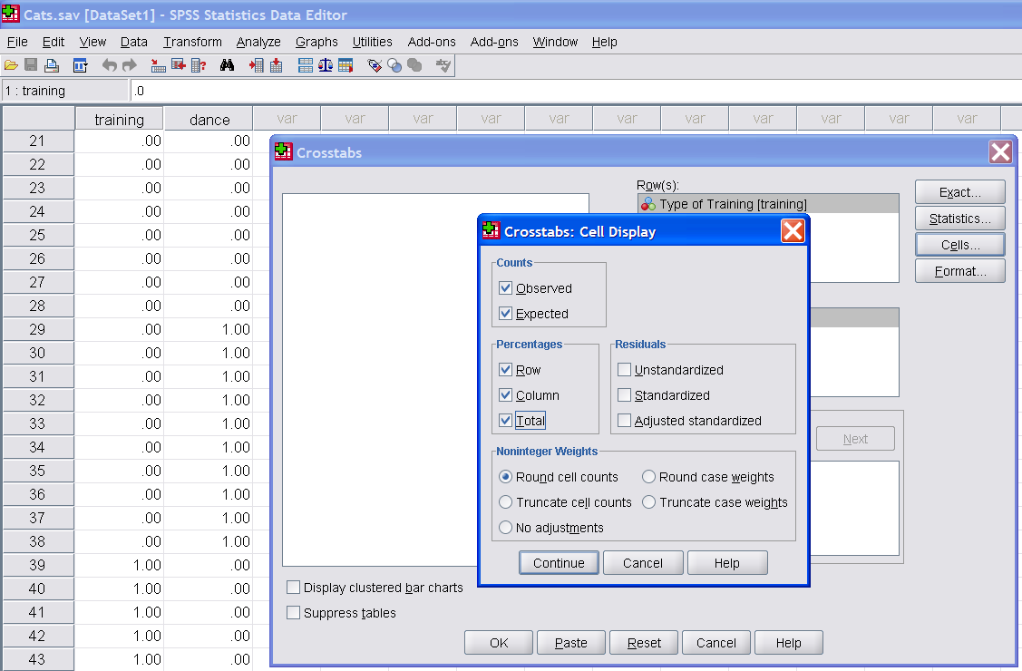
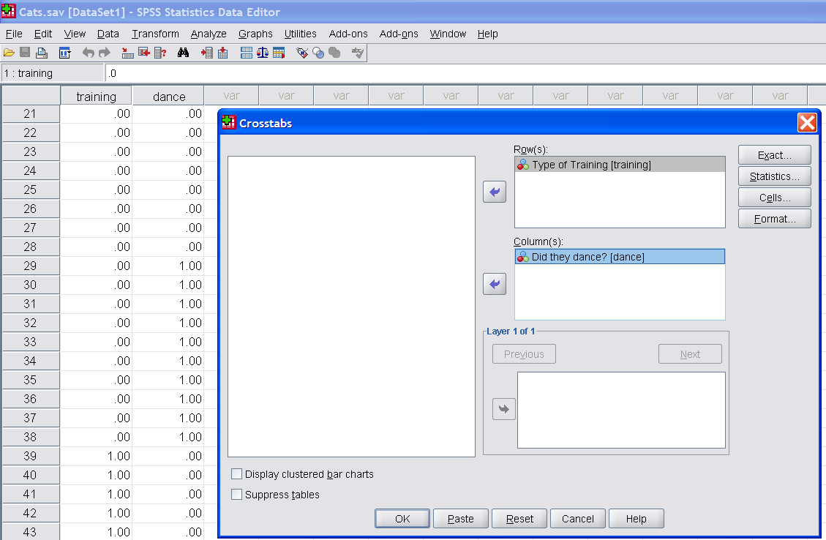
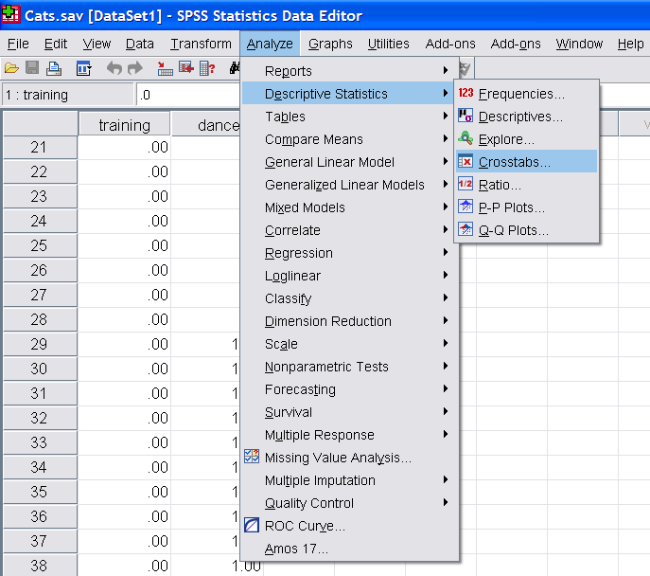
2 x 2: Analysis

Slide 7
2 x 2 Results
1st check to make sure that all cell “expected counts” are greater than 5. You will get a warning if any cell is less than 5. If a cell is less than 5 you may want to consider collapsing categories (assuming you have more than 2).
Review %’s – good way to summarize data
The Chi-square test – tests whether the two variables are independent or not (is there an association or not)?
  H0: 2 variables are independent [no group differences]
  Ha: variables are not independent (are related) [there are differences between the groups]

Slide 8
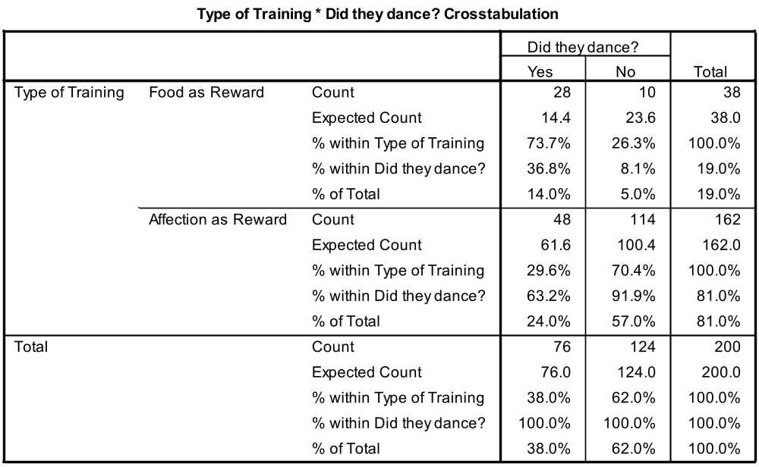
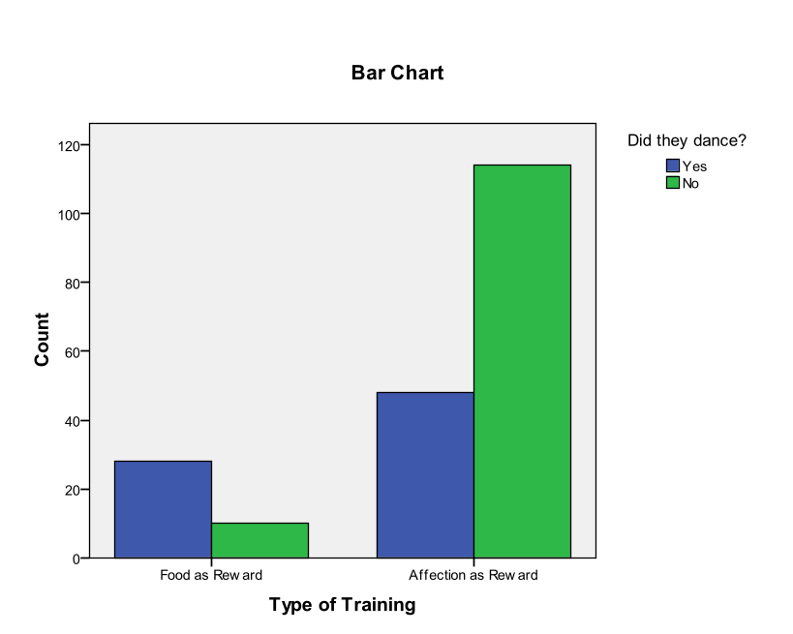
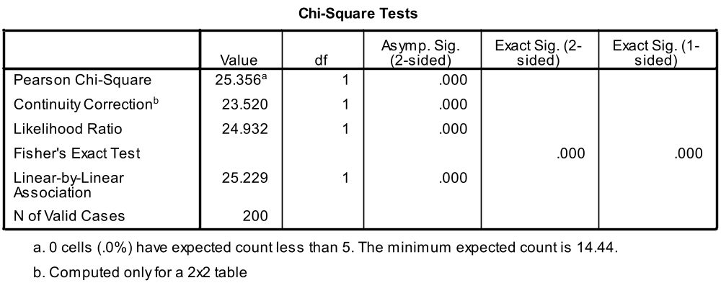

Slide 9
2 x 2 Results
Chi-square Pval < 0.001, so we reject H0 and conclude there is a relationship between training and whether the cats danced or not.
For the cats who danced, 74% received food as a reward compared to only 26% who received food as a reward for the cats who did not dance.
Odds:
  Odds (dancing after food) = number w/food and did dance / number w/food and did not dance = 28/10 = 2.8
  Odds (dancing after affection) = number w/affection did dance / number w/affection did not dance = 48/114 = 0.421
Odds ratio = Odds-dancing w/food / odds-dancing w/affection
= 2.8/0.421 = 6.65
“If a cat was trained with food, it was 6.65 times more likely to dance.”

Slide 10
Logit Model
As in logistic regression we are interested in predicting the probability of an outcome occurring (rather than predicting the actual value of the outcome)
A “log-likelihood” statistic is used to “assess the fit of the model” [e.g. expected versus observed counts]
So, if the “general form” of this 2x2 chi-square test (as a regression model) is:
  Outcome_{i} = (model_{i}) + error_{i}
  Outcome_{i} = (b_{o} + b₁A_{i} + b₂B_{i} + b₃AB_{i}) + ε_{i}
  Outcome_{i} = (b_{o} + b₁Training_{i} + b₂Dance_{i} + b₃Interaction_{i}) + ε_{i}
But we’re really predicting the “probability” – so we take the log:
  ln(O_{i} ) = (b_{o} + b₁Training_{i} + b₂Dance_{i} + b₃Interaction_{i}) + ln(ε_{i})

Slide 11
Multi-way Frequency Analysis
[Log-Linear Analysis]
The purpose of multi-way frequency analysis (MFA) is to discover associations among discrete variables. [more than 2x2 and more than 2 levels] [Tabacknick, et.al. 2007]
After preliminary screening for associations, a model is “fit” that includes only the associations necessary to reproduce to observed frequencies (ideally the “simplest” model)
The model’s parameter estimates are used to predict expected frequencies in each “cell.”

Slide 12
“Log-linear/MFA Model”
[for 3 variables]
“natural log of the expected frequency in cell ijk”
“intercept”
“main effects”
“first-order effects”
“2-way interaction effects”
“second-order effects”
“3-way interaction effect”
“third-order effects”

Slide 13
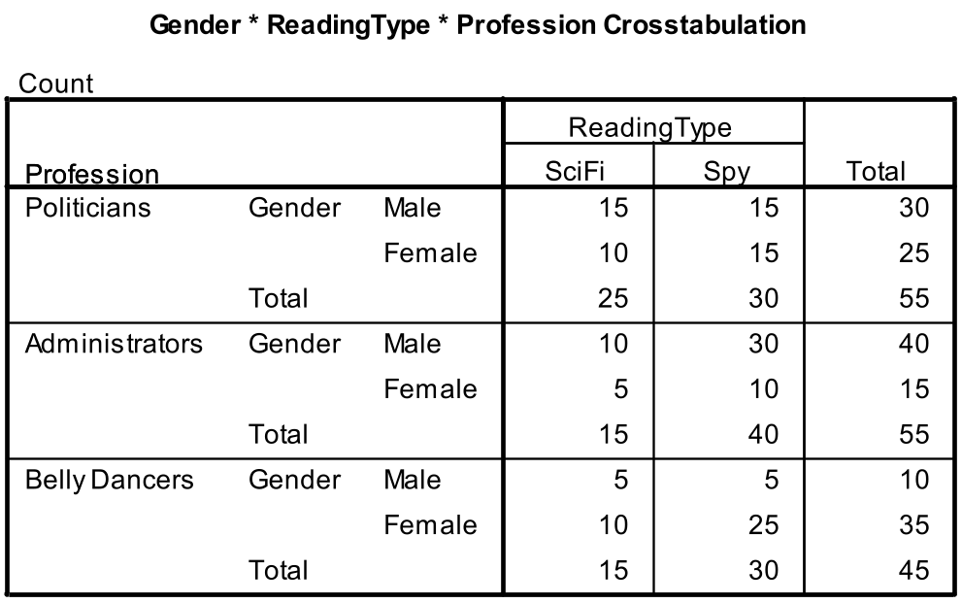
Another Example
Comparison of Reading Material Preference (Science Fiction vs Spy Novels) by Gender and Profession
155 subjects

Slide 14
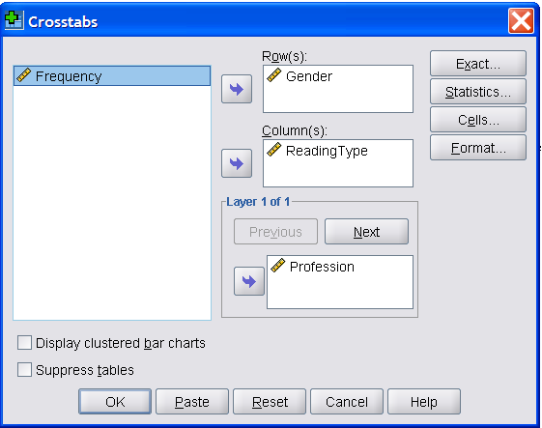
Multi “Layered” Chi-Squares (2x2 Crostabs)

Slide 15
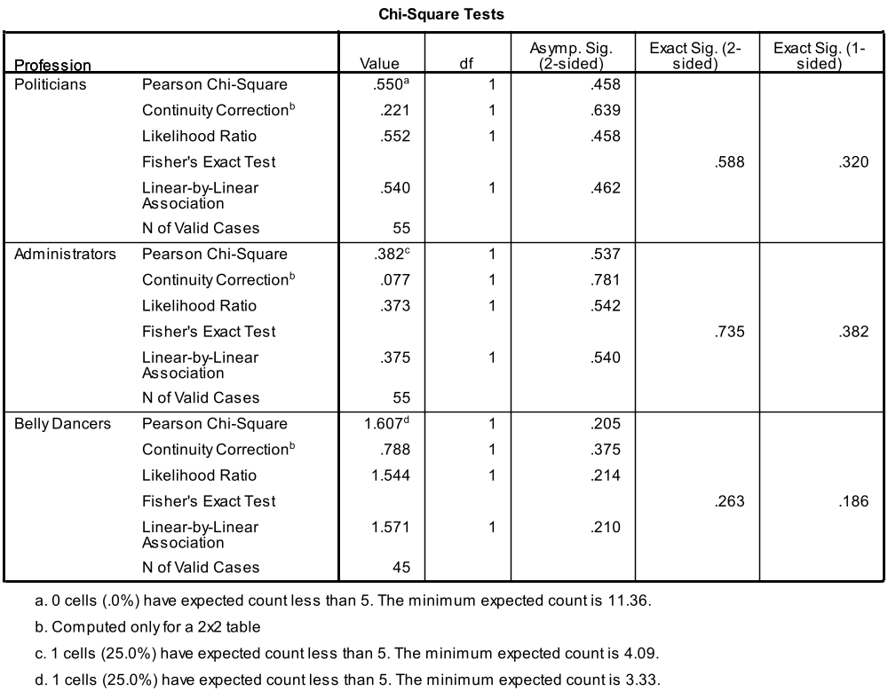
Layer = Profession [test gender x readingtype]

Slide 16
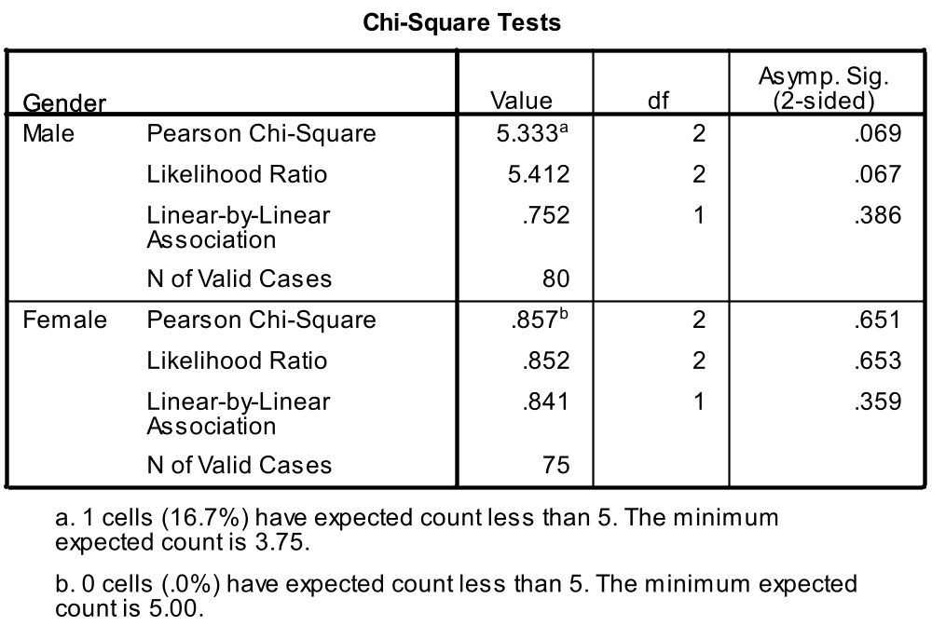
Layer = Gender
[test profession x reading type]

Slide 17
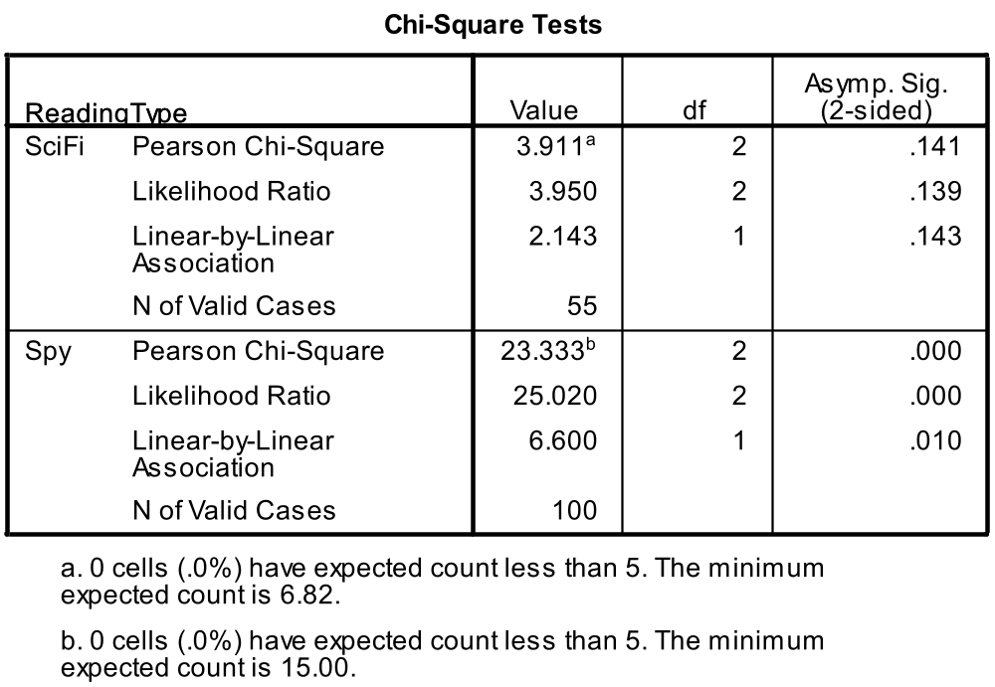
Layer = Reading Type
[test gender x profession]
So it appears there is a difference for Gender x Profession within Reading Type

Slide 18
Some Notes To Remember
If the model contains higher ordered effects, then all lower ordered effects should be retained.
For example, if a two-way intereaction (AB) is significant, then both main effects (A) and (B) should be included.
Likewise, if a third-order effect (ABC) is significant then all two-way interactions (AB, AC, BC) as well as all main effects (A) (B) and (C) should be included.
As such these model are sometimes referred to as “hierarchical or nested” loglinear models.

Slide 19
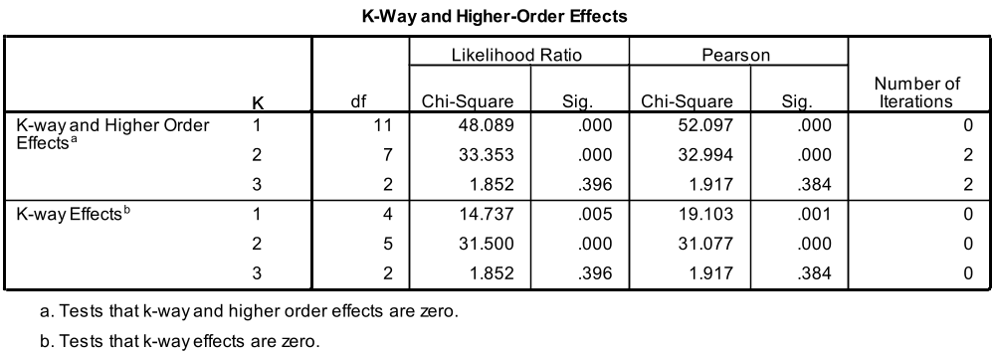
Full Model Analysis
[SPSS HILOGLINEAR]
HILOGLINEAR Profession(1 3) Gender(1 2) ReadingType(1 2)
/CWEIGHT=Frequency
/METHOD=BACKWARD
/CRITERIA MAXSTEPS(10) P(.05) ITERATION(20) DELTA(.5)
/PRINT=FREQ RESID ASSOCIATION ESTIM
/DESIGN.
So, from these results, we can conclude, that at least one 2-way effect is significant.

Slide 20
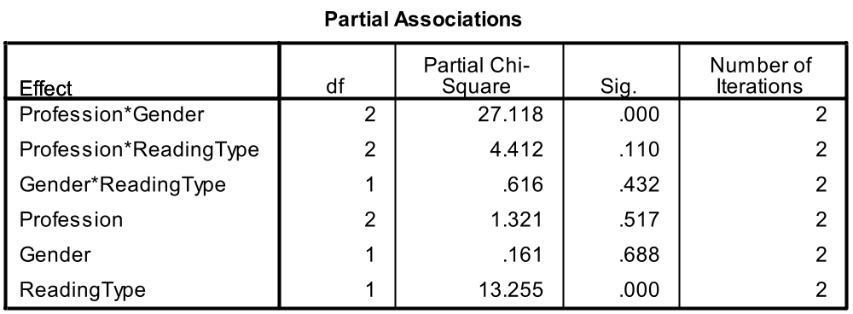
HILOGLINEAR (cont’d)
So, from these results, we can conclude, that the profession x gender is important and that reading type is also important.
So, let’s look at a reduced model with just these effects.

Slide 21
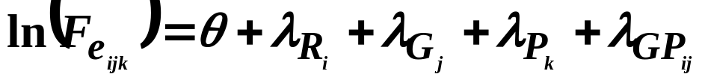
Reduced Model
[Reading Type, Gender, Profession and Profession x Gender]
LOGLINEAR Profession (1 3) Gender (1 2) ReadingType (1 2)
/PRINT=ESTIM
/DESIGN profession*gender profession gender readingtype.

Slide 22
Results – SPSS LOGLINEAR
* * * * * * * * * L O G L I N E A R A N A L Y S I S * * * * * * * * *
Correspondence Between Effects and Columns of Design/Model 1
Starting Ending
Column Column Effect Name
1 2 profession * gender
3 4 profession
5 5 gender
6 6 readingtype
- - - - - - - - - - - - - - - - - - - - - - - - - - - - - - - - - - - - - -
*** ML converged at iteration 4.
Maximum difference between successive iterations = .00000.
- - - - - - - - - - - - - - - - - - - - - - - - - - - - - - - - - - - - - -
Goodness-of-Fit test statistics
Likelihood Ratio Chi Square = 6.55763 DF = 5 P = .256
Pearson Chi Square = 6.58582 DF = 5 P = .253

Slide 23
Estimates for Parameters
profession * gender
Parameter Coeff. Std. Err. Z-Value Lower 95 CI Upper 95 CI
1 .1060961382 .11944 .88828 -.12801 .34020
2 .5053499863 .12567 4.02116 .25903 .75167
profession
Parameter Coeff. Std. Err. Z-Value Lower 95 CI Upper 95 CI
3 .1642139339 .11944 1.37487 -.06989 .39832
4 .0526421582 .12567 .41888 -.19368 .29896
gender
Parameter Coeff. Std. Err. Z-Value Lower 95 CI Upper 95 CI
5 -.0149353598 .09030 -.16539 -.19193 .16206
readingtype
Parameter Coeff. Std. Err. Z-Value Lower 95 CI Upper 95 CI
6 -.2989185004 .08394 -3.56122 -.46344 -.13440

Slide 24
Summary
This is only a quick introduction – I encourage you to work through the exercises in both Andy Field and Tabacknick, et.al. for more thourough explanations.
Explore the additional features within the SPSS/Loglinear Models section.
Screen your data (for more than 2 categorical variables) using “layers” within the SPSS Crosstabs Procedure.

Slide 25
References
Field, Andy. “Discovering Statistics Using SPSS,” 2nd edition, SAGE Publications, 2005. [Chapter 7 focuses on Logistic Regression; Chapter 16 focuses on Categorical Data.]
Tabachnick, Barbara G.; Fidell, Linda S. “Using Multivariate Statistics,” 5th edition, Pearson Education Inc., 2007. [Chapter 15 focuses on Multilevel Linear Modeling.]
*

Slide 26
VIII. Statistical Resources and Contact Info
SON S:\Shared\Statistics_MKHiggins\website2\index.htm
[updates in process]
  Working to include tip sheets (for SPSS, SAS, and other software), lectures (PPTs and handouts), datasets, other resources and references
  Statistics At Nursing Website: [website being updated] http://www.nursing.emory.edu/pulse/statistics/
  And Blackboard Site (in development) for “Organization: Statistics at School of Nursing”
Contact
    Dr. Melinda Higgins
    Melinda.higgins@emory.edu
    Office: 404-727-5180 / Mobile: 404-434-1785

