Slide 1
The Importance of “Correct “ Longitudinal Modeling?
Melinda K. Higgins, Ph.D.
Associate Research Professor/Sr. Biostatistician, Emory – School of Nursing
16 February 2012

Slide 2
Outline
The POWER of Time (linked/nested data points)
Missing Data: Definitions and Implications
Repeated Measures ANOVA
Least Squares Regression
Multi-level Models (MLM)
Definitions
Step-by-Step Example
Current Research Example
Other Examples
Software Options
References

Slide 3
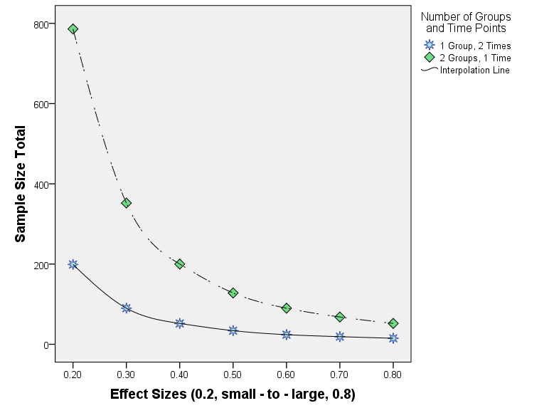
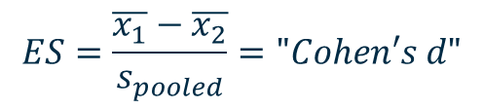
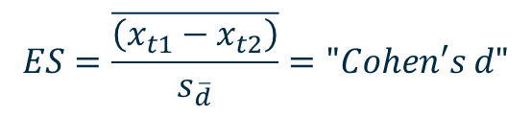
Power of Linking More Than 1 Time Point
Sample Sizes Needed to Detect
Effect Sizes at for 80%
To detect the same Effect Size, adding 1 time point cuts the Sample Size by more than 1/2
$$ES=\frac{\overline{x_{1}}−\overline{x_{2}}}{s_{pooled}}="Cohen′s d"$$
$$ES=\frac{\overline{\left(x_{t1}−x_{t2}\right)}}{s_{\overline{d}}}="Cohen′s d"$$

Slide 4
Sample Sizes Needed to Detect Effect Sizes at for 80%
Effect Size | 1 Time, 2 Groups |  |  | 2 Times 1 Group
 | n1 | n2 | n total | n
0.2 small | 393 | 393 | 786 | 199
0.3 | 176 | 176 | 352 | 90
0.4 | 100 | 100 | 200 | 52
0.5 moderate | 64 | 64 | 128 | 34
0.6 | 45 | 45 | 90 | 24
0.7 | 34 | 34 | 68 | 19
0.8 large | 26 | 26 | 52 | 15
Cohen, Jacob. 1988. Statistical Power Analysis for the Behavioral Sciences, Lawrence Erlbaum Associates, Hillsdale, New Jersey.

Slide 5
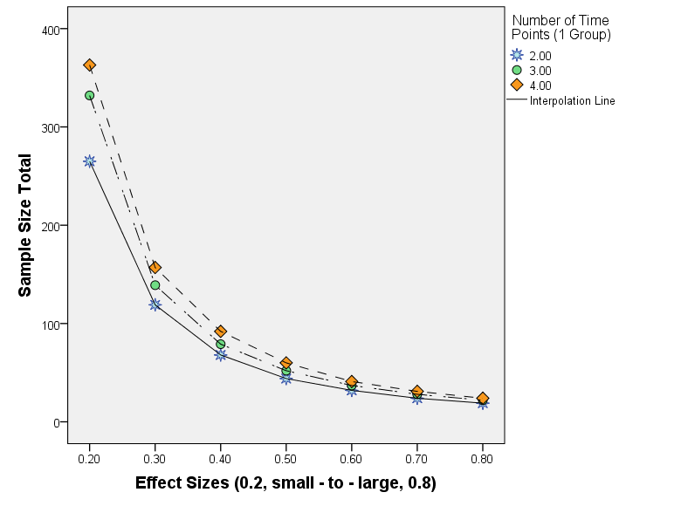
More Time Points – Not Many More Samples
Sample Sizes For Effect Sizes
(RM-ANOVA) at ~ 90%
To detect the same Effect Size, adding more time points only increases the sample size only slightly.

Slide 6
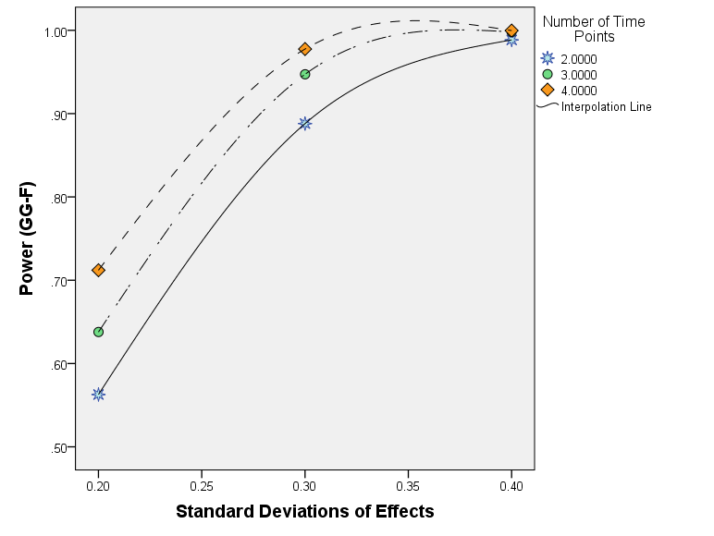
More Time Points – MORE POWER
Adding more Time Points, Increases Power for Same Standard Deviations
Power versus Standard Deviation
of Effects For Sample Size 30

Slide 7
Missing Data Definitions
MCAR – Missing Completely at Random (COMMONLY ASSUMED and NOT MET)
A subject is missing at a particular timepoint for COMPLETELY random reasons (does not depend upon the outcome, Y)
May have increasing attrition over time IF the missingness can be explained by a covariate (X’s) in model [Little 1995] and still be MCAR.
Because it is important to include predictors of missingness, Shafer and Graham 2002 recommended including a question like “How likely is it that you will remain in this study through the next study period?”
MAR – Missing at Random (OCCURS OFTEN)
Allows “missingness” to depend on BOTH the model covariates (X’s) and outcome (Y)
MAR assumes that given these X’s and Y, the missing data are NOT related to the unobserved Y’s (what would have been measured if the data was not missing)
MNAR – Missing Not at Random (NO WAY TO CONFIRM or REJECT)
Example, a subjects drops out of a study because their value has dropped below (or exceeds) a certain level (i.e. no longer depressed).

Slide 8
Repeated Measures Design
Case ID | Outcome T1 | Outcome T2 | Outcome T3
1 | Y_t1(1) | Y_t2(1) | Y_t3(1)
2 | Y_t1(2) | Y_t2(2) | Y_t3(2)
3 | Y_t1(3) | Y_t2(3) | Y_t3(3)
⁞ | ⁞ | ⁞ | ⁞
⁞ | ⁞ | ⁞ | ⁞
100 | Y_t1(100) | Y_t2(100) | Y_t3(100)
Number Missing | 0 | 5 | 15
Depending on how the missing data “line” up, we could end up with anywhere between 85 complete cases (15% loss) down to 80 complete cases (20% loss)

Slide 9
Assumptions of RM-ANOVA (GLM)
Repeated Measures – Analysis of Variance (RM-ANOVA); aka. GLM: General Linear Models
Assumptions:
Complete Cases at All Time Points
Time Points Independent of All Other Times
Time Points Evenly Spaced and SAME (EXACT) for all individuals
Covariates – only at Baseline (assumed same at ALL time points)
Variance assumed SAME at all time points
Covariances between Any 2 Time Points Same for ALL
Variance of all Pairwise Differences are equal (sphericity)
Missing Completely At Random (MCAR) assumed

Slide 10
Linear Regression Design [“Person-Period”]
Case ID | Time Point | Actual Time (days) | Outcome | Number Missing
1 | 1 | 0 | Y_t1(1) | 0 at Time 1
2 | 1 | 0 | Y_t1(2)
3 | 1 | 0 | Y_t1(3)
⁞ | ⁞ | ⁞ | ⁞
100 | 1 | 0 | Y_t1(100)
1 | 2 | 30 | Y_t2(1) | 5 at Time 2
2 | 2 | 25 | Y_t2(2)
3 | 2 | 21 | Y_t2(3)
⁞ | ⁞ | ⁞ | ⁞
100 | 2 | 35 | Y_t2(100)
1 | 3 | 58 | Y_t3(1) | 15 at Time 3
2 | 3 | 60 | Y_t3(2)
3 | 3 | 45 | Y_t3(3)
⁞ | ⁞ | ⁞ | ⁞
100 | 3 | 70 | Y_t3(100)
 |  |  | Total Missing | 20
Looking at the data in this format, where the time points are NOT lined up in the same row (losing a data point at one time point does not affect the other), we do gain the advantage that the missing data has LESS IMPACT.
Here the loss of 20 data points, results in only 20/300 = 6.7% lost, instead of 15-20% as before.
We can also bring in EXACT times (instead of assumed durations)

Slide 11
Assumptions of “Ordinary” Least Squares
Complete Cases at All Time Points
Time Points Independent of All Other Times
Time Points Evenly Spaced
Covariates (other predictors, X’s in addition to TIME)
Only at Baseline (assumed same at ALL time points)
May “interact” with time (different slopes)
Variance assumed SAME at all time points
Covariances between Any 2 Time Points Same for ALL
Variance of all Pairwise Differences are equal (sphericity)
Missing Completely At Random (MCAR)

Slide 12
Hedeker and Gibbons, 2006
“The ANOVA approach (repeated measures) to analysis of longitudinal data represents a well-understood and well-developed statistical methodology. In addition, there is considerable available computer software for ANOVA computation. The results are based on relatively simple and noniterative calculations. Unfortunately, the ANOVA model for repeated measures assumes sphericity, which is UNREALISTIC for most applications where variances tend to increase with time and correlation decreases with increaing intervals in time. Other limitations include limited treatment of missing data and the requirement that all subjects are measured on the SAME occasions.”

Slide 13
Example: Reisby et.al. 1977
Study focused on the longitudinal relationships between imipramine (IMI) and desipramine (DMI) (metabolite of IMI) plasma levels and clinical response in 66 depressed patients.
Primary Outcome: Hamilton Depression Rating Scale (HDRS)
66 patients observed for 5 weeks, only 46 had complete data on all measures (69.7%). 376 total data points measured.
Means decrease over time, SD’s increase over time
Weeks | 0 | 1 | 2 | 3 | 4 | 5
Number of Subjects Complete on ALL Measures (n) | 61 | 63 | 65 | 65 | 64 | 58
Mean (HDRS) | 23.44 | 21.84 | 18.31 | 16.42 | 13.62 | 11.95
Standard Deviation, sd (HDRS) | 4.53 | 4.70 | 5.49 | 6.42 | 6.97 | 7.22

Slide 14
Correlations Between Time Points [Listwise vs Pairwise]
Significant Correlations Between Sequential Time Points, drops off with time

Slide 15
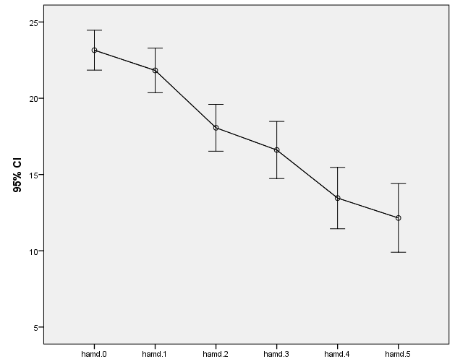
RM-ANOVA Approach
Only 46 data points used !!
30% data loss!!
Fails Sphericity !!

Slide 16
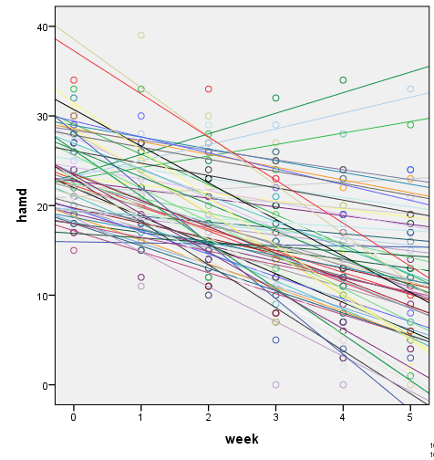
Raw Data: Separate Regression Lines
Lots of Variability at Week 0 (Baseline Intercept)
Also Variability in the Slopes
But keep more data – only lose 21 of 396 possible (5.3% loss)

Slide 17
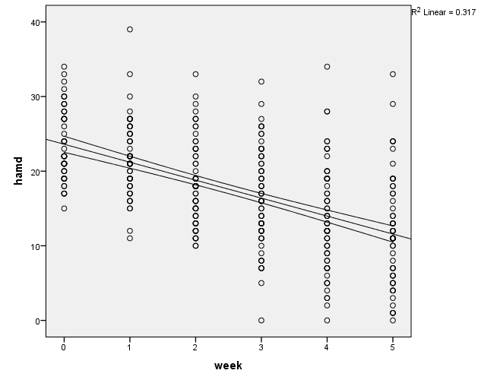
Least Squares Regression Approach
Same Overall Negative Linear Trend
“Scatter” Variabilty seems to be increasing over time
Regression Model assumes Variability constant
Assumes Time points Independent (NOT correlated)

Slide 18
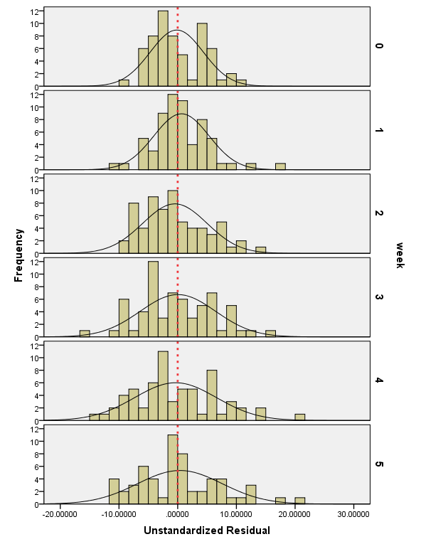
Residuals: Increasing Variance and Other Issues

Slide 19
Raw Data: Separate Regression Lines
Lots of Variability at Week 0 (Baseline Intercept)
Also Variability in the Slopes
But keep more data – only lose 21 of 396 possible (5.3% loss)

Slide 20
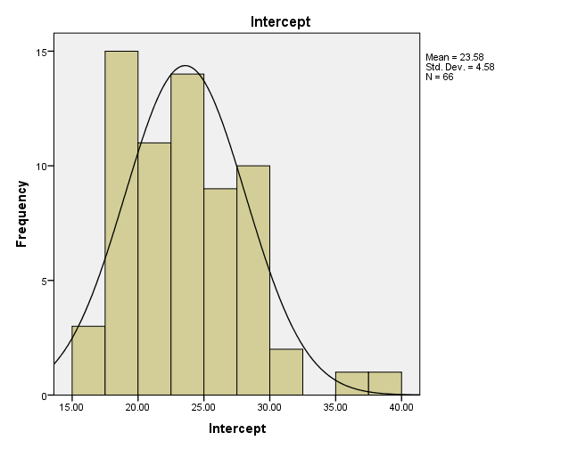
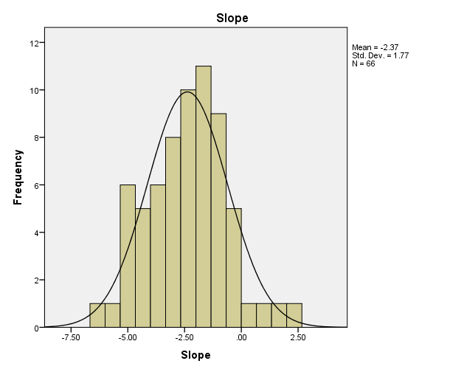
66 Separate Regressions: Range of Intercepts and Slopes
Statistics
 |  | Intercept(s) | Slope(s)
N | Valid | 66 | 66
 | Missing | 0 | 0
Mean |  | 23.5791 | -2.3745
Median |  | 22.9760 | -2.3570
Std. Deviation |  | 4.57978 | 1.77020
Minimum |  | 15.95 | -6.20
Maximum |  | 38.57 | 2.30

Slide 21
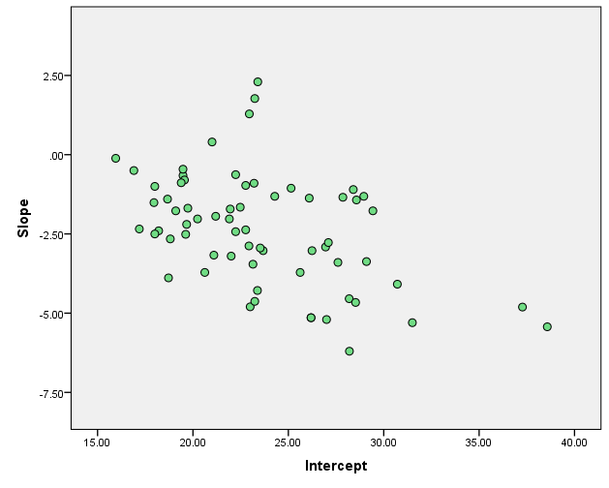
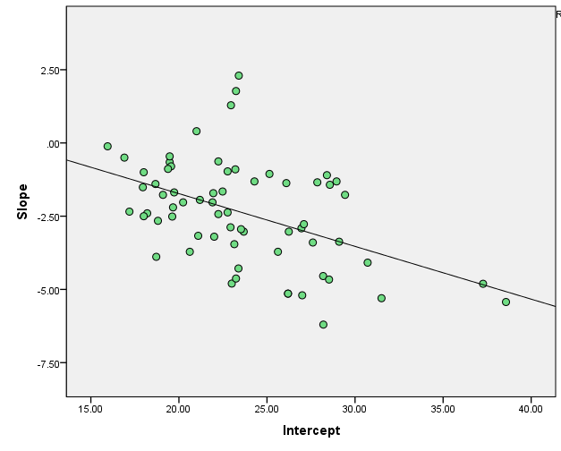
Suppose: Fit 66 Separate Regression Lines Compare Intercepts and Slopes
Significantly Negatively Correlated (r=-0.47, p<.001)
Times Not Independent
Variances not equal
Baseline Values correlated with Slopes
Is there another way?

Slide 22
Multi-Level Models (MLM) are Useful
Ordinary Least Squares (OLS) and all regression models under the General Linear Model (including logistic and poisson regression) assumes that all observations are independent of one another.
Likewise, repeated measures (time1, time2, …) assume that all time points for a given individual are independent of one another (all pairs of time points), including serial dependency (“Durbin–Watson statistic”).
When data are “clustered,” OLS may lead to inaccuracies in inference – standard errors may be too small – leads to overestimation of significance (“alpha-inflation”).
“Clusters” may include individuals within: dyads; twins; families; counseling groups; households; neighborhoods; schools; nursing units; hospitals (and repeated measures over time within an individual – the individual becomes the “cluster”).
MISSINGNESS – Only MAR needed, not MCAR

Slide 23
How to estimate the “degree” of clustering? Intraclass Correlation (ICC)
The ICC measures the proportion of the total variance of an outcome variable that is accounted for by the clustering of the cases.
OLS regression (and GLM) assumes that there is no amount of variance accounted for by these “clusters”/groups/time; ICC=0.
ICC varies from 0 to 1 (normally). [NOTE: ICC can be negative, but it is rare – this would mean that individuals within a given “cluster” were more different from one another within the group than with individuals outside the group.]
The ICC may be initially estimated from a one-way (“Fixed Effects”) ANOVA on the groups or “clusters.”
Even for ICC’s as small as 0.01, for n=25 subjects per group, the actual alpha=0.11 (which is more than 2 times the nominal alpha=0.05). “Alpha-inflation” increases as ICC and number of subjects per group increases.

Slide 24
“Fixed vs. Random Coefficients”
OLS regression – only the outcomes and errors/residuals are considered to be random (i.e. samples from a larger population)
Random
Fixed
“Random Coefficient” regression – now the intercepts and slopes are also considered to be RANDOM (i.e. samples from a larger population)

Slide 25
“Multi-Level / Hierarchical Linear Models”
i=individual j=group
Level 1: Individual Level; “micro-level”
TIME
SUBJECTS
Level 2: Group Level; “macro-level”
Explain/Predict Intercepts and Slopes
&
Combine Level 1 and Level 2
“Additional New Parameters” – Variance Components – help to capture the impact of the group structure on the relationship of the predictors on the dependent variable.

Slide 26
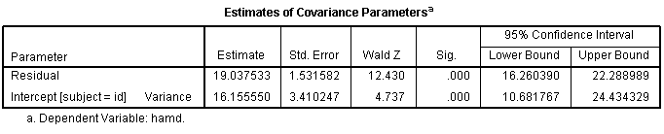
Unconditional Cell Means Model
Calculate ICC from the RC model using only the group membership (no level 1 predictor) – equivalent to a “One-way Random Effects ANOVA”
=
MIXED hamd WITH week
/CRITERIA=CIN(95) MXITER(100) MXSTEP(10) SCORING(1) SINGULAR(0.000000000001) HCONVERGE(0, ABSOLUTE) LCONVERGE(0, ABSOLUTE) PCONVERGE(0.000001, ABSOLUTE)
/FIXED=week | SSTYPE(3)
/METHOD=ML
/PRINT=CPS CORB COVB DESCRIPTIVES G LMATRIX R SOLUTION TESTCOV
/RANDOM=INTERCEPT | SUBJECT(id) COVTYPE(UN)
[46% of the variability in HDRS explained at Individual Level – CANNOT ignore clustering]

Slide 27
Random Coefficient Model
Mixed Level 1 & 2
MIXED hamd WITH week
/CRITERIA=CIN(95) MXITER(100) MXSTEP(10) SCORING(1) SINGULAR(0.000000000001) HCONVERGE(0, ABSOLUTE) LCONVERGE(0, ABSOLUTE) PCONVERGE(0.000001, ABSOLUTE)
/FIXED=week | SSTYPE(3)
/METHOD=ML
/PRINT=CPS CORB COVB DESCRIPTIVES G LMATRIX R SOLUTION TESTCOV
/RANDOM=INTERCEPT week | SUBJECT(id) COVTYPE(UN)
Level 1
Level 2

Slide 28
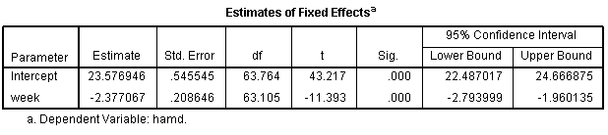
Consider the Fixed Effects Portion of the Model
Fixed
Random
HDRS (Y_{ij}) = 23.6 - 2.38 HDRS units/week *(weeks (x_{ij}))
Both the intercept and slope are significant (both pval<0.001).
So, on average, every week HDRS declines by 2.38; with an average HDRS score of 23.6 at Week 0 (Baseline).

Slide 29
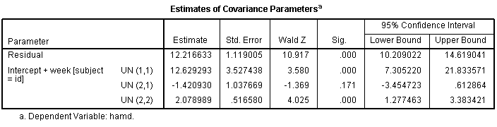
Consider the Random Effect Portion of the Model
variance of the slopes across groups is significant (again do not ignore clustering)
the covariance between slopes and intercepts is negative indicating the higher a subject’s HDRS at Baseline, the more negative their slopes will be, however, this is not significant.
the addition of WEEKS as a predictor reduced the within subject variance in HDRS 36% (from 19.04 to 12.2)
the addition of WEEKS as a predictor also reduced the between subject differences at Baseline (intercepts) by 22% (16.15 to 12.63)
SO, overall there were fluctuations between subjects in terms of their initial (baseline) HDRS AND their changes in HDRS over time.
Cannot test this via ANCOVA nor (g-1) dummy variables in regression.

Slide 30
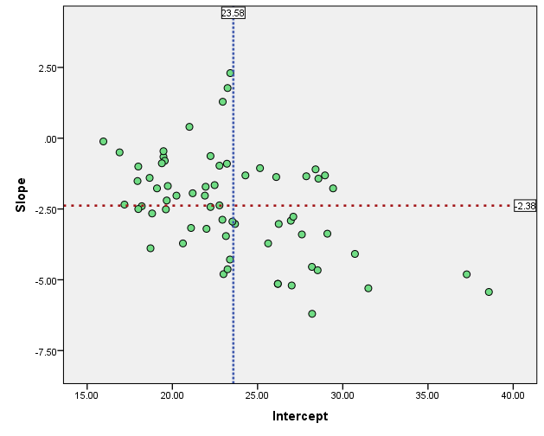
Slopes and Intercepts
Lower Initial Depression
Less Improvement
“Floor Effects”
Getting “worse” ?
Higher Depression
More Improvement

Slide 31
MLM Models
MLM models help to answer questions about
Predictors of intercepts (baseline levels),
Predictors of slopes (changes over time),
Cross-level effects between and within subjects (i.e. group-by-time effects)
Handling time-varying predictors
Dissecting the sources of variances (influences) within and between subjects as well as when adding to or removing predictors and terms from model
Meta-Analysis: Combine Results from Multiple Studies

Slide 32
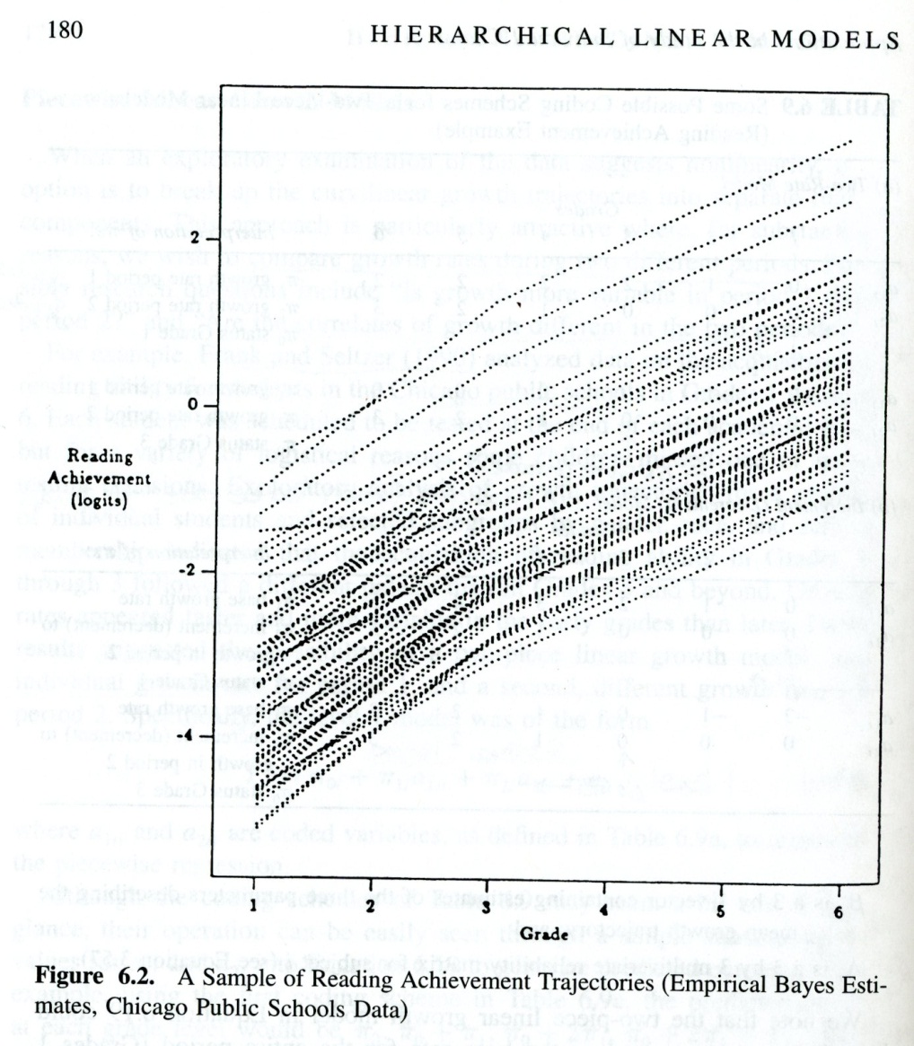
2 Time Periods (Phase 1, Phase 2)
Phase 1
Phase 2
Raudenbush and Byrk, 2002

Slide 33
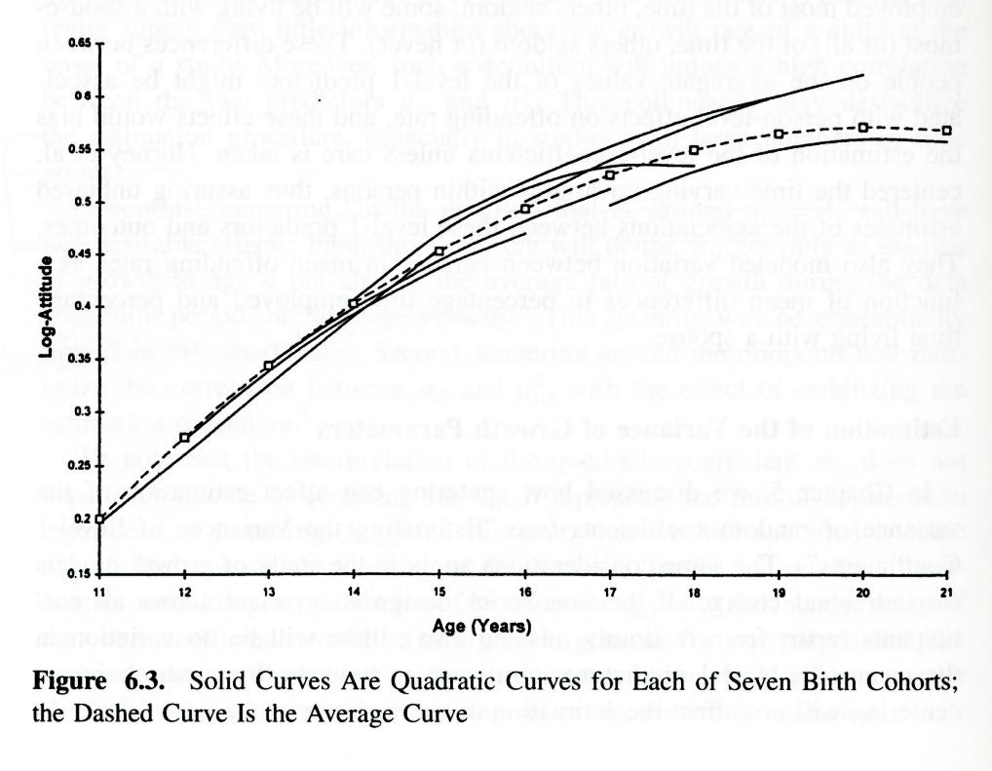
Combining Segments From Different Cohorts
Raudenbush and Byrk, 2002

Slide 34
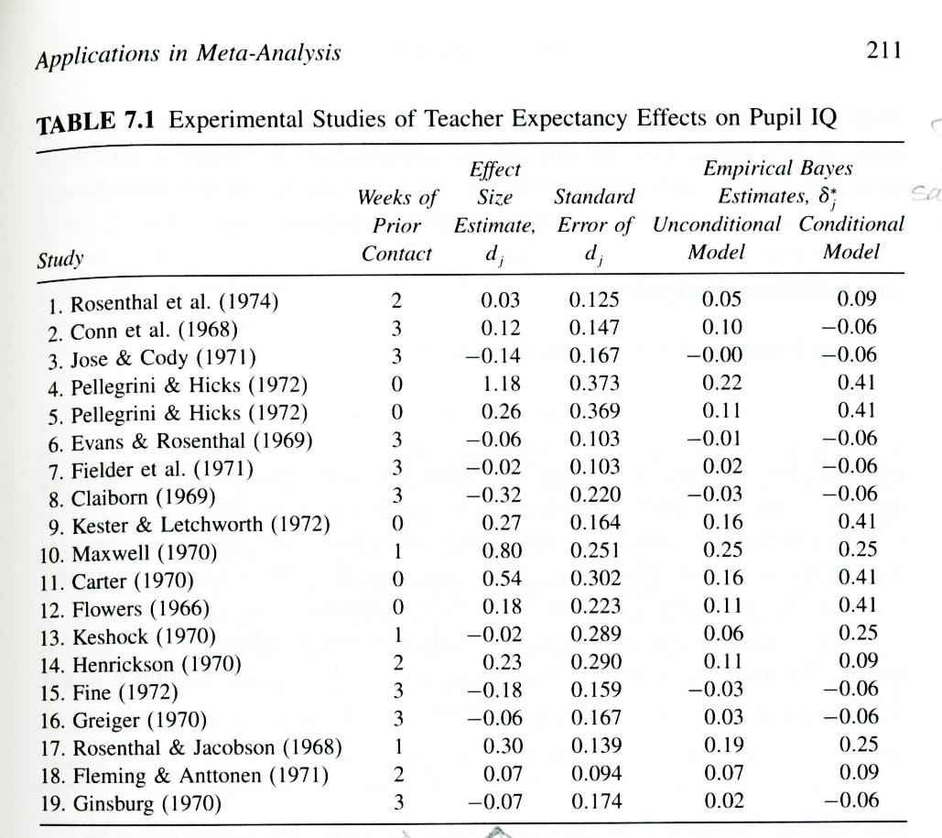
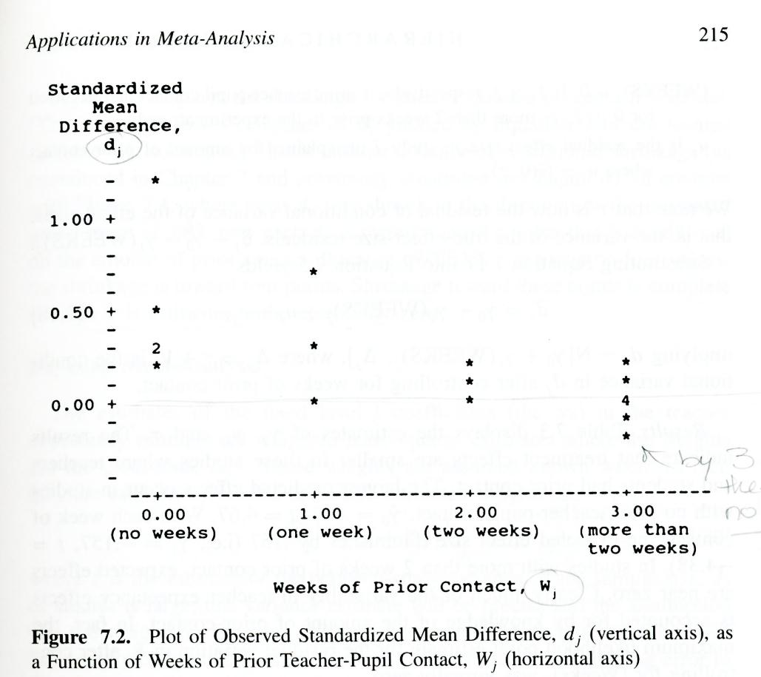
Meta-Analysis Combining Data from Multiple Studies
Raudenbush and Byrk, 2002

Slide 35
Refs
R.J.A. Little and D.B. Rubin. Modeling the drop-out mechanism in repeated-measures studies. Journal of the American Statistical Association (JASA), 90: 1112-1121, 1995.
J.L. Shafer and J.W. Graham. Missing data: our view of the state of the art. Psychological Methods, 7:147-177, 2002.
N. Reisby, L.F. Gram, P. Bech, A. Nagy, G.O. Peterson, J. Ortmann, I. Ibsen, S.J. Dencker, O. Jacobsen, O. Krautwald, I. Sondergaard, and J. Christiansen. Imipramine: clinical effects and pharmacokinetic variability. Psychopharmacology, 54:263-272, 1977.
D. Hedeker and R.D. Gibbons Longitudinal Data Analysis, Wiley Interscience, A John Wiley and Sons, Inc, Publication: Hoboken, JY, 2006.
Judith D. Singer and John B. Willett, Applied Longitudinal Data Analysis: Modeling Change and Event Occurrence, Oxford University Press: New York, 2003.
Andrew Gelman and Jennifer Hill, Data Analysis Using Regression and Multilevel/Hierarchical Models, Cambridge University Press: New York, 2007.
MIXED,
NLMIXED
SAS CODES, SURVIVAL ANALYSES
BUGS

Slide 36
More References
Cohen, Jacob; Cohen, Patricia; West, Stephen; Aiken, Leona. “Applied Multiple Regression/Correlation Analysis for the Behavioral Sciences” 3rd edition, Lawrence Erlbaum Associates Inc., 2003.
Chapter 14 (Random Coefficient Regression and Multilevel Models) and
Section 15.4 (Multilevel Regression of Individual Changes Over Time)
Raudenbush; Stephen W.; Bryk, Anthony S. “Hierarchical Linear Models: Applications and Data Analysis Methods” 2nd edition, SAGE publications, 2002.
Kreft, Ita; de Leeuw, Jan. “Introducing Multilevel Modeling,” SAGE publications, 1998.
Tabachnick, Barbara G.; Fidell, Linda S. “Using Multivariate Statistics,” 5th edition, Pearson Education Inc., 2007. [Chapter 15 focuses on Multilevel Linear Modeling.]
*

Slide 37
Software
SPSS: MIXED, GENLINMIXED
SAS: PROC MIXED, PROC NLMIXED
HLM (Hierarchical Linear and Nonlinear Modeling)
http://www.ssicentral.com/hlm/
R: lme4, nlme, … (http://cran.r-project.org/ )
R: Bayesian Estimation (BUGS, Bayesian Inference Using Gibbs Sampling)
http://www.mrc-bsu.cam.ac.uk/bugs/

Slide 38
Contact Info
Contact
Dr. Melinda Higgins
Melinda.higgins@emory.edu
Office: 404-727-5180
School of Nursing

